Slide 1



Network
Programming
in Python
Prepared by Dr. Hamada I. AbdulWakel
Lecture 8

Slide 2



Email Composition and
Decoding
Lecture 8
Prepared by
Dr. Hamada I. AbdulWakel
www.midocean.ae

Slide 3
Lecture
RECAP: LECTURE 7
08
Domain Name System (DNS).
DNS module in Python.
www.midocean.ae

Slide 4
Lecture
LECTURE MAIN POINTS
08
Email Messages.
E-mail Module in Python.
The Multipurpose Internet Mail Extensions.
www.midocean.ae

Slide 5
Lecture
08
E-MAIL DEFINITION
Sending and receiving of information through internet is known as an E-mail.
Today, email is one of the most popular methods of digital communication.
Sharing an email is done through the use of email address.
Email is a critical means of communication in today’s world, but it can be time-consuming and tedious to send out emails manually.
www.midocean.ae

Slide 6
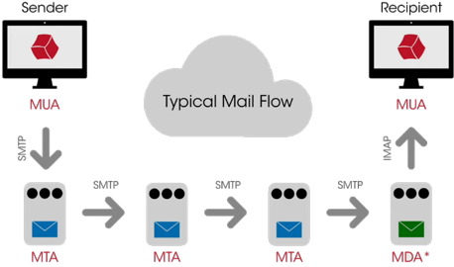
Lecture
08
E-MAIL BASIC FLOW
www.midocean.ae

Slide 7
Lecture
08
E-MAIL BASIC FLOW
Cont'd
A Mail User Agent (MUA): the client application running on a computer that is used to send and receive mail.
  Examples: Apple Mail and Microsoft Outlook.
A Mail Transfer Agent (MTA): accepts messages from a sender and routes them along to their destinations.
  Examples: Sendmail, Postfix, and Microsoft Exchange.
A Mail Delivery Agent (MDA): receives email from an MTA for delivery to a mailbox.
www.midocean.ae

Slide 8
Lecture
08
E-MAIL PARTS
Email headers: consists of the sender, receiver, subject, and timestamp. Headers are part of every email and is has many usages.
Email message:
  The message or body of the email is where a lot of the information about the email exists.
  Using this information, we can extract key details about the purpose of the message.
www.midocean.ae

Slide 9
Lecture
08
E-MAIL PARTS
Cont'd
Email attachment:
  Files that are part of the email body. Since data is sent in various forms, parsing attachments sent through email is important to create a powerful user experience.
Email HTML:
  Emails generally come in plain text and HTML.
  Parsing HTML emails is a powerful way to get extra information to display in a different format and from various sources such as newsletters and transactional emails.
www.midocean.ae

Slide 10
Lecture
08
E-MAIL PARTS
Cont'd
Email specific data fields:
  We can parse emails using different fields available to use. For example, if you want to find more important emails, we can consider using the starred field with communication providers like Gmail.
www.midocean.ae

Slide 11
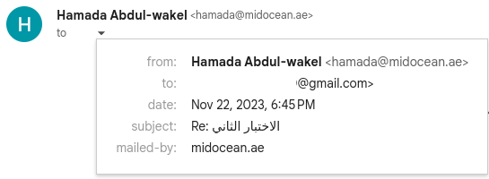
Lecture
08
E-MAIL HEADER INFORMATION
www.midocean.ae

Slide 12
Lecture
08
E-MAIL HEADER INFORMATION
Cont'd
An Email Header: is metadata that accompanies every email and contains detailed information, such as the sender, receiver, route, timestamp, and more.
Mailbox and email service providers use email headers to authenticate the email senders and properly allocate an email in the inbox.
Each field in the header has a corresponding name, followed by a separator character ( : ) and a value identifier. The main fields located in the email message header are the from, to, subject, and date.
www.midocean.ae

Slide 13

Lecture
08
E-MAIL HEADER INFORMATION
Cont'd
Message-ID: is a unique identifier, generated automatically to prevent multiple deliveries. It includes various (around 50) letters and numbers.
www.midocean.ae

Slide 14
Lecture
08
E-MAIL AUTHENTICATION
Email authentication helps keep all of us safe from spam and email attacks. There are multiple email authentication protocols. Each protocol protects against a specific type of email forging.
  Sender policy framework (SPF) authentication keeps malicious senders from spoofing emails and IP addresses. It used as a spam detection mechanism.
  Domain Keys Identified Mail (DKIM) authentication protects against emails that have been altered in transit by a bad actor between the sender and the recipient. The email is signed with a digital signature, which can be verified by checking the sender’s public key in the DNS records of the sender’s domain.
www.midocean.ae

Slide 15
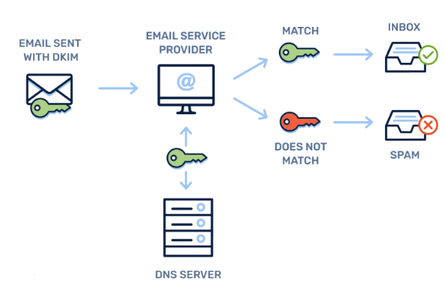
Lecture
08
E-MAIL AUTHENTICATION
Cont'd
www.midocean.ae

Slide 16
Lecture
08
E-MAIL MODULE
The email module is an email message management library.
import email
It has three major components:
  The central component is an “object model” that represents email messages.
  The parser component takes the serialized version of an email message (a stream of bytes) and converts it into a EmailMessage object.
  The generator component takes a EmailMessage object and turns it back into a serialized byte stream.
www.midocean.ae

Slide 17
Lecture
08
E-MAIL MODULE
Cont'd
It used to create the EmailMessage object and add or remove email subcomponents. We can not send an email message using the email module alone.
The EmailMessage dictionary-like interface is indexed by the header names. The values of the dictionary are strings with some extra methods.
The email module also provides support for parsing e-mail messages. Re-constructing the EmailMessage object.
www.midocean.ae

Slide 18
Lecture
08
E-MAIL MODULE METHODS
email.message submodule used to create instances of the EmailMessage class.
  EmailMessage(): create a message object.
  set_payload(): set the body of a message object.
  as_string(): returns the message object as string.
  is_multipart(): check if the message object includes a list of sub-EmailMessage objects.
  keys(): return a list of all the message’s header field names.
  values(): return a list of all the message’s header values.
www.midocean.ae

Slide 19
Lecture
08
E-MAIL MODULE METHODS
Cont'd
email.utils submodule methods:
  make_msgid(): returns a string represents ant Message-ID header.
  formatdate(): returns a date time as string.
    The localtime argument used to return time related to the local timezone.
  parsedate_tz(): returns either None or a 10-tuple datetime.
  mktime_tz(): create a Universal Time Coordinated (UTC) timestamp from a 10-tuple datetime.
    Unix time: the number of seconds that have elapsed since 00:00:00 UTC on 1 January 1970.
www.midocean.ae

Slide 20
Lecture
08
CREATING AN E-MAIL EXAMPLE
Code:
import email.utils, email.message
text = " Hello, This is a test message. I hope you enjoy it! "
msg = email.message.EmailMessage()
msg['To'] = 'recipient@example.com'
msg['From'] = 'sender@example.com'
msg['Subject'] = 'Test Message'
msg['Date'] = email.utils.formatdate(localtime = 1)
msg['Message-ID'] = email.utils.make_msgid()
msg.set_payload(text); print(msg.as_string())
www.midocean.ae

Slide 21
Lecture
08
PARSING AN E-MAIL EXAMPLE
Code:
import email
popular_headers = ('From', 'To', 'Subject', 'Date')
msg = email.message_from_file( open('/path/to/message.txt') )
headers = sorted(msg.keys())
for header in headers:
if header not in popular_headers:
print("Header info. not listed---", header + ':', msg[header] )
else:
print("Header info. listed---", header + ':', msg[header] )
www.midocean.ae

Slide 22
Lecture
08
PARSING AN E-MAIL EXAMPLE
Cont'd
Code:
if msg.is_multipart():
print("This program cannot handle MIME multipart messages.")
else:
print(msg.get_payload())
www.midocean.ae

Slide 23
Lecture
08
PARSING DATA IN AN E-MAIL
Code:
from email.utils import parsedate_tz, mktime_tz
timetuple1 = parsedate_tz('Mon, 27 May 2023 09:00:00 +1000')
print(timetuple1)
timestamp1 = mktime_tz(timetuple1)
print(timestamp1)
www.midocean.ae

Slide 24
THE MULTIPURPOSE INTERNET MAIL
EXTENSIONS
Lecture
08
MIME is a set of rules for encoding data, rather than deal with simple plain text only inside e-mails.
MIME message can include several different parts (e.g., a plain-text message, an image file attachment, a PDF attachment) into the message body.
MIME operates by adding headers to an e-mail message and then giving it content that looks like plain text to the machine.
www.midocean.ae

Slide 25
Lecture
08
COMMON MIME TYPES
There are two primary MIME types:
  text/plain: the default value for textual files.
    A textual file should be human-readable and must not contain binary data.
  application/octet-stream: the default value for all other cases.
    An unknown file type should use this type.
    Browsers pay a particular care when manipulating these files, to protect users from software vulnerabilities and possible dangerous behavior.
www.midocean.ae

Slide 26
Lecture
08
MIME TYPES EXAMPLE
Code:
import mimetypes, os
print(os.getcwd())
print(os.listdir())
print(mimetypes.guess_type('test.py'))
mtype = mimetypes.guess_type('test.py')[0]
print(mtype)
print(mimetypes.guess_all_extensions('image/jpeg'))
print(mimetypes.types_map)
www.midocean.ae

Slide 27
Lecture
08
CREATING A MIME EMAIL
To compose a message with attachments, you will generally follow these steps:
  Create a MIMEMultipart object and set its message headers.
  Create a MIMEText object with the message body text and attach it to the MIMEMultipart object.
  Create appropriate MIME objects for each attachment and attach them to the MIMEMultipart object.
  Finally, call as_string() on the MIMEMultipart object to write out the resulting message.
www.midocean.ae

Slide 28
Lecture
08
MIME TYPES EXAMPLE
Code:
import email.mime.application, email.mime.text, email.mime.multipart, email.utils, os
def attachment(email_message, filename):
with open(filename, 'rb') as f:
file_attachment = email.mime.application.MIMEApplication(f.read())
file_attachment.add_header("Content-Disposition", f"attachments; filename={filename}")
email_message.attach(file_attachment)
www.midocean.ae

Slide 29
Lecture
08
MIME TYPES EXAMPLE
Cont'd
Code:
message = "Hello, This is a test message. I hope you enjoy it!"
msg = email.mime.multipart.MIMEMultipart()
msg['To'] = 'recipient@example.com'
msg['From'] = 'sender@example.com'
msg['Subject'] = 'Test Message'
msg['Message-ID'] = email.utils.make_msgid()
body = email.mime.text.MIMEText(message, 'plain')
msg.attach(body)
attachment(msg, 'Document2.pdf'); print(msg.as_string())
www.midocean.ae

Slide 30
Lecture
08
QUESTIONS FOR ONLINE DISCUSSION
Write a program to build an email with attachment. The attached file should be a Python code file.
www.midocean.ae

Slide 31


Thank You

