Slide 1



Organizational Behavior
and Projects
PMG421
Lecture 03
Motivation Concepts
Prepared by
Dr. Mumen Thabet

Slide 2
Lecture
Learning Objectives
03
Describe the three key elements of motivation.
Compare the classic theories of motivation.
Contrast the content-based theories of motivation, including self determination theory, regulatory-focus theory, and job engagement theory.
Understand the differences between the context-based theories of motivation: reinforcement theory and social learning theory.
Compare the process-based theories of motivation: expectancy theory, goal-setting theory, and self-efficacy theory.
Describe the forms of organizational justice, including distributive justice, procedural justice, informational jus tice, and interactional justice.
Describe how the contemporary theories of motivation complement one another.

Slide 3
Lecture
Learning Outcomes
03
Motivation: Direction and Intensity
Content Theories of Motivation
Process Theories of Motivation
Recent Research on Motivation Theories

Slide 4

Lecture
03

Slide 5


Introduction to Motivation
Motivation is a powerful force.
It can drive employees through encouragement and reward to accomplish challenging goals.
However, it can also prompt employees to cheat when they experience injustice or are threatened by unattainable goals.
Navigating and predicting these forces becomes a challenge to both workers and managers.
Despite the challenges, knowing more about motivation theories can help increase an understanding of how motivation may operate and how employees become motivated.
.

Slide 6
Introduction to Motivation – Cont.
Millions of people each year spend money in the hopes that they will become more “motivated.”
In the United States alone, self-improvement and motivational services is an $11 billion market that is expected to grow 5.1 percent on average until 2027.
Motivation is also one of the most frequently researched topics in organizational behavior (OB), and full-time OB practitioners (e.g., industrial-organizational psychologists, management consultants, human resource professionals) list it as one of the top most-needed areas for continued research in the field.
.

Slide 7
Introduction to Motivation – Cont.
Beyond interest in the topic, people do appear to be generally unmotivated at least for a part of the workweek.
In one survey, 69 percent of workers reported wasting time at work every day, and nearly a quarter said they waste between thirty and sixty minutes each day.
How? Usually by surfing the Internet (checking the news and visiting social network sites) and chatting with coworkers.
Although times change, the problem of motivating a workforce stays the same (Robbins & Judge, 2012).
.

Slide 8
The definition of Motivation
Motivation is the processes that account for an individual’s intensity, direction , and persistence of effort toward attaining a goal.
While general motivation is concerned with effort toward any goal, we will narrow the focus to organizational goals.
Levels of motivation can vary from moment to moment and can also be meaningful individual differences.
In other words, motivation can take form as both a personality trait and a temporary state.

Slide 9
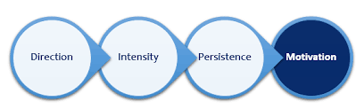
Elements of Motivation
Intensity describes how hard a person tries. This is the element most of us focus on when we talk about motivation.
However, high intensity is unlikely to lead to favorable job performance outcomes unless the effort is channeled in a direction that benefits the organization.
Effort directed toward and consistent with the organization’s goals is the kind of effort organizations should be seeking to improve.
Finally, motivation has a persistence dimension. This measures how long a person can maintain effort. Motivated individuals work intensely on an appropriate task long enough to achieve their goals.

Slide 10

Classic Theories of Motivation
Three theories of employee motivation formulated during the 1950s are considered to be classics in the study of motivation.
They represent a foundation of motivation theory, with many practicing managers still using their terminology which are:
  Hierarchy of Needs Theory
  Two-Factor Theory
  McClelland’s Theory of Needs

Slide 11

Lecture
Hierarchy of Needs Theory
03

Slide 12
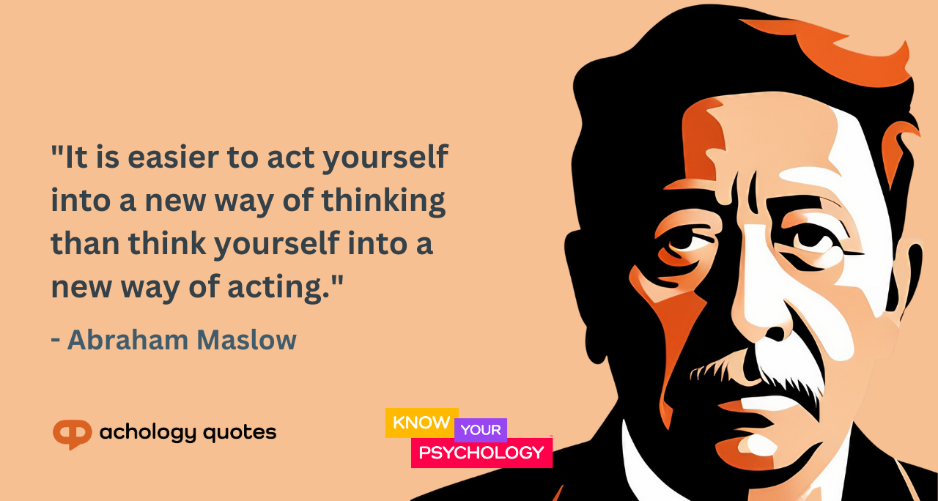
Hierarchy of Needs Theory
The best-known theory of motivation is Abraham Maslow’s hierarchy of needs,
which hypothesizes that within every human being there is a hierarchy of five needs humans are motivated to meet.
A sixth need has been proposed for a highest level—intrinsic values—which is said to have originated from Maslow, but it has not gained widespread acceptance.

Slide 13
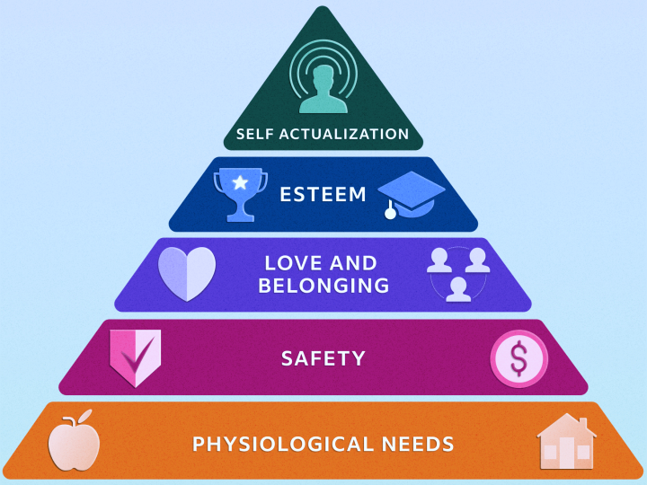
Hierarchy of Needs Theory
The original five needs are:
Physiological. Hunger, thirst, shelter, and other bodily needs.
Safety. Security and protection from physical and emotional harm.
Social-belongingness (originally love). Affection, love, belongingness, acceptance, and friendship.
Esteem. Internal factors such as self-respect, autonomy, and achievement as well as external factors such as status, recognition, and attention.
Self-actualization. Drive to become what we can become; includes growth, achieving our potential, and self-fulfillment.

Slide 14
Lecture
Two-Factor Theory
03

Slide 15

Two-Factor Theory
Believing an individual’s relationship to work is basic and that the attitude toward work can determine success or failure, psychologist Frederick Herzberg wondered, “What do people want from their jobs?”
He asked people to describe, in detail, situations in which they felt exceptionally good or bad about their jobs.

Slide 16
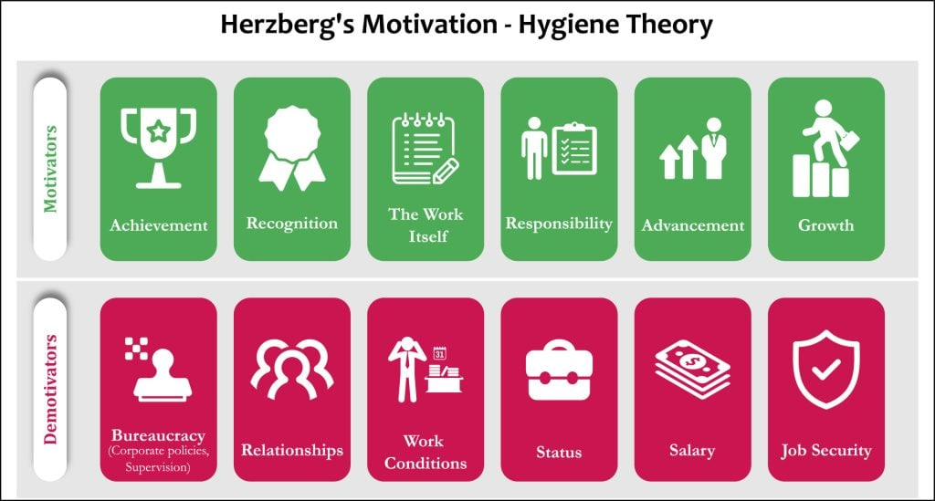
Two-Factor Theory
The responses differed significantly and led Hertzberg to his two-factor theory (also called motivation-hygiene theory, but this term is not used much today).
Two-factor theory is inherently tied to job satisfaction and expresses motivation in terms of intrinsic and extrinsic factors that impact job satisfaction.

Slide 17
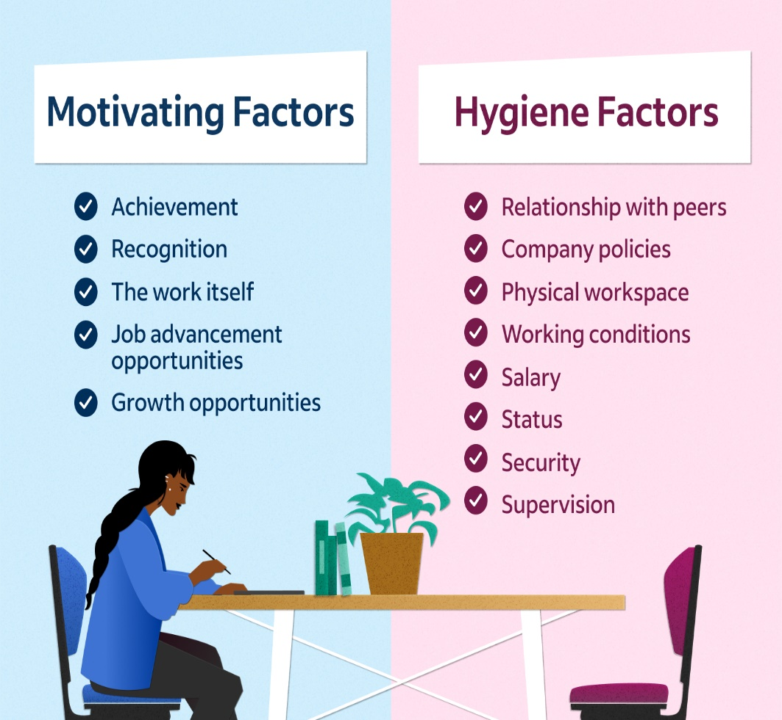
Two-Factor Theory
Under two-factor theory, the factors that lead to job satisfaction are separate and distinct from those that lead to job dissatisfaction.
Intrinsic factors such as advancement, recognition, responsibility, and achievement seem related to job satisfaction.
Respondents who felt good about their work tended to attribute these factors to their situations,
while dissatisfied respondents tended to cite extrinsic factors, such as supervision, pay, company policies, and work conditions.

Slide 18

Two-Factor Theory - Criticisms
The two-factor theory has not been well supported in research.
Criticisms center on Herzberg’s original methodology and his assumptions, such as how the participants may be biased in thinking back to times when they felt good or bad about their jobs.
Furthermore, if hygiene and motivational factors are equally important to a person, both should be capable of motivating.
Regardless of the criticisms, Herzberg’s theory has been quite influential and has been used in many studies.
Most managers worldwide are familiar with its recommendations.

Slide 19
Lecture
McClelland’s Theory of Needs
03

Slide 20

McClelland’s Theory of Needs
McClelland’s theory of needs: A theory that achievement, power, and affiliation are three important needs that help explain motivation.
McClelland’s theory of needs, unlike Maslow’s hierarchy, suggests that needs are more like motivating factors than prerequisites for survival.

Slide 21

McClelland’s Theory of Needs
In McClelland and colleagues’ theory, there are three primary needs:
Need for achievement (nAch) is the need to excel or achieve to a set of standards.
Need for power (nPow) is the need to make others behave in a way they would not have otherwise.
Need for affiliation (nAff) is the need to establish friendly and close inter personal relationships.

Slide 22

Contemporary Theories of Motivation: Content-Based
Contrast the content-based theories of motivation, including self-determination theory, regulatory-focus theory, and job engagement theory.

Slide 23
Lecture
Self-determination Theory
03

Slide 24
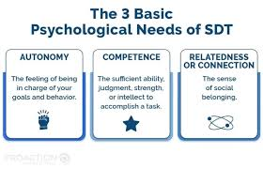
Self-determination Theory
Self-determination theory (SDT) proposes that employees’ well-being and performance are influenced by the nature of their motivation for certain job activities.
For instance, a sense of choice over what they do, how motivating the task is in and of itself, how rewards influence motivation, and how work satisfies psychological needs are all fundamental components of SDT.

Slide 25
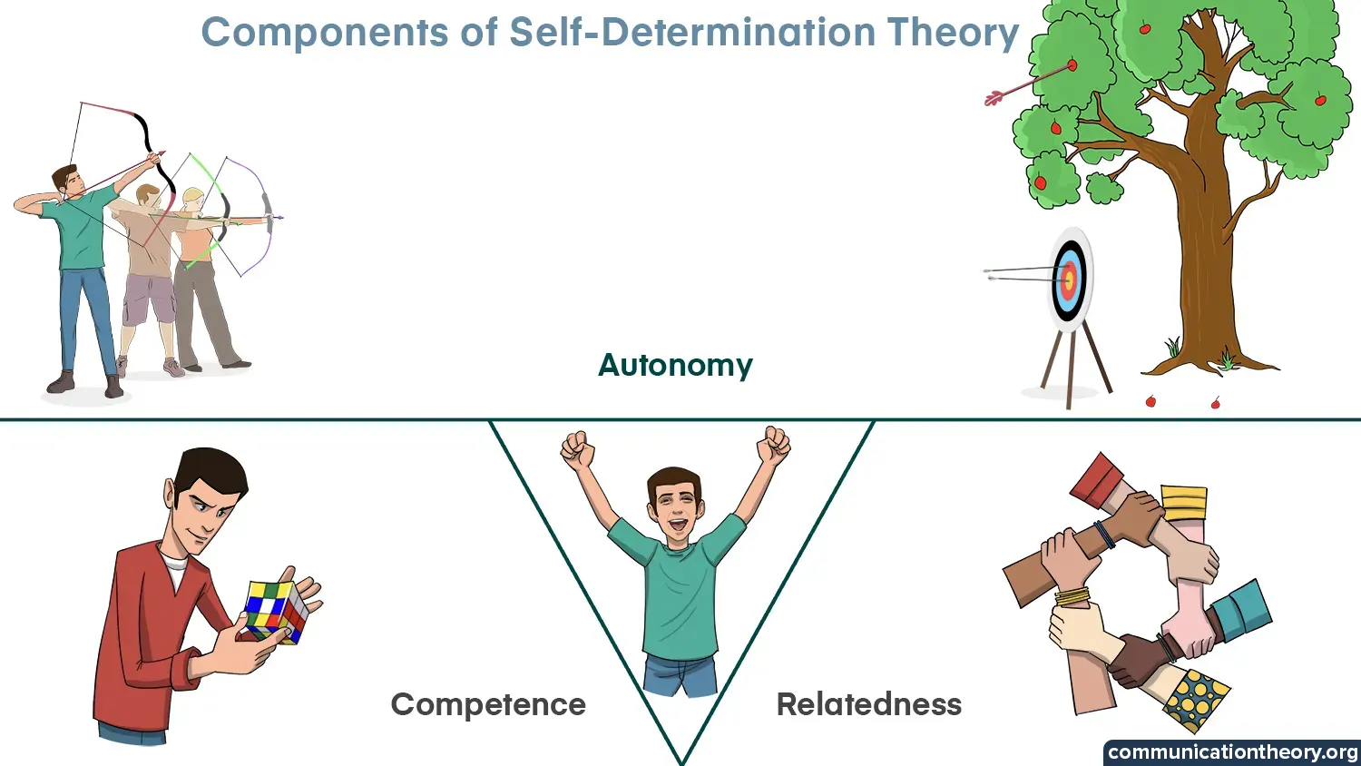
Self-determination Theory
The theory is actually a meta-theory (or a collection of related theories behind a common theme) and is widely used in psychology, management, education, and medical research.
A key tenant of SDT is that motivation can be either autonomous (e.g., freely chosen) or controlled (e.g., as a result of others’ pressure or direction).
Supporting SDT, data from approximately 40,000 schoolteachers showed that autonomous motivation had pronounced effects on teacher well-being, stress, and teaching quality.

Slide 26
Lecture
Cognitive Evaluation Theory
03

Slide 27
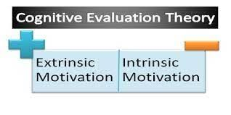
Cognitive Evaluation Theory
Cognitive Evaluation Theory “It’s strange,” said Jordan. “I started work at the Humane Society as a volunteer.
I put in fifteen hours a week helping people adopt pets.
I loved coming to work. But then, three months ago, they hired me full-time at $11 an hour.
I am doing the same work I did before. But I’m not finding it as much fun.” Does Jordan’s reaction seem counterintuitive?

Slide 28
Cognitive Evaluation Theory
One explanation can be found in cognitive evaluation theory (CET), a sub-theory that suggests that extrinsic rewards (e.g., pay) reduce people’s intrinsic interest in a task.
When people are paid for work, it feels less like some thing they want to do and more like something they must do.
For example, if a computer programmer values writing code out of a love for solving problems, a bonus for writing a certain number of lines of code every day could feel coercive, and the programmer’s intrinsic motivation could suffer.

Slide 29
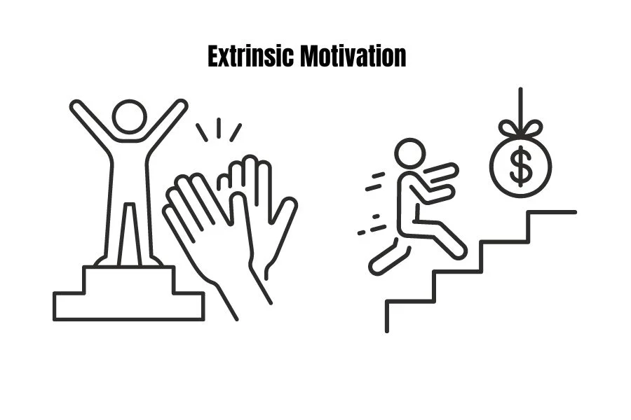
Cognitive Evaluation Theory
CET suggests that some caution in the use of extrinsic rewards to motivate is wise and that pursuing goals from intrinsic motives (such as a strong interest in the work itself) is better for sustaining motivation.
Similarly, CET suggests that providing extrinsic incentives may, in many cases, undermine intrinsic motivation.
In support, research confirms that intrinsic motivation contributes to the quality of work, while incentives contribute to the quantity of work.

Slide 30
Lecture
Self-Concordance Theory
03

Slide 31

Self-Concordance Theory
Self-Concordance Theory: Another aspect of self-determination theory is self concordance theory , which considers how strongly people’s reasons for pursuing goals are consistent with their interests and core values.
People who pursue work goals that align with their interests and values are more satisfied with their jobs, feel they fit into their organizations better, and may perform better.
Across cultures, if individuals pursue goals because of intrinsic interest, they are more likely to attain goals, are happier when they do so, and are happy even if they are unable to attain them.

Slide 32
Self-Concordance Theory
Why? Because they feel like they are more competent at accomplishing the goal and feel like they fit better with their organization.
When people do not enjoy their work for intrinsic reasons, those who work because they feel obligated to do so can still perform acceptably, though they experience higher levels of strain.

Slide 33

Regulatory Focus Theory
People differ in the way they regulate their thoughts and behaviors during goal pursuit.
Generally, people fall into one of two categories, or regulatory foci, though they could belong to both.
  Promotion focus: A self-regulation strategy that involves striving for goals through advancement and accomplishment.
  Prevention focus: A self-regulation strategy that involves striving for goals by fulfilling duties and obligations and avoiding failure.

Slide 34
Lecture
Job Engagement Theory
03

Slide 35
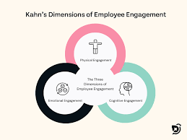
Job Engagement Theory
Job Engagement Theory: When Addison reports to work as a hospital nurse, it seems that everything else melts away.
Addison becomes completely absorbed in the job: All emotions, thoughts, and behavior are all directed toward patient care.
In fact, Addison can get caught up in work to the point of not even being aware of the time.
As a result of this state, Addison is more effective in providing patient care and feels uplifted by the work.

Slide 36
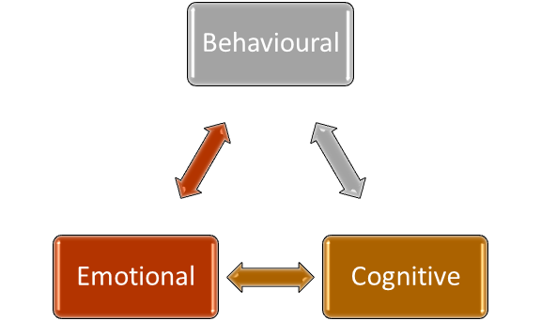
Job Engagement Theory
Addison has a high level of job engagement, the investment of an employee’s physical, cognitive, and emotional energies into job performance.
Many also portray job/work engagement as a motivational state characterized by vigorous completion of the work, dedication to the task, and complete absorption in what one is doing, although more research appears to support the “ energy-investment” state referenced in this text’s definition.

Slide 37
Job Engagement Theory
If this term seems familiar to you, you are correct—employee engagement was a term introduced in the chapter on job attitudes.
Why are we introducing it again here? OB scholars actually view engagement in two different ways:
One is as a job attitude, a level of enthusiasm people have toward their work. The other is as a motivational state.

Slide 38
Job Engagement Theory
Practicing managers and scholars have become interested in facilitating job engagement, given that disengaged employees cost U.S. businesses up to $550 billion annually in lost productivity.
Job engagement appears to matter for organizations and has been found to predict higher levels of task performance and citizen ship behavior.
However, as described in the chapter on job attitudes, the construct is partially redundant with job attitudes like organizational commitment.

Slide 39


Slide 40



Thank You

