Slide 1



Strategies for
Evaluating Opportunities
Prepared by Dr. Mohamed Soliman
ENT624
Entrepreneurial Strategy
Lecture 4

Slide 2



Learning Objectives
1. Understand the role of opportunity evaluation in the entrepreneurship process
2. Learn methods of evaluation that can be used for the initial idea and subsequent opportunities in the life cycle of the new venture
3. Prepare the Opportunity Organizational Proposal (OOPs), which is based on a comprehensive analysis of the feasibility of the venture idea
4. Undertake the feasibility analysis by completing the five sections of the OOPs.

Slide 3
Opportunity Evaluation: Will the Idea for the New Venture Work?
Once entrepreneurs have developed the idea(s) for the new ventures, they must begin the process of assessing whether or not the idea is in fact a viable business opportunity.
Many new ventures have been launched around bad business ideas.
An idea can seem sound in theory but in reality have poor marketplace potential.

Slide 4
Opportunity Evaluation: Will the Idea for the New Venture Work?
While failures can also be attributed to poor execution of the idea, it is important to assess feasibility as early as possible to avoid the much costlier effects of failed implementation.
Assessing an idea’s potential to become a good business opportunity is absolutely necessary to avoid the allocation of scarce resources, including the entrepreneur’s time and effort.
So how do entrepreneurs determine if an idea is an appropriate investment for their resources?

Slide 5
Opportunity identification
begins by determining the unique needs of the industry and marketplace, including what customers expect and demand that the new venture can provide.
Many ideas and opportunities exist; however, resources are scarce, and this means that you must be very careful in your evaluation of business opportunities to be sure they can be supported by the knowledge and information you possess or can obtain fairly easily.
The evaluation process begins with some fundamental questions to help entrepreneurs assess the potential for the new venture to succeed.
Evaluation of business opportunities should be conducted not just by the entrepreneur but also by as many stakeholders in the new venture as possible: potential customers or clients, employees, advisers, investors, and suppliers.

Slide 6
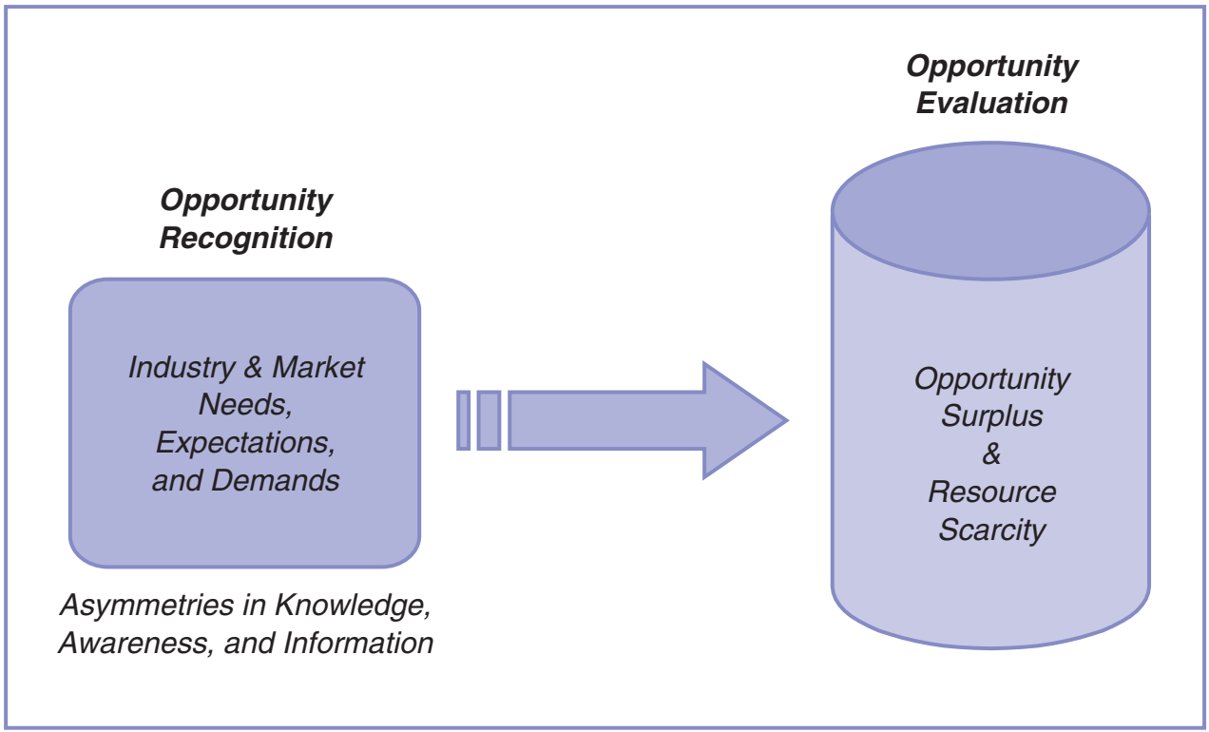
Opportunity Recognition to Opportunity Evaluation: The Assessment Process
Opportunity Recognition to Opportunity Evaluation: The Assessment Process

Slide 7
Four Primary Areas for Assessment
There are many questions to ask during opportunity evaluation, and they can be classified according to four primary areas for exploration:
The people behind the idea:
The background, talents, and experience of the entrepreneur and the management team, employees, and advisers.
Even a great idea with high market potential requires an entrepreneur or team behind it that can effectively (and passionately) support and grow the idea. It is then much more likely to be successful.
An entrepreneur’s skills and talents might have led to the discovery of the idea, but does the entrepreneur have the competence to turn the idea into a business?

Slide 8
2. The resources available to the entrepreneur and the management team, including the equity and debt sources of capital that are available and accessible, additional assistance from people with expertise needed by the firm, and the technology required to support the idea.
What relationships can the entrepreneur or team rely on to acquire the necessary resources?

Slide 9
3. The knowledge and information possessed by the entrepreneur, including knowledge of the new venture concept, the industry, and market research.
Moreover, what is not known that needs to be known for the new venture to be successful? Information about competitors? About customers’ preferences? How will this information be obtained?

Slide 10
4. The idea’s ability to generate revenue.
How great is the potential to sell something that will generate actual revenues? One of the mistakes would-be entrepreneurs make is to assume that everyone will love the idea and that people will be standing in line to buy it, once the business opens.
To what degree can the entrepreneur manage and contain the costs while maximizing returns?
These 4 questions form the basis for the opportunity evaluation, and their answers will help the entrepreneur move forward to create strategies that ultimately support the viable business model.

Slide 11
Business Evaluation Scoring Technique (BEST)
It was developed to help entrepreneurs evaluate a group of ideas before deciding which ones to pursue.
The tool considers the various “windows of opportunity” related to new ventures.
Answer the following questions by scoring them on a 1–5 scale: 1 = low and 5 = high.
1. Is the business really differentiated from other similar businesses?
2. Does the business have growth potential?
3. Will the business require capital? (Note: A low dollar requirement receives a higher score, while a high dollar requirement should receive a low score)
4. Can financing be secured?
5. Does business suit individual’s entrepreneurial profile(e.g., mind-set, experience)?

Slide 12
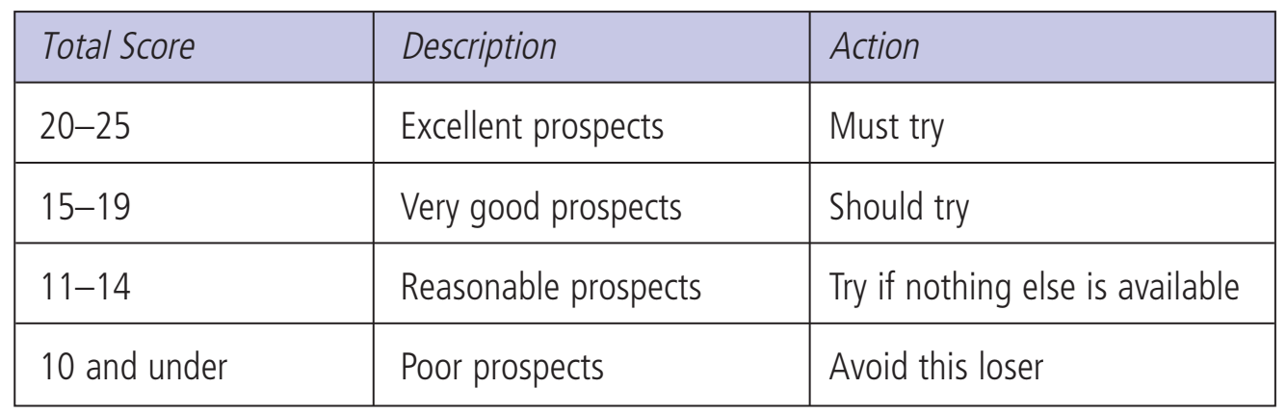

Slide 13
Assessing the Feasibility of the New Venture Idea
Evaluating a new venture idea involves testing its feasibility, the extent to which the idea is a feasible and realistic business opportunity.
One of the first steps required in assessing the feasibility of an idea is to become aware of forces and factors in the internal and external environment that directly influence the new venture opportunity.

Slide 14
Assessing the Feasibility of the New Venture Idea (cont.)
Factors internal to the venture include:
The knowledge, skills, and abilities of the entrepreneur, the management team members, employees, and advisers
The resources available to the entrepreneur, including people, financial resources, and technologies that can be acquired for the launch and growth of the opportunity
Factors external to the new venture include:
• The industry: competitors, structure of the industry, barriers to entry, and trends that affect businesses in the sector in which the new venture intends to locate.

Slide 15
Assessing the Feasibility of the New Venture Idea (cont.)
• The market: knowledge of the preferences, values, and buying behavior of the target market, including demographic and psychographic information necessary to appropriately position, promote, and price the products and services.
• Social norms, values, and trends surrounding the new venture idea. Is it a fad? Is there an increasing need for or awareness of the product or service? Are there ethical concerns about the product, service, or its effects? Realize that a product or service (and any of its components) may be legal but unethical. The social environment of a new venture often involves the perceptions—not necessarily the reality—of the opportunity in the minds of customers and citizens.

Slide 16
Assessing the Feasibility of the New Venture Idea (cont.)
Legal and regulatory forces that could affect the business operations, including laws, policies, procedures, and regulations pertinent to the industry or municipality in which the new venture is located
-- Conducting an environmental feasibility analysis will help the entrepreneur prepare a strategic plan—

Slide 17
In the next section, we examine the major questions to ask that will help you determine the feasibility of your business opportunity.
A model that can guide the entrepreneur through the opportunity evaluation process is presented.

Slide 18
Fourteen Questions to Ask Every Time
To evaluate opportunities, Allis (2003) has developed a set of questions for entrepreneurs. The answers are helpful as entrepreneurs prepare to conduct a comprehensive feasibility analysis and to develop subsequent strategies for the emerging venture.
1. What is the need you fill or problem you solve? (value proposition)
2. To whom are you selling? (target market)
3. How could you make money? (revenue model)
4. How will you differentiate your company from what is already out there? (unique selling proposition)
5. What are the barriers to entry?

Slide 19
6. How many competitors do you have and of what quality are they? (competitive analysis)
7. How big is your market in dollars? (market size)
8. How fast is the market growing or shrinking? (market growth)
9. What percent of the market do you believe you could gain? (market share)
10. What type of company would this be? (lifestyle or high growth potential, sole proprietorship or corporation)
11. How much would it cost to get started? (start-up costs)
12. Do you plan to use debt capital or raise investment? If so, how much and what type? (investment needs)
13. Do you plan to sell your company or go public (list the company on the stock markets) one day? (exit strategy)
14. If you take on investment, how much money do you think your investors will get back in return? (return on investment)

Slide 20
ALUO to Evaluate the New Venture Idea
ALUO (Advantages, Limitations, Uniqueness, and Opportunity) is a useful tool that enables the entrepreneur to examine the advantages and limitations of an idea.
Most entrepreneurs do this, but ALUO is helpful because it also asks you to consider:
- what is unique about the idea and
- what opportunity emerges from the advantages, limitations, and uniqueness of the idea.

Slide 21
A: What are the advantages of the idea? How does it build on or extend what is already available in the market?
L: What are the limitations of the product or service? This may be hard for the entrepreneur to assess realistically (watch out for idea infatuation!). You may want to ask others for their opinions on this. What elements of your idea might not work as well as predicted? What flaws might exist?
U: What is unique about the idea? What can’t be substituted by something already available in the marketplace? Is your idea easily imitated by others? How can the entrepreneur make it difficult for others to copy? If the product or service is not unique, are there ancillary products or services that could be packaged to maintain uniqueness?
O: What opportunities emerge from the unique features and advantages (or even the limitations, as you consider ways these could be minimized)?

Slide 22
The Feasibility Analysis: Beginning the Evaluation Process
The KIC: Knowledge of Industry Checklist
While it may be tempting to take the jump into writing a business plan as soon as you develop and refine your business idea or opportunity, this can prove to be a serious mistake.
Many would-be entrepreneurs underestimate their competitors (both in number and in capability) and therefore develop entrepreneurship strategies that have no likelihood of success.

Slide 23
The KIC: Knowledge of Industry Checklist
Don’t fall into that trap—idea infatuation is one of the strongest predictors of business failure because infatuated entrepreneurs ignore or discount objective industry and market data that even slightly questions their idea.
To increase the odds of success and help you identify potential flaws and areas for improvement a priori, start with the KIC: Knowledge of Industry Checklist.
KIC: is a complete industrial analysis usually includes a review of an industry’s recent performance, its current status, and the outlook for the future. These analyses include a combination of text and statistical data.

Slide 24
Current Industry Analysis
Describe the industry as specifically as possible. Some business ideas fall into more than one industrial classification.
What are the current trends in the industry?
• What is the current size of the industry? Is it dominated by large players? Are there a significant number of small to medium-size enterprises in the industry?
Where is the industry located? Is it local, regional, national, or global?
• What is the average sales and profitability for this industry?

Slide 25
Competitor Analysis
• Obtain basic information on the competitors you have identified. Who are
the direct competitors of the new venture?
• Where are the competitors located? Be careful not to assume that a competitor located across the country—or the world—is not a direct competitor. Many firms conduct business on-line, and a remote competitor may prove to be a formidable one if it has a strong on-line presence.
• What are the advantages and disadvantages of the competitors?
• What features of their products or services are similar to yours?
• How are your products or services distinctive from those of your competitors? This is a key part of the competitive analysis.

Slide 26
Competitor Identification:
Key product or service
Location(s)
Local, regional, national or global?
Primary features of product or service
Advantages of product or service
Disadvantages of product or service
Target market
Market share
Pricing
Promotional activities
Knowledge, skills, and abilities of key staff
Resources
Image
Culture of the business (norms and values)
Financial condition
How is your venture distinctive from this competitor?

Slide 27
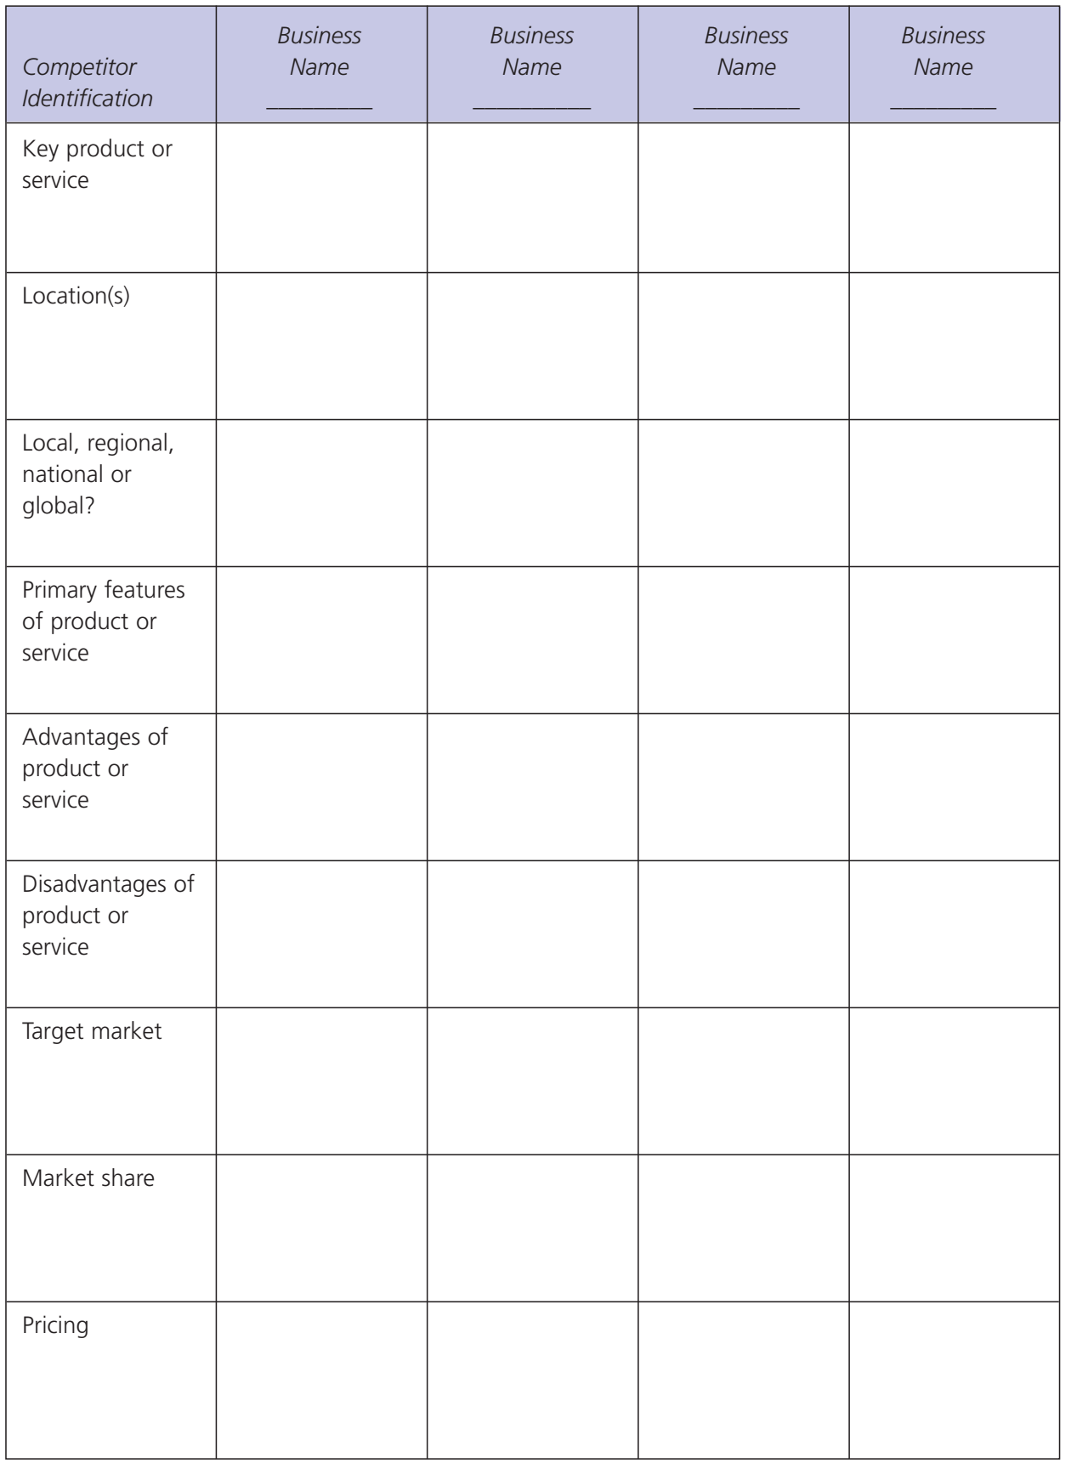

Slide 28
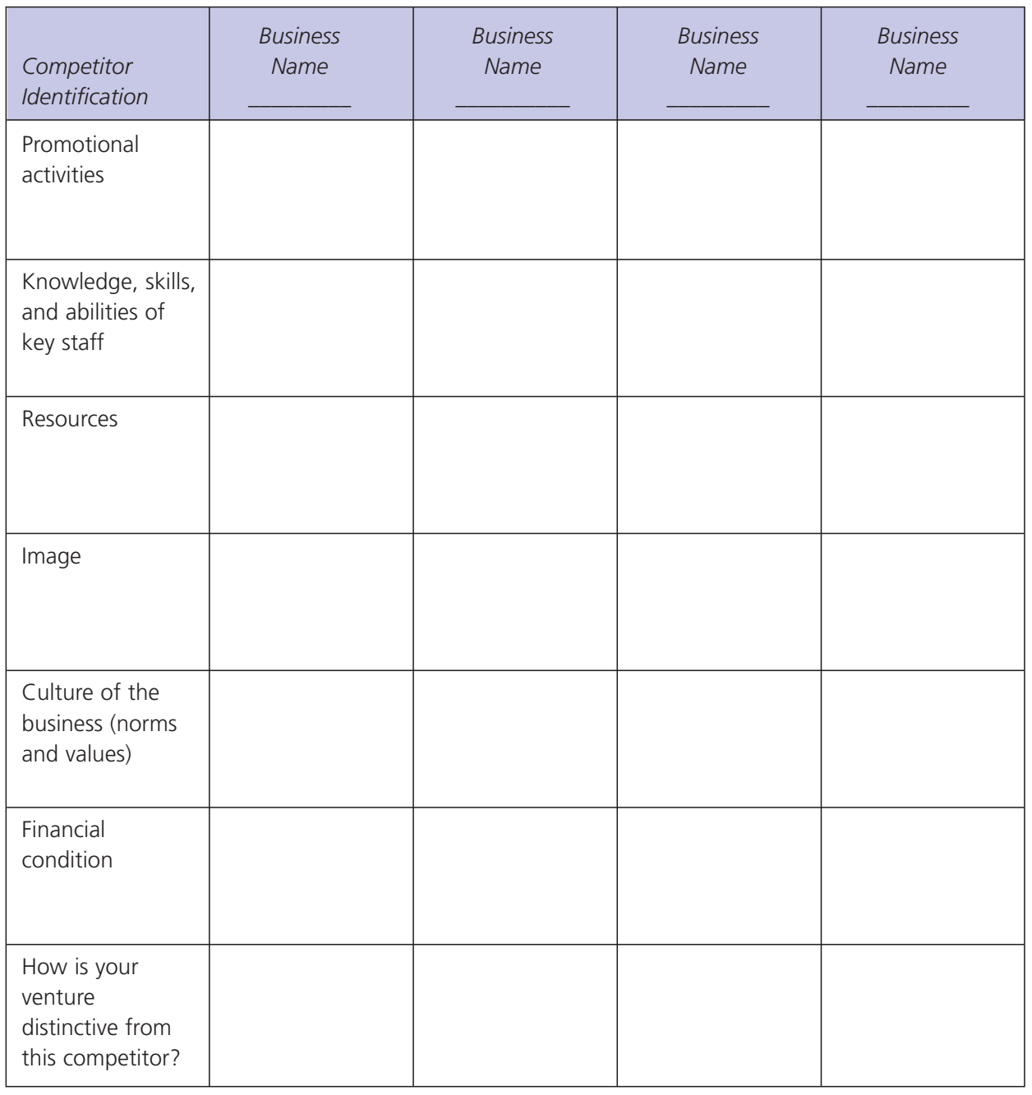

Slide 29
Sources of Information for the Industry and Competitor Analysis
There are many sources of industry analysis:
investment firms,
business and trade periodicals,
trade associations, and
government agencies.
To conduct a thorough industry analysis, include a variety of sources.
As you conduct your research, don’t neglect to record your own personal observations: Visit competitors in a nondisruptive manner. What do you notice? What could be improved? How is the product or service used? Create the experience of being a customer of this business and industry.

Slide 30
From KIC to OOPs: The Opportunity Organizational Proposal
In the first section of this chapter, we examined the key factors that are part of the opportunity assessment.
A comprehensive feasibility study is conducted to help the entrepreneur determine whether the opportunity can lead to the emergence and growth of a successful organization.
The Opportunity Organizational Proposal is composed of five major sections.

Slide 31
Outline for the Opportunity Organizational Proposal: Feasibility Analysis
Description of Your Business
What business are you really in?
Describe your product or service in the most concise way you can, and think beyond the characteristics of the product or service to the experience that you hope the customer receives from buying the product or service.

Slide 32
2. The Product or Service
• a) Describe what you are selling and how it will benefit your customers.
- Explain how your product or service is different from the competition.
- Answer the question, “Why will people buy from me?” (your product/service concept, benefits, and customer profile).
- It is important that you can concisely and accurately describe your product or service in terms that are relevant to your customer and that the customer can understand.
- The ability to describe your product or service will be a critical factor in the success of your marketing and advertising.
- What are the things about your product or service that are important to your customer? What words immediately create an image of your business?

Slide 33
• What are the unique characteristics of your product or service?
What are the unique features of the product or service?
How do these features meet your customers' needs or preferences?
What are the benefits of this product or service compared to the competition?
Describe your product or service very simply, and use photos or drawings to illustrate how it works.
• What are the specific shortcomings of the product or service? Can it become obsolete soon? Is it perishable, is it difficult to use or install, or are there legal restrictions?
- An honest assessment of your product or service is extremely important during this analysis.
Entrepreneurs do themselves no favor by being in denial or failing to see the disadvantages before going into business.
Noting them now will help you prepare solutions or ways to minimize these issues.

Slide 34
• What is your product's stage of development? Is the product still in the idea stage, or is there a model or working prototype available? Have any samples been manufactured? If it is still in the idea or prototype stage, what is the time frame for getting it ready for production.
• b) Research any legal restrictions and rights.
List any patents, copyrights, trademarks, or licenses that apply to your product or service.
If you are entering into a franchise agreement, partnerships, distributorships, and so on, these should be discussed in this section.
Seek the assistance of patent attorneys or intellectual copyright specialists for assistance.
Also, list the government regulations with which you must comply, including any government approvals required, and research zoning restrictions carefully.
If you will be home based and your clients will be coming to your house, will your neighborhood's zoning restrictions be an issue?

Slide 35
• c) What are the insurance requirements?
Research the liability of your product or service, and consult an insurance specialist to be sure you are protected adequately. This will depend on the nature of your business.
A landscape design firm is in a different liability situation than a children's gymnastics and fitness center, for example. If you have employees, you will need insurance to protect them from harm also, along with any insurance benefits you want to provide your staff.
• d) Estimate production or service delivery costs.
Will you be producing or subcontracting out the manufacturing or delivery of your product or service?
List all the costs, including labor, supplies, shipping, repairs, and so on.

Slide 36
3.The Industry and Market
• a) Describe the current industry.
- Determine the trends present in the industry, the size of the industry, the location, and the average sales and profitability of the industry.
- Use the KIC (Knowledge of Industry Checklist) presented earlier in the chapter for this section of the feasibility analysis.
• b) What is the market potential for your idea?
Describe the market for your product or service as specifically as possible. Is the industry in a period of growth, stability, or decline?
Can you predict the demand for your product or service over the next six months to two years?
Would-be entrepreneurs should interview business owners, managers, or other insiders in the industry to learn about trends and market potential for the industry.

Slide 37
• c)What is the impact of technology on the industry and market?
What is the level of technology in use in the industry today?
How available or accessible is that technology to the entrepreneur? How can you remain up-to-date with technological changes in this industry?
What resources will be required to access the technology at start-up?
During the growth stage several months ahead?
• d) What economic and legal/regulatory factors affect this industry?
Are there global businesses in this industry and market?
How will these impact your operations or customers?
What laws and regulations govern the industry, and what information do you need to be sure you operate within legal guidelines?

Slide 38
• e) What ethical values are associated with this industry?
Are there any ethical guidelines for the industry?
How can you be proactive and develop a set of ethical norms and behaviors in this business?
Are there concerns perceived by customers or others in the industry about ethical behavior?
• f) Who are the primary competitors?
- Where are they located, and what are the unique features of their products or services? What are the advantages and disadvantages of these competitors, and how can your business be distinctive? Use the information from your competitor analysis worksheet presented earlier in this chapter.
• g)Who are your customers or clients?
- You will need demographic information, including statistics on where they live, income, educational level, number of children, and so on—whatever factors are relevant to your business opportunity. Searching by zip code through library databases (see the earlier section on sources in this chapter) will be helpful.

Slide 39
You will also need psychographic information, including your customers' preferences, values, attitudes, buying behavior, and so on. You can also use primary research, such as conducting surveys and interviews with potential customers to find out what they think about your ideas and whether or not they would buy the product or service.
Use creative approaches to learn all you can about your potential customers. Don't just listen to their words (or written responses on a survey). Try to observe their behavior—it often tells you much more about what they really think about your product or service. For example, if you are developing a new food, observe how much people eat (or drink) of the samples—not just what they say about them. If you are going to be offering a new consulting service, ask a small sample of potential clients to use the service (or a component of the service) and find out what problems the service solved (or didn't solve) for them. Remember Scott Cook's employees at Intuit who observed how the customers used Quicken as they were developing the product.
• How will you accomplish market penetration? How will you reach your target customers? What forms of distribution, advertising, and promotion will you use? How will your potential customers become aware of your business?

Slide 40
4. The Management
• What is your management and technical experience?
Briefly describe your management/technical skills related to this product or service. Who will you also have on your management team?
Will you develop a board of advisers, including industry experts, accountants, or lawyers?
• Consider the three crucial areas of experience and expertise:
Marketing strategies: This means knowing what kind of product or service to sell, how to target and reach your customers, and how to sell your product or service at a price that maximizes your profits.
2. Technical ability: You must be able to get the work done and done right, so you will have satisfied customers.

Slide 41
3. Financial knowledge: While you do not necessarily have to be a financial wizard, you do need to know how to plan and control your business's cash flow, how to raise or borrow the money you will need to start your business, and how to get through tight periods without being caught short of cash.
- A certain amount of financial sophistication is becoming more and more important in today's increasingly complex financial world, even for the small business owner.
- Being able to focus on the bottom line and pay attention to the numbers is as essential as the ability to price your products and services, manage your cash flow, and make sure you collect payment for the work you do.

Slide 42
5.The Financing: Estimating the Necessary Funds to Launch the New Venture
• a) How much seed money do you need?
Entrepreneurs must estimate the costs of the new venture for at least the first several months.
Every business is different and has its own specific cash needs at different stages of development, so there is no universal method for estimating your start-up costs.
Some businesses can be started on a shoestring budget whereas others may require considerable investment in inventory or equipment.
It is vitally important to know that you will have enough money to launch your business venture.

Slide 43
• b) What expenses will you have during the start-up phase?
Some of these expenses will be one-time costs such as the fee for incorporating your business or the price of a sign for your building.
Some will be ongoing, such as the cost of utilities, inventory, insurance, and so on. While identifying these costs, decide whether they are essential or optional.
A realistic start-up budget should include only those things that are necessary to start the business.
These essential expenses can then be divided into two separate categories:
- Fixed expenses include rent, utilities, administrative costs, and insurance costs.
- Variable expenses include inventory, shipping and packaging costs, sales commissions, and other costs associated with the direct sale of a product or service.

Slide 44
• c) Allow for surprise expenses.
Even with the best of research, opening a new business has a way of costing more than you anticipate.
There are two ways to make allowances for such expenses.
-- The first is to add a little padding to each item in the budget. The problem with that approach, however, is that it destroys the accuracy of your carefully wrought plan.
-- The second approach is to add a separate line item, which we call contingencies, to account for the unforeseeable.
- Talk to others who have started similar businesses to get a good idea of how much to allow for contingencies. If you cannot get good information, we recommend that contingencies should equal at least 20 percent of the total of all other start-up expenses.

Slide 45
• d) Use a worksheet that lists all the various categories of costs.
When listing your start-up costs, be sure to explain your research and how you arrived at your forecasts of expenses.
Give sources, amounts, and terms of proposed loans.
Also explain in detail how much will be contributed by each investor and what percent ownership each will have.
All this information can then be included within your business plan and presentation to your investors and lenders.

Slide 46
Research in Practice: New Venture Capabilities
The results of a feasibility analysis can provide entrepreneurs with a much better understanding of the capabilities of the new venture.
- In the Panel Study of Entrepreneurial Dynamics, 480 entrepreneurs reported how certain they were, on a scale of 1 (very low certainty) to 5 (very high certainty) that the new venture would be able to accomplish the following tasks and activities. The average response is given below:
Obtain raw materials: 1.4
Attract employees 2.3
Obtain start-up capital 2.6
Obtain working capital 2.8
Deal with distributors 2.9
Attract customers 4.0
Compete with other firms 3.5
Comply with regulators 4.0
Keep up with technological advances 3.3
Obtain a bank's help 2.2
Obtain venture capitalists' help 1.7

Slide 47
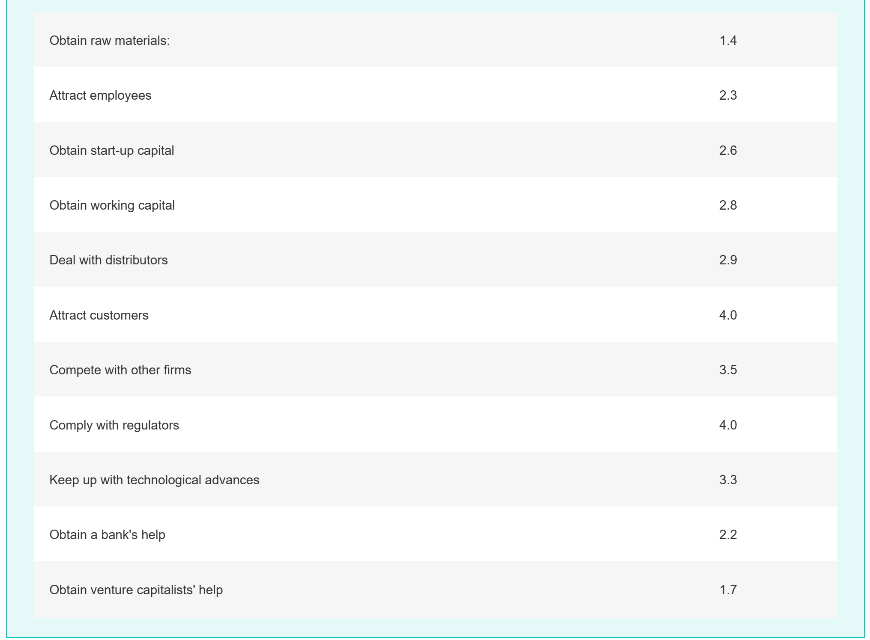

Slide 48
Next Steps: Strategic Planning for the Emerging Venture
-- When the entrepreneur has completed the feasibility analysis, the next steps into business involve strategic planning for the new venture.
-- In the next Chapter, we will examine how to develop a strategic plan and strategies for the launch of the business..

Slide 49
Recap
Opportunity evaluation
Four primary areas for assessment
Methods for evaluation
BEST (Business Evaluation Scoring Technique)
ALUO (Advantages, Limitations, Uniqueness, and Opportunity)
KIC (Knowledge of Industry Checklist)
Opportunity Organizational Proposal (OOPs)

Slide 50
Summary
1. Understand the role of opportunity evaluation in the entrepreneurship process
• The evaluation process begins with some fundamental questions to help entrepreneurs assess the potential for the new venture to succeed.
Four primary areas for assessment are: the people behind the idea (the entrepreneur and the management team); the resources available to carry out the idea; knowledge and information about the industry and market, including barriers to entry, location, competitors, social and economic trends, regulatory factors, target market, and market penetration; and the ability to generate revenue.

Slide 51
Summary
2. Learn methods for evaluation that can be used for the initial idea and subsequent opportunities in the life cycle of the new venture
• Creative tools such as ALUO (Advantages, Limitations, Uniqueness, and Opportunity) can help entrepreneurs identify the key strategic points and differences surrounding their ideas for the business.
• The KIC (Knowledge of Industry Checklist), including a comprehensive competitor analysis, is a useful guide for collecting and interpreting information about the industry.
• “Give Me Five” is a creative tool that is helpful to understanding the experience that the product or service should provide to customers. It asks you to take the perspective of significant constituents to your business.

Slide 52
Summary
3. Prepare the Opportunity Organizational Proposal (OOPs), which is based on a comprehensive analysis of the feasibility of the venture idea
• The OOPs will help the entrepreneur evaluate the ability of the business idea to effectively solve the problem or fill the need for which it was intended, as well as the degree to which the idea can generate sufficient revenues to warrant the resources needed to bring the opportunity into action.

Slide 53
Summary
4. Undertake the feasibility analysis by completing the five sections of the OOPs
• Section I: Description of the Business, asks what business are your really in, and what experience does your product or service bring to the customer?
• Section II: The Product or Service, asks you to delineate as specifically as possible the benefits of what you are selling to the customer. What are the unique features of the product or service? What are the shortcomings? What stage of development is the product or service in presently? Are there any legal restrictions, insurance requirements, or product delivery costs that are involved?
• Section III: The Industry and Market, contains an analysis of current trends in the industry, and the complete KIC (with competitor analysis); the market potential for the opportunity, the impact of technology on the industry and market, economic and regulatory factors, ethical values associated with the industry, information on the customers, and market penetration.

Slide 54
Summary
4. Undertake the feasibility analysis by completing the five sections of the OOPs
• Section IV: The Management, including the managerial and technical experience of the entrepreneur and any team members, including marketing, technical skills, and financial knowledge.
• Section V: The Financing, in which you estimate your start-up costs, the expected annual sales forecast, cost of goods sold, operating expenses, gross profit, pricing and break-even points, and sources of start-up capital.

Slide 55



Thank You

