Slide 1



Project Resources and Time Management
PMG 605
Lecture 4
Developing Project Scheduling Plan
Prepared by
Dr. Eng. Abdullah Jameel Halawany

Slide 2

Lecture
Session Outline
04
Developing a Project Scheduling Plan
Last Lecture Review
Gantt Charts
Developing Project Networks
CPM
PERT
Extended Network Techniques to Come Closer to Reality
4–2

Slide 3
Last Lecture Review
Lecture
04
Developing Project Scheduling Plan
PMG 605
Project Resources and Time Management
4–3

Slide 4
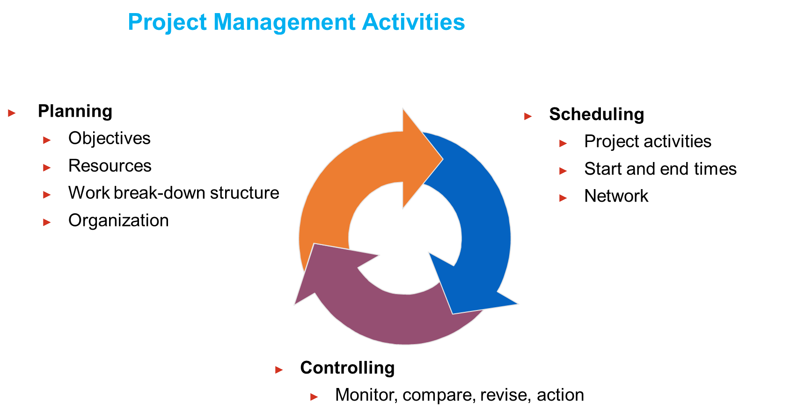
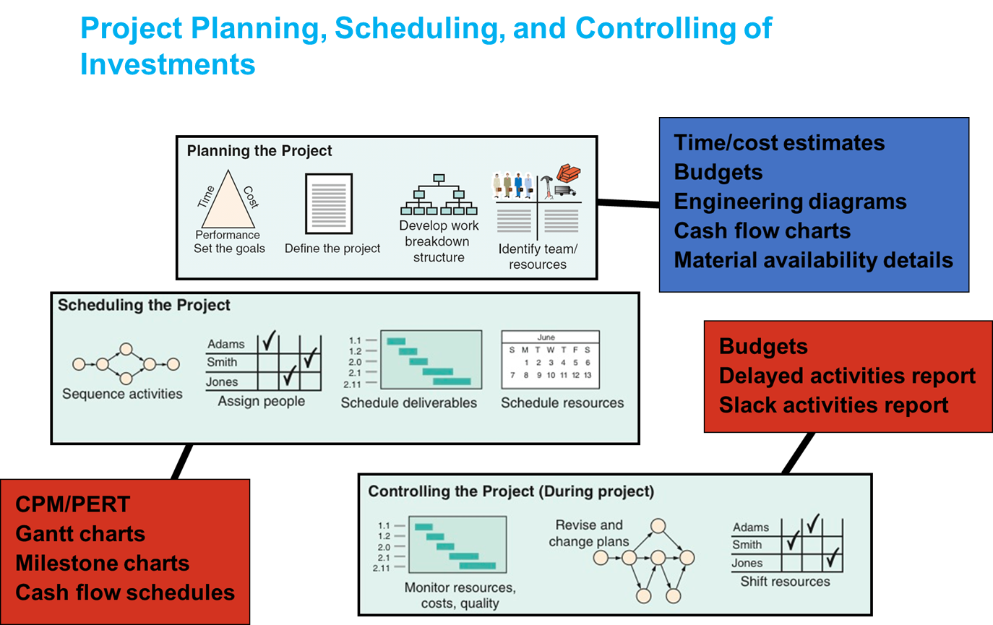
4–4

Slide 5
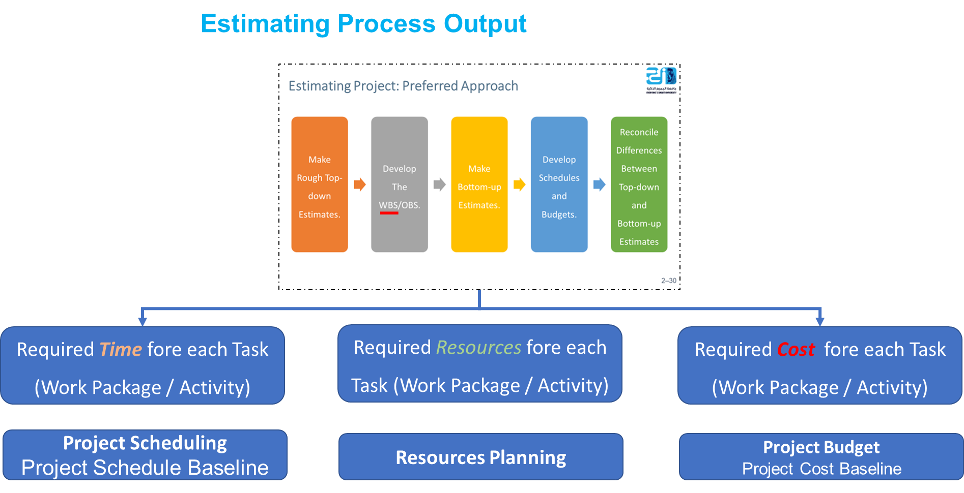
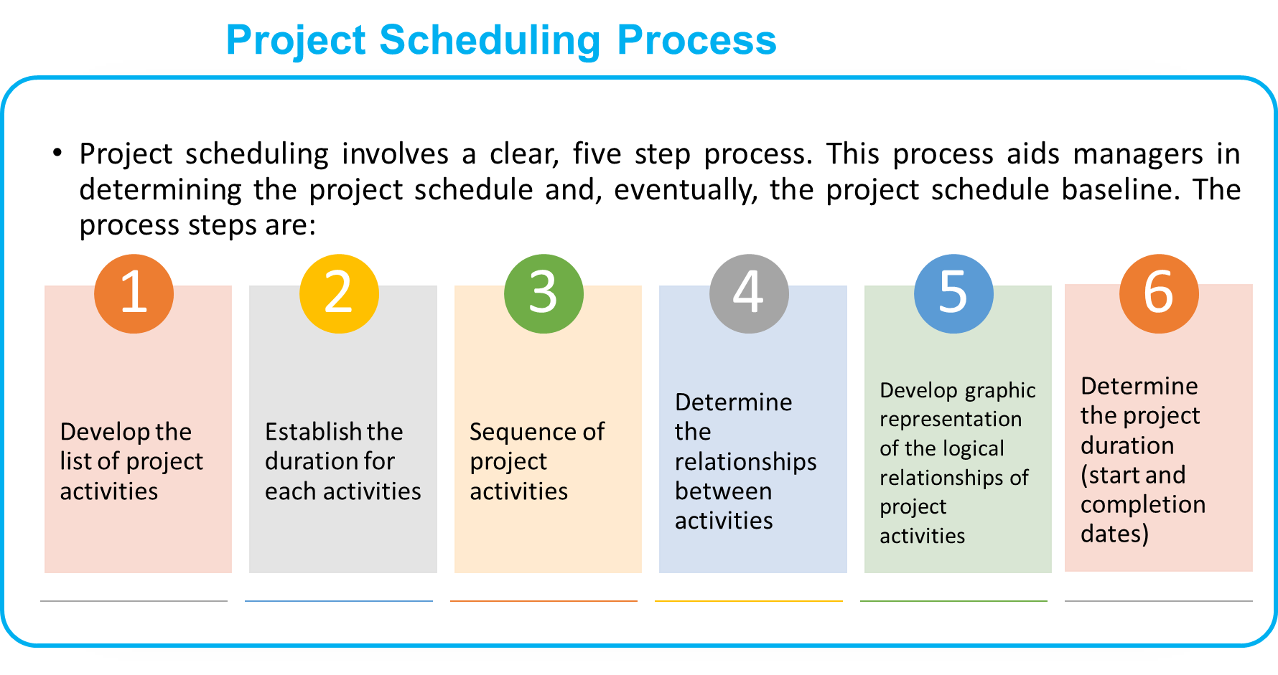
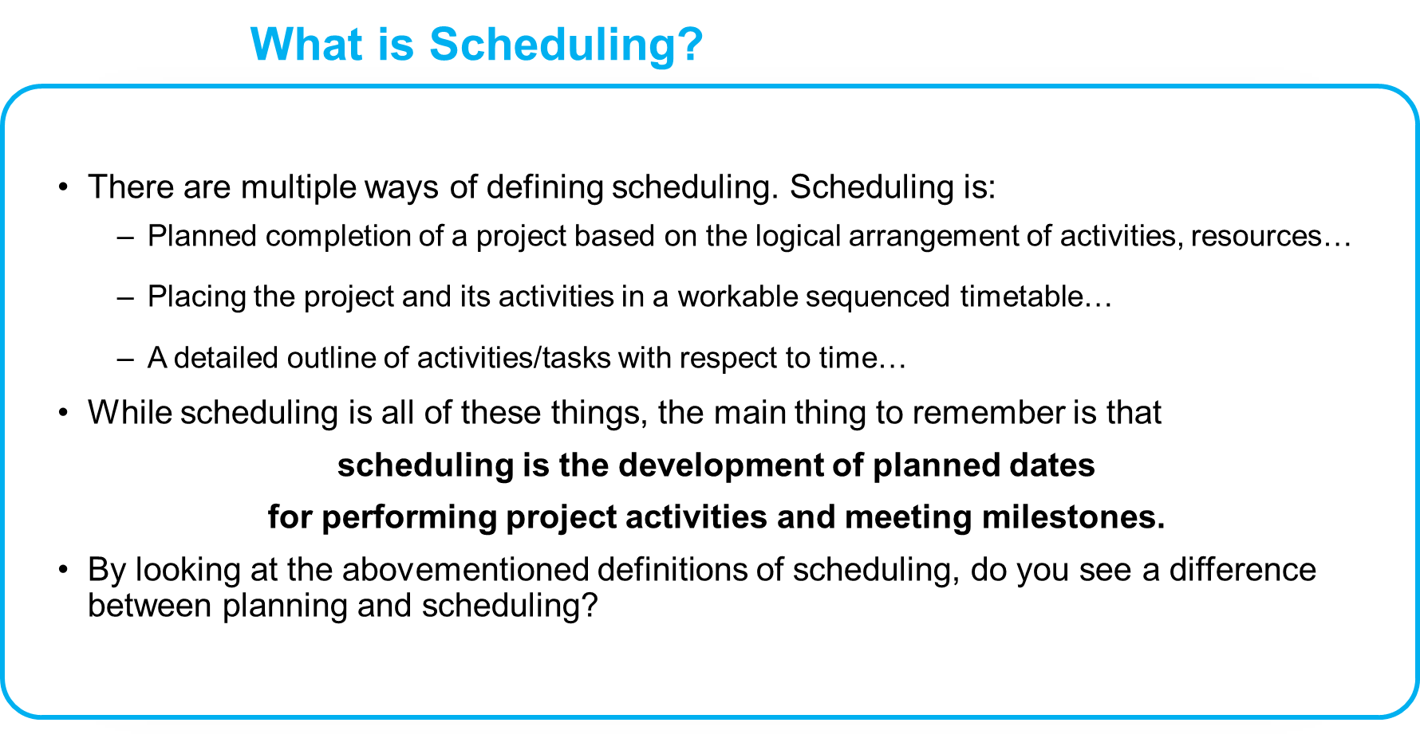
4–5

Slide 6
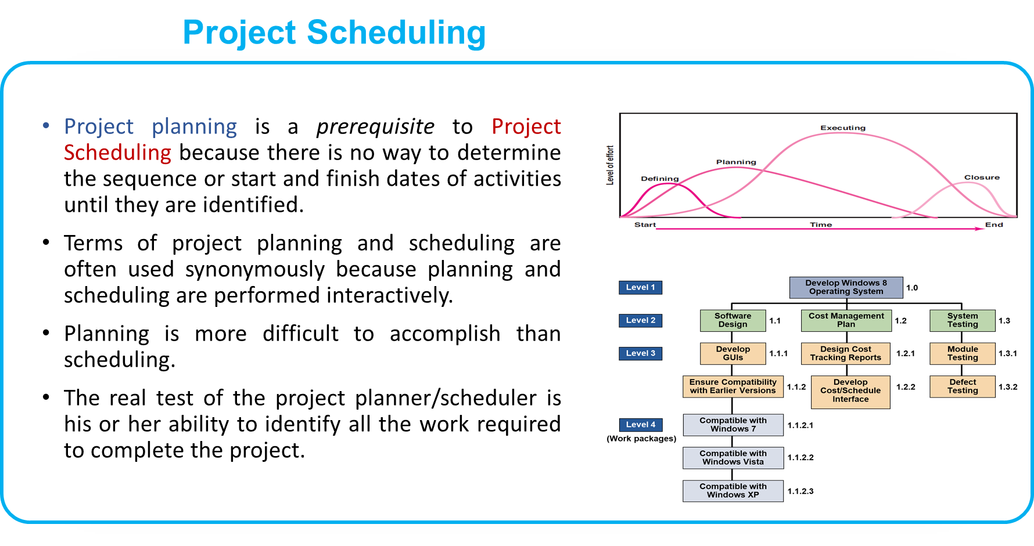
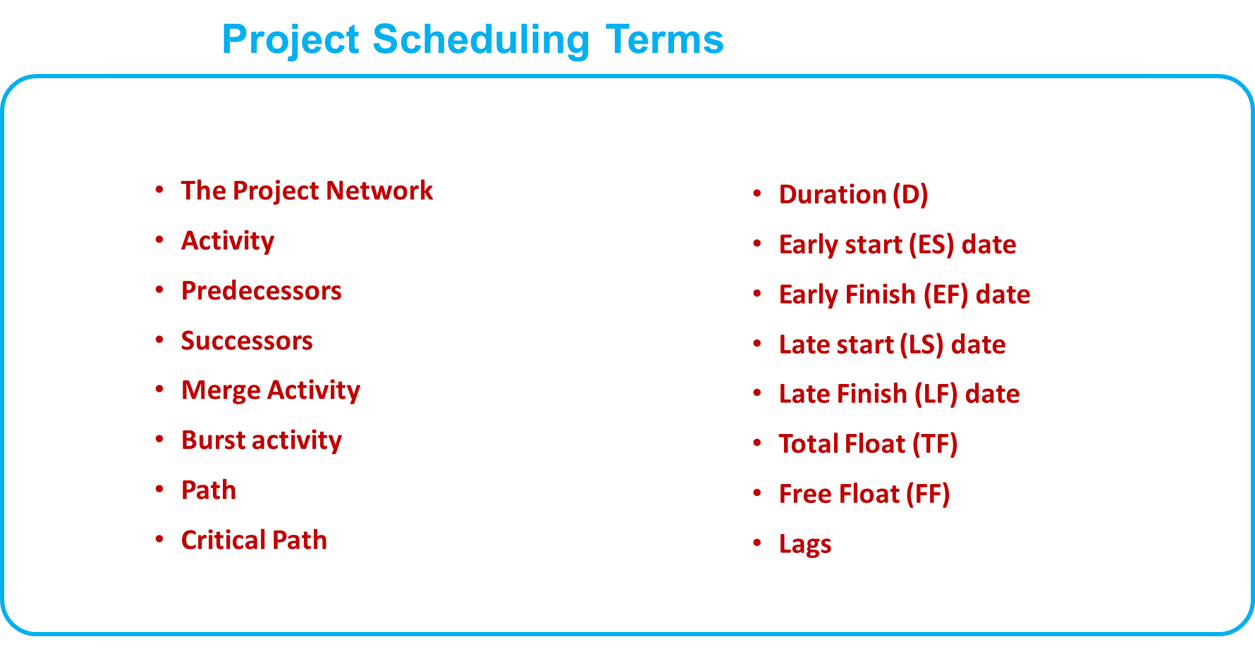
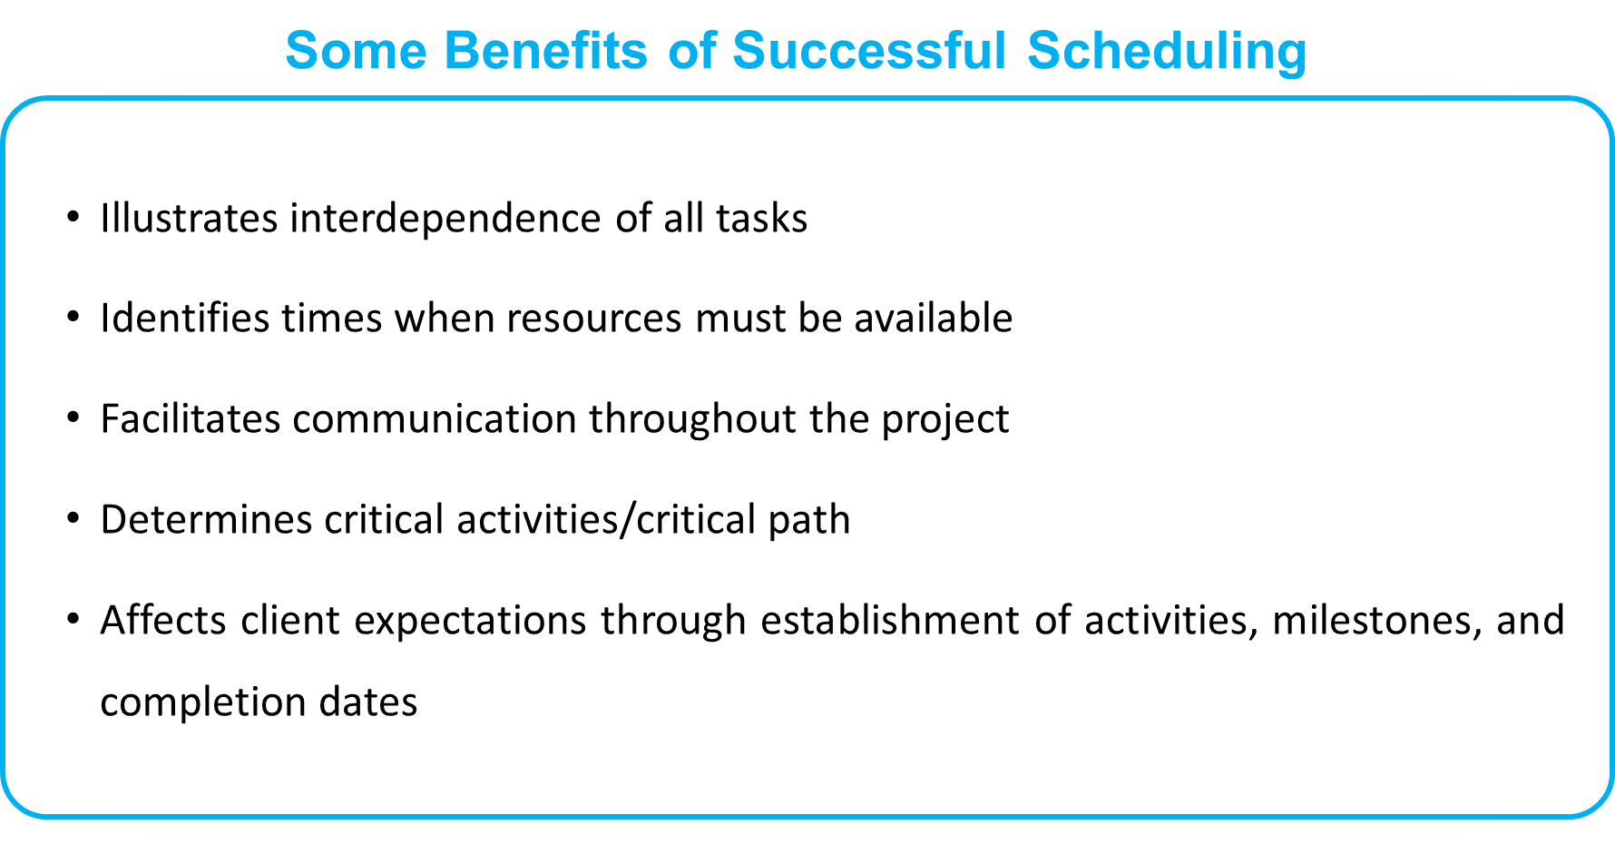
4–6

Slide 7
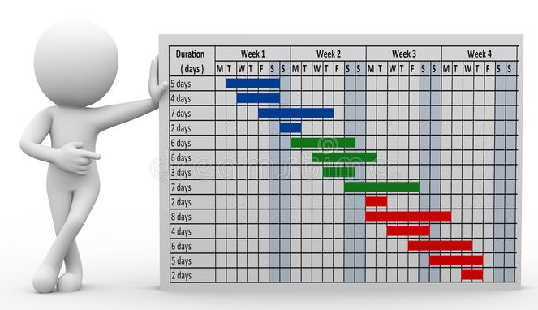
Gantt Chart
4–7

Slide 8
Lecture
Gantt Chart
04
Establish a time-phased network
Can be used as a tracking tool
Benefits of Gantt charts
Easy to understand
Identify the schedule baseline network
Allow for updating and control
Identify resource timing needs
Easy to create
4–8

Slide 9
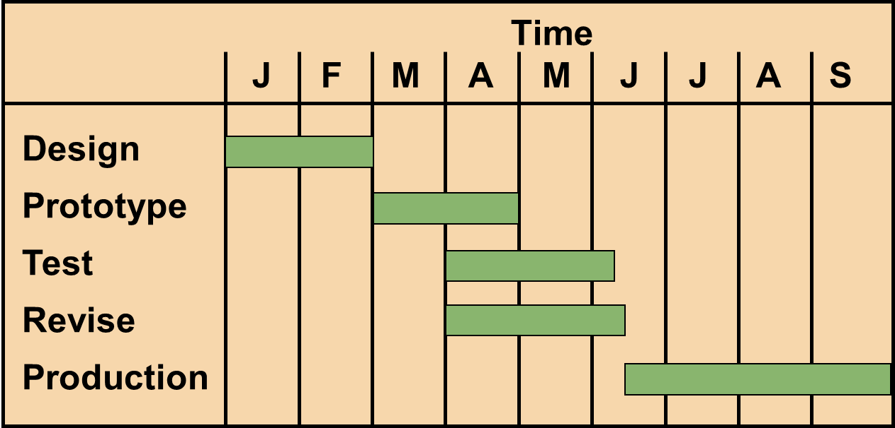
Lecture
A Simple Gantt Chart
04
4–9

Slide 10
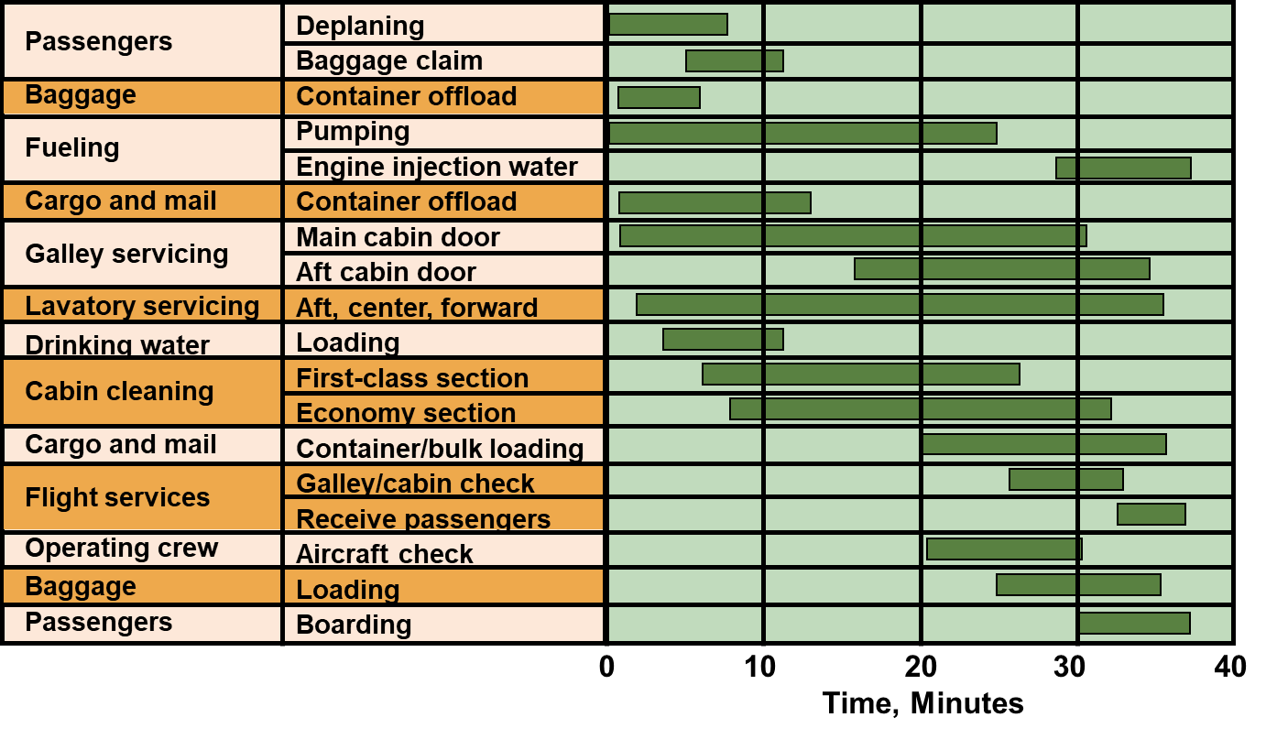
Lecture
Service For a Delta Jet
04
4–10

Slide 11
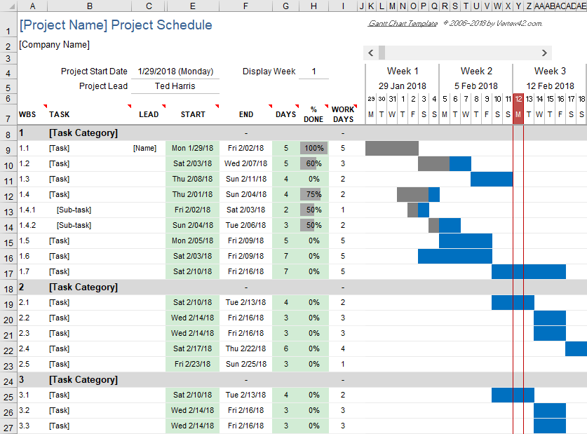
4–11

Slide 12
Developing Project Networks
Lecture
04
Developing Project Scheduling Plan
PMG 605
Project Resources and Time Management
4–12

Slide 13
Lecture
The Project Network
04
  Flow chart that graphically depicts the sequence, interdependencies, and start and finish times of the project job plan
  Provides the basis for scheduling labor and equipment
  Highlight activities that are “critical” and can not be delayed
  Enhances communication among project participants
  Provides an estimate of the project’s duration
  Provides a basis for budgeting cash flow
  Help managers get and stay on plan
4–13

Slide 14
Lecture
Activity on- node (AON) and Activity-on-arrow (AOA)
04
Historically, two methods have been used to develop project networks:
  Activity on-node (AON) and
  Activity-on-arrow (AOA)
Over time the availability of advanced computer graphics improved the clarity and visual appeal of the AON method
Today, the activity-on-node method has come to dominate nearly all project network plans
4–14

Slide 15
Lecture
8 Basic Rules to Follow in Developing Project Networks
04
Networks flow typically from left to right
An activity cannot begin until all preceding connected activities have been completed
Arrows on networks indicate precedence and flow. Arrows can cross over each other
Each activity should have a unique identification number
An activity identification number must be larger than that of any activities that precede it
Looping is not allowed
Conditional statements are not allowed (If successful, do something; if not, do nothing)
When there are multiple starts, a common start node can be used to indicate a clear project beginning on the network. (A single project end node can be used to indicate a clear ending)
4–15

Slide 16
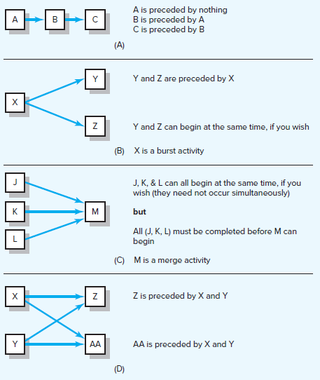
Activity-on-Node (AON) Fundamentals
4–16

Slide 17
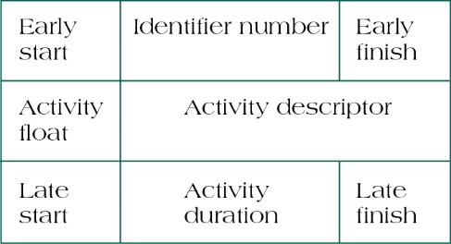
Lecture
Activity-on-Node (AON) Fundamentals
04
Activity Format
Activity Name or Symbol
A
Earliest Finish
Earliest Start
ES
EF
Latest Start
LS
LF
Latest Finish
2
Activity Duration
4–17

Slide 18
Lecture
PERT and CPM
04
Two major duration estimating tools can help project managers estimate the activity duration: the PERT and CPM.
Network techniques
Developed in 1950s
  CPM by DuPont for chemical plants (1957)
  PERT by Booz, Allen & Hamilton with the U.S. Navy, for Polaris missile (1958)
Consider precedence relationships and interdependencies
Each uses a different estimate of activity times
4–18

Slide 19
Lecture
PERT and CPM
04
CPM – Critical Path Method
PERT – Program Evaluation and Review Technique
Three-time estimates can be applied to any activity:
  Optimistic (O)
  Pessimistic (P)
  Most Likely (M)
CPM
requires only a one time estimate per activity. This method uses only a Most Likely time estimate (M).
PERT uses the distribution’s mean to determine individual activity duration. Specifically, the PERT formula is
(P + 4M + O) / 6
4–19

Slide 20
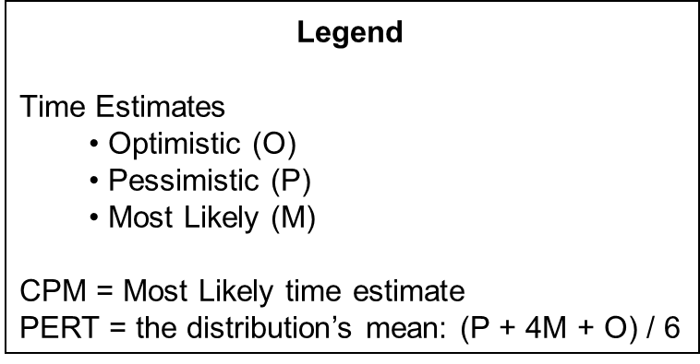
Lecture
PERT and CPM
04
For the activity “1” the following estimates are determined:
  (O) Optimistic estimate = 6 days
  (P) Pessimistic estimate = 18 days
  (M) Most Likely = 9 days
Using CPM, the estimate is 9 days.
Using PERT, the following estimate is derived: (18 + 36 + 6) / 6 = 10 days.
4–20

Slide 21
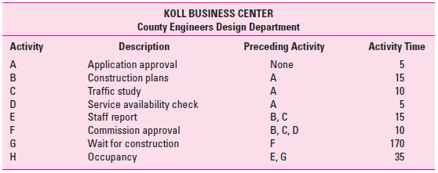
Example 1- Koll Business Center
4–21

Slide 22
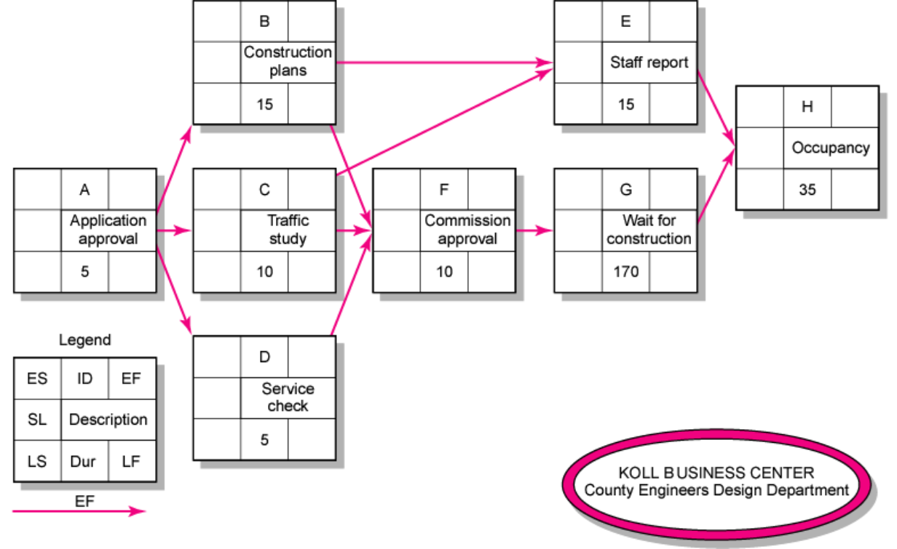
Example 1- Koll Business Center
4–22

Slide 23
Lecture
Network Computation Process
04
Forward Pass—Earliest Times
  How soon can the activity start? (early start—ES)
  How soon can the activity finish? (early finish—EF)
  How soon can the project finish? (expected time—ET)
Backward Pass—Latest Times
  How late can the activity start? (late start—LS)
  How late can the activity finish? (late finish—LF)
  Which activities represent the critical path?
  How long can activity be delayed? (slack or float—SL)
4–23

Slide 24
Lecture
Forward Pass Computation
04
Add activity times along each path in the network (EF = ES + Duration)
Carry the early finish (EF) to the next activity where it becomes its early start (ES) unless…
The next succeeding activity is a merge activity, in which case the largest EF of all receding activities is selected
4–24

Slide 25
Example 1
EF = ES + Duration
LS = LF – Duration
SL = LS - ES or
SL = LF – EF
FS = ES _{successor} - EF
4–25

Slide 26
Lecture
Backward Pass Computation
04
Subtract activity times along each path in the network (LS = LF - Duration)
Carry the late start (LS) to the next activity where it becomes its late finish (LF) unless…
The next succeeding activity is a burst activity, in which case the smallest LF of all preceding activities is selected.
4–26

Slide 27
Lecture
Slack (or Float)
04
Slack (SL) or Total Slack (TS) tells us the amount of time an activity can be delayed and not delay the project. Stated differently, total slack is the amount of time an activity can exceed its early finish date without affecting the project end date or an imposed completion date
  SL = LS - ES or
  SL = LF – EF
Free Slack/Floatis (FS) unique. It is the amount of time an activity can be delayed without delaying any immediately following (successor) activity. Or free slack is the amount of time an activity can exceed its early finish date without affecting the early start date of any successor(s)
FS = ES _{successor} - EF
4–27

Slide 28
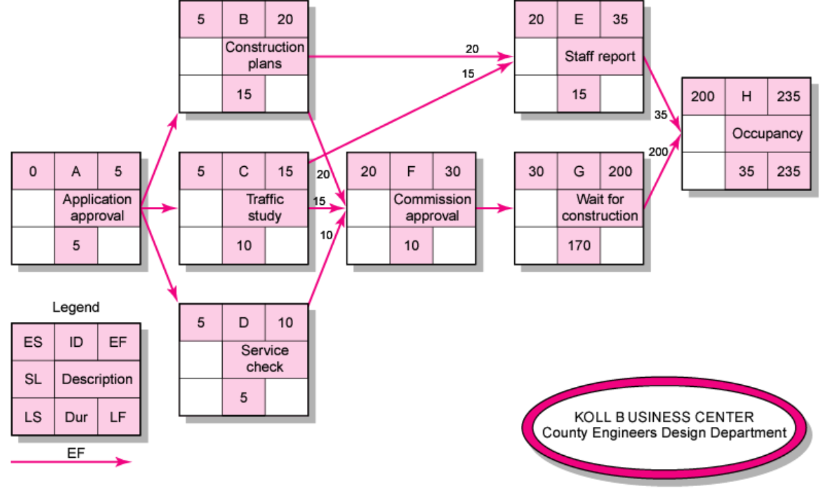
Example 1
EF = ES + Duration
LS = LF – Duration
SL = LS - ES or
SL = LF – EF
FS = ES _{successor} - EF
4–28

Slide 29
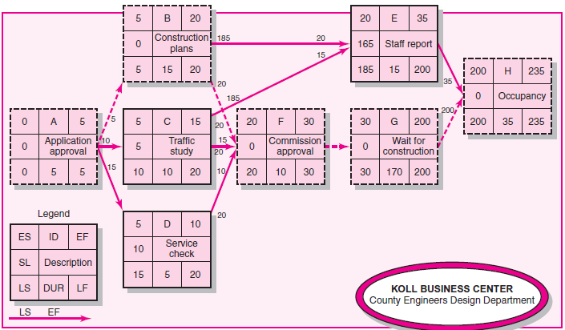
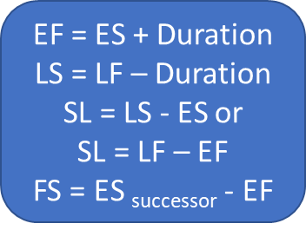
Example 1
4–29

Slide 30
Lecture
Critical Path
04
Path: a sequence of connected, dependent activities.
Critical Path: the longest path through the activity network that where all the activities has no Slack (float)
There could be more than one critical path in the project
The Critical Path tells management the activities that are critical or essential in completing the project on time.
It is also important for management to look at activities with minor float because any delays in those activities could cause them to be on the critical path.
4–30

Slide 31
Example 1
4–31

Slide 32
Example 1 - Koll Business Center
 |  |  | Koll Business Center
Activity | Description | Preceding Activity | Earliest Start Es | Earliest Finish EF | Late Start LS | Late Finish LF | Slack LS – ES | On Critical Path
A | Application approval | - | 0 | 5 | 0 | 5 | 0 | Yes
B | Construction plans | A | 5 | 20 | 5 | 20 | 0 | Yes
C | Traffic study | A | 5 | 15 | 10 | 20 | 5 | No
D | Service Check | A | 5 | 10 | 15 | 20 | 10 | No
E | Staff report | B, C | 20 | 35 | 185 | 200 | 165 | No
F | Commission Approval | B, C, D | 20 | 30 | 20 | 30 | 0 | Yes
G | Wait for Construction | F | 30 | 200 | 30 | 200 | 0 | Yes
H | Occupancy | E, G | 200 | 235 | 200 | 235 | 0 | Yes
Activities with zero slack are on the critical path. It:
Starts at the first activity in the project
Terminates at the last activity in the project
Includes only critical activities
Critical Path: A – B – F – G – H
Project Duration: 235 days
4–32

Slide 33
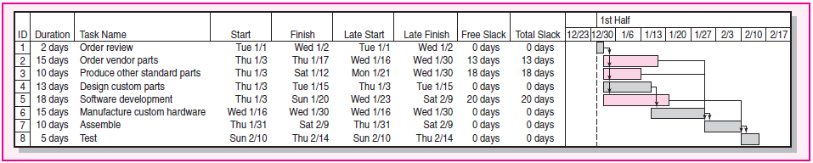
Lecture
Calendar Dates
04
Ultimately you will want to assign calendar dates to your project activities
If a computer program is not used, dates are assigned manually. Lay out a calendar of workdays (exclude nonwork days) and number them. Then relate the calendar workdays to the workdays on your project network.
Most computer programs will assign calendar dates automatically after you identify start dates, time units, non workdays, and other information.
4–33

Slide 34
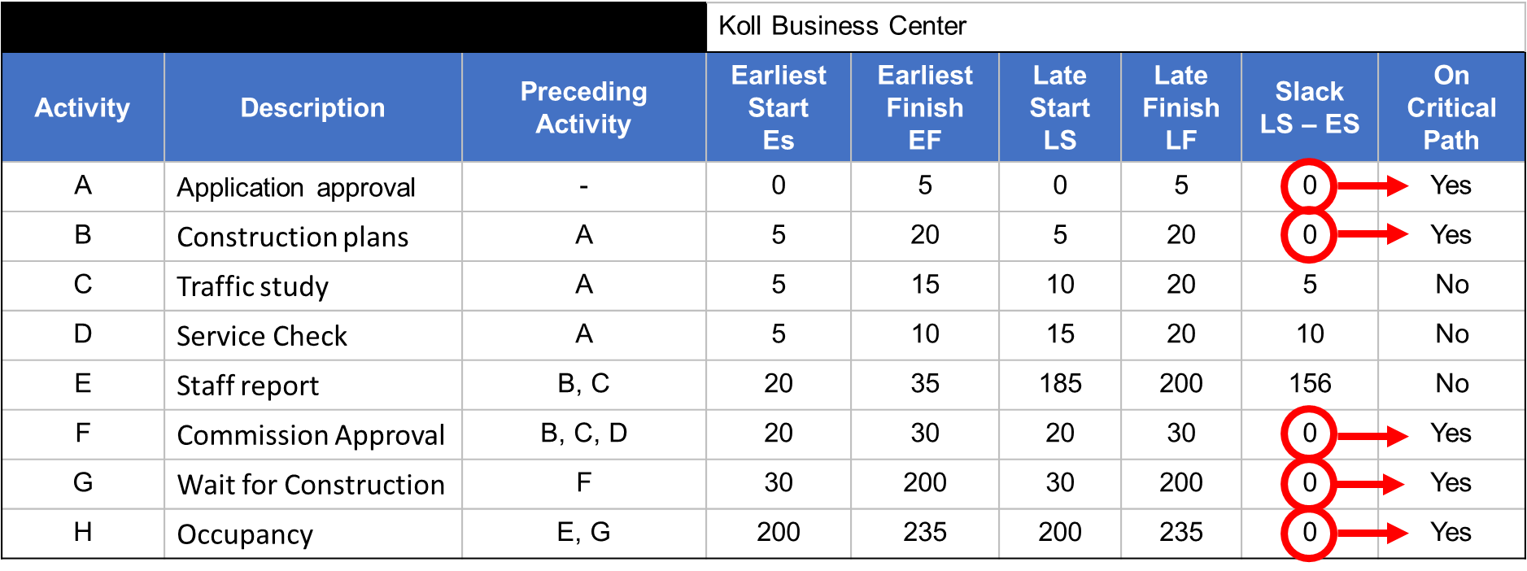
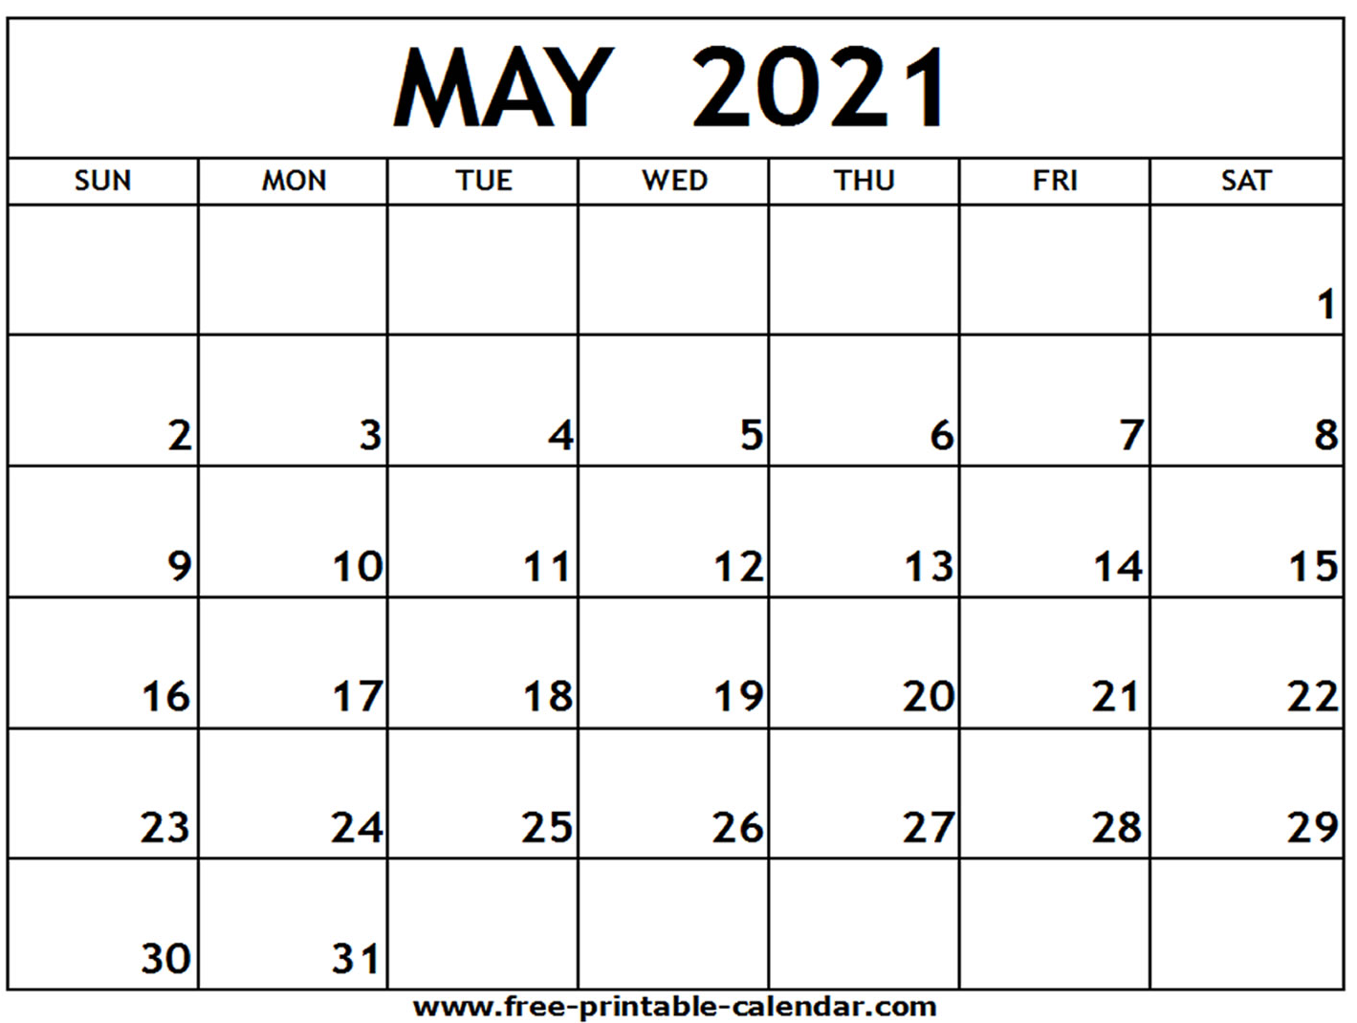
Lecture
Calendar Dates
04
4–34

Slide 35
Extended Network Techniques to Come Closer to Reality
Lecture
04
Developing Project Scheduling Plan
PMG 605
Project Resources and Time Management
4–35

Slide 36
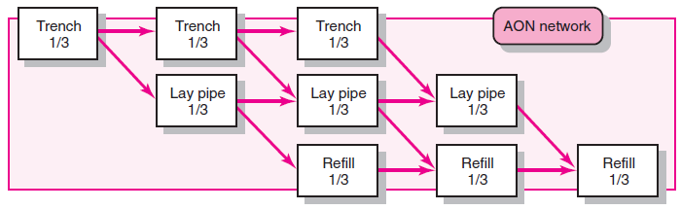
Lecture
Laddering
04
Activities are broken into segments so the following activity can begin sooner and not delay the work
Laddering
4–36

Slide 37
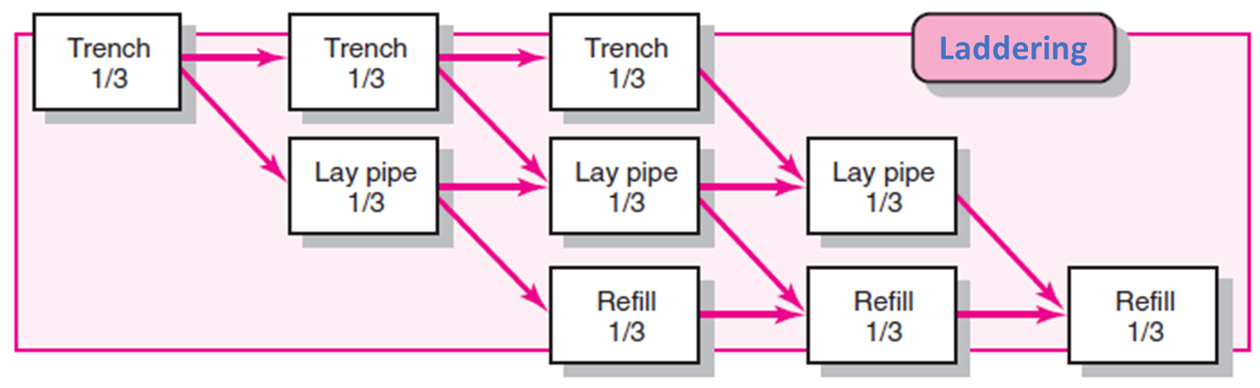
Lecture
Lags
04
The minimum amount of time a dependent activity must be delayed to begin or end
The use of lags in project networks occurs for two primary reasons:
  When activities of long duration delay the start or finish of successor activities, the network designer normally breaks the activity into smaller activities to avoid the long delay of the successor activity. Use of lags can avoid such delays and reduce network detail
  Lags can be used to constrain the start and finish of an activity
4–37

Slide 38
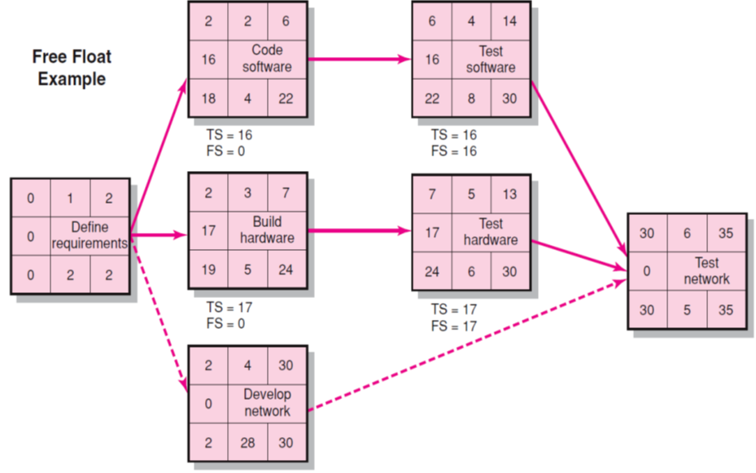
Lecture
Free Float Example
04
Slack (SL) or Total Slack (TS)
  SL = LS - ES or
  SL = LF – EF
Free Slack/Floats (FS)
  FS = ES _{successor} - EF
4–38

Slide 39
Example 2 - Milwaukee Paper's Project
 |  |  | Time Estimates (in weeks) for Milwaukee Paper's Project
Activity | Predecessors | Optimistic O |  | Most Likely M | Pessimistic P | Expected Time D = (P + 4M + O)/6 | Variance [(P – O)/6]²
A | — | 1 |  | 2 | 3 | (1 + 4*2 + 3)/6 = 2 | .11
B | — | 2 |  | 3 | 4 | 3 | .11
C | A | 1 |  | 2 | 3 | 2 | .11
D | A, B | 2 |  | 4 | 6 | 4 | .44
E | C | 1 |  | 4 | 7 | 4 | 1.00
F | C | 1 |  | 2 | 9 | 3 | 1.78
G | D, E | 3 |  | 4 | 11 | 5 | 1.78
H | F, G | 1 |  | 2 | 3 | 2 | .11
4–39

Slide 40
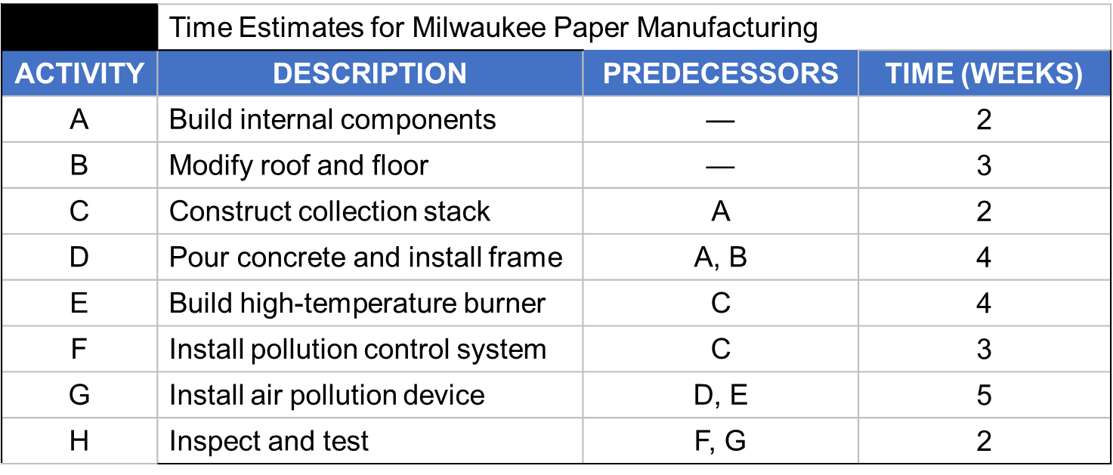
Lecture
ES/EF Network for Milwaukee Paper
04
ES
EF = ES + Activity time
0
0
4–40

Slide 41
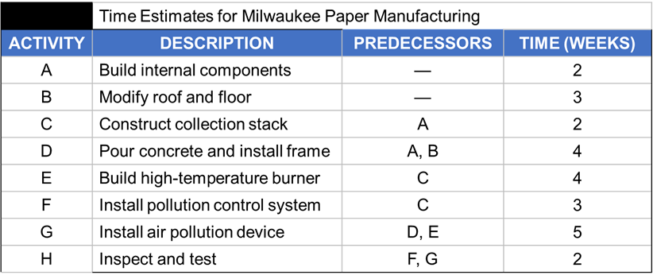
Lecture
ES/EF Network for Milwaukee Paper
04
EF of A = ES of A + 2
ES of A
A
2
0
2
Start
0
0
0
4–41

Slide 42
Lecture
ES/EF Network for Milwaukee Paper
04
A
2
0
2
EF of B =
ES of B + 3
ES
of B
0
Start
0
B
3
0
3
0
4–42

Slide 43
Lecture
ES/EF Network for Milwaukee Paper
04
A
2
C
2
0
2
2
4
0
Start
0
0
B
3
0
3
4–43

Slide 44
Lecture
ES/EF Network for Milwaukee Paper
04
A
2
C
2
0
2
2
4
0
Start
0
= Max (2, 3)
D
4
0
3
B
3
0
3
4–44

Slide 45
Lecture
ES/EF Network for Milwaukee Paper
04
A
2
C
2
0
2
2
4
0
Start
0
0
B
3
D
4
0
3
3
7
4–45

Slide 46
Lecture
ES/EF Network for Milwaukee Paper
04
A
2
C
2
F
3
0
2
2
4
4
7
Start
0
E
4
H
2
0
4
8
13
15
0
B
3
D
4
G
5
0
3
3
7
8
13
4–46

Slide 47
Lecture
ES/EF Network for Milwaukee Paper
04
A
2
C
2
F
3
0
2
2
4
4
7
Start
0
E
4
H
2
0
4
8
13
15
13
15
0
LS = LF – Activity time
B
3
D
4
G
5
0
3
3
7
8
13
LF = EF
of Project
4–47

Slide 48
Lecture
ES/EF Network for Milwaukee Paper
04
A
2
C
2
F
3
0
2
2
4
4
7
10
13
Start
0
E
4
H
2
0
LF = Min(LS of following activity)
4
8
13
15
13
15
0
B
3
D
4
G
5
0
3
3
7
8
13
4–48

Slide 49
Lecture
ES/EF Network for Milwaukee Paper
04
LF = Min(4, 10)
A
2
C
2
F
3
0
2
2
4
4
7
2
4
10
13
Start
0
E
4
H
2
0
4
8
13
15
4
8
13
15
0
B
3
D
4
G
5
0
3
3
7
8
13
8
13
4–49

Slide 50
Lecture
ES/EF Network for Milwaukee Paper
04
A
2
C
2
F
3
0
2
2
4
4
7
0
2
2
4
10
13
Start
0
E
4
H
2
0
4
8
13
15
0
0
4
8
13
15
0
B
3
D
4
G
5
0
3
3
7
8
13
1
4
4
8
8
13
4–50

Slide 51
Computing Slack Time
 |  | Milwaukee Paper’s Schedule and Slack Times
Activity | Expected Time | Earliest Start ES | Earliest Finish EF | Latest Start LS | Latest Finish LF | Slack Ls – Es | On Critical Path | Variance
A | 2 | 0 | 2 | 0 | 2 | 0 | Yes | .11
B | 3 | 0 | 3 | 1 | 4 | 1 | No | .11
C | 2 | 2 | 4 | 2 | 4 | 0 | Yes | .11
D | 4 | 3 | 7 | 4 | 8 | 1 | No | .44
E | 4 | 4 | 8 | 4 | 8 | 0 | Yes | 1.00
F | 3 | 4 | 7 | 10 | 13 | 6 | No | 1.78
G | 5 | 8 | 13 | 8 | 13 | 0 | Yes | 1.78
H | 2 | 13 | 15 | 13 | 15 | 0 | Yes | .11
Activities with zero slack are on the critical path. It:
Starts at the first activity in the project
Terminates at the last activity in the project
Includes only critical activities
Critical Path: A – C – E – G – H
Project Duration: 15 days
4–51

Slide 52
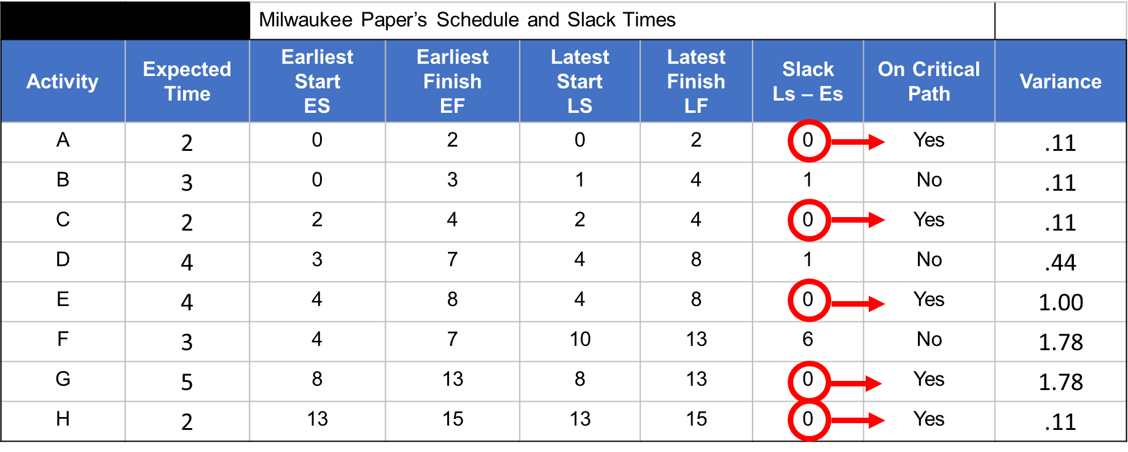
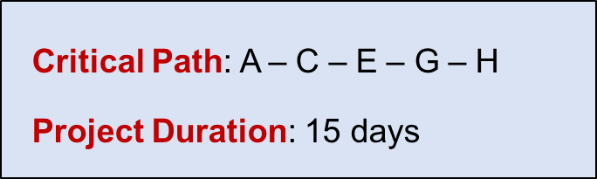
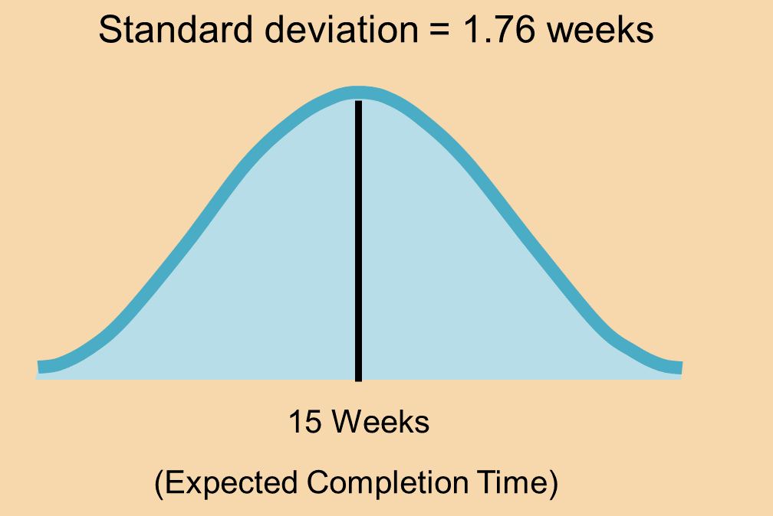
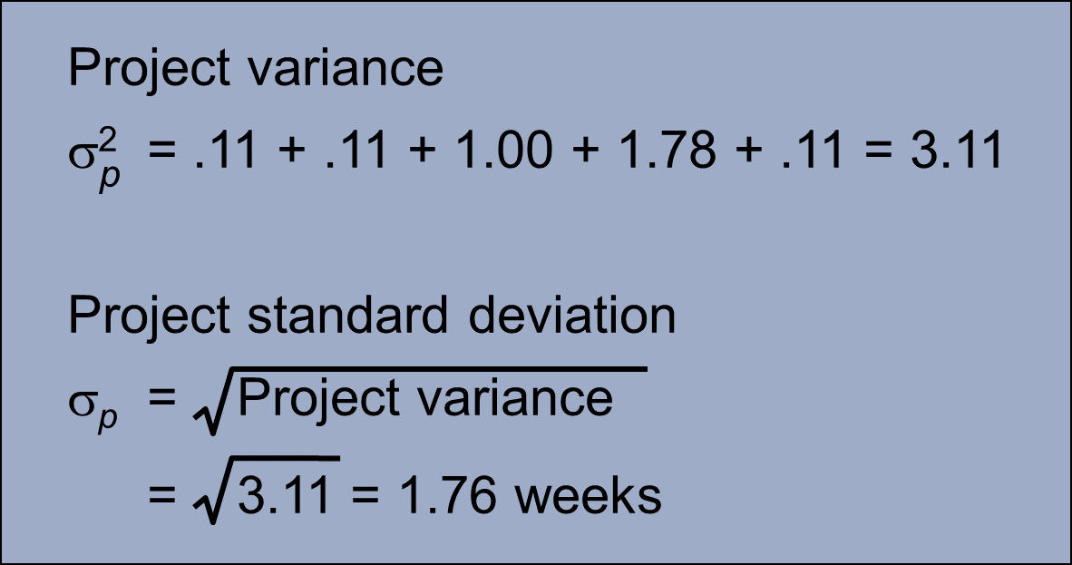
Project variance
σ² = Project variance
= ∑(variances of activities on critical path)
4–52

Slide 53
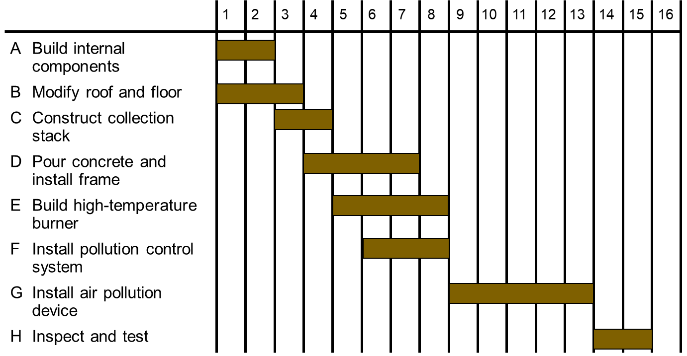
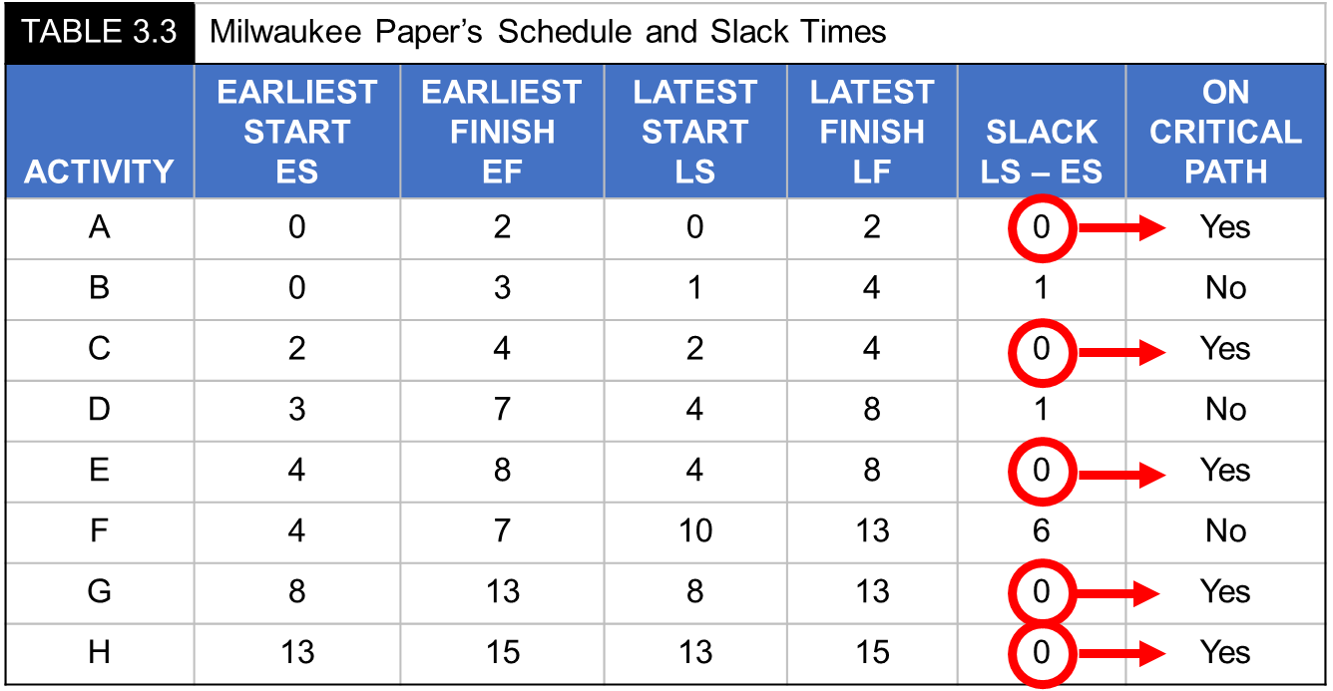
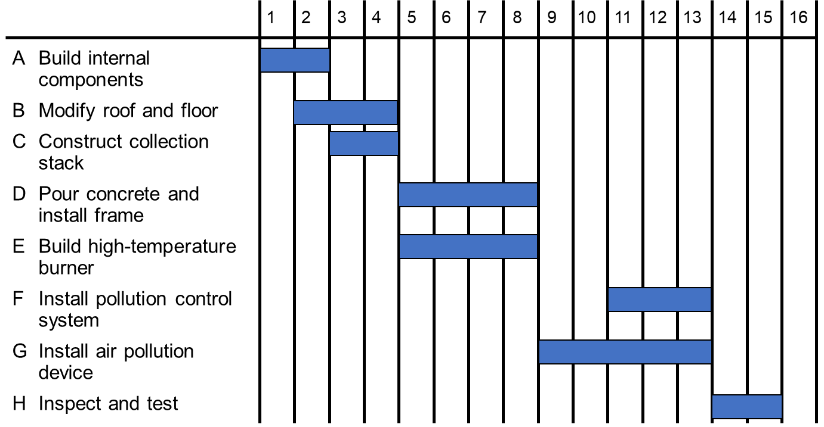
ES – EF Gantt Chart
LS – LF Gantt Chart
4–53

Slide 54
Lecture
04
 | Time Estimates for Milwaukee Paper Manufacturing
ACTIVITY | DESCRIPTION | PREDECESSORS | TIME (WEEKS)
A | Build internal components | — | 2
B | Modify roof and floor | — | 3
C | Construct collection stack | A | 2
D | Pour concrete and install frame | A, B | 4
E | Build high-temperature burner | C | 4
F | Install pollution control system | C | 3
G | Install air pollution device | D, E | 5
H | Inspect and test | F, G | 2
 | Total time (weeks) | — | 25
4–54

Slide 55
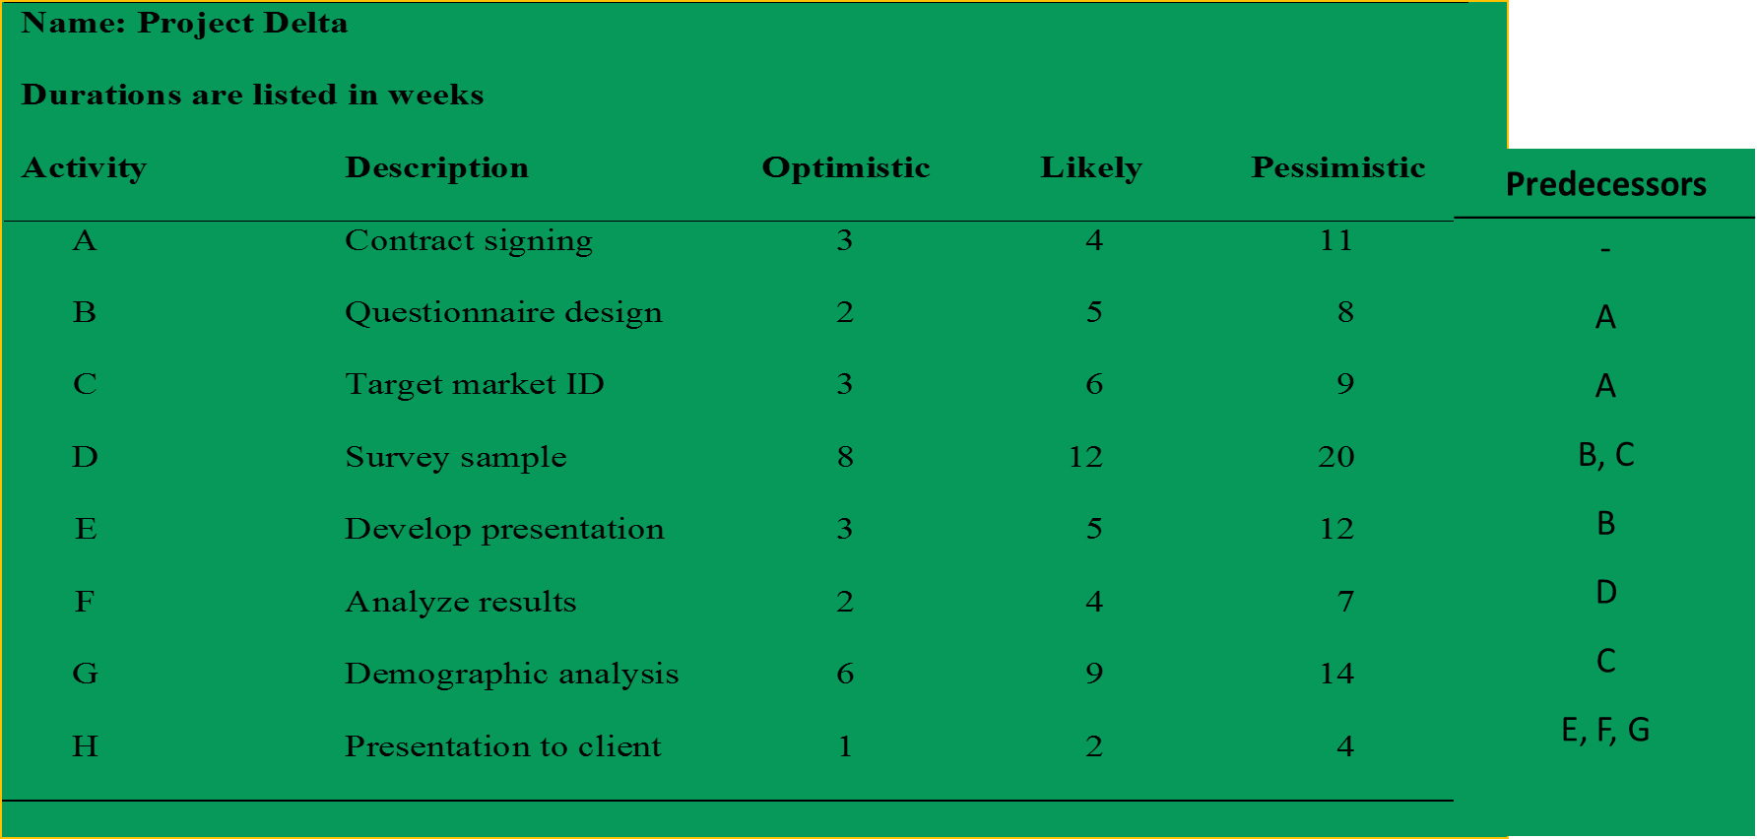
Lecture
Example 3 – Project Delta
04
4–55

Slide 56
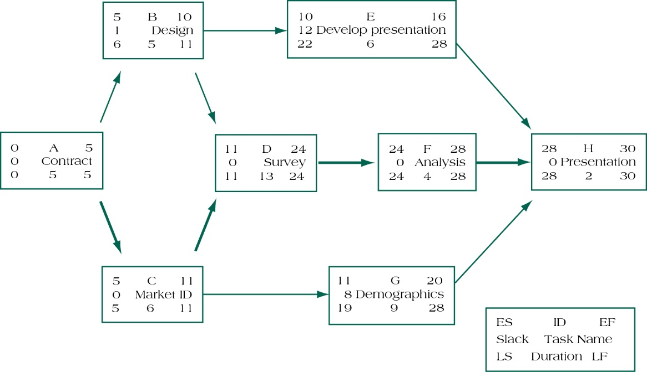
Lecture
Example 3 – Project Delta
04
4–56

Slide 57
Summary of Today Session
Lecture
04
Developing Project Scheduling Plan
PMG 605
Project Resources and Time Management
4–57

Slide 58
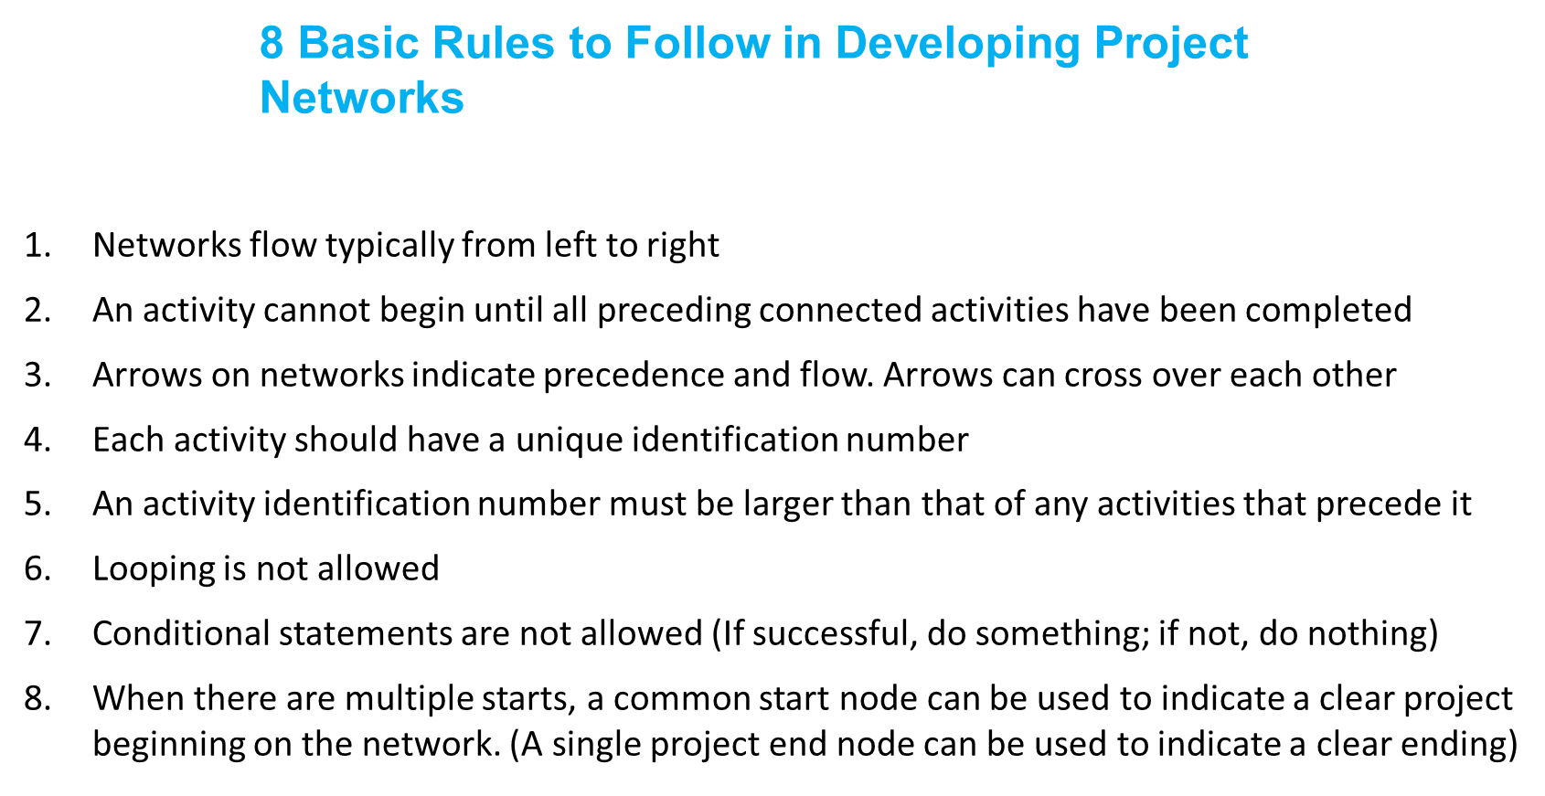
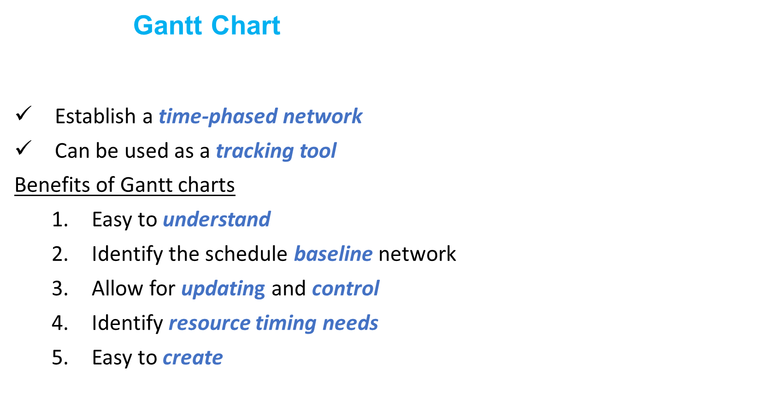
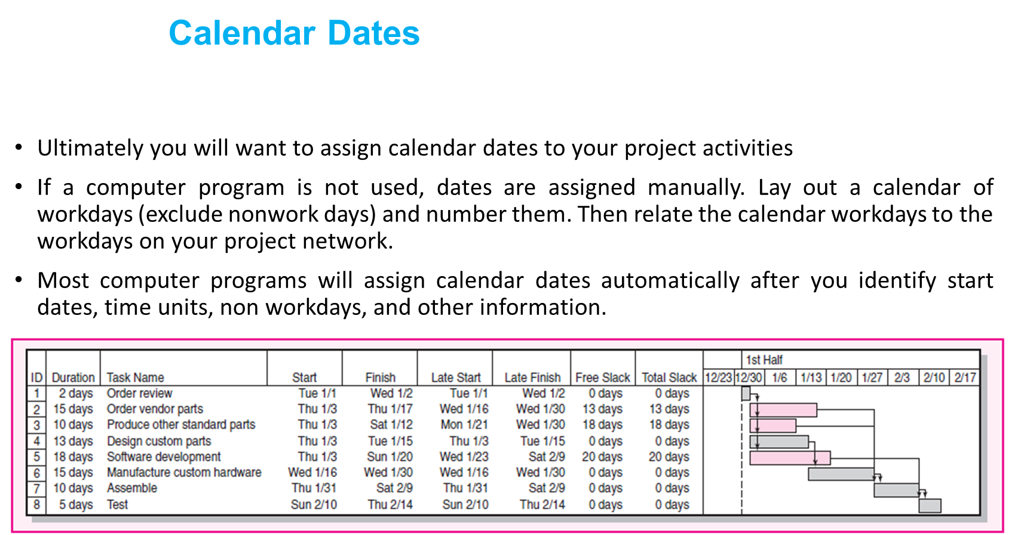
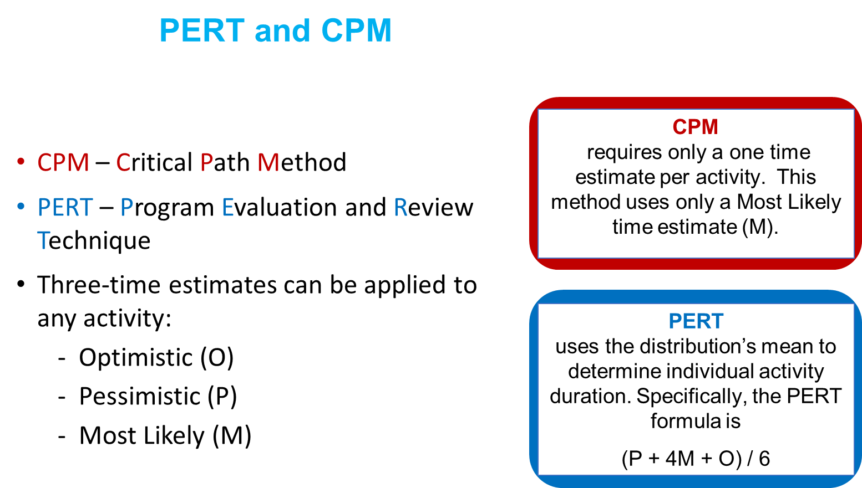
EF = ES + Duration
LS = LF – Duration
SL = LS - ES or
SL = LF – EF
FS = ES _{successor} - EF
4–58

Slide 59
Resources
Project Management
The Managerial Process
Fifth Edition
By: Erik W. Larson
Oregon State University
Clifford F. Gray
Oregon State University
4-59

Slide 60



Thank You

