Slide 2
Contents
Sequential circuits
Flip-flops
Analysis of clocked sequential circuits
State reduction and assignment
Design procedure

Slide 3
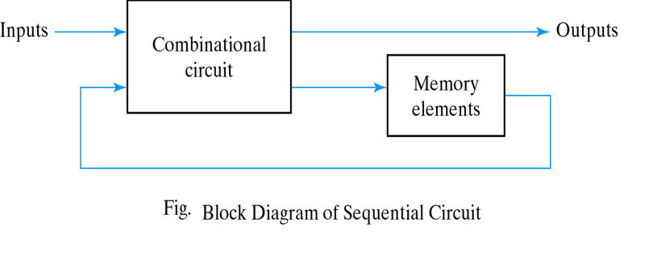
Sequential circuits
A sequential circuit consists of a combinational circuit and a feedback through the storage elements in the circuit.

Slide 4
Sequential circuits
Which type of the logic circuits are faster than the other Combinational or sequential?
  The combinational circuits are often faster than sequential circuits.
  WHY:
    The combinational circuits do not require memory elements whereas the sequential circuits need memory devices to perform their operations in sequence

Slide 5
Sequential circuits
Sequential circuits can be categorized as being synchronous or asynchronous
A synchronous sequential circuit usually has a clock pulse (clocked sequential circuits)
Flip-flops are storage elements which are used in clocked sequential circuits
Each flip-flop can store one bit.

Slide 6
What Exactly is Memory?
A memory unit should support at least three operations.
  It should be able to hold a value.
  We should be able to read the value that is saved.
  We should be able to change that value.

Slide 7
What Exactly is Memory?
  Example: One-bit Memory
It should be able to hold a single bit, 0 or 1.
We should be able to read the bit that is saved.
We should be able to change the bit.
  can set the bit to 1
  can reset or clear the bit to 0

Slide 8
Flip-Flops
A circuit that has 2 stable states and can be used to store state information.
A basic storage element in sequential logic.
A binary cell capable of storing one bit of information, and has 2 outputs: normal and complement values.
It is used in computers to store program like RAM memory and registers
8

Slide 9
What is Clock?
In sequential circuits the output of a circuit is an input to another. So they should be control over thus circuit processes and it cannot operate randomly.
So, Clock is needed to time the circuits or to sequence the sequential circuits.

Slide 10
What is Clock?
It is called clocks, because it decide the time of the inputs and outputs like the real clocks which decide the time of our daily routines.
Also, we can decide the circuit speed by changing the clock frequency.

Slide 11
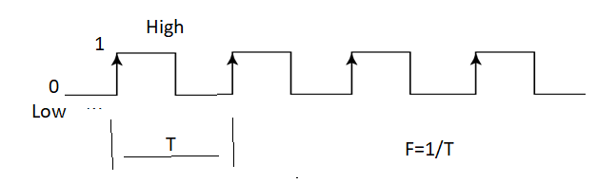
What is Clock?
The clock is nothing but signal that goes from low (0) to high(1) then again low and high and repeat.
The time of high period = the time of low period

Slide 12
What is Clock?
Time period of the clock is T
Frequency of the clock F = 1/T
To increase the speed of the circuit, the frequency should be increased and consequently the time period decrease.

Slide 13
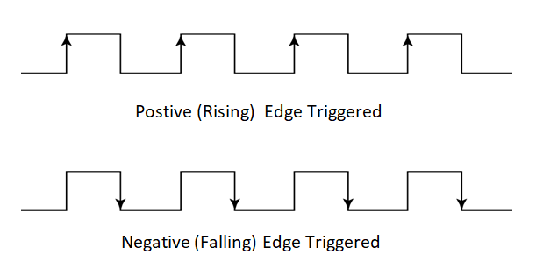
What is Clock?
Positive (Rising) Edge: Describe a circuit or component that changes its state only when an input signal becomes high.
Negative (Falling) Edge: Describe a circuit or component that changes its state only when an input signal becomes low.

Slide 14
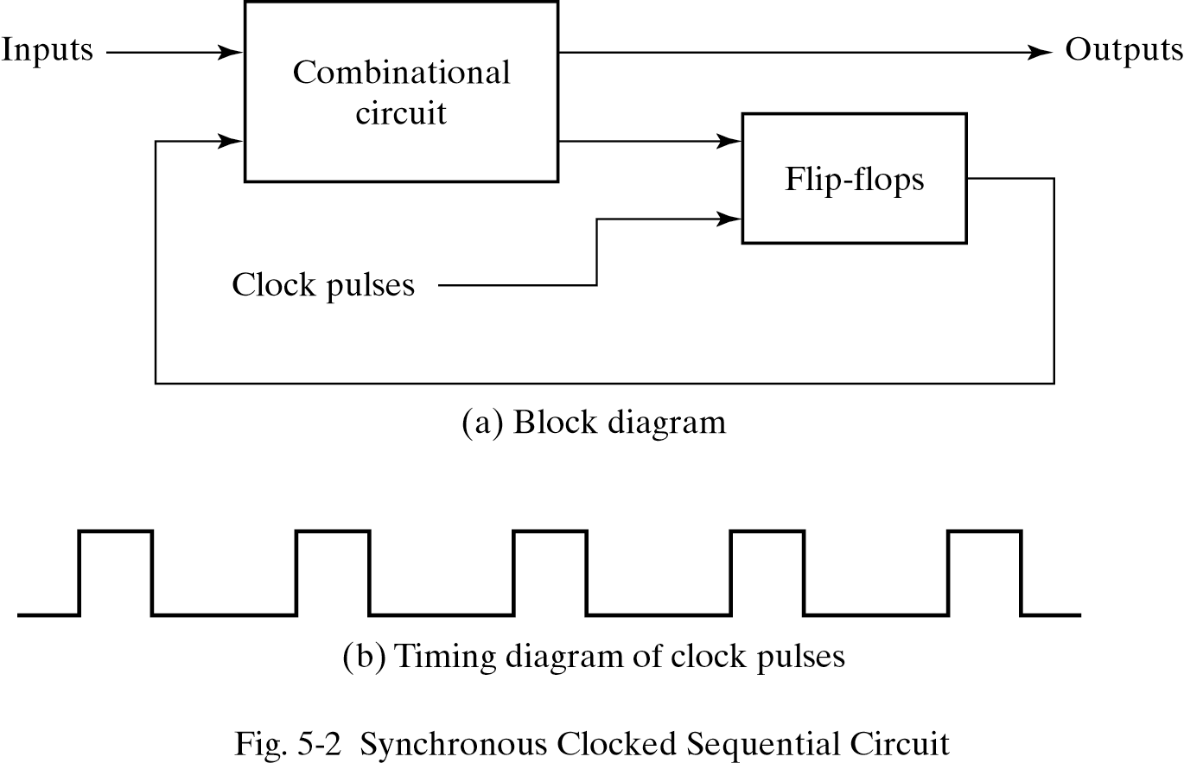
A synchronous clocked sequential circuit is shown below:

Slide 15
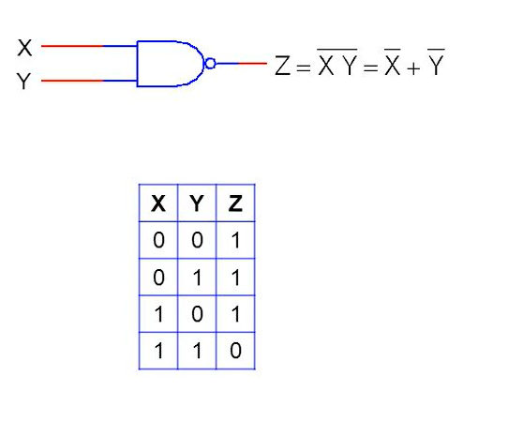
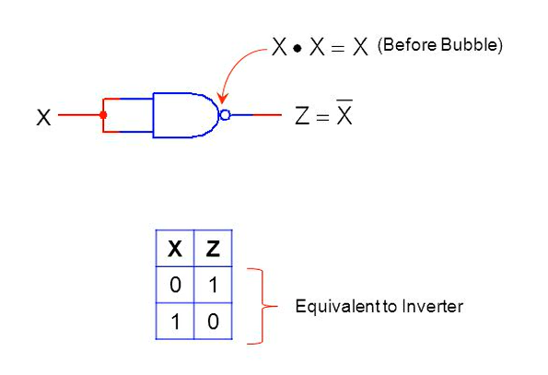
NAND Gate

Slide 16
SR Flip Flop (Contd.)
The SR flip-flop, also known as a SR Latch, can be considered as one of the most basic sequential logic circuit possible.
The SR flip-flop is basically a one-bit memory bistable device that has two inputs:
  The first input will “SET” the device (meaning the output = “1”) labelled S
  The Second input will “RESET” the device (meaning the output = “0”), labelled R.

Slide 17
SR Flip Flop (Contd.)
The simplest way to make any basic single bit set-reset SR flip-flop is to connect together a pair of cross-coupled 2-input NAND gates
This device consists of two inputs, one called the Set, S and the other called the Reset, R with two corresponding outputs Q and its inverse or complement Q (Q’) .

Slide 18
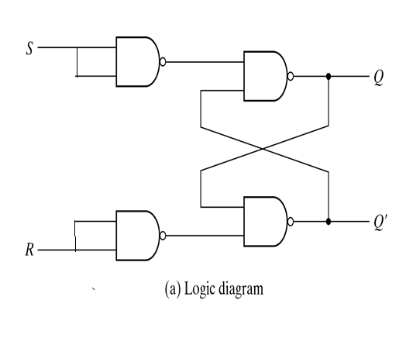
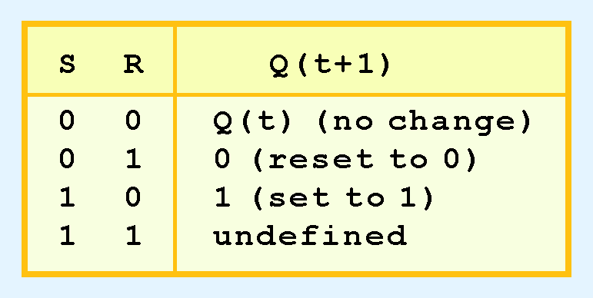
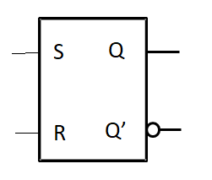
SR Flip Flop (Contd.)
Q(t) means the value of the output at time t.
Q(t+1) is the value of Q after the next clock pulse.
Function Table

Slide 19
D (Data) Flip Flop ;
The D flip flop is the most important flip flop from other types.
It ensures that at the same time, both the inputs, i.e., S and R, are never equal to 1. The D flip-flop is designed using a gated SR flip-flop with an inverter connected between the inputs allowing for a single input D(Data).
This single data input, which is labeled as "D" used in place of the "Set" input and for the complementary "Reset" input.

Slide 20
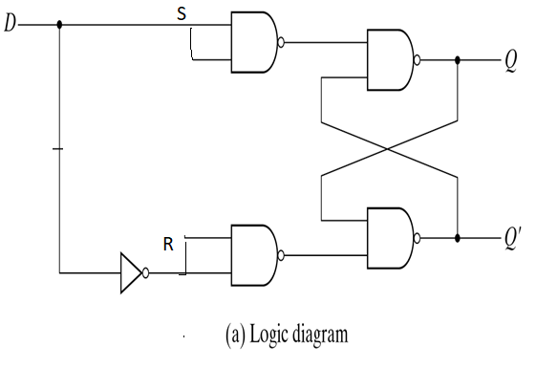
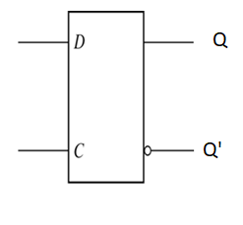
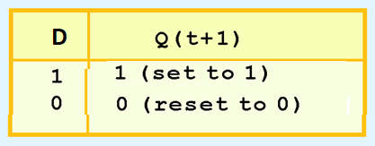
D (Data) Flip Flop (Contd.);
The D-type Flip-flop overcomes one of the main disadvantages of the basic SR NAND Gate Bistable circuit by forbidding the the undefined (indeterminate) input condition.

Slide 21
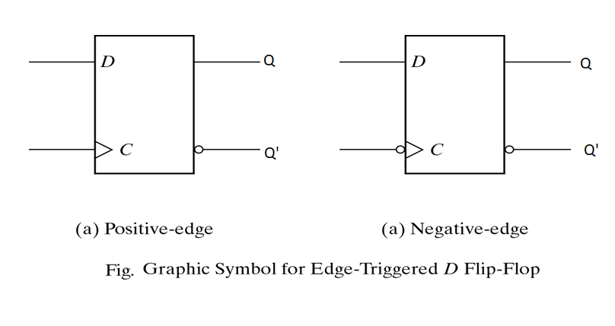
D Flip-flop (Contd.)
The symbols for D flip-flop are shown in the following figures

Slide 22
D Flip-flop (Contd.)
The characteristic table and the characteristic equation describe the operation of a flip-flop through a table and an algebraic equation, respectively
The characteristic equation of the D flip-flop:
Q(t+1)=D ,
The letter D in “D Flip-Flops” stands
  for “Data” since the output Q follows the
  input D. Also, it indicates that the value of the input (1 or 0) is transferred into the flip flops output Q
D | Q(t+1)
0 1 | 0 1 | Reset Set
characteristic Table

Slide 23
JK Flip-flop
This simple JK flip Flop is the most widely used of all the flip-flop designs and is considered to be a universal flip-flop circuit.
The two inputs labelled “J” and “K” are not shortened abbreviated letters of other words, such as “S” for Set and “R” for Reset, but are themselves autonomous letters chosen by its inventor Jack Kilby to distinguish the flip-flop design from other types.

Slide 24
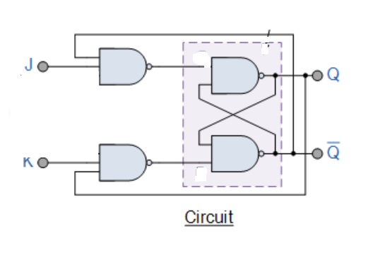
JK Flip-flop (Contd.)
J | K | Q(t) | Q(t+1)
0 | 0 | 0 | 0
0 | 0 | 1 | 1
0 | 1 | 0 | 0
0 | 1 | 1 | 0
1 | 0 | 0 | 1
1 | 0 | 1 | 1
1 | 1 | 0 | 1
1 | 1 | 1 | 0

Slide 25
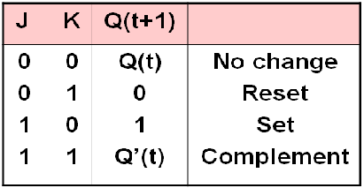
JK Flip-flop (Contd.)
There are four operations that can be performed with a flip-flop: no change, set, reset, or complement the output

Slide 26
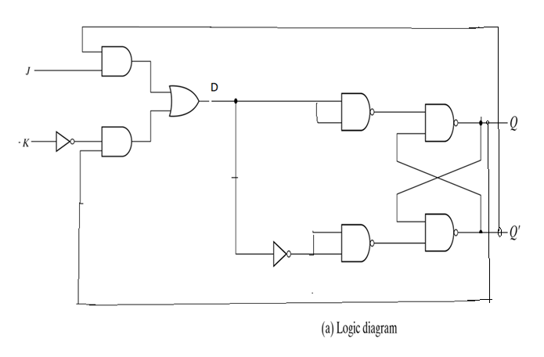
JK Flip-flop (Contd.)
The JK flip-flop can be
derived from the D flip-flop using the Boolean function
D = J.Q’′ + K’′.Q as follows:

Slide 27
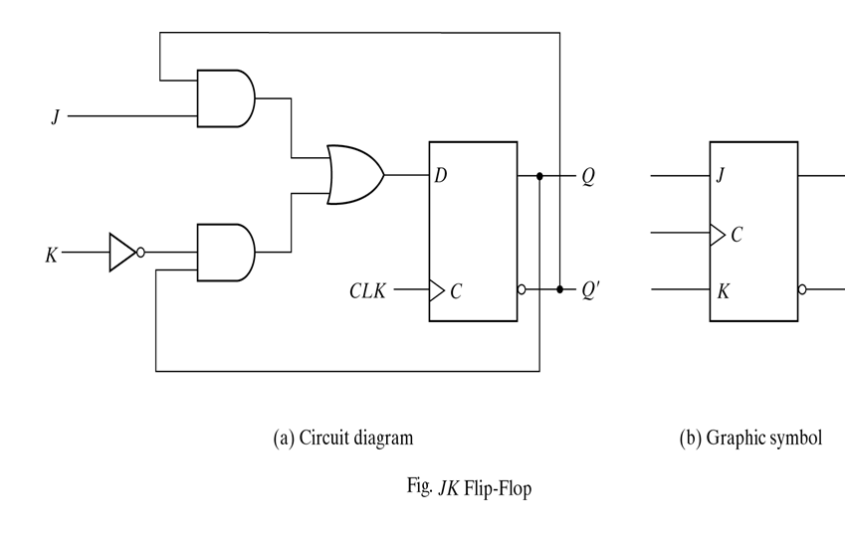
JK Flip-flop (Contd.)

Slide 28
JK Flip-flop (Contd.)
The characteristic equation of the JK flip-flop:
  Q(t+1)=J.Q’(t)+K’.Q(t)
J K | Q(t+1)
0 0 0 1 1 0 1 1 | Q(t) 0 1 Q’(t) | No change Reset Set Complement
characteristic Table

Slide 29
T (Toggle )Flip-flop
In T flip flop, "T" defines the term "Toggle".
This flip-flop work as a Toggle switch. The next output state is changed with the complement of the present state output. This process is known as "Toggling“’.

Slide 30
T (Toggle )Flip-flop (Contd.)
There are the following two methods which are used to form the "T Flip Flop:
  By connecting the input of JK flip flop together. This new single input is called T.
  By Connecting an XOR with T input and Q (PREVIOUS) output to the Data input in D flip – flop.

Slide 31
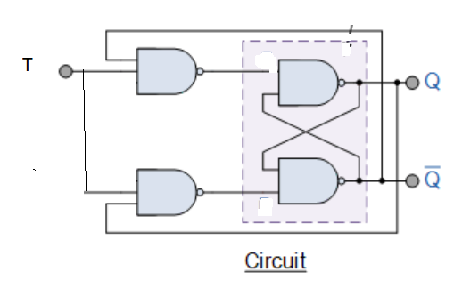
T (Toggle )Flip-flop (Contd.)
The T (toggle) flip-flop can be derived from the J-K Flip flop as follows:
T | Q(t) | Q(t+1)
0 | 0 | 0
0 | 1 | 1
1 | 0 | 1
1 | 1 | 0

Slide 32
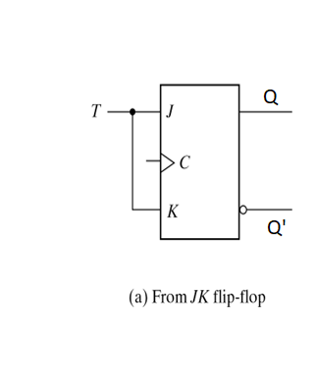
T (Toggle )Flip-flop (Contd.)

Slide 33
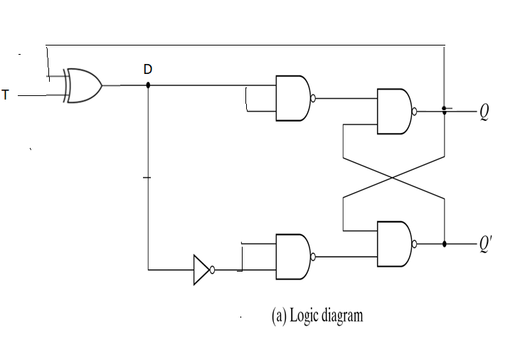
By Connecting an XOR with T input and Q (PREVIOUS) output to the Data input in D flip – flop.

Slide 34
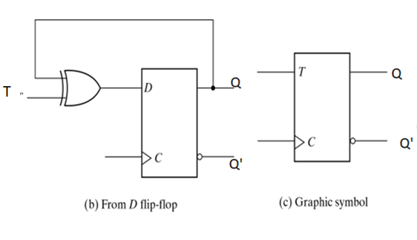
T (Toggle )Flip-flop (Contd.)
The T (toggle) flip-flop can be derived from the D flip-flop using the Boolean function:
  D = T ⊕Q = T.Q′ + T ′.Q as follows

Slide 35
T (Toggle )Flip-flop (Contd.)
The characteristic equation of the T flip-flop can be obtained as follows
Q(t +1) = T.Q’(t)+T ‘.Q(t)
The characteristic table of the T flip-flop is given below
T | Q(t+1)
0 1 | Q(t) Q’(t) | No change Complement

Slide 36
End of lecture 8

