Slide 1



Human Rights in the Digital Law
Lecture 10
LAW 614
English Language for Digital Law
Prepared by
Samara Jasim
www.midocean.ae

Slide 2


Lecture
10
INTRODUCTION
A. DEFINISTION OF HUMAN RIGHTS
Human rights embody the essential freedoms and protections that every individual is inherently entitled to, regardless of their nationality, ethnicity, gender, or any other factor. These rights form the moral bedrock of a just society, ensuring dignity, equality, and autonomy for all. The Universal Declaration of Human Rights, adopted by the United Nations in 1948, encapsulates this universal vision.
www.midocean.ae

Slide 3
Lecture
10
INTRODUCTION
A. DEFINISTION OF HUMAN RIGHTS
The digital age has ushered in a new dimension to the application and protection of human rights. Traditional human rights principles must be recalibrated to address the unique challenges and opportunities presented by digital technologies. This adaptation necessitates a deep understanding of how digital transformations intersect with core human rights.
www.midocean.ae

Slide 4

Lecture
10
INTRODUCTION
B. DIGITAL REVOLUTION AND ITS IMPACT
The digital revolution, often referred to as the fourth industrial revolution, marks an epochal shift in human history. This revolution is characterized by the rapid and profound integration of digital technologies into virtually every sphere of human existence. This encompasses advancements such as the internet, mobile devices, artificial intelligence, big data, and the Internet of Things.
www.midocean.ae

Slide 5
Lecture
10
INTRODUCTION
B. DIGITAL REVOLUTION AND ITS IMPACT
These technological innovations have sparked an unparalleled wave of transformation across society. Communication has transcended boundaries, enabling instant global connectivity. Information has become accessible at exceptional speeds, reshaping how we acquire knowledge and engage with the world. Commerce has migrated to the virtual realm, revolutionizing business models and market dynamics.
www.midocean.ae

Slide 6
Lecture
10
INTRODUCTION
B. DIGITAL REVOLUTION AND ITS IMPACT
The legal landscape has not been immune to this seismic shift. The digital revolution has ushered in novel legal challenges and opportunities. Concepts of jurisdiction have been stretched as digital transactions transcend physical borders. Intellectual property rights have been redefined in the digital reproduction era, leading to debates on copyright and piracy.
www.midocean.ae

Slide 7

Lecture
10
INTRODUCTION
C. HUMAN RIGHTS CHALLENGES
The digital age has brought forth an era of unprecedented connectivity and accessibility. With this, however, arise intricate challenges that intertwine technology and the fundamental principles of human rights. The surge in digital surveillance, data collection, and algorithmic decision-making raises relevant questions about privacy, autonomy, and fairness.
www.midocean.ae

Slide 8
Lecture
10
INTRODUCTION
C. HUMAN RIGHTS CHALLENGES
The ubiquity of digital technologies has led to the accumulation of great amounts of personal data. Governments and corporations engage in surveillance practices that often violate upon the right to privacy, a cornerstone of human rights. This evolving landscape challenges traditional notions of consent and control over personal information.
www.midocean.ae

Slide 9
Lecture
10
INTRODUCTION
C. HUMAN RIGHTS CHALLENGES
Digital platforms rely heavily on algorithms for decision-making processes, such as employment recruitment, credit scoring, and criminal justice. However, these algorithms can carry on the biases present in training data, leading to discrimination against marginalized groups. This challenge demands a recalibration of algorithms to align with principles of equality and non-discrimination.
www.midocean.ae

Slide 10

Lecture
10
HUMAN RIGHTS ISSUES IN PRIVACY AND
DATA PROTECTION
Privacy, often considered a cornerstone of human dignity, is the foundation upon which many other rights rest. Samuel D. Warren and Louis D. Brandeis, in their iconic 1890 article "The Right to Privacy," laid the groundwork for recognizing privacy as an inherent right. It shields individuals from unwarranted intrusion, preserving their autonomy and freedom.
www.midocean.ae

Slide 11
Lecture
10
HUMAN RIGHTS ISSUES IN PRIVACY AND
DATA PROTECTION
In the digital era, the concept of privacy has taken on new dimensions. Rapid advancements in technology have paved the way for data collection on an unprecedented scale. This raises concerns about the erosion of personal boundaries, as vast amounts of information are harvested, analyzed, and sometimes exploited without consent.
www.midocean.ae

Slide 12
Lecture
10
HUMAN RIGHTS ISSUES IN PRIVACY AND
DATA PROTECTION
Data protection has emerged as a critical concern, as personal information is the lifeblood of the digital economy. Striking a balance between harnessing the benefits of data-driven innovation and safeguarding individual privacy is a formidable challenge. Bruce Schneier's "Data and Goliath" sheds light on the power dynamics at play in the digital realm, where personal data has become a valuable commodity.
www.midocean.ae

Slide 13
Lecture
10
HUMAN RIGHTS ISSUES IN PRIVACY AND
DATA PROTECTION
To address these challenges, legal frameworks like the European Union's General Data Protection Regulation (GDPR) have been established. GDPR emphasizes the individual's right to control their data and imposes obligations on organizations to ensure data protection. This regulatory landscape is constantly evolving as policymakers grapple with the intricacies of data privacy in the digital age.
www.midocean.ae

Slide 14
Lecture
10
HUMAN RIGHTS ISSUES IN PRIVACY AND
DATA PROTECTION
Ethical considerations are paramount in this arena. Obtaining informed and meaningful consent in the age of complex data processing requires transparency and clarity. As guardians of digital rights, it falls upon legal experts like yourselves to advocate for robust privacy protections and ethical data practices.
www.midocean.ae

Slide 15
Lecture
10
HUMAN RIGHTS IN FREEDOM OF
EXPRESSION AND ONLINE SPEECH
Freedom of expression stands as a cornerstone of democratic societies, nurturing intellectual growth and societal progress. This cherished right enables the exchange of ideas, fostering the evolution of societies.
www.midocean.ae

Slide 16
Lecture
10
HUMAN RIGHTS IN FREEDOM OF
EXPRESSION AND ONLINE SPEECH
The digital age has revolutionized the landscape of free expression. Online platforms have democratized communication, providing individuals with unprecedented avenues to voice their thoughts, opinions, and concerns. The digital realm has become an arena where conversations, debates, and activism unfold at an accelerated pace.
www.midocean.ae

Slide 17
Lecture
10
HUMAN RIGHTS IN FREEDOM OF
EXPRESSION AND ONLINE SPEECH
However, the digital realm is not without challenges. Cautions are raised against the over-idealization of the internet as a realm of unrestricted free expression. Governments and corporations can manipulate online spaces, employing surveillance, censorship, and algorithms to shape narratives and limit dissent.
www.midocean.ae

Slide 18
Lecture
10
HUMAN RIGHTS IN FREEDOM OF
EXPRESSION AND ONLINE SPEECH
Balancing freedom of expression with the need to combat hate speech, disinformation, and cyberbullying presents a multifaceted challenge. Striking this balance entails considering the ethical implications of content moderation, the role of platforms in shaping discourse, and the potential impact on marginalized voices.
www.midocean.ae

Slide 19
Lecture
10
HUMAN RIGHTS IN FREEDOM OF
EXPRESSION AND ONLINE SPEECH
Legal frameworks play a pivotal role in safeguarding online speech. International human rights documents enshrine the right to freedom of expression. However, crafting legislation that navigates the complexities of online spaces while protecting users' rights demands innovative approaches.
www.midocean.ae

Slide 20
Lecture
10
HUMAN RIGHTS IN FREEDOM OF
EXPRESSION AND ONLINE SPEECH
As future professionals in digital law, your task involves advocating for a digital landscape that upholds the principles of free expression while addressing the challenges inherent in online speech. This exploration underscores that the dynamics of free expression remain essential, both in historical contexts and in the evolving digital age.
www.midocean.ae

Slide 21

Lecture
10
CYBERSECURITY AND HUMAN RIGHTS
Cybersecurity, the safeguarding of digital systems and information, has emerged as an indispensable concern in the digital age. It aims to protect individuals, organizations, and societies from the growing threats posed by cyberattacks, data breaches, and digital espionage. Striking a balance between ensuring security and upholding human rights is a formidable challenge.
www.midocean.ae

Slide 22
Lecture
10
CYBERSECURITY AND HUMAN RIGHTS
"The Future of Violence" by Wittes and Blum examines the evolving landscape of conflict and security in the digital era. Their analysis sheds light on the intricate interplay between technological advancements and the preservation of human rights.
www.midocean.ae

Slide 23
Lecture
10
CYBERSECURITY AND HUMAN RIGHTS
Cyberattacks, whether orchestrated by state actors, criminal organizations, or hacktivists, have far-reaching implications for human rights. These attacks can infringe upon the right to privacy, freedom of expression, and even physical safety. It is imperative to recognize that cybersecurity measures themselves must align with established human rights principles.
www.midocean.ae

Slide 24
Lecture
10
CYBERSECURITY AND HUMAN RIGHTS
Ethical considerations loom large in the realm of cybersecurity. The potential collateral damage from cyber countermeasures can impact innocent individuals, leading to disruptions in communication networks and unintended consequences. Striking the right balance between defensive actions and preserving the digital rights of individuals requires careful deliberation.
www.midocean.ae

Slide 25
Lecture
10
CYBERSECURITY AND HUMAN RIGHTS
Cybersecurity challenges transcend national boundaries, necessitating international collaboration. Ben Wagner's work, "Cybersecurity and Human Rights," underscores the global nature of these issues and emphasizes the need for coordinated efforts to address them.
www.midocean.ae

Slide 26
Lecture
10
CYBERSECURITY AND HUMAN RIGHTS
As digital technologies evolve, there's a growing need for accountability and transparency in cybersecurity practices. This includes ensuring that surveillance activities are subject to oversight and that data breaches are met with swift and appropriate responses.
www.midocean.ae

Slide 27
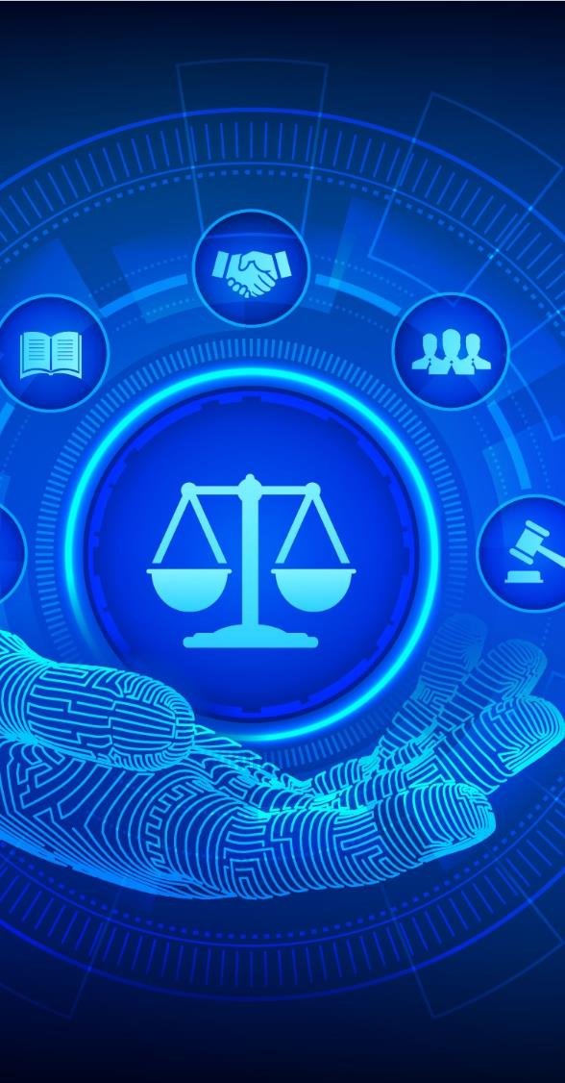
Lecture
10
LEGAL RESPONSES AND SOLUTIONS
The digital age has ushered in a paradigm shift, necessitating the evolution of legal frameworks to address the unique challenges posed by technology. International treaties and conventions serve as foundational pillars, guiding nations toward a cohesive approach to human rights in the digital realm. The Universal Declaration of Human Rights, International Covenant on Civil and Political Rights, and others provide a robust foundation.
www.midocean.ae

Slide 28
Lecture
10
LEGAL RESPONSES AND SOLUTIONS
GDPR in the European Union and the Convention for the Protection of Individuals with regard to Automatic Processing of Personal Data (Convention 108) by the Council of Europe, exemplify the intricate balance between technological advancements and human rights preservation at a regional level. National laws, too, play a vital role in addressing the unique contexts and challenges faced by individual countries.
www.midocean.ae

Slide 29
Lecture
10
LEGAL RESPONSES AND SOLUTIONS
Scholarly works and research papers contribute significantly to shaping legal responses in the digital age. By critically examining the implications of emerging technologies on human rights, legal scholars provide the intellectual foundation upon which legal solutions can be crafted.
www.midocean.ae

Slide 30
Lecture
10
LEGAL RESPONSES AND SOLUTIONS
Legal responses must embody technological neutrality and adaptability. The rapidly evolving nature of technology demands legal frameworks that can keep pace, ensuring that protections remain relevant and effective.
www.midocean.ae

Slide 31
Lecture
10
LEGAL RESPONSES AND SOLUTIONS
In addition to government action, tech companies play a pivotal role in shaping the digital landscape. Corporate responsibility extends to transparent data practices, robust security measures, and collaboration with governments and civil society to address emerging challenges.
www.midocean.ae

Slide 32
Lecture
10
LEGAL RESPONSES AND SOLUTIONS
The effectiveness of legal responses hinges on enforcement mechanisms and accountability. Oversight, reporting mechanisms, and judicial remedies ensure that violations of digital human rights are met with appropriate consequences.
www.midocean.ae

Slide 33
Lecture
10
FUTURE CHALLENGES & OPPORTUNITIES
The digital age is marked by rapid technological advancements that hold immense potential. However, with progress comes challenges. Emerging technologies such as artificial intelligence, biometrics, and the Internet of Things introduce new complexities that demand careful consideration of their implications on human rights.
www.midocean.ae

Slide 34
Lecture
10
FUTURE CHALLENGES & OPPORTUNITIES
Privacy in the Era of AI and Big Data:
The proliferation of artificial intelligence and big data analytics brings forth a fundamental question: How can we preserve privacy in an age where every interaction generates data? Striking a balance between data-driven innovation and protecting individual privacy is an ongoing challenge.
www.midocean.ae

Slide 35
Lecture
10
FUTURE CHALLENGES & OPPORTUNITIES
Ethical Dilemmas in Algorithmic Decision-Making:
As algorithms influence critical decisions in various domains, ethical dilemmas arise. Ensuring that algorithmic decision-making aligns with human rights principles, remains transparent, and avoids discriminatory outcomes is an evolving challenge.
www.midocean.ae

Slide 36
Lecture
10
FUTURE CHALLENGES & OPPORTUNITIES
Digital Inclusion in an Unequal World:
While technology has the potential to bridge gaps, the digital divide persists. Bridging this gap requires not only access to technology but also digital literacy, which becomes a crucial factor in ensuring equitable participation in the digital society.
www.midocean.ae

Slide 37
Lecture
10
FUTURE CHALLENGES & OPPORTUNITIES
Global Collaboration on Cybersecurity:
As cyber threats transcend borders, international collaboration on cybersecurity becomes imperative. Nations must work together to develop norms, regulations, and response mechanisms that protect individuals' rights while safeguarding digital infrastructure.
www.midocean.ae

Slide 38
Lecture
10
FUTURE CHALLENGES & OPPORTUNITIES
Empowerment through Digital Rights Education:
Education is a powerful tool for ensuring the protection of digital human rights. By raising awareness among citizens about their rights and responsibilities in the digital realm, we can empower individuals to actively participate in shaping digital policies.
www.midocean.ae

Slide 39

Lecture
10
Conclusion
The challenges and opportunities that lie ahead in the digital landscape are profound and multifaceted. As aspiring experts in digital law, your role in addressing these challenges and seizing opportunities is vital.
www.midocean.ae

Slide 40
Lecture
10
Conclusion
By understanding the potential of emerging technologies and their implications on human rights, you are poised to play a significant role in shaping a future where technology and human rights coexist harmoniously. Your journey towards becoming advocates of digital rights will contribute to the ongoing evolution of our digital world.
www.midocean.ae

Slide 41



Thank You

