Slide 1


Strategic Management
Prepared by Dr. Amira El fekky
MGM414
Lecture 4

Slide 2



Strategic Management
Lecture 4
MGM414
Prepared by
Dr. Amira El Fekky

Slide 3


Strategic Management
Strategic management involves developing and implementing plans to help an organization achieve its goals and objectives. This process can include formulating strategy, planning organizational structure and resource allocation, leading change initiatives, and controlling processes and resources.

Slide 4

Content
Part One / Analysis
Chapter 1 What Is Strategy?
Chapter 2 Strategic Leadership: Managing the Strategy Process
Chapter 3 External Analysis: Industry Structure, Competitive Forces, and Strategic Groups
Chapter 4 Internal Analysis: Resources, Capabilities, and Core Competencies
Chapter 5 Competitive Advantage, Firm Performance, and Business Models

Slide 5
Content
Part Two/ Formulation
Chapter 6 Business Strategy: Differentiation, Cost Leadership, and Blue Oceans
Chapter 7 Business Strategy: Innovation, Entrepreneurship, and Platforms
Chapter 8 Corporate Strategy: Strategic Alliances, Mergers, and Acquisitions
Chapter 9 Global Strategy: Competing Around the World
Part Three/ Implementation
Chapter 10 Organizational Design: Structure, Culture, and Control

Slide 6
Agenda Internal Analysis: Resources, Capabilities, and Core Competencies
4.1 Core Competencies
Differentiate among a firm’s core competencies, resources, capabilities, and activities
Core Competencies – Honda
Core Competencies - Company Examples of Core Competencies and Applications
4.2 The Resource-Based View
The VRIO Framework
Isolating Mechanisms: How to Sustain a Competitive Advantage
4.3 Implications for Strategic Leaders
Using SWOT Analysis to Generate Insights from External and Internal Analysis

Slide 7
Agenda Internal Analysis: Resources, Capabilities, and Core Competencies
4.1 Core Competencies
Differentiate among a firm’s core competencies, resources, capabilities, and activities
Core Competencies – Honda
Core Competencies - Company Examples of Core Competencies and Applications
4.2 The Resource-Based View
The VRIO Framework
Isolating Mechanisms: How to Sustain a Competitive Advantage
4.3 Implications for Strategic Leaders
Using SWOT Analysis to Generate Insights from External and Internal Analysis

Slide 8
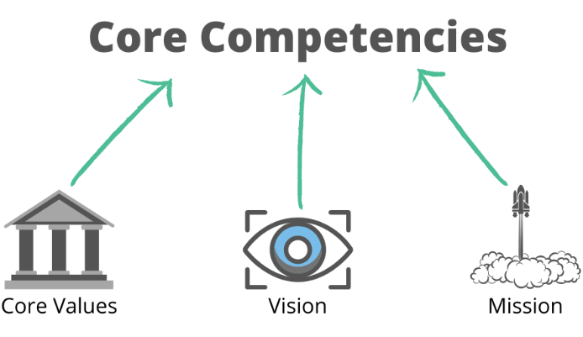
Core Competencies
Core competencies are the defining characteristics that make a business or an individual stand out from the competition.

Slide 9

Differentiate among a firm’s core competencies, resources, capabilities, and activities
Core competencies are unique, deeply embedded, firm-specific strengths that allow companies to differentiate their products and services and thus create more value for customers than their rivals, or offer products and services of acceptable value at lower cost.

Slide 10

Differentiate among a firm’s core competencies, resources, capabilities, and activities
Resources are any assets that a company can draw on when crafting and executing strategy.

Slide 11

Differentiate among a firm’s core competencies, resources, capabilities, and activities
Capabilities are the organizational and managerial skills necessary to coordinate a diverse set of resources to deploy them strategically.

Slide 12

Differentiate among a firm’s core competencies, resources, capabilities, and activities
Activities are outstanding and fine-grained business processes that enable firms to add incremental value by transforming inputs into goods and services.

Slide 13

Chapter
Core Competencies - Honda
04
Take Honda as an example of a company with a clearly defined core competency. Its life began with a small two-cycle motorbike engine. Through continuous learning over several decades, and often from lessons learned from failure, Honda built the core competency to design and manufacture small but powerful and highly reliable engines for which it now is famous.

Slide 14
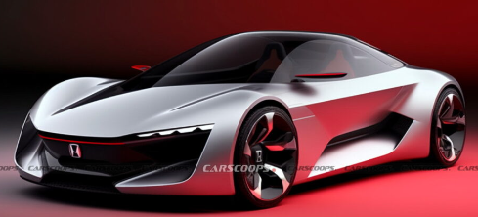
Chapter
Core Competencies - Honda
04
Today, Honda engines can be found everywhere: in cars, SUVs, vans, trucks, motorcycles, ATVs, boats, generators, snowblowers, lawn mowers and other yard equipment, and even small airplanes. Due to their superior performance, Honda engines have been the most popu lar in the Indy Racing League (IRL) since 2006.

Slide 15

Core Competencies - Company Examples of Core Competencies and Applications
Chapter
04
1- Amazon
Core Competencies
• Superior IT capabilities.
• Superior customer service.
Application Examples
• Online retailing: Largest selection of items online.
• Cloud computing: Largest provider through Amazon Web Services (AWS).

Slide 16
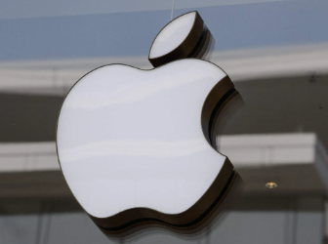
Core Competencies - Company Examples of Core Competencies and Applications
Chapter
04
2- Apple
Core Competencies
• Superior industrial design in integration of hardware and software.
• Superior marketing and retailing experience.
• Establishing an ecosystem of products and services that reinforce one another in a virtuous fashion.
Application Examples
• Creation of innovative and category-defining mobile devices and software services that take the user’s experience to a new level (e.g., iMac, iPod, iTunes, iPhone, iPad, Apple Pay, and Apple Watch).

Slide 17
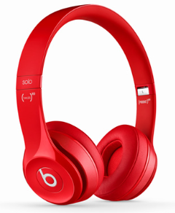
Core Competencies - Company Examples of Core Competencies and Applications
Chapter
04
3- Beats Electronics
Core Competencies
• Superior marketing: creating a perception of coolness.
• Establishing an ecosystem, combining hardware (headphones) with software (streaming service).
Application Examples
• Beats by Dr. Dre and Beats Music.

Slide 18

Core Competencies - Company Examples of Core Competencies and Applications
Chapter
04
4- Coca-Cola
Core Competencies
• Superior marketing and distribution.
Application Examples
• Leveraging one of the world’s most recognized brands (based on its original “secret formula”) into a diverse lineup of soft drinks.
• Global availability of products.

Slide 19

Core Competencies - Company Examples of Core Competencies and Applications
Chapter
04
5- Facebook
Core Competencies
• Superior IT capabilities to provide reliable social network services globally on a large scale.
• Superior algorithms to offer targeted online ads.
Application Examples
• Connecting 2 billion social media users worldwide.
• News feed, timeline, graph search, and stories.

Slide 20

Core Competencies - Company Examples of Core Competencies and Applications
Chapter
04
6- General Electric
Core Competencies
• Superior expertise in industrial engineering, designing and implementing efficient management processes, and developing and training leaders.
Application Examples
• Providing products and services to solve tough engineering problems in energy, health care, and aerospace, among other sectors.

Slide 21

Core Competencies - Company Examples of Core Competencies and Applications
Chapter
04
7- Google
Core Competencies
• Superior in creating proprietary algorithms based on large amounts of data collected online.
Application Examples
• Software products and services for the internet and mobile computing, including some mobile devices (Pixel phone, Chromebook).
• Online search, Android mobile operating system, Chrome OS, Chrome web browser, Google Play, AdWords, AdSense, Google docs, Gmail, etc.

Slide 22

Core Competencies - Company Examples of Core Competencies and Applications
Chapter
04
8- Honda
Core Competencies
• Superior engineering of small but powerful and
highly reliable internal combustion engines.
Application Examples
• Motorcycles, cars, ATVs, sporting boats,
snowmobiles, lawn mowers, small aircraft, etc.

Slide 23

Core Competencies - Company Examples of Core Competencies and Applications
Chapter
04
9- IKEA
Core Competencies
• Superior in designing modern functional home furnishings at low cost.
• Superior retail experience.
Application Examples
• Fully furnished room setups, practical tools for all
rooms, do-it-yourself.

Slide 24

Core Competencies - Company Examples of Core Competencies and Applications
Chapter
04
10- Netflix
Core Competencies
• Superior in creating proprietary algorithms-based
individual customer preferences.
Application Examples
• DVD-by-mail rentals, streaming media (including
proprietary) content, connection to game consoles.

Slide 25

Core Competencies - Company Examples of Core Competencies and Applications
Chapter
04
11- Tesla
Core Competencies
• Superior engineering expertise in designing high performance battery-powered motors and power trains.
• Superior expertise in decentralized power storage and management based on renewable (solar) energy.
Application Examples
• Model S, Model X, and Model 3.
• Power wall, solar roof tiles, and complete rooftop solar systems.

Slide 26

Core Competencies - Company Examples of Core Competencies and Applications
Chapter
04
12- Uber
Core Competencies
• Superior mobile-app–based transportation and logistics
expertise focused on cities, but on global scale.
Application Examples
• Uber, UberX, UberBlack, UberLUX, UberSUV, etc.

Slide 27
Agenda Internal Analysis: Resources, Capabilities, and Core Competencies
4.1 Core Competencies
Differentiate among a firm’s core competencies, resources, capabilities, and activities
Core Competencies – Honda
Core Competencies - Company Examples of Core Competencies and Applications
4.2 The Resource-Based View
The VRIO Framework
Isolating Mechanisms: How to Sustain a Competitive Advantage
4.3 Implications for Strategic Leaders
Using SWOT Analysis to Generate Insights from External and Internal Analysis

Slide 28
Chapter
The Resource-Based View
04
To gain a deeper understanding of how the interplay between resources and capabilities creates core competencies that drive firm activities leading to competitive advantage, we turn to the resource-based view of the firm. This model systematically aids in identifying core competencies. As the name suggests, this model sees resources as key to superior firm performance. Resources fall broadly into two categories:
Tangible and Intangible. Tangible resources have physical attributes and are visible.

Slide 29
Chapter
The Resource-Based View
04
Compare and contrast tangible and intangible resources;
■ Tangible resources have physical attributes and are visible.
■ Intangible resources have no physical attributes and are invisible.
■ Competitive advantage is more likely to be based on intangible resources.

Slide 30

Chapter
The Resource-Based View
04
1- Tangible - Resource
Visible, Physical Attributes
• Labor
• Capital
• Land
• Buildings
• Plant
• Equipment
• Supplies

Slide 31

Chapter
The Resource-Based View
04
Intangible – Resource
Invisible, No Physical Attributes
• Culture
• Knowledge
• Brand Equity
• Reputation
• Intellectual Property;
“Patents, Designs, Copyrights, Trademarks, Trade Secrets”

Slide 32
Chapter
The Resource-Based View
04
Rank and position | Company | Total Intangible Value (USD $bn) | Total Intangible Value/Enterprise Value (%)
1 | Amazon.com Inc | 827 | 96%
2 | Microsoft Corp | 686 | 95%
3 | Apple Inc | 648 | 85%
4 | Alphabet Inc | 576 | 80%
5 | Alibaba Group Holding | 478 | 93%
6 | Facebook Inc | 470 | 89%

Slide 33
Agenda Internal Analysis: Resources, Capabilities, and Core Competencies
4.1 Core Competencies
Differentiate among a firm’s core competencies, resources, capabilities, and activities
Core Competencies – Honda
Core Competencies - Company Examples of Core Competencies and Applications
4.2 The Resource-Based View
The VRIO Framework
Isolating Mechanisms: How to Sustain a Competitive Advantage
4.3 Implications for Strategic Leaders
Using SWOT Analysis to Generate Insights from External and Internal Analysis

Slide 34
Chapter
THE VRIO FRAMEWORK
04
Our tool for evaluating a firm’s resource endowments is a framework that answers the question of what resource attributes underpin competitive advantage. This framework is implied in the resource-based model, identifying certain types of resources as key to superior firm performance. For a resource to be the basis of a competitive advantage, it must be;
Valuable,
Rare, and
Costly to Imitate.
And finally, the firm itself must be Organized to capture the value of the resource.

Slide 35
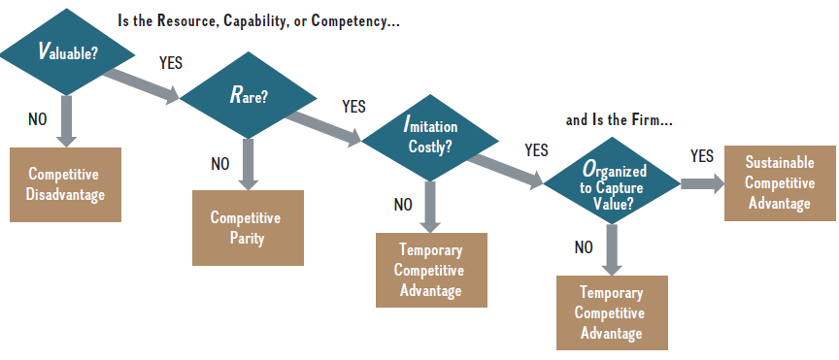
Chapter
THE VRIO FRAMEWORK
04

Slide 36
Chapter
THE VRIO FRAMEWORK
04
1- Valuable
A valuable resource is one that enables the firm to exploit an external opportunity or offset an external threat. This has a positive effect on a firm’s competitive advantage. In particular, a valuable resource enables a firm to increase its economic value creation (V − C). Revenues rise if a firm is able to increase the perceived value of its product or service in the eyes of consumers by offering superior design and adding attractive features (assuming costs are not increasing).

Slide 37
Chapter
THE VRIO FRAMEWORK
04
1- Valuable
For example, Beats Electronics’ ability to design and market premium headphones that bestow a certain air of coolness upon wearers is a valuable resource. The profit margins for Beats designer headphones are astronomical: The production cost for its headphones is estimated to be no more than $15, while they retail for $150 to $450, with some special editions over $1,000. Thus, Beats’ competency in designing and marketing premium headphones is a valuable resource in the VRIO framework.

Slide 38
Chapter
THE VRIO FRAMEWORK
04
2- Rare
A resource is rare if only one or a few firms possess it. If the resource is common, it will result in perfect competition where no firm is able to maintain a competitive advantage. A resource that is valuable but not rare can lead to competitive parity at best. Beats Electronics’ ability and reach in product placement and celebrity endorsements that build its coolness factor are certainly rare. No other brand in the world, not even Apple or Nike, has such a large number of celebrities from music, movies, and sports using its product in public. Thus, this resource is not only valuable but also rare.

Slide 39
Chapter
THE VRIO FRAMEWORK
04
3- Costly to Imitate
A resource is costly to imitate if firms that do not possess the resource are unable to develop or buy the resource at a reasonable price. If the resource in question is valuable, rare, and costly to imitate, then it is an internal strength and a core competency. If the firm’s competitors fail to duplicate the strategy based on the valuable, rare, and costly - to imitate resource, then the firm can achieve a temporary competitive advantage.

Slide 40
Chapter
THE VRIO FRAMEWORK
04
3- Costly to Imitate
Beats’ core competency in establishing a brand that communicates coolness is built upon the intuition and feel for music and cultural trends of Dr. Dre, one of music’s savviest marketing minds. Because its creator Dr. Dre relies on gut instinct in making decisions rather than market research, this resource is costly to imitate. Even if a firm wanted to copy Beats’ core competency—how would it go about it?
A firm that enjoys a competitive advantage, however, attracts significant attention from its competitors. They will attempt to negate a firm’s resource advantage by directly imitating the resource in question (direct imitation) or through working around it to provide a comparable product or service (substitution).

Slide 41
Chapter
THE VRIO FRAMEWORK
04
5- Organized to capture value
The final criterion of whether a rare, valuable, and costly-to-imitate resource can form the basis of a sustainable competitive advantage depends on the firm’s internal structure. To fully exploit the competitive potential of its resources, capabilities, and competencies, a firm must be organized to capture value— that is, it must have in place an effective organizational structure and coordinating systems.

Slide 42
Agenda Internal Analysis: Resources, Capabilities, and Core Competencies
4.1 Core Competencies
Differentiate among a firm’s core competencies, resources, capabilities, and activities
Core Competencies – Honda
Core Competencies - Company Examples of Core Competencies and Applications
4.2 The Resource-Based View
The VRIO Framework
Isolating Mechanisms: How to Sustain a Competitive Advantage
4.3 Implications for Strategic Leaders
Using SWOT Analysis to Generate Insights from External and Internal Analysis

Slide 43

Isolation mechanisms:
How to maintain competitive advantage?
Chapter
04
Although VRIO resources can lay the foundation of a competitive advantage, no competitive advantage can be sustained indefinitely. Several conditions, however, can offer some protection to a successful firm by making it more difficult for competitors to imitate the resources, capabilities, or competencies that underlie its competitive advantage.

Slide 44
Isolation mechanisms:
How to maintain competitive advantage?
Chapter
04
Barriers to imitation are important examples of isolating mechanisms because they prevent rivals from competing away the advantage a firm may enjoy; they include:
■ Better expectations of future resource value.
■ Path dependence.
■ Causal ambiguity.
■ Social complexity.
■ Intellectual property (IP) protection.

Slide 45
Chapter
Intellectual property protection
04
Intellectual property (IP) protection is a critical intangible resource that can also help sustain a competitive advantage. The five major forms of IP protection are:
■ Patents
■ Designs
■ Copyrights
■ Trademarks
■ Trade secrets

Slide 46
Agenda Internal Analysis: Resources, Capabilities, and Core Competencies
4.1 Core Competencies
Differentiate among a firm’s core competencies, resources, capabilities, and activities
Core Competencies – Honda
Core Competencies - Company Examples of Core Competencies and Applications
4.2 The Resource-Based View
The VRIO Framework
Isolating Mechanisms: How to Sustain a Competitive Advantage
4.3 Implications for Strategic Leaders
Using SWOT Analysis to Generate Insights from External and Internal Analysis

Slide 47
Chapter
Implications for Strategic Leaders
04
We’ve now reached a significant point: We can combine external and internal analyses. Both types of analysis in tandem allow managers to formulate a strategy that is tailored to their company, creating a unique fit between the company’s internal resources and the external environment. A strategic fit increases the likelihood that a firm is able to gain a competitive advantage. If a firm achieves a dynamic strategic fit, it is likely to be able to sustain its advantage over time.

Slide 48
Chapter
SWOT Analysis
04
A SWOT matrix, often referred to as SWOT analysis, is a strategic planning tool businesses and individuals use to identify and assess the strengths, weaknesses, opportunities and threats associated with an organization, project, business plan or activity. This technique helps managers gauge how internal and external factors can affect the success or viability of new projects. A SWOT matrix can help businesses leverage their comparative advantage and achieve strategic objectives when combined with other managerial tools.

Slide 49
Chapter
SWOT Analysis
04
The name is an acronym for the four parameters the technique examines: S = Strengths : Characteristics of the business or project that give it an advantage over others. W = Weaknesses : Characteristics that place the business or project at a disadvantage relative to others. O = Opportunities : Elements in the environment that the business or project could exploit to its advantage. T = Threats : Elements in the environment that could cause trouble for the business or project.

Slide 50
Chapter
SWOT Analysis
04
The name is an acronym for the four parameters the technique examines: S = Strengths : Strengths are the qualities that give a business, organization or individual a comparative advantage over others. They're the factors that enable a company to achieve its objectives. Strengths can be tangible resources, such as a strong balance sheet, buildings, machinery, employees and a market. Intangible strengths may include strong customer loyalty, a talented staff, patents and an excellent reputation.

Slide 51
Chapter
SWOT Analysis
04
The name is an acronym for the four parameters the technique examines: W = Weaknesses Weaknesses are factors that reduce an organization's ability to accomplish its goals. They can include a lack of funds, low production capacity, unmotivated employees and a small market share. A SWOT analysis can help a business identify its weaknesses and turn them into strengths.

Slide 52
Chapter
SWOT Analysis
04
The name is an acronym for the four parameters the technique examines: O = Opportunities : Opportunities are unexplored factors that can provide rewards for a business, project or individual. Opportunities can take the form of experience, new technology, new markets or even a poorly performing competitor. Identifying opportunities can help a business use its strengths to its advantage.

Slide 53
Chapter
SWOT Analysis
04
The name is an acronym for the four parameters the technique examines: T = Threats : Threats are events or factors beyond a company's or person's control that can affect them negatively. Also known as risks, threats are external factors that a SWOT analysis can help businesses identify and take proactive measures. This can help reduce or eliminate the threat's effects.

Slide 54
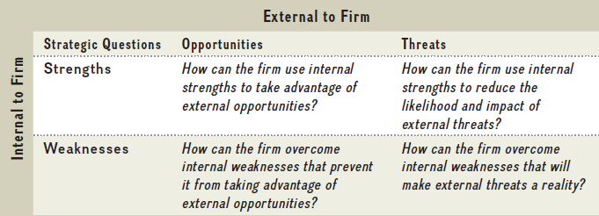
Chapter
SWOT Analysis
04

Slide 55
Chapter
SWOT Analysis - Example
04
Strengths: | Weaknesses:
New product line popular among buyers, talented staff, over $50 million in marketing budget, three times more than our competitor has, 90% customer loyalty rate | High staff turnover, huge production costs, disruptive technology
Opportunities: | Threats:
New demographic that loves our product, a merger with two companies that promise new markets | Online retailers selling unbranded substitutes of our products, competitors' use of social media channels for orders, new government regulations that might change market conditions

Slide 56



Thank You

