Slide 1



Strategic and Operational
Management
MGM 630
Orientation Lecture
Prepared by
Dr. Ahmad AL-Naimi

Slide 2

Lecture
Basic Model of Strategic Management
01
What Strategy Is: Gaining and Sustaining Competitive Advantage.
Stakeholders and Competitive Advantage.
The AFI Strategy Framework.

Slide 3
Lecture
Strategic Leadership: Managing the Strategy Process
02
Vision, Mission, and Values
Strategic Leadership.
The Strategic Management Process.

Slide 4
Lecture
External Analysis: Industry Structure, Competitive Forces, and Strategic Groups
03
The PESTEL Framework .
Industry Structure and Firm Strategy: The Five Forces Model.
Changes over Time: Industry Dynamics.
Performance Differences within the Same Industry: Strategic Groups.

Slide 5
Lecture
Internal Analysis: Resources, Capabilities, and Core Competencies
04
Core Competencies.
The Resource-Based View.
The Dynamic Capabilities Perspective.
The Value Chain Analysis.
Implications for the Strategist.

Slide 6
Lecture
Competitive Advantage, Firm Performance, and Business Models
05
Competitive Advantage and Firm Performance.
Business Models: Putting Strategy into Action.

Slide 7
Lecture
Business Strategy: Differentiation, Cost Leadership, and Blue Oceans
06
Business-Level Strategy: How to Compete for Advantage
Differentiation Strategy: Understanding Value Drivers
Cost-Leadership Strategy: Understanding Cost Drivers
Business-Level Strategy and the Five Forces: Benefits and Risks
Blue Ocean Strategy: Combining Differentiation and Cost Leadership

Slide 8
Lecture
Corporate Strategy: Vertical Integration and Diversification
07
What Is Corporate Strategy?
The Boundaries of the Firm:
Vertical Integration along the Industry Value Chain:
Corporate Diversification: Expanding Beyond a Single Market,

Slide 9
Lecture
Organizational Design: Structure, Culture, and Control
08
1. Organizational Design and Competitive Advantage.
2. Strategy and Structure.
3. Organizational Culture: Values, Norms, and Artifacts.
4. Strategic Control-and-Reward Systems.

Slide 10
Lecture
Corporate Governance and Business Ethics
09
1. The Shared Value Creation Framework.
2. Corporate Governance.
3. Strategy and Business Ethics.

Slide 11
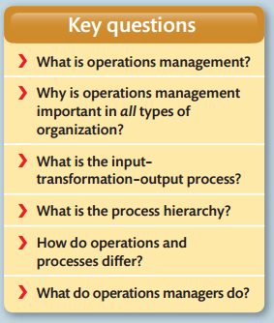
Lecture
Operations management
10

Slide 12
Lecture
Course Learning Outcomes
00
Understand the business process and analyze the operations
Acquire knowledge of production planning and resource management
Understand the concept of Corporate Vision - Mission and Objectives
Understand the concept of SWOT and Portfolio Analysis
Understand the different stages in strategy formulation process
Understand the concept of Strategic Business Unit and Business Process re-engineering.

Slide 13
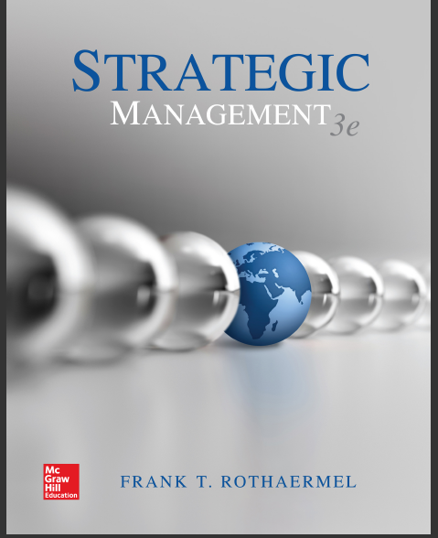
References
1- Strategic management, third edition, 2017 By Frank t. Rothaermel
Georgia Institute of Technology.

Slide 14
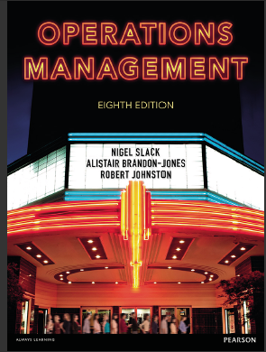
References
2. Operations management, Eighth edition By Nigel Slack Alistair Brandon-Jones Robert Johnston.

Slide 15

Strategic and Operational Management

Slide 16

Strategic and Operational Management

Slide 17



Thank You

