Slide 1
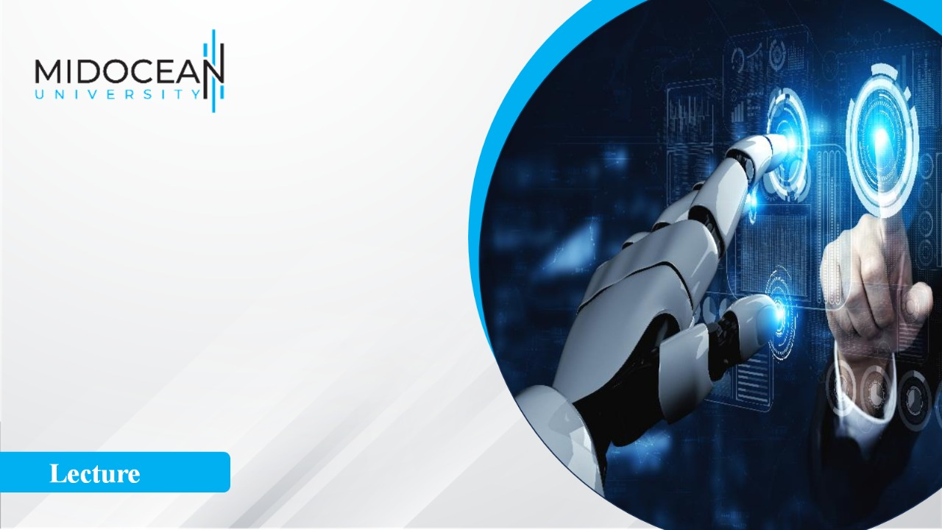
Integrated Marketing
Communication
Designs
Prepared by Dr. Perihan Salah
MKT728
An Introduction to Integrated
Marketing Communications
Introduction

Slide 2


Integrated Marketing
Communication
Designs
Introduction
MKT728
An Introduction to Integrated
Marketing Communications
Prepared by
Dr. Perihan Salah

Slide 3


Chapter
00
LEARNING OBJECTIVES
You explore the scope of marketing communications within the dynamic contextualized communication coexistence of digital and classical channels.
The module introduces key terms and concepts, current theories, and practices with a focus on the integration between digital and classical communication methods.
Explore the main factors that influence the success of marketing communications campaigns and the main Marketing Communications theoretical framework
Explore specific communication campaigns, and to create recommendations with a focus on the planned and integrated perspectives within various marketing communication environments.
www.midocean.ae

Slide 4
Chapter
00
LEARNING OBJECTIVES
Having successfully completed this module you will be able to:
Evaluate and apply the complex principles of the marketing communication planning process.
Analyze and present coherent recommendations of the kind that inform creative and effective marketing communications decisions.
Review advanced integrated communication methods and formats for higher levels of engagement with the audience.
Present complex ideas in various formats in a creative and effective manner.
Demonstrate critical, analytical, non-linear, and creative thinking in evaluating marketing communication contexts.
www.midocean.ae

Slide 5
Chapter
00
LEARNING OBJECTIVES
Having successfully completed this module you will be able to:
Evaluate the main strengths and weaknesses for different marketing
Know the communications strategies and tools with ethical considerations within the overall marketing strategy.
Know the scope and specificity of the marketing communications domain.
To know the advanced value of the integrated marketing communication (IMC) perspective in a variety of classical and digital communication channels.
www.midocean.ae

Slide 6
Topics
1 AN INTRODUCTION TO INTEGRATED MARKETING COMMUNICATIONS.
2 THE ROLE OF IMC IN THE MARKETING PROCESS .
3 THE COMMUNICATION PROCESS .
4 SOURCE, MESSAGE, AND CHANNEL FACTORS
5 CREATIVE STRATEGY: PLANNING AND DEVELOPMENT, MEDIA PLANNING AND STRATEGY .
6 DIRECT MARKETING.
7 THE INTERNET: DIGITAL AND SOCIAL MEDIA.
8 SALES PROMOTION.
9 PUBLIC RELATIONS, PUBLICITY, AND CORPORATE ADVERTISING .
10 PERSONAL SELLING.
www.midocean.ae

Slide 7
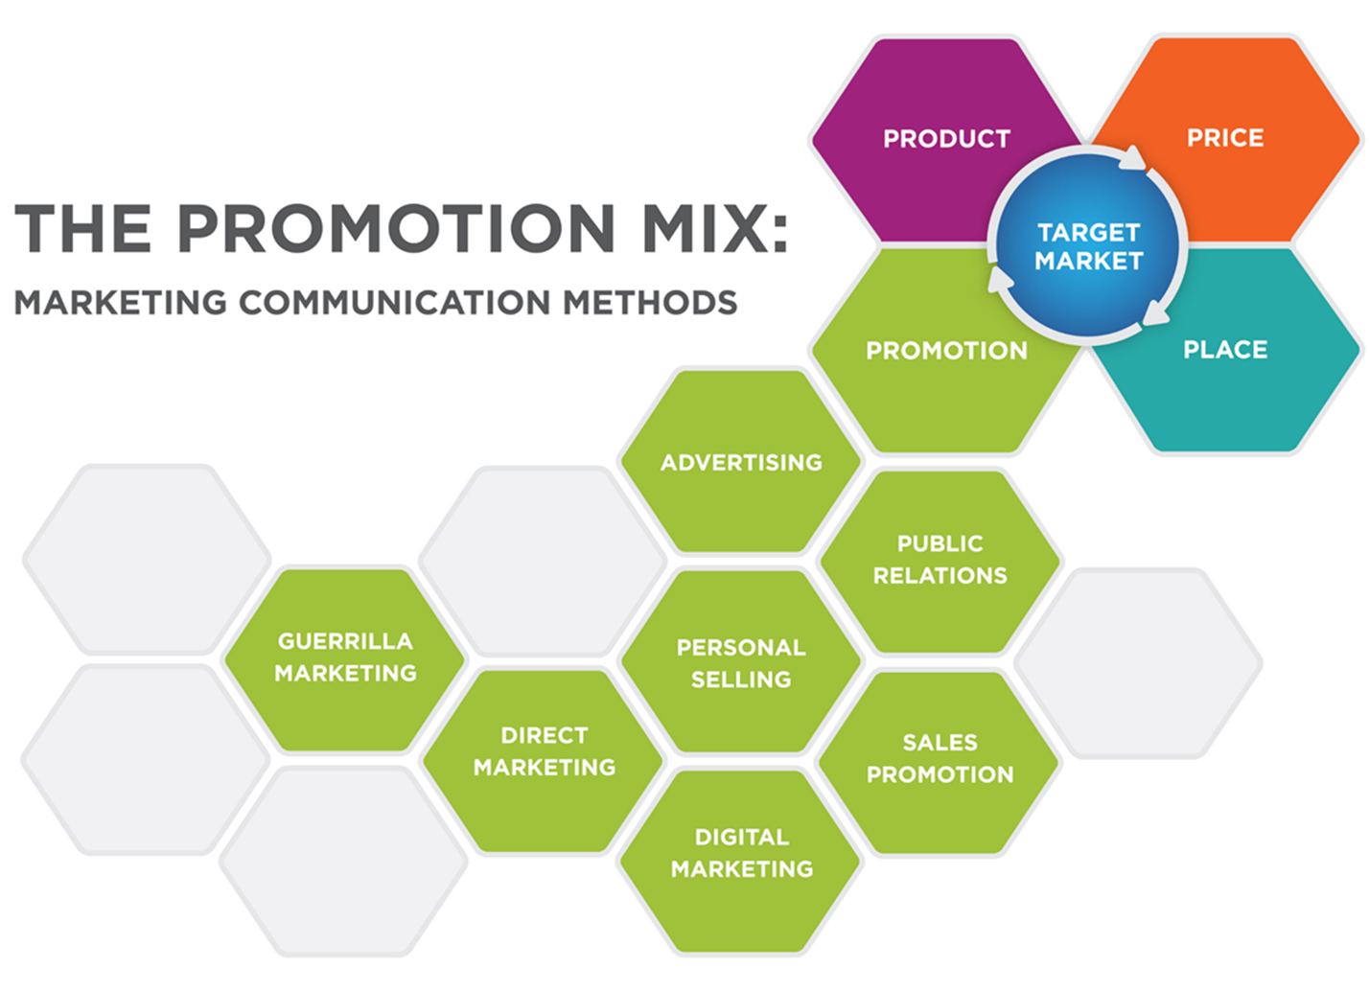
www.midocean.ae

Slide 8
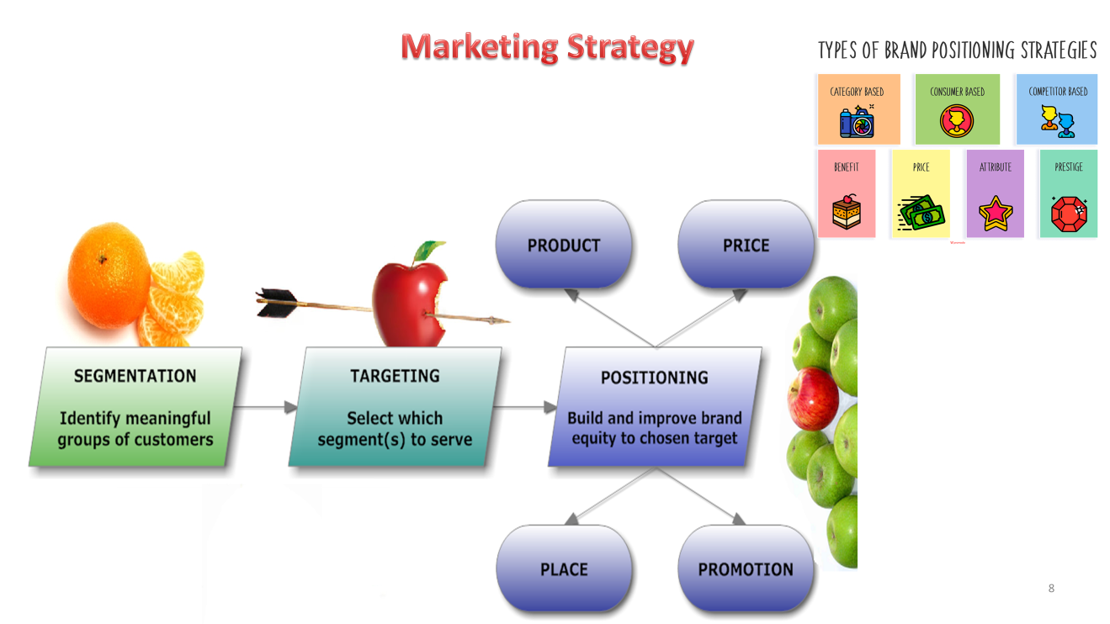
What is Strategy?
www.midocean.ae

Slide 9
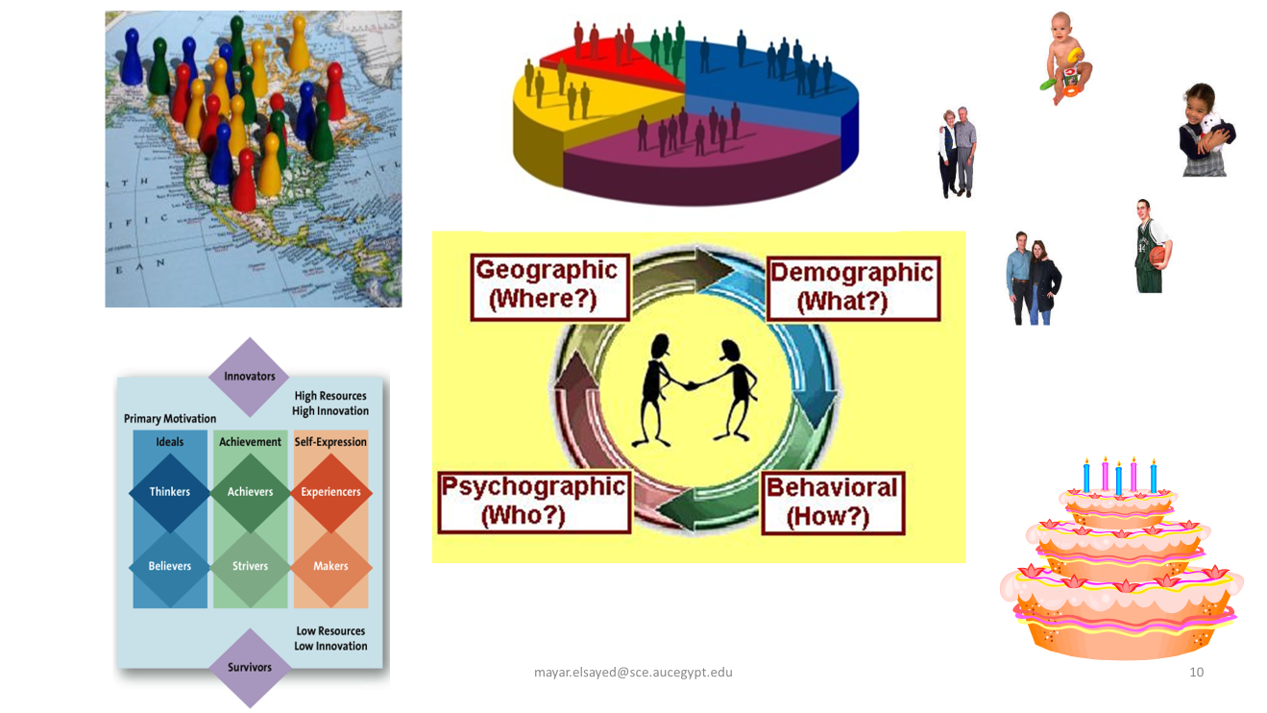
What is Strategy?
www.midocean.ae

Slide 10
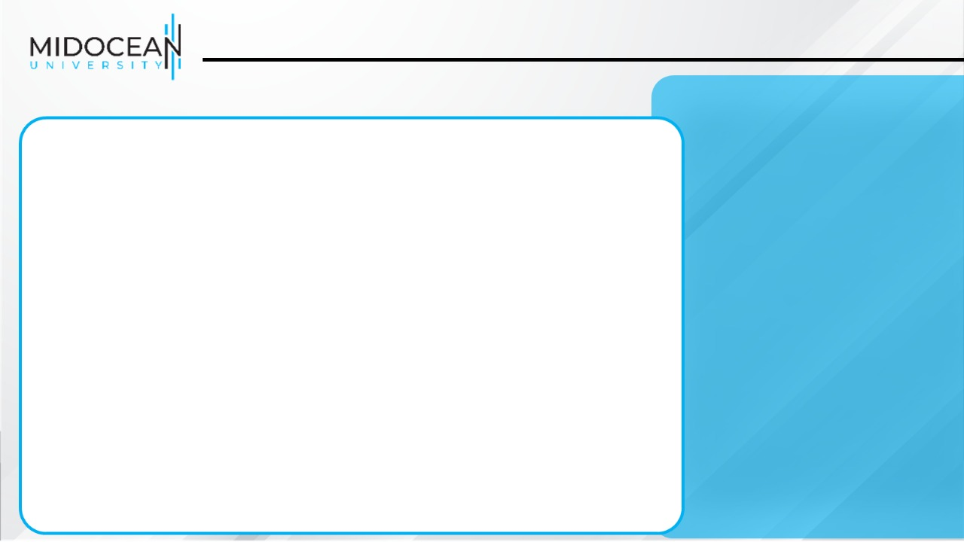
The Promotion Mix
The promotion mix is the specific blend of
advertising,
public relations,
personal selling,
direct-marketing,
digital marketing tools that the company uses to persuasively communicate customer value and build customer relationships

Slide 11
Integrated Marketing Communications Strategy
Integrated marketing communications is the integration by the company of its communication channels to deliver a clear, consistent, and compelling message about the organization and its brands

Slide 12
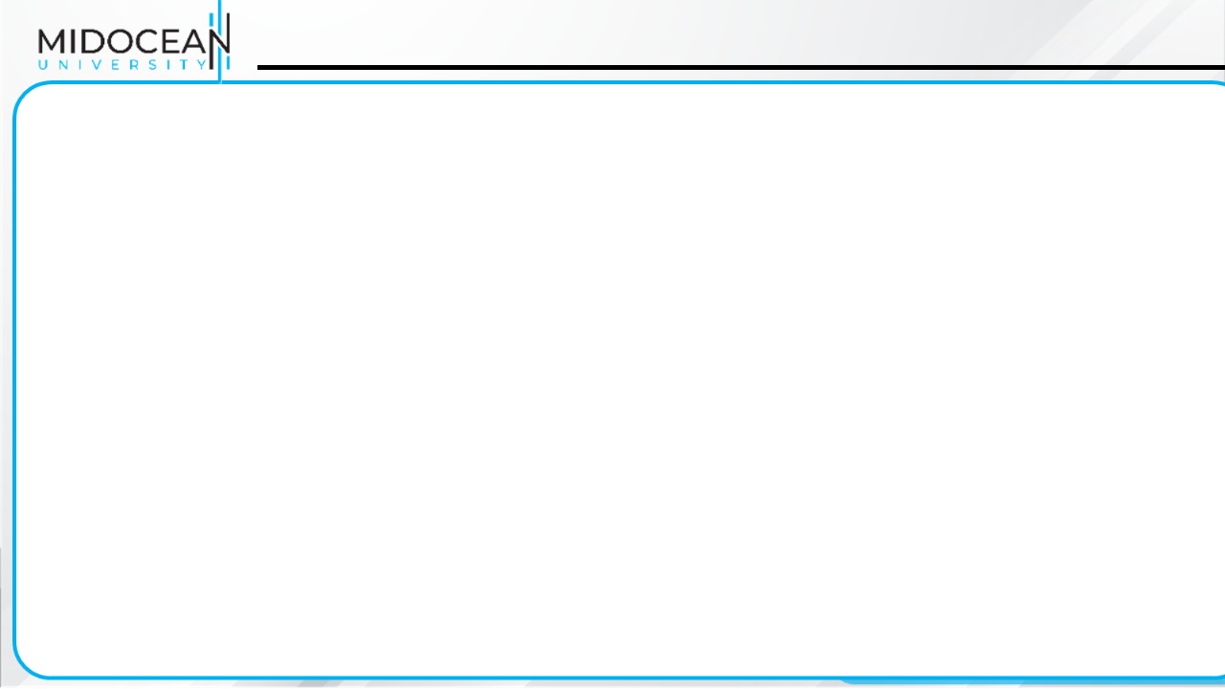
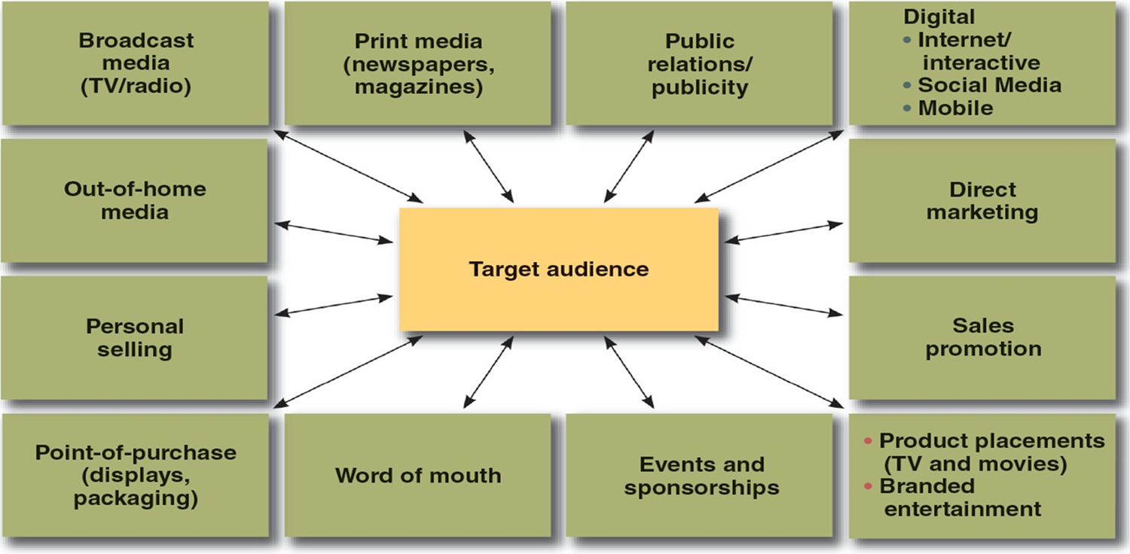
IMC Touchpoints

Slide 13
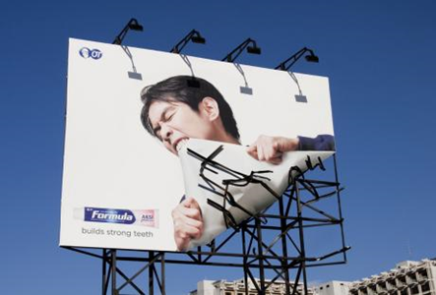
Advertising
Advertising is any paid form of non-personal presentation/communication and promotion of ideas, goods, or services by an identified sponsor
→Broadcast
→Print
→Internet
→Outdoor
The company cannot take instant feedback from the customer.

Slide 14

Personal selling
Personal selling is the personal presentation by the firm’s sales force for the purpose of making sales and building customer relationships
→Sales presentations
→Trade shows
→Incentive programs

Slide 15
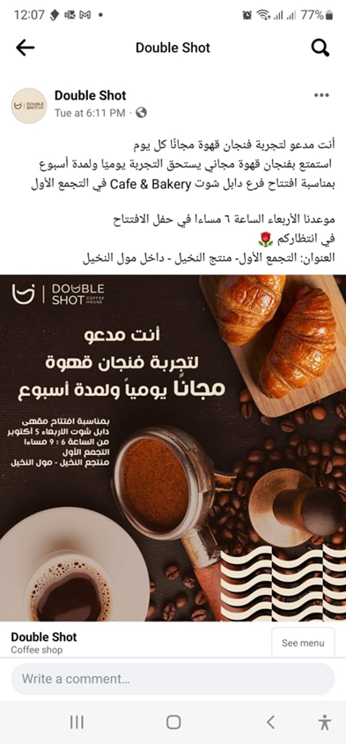
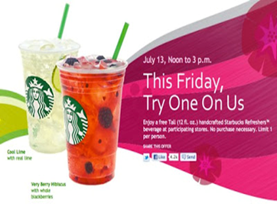

Sales promotion
Sales promotion includes coupons, contests, cents-off deals, and premiums that attract consumer attention and offer strong incentives to purchase, and can be used to dramatize product offers and to boost sagging sales

Slide 16
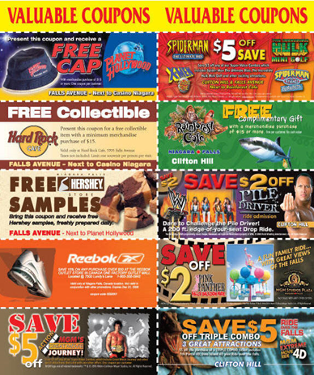
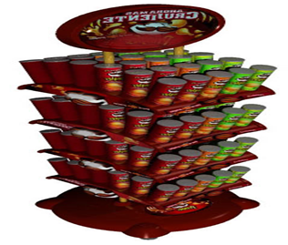
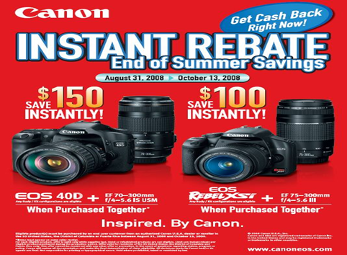
Sales promotion
Sales promotion is the short-term incentive to encourage the purchase or sale of a product or service
→Discounts
→Coupons
→Displays
→Demonstrations

Slide 17


Slide 18
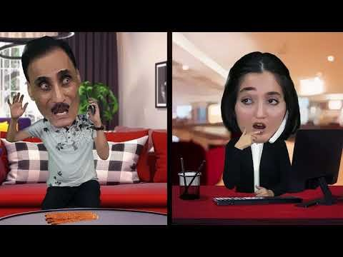
Was 500
NOW499

Slide 19
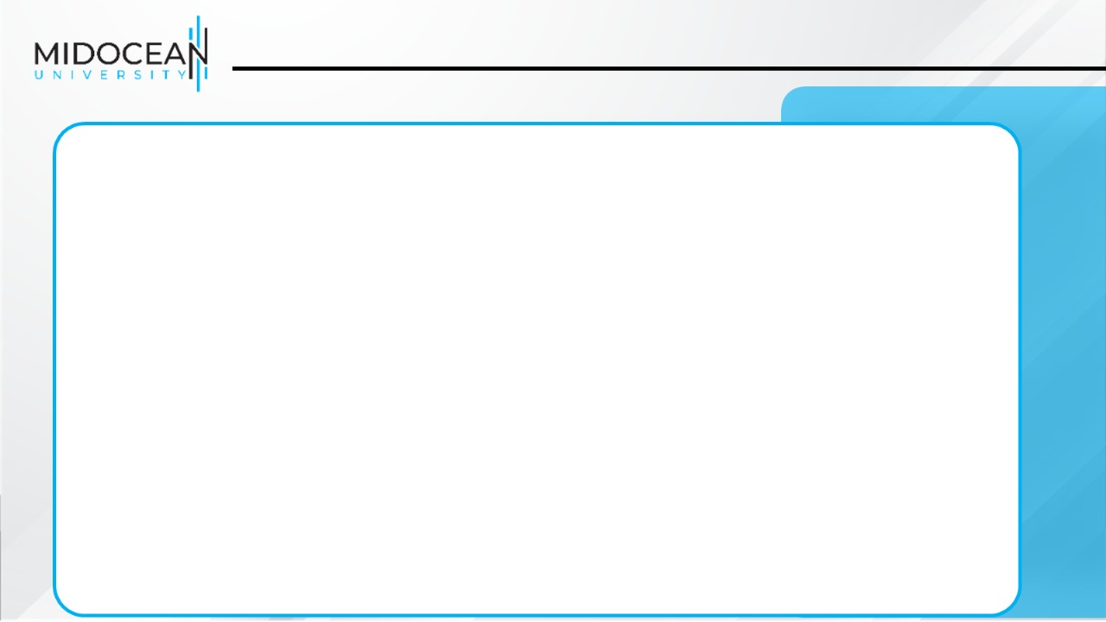
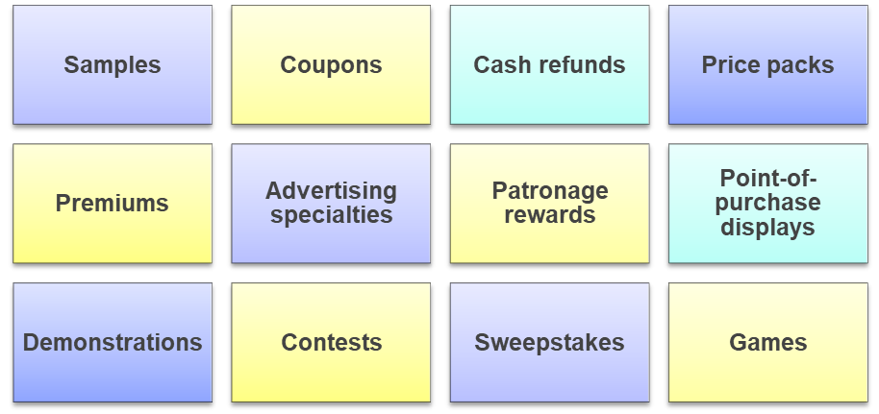
Major Sales Promotion Tools

Slide 20
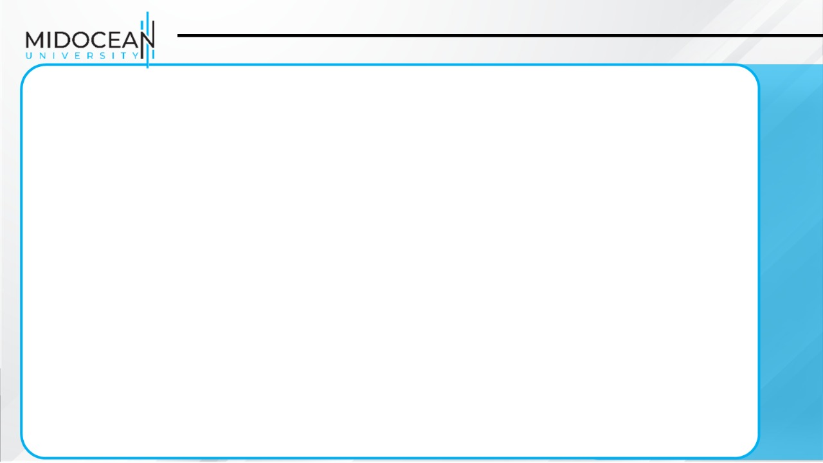
Consumer Promotion Tools
Samples offer a trial amount of a product
Coupons are certificates that give buyers a saving when they purchase specified products
Cash refunds are similar to coupons except that the price reduction occurs after the purchase
Price packs offer consumers savings off the regular price of a product
Premiums are goods offered either for free or at a low price
Advertising specialties are useful articles imprinted with the advertiser’s name, logo, or message that are given as gifts to consumers
Point-of-purchase promotions include displays and demonstrations that take place at the point of sales

Slide 21
Consumer Promotion Tools
Contests, sweepstakes, and games give consumers the chance to win something—such as cash, trips, or goods—by luck or through extra effort
Contests require an entry by a consumer
Sweepstakes require consumers to submit their names for a drawing
Games present consumers with something that may or may not help them win a prize
Event marketing

Slide 22
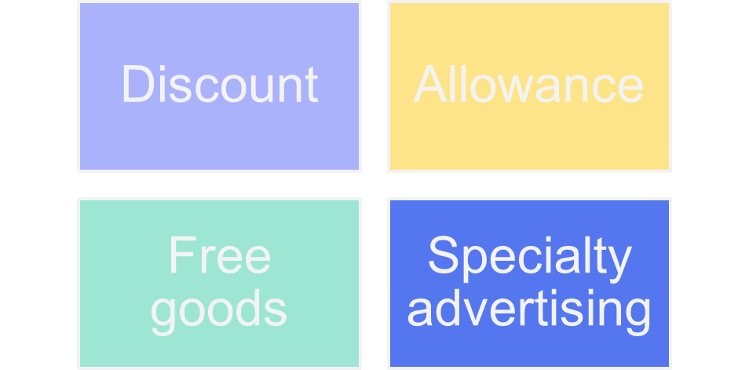
Trade Promotion Tools

Slide 23
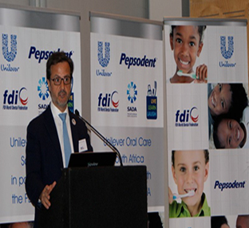
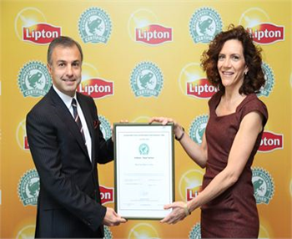
Public relations
Public relations involves building good relations with the company’s various publics by obtaining favorable publicity, building up a good corporate image, and handling or heading off unfavorable rumors, stories, and events
          →Press releases
          →Sponsorships
          →Special events
          →Web pages
Public relations is a very believable form of promotion that includes news stories, features, sponsorships, and events

Slide 24
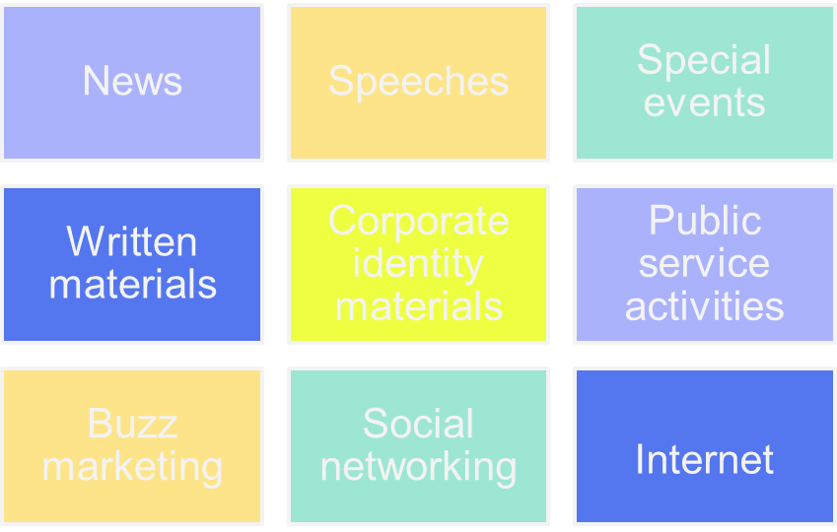
Major Public Relations Tools

Slide 25
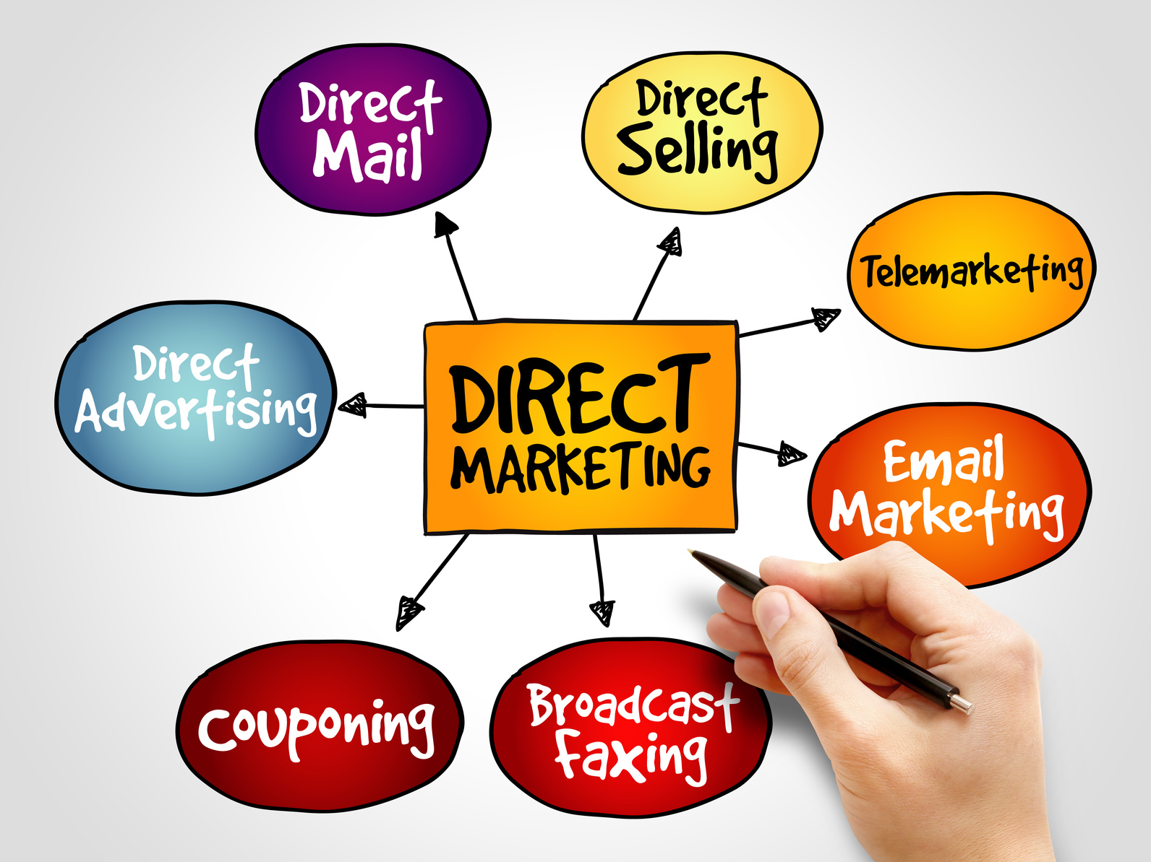
Direct marketing
Direct marketing is a non-public, immediate, customized, and interactive promotional tool that includes direct mail, catalogs, telemarketing, and online marketing
Direct marketing involves making direct connections with carefully targeted individual consumers to both obtain an immediate response and cultivate lasting customer relationships—through the use of direct mail, telephone, direct-response television, e-mail, and the Internet to communicate directly with specific consumers
→Catalog
→Telemarketing
→Kiosks

Slide 26
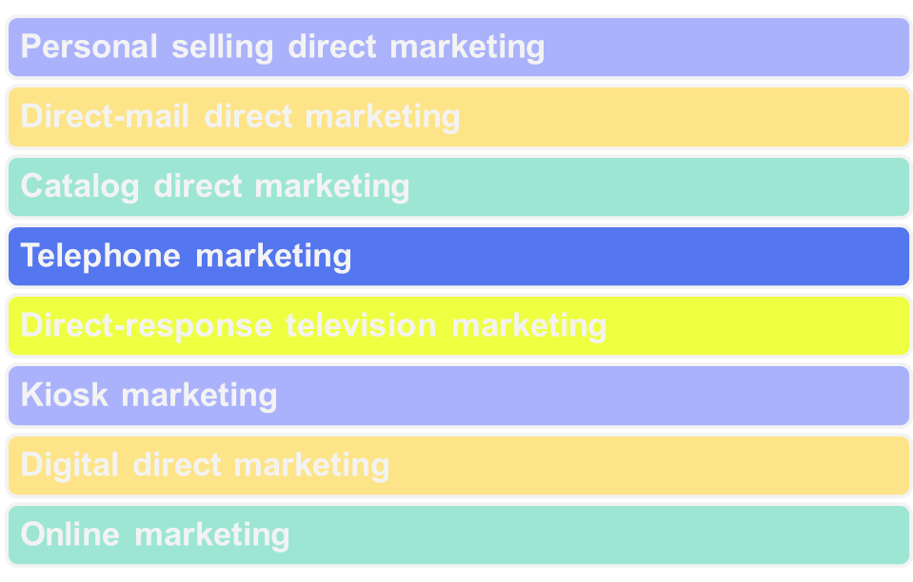
Forms of Direct Marketing

Slide 27
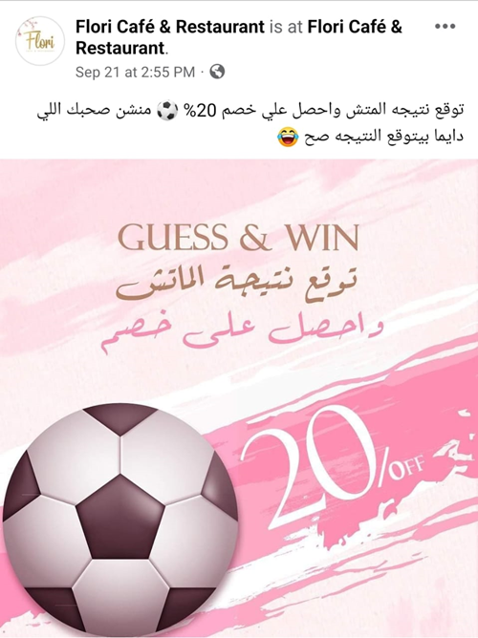
Digital/Internet Marketing
Marketing and the Internet
Internet is a vast public Web of computer networks that connects users of all types around the world to each other and to a large information repository

Slide 28
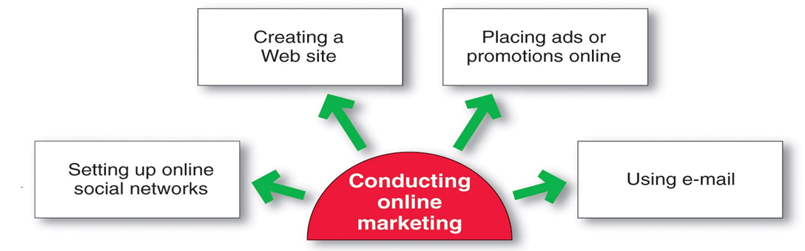
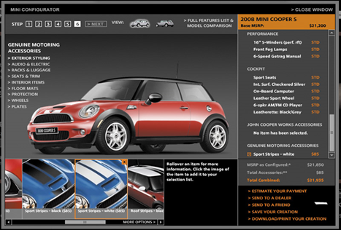
Digital/Internet Marketing
Setting Up an Online Presence
Creating a Web site requires designing an attractive site and developing ways to get consumers to visit the site, remain on the site, and return to the site
Types of sites
→Corporate Web site
→Marketing Web site

Slide 29
Steps in Developing Effective Marketing Communication
Determining the Communication Objectives
Marketers seek a purchase response that results from a consumer decision-making process that includes the stages of buyer readiness

Slide 30
Steps in Developing Effective Marketing Communication
Designing a Message
Message content is an appeal or theme that will produce the desired response
→Rational appeal
audience’s self-interest
→Emotional appeal
positive or negative emotions
→Moral appeal
sense of right and proper
Message Format
What will be the color, the text, the copy, the images?
  Logic
  Emotion
  humor
  celebrity
  Music
  Fear

Slide 31
Message Factors
Designing a Message
Message structure
  Order of presentation
  Conclusion drawing
  Message sidedness
  Refutation
  Verbal versus visual messages
Message appeals
  Comparative advertising
  Fear appeals
  Humor appeals
  Sex appeal

Slide 32
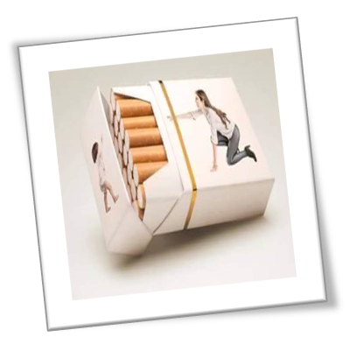

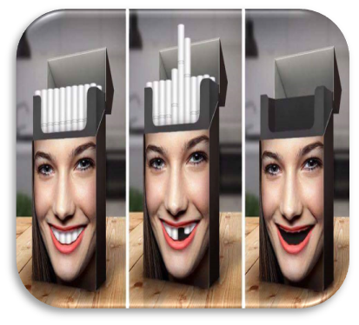
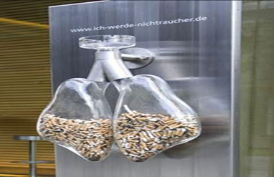
Message Factors
Designing a Message

Slide 33

Thank You
Dr. Perihan Salah

