Slide 1



Change Management:
The Good, the Bad and the Ugly
Prepared by Dr. Sami Alzahrani
Lecture 3
PMG 665
Program and Portfolio Management

Slide 2
Introduction
Chapter
03
Whether outsourcing back office functions for the corporation, implementing Six Sigma in a manufacturing plant, or leading an information technology (IT) consolidation effort for the government, today’s program managers are faced with the complex challenges associated with change management. Change management, in this context, does not mean following the steps to deal with a change in project schedule, scope, or the program management plan.

Slide 3

Introduction
Chapter
03
Introduction
It does mean managing the people side of change to achieve the required outcomes of a change program or initiative, which includes policy, process, workforce, data, and technology. Theunderlying fundamental implication is that in change management initiatives, like the examples cited above, people are required to change how they do their day-to- day jobs. No big deal, right? Document the new processes and/or install the new equipment, train the employees, and declare success.

Slide 4
Introduction
Chapter
03
Introduction
This chapter will describe what is meant when people refer to a change management program or initiative, the top reasons employees are resistant to change, how program managers can deal with this resistance, the change management roles and responsibilities of the program players, and the challenge of measuring program success.

Slide 5
What is change management?
Chapter
03
What is Change Management ?
When program managers hear the term change management, they usually think of program governance and the monitor and control of program changes. As discussed the Project Management Institute’s (PMI®) The Standard for Program Management, this is the “process that ensures the appropriate level of governance is applied to decision making regarding proposed changes to the program plan”. It is understood that every program will encounter changes throughout the program life cycle or phases and therefore must establish some form of governance to handle those changes in a consistent and repeatable manner.

Slide 6
What is change management?
Chapter
03
What is Change Management ?
A change management program or initiative refers to a particular type of program. Typically, a change management program is initiated to cause improvements in the performance of the corporation or enterprise. It usually involves making changes to policies, processes, data, technology, and people (organization structures). A change management program often takes years to achieve success.

Slide 7
What is change management?
Chapter
03
What is Change Management ?
It involves a change in the culture of the organization, a transformation from the current way of operating to an improved future state or better enterprise. As Kotter (1995) stated, the basic goal is the same in almost all change management efforts, which is to make fundamental changes in how business is conducted in order to help cope with a new, more challenging market environment.

Slide 8
What is change management?
Chapter
03
What is Change Management ?
While a change management program is a particular type of program, it still follows the major phases of the program life cycle as defined by PMI® pre-program preparations, program initiation, program setup, delivery of the program benefits, and program closure.

Slide 9
What is change management?
Chapter
03
What is Change Management ?
However, the approach to implementing a change management program can be very different. The US government recently conducted a series of technical exchange meetings on the topic of Enterprise Transformation with several companies from the private and public sectors. The companies’ management of enterprise transformations could be grouped into three broad categories:

Slide 10
What is change management?
Chapter
03
What is Change Management ?
companies who had undergone transformations within their respective organizations, companies who developed a structured approach to change management and provided that methodology as a service to other companies wanting to transform, and companies who had undergone transformation and were now providing their methodology and expertise to other companies as an offered service. All company representatives discussed the program life cycle and several similar themes in how to attain a successful transformation:

Slide 11
What is change management?
Chapter
03
What is Change Management ?
• Leadership Support and Endorsement—it is essential that organization leadership enable and support the effort throughout the life cycle.
• Mission Improvement—regardless of the nature of the change, leadership must communicate how the primary corporate mission will be improved and how that in turn will benefit the employees.
• Long-Term Commitment—all companies pointed out that transformation takes a long time and that leadership’s endorsement and support must be sustained.

Slide 12
What is change management?
Chapter
03
What is Change Management ?
• Expected Outcomes and Performance Measures—a performance management framework must be established to enable visibility as to how the transformation is proceeding and where additional attention might be needed.
• Quick Wins—it is critical to devise a strategy that achieves improvement results early in the program
• Establish a Change Management Team/Program Management Office—an identified organization and specific individuals need to be responsible and accountable for the change management.

Slide 13
What is change management?
Chapter
03
What is Change Management ?
While the companies agreed on the above activities, they disagreed on approach. Some said a top-down approach was best, where leadership defines the end state or concept of operations with a strong focus on deliverables.

Slide 14
What is change management?
Chapter
03
What is Change Management ?
However, other companies believe a bottom-up approach is better, where the employees are more involved such as through “communities of interest” that foster the needed innovation. Then there was a third proponent that stated a combination of the two was most successful (Lewis and Brown, 2011). Figure 3.1 shows the differences between the two extremes.

Slide 15
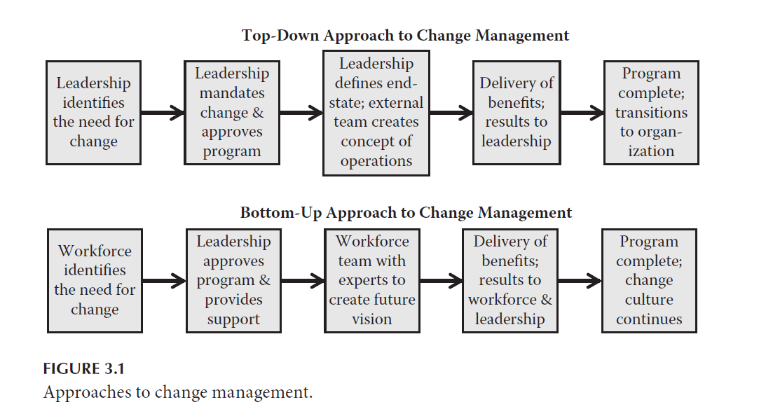
What is change management?
Chapter
03
What is Change Management ?

Slide 16
Chapter
03
Top ten reasons people are resistant to change
Resistance is a natural and unavoidable reaction to a change situation. There are many reasons why people resist change; most people are reluctant to leave the familiar behind. They are concerned about how they will get from the current state to the new improved state. According to de Jager (2001) resistance is simply a very effective, very powerful, very useful survival mechanism.

Slide 17
Chapter
03
Top ten reasons people are resistant to change
In this scenario, the top ten reasons for resistance to change as identified by Schuler (2003) can be anticipated:
1. The risk of change is seen as greater than the risk of standing still.
2. People feel connected to other people who are identified with the old way of working.
3. People have no role models for the new activity.
4. People fear they lack the competence to change.

Slide 18
Chapter
03
Top ten reasons people are resistant to change
5. People feel overloaded and overwhelmed.
6. People have a healthy skepticism and want to be sure the new ideas are sound.
7. People fear hidden agendas exist among would-be reformers.
8. People feel the proposed change threatens their notions of themselves.
9. People anticipate a loss of status or quality of life.
10. People genuinely believe that the proposed change is a bad idea.

Slide 19
Chapter
03
How to address change resistance and change
Now that the reasons for change resistance are better understood, how can they best be addressed? Lawson and Price (2003) identified four conditions for changing the mind-sets of employees. Independently, but during this same time period, an automotive supplier was implementing Six Sigma throughout the corporation to improve quality and create efficiencies. The project was successful and will demonstrate a practical application for the theoretical concepts.

Slide 20
Chapter
03
How to address change resistance and change
The first condition to altering an employee’s mind-set is to create “a purpose to believe in. The implication of this finding for an organization is that if its people believe in its overall purpose, they will be happy to change their individual behavior to serve that purpose—indeed, they will suffer from cognitive dissonance if they don’t” (Lawson and Price, 2003). In this situation, cognitive dissonance is a [mental] discomfort caused by holding conflicting cognitions (e.g., ideas, beliefs, values, and emotional reactions) simultaneously.

Slide 21
Chapter
03
How to address change resistance and change
The second condition for changing the mind-set of employees, as described by Lawson and Price (2003), is to ensure that the infrastructure, i.e., measurement systems, rewards and recognition programs, and operational processes, align with the desired behavior. B. F. Skinner’s theories of conditioning and positive reinforcement are used as the basis of this condition.

Slide 22
Chapter
03
How to address change resistance and change
the third condition for changing an employee’s mind-set is to provide employees the skills required to change. They make the case that it is unreasonable to expect adults to make relevant changes in behavior if they are not equipped with the skills needed. Lawson and Price (2003) reference David Kolb’s four-phase adult learning cycle to make the point that learning cannot occur merely by listening to instructions; “they must also absorb the new information, use it in experimentation, and integrate it with their existing knowledge.”

Slide 23

Chapter
03
How to address change resistance and change
The last condition for changing employee behavior, described by Lawson and Price (2003), is to provide role models—seeing people they respect performing the new behaviors that are desired by the organization. They believe that people model their behavior on “significant others”, other people they see in a position of influence. Role models can be at various levels of the organization and can deal with tasks differently, but the underlying values informing their behavior must be consistent. Additionally, role models should be associated with and supported by the groups that surrounded them, the groups with which people identify.

Slide 24
Program roles and responsibilities
Chapter
03
Program roles & responsibilities
Successful program managers of change understand that there are a number of players throughout the organization that must be actively engaged, fulfilling their specific role based on their unique relationship to change. Understanding the players and their roles will provide a better context for understanding the roles and responsibilities of the program manager. Each of the roles, presented in Figure 3.2 below, has a unique relationship to change, and thus has a unique role in change management.

Slide 25
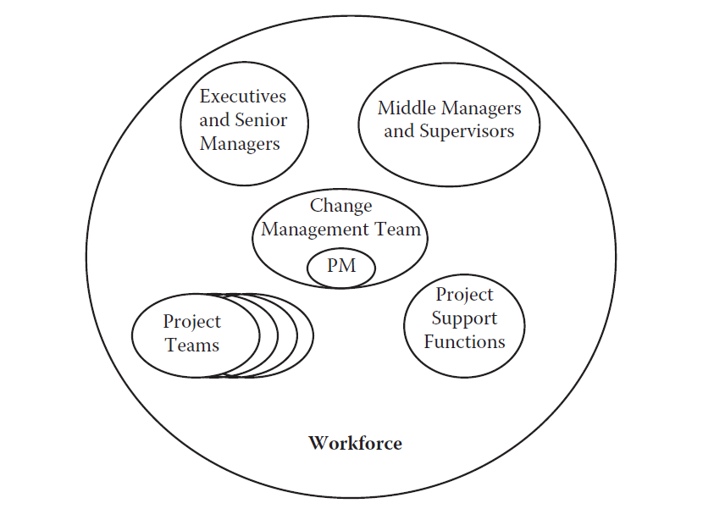
Program roles and responsibilities
Chapter
03
Program roles & responsibilities

Slide 26
Chapter
03
Program roles & responsibilities
1. Executives and Senior Managers: Leadership and support was one of the common themes cited as needed for success during the industry and government technical exchange meetings, discussed earlier in this chapter. Employees want to see and hear the executive’s commitment to the change. The authority they provide carries over to other change management roles. Specific responsibilities include:

Slide 27
Program roles and responsibilities
Chapter
03
Program roles & responsibilities
- Participate actively and visibly throughout the project—sponsors must be engaged in the project and seen by employees.
- Build a collaboration of sponsorship and manage resistance—the executives should create a collaborative environment for sponsors, managers, and leaders, who will make decisions and take the change back to their department, division, workgroup, program, etc. In more formal organizations, the executive sponsor may establish a steering committee, which meets periodically to discuss the progress and direction of the change effort.

Slide 28
Program roles and responsibilities
Chapter
03
Program roles & responsibilities
- Communicate directly with employees—employees want to hear the business reasons for the change from someone at the top; executives and senior managers are preferred senders of change messages.

Slide 29
Program roles and responsibilities
Chapter
03
Program roles & responsibilities
2. Middle Managers and Supervisors: Managers and supervisors are close to the action and the workforce—it is their people who must change how they do their jobs for the change to be successful. Whether a top-down or bottom-up approach is followed, managers and supervisors support their employees. The employees reflect the attitude and actions of a manager—whether the attitude is one of support or one of opposition. Responsibilities for this role are to be:

Slide 30
Program roles and responsibilities
Chapter
03
Program roles & responsibilities
• A Communicator—employees tend to believe messages about how the change directly impacts them and their team from the person who provides their day-to-day assignments.
• An Advocate—if the manager opposes the change, chances are that his or her people will as well—in many cases, the opposite is also true.

Slide 31
Program roles and responsibilities
Chapter
03
Program roles & responsibilities
• A Coach—helping employees through their own personal transitions is the essence of change coaching by middle managers and supervisors. It is a natural role of the supervisor regardless of whether it is a change program or something else.
• A Liaison—the role of liaison involves interacting with the project team, taking direction and providing input and feedback.
• A Resistance Manager—as the immediate supervisor is closest to the employee, he or she can provide the best intervention to mitigate resistance.

Slide 32
Program roles and responsibilities
Chapter
03
Program roles & responsibilities
3. Project Team(s): The project teams are tasked with managing the technical side of the change. They are responsible for producing the products, services, and/or results. The project teams ensure the overall goals, schedules, budget, and benefits of the program will be met. The project team also plays a role in ensuring that change management is part of the project. Responsibilities of this role are to:

Slide 33
Program roles and responsibilities
Chapter
03
Program roles & responsibilities
• Design the actual change—create the solution that ultimately impacts how people do their jobs.
• Manage the “technical side”—with tools such as the business case, schedule, resources, work breakdown structure, budget, etc.

Slide 34
Program roles and responsibilities
Chapter
03
Program roles & responsibilities
• Engage with the change management team—work with the change management team to ensure that the technical side and the people side of the change progress is in unison.
• Integrate the change management plans into the project plans—start change management at the beginning of the project and weave the change management strategy and plans into the technical side plans to create one seamless project plan.

Slide 35
Program roles and responsibilities
Chapter
03
Program roles & responsibilities
4. Project Support Functions: Project support functions bring expertise in a particular area—these groups include: Human Resources staff, Training Specialists, Communication Specialists, Subject Matter Experts, Solution Designers, etc. In some programs, these employees would design the future state vision (particularly if the program uses a bottom-up approach). At a minimum, these functions would provide the “as-is” documents. In general, their responsibilities are to provide:

Slide 36
Program roles and responsibilities
Chapter
03
Program roles & responsibilities
• Experience and expertise—project support functions bring experience from past changes, i.e., lessons learned and best practices that can be applied to the current change.
• Knowledge—each of these groups has specialized knowledge that can help the project team and the change management team.
• Tools—each of the areas may have specific tools that would support the change management activities.

Slide 37
Program roles and responsibilities
Chapter
03
Program roles & responsibilities
• Change Management Team: Having dedicated resources for change management was also on the list of the overall greatest contributors to success from the technical exchange meetings. There is a growing body of data that shows a correlation between the success of a change initiative and how well the people side was managed.

Slide 38
Program roles and responsibilities
Chapter
03
Program roles & responsibilities
The establishment of a Change Management Team/Program Management Office (PMO) is a critical signal to the organization that leadership is seeking significant changes and is willing to make the needed investment. Responsibilities of this role, in addition to the normal PMO responsibilities, are to:

Slide 39
Program roles and responsibilities
Chapter
03
Program roles & responsibilities
• Apply a structured change management methodology—instead of operating in an ad hoc manner, approach change management with purpose and intent, following a process, and using standard tools.
• Formulate strategy—evaluate how large the change is and who will be impacted to develop a customized strategy.

Slide 40
Program roles and responsibilities
Chapter
03
Program roles & responsibilities
• Develop plans—based on the strategy work, create a customized set of plans for moving people forward including a communication plan, a stakeholder management plan, a transformation roadmap, a training plan, and a resistance management plan.
• Support other roles—the change management team is the “focal point for change” and the go-to team for the other roles, particularly the executives, senior leaders, managers, and supervisors.

Slide 41
Program roles and responsibilities
Chapter
03
Program roles & responsibilities
5. Program Manager: The program manager is the leader of the Change Management Team/PMO. As such, he or she has a very challenging set of responsibilities and must wear a variety of hats, many at the same time. The importance of each role will vary depending what is happening in the program. The most critical roles for the program manager in this type of program are:

Slide 42
Program roles and responsibilities
Chapter
03
Program roles & responsibilities
• Strategist—every change initiative is different. The organizations are different. The imperative for change is different. The scope, cost, and schedule are different, etc. The program manager must take everything into consideration when creating a strategy. Additionally, it is almost a guaranteed that the parameters will change throughout the life of the program; therefore, the program manager should consider the strategy a living document that will be updated as required.

Slide 43
Program roles and responsibilities
Chapter
03
Program roles & responsibilities
• Communicator—because of the large number of stakeholders involved in the program, communications are key to the success of the program. It has not been stated that a program failed because there was too much messaging. However, it is important that the key messages are clear and consistent regardless of who is giving them. The program manager is responsible for creating the key messages and executing the communication plan.

Slide 44
Program roles and responsibilities
Chapter
03
Program roles & responsibilities
• Integrator—the program manager is the focal point for ensuring that all the moving parts fit together and are moving in the same direction. Unlike a typical IT program, the program manager also needs to ensure that the people side of the program aligns with the technical side of the program.

Slide 45
Program roles and responsibilities
Chapter
03
Program roles & responsibilities
• Overseer—as the program progresses, the program manager is responsible to provide a periodic program assessment to the executives and senior leadership team, the steering committee, and other key stakeholders. This assessment includes an update on program progress, the risks and mitigation plans, as well as, how the change is impacting the performance of the organization. Performance measures should include incremental value delivered, i.e., quick wins, such that buy-in is achieved and sustained by the stakeholders.

Slide 46
Chapter
03
Reference
Program Management: A Life Cycle Approach
by Ginger Levin, PMP, PgMP
Chapter 3

