Slide 1



Project Planning
Lecture 3
PMG202
Feasibility Study
Prepared by
Lec. Dina ElWakkad

Slide 2


.

Slide 3

Learning Outcomes
At the end of this chapter, students should be able to:
Design the framework for a sound project feasibility study.
Conduct a simple marketing feasibility study.
Determine the components of the technical feasibility study.
Conduct a financial analysis to determine the viability of the project.
Identify the scope of the project environmental impact study, project organization study, and legal study.
Illustrate the need to determine the project's impact on the national economy and society.
.

Slide 4
The project feasibility study
.

Slide 5
The project feasibility study - Definition
The Term “feasibility” is derived from “feasible”, which simply means capable of being done or accomplished.
.

Slide 6
The project feasibility study - Definition
The word “feasibility” means the expected benefit or return from the project.
  The return may be financial, which is the profit that will accrue to the owner of the project.
  The return may be social, which is the benefit that will accrue to society, such as satisfying the community’s need or employing a number of workers, as a solution to the problem of unemployment or meeting the needs of the local market for a specific good or service.
.

Slide 7
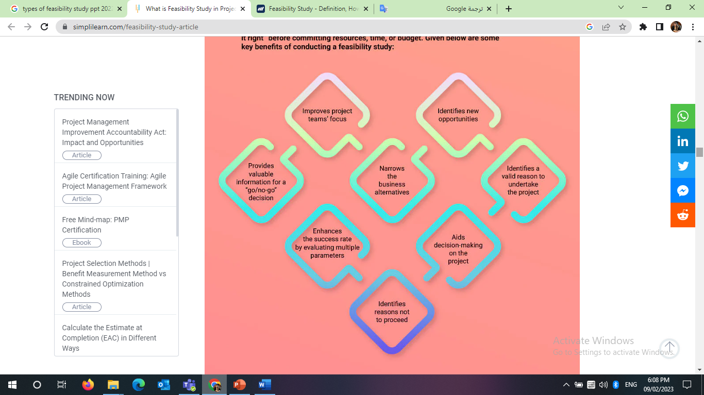
There are some key benefits of conducting a feasibility study:
.

Slide 8
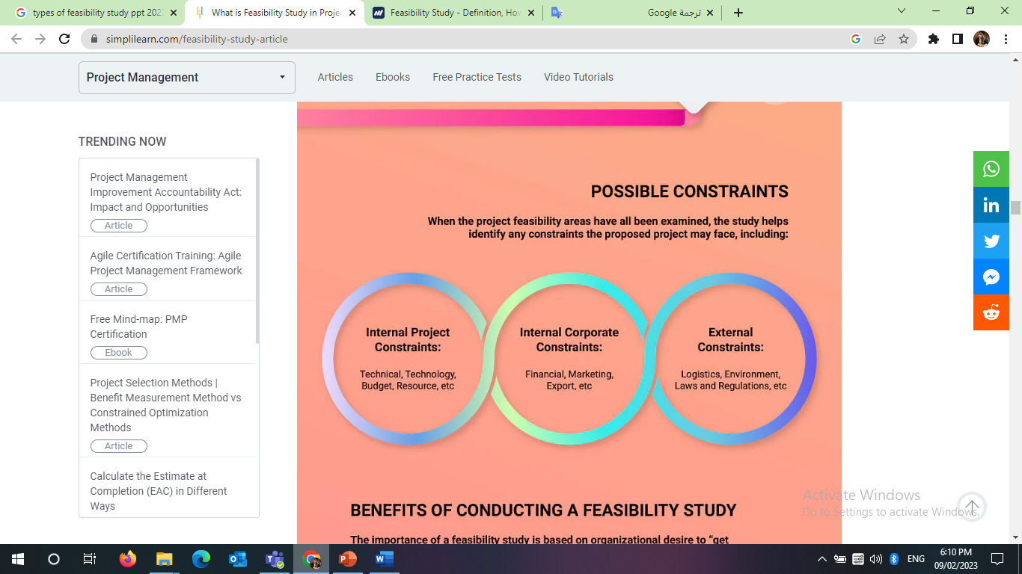
Possible Constrains
.

Slide 9
Data Sources for a Feasibility Assessment
Data required for a feasibility study can come from primary or secondary sources
  Primary data can include formal interviews and surveys
    Collection of primary data can be expensive and time consuming
    Ex: Focus groups, interviews, observation, Questionnaire
  Secondary data can include industry and trade publications, statistics of industry associations, and government agency reports, newspapers, magazines
.

Slide 10
Types of Feasibility (7 Types)
Feasibility study
Market Feasibility
Technical Feasibility
Financial Feasibility
legal Feasibility
Administrative Feasibility
Environmental Feasibility
Commercial profitability study
.

Slide 11
(1) Market Feasibility study
.

Slide 12
(1) Market Feasibility study
Market Feasibility study means to ascertain whether there is a need, demand, or gap in the market for the project idea as a product or service.
.

Slide 13
(1) Market Feasibility study
A market study needs to collect information that covers the following questions:
What is the volume of demand for the product to be studied?
What is the supply size of the product to be studied?
What is the expected gap in the market?
What are the methods of distributing the product to be studied in the current market?
What is the selling price of the product in the market?
What are the strengths and weaknesses of the product compared to competing products?
Are the required raw materials available or not? And what is the alternative?
Where is the site chosen for the establishment of the project?
Is this site equipped with the basic services for establishing the project?
Is the labor required for the project available?
.

Slide 14
(1) Market Feasibility study
This study means that the owner of the project or its manager should stand on the following factors.
The availability of the project's needs of raw materials and services
The appropriate quality of these needs
The appropriateness of the price
The appropriateness of the quantity
The appropriate timing for the supply of these requirements
What are the appropriate sources of supply.
.

Slide 15
(2) Technical Feasibility study
.

Slide 16
(2) Technical Feasibility study
After determining the quantity of the product for the market that we mentioned in the previous step, the technical study comes as a next step.
The technical study means knowing the extent to which the product (commodity / service) can be manufactured, the steps for its production and manufacturing, the equipment and machinery required for production, determining the required labor, the project area, and what are the sources of raw materials and their specifications.
.

Slide 17
(2) Technical Feasibility study
The technical study includes the following stages:
Determine the quantity/size of production capacity needed by the market
Determine the type of technical method for manufacturing production.
Determine the raw materials required for manufacturing and their cost according to the production capacity
Determine technological equipment and machines according to production and their cost, in addition to other equipment.
Determine the labor required for production (administrative - financial - marketing) and its cost.
.

Slide 18
(2) Technical Feasibility study
The technical study includes the following stages:
Determine the driving energy (electricity - gas - water) and its cost.
Determine the location of the project and its proximity to markets, means of transportation and transportation, and its proximity to the main facilities.
Determine the unit cost of the product + profit margin.
Is the project technically feasible?
.

Slide 19
(3) Financial Feasibility study
.

Slide 20
(3) Financial Feasibility study
This study aims to determine the size of the necessary and optimal financing for the project (self - loan).
This study requires collecting information related to estimating the costs of establishing and operating the project, how to obtain the necessary financing and its proper use, as well as its continuation for a reasonable period so that a return can be achieved.
.

Slide 21
(3) Financial Feasibility study
Fixed asset costs
buildings
working capital
Equipment and machines
lands
Supports 2-3 duty cycles.
Project for production.
The operating cycle is meant from the time of purchasing raw materials, manufacturing them, selling the product and collecting its price to buy raw materials again to start a second cycle.
Labor wages.
Establishment expenses
Feasibility study expenses.
License fees.
Training expenses.
Promotional and marketing expenses.
.

Slide 22
(4) Legal Feasibility study
.

Slide 23
(4) Legal Feasibility study
Legal Feasibility study aims to identify the legislation that governs investment in the project and its impact on the establishment of the project, production, export, contracting and pricing.
.

Slide 24
(4) Legal Feasibility study
In this study, the following are known:
Public laws and government regulations
Choose the legal form of the project
Import systems
Rules for the use of labor, if required
.

Slide 25
(5) Administrative Feasibility study
.

Slide 26
(5) Administrative Feasibility study
This study aims to determine the following:
❑ Determine the type of organizational structure for the project
❑ Designing the organizational structure of the project
❑ Determine work systems (places - procedures - methods)
❑ Job descriptions
❑ Appropriate employment as / in quality / at the right time
❑ Wage scales
.

Slide 27
(6) Environmental Feasibility study
.

Slide 28
(6) Environmental Feasibility study
This study aims to determine the following:
❑ Determine the impact of production in the new project or product on the environment.
❑ How to treat project waste and its impact on the environment.
❑Security and safety of project personnel
.

Slide 29
(7) Commercial Feasibility study
.

Slide 30
(7) Commercial Feasibility study
It aims to determine the profitability of the project and is considered one of the topics of utmost importance in the feasibility study of projects.
Through it, we know all the costs incurred by the project and all the returns it receives during the life of the project and compare the cost with the returns so that we can know the extent of the profitability of the project or not.
Taking into account the timing of all the costs incurred by the project and all the revenues it collects, so that the costs and revenues are calculated according to the present value concept (the real value).
.

Slide 31
Summary
The project feasibility study (definition, benefits, constraints, Data Sources, and types)
  Market Feasibility
  Technical Feasibility
  Financial Feasibility
  legal Feasibility
  Administrative Feasibility
  Environmental Feasibility
  Commercial profitability study
.

Slide 32

.

Slide 33
Questions
Which of the following is not the purpose of feasibility study? Establish market trends Provide quality information for decision making Give focus to the project and outline alternatives Specify business alterative
Which of the following is included in the composition of feasibility study? Financial feasibility study Demographic feasibility study Physical feasibility study Resources feasibility study
.

Slide 34
Questions
Which of the following is among aspects of technical feasibility study? Location Demand Security Instruction
________ is the process of determining whether a project idea is viable. Feasibility study Opportunity recognition Viability analysis Achievability analysis
.

Slide 35
Questions
________ feasibility study is a quick financial assessment of the viability of a project idea. Financial Organizational Institutional Product/service
"Measures whether the organization has or can obtain the hardware, software, and people needed to deliver and then support the proposed information system." The above statement describes one of the 4 feasibility assessments done by a System Analyst. what is the feasibility assessment about? Technical feasibility Financial feasibility Economic feasibility Operational feasibility
.

Slide 36
Questions
Talking to industry experts, obtaining feedback from prospective customers, and administering surveys are examples of ________ research. primary secondary derivative fundamental
Trade journals, industry-related publications, government statistics, and competitors' Web sites are examples of ________ research. secondary primary derivative fundamental
.

Slide 37
Questions
What is an example of secondary research? Newspaper Focus Group Observation Questionnaire
What is an example of primary research? Observation Magazine Newspaper Government statistics
.

Slide 38
Questions
Public laws and government regulations are part of----- Legal feasibility Technical feasibility Financial feasibility Economic feasibility
Designing the organizational structure of the project is part of----- Administrative feasibility Technical feasibility Financial feasibility Economic feasibility
.

Slide 39
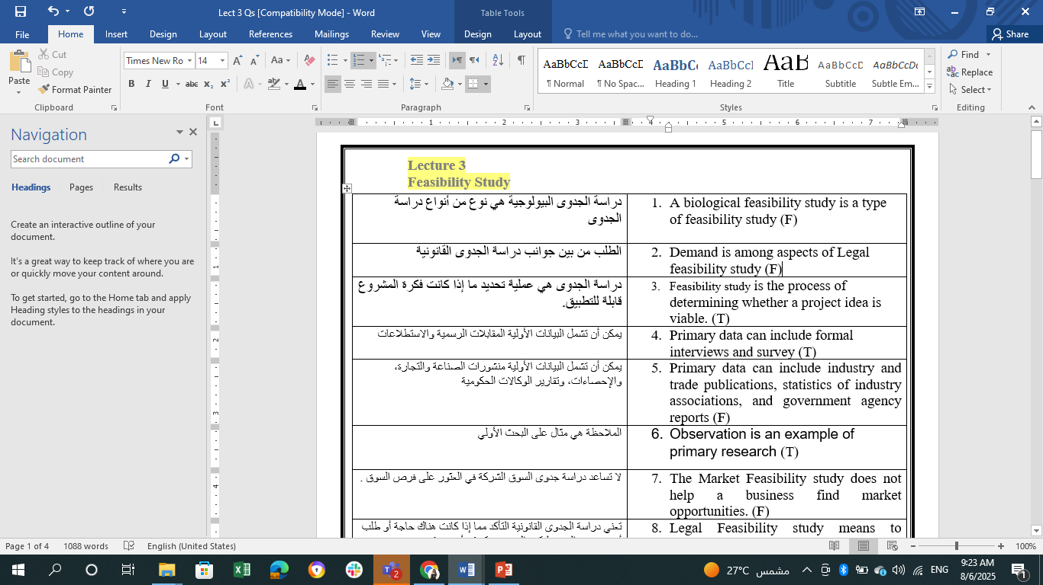
Questions
.

Slide 40

Questions
.

Slide 41
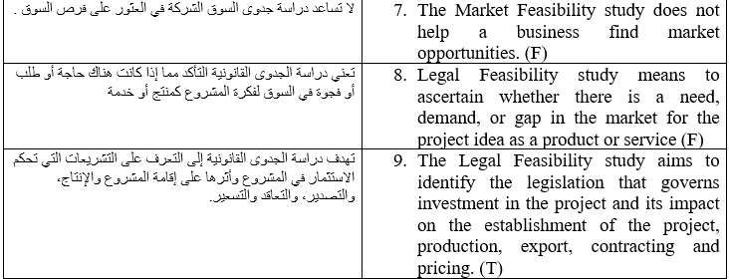
Questions
.

Slide 42
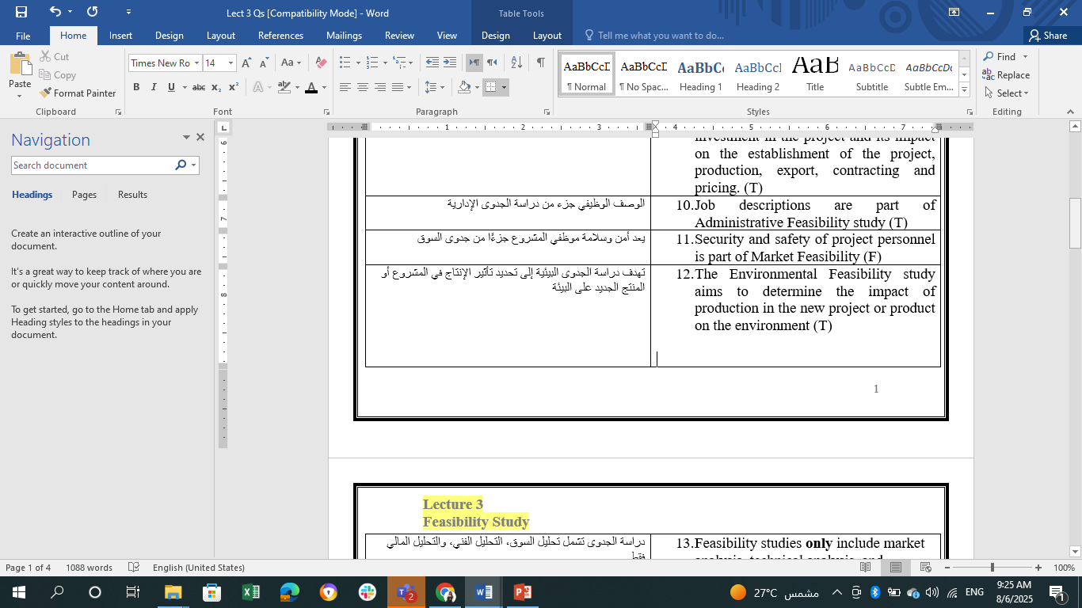
Questions
.

Slide 43
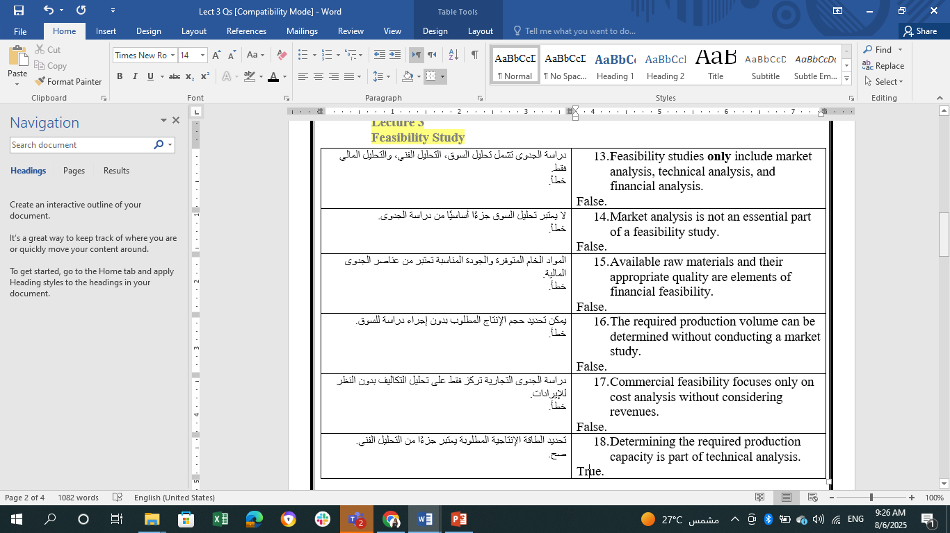
Questions
.

Slide 44
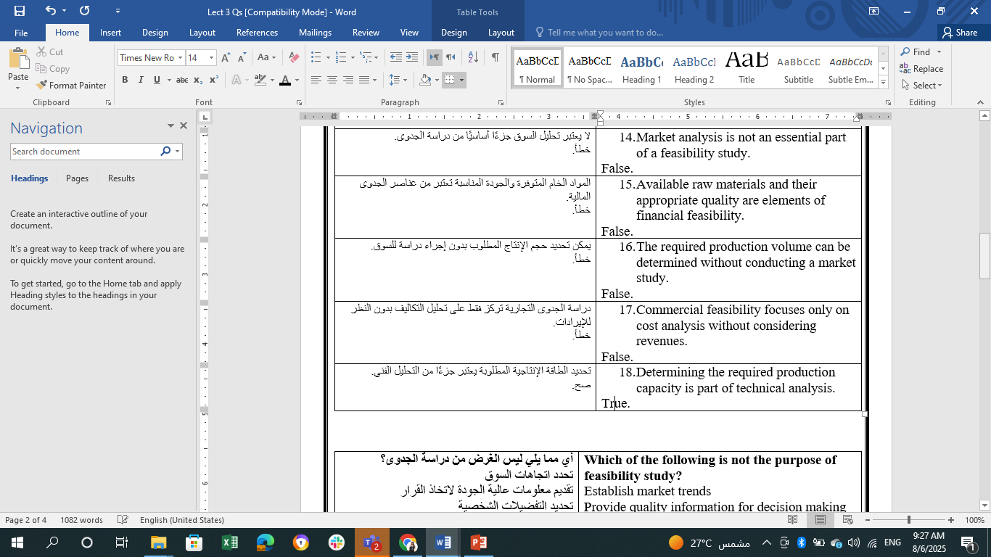
Questions
.

Slide 45


Thank You

