Slide 1



Deep Learning & Neural Networks
Dr. Shahira Ahmed
DS710
Lecture 4

Slide 2


Slide 3
Lecture Outline
Single Layer Perceptron : Review
Perceptron Learning algorithm
Perceptron Learning algorithm: Example

Slide 4
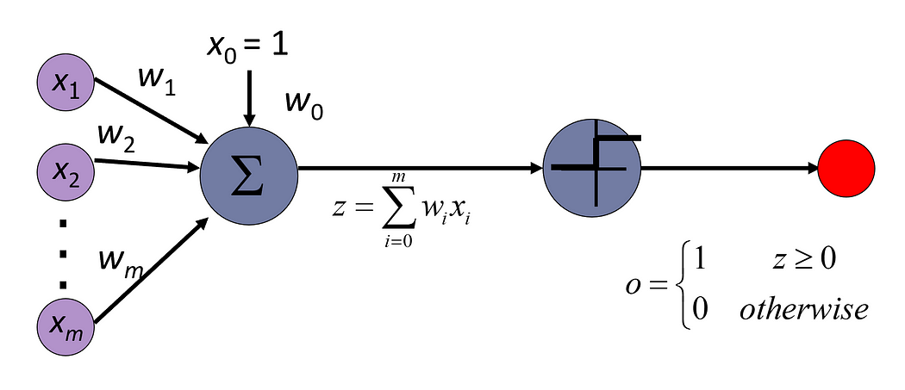
Single Layer Perceptron : Review

Slide 5
Limitation of Perceptron
A perceptron model’s output can only be a binary number i.e. “0” or “1” because of activation function. ➔Classification
The perceptron model can only be used to categorize the input vectors’ linearly separable sets. If input vectors are non-linear, they can’t be properly classified.

Slide 6
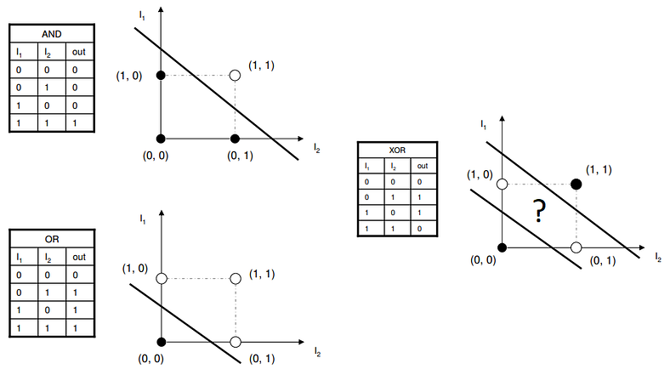
Limitation of Perceptron

Slide 7

Option 1: Construct by hand
0,1
-1,0
1,0
0,-1
Given a function, handcraft a network to satisfy it
E.g.: Build an MLP to classify this decision boundary
https://deeplearning.cs.cmu.edu/S23/

Slide 8














Option 1: Construct by hand
1
X₂
1
1
-1
0,1
-1
-1
X₁
X₂
X₁
X₂
-1,0
1,0
X₁
1
1
1
1
0,-1
-1
1
X₁
X₂
-4
X₁
X₂
1
1
1
1
1
₁ -1
1
1
-1
1
1
-1
-1
1
1
https://deeplearning.cs.cmu.edu/S23/
https://deeplearning.cs.cmu.edu/S23/
Assuming simple perceptrons:
output = 1 if
X₁
X₂
19
i i i i

Slide 9




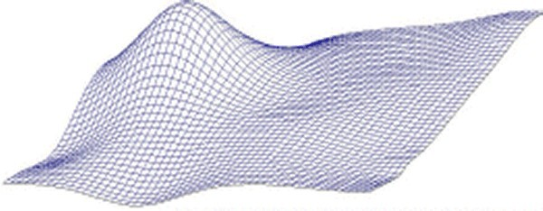








Option 2: Automatic estimation
More generally, given the function to model, we can derive the parameters of the network to model it, through computation
https://deeplearning.\cs.cmu.edu/S23/
https://deeplearning.\cs.cmu.edu/S23/
21

Slide 10
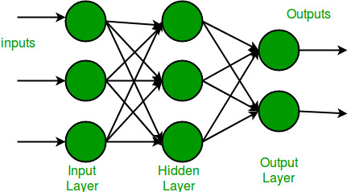
How to learn a network?
What is the purpose of learning in a multi-layer perceptron (MLP)?
  To train the model and adjust its weights and biases

Slide 11
How to learn a network?
The input layer is the first layer of the neural network and its purpose is to receive and process the input data. The input layer receives data in the form of vectors (arrays of numbers) and typically includes one node (neuron) for each feature in the input data
The output layer is the last layer of the neural network and its purpose is to produce the network's prediction or output.

Slide 12
How to learn a network?
  Hidden layers
  learn complex representations
  Hidden layers allow for the function of a neural network to be broken down into specific transformations of the data.
  Each hidden layer function is specialized to produce a defined output.
  a hidden layer functions that are used to identify human eyes and ears may be used in conjunction with subsequent layers to identify faces in images. While the functions to identify eyes alone are not enough to independently recognize objects, they can function jointly within a neural network.

Slide 13

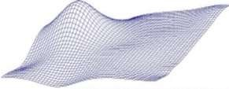

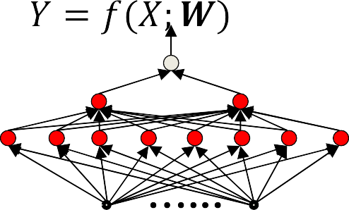



How to learn a network?
Actual shape depends on
Solution: Estimate parameters to minimize the error between the target function and the network function
– Find the parameter that minimizes the shaded area
https://deeplearning.\cs.cmu.edu/S23/
22

Slide 14





How to learn a network?
The shaded area
The optimal
https://deeplearning.\cs.cmu.edu/S23/
23

Slide 15

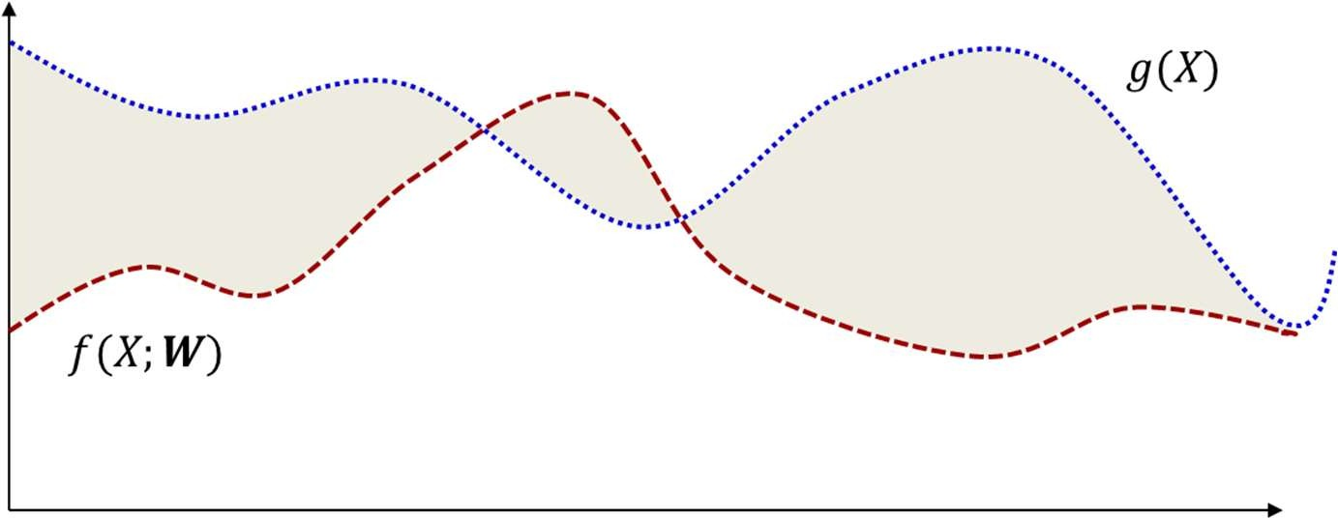
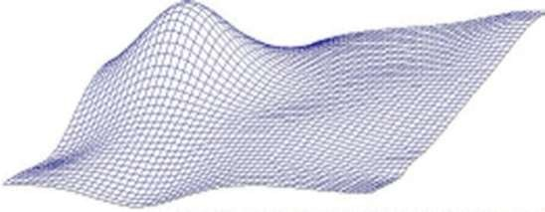




Problem:
is unknown
Function
must be fully specified in order to compute
– Known everywhere, i.e. for every input
In practice we will not have such specification
https://deeplearning.\cs.cmu.edu/S23/
24

Slide 16
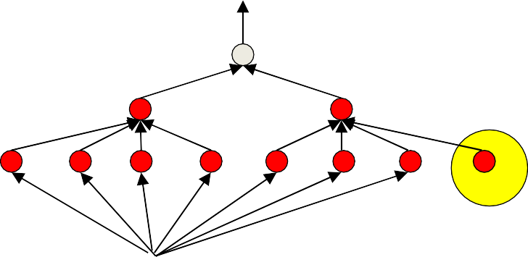
History: The original MLP
1
. 3
1
i i
i
2
2
3
+
.
N
N
The original MLP as proposed by Rosenblatt/Minsky: a network of threshold units
  But how do you train it?
    Given only “training” instances of input-output pairs
34

Slide 17
Drawing samples
d_{i}
X_{i}
We must learn the entire function from these few examples
– The “training” samples
26

Slide 18
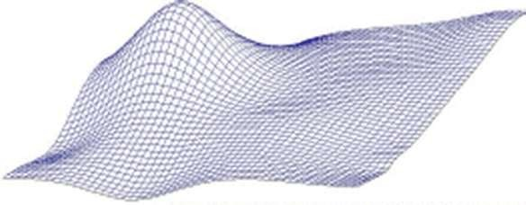
Sampling the function
output
X_{i}
Sample – Basically, get input-output pairs for a number of samples of input
Many samples input + output
Very easy to do in most problems: just gather training data
              E.g. set of images and their class labels –
              E.g. speech recordings and their transcription
25

Slide 19








The Empirical error(Training Error)
1
𝑓(𝑋₃; 𝑊)
2
5
4
𝑓(𝑋₂; 𝑊)
𝑓(𝑋₁; 𝑊)
3
𝑓(𝑋₄; 𝑊)
𝑓(𝑋₅; 𝑊)
1 2 3 4 5
The empirical estimate of the error is the average error over the training samples
N
i i
i=1
Estimate network parameters to minimize this average error instead
https://deeplearning./cs.cmu.edu/S23/
W
27

Slide 20
Learning the function from training samples
Find the network parameters that “fit” the training points exactly
hopefully the resulting function is also correct where we don’t have training samples

Slide 21
Learning the function from training samples
Find the network parameters that “fit” the training points exactly
hopefully the resulting function is also correct where we don’t have training samples
This Phase is called the training Phase
The aim of the training phase is to minimize empirical error(Training Error).
The test phase: model use new data.

Slide 22
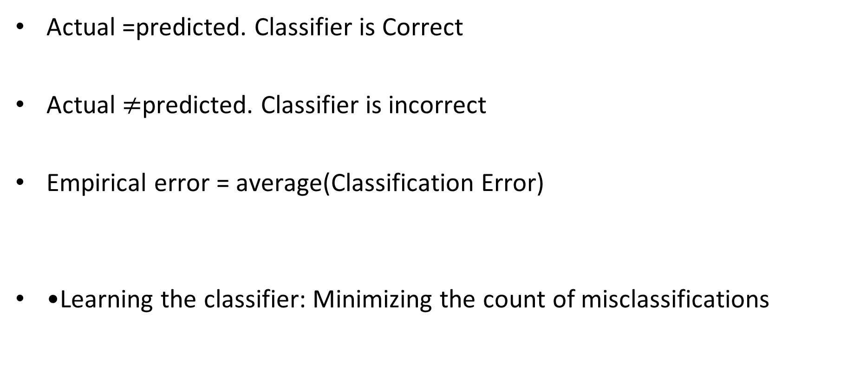
The Empirical Classification error
Actual =predicted. Classifier is Correct
Actual $≠$predicted. Classifier is incorrect
Empirical error = average(Classification Error)
•Learning the classifier: Minimizing the count of misclassifications

Slide 23
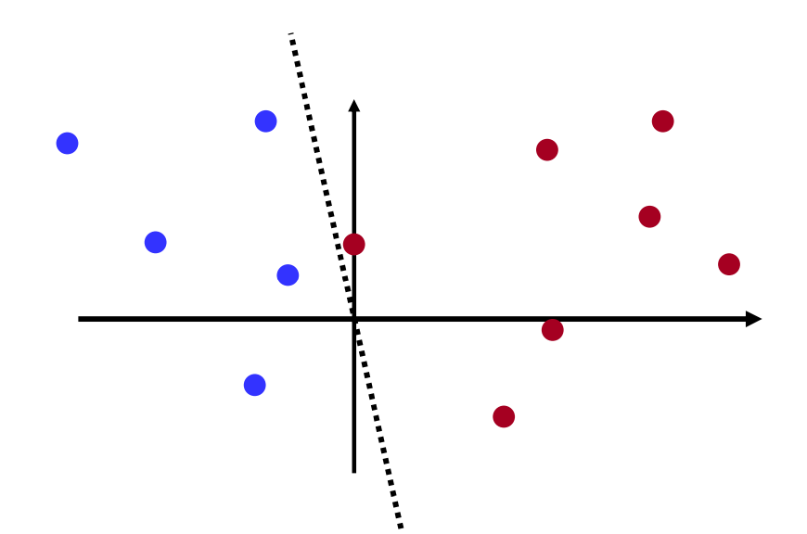
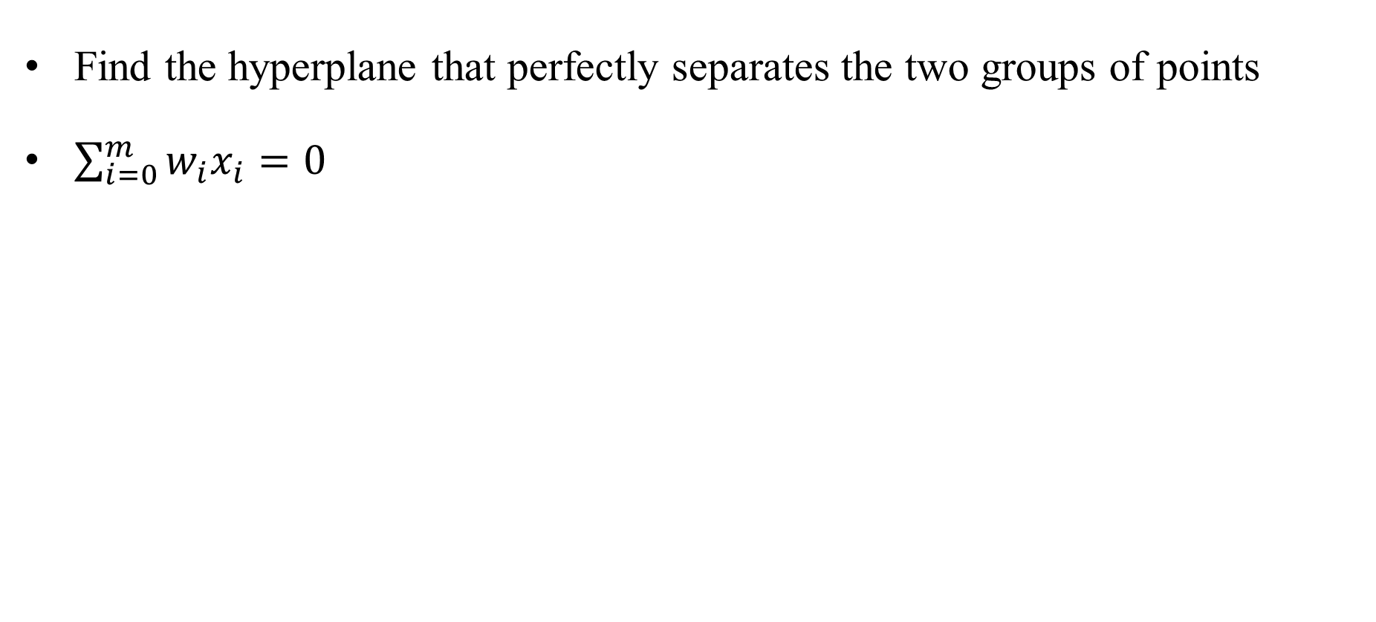
The Original Perceptron Problem
Find the hyperplane that perfectly separates the two groups of points
$\sum_{i=0}^{m}{w_{i}x_{i}}=0$
https://deeplearning.cs.cmu.edu/S23/

Slide 24
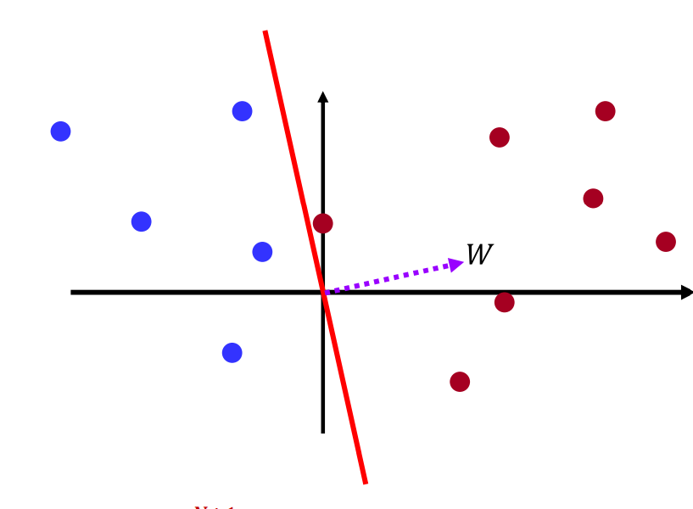
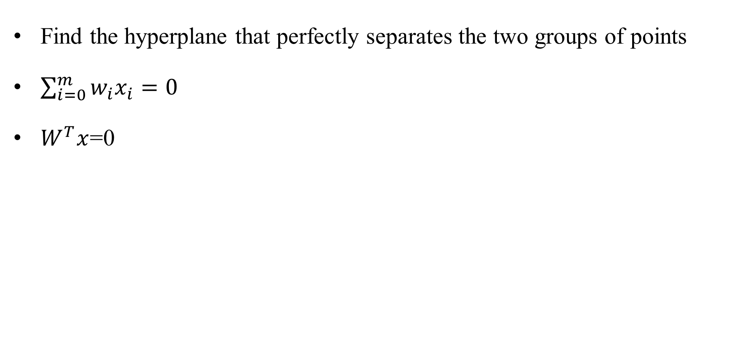
The Original Perceptron Problem
Find the hyperplane that perfectly separates the two groups of points
$\sum_{i=0}^{m}{w_{i}x_{i}}=0$
$W^{T}x$=0
https://deeplearning.cs.cmu.edu/S23/

Slide 25
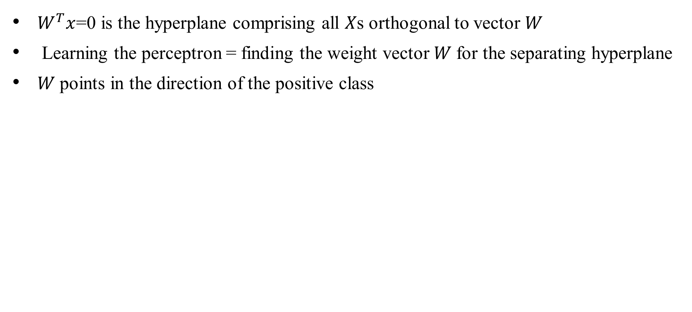
The Original Perceptron Problem
$W^{T}x$=0 is the hyperplane comprising all 𝑋s orthogonal to vector 𝑊
Learning the perceptron = finding the weight vector 𝑊 for the separating hyperplane
𝑊 points in the direction of the positive class
https://deeplearning.cs.cmu.edu/S23/

Slide 26
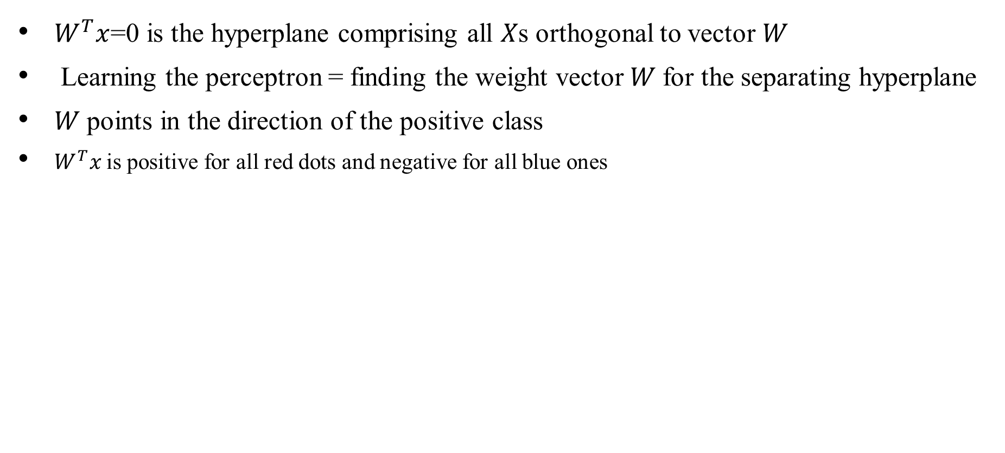
The Original Perceptron Problem
$W^{T}x$=0 is the hyperplane comprising all 𝑋s orthogonal to vector 𝑊
Learning the perceptron = finding the weight vector 𝑊 for the separating hyperplane
𝑊 points in the direction of the positive class
$W^{T}x$is positive for all red dots and negative for all blue ones
https://deeplearning.cs.cmu.edu/S23/

Slide 27
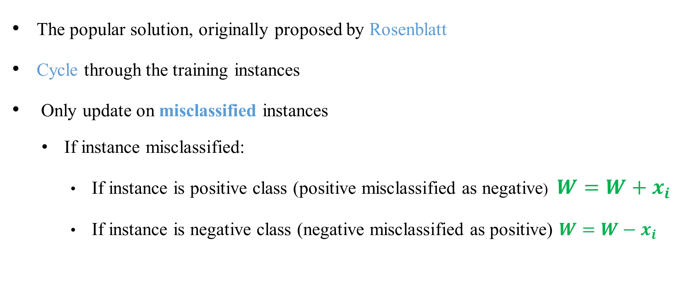
The Original Perceptron Problem
The popular solution, originally proposed by Rosenblatt
Cycle through the training instances
Only update on misclassified instances
  If instance misclassified:
    If instance is positive class (positive misclassified as negative) $W=W+x_{i}$
    If instance is negative class (negative misclassified as positive) $W=W−x_{i}$
https://deeplearning.cs.cmu.edu/S23/

Slide 28
The Original Perceptron Problem
The popular solution, originally proposed by Rosenblatt
Cycle through the training instances
Only update on misclassified instances
  If instance misclassified:
    If instance is positive class (positive misclassified as negative) $W=W+x_{i}$
    If instance is negative class (negative misclassified as positive) $W=W−x_{i}$
https://deeplearning.cs.cmu.edu/S23/

Slide 29
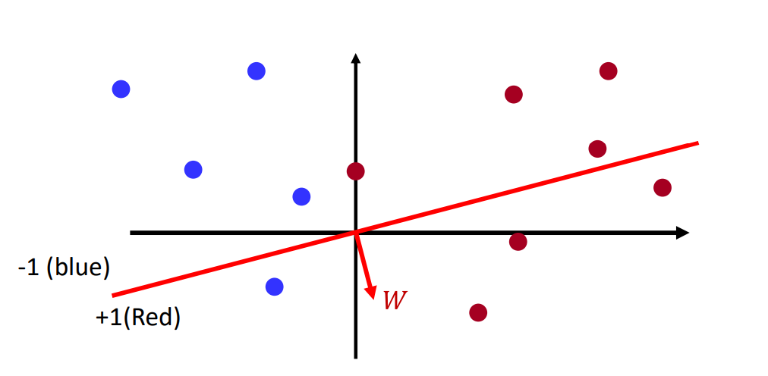
The Original Perceptron Problem
Initialize: Randomly initialize the hyperplane (Randomly choose values for W)
Classification rule
  Vectors on the same side of the hyperplane as will be assigned +1 class
  Vectors on the other side will be assigned -1
The random initial plane will make mistakes
https://deeplearning.cs.cmu.edu/S23/

Slide 30
The Original Perceptron Problem
Initialize: Randomly initialize the hyperplane (Randomly choose values for W)
Classification rule
  Vectors on the same side of the hyperplane as will be assigned +1 class
  Vectors on the other side will be assigned -1
The random initial plane will make mistakes
https://deeplearning.cs.cmu.edu/S23/

Slide 31
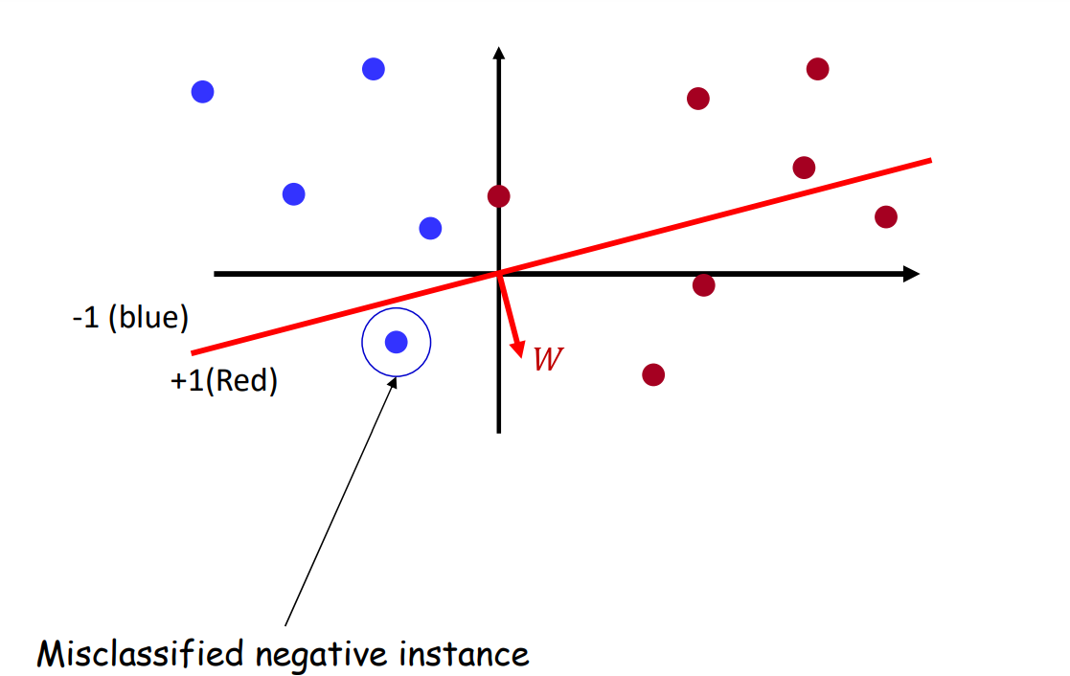
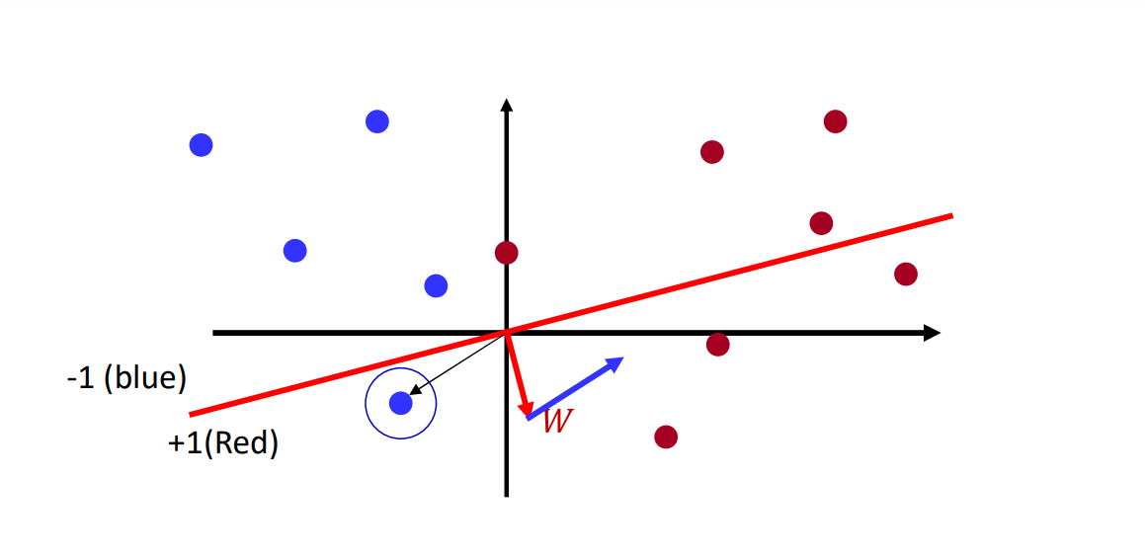
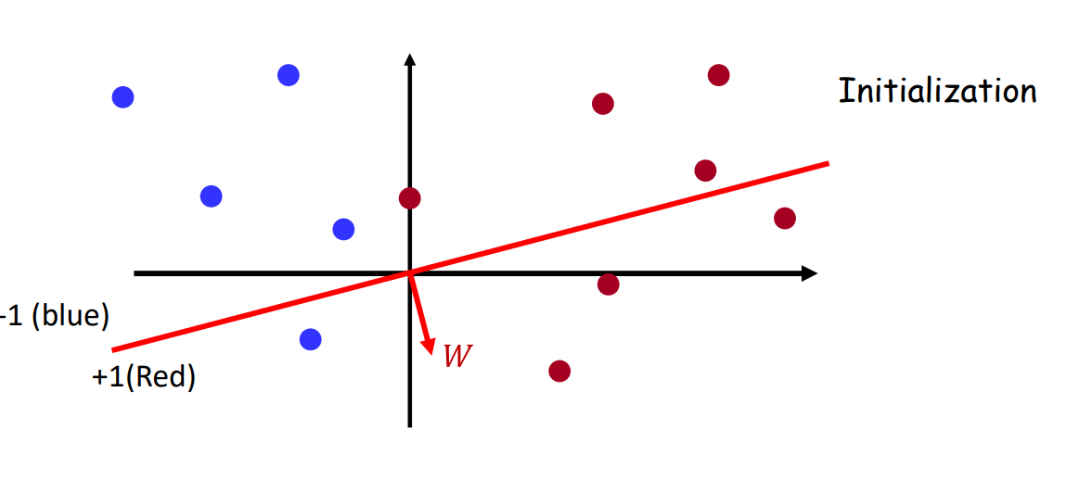
The Original Perceptron Problem
https://deeplearning.cs.cmu.edu/S23/

Slide 32
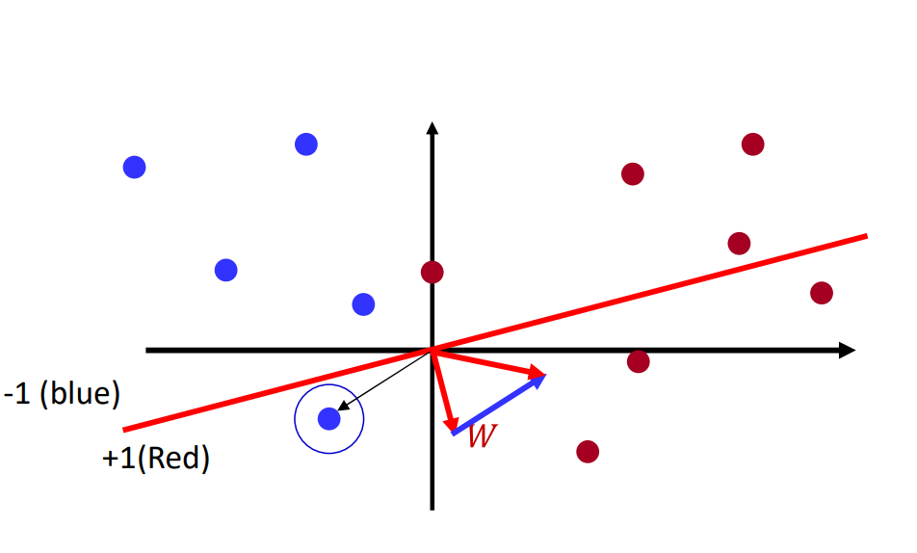
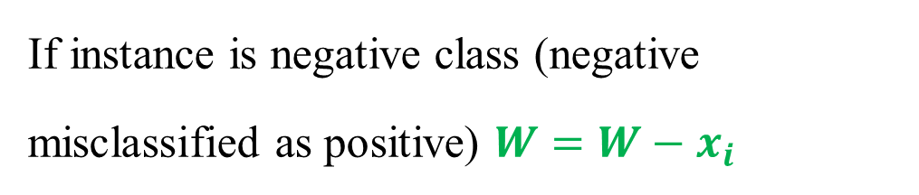
The Original Perceptron Problem
    If instance is negative class (negative misclassified as positive) $W=W−x_{i}$
https://deeplearning.cs.cmu.edu/S23/

Slide 33
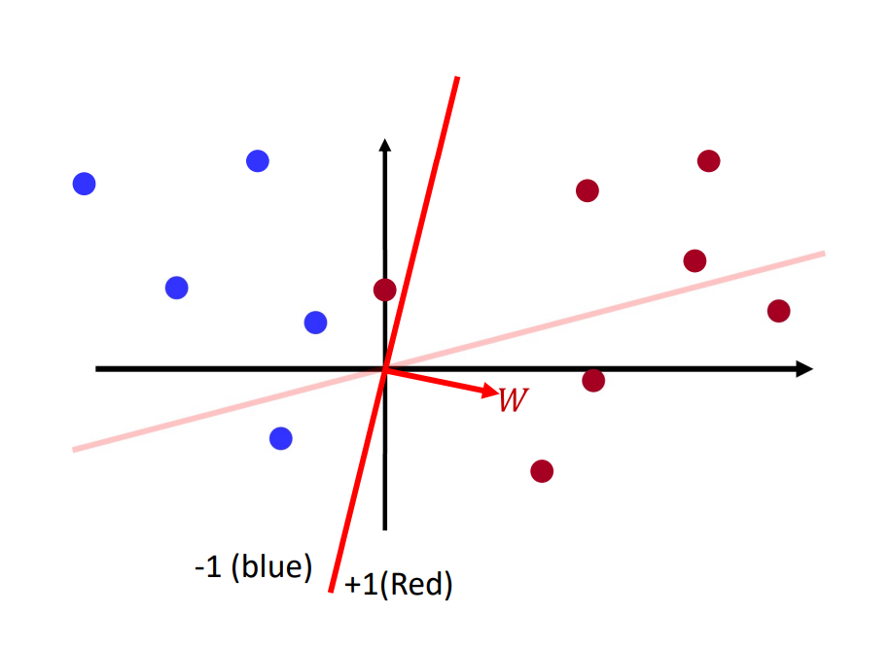
The Original Perceptron Problem
https://deeplearning.cs.cmu.edu/S23/

Slide 34
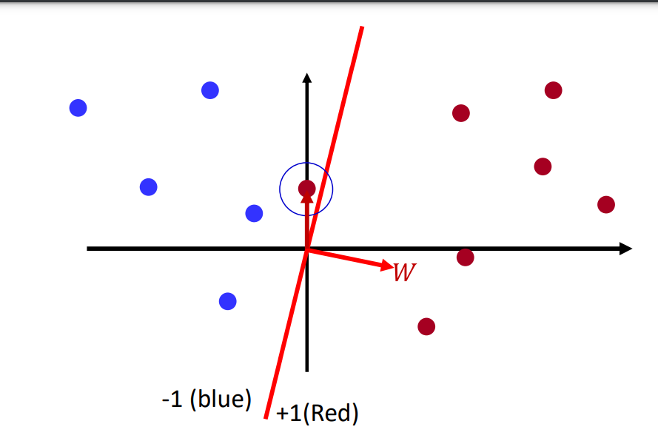
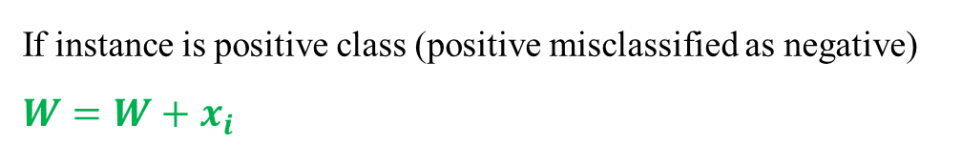
The Original Perceptron Problem
Misclassified positive instance
    If instance is positive class (positive misclassified as negative) $W=W+x_{i}$
https://deeplearning.cs.cmu.edu/S23/

Slide 35
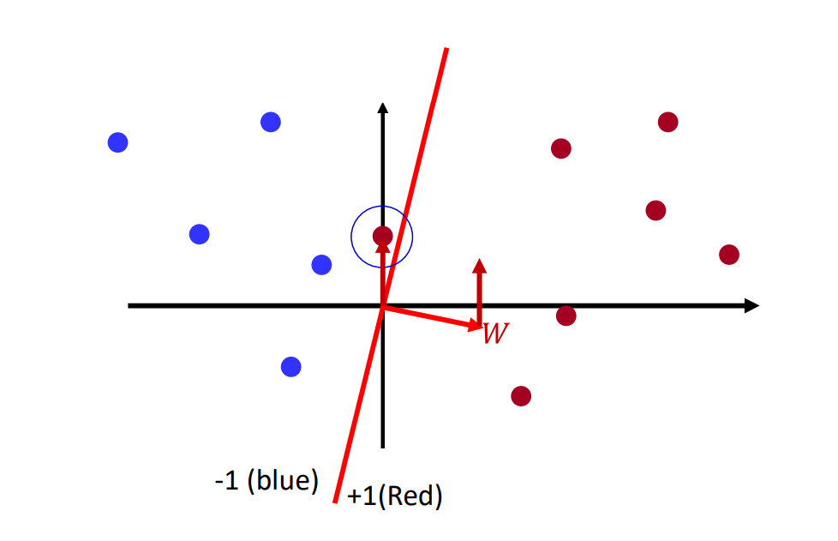
The Original Perceptron Problem
Misclassified positive instance
    If instance is positive class (positive misclassified as negative) $W=W+x_{i}$
Misclassified positive instance, add it to W
https://deeplearning.cs.cmu.edu/S23/

Slide 36
The Original Perceptron Problem
Misclassified positive instance
    If instance is positive class (positive misclassified as negative) $W=W+x_{i}$
Misclassified positive instance, add it to W
https://deeplearning.cs.cmu.edu/S23/

Slide 37
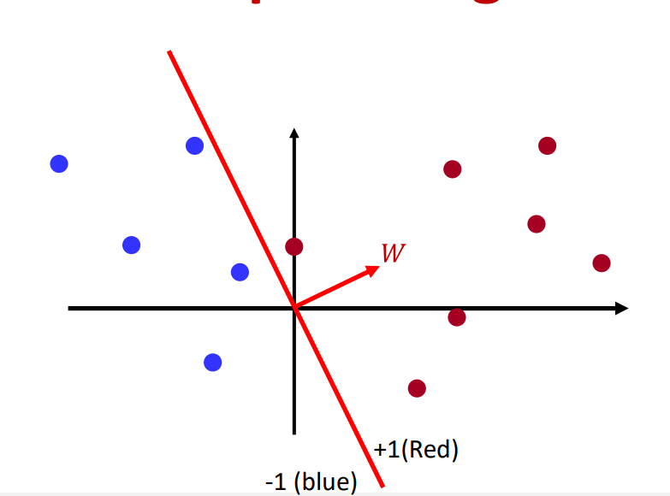
The Original Perceptron Problem
The new decision boundary Perfect classification, no more updates, we are done.
All points are correctly classified.
If the classes are linearly separable, guaranteed to converge in a finite number of steps
https://deeplearning.cs.cmu.edu/S23/

Slide 38
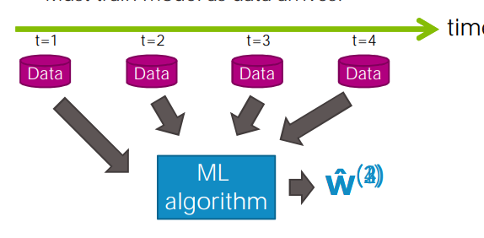
Batch vs online learning
The perceptron algorithm is an online learning, which means→It can update its weights after each training example

Slide 39
Perceptron Learning: Simple Example
Input : Set of examples, each example is a pair an input vector and a label (0 or 1).
Initialize weights randomly
Cycle (repeatedly) through examples and for each example do:
  – If perceptron is 0 while it should be 1,
    add the input vector to the weight vector
  – If perceptron is 1 while it should be 0,
    subtract the input vector to the weight vector
  – Otherwise do nothing.
https://www.cs.cornell.edu/courses/cs4700/2016fa/slides/CS4700-NN-part_1_cpg_v2.pdf

Slide 40
Perceptron Learning: Simple Example
Our examples are:
https://www.cs.cornell.edu/courses/cs4700/2016fa/slides/CS4700-NN-part_1_cpg_v2.pdf

Slide 41
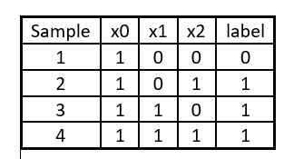
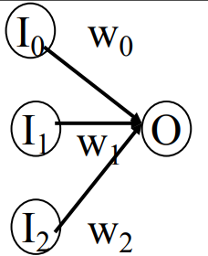
Perceptron Learning: Simple Example
use a single perceptron with three inputs.
start with all weights randomly
  (we use 0 for simple calculation)→[0 0 0]
Example 1 x= [1 0 0] label=0
  Perceptron (1*0+ 0*0+ 0*0 =0, Class=0) output 0
  correct classification, do nothing
Example 2 x= [1 0 0] label=1
  Perceptron (1*0+ 0*0+ 1*0 = 0) output 0
  classifies it as 0, while it should be 1,
  add input to weights W =[0 0 0] +[1 0 1] = [1 0 1]
https://www.cs.cornell.edu/courses/cs4700/2016fa/slides/CS4700-NN-part_1_cpg_v2.pdf

Slide 42
Perceptron Learning: Simple Example
use a single perceptron with three inputs.
W=[1 0 1]
Example 3 x= [1 1 0] label=1
  Perceptron (1*1+ 1*0+ 0*1 =1, Class=1) output 1
  correct classification, do nothing
Example 4 x= [1 1 1] label=1
  Perceptron (1*1+ 1*0+ 1*1 = 1,Class=1) output 1
  Correct classification, do nothing
https://www.cs.cornell.edu/courses/cs4700/2016fa/slides/CS4700-NN-part_1_cpg_v2.pdf

Slide 43
Perceptron Learning: Simple Example
Epoch 2:
W=[1 0 1]
Example 1 x= [1 0 0] label=0
  Perceptron (1*0+ 0*0+ 0*1 =1, Class=0) output 1
  classifies it as 1, while it should be 0
  subtract input from weights = [1 0 1]-[1 0 0]=[0 0 1]
Example 2 x= [1 0 1] label=1
  Perceptron (1*0+ 0*0+ 1*1 > 0,class=1) output 1
  do noting
https://www.cs.cornell.edu/courses/cs4700/2016fa/slides/CS4700-NN-part_1_cpg_v2.pdf

Slide 44
Perceptron Learning: Simple Example
Epoch=2
W=[0 0 1]
Example 3 x= [1 1 0] label=1
  Perceptron (1*0+ 1*0+ 0*1 =0, Class=1) output 0
  Add to weight=[0 0 1]+[1 1 0]=[1 1 1]
Example 4 x= [1 1 1] label=1
  Perceptron (1*1+ 1*1+ 1*1 = 1,Class=1) output 1
  Correct classification, do nothing
https://www.cs.cornell.edu/courses/cs4700/2016fa/slides/CS4700-NN-part_1_cpg_v2.pdf

Slide 45
Perceptron Learning: Simple Example
Epoch 3:
W=[1 1 1]
Example 1 x= [1 0 0] label=0
  Perceptron (1*1+ 0*1+ 0*1 =1, Class=0) output 1
  classifies it as 1, while it should be 0
  subtract input from weights = [1 1 1]-[1 0 0]=[0 1 1]
Example 2 x= [1 0 1] label=1
  Perceptron (1*0+ 0*1+ 1*1 > 0,class=1) output 1
  do noting
https://www.cs.cornell.edu/courses/cs4700/2016fa/slides/CS4700-NN-part_1_cpg_v2.pdf

Slide 46
Perceptron Learning: Simple Example
Epoch=3
W=[0 1 1]
Example 3 x= [1 1 0] label=1
  Perceptron (1*0+ 1*1+ 0*1 >=0, Class=1) output 1
  Correct classification, do nothing
Example 4 x= [1 1 1] label=1
  Perceptron (1*0+ 1*1+ 1*1 = 1,Class=1) output 1
  Correct classification, do nothing
https://www.cs.cornell.edu/courses/cs4700/2016fa/slides/CS4700-NN-part_1_cpg_v2.pdf

Slide 47
Perceptron Learning: Simple Example
Epoch 4:
W=[0 1 1]
Example 1 x= [1 0 0] label=0
  Perceptron (0*1+ 0*1+ 0*1 =1, Class=0) output 1
  do noting
https://www.cs.cornell.edu/courses/cs4700/2016fa/slides/CS4700-NN-part_1_cpg_v2.pdf

Slide 48
Epoch | x0 | x1 | x2 | Desired Target | w0 | w1 | w2 | Output | Error | New w0 | New w1 | New w2
1 example 1 | 1 | 0 | 0 | 0 | 0 | 0 | 0 | 0 | 0 | 0 | 0 | 0
1 0 1 1 0 0 0 0 1 1 0 1
1 1 0 1 1 0 1 1 0 1 0 1
1 1 1 1 1 0 1 1 0 1 0 1
2 1 0 0 0 1 0 1 1 -1 0 0 1
1 0 1 1 0 0 1 1 0 0 0 1
1 1 0 1 0 0 1 0 1 1 1 1
1 1 1 1 1 1 1 1 0 1 1 1
3 1 0 0 0 1 1 1 1 -1 0 1 1
1 0 1 1 0 1 1 1 0 0 1 1
1 1 0 1 0 1 1 1 0 0 1 1
1 1 1 1 0 1 1 1 0 0 1 1
4 1 0 0 0 0 1 1 0 0 0 1 1

Slide 49
Epoch | x0 | x1 | x2 | Desired Target | w0 | w1 | w2 | Output | Error | New w0 | New w1 | New w2
1 example 1 | 1 | 0 | 0 | 0 | 0 | 0 | 0 | 0 | 0 | 0 | 0 | 0
example 2 | 1 | 0 | 1 | 1 | 0 | 0 | 0 | 0 | 1 | 1 | 0 | 1
1 1 0 1 1 0 1 1 0 1 0 1
1 1 1 1 1 0 1 1 0 1 0 1
2 1 0 0 0 1 0 1 1 -1 0 0 1
1 0 1 1 0 0 1 1 0 0 0 1
1 1 0 1 0 0 1 0 1 1 1 1
1 1 1 1 1 1 1 1 0 1 1 1
3 1 0 0 0 1 1 1 1 -1 0 1 1
1 0 1 1 0 1 1 1 0 0 1 1
1 1 0 1 0 1 1 1 0 0 1 1
1 1 1 1 0 1 1 1 0 0 1 1
4 1 0 0 0 0 1 1 0 0 0 1 1

Slide 50
Epoch | x0 | x1 | x2 | Desired Target | w0 | w1 | w2 | Output | Error | New w0 | New w1 | New w2
1 example 1 | 1 | 0 | 0 | 0 | 0 | 0 | 0 | 0 | 0 | 0 | 0 | 0
example 2 | 1 | 0 | 1 | 1 | 0 | 0 | 0 | 0 | 1 | 1 | 0 | 1
example 3 | 1 | 1 | 0 | 1 | 1 | 0 | 1 | 1 | 0 | 1 | 0 | 1
1 1 1 1 1 0 1 1 0 1 0 1
2 1 0 0 0 1 0 1 1 -1 0 0 1
1 0 1 1 0 0 1 1 0 0 0 1
1 1 0 1 0 0 1 0 1 1 1 1
1 1 1 1 1 1 1 1 0 1 1 1
3 1 0 0 0 1 1 1 1 -1 0 1 1
1 0 1 1 0 1 1 1 0 0 1 1
1 1 0 1 0 1 1 1 0 0 1 1
1 1 1 1 0 1 1 1 0 0 1 1
4 1 0 0 0 0 1 1 0 0 0 1 1

Slide 51
Epoch | x0 | x1 | x2 | Desired Target | w0 | w1 | w2 | Output | Error | New w0 | New w1 | New w2
1 example 1 | 1 | 0 | 0 | 0 | 0 | 0 | 0 | 0 | 0 | 0 | 0 | 0
example 2 | 1 | 0 | 1 | 1 | 0 | 0 | 0 | 0 | 1 | 1 | 0 | 1
example 3 | 1 | 1 | 0 | 1 | 1 | 0 | 1 | 1 | 0 | 1 | 0 | 1
example 4 | 1 | 1 | 1 | 1 | 1 | 0 | 1 | 1 | 0 | 1 | 0 | 1
2 1 0 0 0 1 0 1 1 -1 0 0 1
1 0 1 1 0 0 1 1 0 0 0 1
1 1 0 1 0 0 1 0 1 1 1 1
1 1 1 1 1 1 1 1 0 1 1 1
3 1 0 0 0 1 1 1 1 -1 0 1 1
1 0 1 1 0 1 1 1 0 0 1 1
1 1 0 1 0 1 1 1 0 0 1 1
1 1 1 1 0 1 1 1 0 0 1 1
4 1 0 0 0 0 1 1 0 0 0 1 1

Slide 52
Epoch | x0 | x1 | x2 | Desired Target | w0 | w1 | w2 | Output | Error | New w0 | New w1 | New w2
1 example 1 | 1 | 0 | 0 | 0 | 0 | 0 | 0 | 0 | 0 | 0 | 0 | 0
example 2 | 1 | 0 | 1 | 1 | 0 | 0 | 0 | 0 | 1 | 1 | 0 | 1
example 3 | 1 | 1 | 0 | 1 | 1 | 0 | 1 | 1 | 0 | 1 | 0 | 1
example 4 | 1 | 1 | 1 | 1 | 1 | 0 | 1 | 1 | 0 | 1 | 0 | 1
2 example 1 | 1 | 0 | 0 | 0 | 1 | 0 | 1 | 1 | -1 | 0 | 0 | 1
1 0 1 1 0 0 1 1 0 0 0 1
1 1 0 1 0 0 1 0 1 1 1 1
1 1 1 1 1 1 1 1 0 1 1 1
3 1 0 0 0 1 1 1 1 -1 0 1 1
1 0 1 1 0 1 1 1 0 0 1 1
1 1 0 1 0 1 1 1 0 0 1 1
1 1 1 1 0 1 1 1 0 0 1 1
4 1 0 0 0 0 1 1 0 0 0 1 1

Slide 53
Epoch | x0 | x1 | x2 | Desired Target | w0 | w1 | w2 | Output | Error | New w0 | New w1 | New w2
1 example 1 | 1 | 0 | 0 | 0 | 0 | 0 | 0 | 0 | 0 | 0 | 0 | 0
example 2 | 1 | 0 | 1 | 1 | 0 | 0 | 0 | 0 | 1 | 1 | 0 | 1
example 3 | 1 | 1 | 0 | 1 | 1 | 0 | 1 | 1 | 0 | 1 | 0 | 1
example 4 | 1 | 1 | 1 | 1 | 1 | 0 | 1 | 1 | 0 | 1 | 0 | 1
2 example 1 | 1 | 0 | 0 | 0 | 1 | 0 | 1 | 1 | -1 | 0 | 0 | 1
example 2 | 1 | 0 | 1 | 1 | 0 | 0 | 1 | 1 | 0 | 0 | 0 | 1
1 1 0 1 0 0 1 0 1 1 1 1
1 1 1 1 1 1 1 1 0 1 1 1
3 1 0 0 0 1 1 1 1 -1 0 1 1
1 0 1 1 0 1 1 1 0 0 1 1
1 1 0 1 0 1 1 1 0 0 1 1
1 1 1 1 0 1 1 1 0 0 1 1
4 1 0 0 0 0 1 1 0 0 0 1 1

Slide 54
Epoch | x0 | x1 | x2 | Desired Target | w0 | w1 | w2 | Output | Error | New w0 | New w1 | New w2
1 example 1 | 1 | 0 | 0 | 0 | 0 | 0 | 0 | 0 | 0 | 0 | 0 | 0
example 2 | 1 | 0 | 1 | 1 | 0 | 0 | 0 | 0 | 1 | 1 | 0 | 1
example 3 | 1 | 1 | 0 | 1 | 1 | 0 | 1 | 1 | 0 | 1 | 0 | 1
example 4 | 1 | 1 | 1 | 1 | 1 | 0 | 1 | 1 | 0 | 1 | 0 | 1
2 example 1 | 1 | 0 | 0 | 0 | 1 | 0 | 1 | 1 | -1 | 0 | 0 | 1
example 2 | 1 | 0 | 1 | 1 | 0 | 0 | 1 | 1 | 0 | 0 | 0 | 1
example 3 | 1 | 1 | 0 | 1 | 0 | 0 | 1 | 0 | 1 | 1 | 1 | 1
1 1 1 1 1 1 1 1 0 1 1 1
3 1 0 0 0 1 1 1 1 -1 0 1 1
1 0 1 1 0 1 1 1 0 0 1 1
1 1 0 1 0 1 1 1 0 0 1 1
1 1 1 1 0 1 1 1 0 0 1 1
4 1 0 0 0 0 1 1 0 0 0 1 1

Slide 55
Epoch | x0 | x1 | x2 | Desired Target | w0 | w1 | w2 | Output | Error | New w0 | New w1 | New w2
1 example 1 | 1 | 0 | 0 | 0 | 0 | 0 | 0 | 0 | 0 | 0 | 0 | 0
example 2 | 1 | 0 | 1 | 1 | 0 | 0 | 0 | 0 | 1 | 1 | 0 | 1
example 3 | 1 | 1 | 0 | 1 | 1 | 0 | 1 | 1 | 0 | 1 | 0 | 1
example 4 | 1 | 1 | 1 | 1 | 1 | 0 | 1 | 1 | 0 | 1 | 0 | 1
2 example 1 | 1 | 0 | 0 | 0 | 1 | 0 | 1 | 1 | -1 | 0 | 0 | 1
example 2 | 1 | 0 | 1 | 1 | 0 | 0 | 1 | 1 | 0 | 0 | 0 | 1
example 3 | 1 | 1 | 0 | 1 | 0 | 0 | 1 | 0 | 1 | 1 | 1 | 1
example 4 | 1 | 1 | 1 | 1 | 1 | 1 | 1 | 1 | 0 | 1 | 1 | 1
3 1 0 0 0 1 1 1 1 -1 0 1 1
1 0 1 1 0 1 1 1 0 0 1 1
1 1 0 1 0 1 1 1 0 0 1 1
1 1 1 1 0 1 1 1 0 0 1 1
4 1 0 0 0 0 1 1 0 0 0 1 1

Slide 56
Epoch | x0 | x1 | x2 | Desired Target | w0 | w1 | w2 | Output | Error | New w0 | New w1 | New w2
1 example 1 | 1 | 0 | 0 | 0 | 0 | 0 | 0 | 0 | 0 | 0 | 0 | 0
example 2 | 1 | 0 | 1 | 1 | 0 | 0 | 0 | 0 | 1 | 1 | 0 | 1
example 3 | 1 | 1 | 0 | 1 | 1 | 0 | 1 | 1 | 0 | 1 | 0 | 1
example 4 | 1 | 1 | 1 | 1 | 1 | 0 | 1 | 1 | 0 | 1 | 0 | 1
2 example 1 | 1 | 0 | 0 | 0 | 1 | 0 | 1 | 1 | -1 | 0 | 0 | 1
example 2 | 1 | 0 | 1 | 1 | 0 | 0 | 1 | 1 | 0 | 0 | 0 | 1
example 3 | 1 | 1 | 0 | 1 | 0 | 0 | 1 | 0 | 1 | 1 | 1 | 1
example 4 | 1 | 1 | 1 | 1 | 1 | 1 | 1 | 1 | 0 | 1 | 1 | 1
3 example 1 | 1 | 0 | 0 | 0 | 1 | 1 | 1 | 1 | -1 | 0 | 1 | 1
1 0 1 1 0 1 1 1 0 0 1 1
1 1 0 1 0 1 1 1 0 0 1 1
1 1 1 1 0 1 1 1 0 0 1 1
4 1 0 0 0 0 1 1 0 0 0 1 1

Slide 57
Epoch | x0 | x1 | x2 | Desired Target | w0 | w1 | w2 | Output | Error | New w0 | New w1 | New w2
1 example 1 | 1 | 0 | 0 | 0 | 0 | 0 | 0 | 0 | 0 | 0 | 0 | 0
example 2 | 1 | 0 | 1 | 1 | 0 | 0 | 0 | 0 | 1 | 1 | 0 | 1
example 3 | 1 | 1 | 0 | 1 | 1 | 0 | 1 | 1 | 0 | 1 | 0 | 1
example 4 | 1 | 1 | 1 | 1 | 1 | 0 | 1 | 1 | 0 | 1 | 0 | 1
2 example 1 | 1 | 0 | 0 | 0 | 1 | 0 | 1 | 1 | -1 | 0 | 0 | 1
example 2 | 1 | 0 | 1 | 1 | 0 | 0 | 1 | 1 | 0 | 0 | 0 | 1
example 3 | 1 | 1 | 0 | 1 | 0 | 0 | 1 | 0 | 1 | 1 | 1 | 1
example 4 | 1 | 1 | 1 | 1 | 1 | 1 | 1 | 1 | 0 | 1 | 1 | 1
3 example 1 | 1 | 0 | 0 | 0 | 1 | 1 | 1 | 1 | -1 | 0 | 1 | 1
example 2 | 1 | 0 | 1 | 1 | 0 | 1 | 1 | 1 | 0 | 0 | 1 | 1
1 1 0 1 0 1 1 1 0 0 1 1
1 1 1 1 0 1 1 1 0 0 1 1
4 1 0 0 0 0 1 1 0 0 0 1 1

Slide 58
Epoch | x0 | x1 | x2 | Desired Target | w0 | w1 | w2 | Output | Error | New w0 | New w1 | New w2
1 example 1 | 1 | 0 | 0 | 0 | 0 | 0 | 0 | 0 | 0 | 0 | 0 | 0
example 2 | 1 | 0 | 1 | 1 | 0 | 0 | 0 | 0 | 1 | 1 | 0 | 1
example 3 | 1 | 1 | 0 | 1 | 1 | 0 | 1 | 1 | 0 | 1 | 0 | 1
example 4 | 1 | 1 | 1 | 1 | 1 | 0 | 1 | 1 | 0 | 1 | 0 | 1
2 example 1 | 1 | 0 | 0 | 0 | 1 | 0 | 1 | 1 | -1 | 0 | 0 | 1
example 2 | 1 | 0 | 1 | 1 | 0 | 0 | 1 | 1 | 0 | 0 | 0 | 1
example 3 | 1 | 1 | 0 | 1 | 0 | 0 | 1 | 0 | 1 | 1 | 1 | 1
example 4 | 1 | 1 | 1 | 1 | 1 | 1 | 1 | 1 | 0 | 1 | 1 | 1
3 example 1 | 1 | 0 | 0 | 0 | 1 | 1 | 1 | 1 | -1 | 0 | 1 | 1
example 2 | 1 | 0 | 1 | 1 | 0 | 1 | 1 | 1 | 0 | 0 | 1 | 1
example 3 | 1 | 1 | 0 | 1 | 0 | 1 | 1 | 1 | 0 | 0 | 1 | 1
1 1 1 1 0 1 1 1 0 0 1 1
4 1 0 0 0 0 1 1 0 0 0 1 1

Slide 59
Epoch | x0 | x1 | x2 | Desired Target | w0 | w1 | w2 | Output | Error | New w0 | New w1 | New w2
1 example 1 | 1 | 0 | 0 | 0 | 0 | 0 | 0 | 0 | 0 | 0 | 0 | 0
example 2 | 1 | 0 | 1 | 1 | 0 | 0 | 0 | 0 | 1 | 1 | 0 | 1
example 3 | 1 | 1 | 0 | 1 | 1 | 0 | 1 | 1 | 0 | 1 | 0 | 1
example 4 | 1 | 1 | 1 | 1 | 1 | 0 | 1 | 1 | 0 | 1 | 0 | 1
2 example 1 | 1 | 0 | 0 | 0 | 1 | 0 | 1 | 1 | -1 | 0 | 0 | 1
example 2 | 1 | 0 | 1 | 1 | 0 | 0 | 1 | 1 | 0 | 0 | 0 | 1
example 3 | 1 | 1 | 0 | 1 | 0 | 0 | 1 | 0 | 1 | 1 | 1 | 1
example 4 | 1 | 1 | 1 | 1 | 1 | 1 | 1 | 1 | 0 | 1 | 1 | 1
3 example 1 | 1 | 0 | 0 | 0 | 1 | 1 | 1 | 1 | -1 | 0 | 1 | 1
example 2 | 1 | 0 | 1 | 1 | 0 | 1 | 1 | 1 | 0 | 0 | 1 | 1
example 3 | 1 | 1 | 0 | 1 | 0 | 1 | 1 | 1 | 0 | 0 | 1 | 1
example 4 | 1 | 1 | 1 | 1 | 0 | 1 | 1 | 1 | 0 | 0 | 1 | 1
4 1 0 0 0 0 1 1 0 0 0 1 1

Slide 60
Epoch | x0 | x1 | x2 | Desired Target | w0 | w1 | w2 | Output | Error | New w0 | New w1 | New w2
1 example 1 | 1 | 0 | 0 | 0 | 0 | 0 | 0 | 0 | 0 | 0 | 0 | 0
example 2 | 1 | 0 | 1 | 1 | 0 | 0 | 0 | 0 | 1 | 1 | 0 | 1
example 3 | 1 | 1 | 0 | 1 | 1 | 0 | 1 | 1 | 0 | 1 | 0 | 1
example 4 | 1 | 1 | 1 | 1 | 1 | 0 | 1 | 1 | 0 | 1 | 0 | 1
2 example 1 | 1 | 0 | 0 | 0 | 1 | 0 | 1 | 1 | -1 | 0 | 0 | 1
example 2 | 1 | 0 | 1 | 1 | 0 | 0 | 1 | 1 | 0 | 0 | 0 | 1
example 3 | 1 | 1 | 0 | 1 | 0 | 0 | 1 | 0 | 1 | 1 | 1 | 1
example 4 | 1 | 1 | 1 | 1 | 1 | 1 | 1 | 1 | 0 | 1 | 1 | 1
3 example 1 | 1 | 0 | 0 | 0 | 1 | 1 | 1 | 1 | -1 | 0 | 1 | 1
example 2 | 1 | 0 | 1 | 1 | 0 | 1 | 1 | 1 | 0 | 0 | 1 | 1
example 3 | 1 | 1 | 0 | 1 | 0 | 1 | 1 | 1 | 0 | 0 | 1 | 1
example 4 | 1 | 1 | 1 | 1 | 0 | 1 | 1 | 1 | 0 | 0 | 1 | 1
4 example 1 | 1 | 0 | 0 | 0 | 0 | 1 | 1 | 0 | 0 | 0 | 1 | 1

Slide 61
Perceptron Learning: Simple Example
In more realistic cases the bias (W0) will not be 0.
Also, in general, many more inputs (100 to 1000)
Each time a dataset passes through an algorithm, it is said to have completed an epoch. Therefore, Epoch, in machine learning, refers to the one entire passing of training data through the algorithm.
A machine learning model reaches convergence when it achieves a state during training in which loss settles to within an error range around the final value. In other words, a model converges when additional training will not improve the model.

Slide 62
Lecture Summary
Single Layer Perceptron : Review
Learning Problem
Perceptron Learning algorithm
Perceptron Learning algorithm: Example
Carla P. Gomes CS4700

