Slide 1

Facial emotion analysis through image processing using artificial intelligence
Advisor: Dr. Ashraf Elsayed.
Student : Turki Arif
Midocean University

Slide 2



Pepper
Sentiment analysis on images using different transfer learning models
Magazine name:
Procedia Computer Science 218 (2023) 1640–1649
Year of publication : 2023
Authors' names: Gaurav Meena* , Krishna Kumar Mohbey ( Department of Computer Science, Central University of Rajasthan, Ajmer, India )

Slide 3

Research methodology
Development
Implementation
Evaluation
Expected outcomes

Slide 4
Research methodology
Development:
1. Define transfer learning models for image sentiment analysis.
2. Define preprocessing techniques and dataset selection criteria.
3. Design modifications to the model architecture to suit the classification task.

Slide 5
Research methodology
Implementation:
1. Apply techniques that help augment the processed data to achieve balance and improve image quality.
2. Perform sampling and parameter tuning to train models.
3. Use tools such as Keras to perform training and evaluate models.

Slide 6
Research methodology
Evaluation:
1. Evaluate model performance using metrics such as precision, recall, positive precision, and F1-score.
2. Compare results across the dataset.
3. Visualize performance using accuracy matrices and plots.

Slide 7
Research methodology
Expected outcomes:
Establish a performance benchmark.
2. Gain a deeper understanding of the impact of data quality.
3. Develop a framework.

Slide 8
Models used in the research
VGG19
  A deep network using multiple layers of convolution and pooling.
  The last layer was modified to contain a dense layer with two output units, and Softmax was used for classification.
Inception-v3
  It relies on the idea of ​​reducing the size of filters to reduce the number of parameters.
  It uses multiple convolution units of size 3x3, 1x1, and 5x5.
  It also uses auxiliary layers to strengthen training and reduce missing gradients.
XceptionNet :
  Advanced models based on depthwise separable convolutions
  Effective in reducing the number of parameters while maintaining high performance

Slide 9
Examples of facial polarities

Slide 10
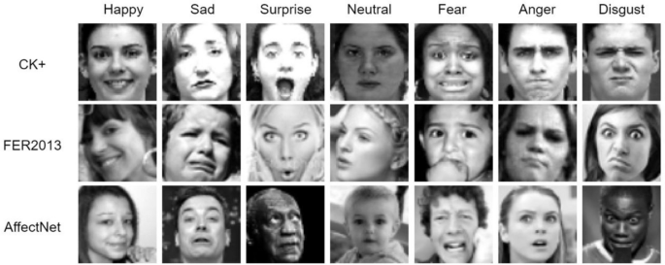

Slide 11
Image sentiment analysis workflow

Slide 12
Data preprocessing step
The Keras library was used to
  implement image resizing (Rescaling)
  horizontal rotation.
  Images were converted to a uniform size (124x124x3).
  Split the data into 80% training, 20% testing using stratified sampling to ensure balance between classes.

Slide 13
Data description and size
Using 3 main data sets:
  FER2013
    35,887 grayscale images (48x48 pixels)
    28,709 training samples, 3,539 testing samples
    Classes: Anger, Disgust, Fear, Joy, Sadness, Surprise, Neutral
    However, this classification presents a balance and quality issue.
  JAFFE
    213 images of 10 Japanese women
    Very small size
    Represents the main facial expressions
  +ck
    539 photos of 123 people
    7 emotions: anger, contempt, disgust, fear, happiness, sadness, surprise

Slide 14
Advantages and disadvantages
Advantages
Disadvantages
Using pretrained models saves training time and improves performance.
The models demonstrated strong performance, especially on the CK+ dataset.
Modern techniques such as dropout were used to avoid overgeneralization.
Model performance varies significantly depending on the dataset.
The JAFFE dataset is very small, which affects the accuracy of the results.
FER2013 has unbalanced data and low-quality images, which reduces performance.

Slide 15
Results
Model accuracy
Model | +CK | FER2013 | JAFFE
VGG-19 | 99% | 65% | 94%
INCAPTION | 99% | 86% | 84%
XCEPTIONNET | 99% | 92% | 77%

Slide 16

Thank you

