Slide 1



Change Management
Lecture 10
MGM111
Principle of Management
Prepared by
Dr. Bothaina Mahmoud Fouad
www.midocean.ae
www.midocean.ae

Slide 2

Lec. 10
The main points:
Definition of Change Management
What Causes Organizational Change?
Types of Change
A Manager’s Role In Organizational Change
Resistance to Change
12 Change Management Best Practices
www.midocean.ae

Slide 3
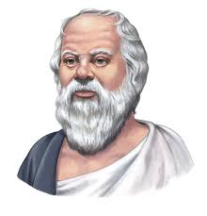
The Secret of Change
The Secret of change is to focus all your energy, not on fighting the old, but on building the new.
Socrates
www.midocean.ae

Slide 4
What is Change
  Definition of Change
  A transition.
  The process of going from one steady state to another
  Change occurs when the balance of our capabilities against our challenges is disrupted.
www.midocean.ae

Slide 5
Change is inevitable. When a business is static, a steady decline happens across all areas. To stay competitive, your company needs to be constantly changing. It involves continuous employee training, digital transformation, process improvement, and performance monitoring
www.midocean.ae

Slide 6
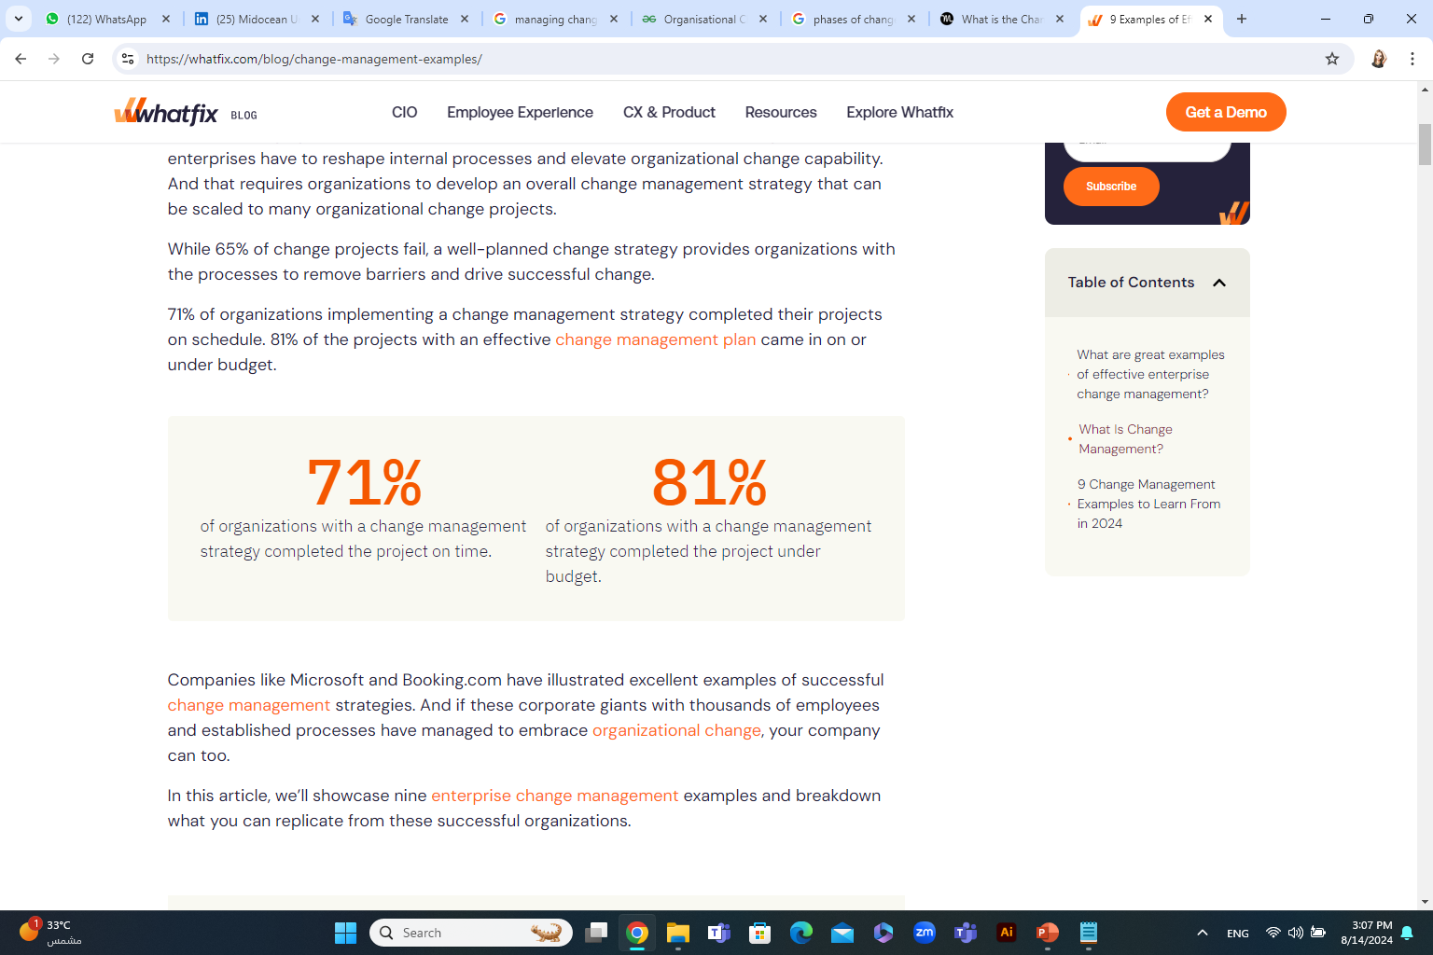
www.midocean.ae

Slide 7
Managers must predict and diagnose the need for change
www.midocean.ae

Slide 8
Diagnosing the Need for Change
Creativity
Direction
Delegation
Control
Collaboration
An organizational development theory developed by Larry E. Greiner is helpful in change management.
Greiner's model shows an organization as it evolves through the five stages of growth, and the end of each of these stages is marked by a crisis that calls for a change. The five stages of growth are as follows:
https://www.cliffsnotes.com/study-guides/principles-of-management/managing-change/diagnosing-the-need-for-change
www.midocean.ae

Slide 9
Change Management
Increasing the organization's ability to adapt
Adopt new ways of going about business activities
  Change management is organizational or management discipline focused on:
www.midocean.ae

Slide 10
Definition of Change Management
the actions in which a company or business alters a major component of its organization, such as its culture, the underlying technologies or infrastructure it uses to operate, or its internal processes.
www.midocean.ae

Slide 11
Definition of Change Management
Change management is the process, tools and techniques to manage the people side of change to achieve the required business outcome.
Change management incorporates the organizational tools that can be utilized to help individuals make successful personal transitions resulting in the adoption and realization of change.
www.midocean.ae

Slide 12
Change Management can be split into three levels:
Organizational change management
Project-level change management
Individual change management
www.midocean.ae

Slide 13
Why is change management important?
Manage change as smoothly as possible
Change management provides a structured approach to managing the complexities of change. As a result, it reduces disruptions to your workflow and helps you enact change as efficiently as possible.
www.midocean.ae

Slide 14
Why is change management important?
Get people on board
A big deal in effective change management is winning the hearts and minds of your people. Real change can’t happen without that, but it’s human nature to resist change. People need to go from “I hear you, but I don’t like it” to embracing the change as enthusiastically as you do. With a change management process, you’re better positioned to convince team members that your change is a good idea and get them 100% behind you.
www.midocean.ae

Slide 15
Why is change management important?
Mitigate risks
Change inherently carries risk. There can be disruptions to your work, a decrease in productivity, or negative impacts on employee morale. Change management identifies and assesses these risks, allowing you to develop strategies to mitigate and address them effectively.
www.midocean.ae

Slide 16
Categories of change
Categories of Change
People
Structure
Technology
www.midocean.ae

Slide 17
Categories of change
Techniques for
Managing Change
Authority
Coordination
Centralization
Processes
Methods
Equipment
Attitudes
Expectations
Behavior
Structure
Technology
People
www.midocean.ae

Slide 18
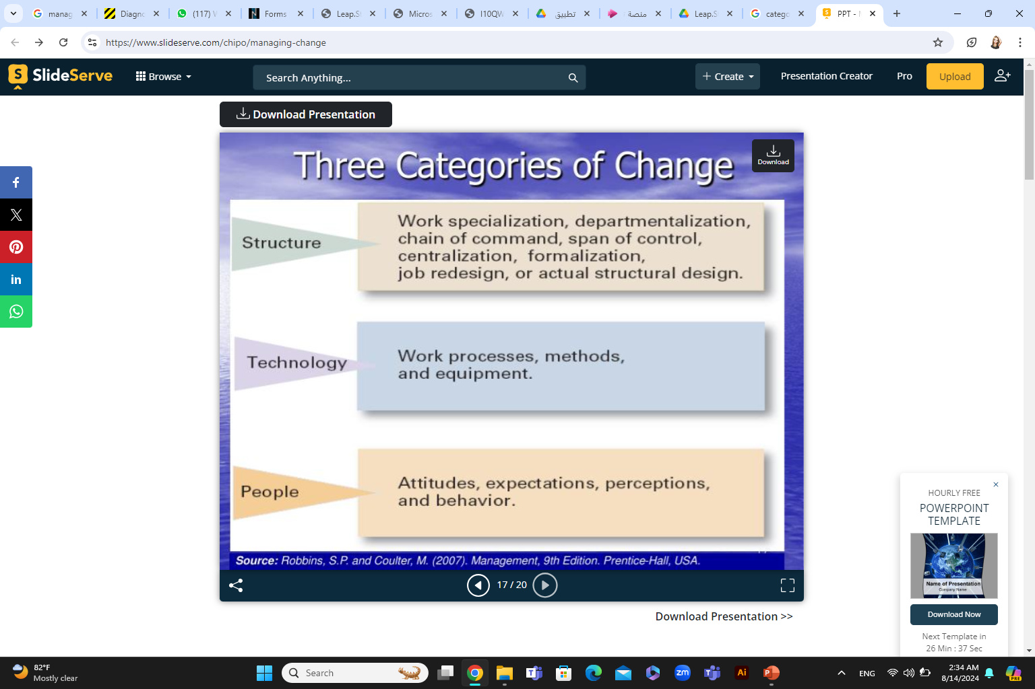
Categories of change
www.midocean.ae

Slide 19
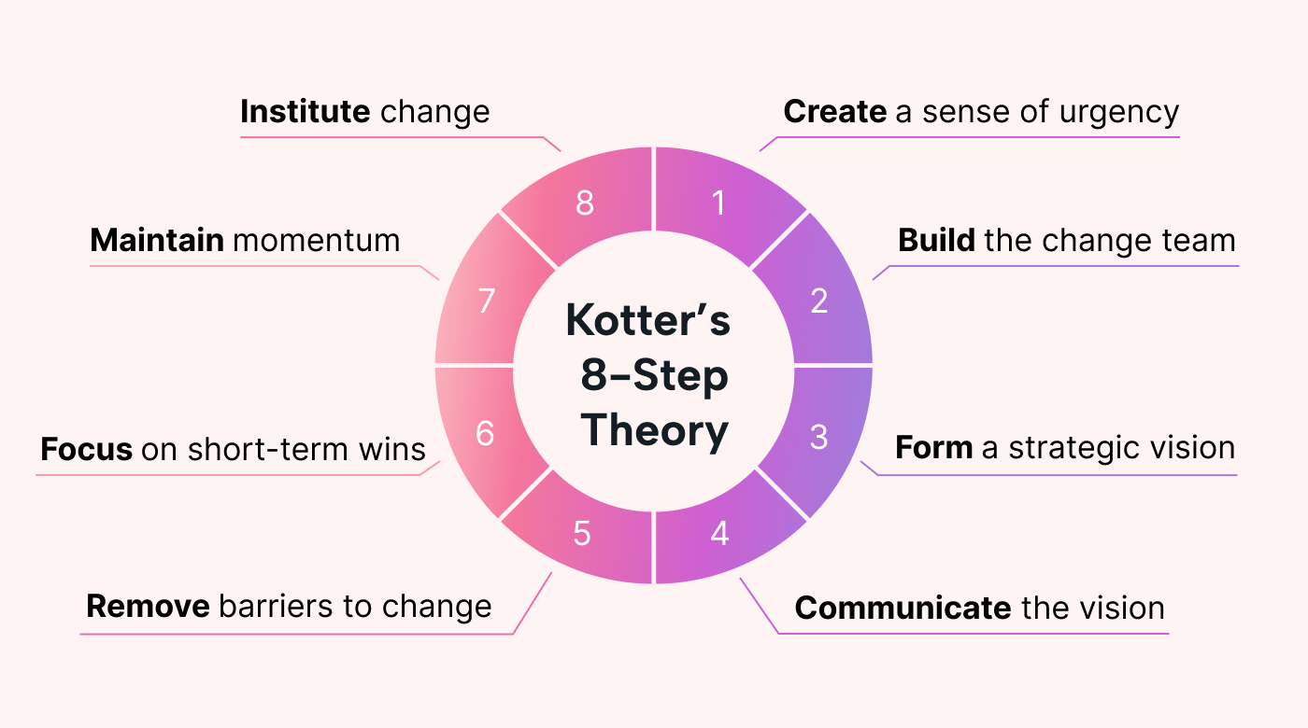
the common change management models?
Kotter’s 8-Step Theory
is a framework developed by Dr. John Kotter of Harvard Business School, a leadership and change management expert.
It focuses on the importance of engaging employees and stakeholders throughout the organizational change management process.
www.midocean.ae

Slide 20
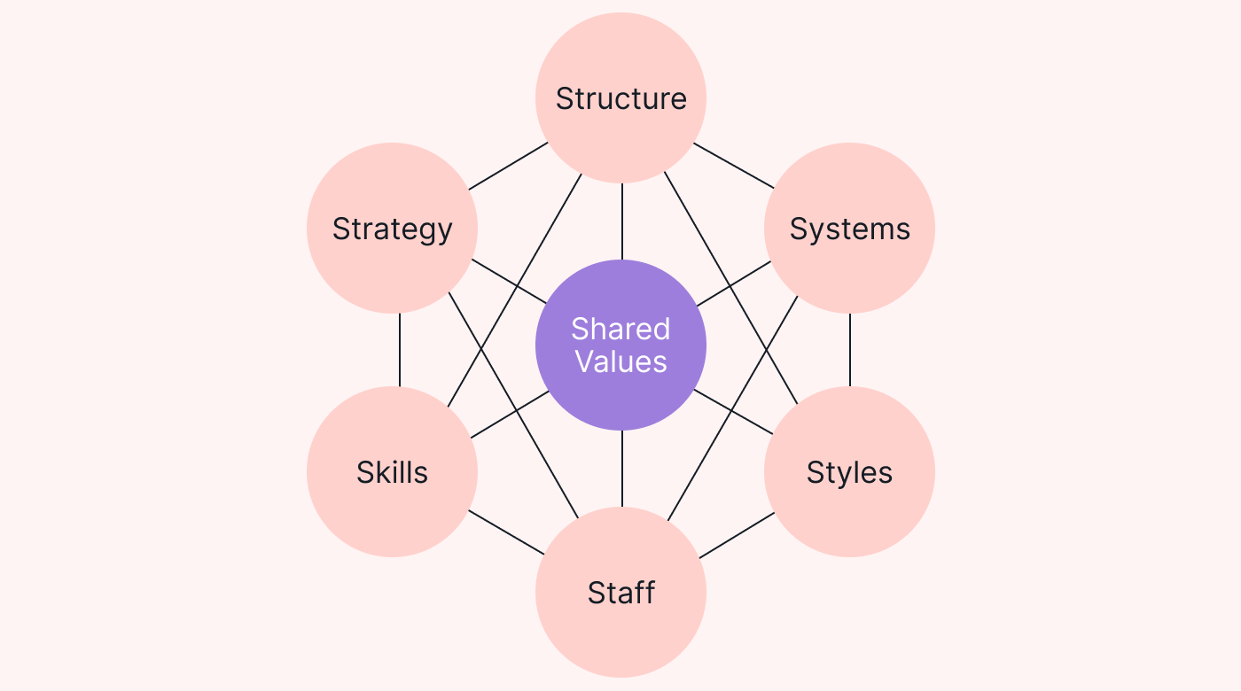
the common change management models?
McKinsey’s 7-S Model
McKinsey’s 7-S Model is used to assess how different parts of a business interact and influence each other.
Analyzing these elements helps you figure out what change needs to happen and how to implement it effectively.
www.midocean.ae

Slide 21
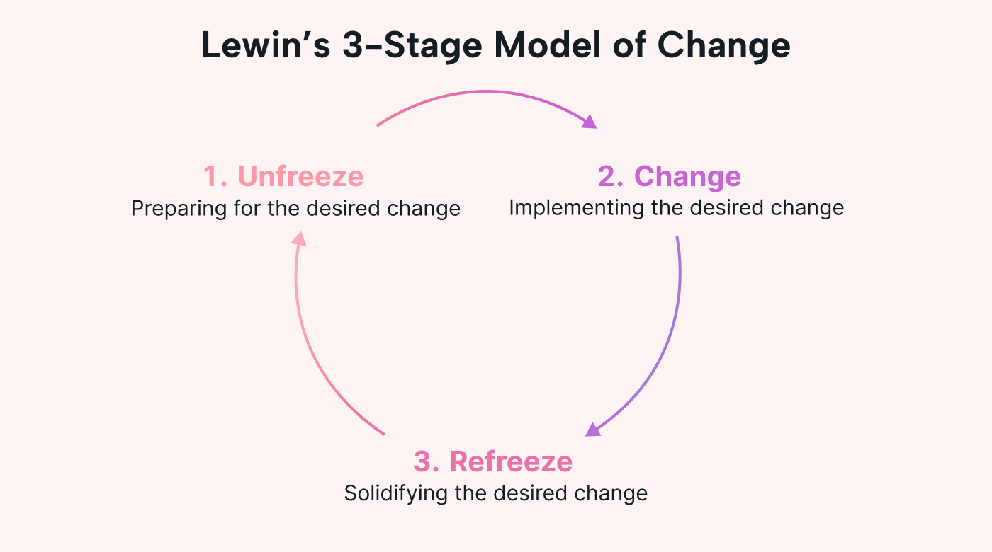
the common change management models?
Lewin’s 3-Stage Model of Change
Lewin’s 3-Stage Model of Change is a framework that focuses on the importance of “unfreezing” the existing state of your business before introducing change. According to Lewin, this helps reduce resistance and increase acceptance.
www.midocean.ae

Slide 22



the common change management models?
• He explained organizational change using the analogy of changing the shape of a block of ice
Lewin’s 3-Stage Model of Change
Creating a sense a change is needed
Lewin explained organizational change using the analogy of changing the shape of a block of ice
Moving towards a new and desired behavior
Setting this behavior as the new normal
www.midocean.ae

Slide 23
the common change management models?
• He explained organizational change using the analogy of changing the shape of a block of ice
Lewin’s 3-Stage Model of Change
www.midocean.ae

Slide 24
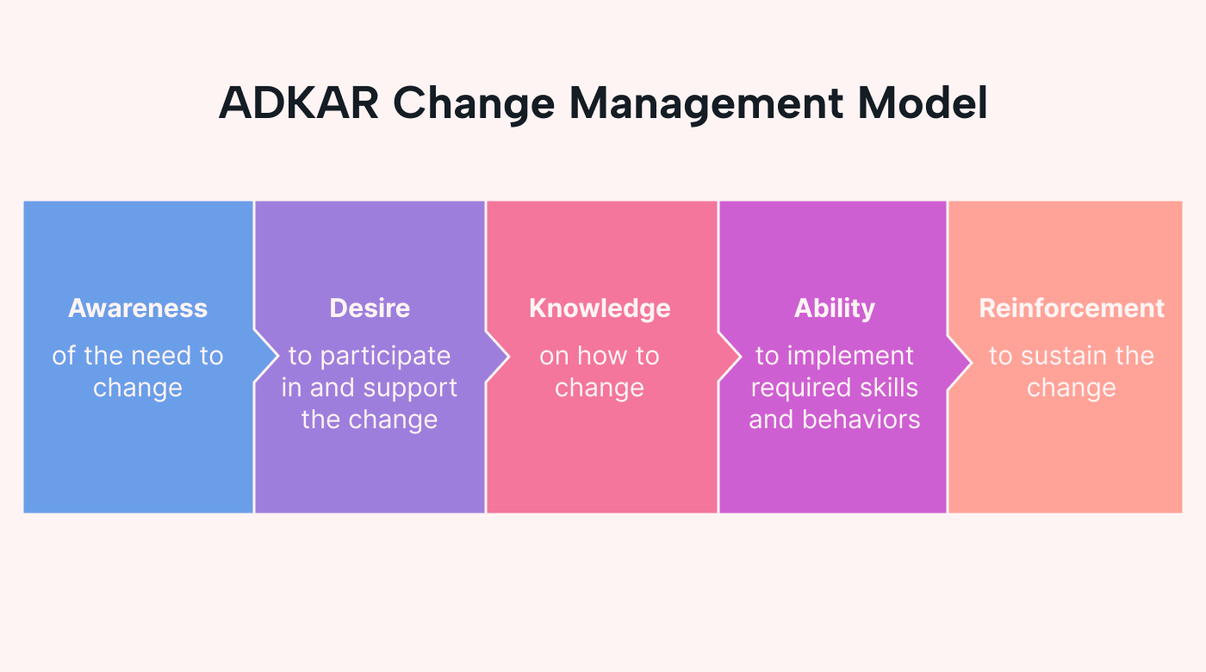
the common change management models?
ADKAR Change Management Model
tracks the stages of employee performance to measure how they feel about the change.
www.midocean.ae

Slide 25
Change Management Process
Monitor Performance
Change Management
Current
Transition
Future
www.midocean.ae

Slide 26
Change Management Process
Change Management using the
7 step Problem Solving Process
Problem
Gather Facts and Make Assumptions
Define End States and Establish Criteria
Develop Possible Solutions
Analyze and Compare Possible Solutions
Select and Implement Solution
Analyze Solution for Effectiveness
www.midocean.ae

Slide 27
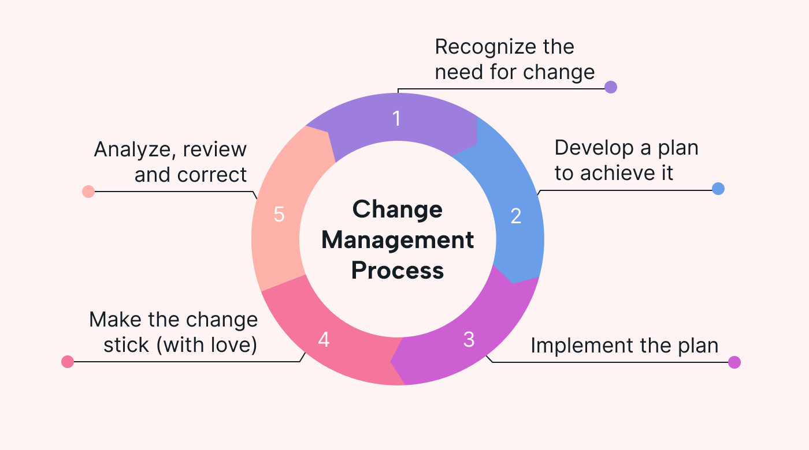
Change Management Process
www.midocean.ae

Slide 28
Top tips for creating a successful change management process
Choose the right change management model
Assign clear responsibilities.
‎Monitor your change management performance.
www.midocean.ae

Slide 29
Why Organizations change
Organizational change can be triggered by internal or external factors and is guided by the need to foster growth and success.
It encompasses diverse areas such as restructuring, cultural evolution, process optimization, technological advancements, strategic realignment, and people-centric initiatives.
www.midocean.ae

Slide 30
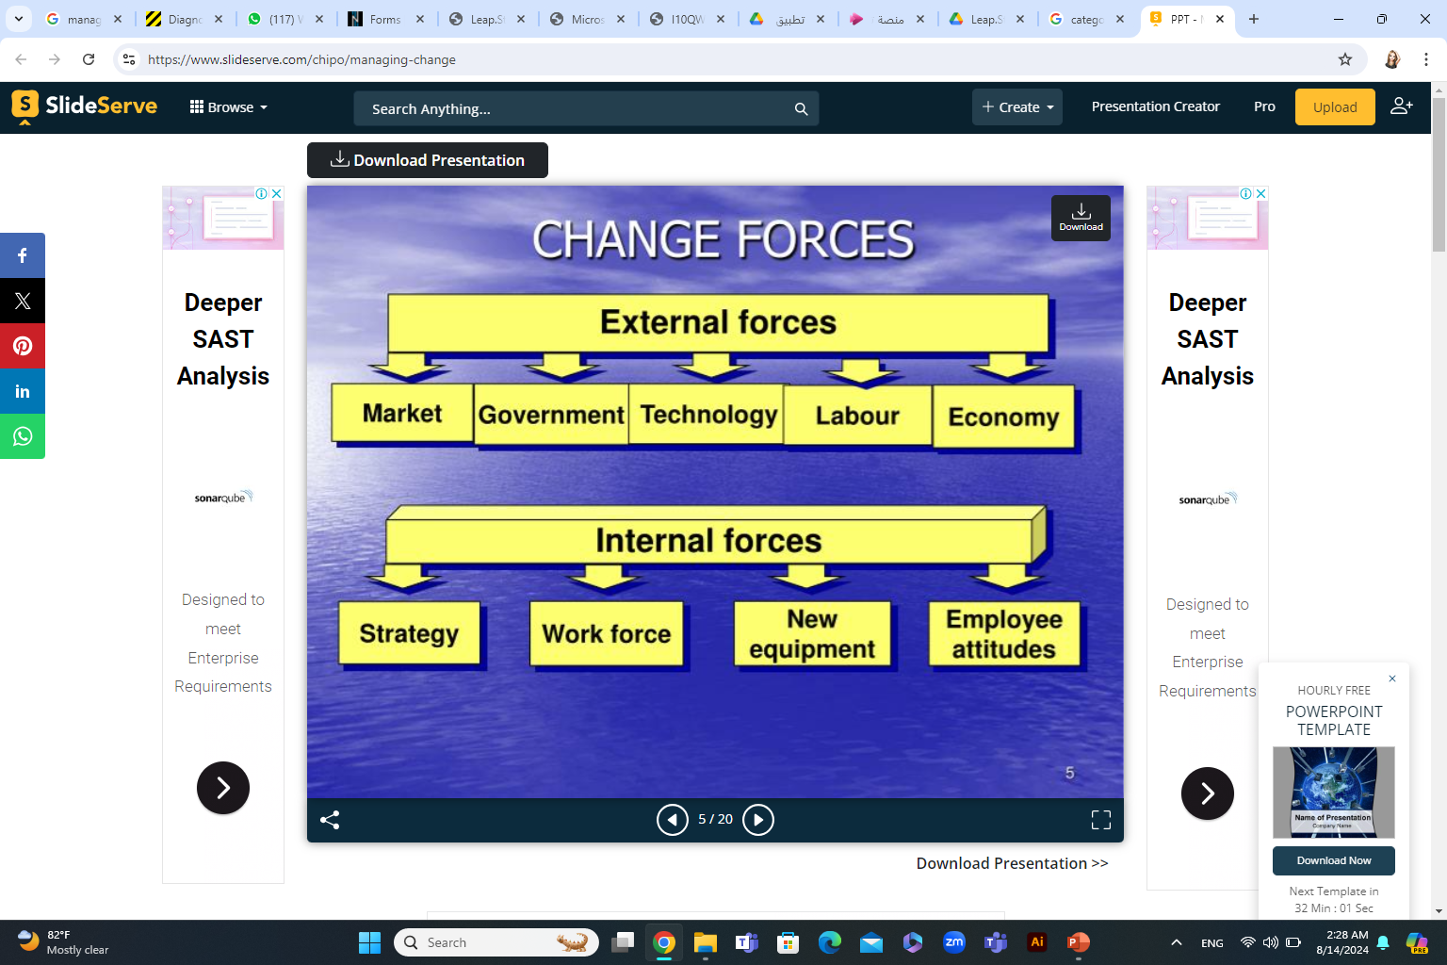
Source of change
www.midocean.ae

Slide 31
Other Source of Change
External
Changing nature of markets
Economic & Finance
Geographic
Social
Legal
Political
Technological
environmental
Internal
Accelerating new technology
New system and procedures
New business culture
New leadership at the company or within its departments
Shifts in the organizational team structure
The adoption of new business models
Equipment/resources
Implement E-Commerce
www.midocean.ae

Slide 32
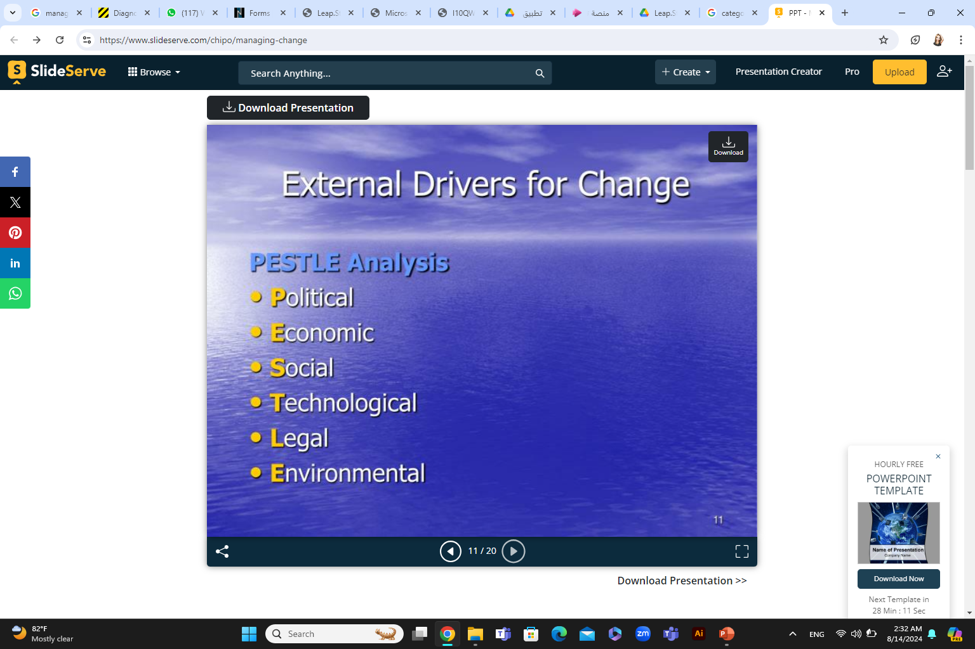
www.midocean.ae

Slide 33
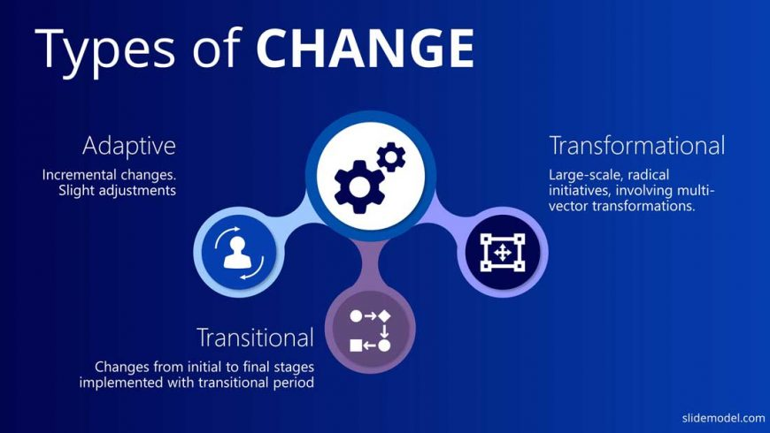
3 most common types of organizational change include
www.midocean.ae

Slide 34
3 most common types of organizational change include
Developmental change
Any organizational change that improves and optimizes on previously established processes, strategies and procedures.
Transitional change
Change that moves an organization away from its current state to a new state in order to solve a problem, such as mergers and acquisitions and automation.
Transformational change
Change that radically and fundamentally alters the culture, core values and operations.
www.midocean.ae

Slide 35
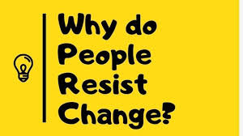
Why People Resist Changes ?
Change
Response
Attitudes
Personal History
Social Situation
www.midocean.ae

Slide 36
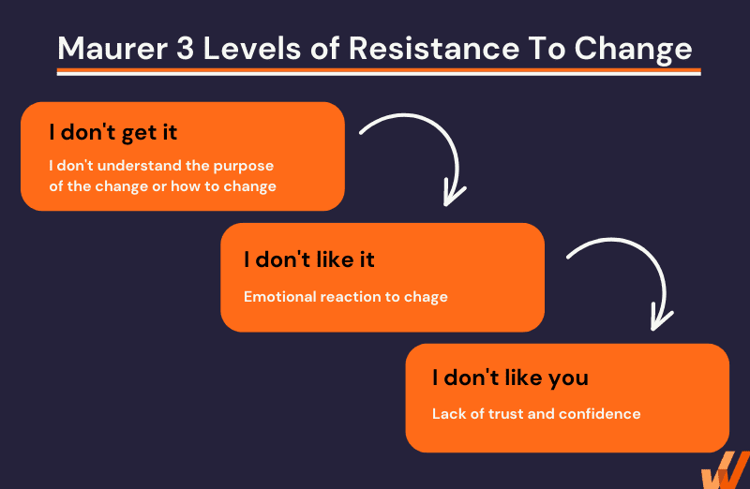
Why People Resist Changes ?
www.midocean.ae

Slide 37
A MANAGER’S ROLE IN ORGANIZATIONAL CHANGE
Within an organization, every employee has a different role in assisting with change. While many staff members may complete heavily detailed work, senior-level executives with longer tenure might have different goals. Even within management, leaders and managers perform different tasks.
www.midocean.ae

Slide 38
A MANAGER’S ROLE IN ORGANIZATIONAL CHANGE
To achieve this, managers must have a wide array of skills, such as:
The ability to communicate clearly and effectively—this includes actively listening to their team and colleagues
A highly developed level of emotional intelligence
Strong organizational skills
An eye for detail
Problem-solving and decision-making skills
Delegating.
www.midocean.ae

Slide 39
Techniques for
Reducing Resistance
Education and
Communication
Participation
Negotiation
Facilitation
and Support
Manipulation
and Cooptation
Coercion
www.midocean.ae

Slide 40
12 Change Management Best Practices
There are some rules and best practices every organization should follow:
1. Define clear goals
2. Be honest and transparent
3. Train and reassure your teams
4. Encourage conversations and communicate regularly
5. Listen to your employees
www.midocean.ae

Slide 41
12 Change Management Best Practices
6. Bring your good leaders
7. Choose the right communication tool
8. Empower your employees
9. Encourage knowledge sharing
10. Document and make information easily accessible
11. Recognize and reward
12. Make it social
www.midocean.ae

Slide 42
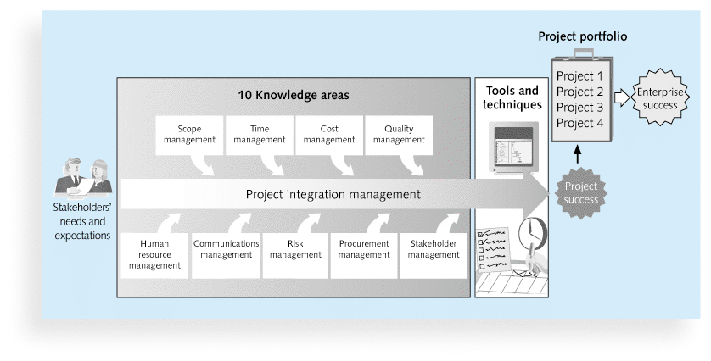
www.midocean.ae

Slide 43



Thank You

