Slide 1


Financial Management

Slide 2




Financial Management
Lecture 3
Prepared by
Dr. Mohamed Hamouda
www.midocean.ae

Slide 3
Financial Statement Analysis

Slide 4
Learning Objectives
Help yourself grow as a stock
analyst by knowing:
    How to obtain financial information about companies.
    How to read basic financial statements.
    How to use performance and price ratios.

Slide 5
Framework of Analysis
Top-down approach (“Three-Step” Approach)
  Step 1: Domestic and global economic analysis
    Market timing: Should you try to buy and sell in anticipation of the future direction of the market?
  Step 2: Industry analysis
    Asset allocation: How should you distribute your investment funds across the different classes of assets? For example, it is a decision of allocating your money into stocks, fixed income securities, and cash.
  Step 3: Company analysis
    Security selection: Within each class, which specific securities should you buy?

Slide 6
Security Analysis
Two different approaches
  Fundamental analysis
  Technical analysis
Fundamental analysis
  A term for studying a company’s accounting statements and other financial and economic information to estimate the economic value of a company’s stock.
  The basic idea: to identify both “undervalued” or “cheap” stocks to buy and “overvalued” or “rich” stocks to sell.
  Simply, it is a process of finding an “intrinsic value” of a stock.
  Fundamental analysis is often the most demanding and most time-consuming phase of stock selection

Slide 7
Steps in Valuing a Company
Three steps are necessary to project key financial variables into the future:
  Step 1: Analyze financial statements and ratios
  Step 2: Forecast future sales, dividends, EPS, and P/E ratios.
  Step 3: Forecast future stock price.

Slide 8
Security Selection
Once we have an estimated future stock price, we can compare it to the current market price to see if it may be a good investment candidate:
current price < estimated price undervalued
current price = estimated price fairly valued
current price > estimated price overvalued

Slide 9
Analyze financial statements and ratios
Step 1:

Slide 10
Three Important Financial Statements
The Balance Sheet:
  Provides a snapshot view of a company’s assets and liabilities.
  The Balance Sheet is as of a particular date.
The Income Statement:
  Provides a summary of a firm’s revenues and expenses.
  The Income Statement is over a specific accounting period, usually a quarter or a year.
The Cash Flow Statement:
  Is an analysis of the sources and uses of cash by the firm over an accounting period.
  Summarizes operating, investing, and financing cash flows.

Slide 11
Financial Statements:
The Balance Sheet
Summary of a company’s assets, liabilities, and shareholders’ equity at a point in time
  Assets: what the company owns (i.e. cash, inventory, accounts receivable, equipment, buildings, land)
  Liabilities: what the company owes (i.e. bills, debt)
  Equity: capital the stockholders have invested in
  the company
What are we looking for on the balance sheet?
  Relative amounts (large vs. small)
  Trends (improving vs. decreasing)
Assets = Liabilities + Equity

Slide 12
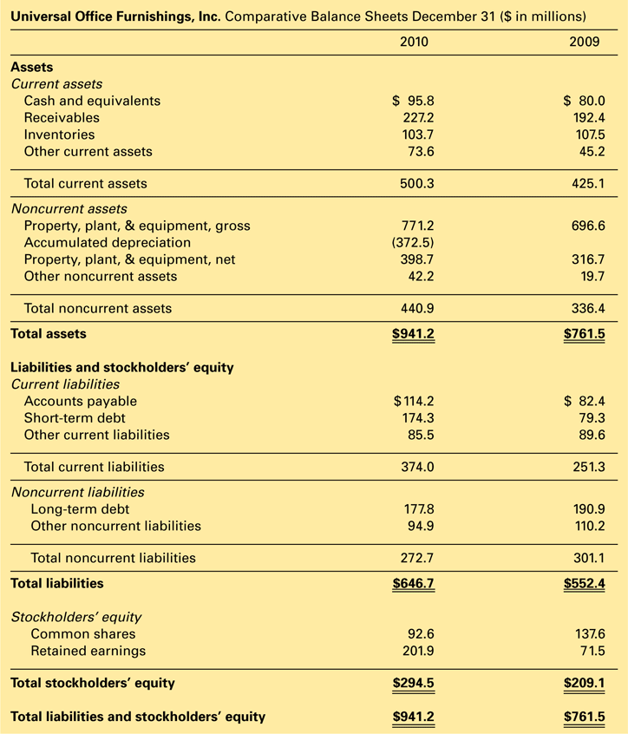
Corporate Balance Sheet

Slide 13
Financial Statements:
The Income Statement
Summary of a company’s operating results over a specific period of time, usually one year
  Revenues: funds received for providing products and/or services
  Expenses: funds used to pay for materials, labor, and other business costs
  Profit/Loss: revenues less expenses
What are we looking for on the income statement?
  Relative amounts (large vs. small)
  Relationships (Are expenses growing faster or slower
  than revenues?)
  Trends (improving vs. decreasing)
Net income = Revenues – Expenses
  = Dividends + Addition to Retained earnings

Slide 14
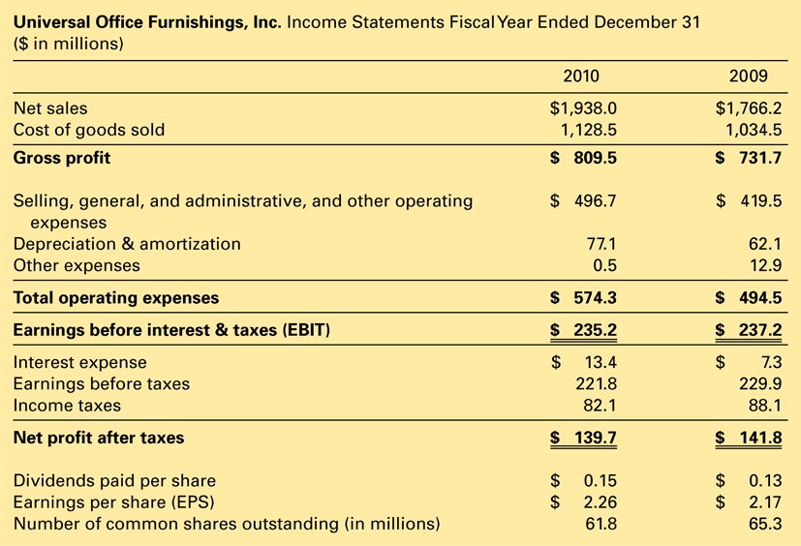
Corporate Income Statement

Slide 15
Financial Statements:
The Statement of Cash Flows
Summary of a company’s cash flows and other events that caused changes in company’s cash
  Sources of Cash: proceeds from sale of products/ services, sales of equipment, borrowing money, sale of stock
  Use of Cash: payment of wages and/or materials, payment of operating expenses, purchases of equipment, payment of debt, payment of dividends
Net Income does not equal cash flow.
  Net income contains non-cash items.
  Non-cash items are income and expenses not realized in cash form.
  Depreciation can be a significant non-cash item.
Cash flow represents all income realized in cash form.
  Adjusting net income for non-cash items yields Operating Cash Flow.
  Investment Cash Flow includes any purchases or sales of fixed assets and investments.
  Financing Cash Flow includes funds raised by issuing securities or expended by repurchasing outstanding securities.
What are we looking for on the cash flow statement?
  Relative amounts (more cash or less cash)
  Liquidity
  Trends (improving vs. decreasing)

Slide 16
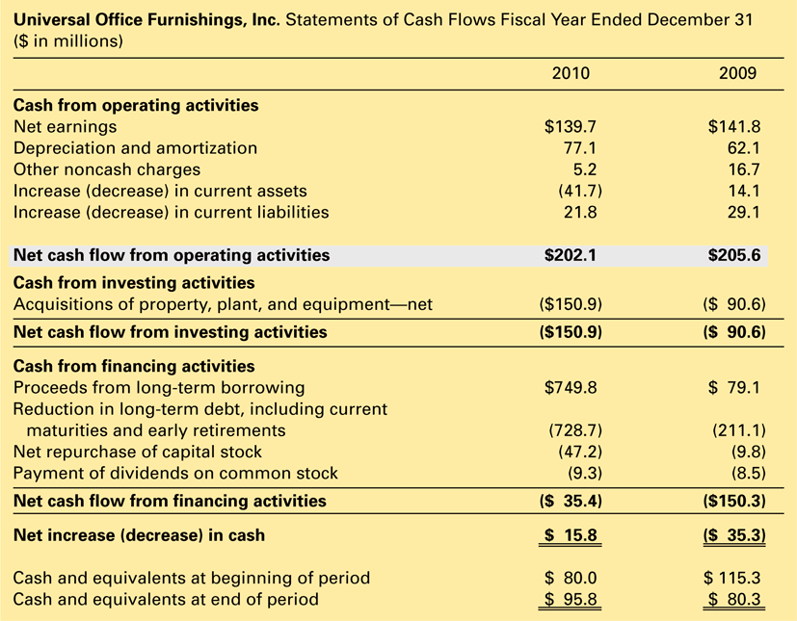
Statement of Cash Flows

Slide 17
Sources for Financial Statements
The Securities and Exchange Commission (SEC) requires companies to prepare and submit regular reports
  These reports are freely made available through the Electronic Data Gathering and Retrieval (EDGAR) archives (www.sec.gov)
  10K: Annual company report filed with the SEC.
  10Q: Quarterly updates of 10K reports.
Securities & Exchange Commission
Standard & Poor’s or Moody Reports
Internet financial portals and brokerage firm reports
Also, the SEC Regulation FD (Fair Disclosure) requires companies making a public disclosure of material nonpublic information to do so fairly without preferential recipients.
  Material nonpublic information is previously unknown information that could reasonably be expected to affect the price of a security.
  Most companies satisfy Regulation FD by distributing important announcements via e-mail alerts to those who register for the service at the company’s website (look in the investor relations section).

Slide 18
Key Financial Ratios
Study of the relationships between financial statement accounts
Purpose is to develop information about the past that can be used to get a handle on the future
  “X-rays” of the financial statements to look for meaningful relationships between numbers
  Looks at company’s historical trends to see if improving or declining
  Looks at industry standards to see how company compares to competitors

Slide 19
Major Groups of Financial Ratios
Liquidity Ratios: the company’s ability to meet day-to-day operating expenses and satisfy short-term obligations as they become due
Activity Ratios: how well the company is managing
its assets
Leverage Ratios: amount of debt used by the company
Profitability Ratios: measures how successful the company is at creating profits
Price Ratios: converts key financial information into per-share basis to simplify financial analysis

Slide 20

Liquidity Ratios
Current Ratio: how many dollars of short-term assets are available for every dollar of short-term liabilities owed
  Higher ratio: more liquidity
  Lower ratio: less liquidity
Net Working Capital: how many dollars of working capital are available to pay bills and grow the business
  Higher amounts: firm makes large investments in working capital
  Lower amounts: firms operates with less working capital

Slide 21

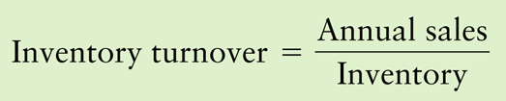

Activity Ratios
Accounts Receivable Turnover: how quickly the company is collecting its accounts receivable (sales to customers on credit)
  Higher ratio: better
  Lower ratio: worse
Inventory Turnover: how quickly the company is selling its inventory
  Higher ratio: better
  Lower ratio: worse
Total Asset Turnover: how efficiently the company is using its assets to support sales
  Higher ratio: better
  Lower ratio: worse

Slide 22


Leverage Ratios
Debt-Equity Ratio: how much debt the company is using to support its business compared to how much stockholders’ equity it is using to support its business
  Higher ratio: worse
  Lower ratio: better
Time Interest Earned: measures the ability of the firm to meet its fixed interest payments
  Higher ratio: better
  Lower ratio: worse

Slide 23

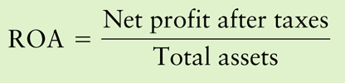

Profitability Ratios
Net Profit Margin: amount of profit earned from sales and other operations
  Higher ratio: better
  Lower ratio: worse
Return on Assets: amount of profit earned on each dollar invested in assets; measures management’s efficiency at using assets
  Higher ratio: better
  Lower ratio: worse
Return on Equity: amount of profit earned on each dollar invested by stockholders; measures management’s efficiency at using stockholders’ funds
  Higher ratio: better
  Lower ratio: worse

Slide 24
Breaking Down
Return on Assets (ROA)
Breaking down ROA allows investors to identify the components that are driving company profits.
Investors want to know if ROA is moving up (or down) because of improvement (or deterioration) in the company’s profit margin and/or its total asset turnover.

Slide 25

Breaking Down
Return on Equity (ROE)
Breaking down ROE allows investors to identify the impact of financial leverage on company return.
Investors want to know if ROE is moving up (or down) because of how much debt the company is using or because of how the firm is managing its assets and operations.

Slide 26
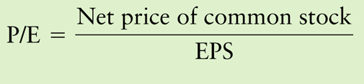
Price Ratios
Price/Earnings Ratio: shows how the stock market is pricing the company’s common stock
  One of the most widely used ratios in common stock selection
  Often used in stock valuation models
Higher ratio: more expensive
Lower ratio: less expensive

Slide 27
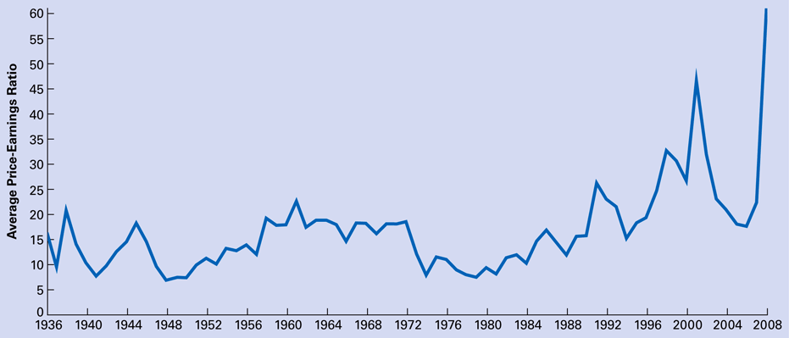
Average P/E Ratio of S&P 500 Stocks

Slide 28
Price Ratios (cont'd)
What is the P/E ratio for a company with profits of $139.7 million, 61,815,000 outstanding shares of common stock and a current market price of $41.50 per share?

Slide 29

Price Ratios (cont'd)
Price/Earnings Growth Ratio (PEG): compares company’s P/E ratio to the rate of growth in earnings
Ratio > 1: stock may be fully valued
PEG = 1: stock price in line with earnings growth
Ratio < 1: stock may be undervalued

Slide 30

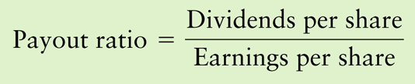
Price Ratios (cont'd)
Dividends per share: the amount of dividends paid out to common stockholders
Payout Ratio: how much of its earnings a company pays out to stockholders in the form of dividends
  Traditional payout ratios have been 40% to 60%
  Recent trends have been lower payout ratios, with more tax efficient stock buyback programs used frequently
  High payout ratios may be difficult to maintain and the stock market does not like cuts in dividends

Slide 31

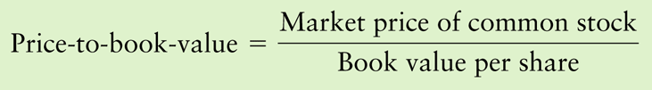
Price Ratios (cont'd)
Book Value per Share: difference between assets and liabilities (equity) per share
  A company should be worth more than its book value.
Price-to-Book Ratio: compares stock price to book value to see how aggressively the stock is being priced
  Higher ratio: stock is fully-priced or overpriced
  Lower ratio: stock may be fairly priced or underpriced

Slide 32
Three Price Multiples
Annual reports will often report per-share calculations of book value, earnings, and operating cash flow.
  Per share calculations require the number of shares outstanding.
  Cash flow per share uses operating cash flow!

Slide 33
Interpreting Financial Ratios
Sources of Ratio Analysis
  Standard & Poor’s Stock Reports
  Brokerage firm reports
  Value Line Reports

Slide 34
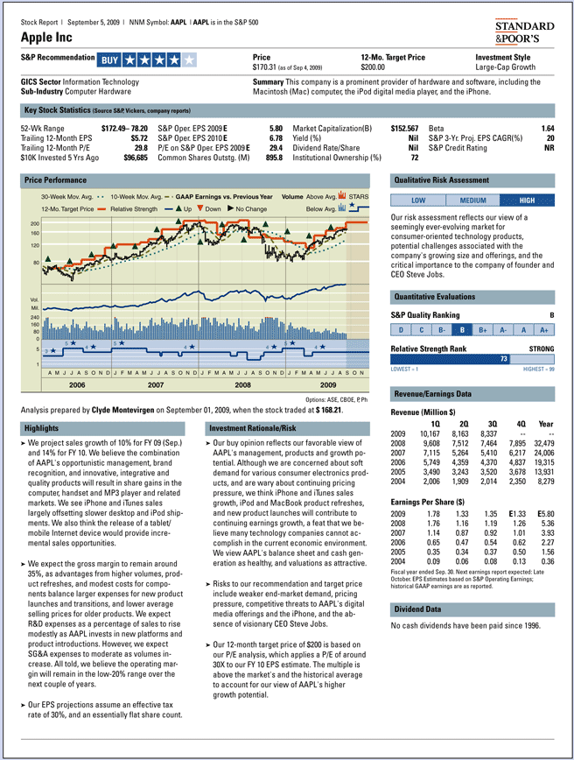
Example of Published Report with Financial Statistics

Slide 35
Interpreting Financial Ratios
Look at historical ratio trends for the company
Look at ratios for the industry
Evaluate the firm relative to two or three major competitors
Try to determine if the financial information is telling you a good story about the company or a bad story
Use the story to decide if you think the stock has intrinsic value for you as an investor

Slide 36
Could There Be Trouble Brewing?
The following financial statement developments could indicate a company heading for financial problems:
  Inventories and receivables growing faster than sales
  A falling current ratio, caused by current liabilities increasing faster than current assets
  A high and rapidly increasing debt-to-equity ratio, suggesting problems with servicing debt in future
  Cash flow from operations dropping below net income
  Presence of lots of indecipherable off-balance sheet accounts and extraordinary income entries

Slide 37
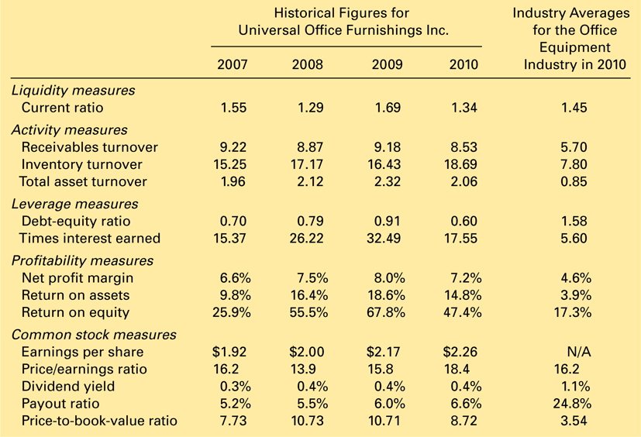
Comparative Historical and Industry Ratios

Slide 38
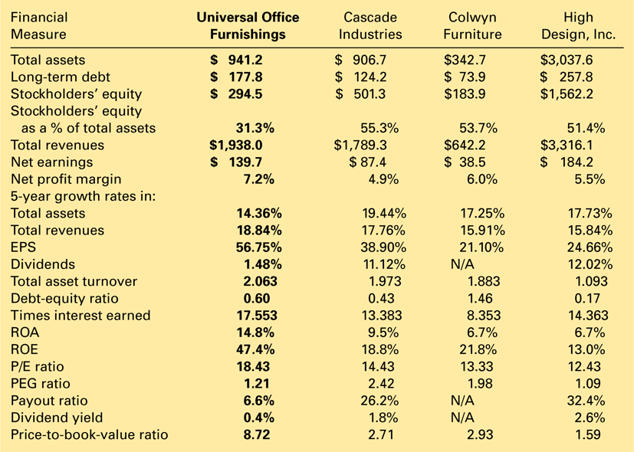
Comparative Financial Statistics: Universal Office Furnishings and Its Major Competitors (All figures are for year-end 2010 or for the five-year period ending in 2010; $ in millions)

