Slide 1



Business law
Lecture 7
MGM412
Business law
Prepared by
Dr. Fatma Abdalla

Slide 2

Lecture goals
. 1- Quick revision of the previous lecture
2- Our educational goals today
3- Conclusion
4- References

Slide 3

1- quick revision of the previous lecture
a- standard contracts.
Battle of forms
B-Agency contract.

Slide 4

2- educational goal today
Part 4: Sources of obligation
VI- Different applications of business-related contracts.
c- franchise contract.
Part 5: business acts.
A- companies.

Slide 5

c- franchise contract
1- introduction :
Franchising is concluded when a company or institution called the franchisor or licensor rents its distinctive brand name, product, service or technology, as well as its production, marketing, administrative and accounting systems, all this is called the Franchise Package.
to another person or company is called The franchisee or the licensee. Franchisee want to benefit from the success of the product and brand name of the leasing company.
franshise grants the franshisee this right in a specific area and for a specific period, which is the period of the contract between the two parties. This can be at the local or international level.

Slide 6
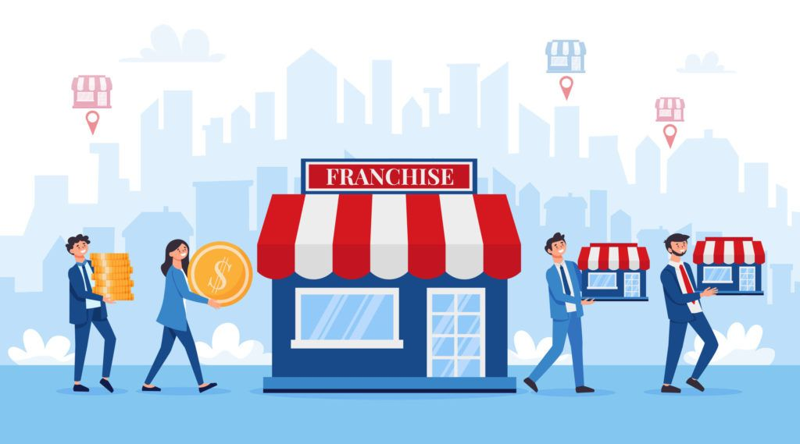
the franchisor grants this right in return for an amount paid to the franchisor, which is called the franchise fee, in addition to a percentage of the total sales value, which is called Royalty.
The franchisee's activity is not considered a branch of the franchisor's activity. It is considered an independent business or project under the trade name of the franchisee (licensor), but it is distinguished by complete similarity between the different franshised units in different regions despite they are owned by multiple people (Franchisees).

Slide 7
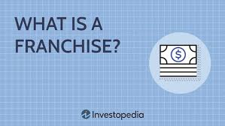
2- The legal definition of a commercial franchise:
is the contract by which the first party (the franchisor) is granted the right to use intellectual property rights: (trade name - trademark - patent) in addition to the technical knowledge to produce goods, distribute products and provide services to the second party (the franchisee) to enable him to start the commercial activity and perform work in the franchise area in return of fees paid by the franchisee

Slide 8
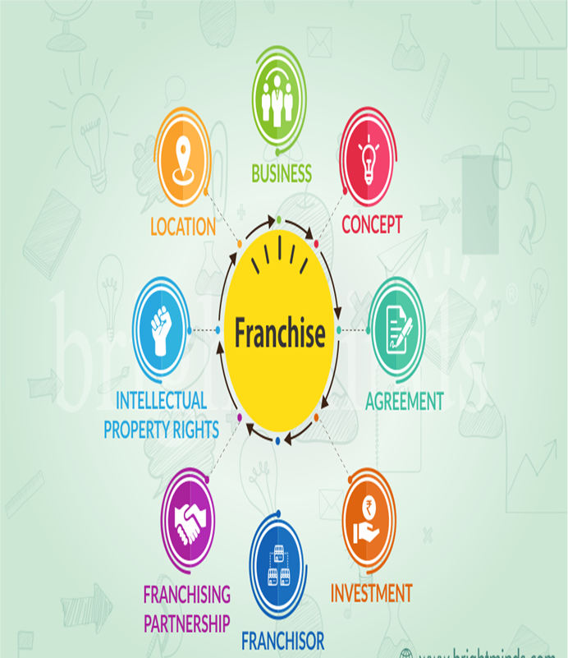
3- The basic pillars of managing commercial franchise systems:
1- Franchisor : who owns a successful business activity with a well-known trade name and successful management systems.
2- Franchisee : He is the one who has the following: • The administrative and financial ability to establish a commercial project • The willingness to work hard • The willingness to commit to the franchisor’s work system • The commitment to pay the franchise fees •
3- Franchise Contract : This system is only implemented through an agreement between the grantor and the grantee.

Slide 9
4- Privilege package : Which includes leasing the distinctive brand as well as the leasing company’s production, marketing, administrative and accounting systems.
It may also include Franchise support systems may also include: • Information technology • Internet services • Research and development • Franchise promotion • Accounting systems • Financial auditing and quality control • Support team • Financing methods.
5-Franchise fee : An amount paid to the franchisor. This is called the Franchise Fee. In addition to a percentage of the total sales value, which is called Royalty .
6- The franchise area: is the geographical area agreed upon in the legal contract for the commercial franchise between the franchisor and the franchisee to operate the activity within the framework of this area, whether through commercial units wholly owned by the franchisee or by granting him sub-franchises .
Notes:
.

Slide 10

4- Franchising Advantages:
A Proven System: A franchise increases your chances of business success because you work under a proven system. Franchises offer consumers consistency from a familiar brand.
Help Getting Started: Before even opening the business, the franchise offers support in the form of site selection, design, construction, financing, training, and a grand-opening program.
Lower Failure Rate: Generally speaking, franchises have a lower failure rate when compared to solo businesses. This is due to the fact that franchises are already proven to be successful and have a working concept.
Notes:
.

Slide 11
Continued Support: The support continues after the business is open in the form of training, national and regional advertising, operating procedures, operational assistance, ongoing supervision and management support, increased spending power, and access to bulk purchasing.
A Fast-Track to a New Field: You can enter an entirely new industry without having to go back to school. The franchisor will teach you how to do everything and tell you everything that you need to know.
Notes:
.

Slide 12

Brand Recognition: As a recognizable brand, franchisees have a built-in fan base that new independent businesses simply don't have.
Vendor Relationships: An advantage to investing in a franchise business is the fact that the franchiser likely has relationships with vendors. The franchisee doesn’t not have to worry about where to get supplies.
No Prior Experience Necessary: Since the franchisor provides you with great support and training, you likely don't need a ton - or any - prior business experience. The franchisor will give you all the tools to run the franchise business properly.
Notes:
.

Slide 13

5- Franchising Disadvantages:
Limited Control: As a franchise business owner, you have limited control. The franchisee is the one who provides the working system, so the franchisee has to follow it.
Costs: Opening a franchise is not a cheap endeavor. On top of the initial franchise fees and royalty fees, the franchisee is responsible for coming up with all of the capital to open the business and managing overhead.
Lack of Privacy: Being a franchisee also comes with a lack of financial privacy. The franchise agreement will likely come with a stipulation that the franchiser can oversee the entire financial system of the business.
Notes:
.

Slide 14
Reputation Control: All it takes is one bad franchisee to upset the applecart and the whole franchise system can be tarnished.
Difficult to Resell: Once your time as a franchise owner with a brand is over, you may sell it back to the franchiser as part of your exit strategy. But it may be difficult to find someone to buy your franchise store or business because the franchiser has to approve it.
Possibility of dissoving the contract: The parent company (franchisee) sets strict legal rules in the franchise sale contracts that may sometimes lead to terminating the franchise contract if these rules are not adhered to.
Notes:
.

Slide 15
6- Obligations of the parties to the franchise agreement:
I- Obligations of the franchisee : Adherence to the systems and standards established and developed by the licensor so that he can reap the best benefits from the commercial opportunities available under the franchise agreement and so that he can achieve success. The matter does not stop at increasing the income of each party only, but rather goes beyond that to contribute to establishing a good customer base and ensuring a share of the market. This depends on commitment and adherence to the systems, which are the operating manual, work procedures, quality control requirements and standards, confidentiality requirements standards, raw materials, resources, etc.
Notes:
.

Slide 16

II- franchisor’s obligations: Licensing the licensee to use his intellectual property rights, including trademarks, industrial models, patents, trade secrets, technical know-how, and manufacturing data, as well as providing the necessary support and training on an ongoing basis to ensure the efficient transfer of the system subject to the franchise to the licensee. The licensor must provide the licensee with an Operational Manual , which contains all of the above.
Notes:
.

Slide 17
7- Factors to Consider When Deciding to Franchise:
I- Choose a successful and suitable brand: While this step may seem obvious, many entrepreneurs who have purchased franchise rights for promising brands – NOT GROWN UP ENOUGH- suffer after a period of time from many problems. Study the market, ask for as much information as possible and review the company’s revenues. Investigate the existence of legal issues or disputes between franchisors and their customers.
Elements of a successful franchise: • Unified and continuous quality level • A strong market segment • Elements that outperform competitors • Ease of transferring knowledge of activity performance • Availability of mental image elements • Advanced information systems • Continuous increase in sales • Good reputation and credibility • Length of practical experience • High learning curve •
Make sure there is a need for this brand in the market and you should look for a suitable location that is easy to access and in an area that is not saturated with the same products.
Notes:
.

Slide 18

II- Hire a strong core team: As is the case when starting any company, the core team contributes greatly to the success or failure of the project. Train them by providing training courses and organizing visits to other sites as the most important responsibilities of the core team are to train new employees and develop their skills.
Notes:
.

Slide 19
III- Obtaining financing: Purchasing a franchise is not a low-cost project. The franchisee must cover rent, salaries, operating costs, maintenance, and bills, in addition to paying franchise fees and operating royalties, which can be very high.
For example, the franchise fee for a McDonald's store is $45,000 and the cost required to open a McDonald's store ranges from $500,000 to $1.6 million. As for operating fees , they represent about 12.5% of total annual sales.
At Dunkin Donuts , for example, the franchisee pays about 5.9% of total annual sales plus a franchise fee that ranges from $40,000 to $80,000. So, study all operating costs, franchise fees, and profit margins, and create a clear and detailed financial plan, then approach banks or financial institutions to get the loan you need. Don’t expect a franchisor to come to your aid if you run into financial difficulties.
Notes:
.

Slide 20
IV- Be prepared to give up your creative tendencies : Standardization Franchising companies impose many controls and conditions on the franchisee, not only financially but also operationally. They determine the interior design, the products offered, the employee’s dress code, and other matters. Although there are some franchise companies that are flexible in dealing with their customers and allow them to control some aspects, they are very few .
If the franchisee is someone who does not accept monotony and conformity and who values their creative freedom, then the franchise system is not the right investment option for him.
Notes:
.

Slide 21
8- Franchise granting methods:
There are three methods for granting a commercial franchise , which are:
I- individual unit franchise: It is the individual project, where in this system the franchisee grants the franchise right to individual units directly, and this is suitable in the local system for granting the franchise.
II- Granting multi-unit franchises: in which the franchise buyer pays a low total amount to purchase several units of the same franchise (several branches) for his personal account and does not dispose of them by selling or renting them without prior approval from the seller, such as the McDonald’s restaurant chain in Egypt. This is a system suitable for granting franchises to large companies.
Notes:
.

Slide 22
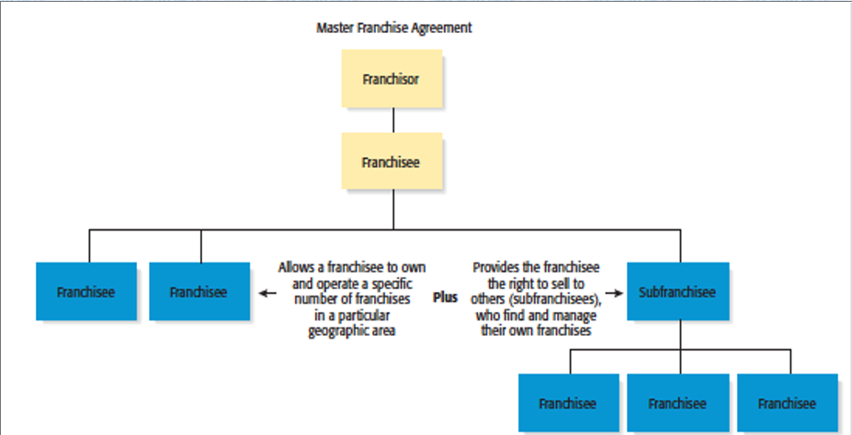
III- Sub –Franchise ( Master Franchise) : Granting a multi-unit franchise while the buyer retains the right to sell or lease the franchise in a specific territory.
Notes:
.

Slide 23
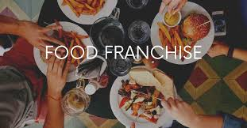
9- Types of Franchise Systems:
I- Manufacturing Franchise: The licensee grants the licensee the rights to manufacture a product and sell it under the licensor’s commercial name and trademark, using the licensor’s raw materials, specifications, or technologies. Sometimes, it grants the licensee the right to use a trade secret or patented technology. This type of franchise is widely used in the food and beverage industries.
Notes:
.

Slide 24
II- Business Format Franchise : According to this system, the licensor usually does not manufacture any goods, but rather provides the equipment, raw materials, packaging and advertising materials, and other means of producing and distributing goods and services. On the other hand, the licensee deals with the services of the licensor subject to the franchise, so that he adopts the licensor’s trademark and its comprehensive method of displaying products to become part of his commercial identity.
This is the most common and popular type of franchise, in addition to being considered the ideal type for franchising hotels, inns and fast food restaurants. Here, the franchisee invests a large sum of money to obtain the franchise right and often needs professional management to manage the project.
Notes:
.

Slide 25
III- Distribution Franchise : This form aims to establish a distribution center for goods manufactured by the licensor .
Under this form, the licensor - or his representative - manufactures the product and sells it to the licensees who themselves sell it to consumers under the licensor’s trademark. This form of franchise provides the licensor with a distribution system to market his product and gives the licensor the right to prevent the licensee from selling a competing product. Examples of this type of franchise include gas stations, car dealers, ready-made clothing stores, jewelry stores, and women’s accessories .
In this type, the franchisee spends large sums of money on equipping the sales outlet in terms of location, furnishings and decorations, and the licensee takes over the management and operation himself .
Notes:
.

Slide 26
Part 5: business acts.
This part will be devoted for studying business related acts either exercised by a natural person as a sole trader, or exercised by a group of natural persons who gathered with the aim of achieving profit which takes the form of a company. In includes also the different kinds of commercial acts as distinguished from civil non-commercial acts
Notes:
.

Slide 27

A- companies
1- Definition of the company contract:
The Civil Code defined the company as a contract by which two or more persons undertake to contribute to a financial project by providing a share of money or work to share any profit or loss that may arise from this project .
Notes:
.

Slide 28
2- Characteristics of the company contract:
  I- General characteristics of the company contract:
A nominated contract : where the law has organized special rules for the company contract, civil law. And commercial legislation.
Formal contract : where the contract is not concluded except in writing as a formal element. - A contract binding on all partners, where the contract imposes reciprocal obligations on the partners.
Exchange contract (onerous): where each partner gets a share of the company’s profits when they are achieved - in exchange for his share or shares in the company’s capital.
Continuous contract: The company’s contract takes a period of time to be implemented, as it is considered a continuous contract.
Notes:
.

Slide 29
II - Special characteristics of the company contract:
The company contract is distinguished from other contracts by two main advantages:
The company, as a legal entity, acquires a legal personality independent of the partners’ personality, with all the resulting effects.
- The interests of the partners in the company contract are united and not conflicting: The contract is based on cooperation and acceptance of the risks arising from the project with the aim of achieving the interests of the partners and the company alike, unlike some other contracts such as the sales contract where the interests of the seller and the buyer conflict.
Notes:
.

Slide 30
3- company form :
According to the provisions of most Arab busines laws, a company established in the country must take one of the following forms :
1- General Partnership.
2- Simple Limited Partnership .
3- Joint stock company
4- Limited liability company.
5- Limited partnership.
These types are exclusive. Each country defines the form of companies within its territory in an exclusive way so stablishing a company outside these kinds is totally void.
Notes:
.

Slide 31
The extent of the partners’ right to choose the form of the commercial company:
The rule is that partners have absolute freedom to choose the form of the company that they see as appropriate for them, provided that this form falls within the forms stipulated by law. However, the law may restrict the will of individuals in choosing the form of the company execrcising certain commercial activity in order to achieve certain considerations. For example, some legislators prohibit the establishment of a limited liability company to conduct insurance, banking, savings, receiving deposits, and investing money on behalf of others in general, in order to protect others dealing with this company, given the small amount of credit it provides to others.
Notes:
.

Slide 32
These Companies are divided into the following groups:
I- Personal companies: These companies are based on personal consideration and mutual trust between a group of people who are linked by certain ties, such as friendship. Therefore, the acceptance of each partner to contribute to the company is based on understanding and trust between him and the other partners. Therefore, it is said that these companies are based on the person, not on money. These companies such as General Partnership.Partners may be liable for the company’s debts outside their shares.
Notes:
.

Slide 33
II- Capital companies: Capital companies are based on financial considerations, as this company works to collect the largest possible amount of capital necessary to achieve the company’s purpose, and the ideal model for these companies is the joint-stock company. Partners may never be liable for the company’s debts outside their shares.
III- Mixed nature companies: This category of companies combines the characteristics of personal companies and capital companies and includes the limited partnership and the limited liability company.
Notes:
.

Slide 34
4- The elements of the company contract are divided into:
First: The objective elements, which are divided into two subgroups:
A- General substantive elements: that include The general requirements of the validity of all contracts which are consent, subject matter, and cause.
B- special substantive elements of the company contract specifically .
Second: Formal elements: Since the company will deal with others, it is necessary to inform others of its existence. Therefore, the formal elements of the contract that demonstrate the legal existence of the company must be present.
If one of the pillars of the contract is missing, the company is void, but this voidness has some characteristics that distinguish it from the general rules.
Notes:
.

Slide 35
Substantive elements of company contract
consent
Special substantive elements
Elements of company contract
Formal elements of company contract
General substantive elements
Legality of the object
Legality of cause
the association of two or more companies
The intention to share profit and losses
Contribution in money kind or in service
Contract must be written
Contract must be publicized
Notes:
.

Slide 36
I- The substantive elements.
a- The general substantive elements:
* consent:
All the parties must have the consent to make a company of certain type.
their must be free from what is called vices of consent (mistake, fraud, duress, exploitation).
Finally, they should have the legal capacity to make a company contract, i.e. all the parties must be mature (attained the age of 18 or authorized to administrate business) and must be of a sound mind.
Notes:
.

Slide 37
* Legality of the object:
The object of the contract is the economic activity that the company is created to carry on.
If the object of the contract is unlawful the company contract will be void.
* Legality of the cause of the contract:
The cause of the company contract is the intention to make profit this cause is always lawful.
Notes:
.

Slide 38

3- Conclusion

Slide 39
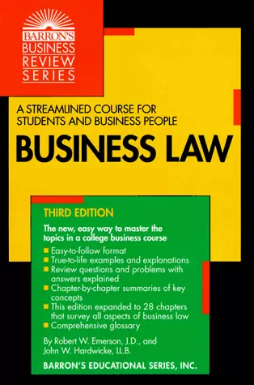
4- References
Business Law (Barron's Business Review) by Robert W. Emerson JD

Slide 40



Thank You

