Slide 1



Secure Operating Systems (CYB610)
Master of Science in Cybersecurity
Lecture 4
OS Attacks and Countermeasures
Dr. Ibrahim Gomaa
Faculty of Informatics
Midocean University
Lecture-4
www.midocean.ae

Slide 2


Chapter
Topics
04
This chapter covers the following topics and concepts:
Types of Malware
Relocation
Base / Bounds Registers
Buffer Overflow attack
Cross Site Scripting (XSS) attack
Input Validation

Slide 3
Chapter
Goals
04
When you complete this chapter, you will be able to:
Define the difference between types of malware
Explain the virus effects
Determine the virus signatures
Build a protected memory and address
Explain what is the memory corruption defenses
How to validating input syntax

Slide 4
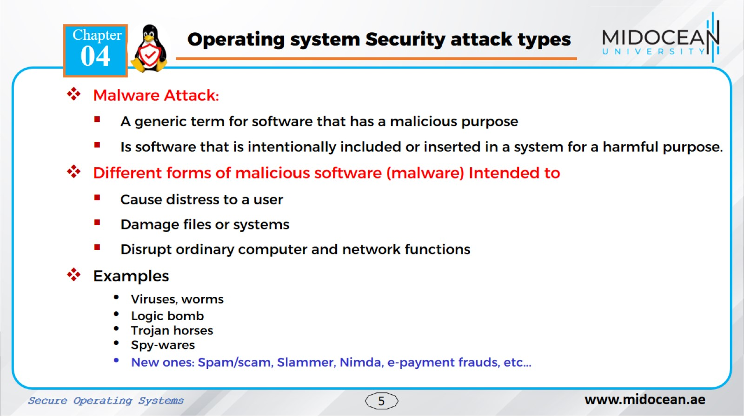

Slide 5
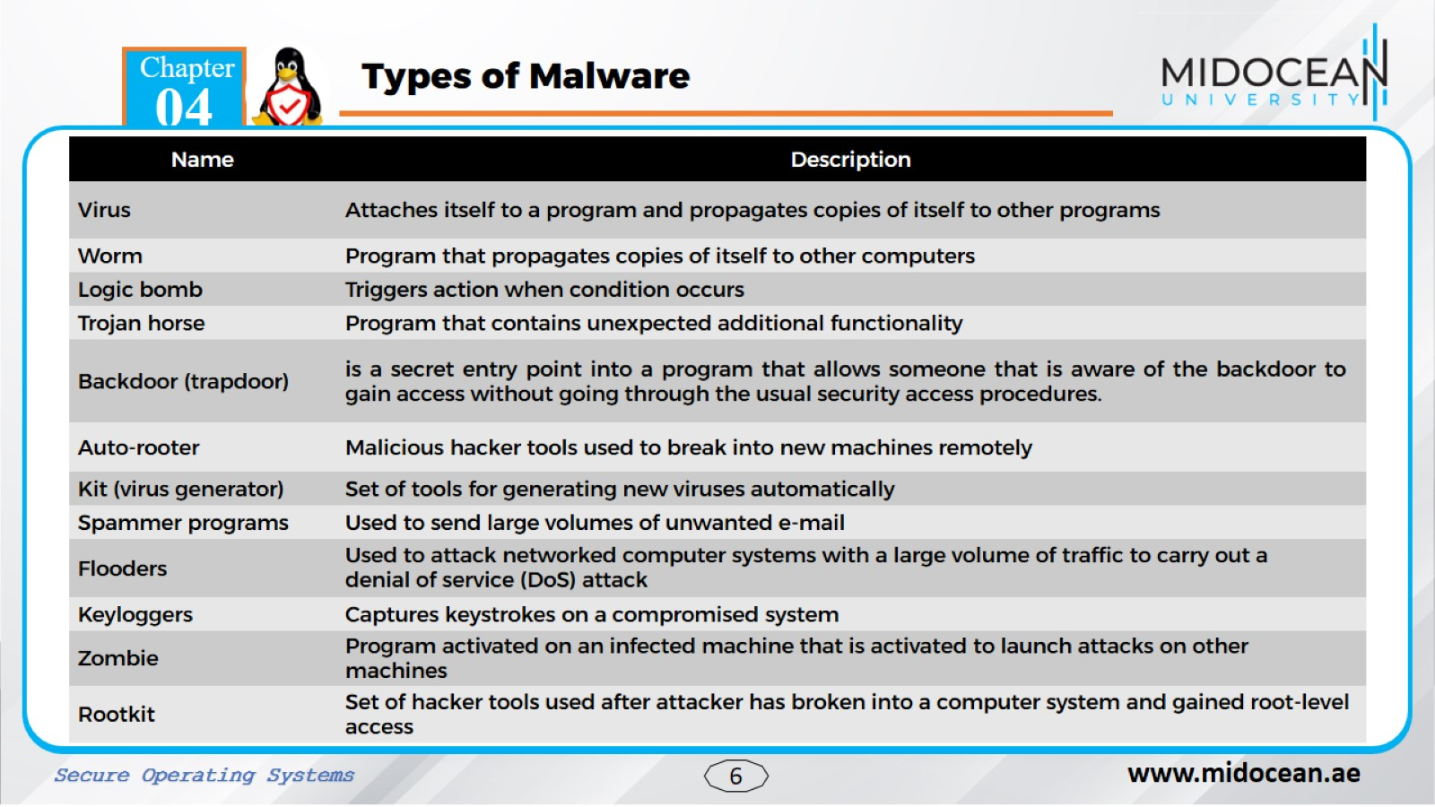

Slide 6
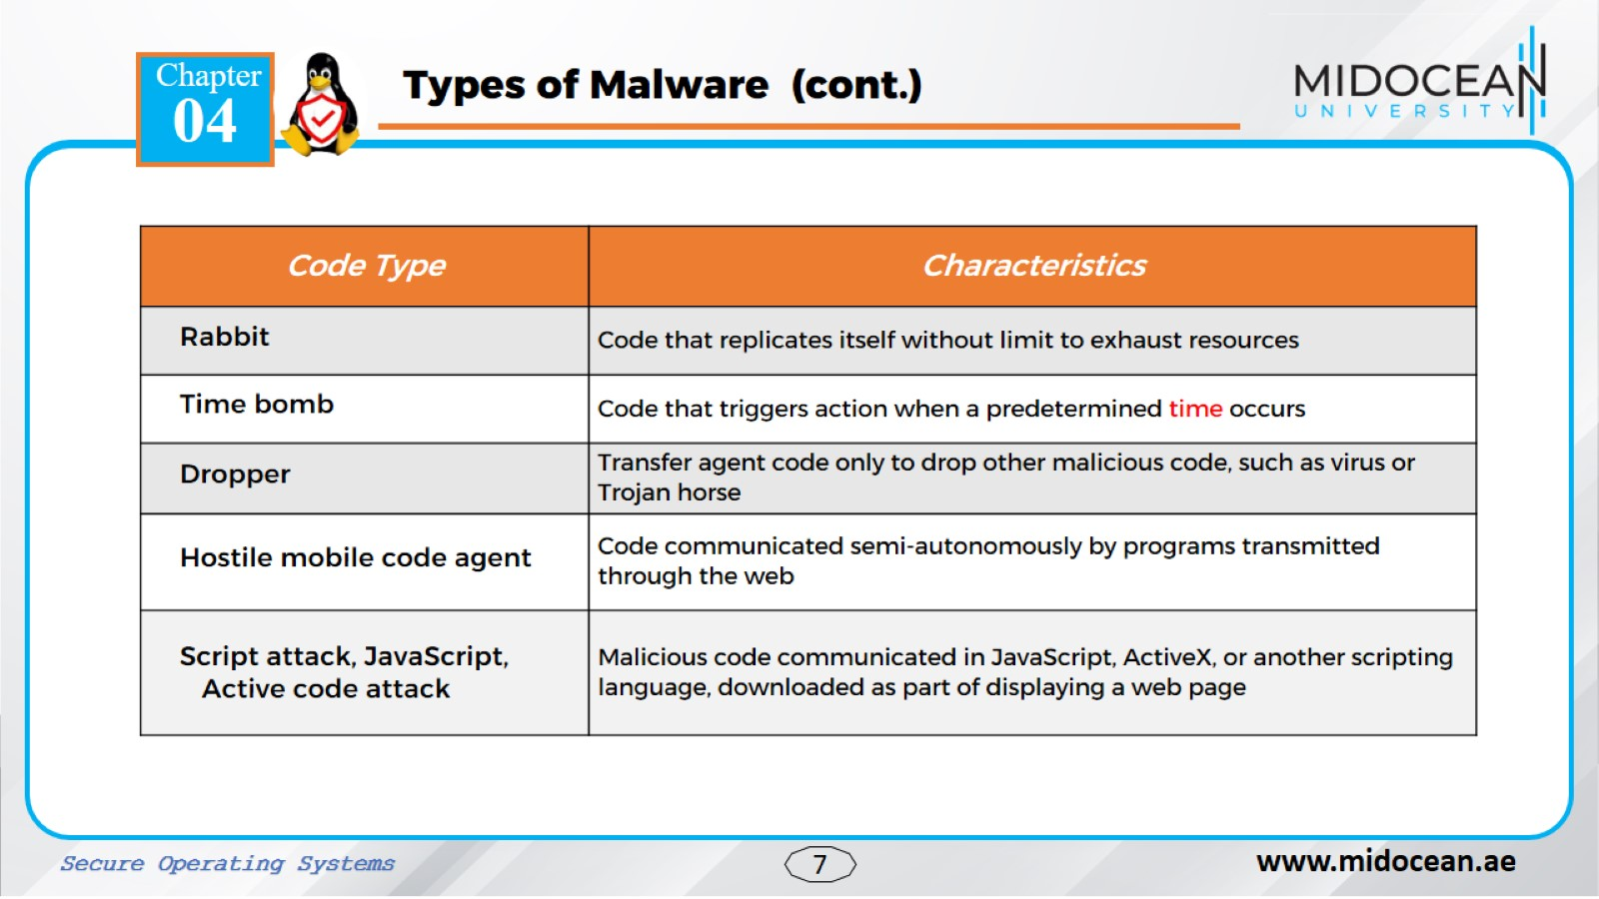
A dropper is a Trojan horse that has been designed to install malware (such as viruses and backdoors) onto a computer. The malware within the dropper can be packaged to evade detection by antivirus software.
Hostile mobile code agent malware refers to malicious software designed to infiltrate mobile devices and carry out harmful actions

Slide 7
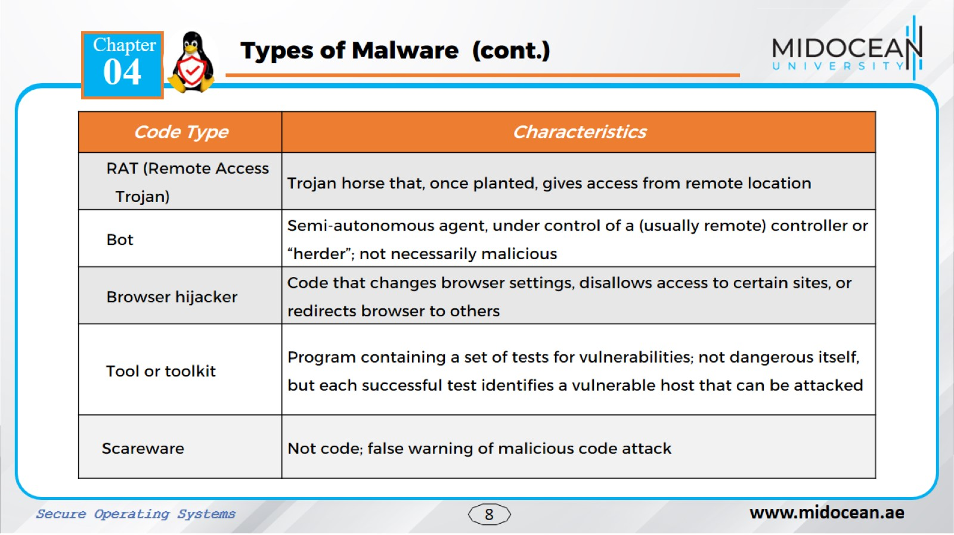

Slide 8
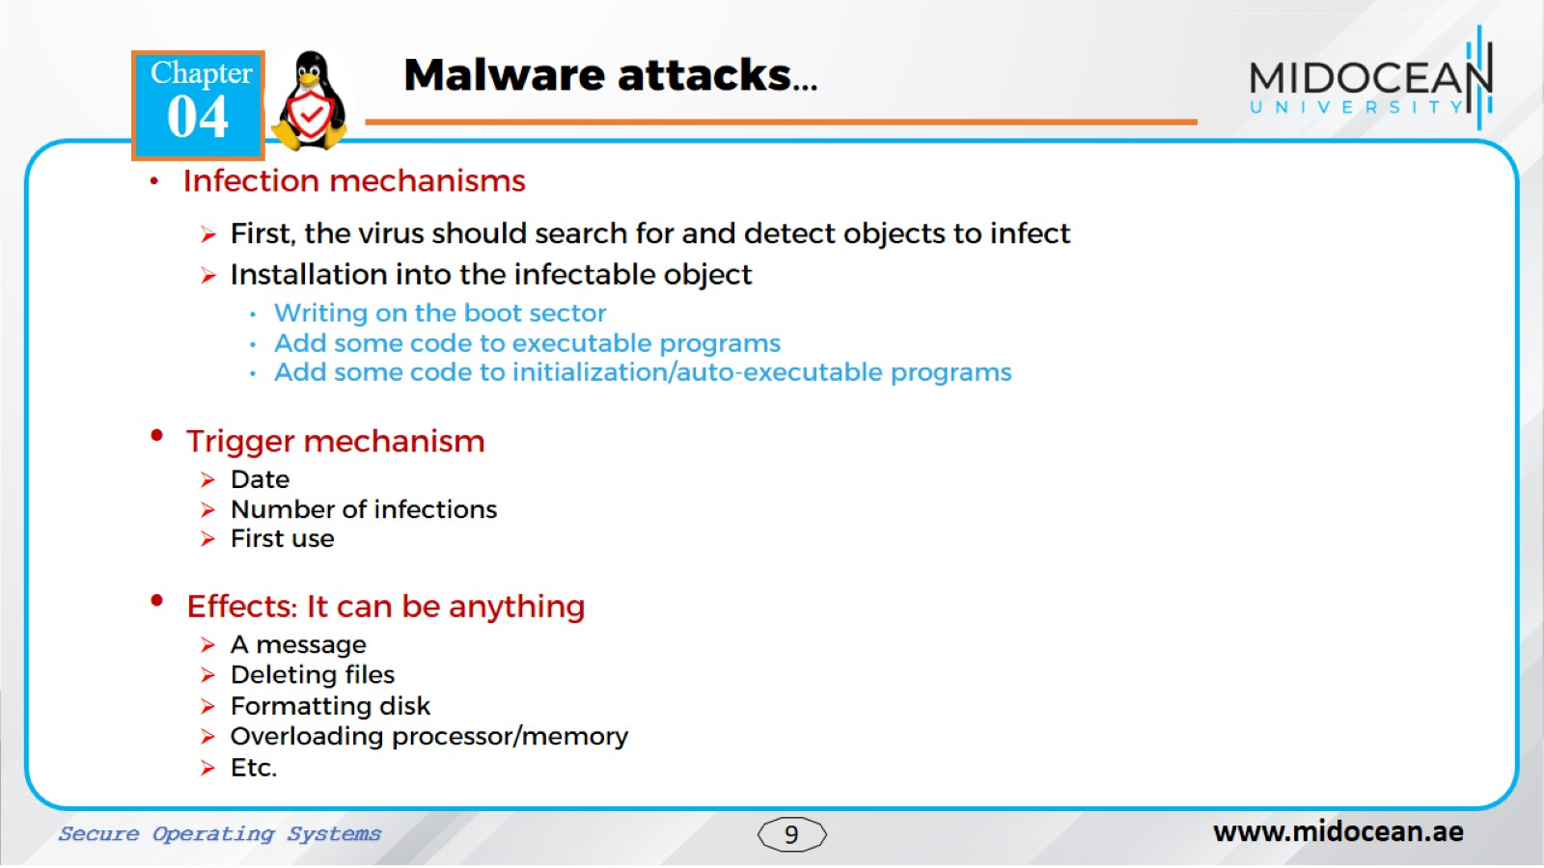

Slide 9
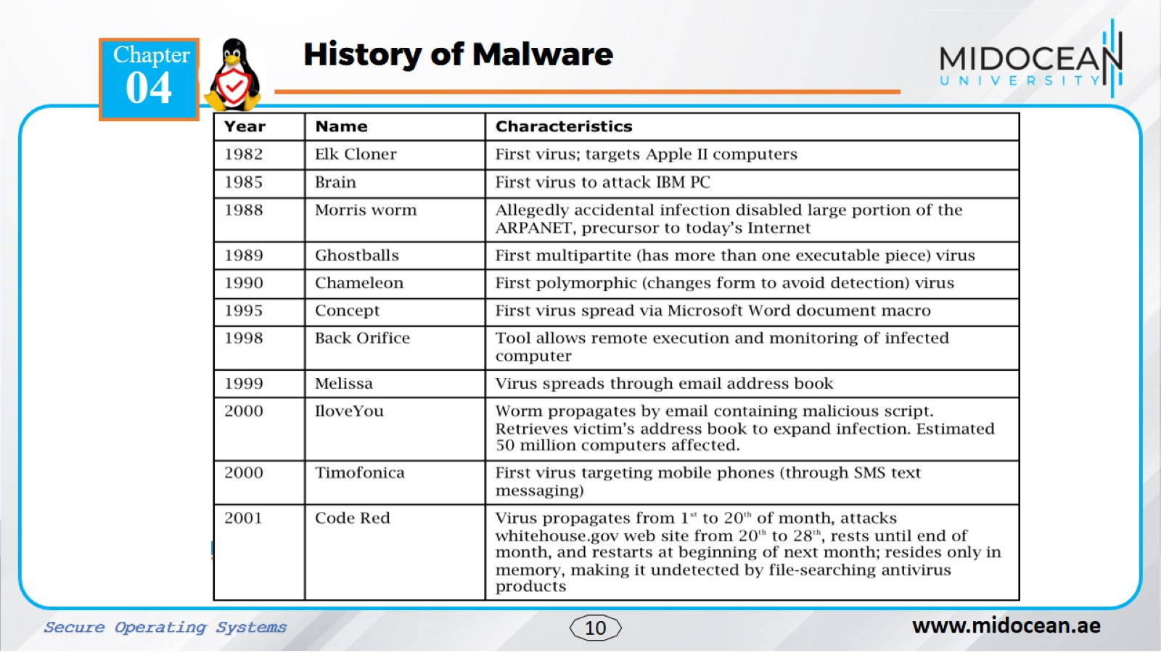

Slide 10
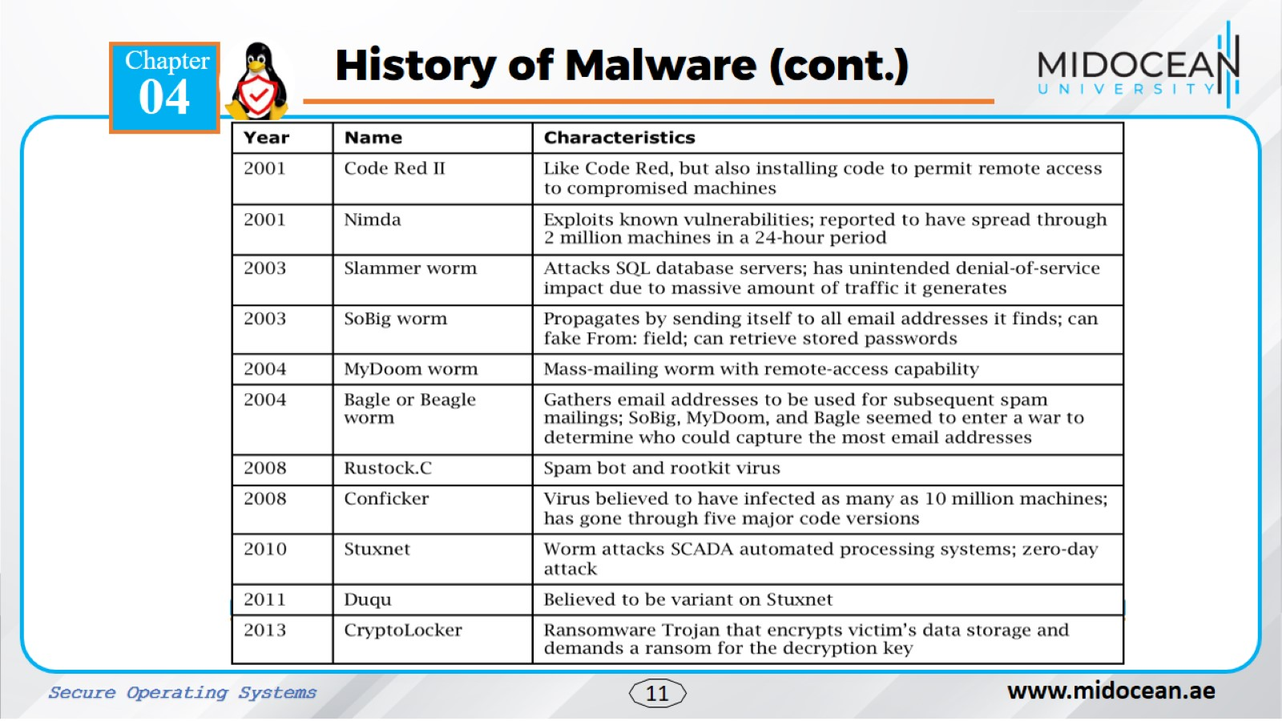

Slide 11
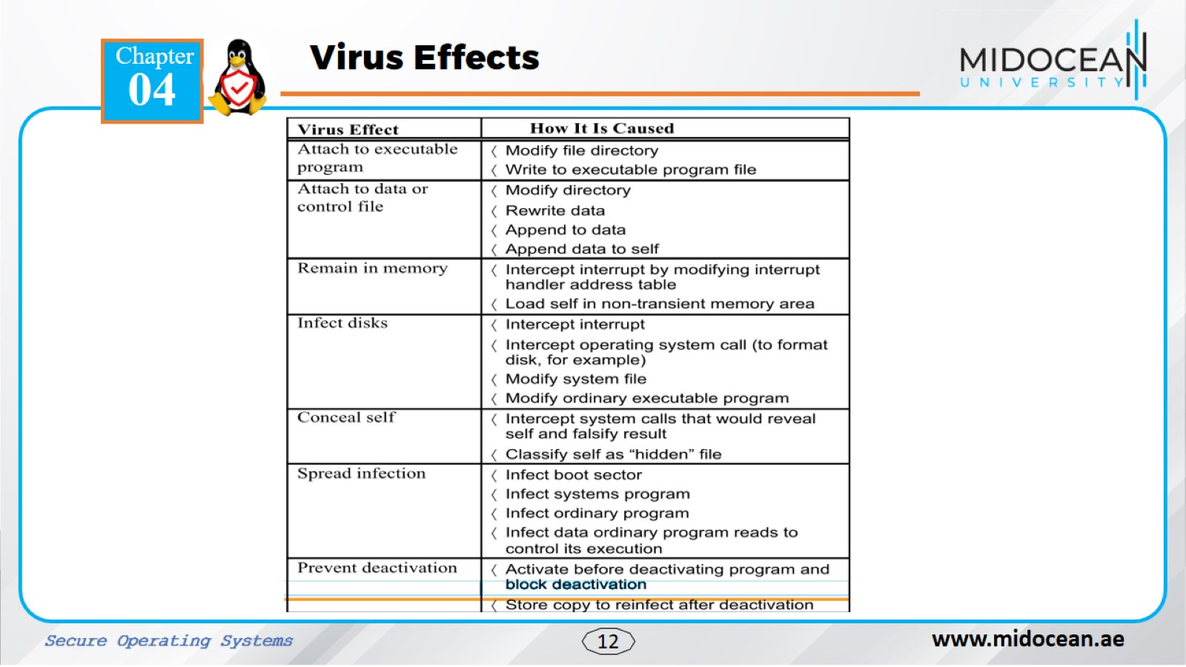

Slide 12
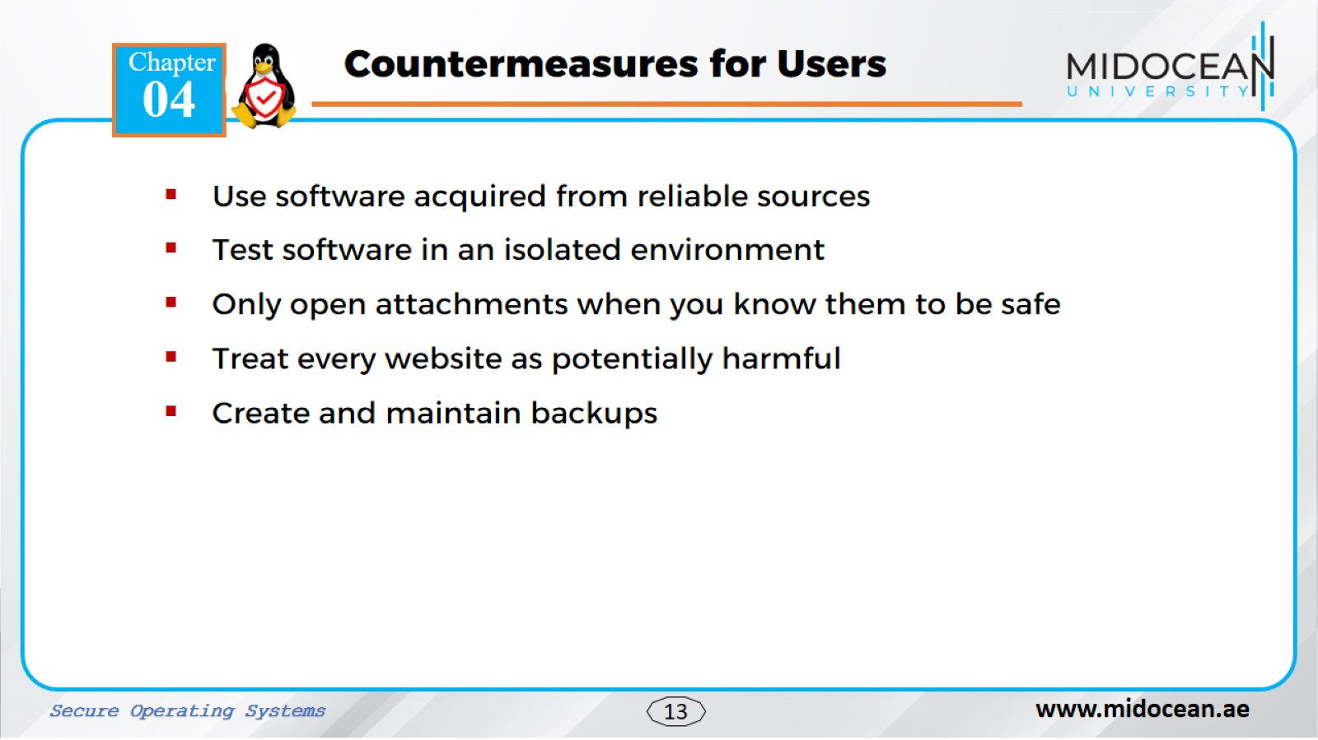

Slide 13
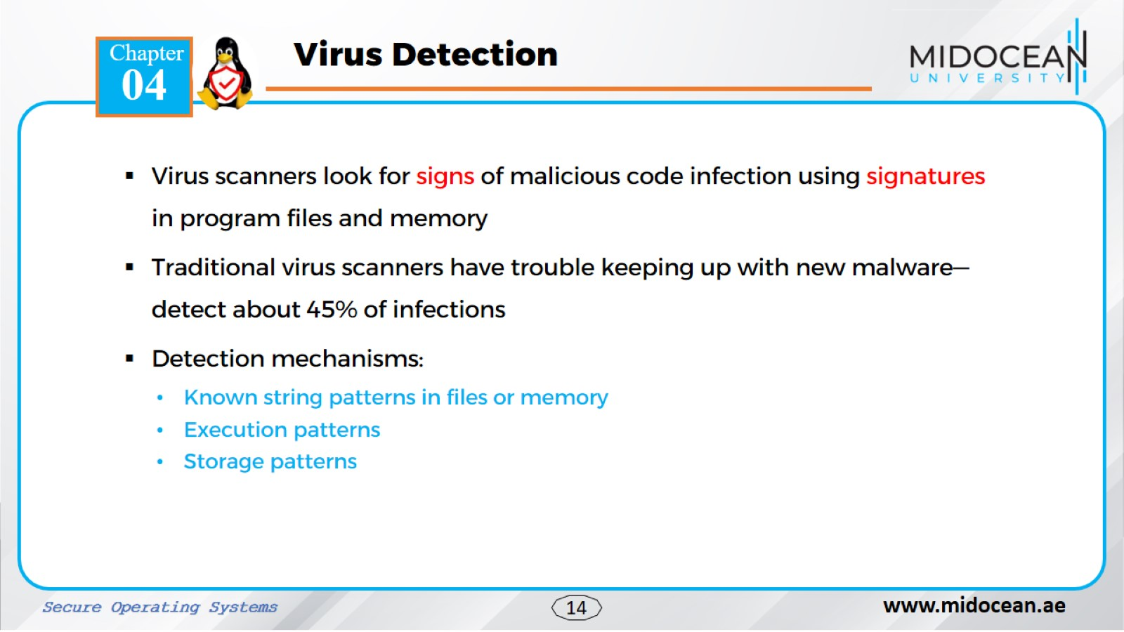

Slide 14
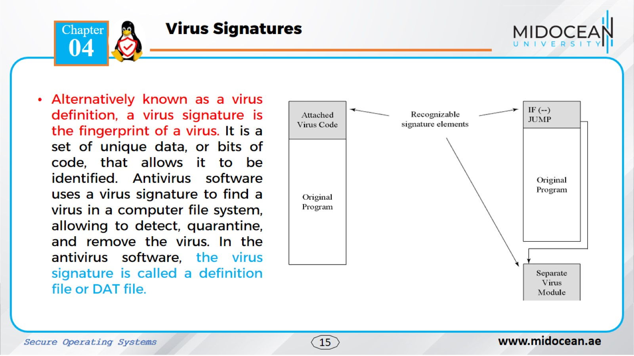

Slide 15
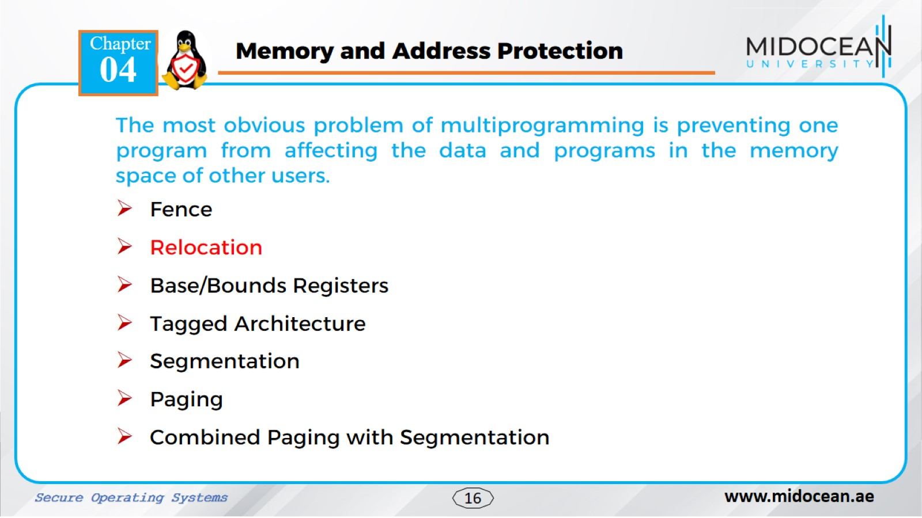

Slide 16
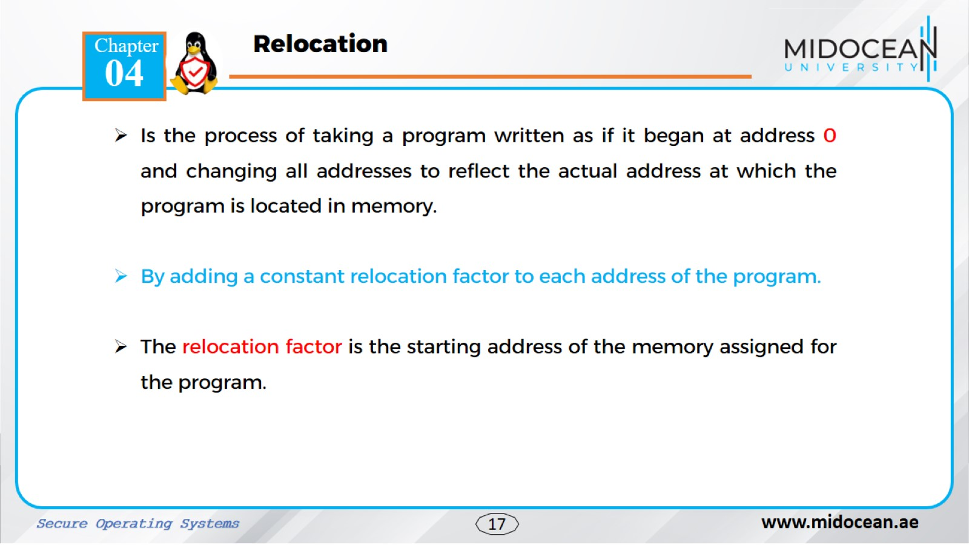
Relocation, in the context of memory address protection, is the process of adjusting the addresses within a program or data so that it can be loaded and executed at a different location in memory than where it was initially designed to run.

Slide 17
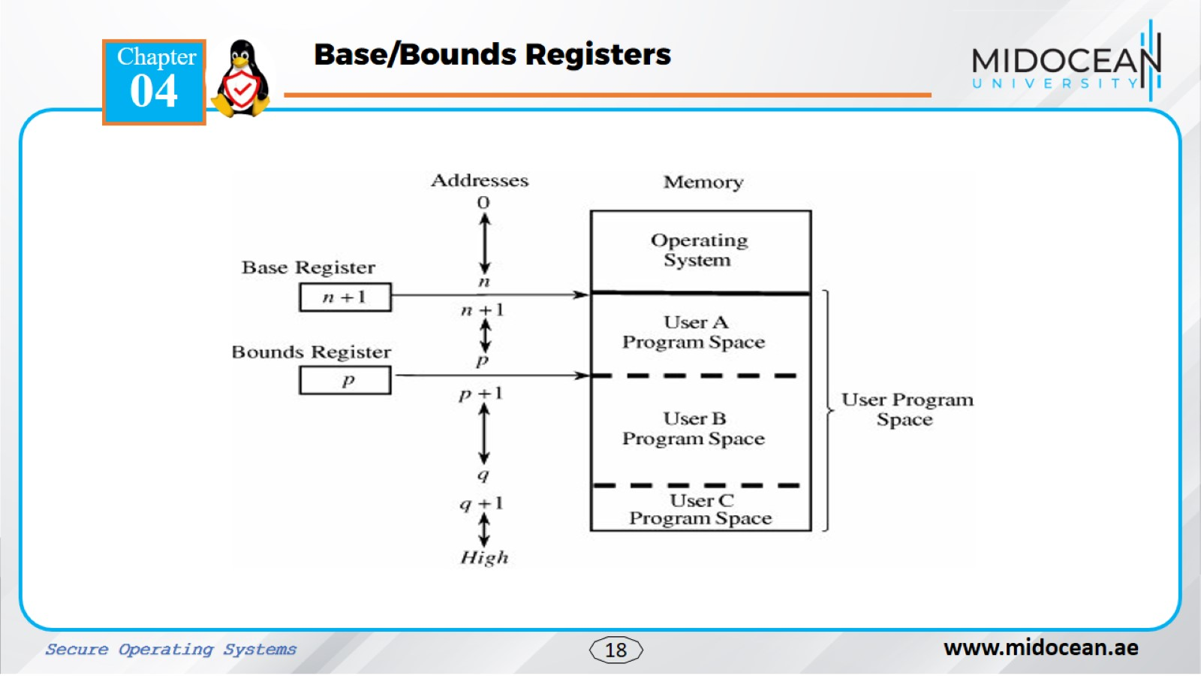
Notes:
In computing base and bounds refers to a simple form of virtual memory where access to computer memory is controlled by one or a small number of sets of processor registers called base and bounds registers. In its simplest form each user process is assigned a single contiguous segment of main memory

Slide 18
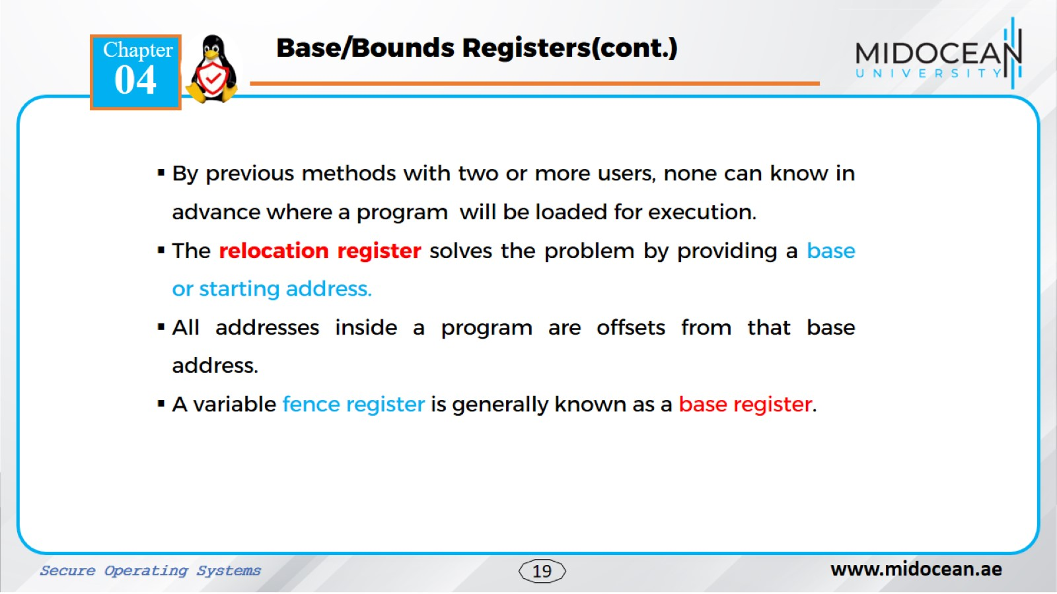

Slide 19
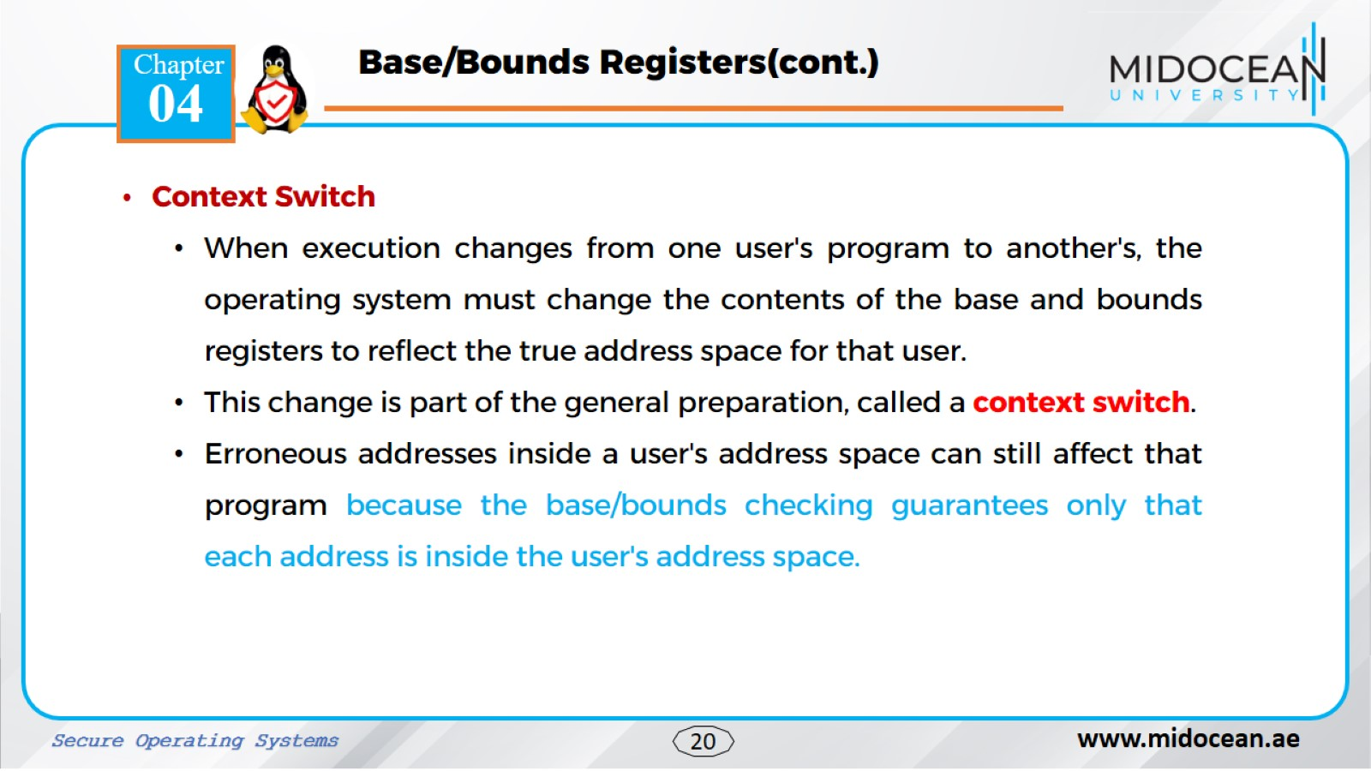

Slide 20
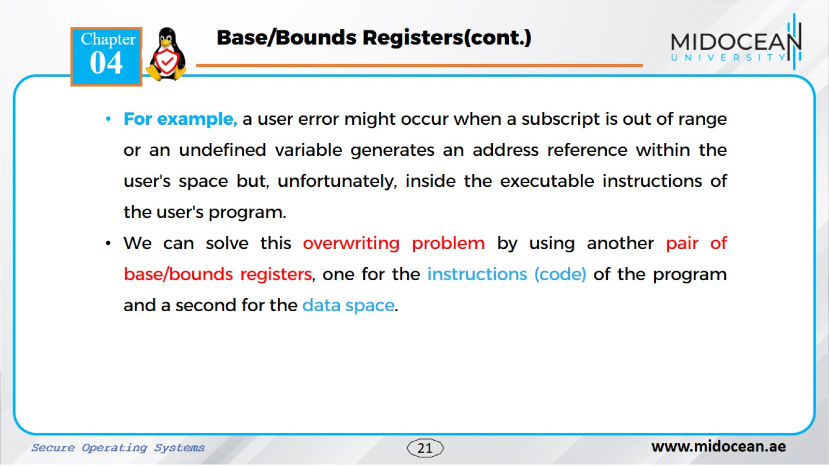

Slide 21
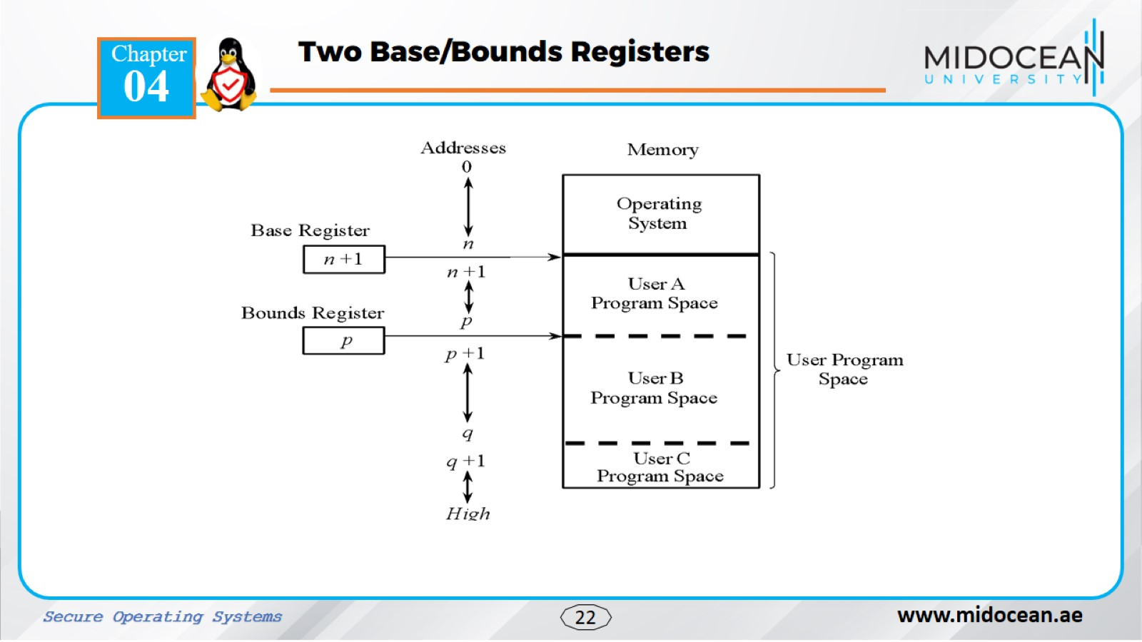

Slide 22
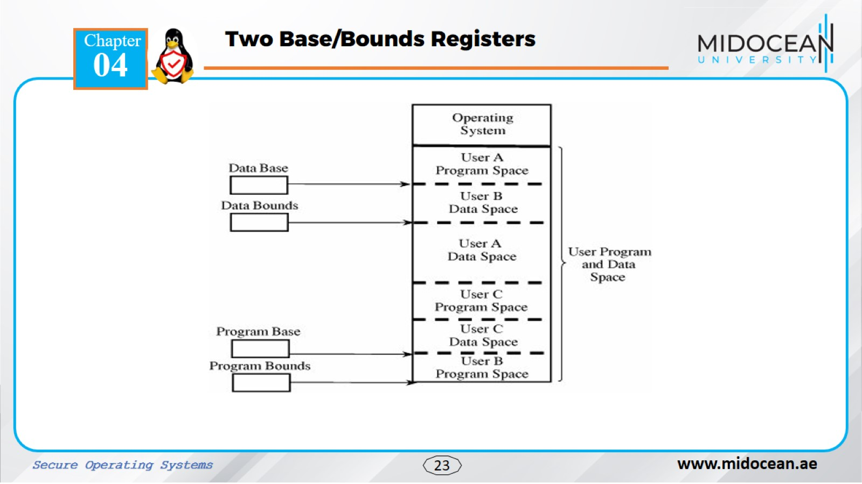

Slide 23
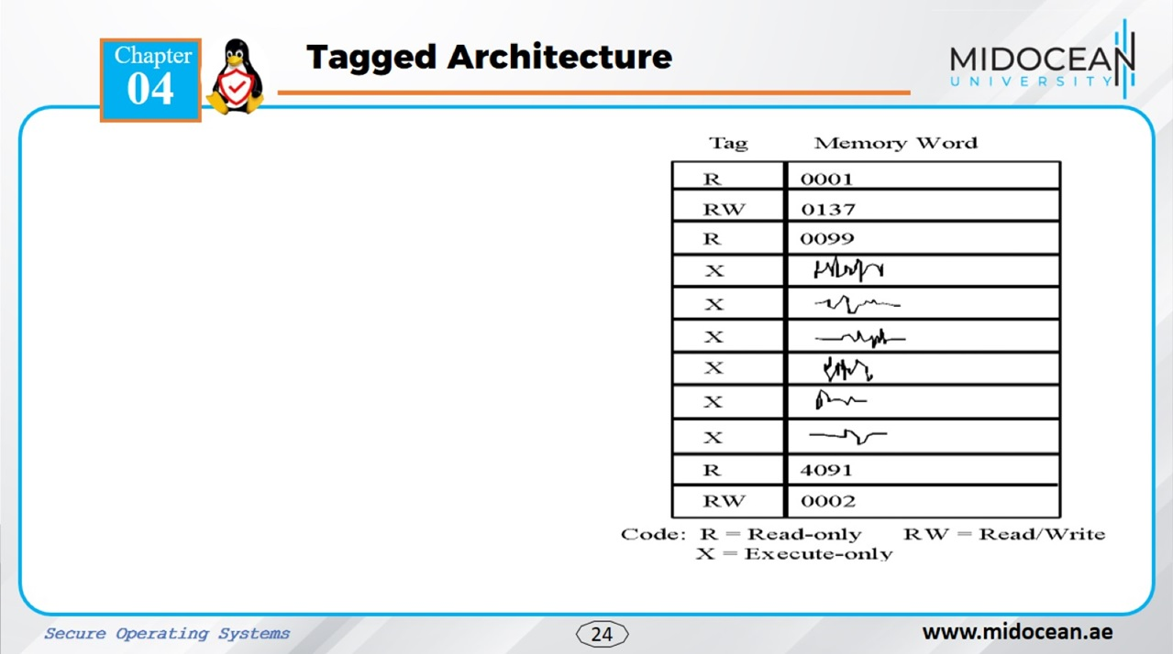
Tagged architecture enhances memory address protection by associating extra bits (tags) with each memory word, acting as metadata that defines the data type or function.
These tags are checked at runtime by the hardware to enforce security policies, preventing unauthorized access and thus enhancing security. This contrasts with software-based approaches which can be more vulnerable to attacks
As shown in the figure, one memory location may be protected as execute-only (for example, the object code of instructions), whereas another is protected for fetch-only (for example, read) data access, and another accessible for modification (for example, write). In this way, two adjacent locations can have different access rights.

Slide 24
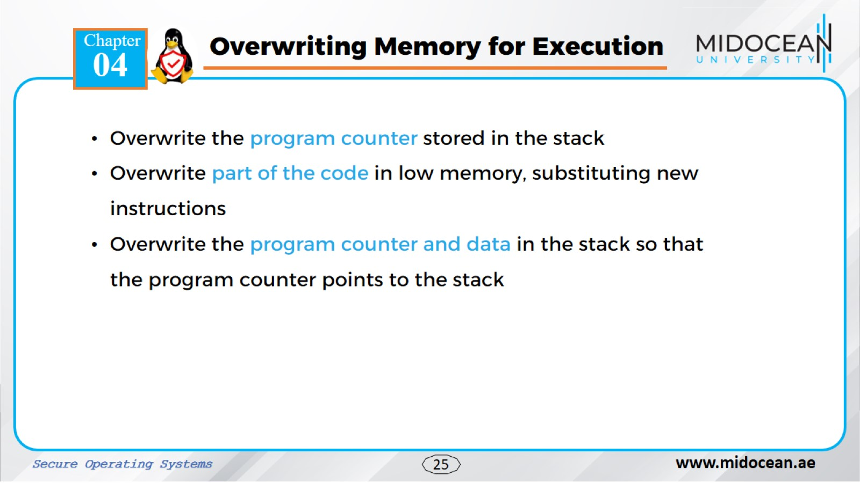

Slide 25
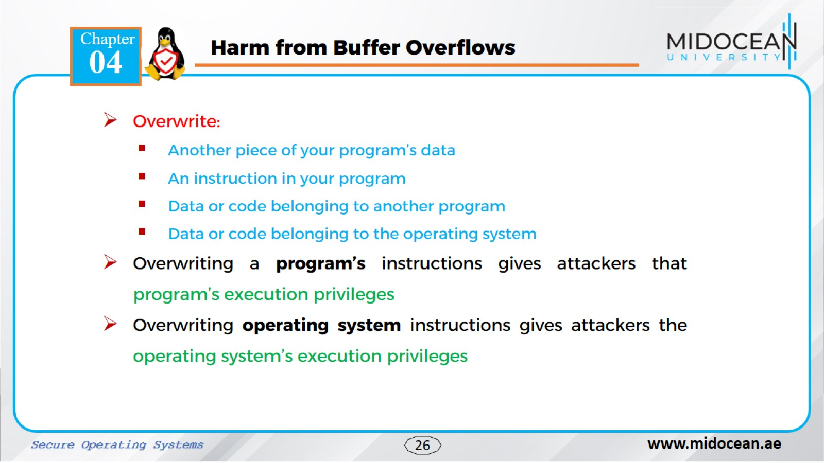

Slide 26
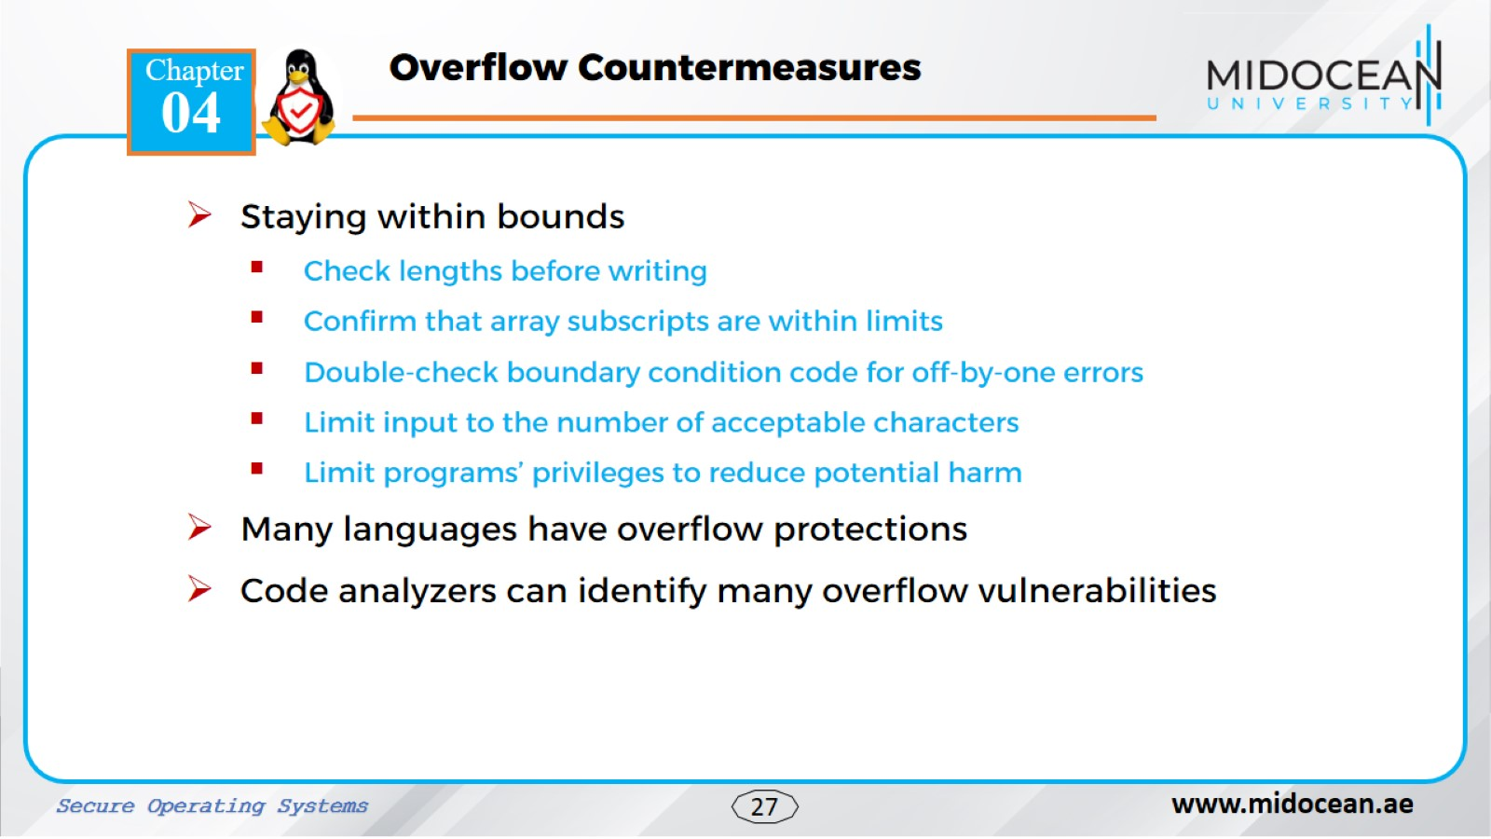

Slide 27
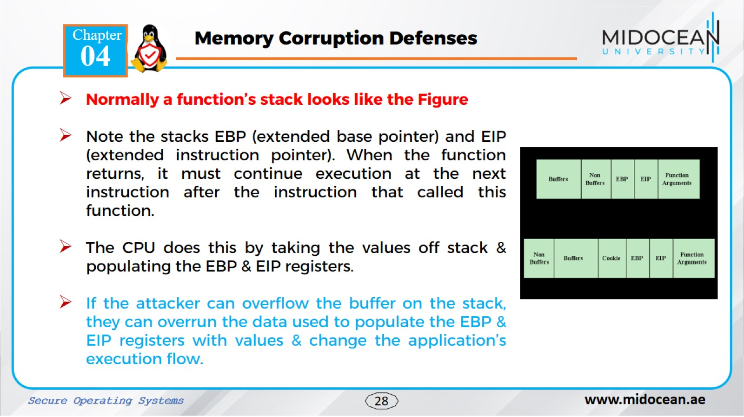

Slide 28
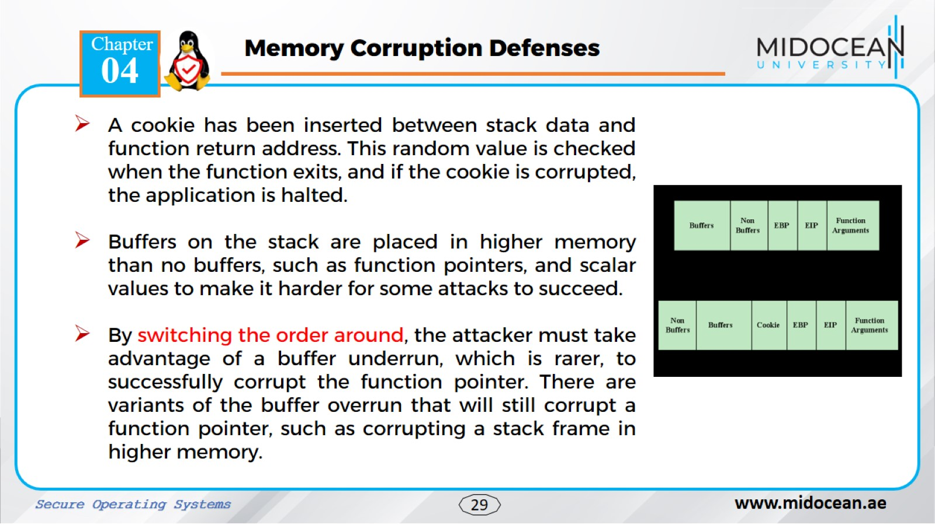

Slide 29
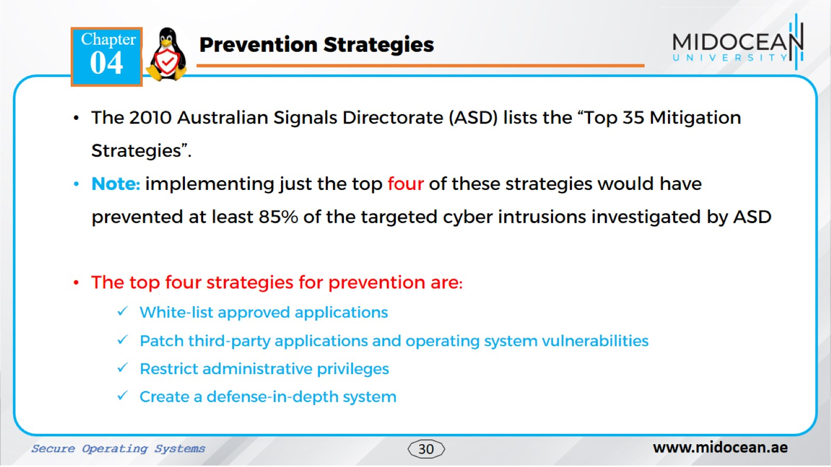

Slide 30
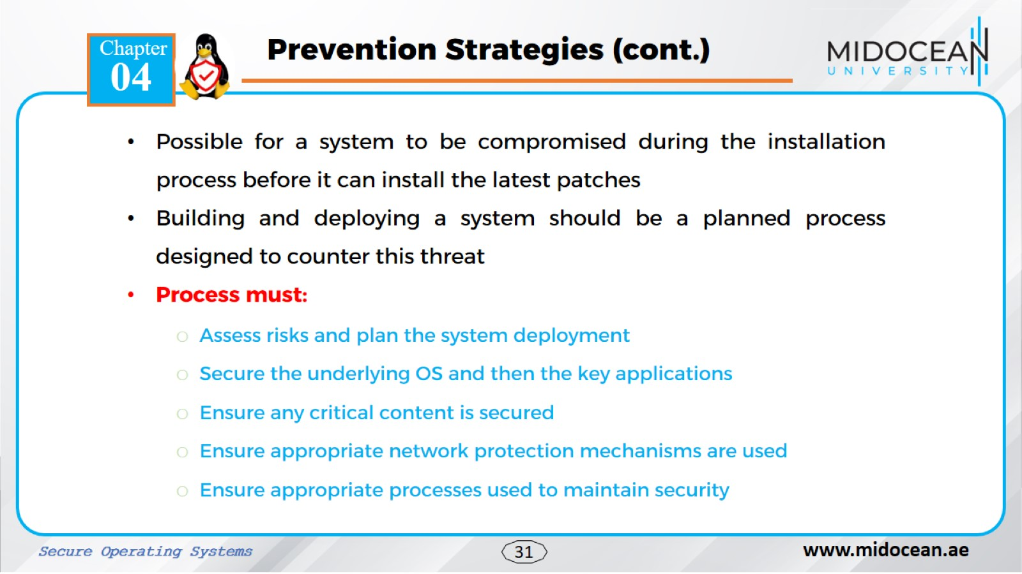

Slide 31
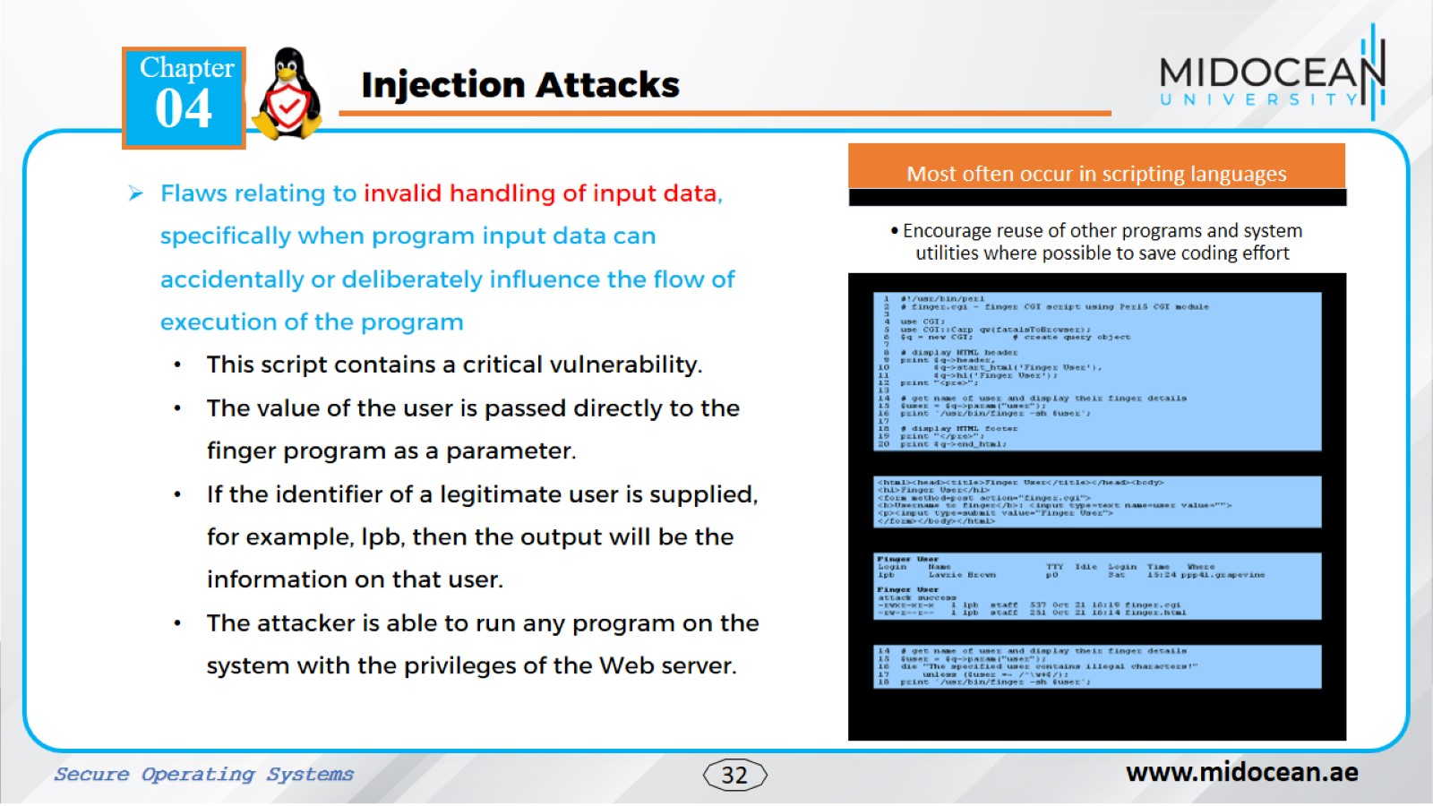

Slide 32
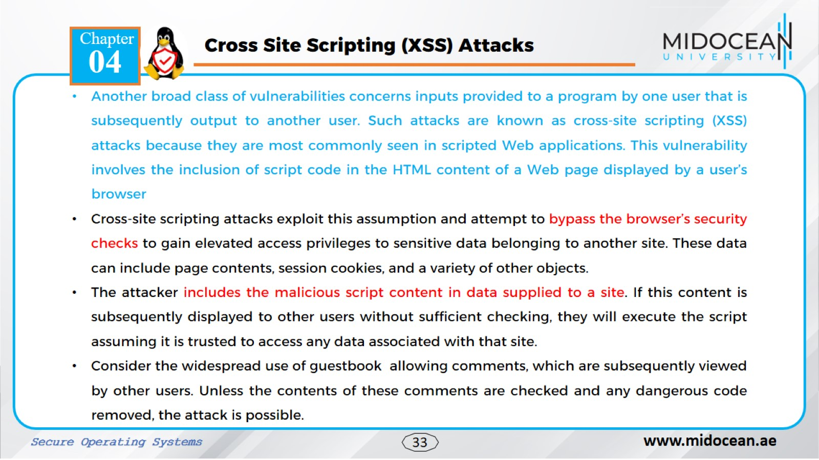

Slide 33
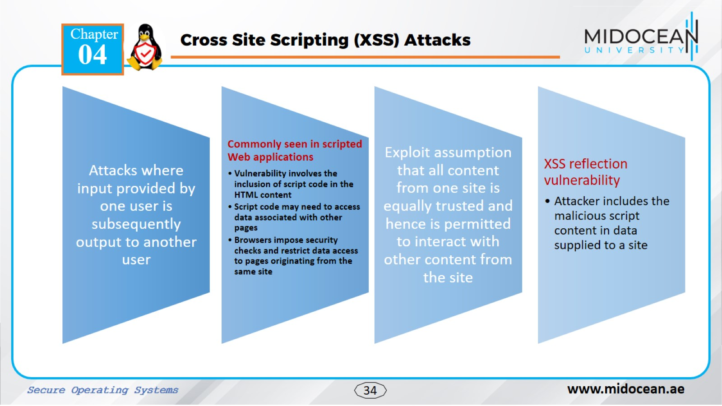

Slide 34
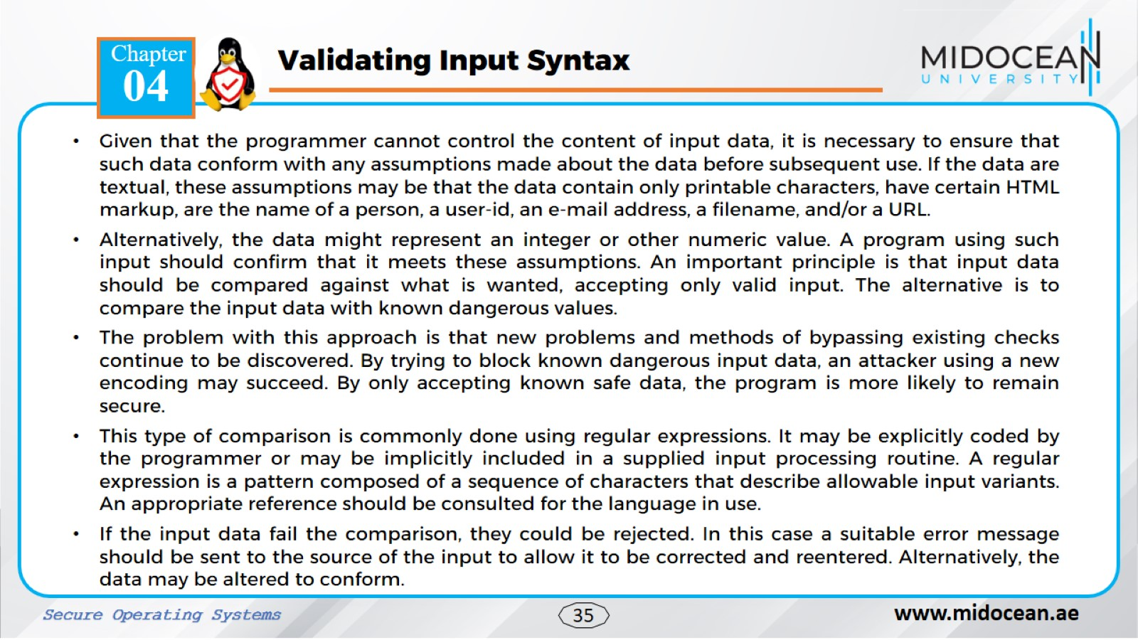

Slide 35
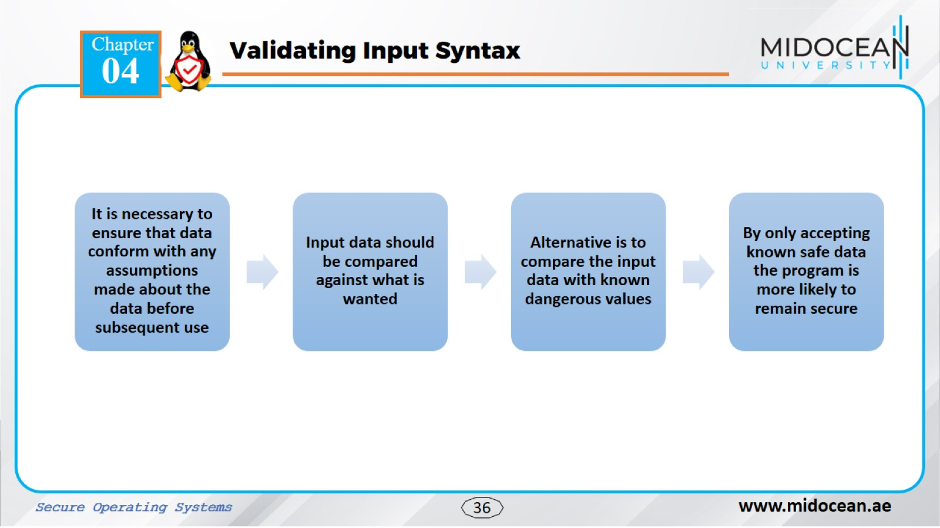

Slide 36
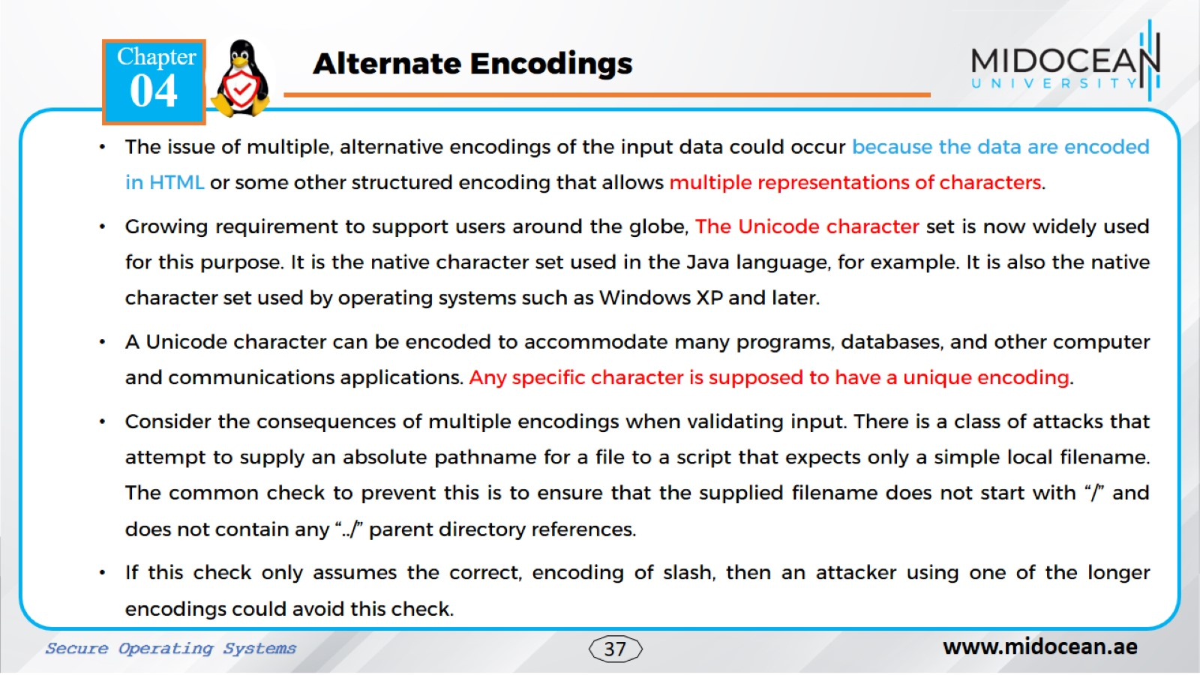

Slide 37
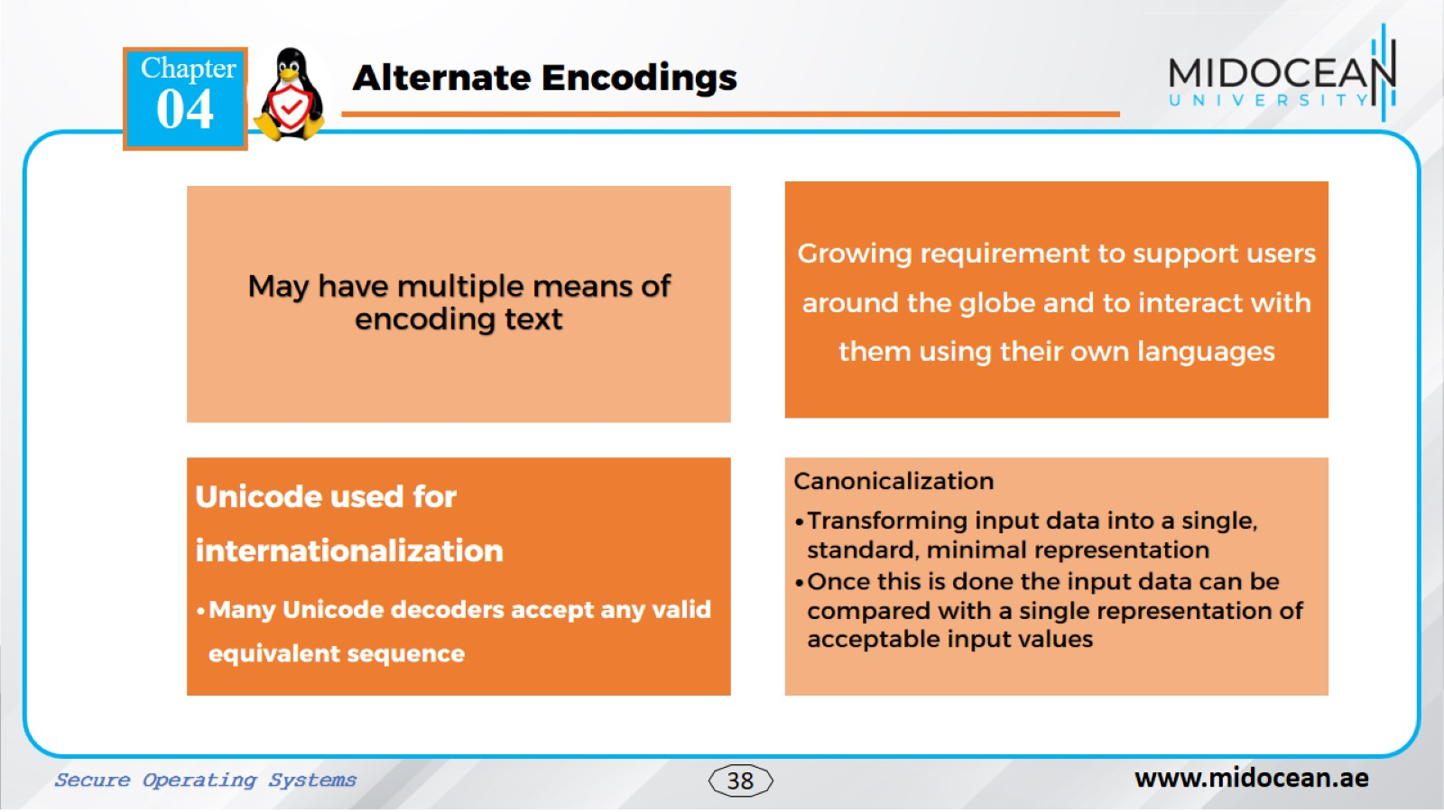

Slide 38
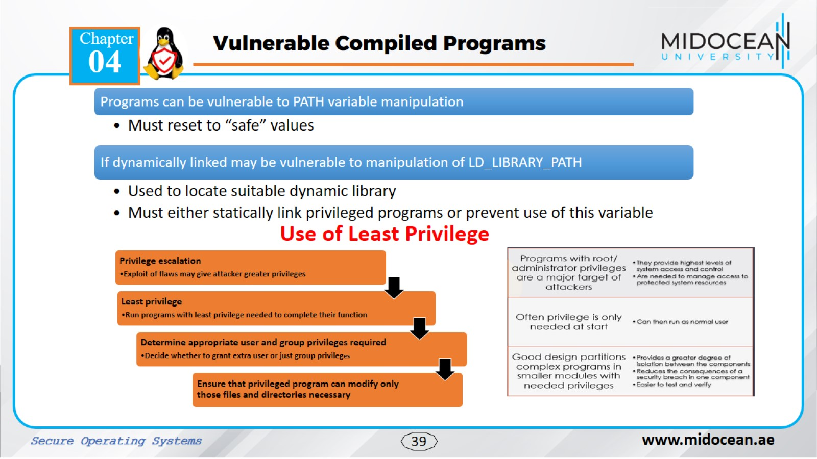

Slide 39
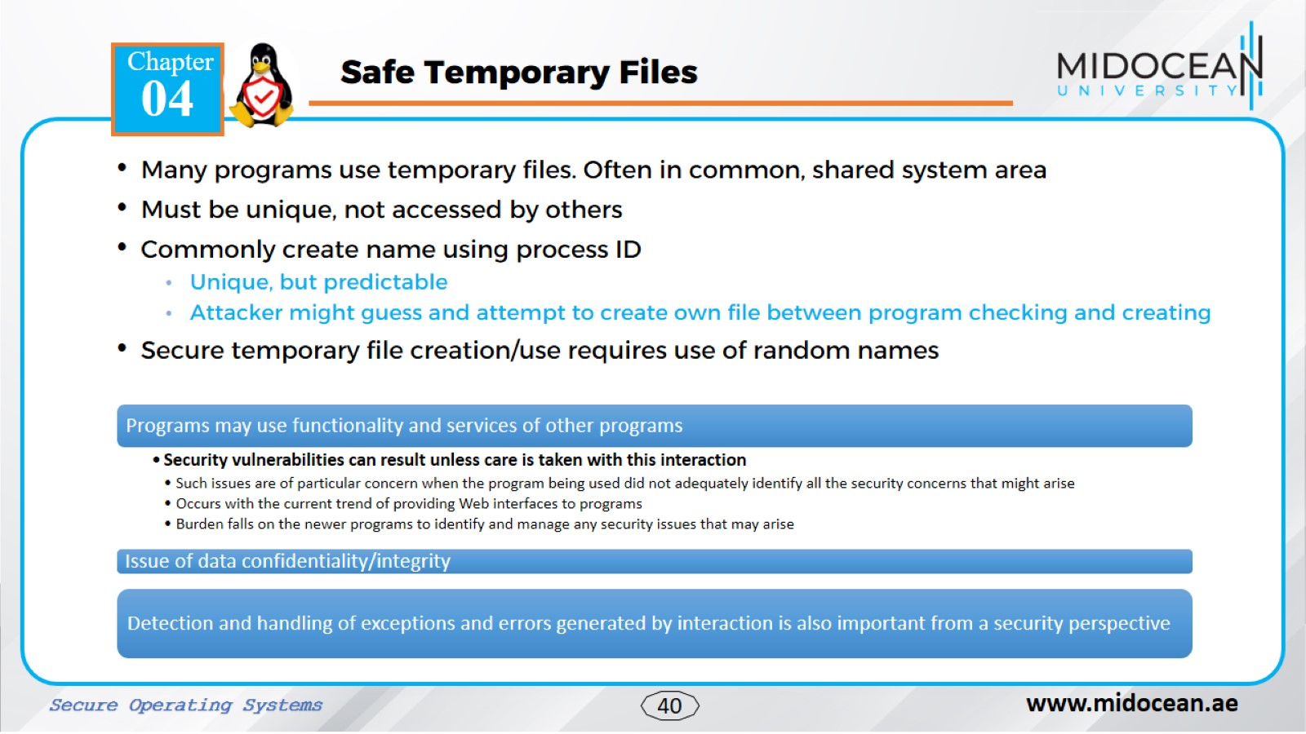

Slide 40
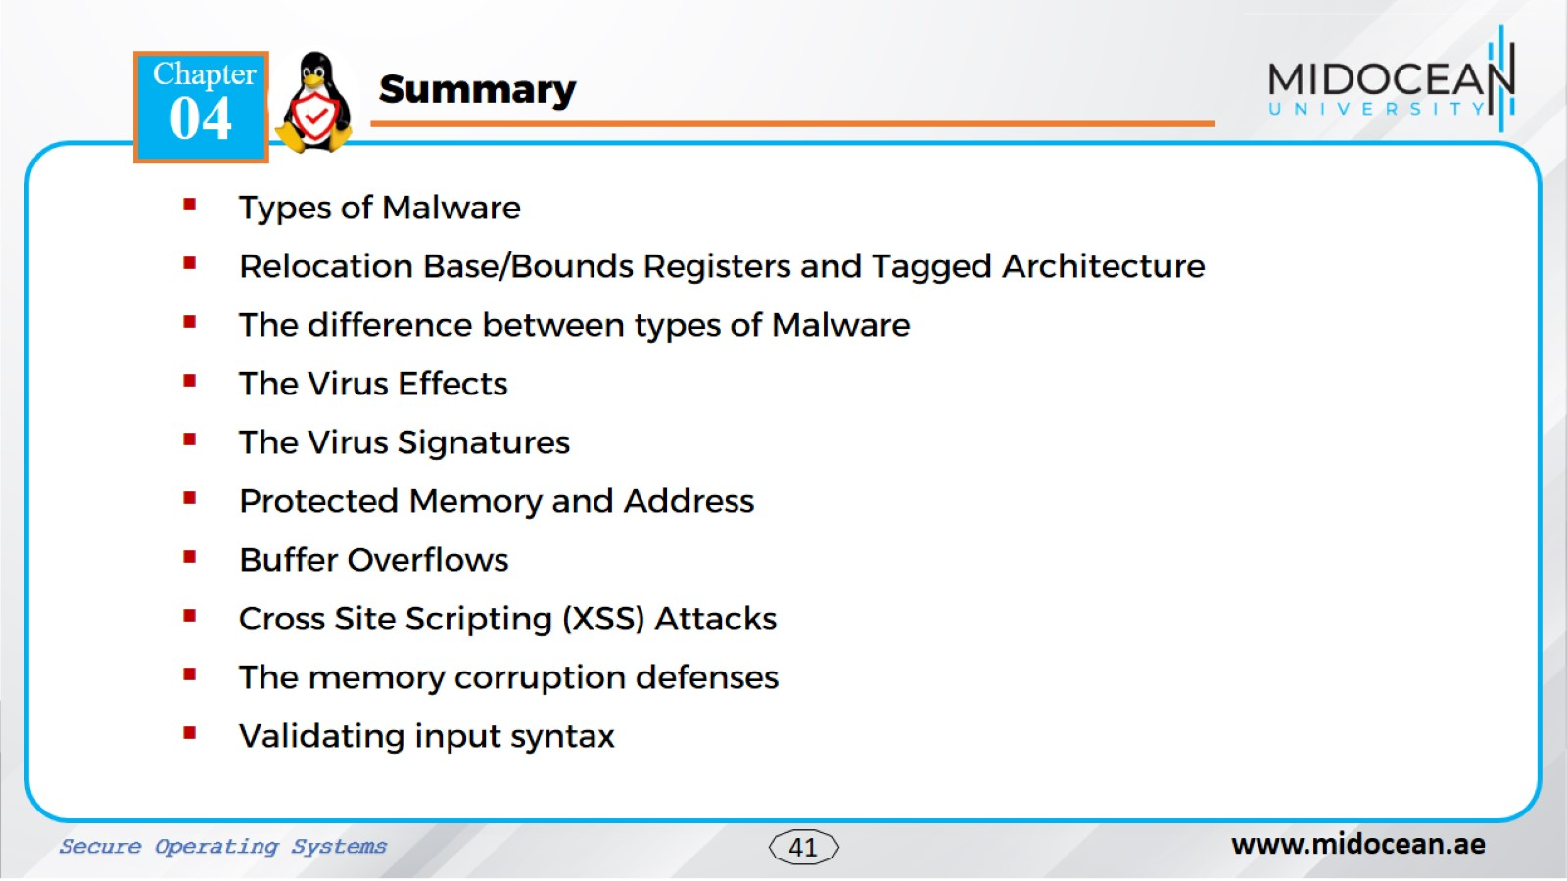

Slide 41


