Slide 1

Digital Consumer Behavior
Prepared by Dr. Noha El Aswad
Lecture 8
MKT713_
Master of Digital Marketing

Slide 2
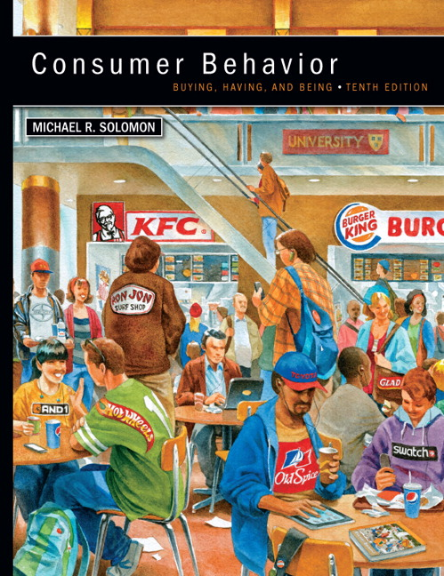

Chapter
02
Buying, Having, Being
CONSUMER BEHAVIOR, 10e
Michael R. Solomon

Slide 3
Chapter
02
Chapter Objectives
When you finish this chapter, you should understand why:
  Ethical business is good business.
  Marketers have an obligation to provide safe and functional products as part of their business activities.
  Consumer behavior impacts directly on major public policy issues that confront our society.
  Consumer behavior can be harmful to individuals and to society

Slide 4
Chapter
02
Lecture Objectives 1/2
When you finish this lecture, you should understand why:
Part 2 in Learning objective two in chapter 2
  Market regulation
    Corrective advertising
  Consumerism
    Culture jamming
  Transformative Consumer
  Social Marketing and Corporate Social responsibility
    Corporate Social responsibility
    Social Marketing
    Cause marketing

Slide 5
Chapter
02
Lecture Objectives 2/2
When you finish this lecture, you should understand why:
Part 1 in Learning objective three in chapter 2 (Consumer behavior impacts directly on major public policy issues that confront our society.).
  Major policy issues relevant to Consumer Behavior
    Data privacy and identity theft
    Real-time bidding
    Identity theft
  ?

Slide 6
Chapter
2
Market regulation 1/3
Concern for the welfare of consumers has been an issue since a least the beginning of the 20th century, and activists continue to voice concerns about a range of issues such as child labor, exploitative advertising, and genetically engineered food

Slide 7
Chapter
2
Market regulation 2/3
Partly as a result of consumers’ efforts, the U.S. government established many federal agencies to oversee consumer-related activities. These include the Department of Agriculture, the Federal Trade Commission, the Food and Drug Administration, the Securities and Exchange Commission, and the EPA.

Slide 8
Chapter
2
Market regulation 3/3
One of the most important ones for consumers is The Food and Drug Administration (FDA); it polices advertising claims as well as the contents of edible products and pharmaceuticals.

Slide 9
Chapter
2
A- Corrective advertising 1/3
For example, as part of an FDA crackdown on consumer drug advertising, Bayer HealthCare Pharmaceuticals launched a $20 million corrective advertising campaign for Yaz, the most popular birth control pill in the United States.

Slide 10
Chapter
2
A-Corrective advertising 2/3
This term means that the company must inform consumers that previous messages were wrong or misleading.

Slide 11
Chapter
2
A-Corrective advertising 3/3
The TV commercials, which ran during prime-time shows such as Grey’s Anatomy and on cable networks, warn that nobody should take Yaz hoping that it will also cure pimples. Bayer was required to run these ads to correct previous messages after regulators decided the previous ads overstated the drug’s ability to improve women’s moods and clear up acne.

Slide 12
Chapter
2
Consumerism 1/3
President John F. Kennedy ushered in the modern era of consumerism with his “Declaration of Consumer Rights” in 1962. These include the right to safety, the right to be informed, the right to redress, and the right to choice.

Slide 13
Chapter
2
Consumerism 2/3
The 1960s and 1970s were a time of consumer activism as consumers began to organize to demand better-quality products (and to boycott companies that did not provide them).

Slide 14
Chapter
2
Consumerism 3/3
Many people have a vigorous interest in consumer-related issues, ranging from environmental concerns such as global warming and climate change, toxic waste, and so on

Slide 15
Chapter
2
A-Culture jamming 1/2
which is a strategy to disrupt efforts by the corporate world to dominate our cultural landscape.

Slide 16
Chapter
2
A-Culture jamming 2/2
The movement believes that “culture jamming” will change the way information flows; the way institutions wield power; the way TV stations are run; and the way the food, fashion, automobile, sports, music, and culture industries set their agendas.

Slide 17
Chapter
2
Transformative Consumer 1/3
Indeed, some consumer researchers are themselves organizing, not only to study but also to rectify what they see as pressing social problems in the marketplace. This perspective is called participatory action research (PAR) or transformative consumer research (TCR).

Slide 18
Chapter
2
Transformative Consumer 2/3
It promotes research projects that include the goal of helping people or bringing about social change.

Slide 19
Chapter
2
Transformative Consumer 3/3
Adherents of TCR work with at-risk populations, such as children, the disadvantaged, and the disabled, or on such topics as materialism and consumption of dangerous products.

Slide 20
Chapter
2
Social Marketing and Corporate Social responsibility (CSR) 1/3
The evidence is mounting that a brand’s philanthropic activities can influence shopper behavior and ultimately purchase decisions. Consumers are especially interested in choosing brands that support causes they find personally relevant.

Slide 21
Chapter
2
Social Marketing and Corporate Social responsibility (CSR) 2/3
These causes include medical cures and disease prevention, social change, faith-based initiatives, and animal and child welfare.

Slide 22
Chapter
2
Social Marketing and Corporate Social responsibility (CSR) 3/3
As the emerging TCR ( Transformative Consumer Research) perspective shows, the field of consumer behavior can help to improve our lives as consumers.

Slide 23
Chapter
2
A- Corporate Social responsibility (CSR) 1/3
Many firms today try to integrate corporate social responsibility (CSR) into their business models. CSR describes processes that encourage the organization to make a positive impact on the various stakeholders in its community including consumers, employees, and the environment.

Slide 24
Chapter
2
A-Corporate Social responsibility (CSR) 2/3
For example, the shoe company TOMS is well-known for its promise to give a needy child a pair of shoes for every pair it sells. CSR is more than a nice idea; it’s also good business.

Slide 25
Chapter
2
A-Corporate Social responsibility (CSR) 3/3
Consumer research shows that, all things equal, people are likely to choose a brand that gives back to the community.

Slide 26

Chapter
2
B- Social Marketing 1/2
Social marketing strategies use the techniques that marketers normally employ to sell beer or detergent to encourage positive behaviors such as increased literacy and to discourage negative activities such as drunk driving.

Slide 27
Chapter
2
B- Social Marketing 2/2
Many researchers help to evaluate or create public policies to ensure that products are labeled accurately, to certify that people can comprehend important information in advertising messages, or to prevent children from being exploited by program-length toy commercials that masquerade as television shows.

Slide 28
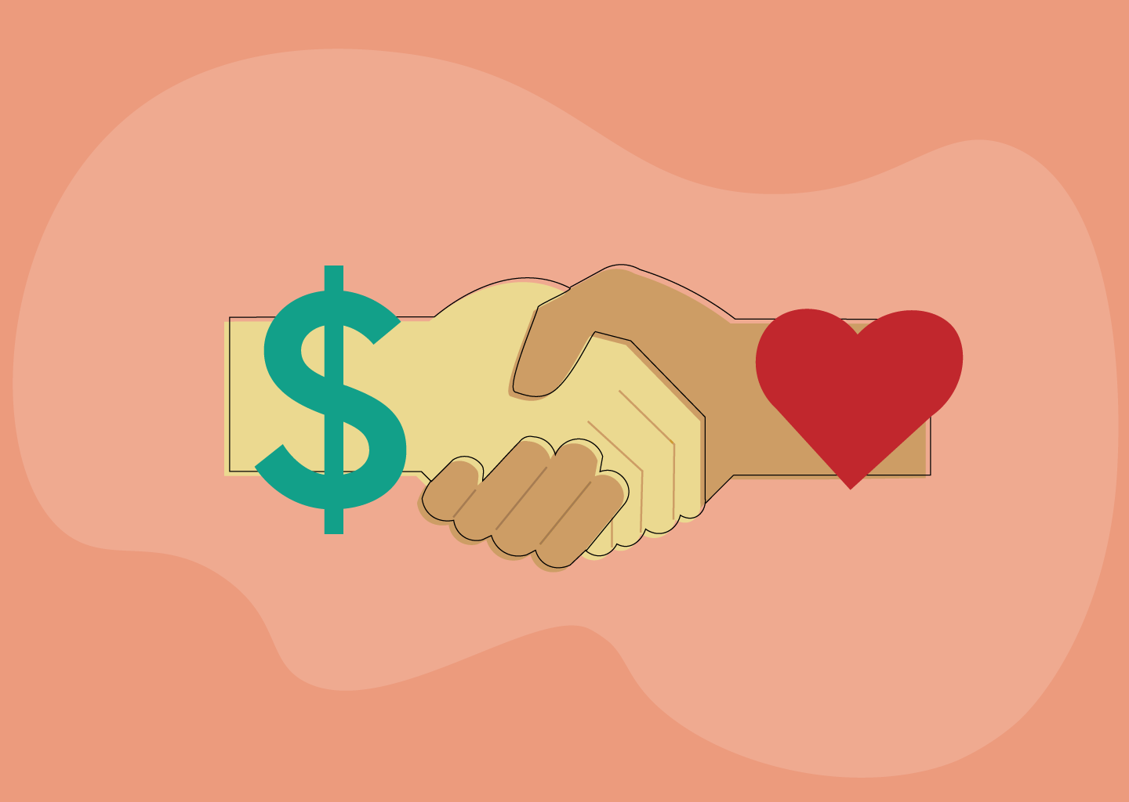
Chapter
2
Cause marketing 1/2
Cause marketing is a popular strategy that aligns a company or brand with a cause to generate business and societal benefits.

Slide 29
Chapter
2
Cause marketing 2/2
Indeed, one survey reported that three out of five consumers bought a product or service in the previous year because of its association with a cause. An executive observed, “As a whole, Americans do have a heightened sensitivity to how they can help make a difference.

Slide 30
Chapter
2
Learning objective 3
Consumer behavior impacts directly on major public policy issues that confront our society.

Slide 31
Chapter
2
Major policy issues relevant to Consumer Behavior 1/2
It’s hard to divorce consumer behavior from most of what goes on around us.
The field intersects with many of the big issues we read about and debate every day.

Slide 32
Chapter
2
Major policy issues relevant to Consumer Behavior 1/2
These range from human rights and humane working conditions to the safety of what we eat, the future of our environment, and our relationships with governments, corporations, and other organizations.
In this section, we’ll introduce three major issues—without pretending to cover all of the important ones.

Slide 33
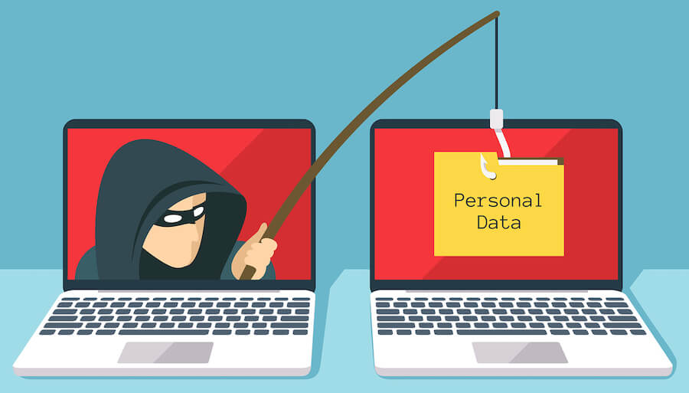
Chapter
2
Data privacy and identity theft 1/3
One of the biggest ethical issues many marketers face today relates to how much they can—or should—know about their customers. Virtually anyone who surfs the Web or who carries a cell phone (especially a smartphone with GPS capability) shares reams of personal information with all sorts of companies (whether they know it or not).

Slide 34
Chapter
2
Data privacy and identity theft 2/3
Clearly, we all benefit from technologies that allow companies to precisely tailor their messages to our needs based on the product information we look for. Indeed, industry researchers report that a lot of people actually don’t mind the ads if they are personally relevant.

Slide 35
Chapter
2
Data privacy and identity theft 3/3
But some consumer advocates argue that we pay a high cost for this convenience. As the director of one consumer group phrased it in a complaint to the Federal Trade Commission, “Online consumers are being bought and sold like chattel.”

Slide 36
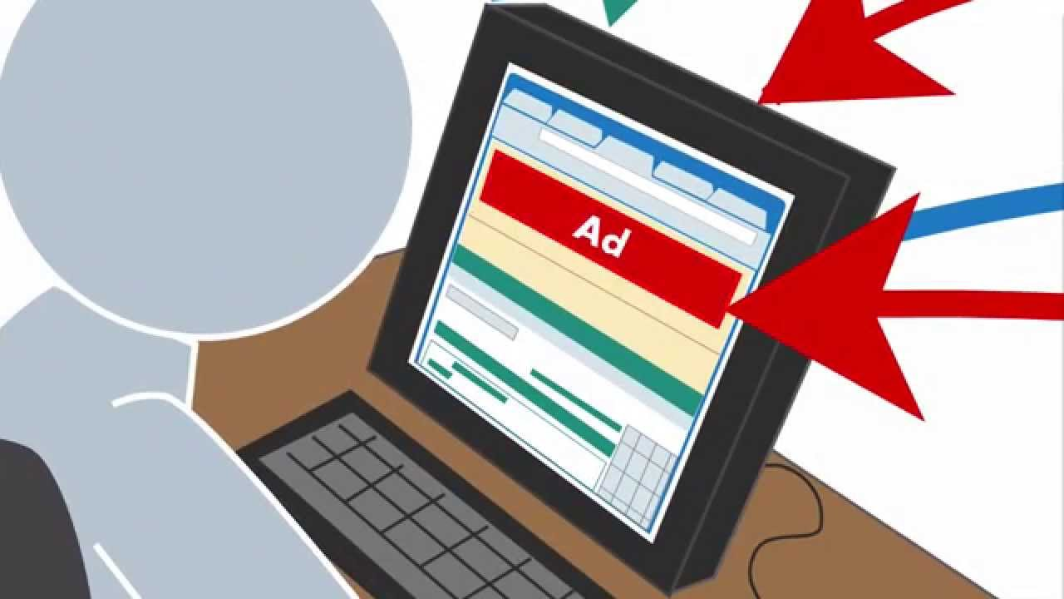
Chapter
2
Real-time bidding 1/2
Are we for sale? In some sense, yes. If you surf the Web (and who doesn’t today?), it’s likely that someone is carefully tracking your clicks—the search items you Google, the sites you visit, perhaps even the comments you post on Facebook.

Slide 37
Chapter
2
Real-time bidding 2/2
Your digital actions have actual financial value, because of the industry called real-time bidding; an electronic trading system that sells ad space on the Web pages people click on at the moment they visit them

Slide 38

Chapter
2
Identity theft
Identity theft occurs when someone steals your personal information and uses it without your permission. They may charge items on a credit card or perhaps access medical services via your health benefits.

Slide 39
Chapter
2
Lecture summary
We have been learning:-
Part 2 in Learning objective two in chapter 2
  Market regulation
    Corrective advertising
  Consumerism
    Culture jamming
  Transformative Consumer
  Social Marketing and Corporate Social responsibility
    Corporate Social responsibility
    Social Marketing
    Cause marketing
Part 1 in Learning objective three in chapter 2 (Consumer behavior impacts directly on major public policy issues that confront our society.).
  Major policy issues relevant to Consumer Behavior
    Data privacy and identity theft
    Real-time bidding
    Identity theft

Slide 40


