Slide 1



Enterprise Risk Management
PMG 611
Lecture 6
Compliance Issues Today
Prepared by
Dr. Eng. Abdullah Jameel Halawany

Slide 2

Lecture
Session Outline
06
Compliance Issues Today
Establish A Compliance Assessment Team
Compliance Risk Assessments and Compliance Program Reviews
Work Unit–level Compliance Tracking and Review Processes
6–2

Slide 3
Lecture
Introduction
06
Compliance Issues Today
PMG 611
Enterprise Risk Management
6–3

Slide 4
Lecture
Compliance
06
Dictionary definition, compliance is either a state of being in accordance with established guidelines, specifications, or legislation, or the process of becoming so.
For enterprise management, compliance is the process of adhering to a set of guidelines or rules established by government agencies, standards groups, or internal corporate policies.
6–4

Slide 5
Lecture
Compliance
06
Adhering to compliance-related requirements is a challenge because of the many and varied laws, rules, and standards that an enterprise faces on a local, national, international, and industry-wide basis.
Failure to comply with some of these matters can result in fiscal, legal, or even criminal penalties.
6–5

Slide 6
Lecture
Compliance
06
Techniques for an enterprise to assess its current compliance requirements and then to establish processes to monitor its compliance with significant rules and regulations affecting its operations.
6–6

Slide 7
Lecture
Compliance
06
An enterprise will probably never be in full compliance with the myriad, often conflicting, rules and procedures it faces.
It must develop a program to be generally in compliance with its most important and significant rules.
6–7

Slide 8
Lecture
Compliance
06
A strong compliance program will help to build an effective GRC culture and set of principles.
Techniques for an enterprise to assess its current compliance requirements and then to establish processes to monitor its compliance with significant rules and regulations affecting its operations.
6–8

Slide 9
Lecture
Compliance Issues Today
06
Compliance Issues Today
PMG 611
Enterprise Risk Management
6–9

Slide 10
Lecture
Compliance Issues Today
06
Levels of compliance rules have always been with business enterprises.
It is almost a natural response for a business manager to say that rules are a lot worse ‘‘now’’ than in past years.
But this a typical response over time.
Hearings leading up to the Sox legislation identified that some existing compliance rules were ignored or there were no rules in other areas.
6–10

Slide 11
Lecture
Compliance Issues Today
06
Multiple new rules were established for financial reporting and auditing, public accounting firms, board governance, and more.
The level and complexity of these new compliance rules continues.
An enterprise should develop an overall compliance program to identify new and existing rules, to identify and reduce the risk of breaching such rules, and to rapidly and effectively remedy any breaches that may occur.
6–11

Slide 12
Lecture
Compliance Issues Today
06
A successful Compliance Program will engender a culture of compliance within an enterprise and assist it to become or remain a good corporate citizen.
There is no single generic compliance program as each enterprise’s circumstances are different.
6–12

Slide 13
Lecture
Compliance Issues Today
06
Depending on the size and risk profile of the company, a compliance program can be as
  Simple as implementing an effective complaints handling system and providing all relevant staff with trade practices training tailored to the business activity
  It could be more comprehensive
6–13

Slide 14
Lecture
Compliance Program Activities
06
Establish or set up a team of dedicated compliance staff.
Conduct regular trade practices compliance risk assessments and compliance program reviews.
Design detailed guidelines and procedures for different business units that face all unique operational, financial, or trade practices risks.
Establish systems to keep track of the enterprise’s legal and regulatory requirements.
Develop and maintain compliance-related staff education programs.
6–14

Slide 15
Lecture
06
Justification for a Compliance Monitoring and Control
Enterprise should take steps to comply with legal obligations they must ‘‘comply or die’’;
The need for statutory due diligence defenses;
Statutory and common law obligations of directors/officers to exercise reasonable care;
The duty of directors to assure themselves that they are reasonably informed of material events concerning the corporation, including possible breaches by it of legal obligations;
Avoidance of corporate criminal responsibility for breaches by individual officers and employees;
Mitigation of penalties in the event of breach;
Maintenance of market integrity;
Numerous statutory legal requirements.
6–15

Slide 16
Lecture
Establish A Compliance Assessment Team
06
Compliance Issues Today
PMG 611
Enterprise Risk Management
6–16

Slide 17
Lecture
06
Establish A Compliance Assessment Team
There are typically three different groups of functions that should have responsibility for monitoring and directing an enterprise compliance performance:
  Legal
  Internal audit
  Other Specialized Compliance Assessment Functions
There are significant differences between these three groups.
6–17

Slide 18
Lecture
06
Establish A Compliance Assessment Team
Specialized Compliance Assessment Functions
Is more of a foot on the ground type of function that better understands specialized areas of operations such as
  issues on the export requirements for dealing with some specialized products or
  customer complaints over a hotline type of telephone referral system regarding product quality or pricing compliance rules.
6–18

Slide 19
Lecture
06
Establish A Compliance Assessment Team
There can often be a significant overlap between a Compliance Function and Legal.
These two departments share responsibility for ensuring the enterprise complies with its legal and regulatory obligations and will often jointly undertake the functions.
In some industries, such as in the financial services industry, the corporate law department often performs both legal and compliance functions.
6–19

Slide 20
Lecture
06
Establish A Compliance Assessment Team
Compliance Function cannot act as legal representative for the organization and therefore does not draw up contractual documentation, act in litigation, or give formal legal opinions.
A Corporate Law Department generally acts in a representative or advisory capacity and does not get involved in the administration of systems and procedures nor in their monitoring and surveillance.
6–20

Slide 21
Lecture
06
Establish A Compliance Assessment Team
Internal Audit is a risk control function that is responsible, among other duties, for testing the adequacy of internal control systems and recommending improvements.
These will overlap with some areas that also fall within the responsibility of a Compliance Function.
6–21

Slide 22
Lecture
06
Establish A Compliance Assessment Team
Internal Audit generally carries out its reviews based on an annual plan and selects areas to review based on an audit sample and test basis.
The monitoring and surveillance undertaken by a Compliance Function should generally be done on a real-time basis.
Recommendation here is that an enterprise should establish a specialized compliance function or operating department, separate from either legal or internal audit.
6–22

Slide 23
Lecture
06
Essential Ingredients of an Effective Compliance Program
Total Commitment
Compliance policy
  Clear statement of the enterprise’s commitment to compliance
Compliance-Related Operational Procedures
  Address the problems identified through audits and ensure breaches of the law will be avoided.
  Documented procedures / Due diligence procedures / Incentive and reward programs / Vetting trade practices
Active, Ongoing Program to Maintain Compliance Processes
  The compliance program and systems should be monitored, maintained, well documented, and communicated to staff to ensure the program continues to be both effective and efficient.
6–23

Slide 24
Compliance Risk Assessments and Compliance Program Reviews
Lecture
06
Compliance Issues Today
PMG 611
Enterprise Risk Management
6–24

Slide 25
Lecture
Compliance Risk Assessments and Compliance Program Reviews
06
Businesses must make Compliance Decisions when faced with the multiple rules in the many areas where they operate.
Compliance Decisions is somewhat based on their appetite for risk
Risk Appetite
  Is the amount of risk an enterprise is willing to accept in the pursuit of its objectives.
  Can be measured in quantitative or qualitative terms
6–25

Slide 26
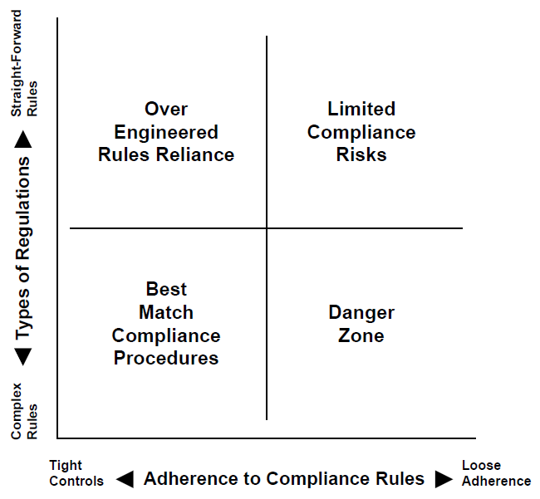
Lecture
06
Enterprise Rules Versus Compliance Options
The horizontal axis shows an enterprise’s levels of adherence to compliance rules and regulations.
The vertical axis covers the complexity of compliance rules.
  Nuclear Power Plant
  Retail Merchant
6–26

Slide 27
Lecture
06
Enterprise Rules Versus Compliance Options
Both of these horizontal and vertical measures are judgmental and represent both general attitudes and management policy.
A CEO cannot announce at an annual meeting that the enterprise will only comply with most of its legal rules.
Enterprises should identify those compliance issue risk areas that may have significant impacts on them and should use these identified risks to provide the infrastructure for the development of a compliance program.
6–27

Slide 28
Lecture
06
Identify A Compliance Risk Assessment Process
Step 1: Identify the Compliance Risks and Exposures
Develop a list of all the compliance risks that can affect the successful achievement of the work unit’s goals and objectives.
Determine the applicable laws, rules, regulations, policy, or procedure driving the identified risks.
Step 2: Measure the Identified Compliance Risks
The impact of the risk (also in terms of high or H, medium as M, or L for low), when it happens, on the achievement of the work unit goals and objectives.
The probability of the risk becoming a reality (High, Medium, or Low).
Step 3: Prioritize the Identified Compliance Risks
All risks that have an HH ‘‘measurement value’’ should be placed at the top of the risk inventory, followed by HM, HL, MH, MM, ML, LH, LM, and LL groups in that order.
Rank order each ‘‘measurement value’’ group from most to least significant via a paired elimination process.
Step 4: Develop a Risk Assessment Matrix for Each ‘‘Measurement Value’’
Step 5: Review the Risk Assessment Matrix
6–28

Slide 29
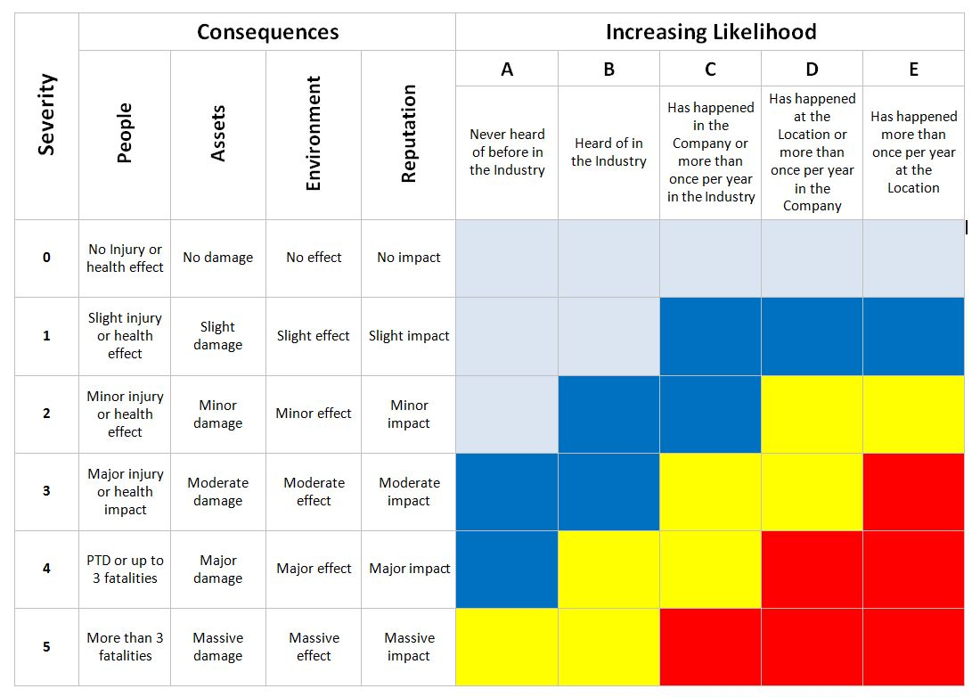
Lecture
06
Identify A Compliance Risk Assessment Process
6–29

Slide 30
Lecture
Identify A Compliance Risk Assessment Process
06
The concept behind this risk assessment matrix is that each significant organizational or budget-level work unit should inventory all of their applicable policies, procedures, rules, and regulations.
This can be accomplished by asking each unit:
  ‘‘What are the problems you recognize, concerns you have, and risks you perceive regarding compliance with the federal and state laws and regulations, and corporate and systems-related policies and procedures in this work unit?’’
6–30

Slide 31
Lecture
06
Identify A Compliance Risk Assessment Process
High Impact. If the risk happens, the work unit will probably not achieve its objectives or to do so will require major damage control.
Medium Impact. If the risk happens, the work unit will have to do extra work or will be more inefficient but can still achieve its goals and objectives.
Low Impact. If the risk happens, the work unit will be aware of it, but it will have little or no effect upon operations or the achievement of the objective.
6–31

Slide 32
Lecture
Compliance Program Reviews
06
Beyond just designating a work unit as being responsible for a risk, there should be one employee (management or staff) who is delegated as responsible for the management of a particular compliance risk or risk area.
The whole concept here is to empower enterprise work units with their responsibilities for compliance issues to help assure the enterprise continues to operate in compliance with key laws, rules, and other procedures.
6–32

Slide 33
Work Unit–level Compliance Tracking and Review Processes
Lecture
06
Compliance Issues Today
PMG 611
Enterprise Risk Management
6–33

Slide 34
Lecture
Compliance Program Reviews
06
An enterprise needs processes to track and review their compliance activities at both a total enterprise level and by individual budgetary departments or work units.
There is always a need for education programs throughout the enterprise to communicate compliance rules at all levels as well as corrective action processes to make adjustments when work units are found to be not in compliance with rules and regulations.
6–34

Slide 35
Lecture
Internal Audit Compliance Reviews
06
Internal Audit Departments have had a major responsibility to assess the status of internal controls in various areas of their enterprise
Report their internal audit review findings as well as recommendations for corrective actions to management and their audit committee.
They plan to review on risk-based internal audit planning approaches
Because of limited time and resources, they will tend to focus their reviews on more major issues, such as compliance with specific internal controls rules.
6–35

Slide 36
Lecture
Internal Audit Compliance Reviews
06
Planned internal audits and the audit programs developed to support the areas to be removed tend to support the more major internal controls concerns, such as do-the-debits-equal-the-credits internal accounting rules.
The problem is that there are so many laws with compliance-related rules that it is very difficult to even maintain a level of full compliance with some of these applicable rules.
Internal audit will typically not review a given area or location on a regular basis because of time and resource constraints.
6–36

Slide 37
Lecture
Compliance Self-Audits
06
An effective way to assess compliance in many enterprise work units is to request that managers in operating units perform self-audits in the area of operations and report their results back to the enterprise compliance function or to internal audit.
Compliance self-audits will migrate the ownership of compliance monitoring and assessment to business units to raise the awareness and understanding of compliance risks in routine processes and activities.
6–37

Slide 38
Lecture
Compliance Program Transformation
06
COVID-19 accelerated the digital agenda for many financial institutions, but the work is not done.
Decisions made under the pressure of adapting to the COVID-19 environment will need to be revisited to determine:
  If they are optimal and sustainable
  If there is alignment between technologies that have been deployed and the institution’s target operating model
  If the existing compliance workforce understands and can explain the technologies being deployed
  What the impact has been on the customer journey
Both management and regulators will likely be looking more closely at the choices that were made and how the benefits of those choices can be optimized, and the risks mitigated.
6–38

Slide 39
Summary
Lecture
06
Compliance Issues Today
PMG 611
Enterprise Risk Management
6–39

Slide 40
Lecture
Summary
06
Compliance issues are often the most difficult element of establishing effective enterprise GRC programs.
An enterprise can establish a governance framework where it understands the governance rules it will need to follow.
Risk management is somewhat easier as we have established some good procedures for estimating and taking actions to manage risks, but compliance can cause some major challenges.
The problem with compliance is that there are so many often conflicting legal and procedural rules that it is difficult to determine the most significant or important of them.
6–40

Slide 41
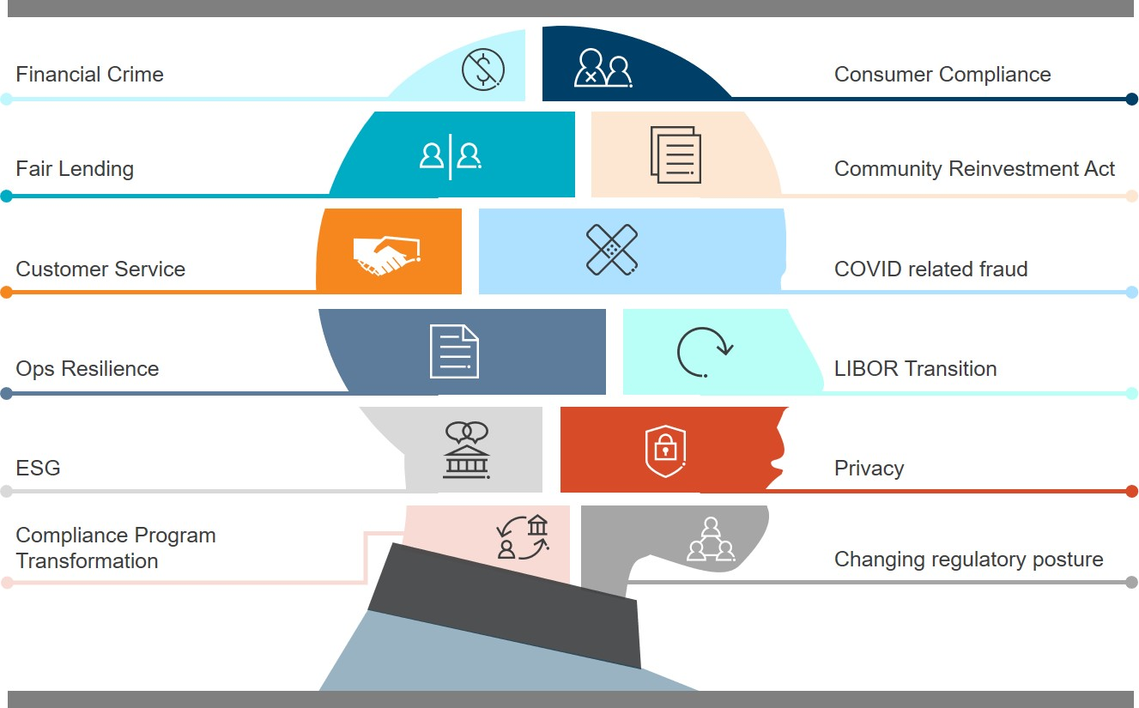
Lecture
Summary
06
6–41

Slide 42
References
COSO Enterprise Risk Management: Establishing Effective Governance, Risk, and Compliance Processes. Robert R. Moeller.
6-42

Slide 43



Thank You

