Slide 1



Strategic Planning and Program Management
Lecture 2
PMG 665
Program and Portfolio Management
Prepared by Dr. Sami Alzahrani

Slide 2


Chapter
02
Introduction
Strategic planning is extremely important to many organizations. The process involves creating an understanding of how the organization defines itself and is typically handled by identifying and authoring an organizational mission statement. In addition, the process develops an organizational vision statement, which identifies the high level where the executive management wants the organization to be in the future.

Slide 3
Chapter
02
What is strategic planning?
There are many published definitions of strategic planning. One definition that both captures the importance of strategic planning and speaks to some of the work of implementing the plan is from BusinessDictionary.com:

Slide 4
Chapter
02
What is strategic planning?
Systematic process of envisioning a desired future, and translating this vision into broadly defined goals or objectives and a sequence of steps to achieve them. In contrast to long-term planning (which begins with the current status and lays down a path to meet estimated future needs); strategic planning begins with the desired-end and works backward to the current status. (Strategic Planning)

Slide 5
Chapter
02
What is strategic planning?
In large companies, the strategic plan is often created by high-level corporate executives. In many cases, the company will hire an outside management consulting firm to determine the future vision and create the strategic plan. After agreement and publication of the plan, the execution is often left to mid-level managers and directors who were not included in developing the plan and may not have a clear and complete understanding of the end state that the authors had in mind.

Slide 6
Chapter
02
Program life cycle and program benefits management
While many organizations implement a strategic project management process, that usually means that projects are qualified and assessed for funding based on their support and alignment with the strategy of the company or organization. While that is indeed a worthwhile process to determine project investment, it does not directly speak to implementing the strategic plan.

Slide 7
Chapter
02
Program life cycle and program benefits management
Consider instead the discipline of delivering a strategic vision using the program management framework as outlined in the Project Management Institute’s (PMI®) The Standard for Program Management—Second Edition (2008).

Slide 8
Chapter
02
Pre-program preparations
The first benefits management process is benefits identification. Traditionally, program management benefits identification assumes that the organization has completed and published a strategic plan. Why can we not use the same processes to develop the actual strategic plan? Benefits identification then begins with a clean slate. In reality, the process of developing a strategic plan starts by developing the vision of what the organization is going to look like at the end of the strategic planning horizon.

Slide 9
Chapter
02
Pre-program preparations
Often, the strategy development team will assess where they are currently by looking at the organization’s strengths and weaknesses and by determining the external environment’s strengths, weaknesses, opportunities and threats (SWOT analysis). Those end points become the gap that will need to be bridged by implementing the strategic plan.

Slide 10
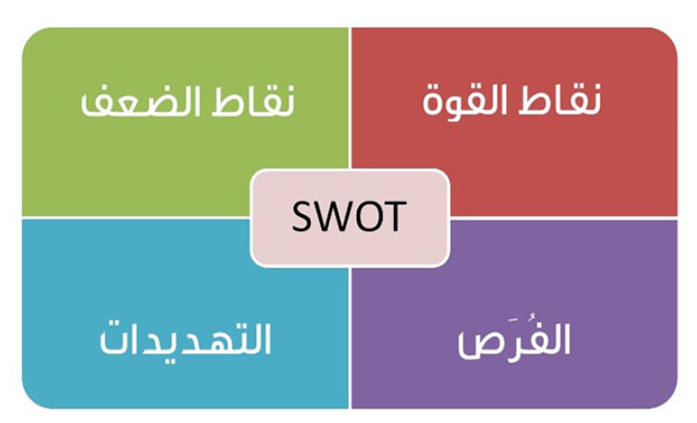
SWOT
Chapter
02
Pre-program preparations

Slide 11
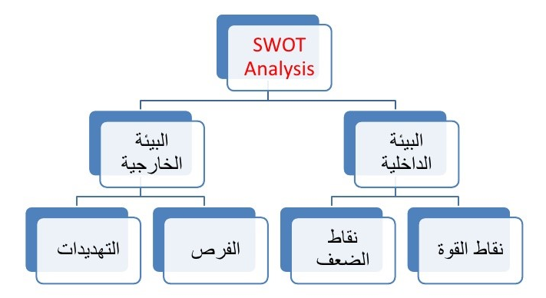
Chapter
02
Pre-program preparations

Slide 12
نقاط القوة
نقاط قوة أي شركة هي عبارة عن مصادرها وقدراتها المتوفرة، والتي يمكن استخدامها لإيجاد ميزات تنافسية، فهي تلك الجوانب التى تستطيع أن تنافس بها الشركة فى الأسواق، والتى تبني حولها استراتيجياتها.
بمعنى أنها العوامل الذاتية والإمكانيات الداخلية الموجودة فعلاً والتي تؤثر إيجاباً، وتساعد على استغلال الفرص المتاحة والممكنة، وعلى مكافحة التهديدات، مثل:
توفر السيولة المطلوبة.
وجود العمالة ذات الخبرة والكفاءة.
براءات الاختراع التي تنفرد فيها الشركة، مثل iPod من أبل.
علامات تجارية مميزة وقوية.
سمعة جيدة لدى الزبائن في السوق.
شبكة توزيع واسعة في السوق.

Slide 13
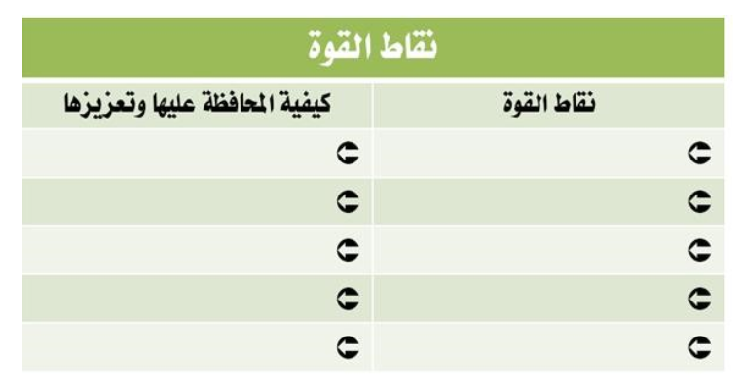
نقاط القوة

Slide 14
نقاط الضعف
هي العوامل الداخلية التي تؤثر سلباً على نشاط الشركة، بمعنى أي ظروف وعوامل نقص داخلية موجودة فعلاً تعيق القدرة على استغلال الفرص. كما أن الغياب الفعلي لنقاط القوة ما هو إلا نقاط ضعف تواجهها الشركة، مثل:
عدم القدرة على حماية براءات الاختراع الخاصة بالشركة.
علامات تجارية ضعيفة.
سمعة تجارية سيئة بين الزبائن.
شبكة توزيع هشة في السوق.
بطء عمليات التوزيع.
ضعف المبيعات.

Slide 15
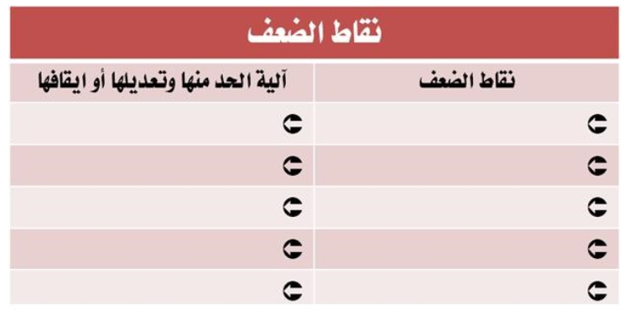
نقاط الضعف

Slide 16
تحليل البيئة الخارجية للشركة / الوضع الخارجي (الفرص – التهديدات)
وهى العوامل الخارجية، والتي ليس للشركة تأثير عليها، والتي يمكن أن تُستغل في صالح الشركة فتصبح فرصة، أو تستخدم ضدها فتصبح تهديداً.
وهنا يؤخذ بعين الاعتبار الوضع الفعلي والحقيقي، حيث تؤخذ التهديدات الموجودة والفرص غير المستغلة من ناحية، وتحليل التغيير المحتمل فى كل منهما من ناحية أخرى.

Slide 17
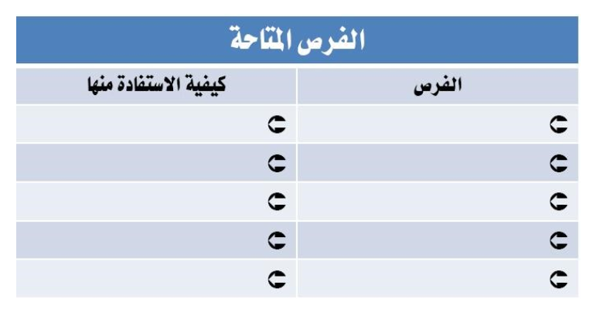
الفرص المتاحة

Slide 18
تحليل البيئة الخارجية للشركة / الوضع الخارجي (الفرص – التهديدات)
العوامل الخارجية التي تصب في مصلحة الشركة، بمعنى أيّ ظروف أو اتجاهات خارجية ذات أثر إيجابي مكّنت أو تمكّن فرصة للتطور والنمو. قد ينتج أحياناً عن تحليل البيئة الخارجية للشركة بعض الفرص لتحقيق الأرباح و النمو للشركة، مثل:
وجود الدعم الحكومي.
سهولة إيجاد التقنية وتطبيقها.
حاجات ومتطلبات لدى الزبائن لم يسبق لأحد من الشركات أن قام بتلبيتها.
التوصل إلى تكنولوجيا جديدة.
انخفاض في القيود القانونية التي تحيط بالمشاريع.
إزالة بعض القيود المعيقة للتجارة الدولية بين الدول مما يسمح بفتح أسواق جديدة.

Slide 19
تحليل البيئة الخارجية للشركة / الوضع الخارجي التهديدات المحتملة
أى ظروف أو اتجاهات خارجية أثرت أو قد تؤثر بشكل سلبي، وهى عامل مهدد أو قد تسبب خسارة وضرر، كما أن أي تغييرات تنشأ في البيئة الخارجية قد ينتج عنها تهديدات تؤثر على الشركة وأدائها بشكل مباشر، مثل:
انحراف في أذواق المستهلكين مبتعدين فيه عن المنتجات التي تنتجها الشركة.
حدة المنافسة، ودخول مفاجئ لمنتج بديل لما تنتجه الشركة إلى السوق الذي تتعامل فيه الشركة.
قوانين معيقة جديدة تفرض على قطاع الأعمال.
المؤشرات الاقتصادية السلبية
زيادة في القوانين المعيقة للتجارة الدولية.

Slide 20
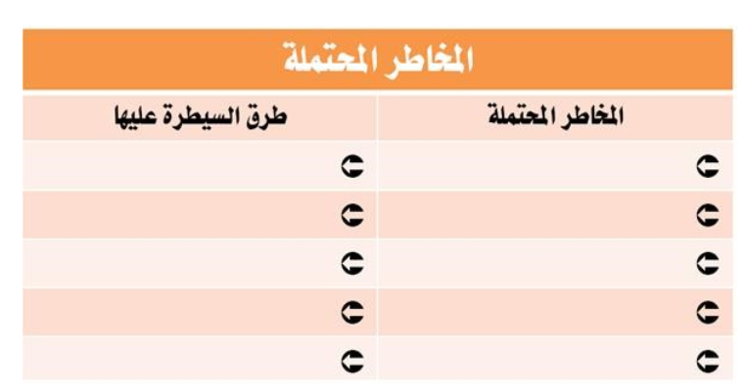
المخاطر والتهديدات المحتملة

Slide 21
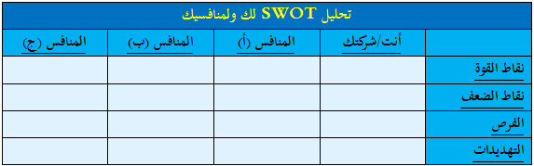
استخدام تحليل SWOT فى عمل مقارنة بينك وبين منافسيك

Slide 22
مثال توضيحي
تعمل شركة Sh.G في مجال خدمات الاتصالات وأنظمة إدارة علاقات العملاء. تستحوذ الشركة على نسبة 10% من السوق منذ عدة سنوات، بينما تمتلك 15% من سعة التشغيل. وتعاني الشركة أحياناً من عدم القدرة على الاحتفاظ بالموظفين بسبب نظام الورديات وبعد موقع الشركة عن العاصمة.

Slide 23
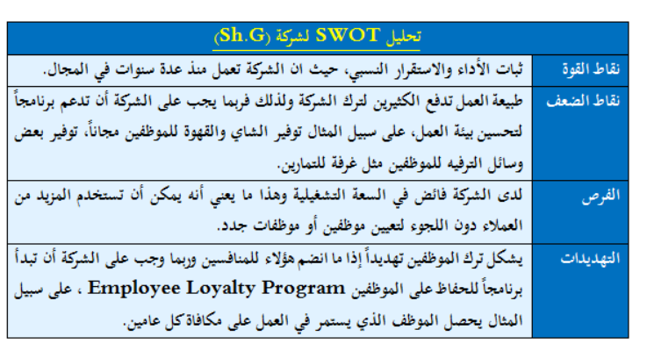
مثال توضيحي

Slide 24
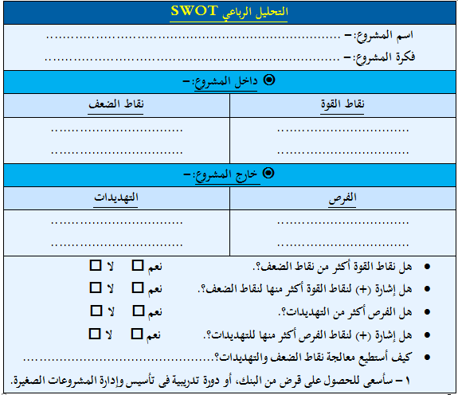
نموذج SWAT

Slide 25
كيفية استخدام النموذج
راجع جميع نقاط القوة والضعف والفرص والمخاطر التى سجلتها فى القائمة. قيم كلاً منها. ضع إشارة (+) على أهم نقاط القوة والضعف والمخاطر الأكثر أهمية، والتى قد يكون لها تأثير قوي على شركتك، والتى ستحتاج إلى انتباهك بشكل خاص، ويمكن وضع إشارتي (+) أو أكثر مقابل النقاط ذات الأهمية الأكبر. إذ ليس لجميع الجوانب التى سجلتها نفس درجة الأهمية بالنسبة لشركتك.
انظر الى كل جانب فى تحليل SWOT وفكر فى أهميته المستقبلية بالنسبة لشركتك، ثم قيم فكرة شركتك عن طريق التفكير فى آثار هذه العناصر فى تحليل SWOT التى يمكنها أن تؤثر بشدة على عمل شركتك المستقبلي (فكر فى مدى تأثيرها على زبائنك ومنافسيك ودورة رأس المال وأرباح شركتك)..فكر كيف تعمل نقاط القوة والفرص التى قمت بتحديدها على تطوير شركتك بطرقة أفضل وأسرع، ولكن فكر أيضًا كيف يمكن أن تؤدى نقاط القوة والضعف والمخاطر إلى مخاطرات كبيرة أو خسارة حقيقية للمشروع.
  هل نقاط القوة أكثر من نقاط الضعف؟.
  هل عدد علامات (+) لنقاط القوة أكثر منها لنقاط الضعف؟.
  هل الفرص أكثر من المخاطر؟.
  هل عدد علامات (+) للفرص أكثر منها للمخاطر؟.
قارن فكرة شركتك بما يفعله منافسوك المحتملون، كيف يتعاملون مع الفرص والمخاطر ونقاط القوة ونقاط الضعف الخاصة بهم؟ وكيف يمكن أن تتحسن؟ وفي سياق إجرائك لتحليل SWOT الخاص بك لابد أنك قارنت بين شركتك وبين شركات الآخرين فى السوق نفسه. تأمل مجدداً الفرص والتهديدات التى أوردتها فى تحليلك.
  ما الجانب الذى يتعلق بصورة مباشرة بمنافسيك؟.
  فى أى جانب ترى لشركتك فرصاً أفضل؟.
  أين يمكنك العمل على تقليل المخاطر التى تواجه الشركة بواسطة فهم أفضل لما يفعله المنافسون؟
  كيف يمكنك تمييز شركتك عن غيرها؟
قرر كيف يمكن أن تعزز فكرة شركتك (إذا ما قررت الاستمرار فى الشركة) عن طريق طرح الأسئلة التالية:
  هل ستحتاج إلى التركيز على خدمات أو منتجات معينة؟
  هل ستحتاج إلى استهداف نوعية معينة من الزبائن بطريقة أفضل؟
  هل ستحتاج إلى العمل على منتج ذو جودة أعلى؟.
  هل ستحتاج الى الاختلاف عن منافسيك؟
  ما الجانب الذى يمكنك التعاون فيه مع غيرك؟
  من منهم سيتحتم عليك أن تتعاون معه؟
وأخيراً.. يجب أن تكون قادراً على تحديد المزايا التى قارنتها بالشركات الأخرى. وهذه المزايا قد تكون قدرتك على التركيز على منتج واحد أو عدد قليل من المنتجات، أو على فئة محددة من الزبائن، حتى وإن كان منافسوك فى وضع جيد، حيث ينبغى عليهم أيضاً أن يحاولو التركيز على منتجات أو خدمات أخرى. ما هى مزاياك التنافسية التى تود استكشافها واستغلالها أكثر؟
فكر جيداً فى جميع الأشياء التى سجلتها فى تحليل SWOT، وقرر كيف يمكنك تحسين فكرة شركتك. قرر أيضاً إذا كنت ما تزال تريد الاستمرار فى فكرة الشركة هذه أو لا.
اتخذ قرارك النهائي.
هل ستستمر فى فكرة الشركة هذه، وستذهب للخطوة التالية (كتابة خطة العمل)؟
قبل أن تواصل، هل ستعمل على تحسين فكرة الشركة هذه أو لا؟
هل ستتخلى عن فكرة الشركة هذه نهائياً، وستبدأ فى صياغة فكرة جديدة؟
هل ستتخلى عن فكرة الدخول فى شركتك من الأساس؟

Slide 26
Chapter
02
The organization then develops, evolves, or confirms its mission statement and creates its vision statement. The vision statement is that high-level description of what the organization will be at the end of the planning horizon. From that ending point, the strategic planning group formulates the three to five strategic goals that, once realized, will create the vision.

Slide 27
Chapter
02
In the vernacular of program benefits management, benefits identification will identify and qualify business benefits. If done at the strategic planning level, this identification and qualification creates the strategic goals. In the program life cycle, PMI® identifies this phase as Pre-Program Preparations.

Slide 28
Chapter
02
Program initiation
Once the strategic vision and strategic goals are finalized, the executive in charge of executing the plan would be wise to enlist the skills of an experienced program manager with the authority to implement the governance needed to realize the identified benefits (goals). At this point, the program manager will oversee benefits analysis and planning as the program is initiated.

Slide 29
Chapter
02
Program initiation
Furthering the implementation of the strategic vision, an organization would create strategic initiatives for each of the strategic goals. Using the program management discipline, the organization would initiate the strategic plan by creating a specific justification for creating the vision.

Slide 30
Chapter
02
Program initiation
Further clarification of the benefits of the vision and the objectives can help to determine if the vision is feasible in order that the outcomes will justify the effort. Also, often in implementing a strategic plan, an organization does not define the critical success factors for the strategic goals, which in turn drive the success factors for the individual initiatives.

Slide 31
Chapter
02
Program initiation
While many organizations seek to work on too many initiatives at one time, within the program initiation phase, the program manager and executive sponsor develop a high-level roadmap. This roadmap serves to create a more realistic expectation of what benefits will be delivered and in what time frame.

Slide 32
Chapter
02
Program initiation
While, at this point, the detailed planning process has not occurred, the expectations can, nevertheless, be communicated, and the groundwork for expectations is laid. In keeping with effective program management governance, a program charter document is created. This document will authorize the program manager to apply organizational resources to, in the case of the strategic plan, create the organization’s strategic vision.

Slide 33
Chapter
02
Program setup
With the approval of the organization’s executives, the strategic plan program moves past this phase gate and to program setup. “The purpose of program setup phase is to progressively elaborate the program charter and develop the foundation for the program by establishing an infrastructure and building a detailed ‘roadmap’ that provides direction on how the program will be managed and defines its key deliverables.

Slide 34
Chapter
02
Program setup
The term “progressively elaborate” means that we are moving from the higher-level strategic goals toward individual initiatives with verifiable deliverables. The roadmap created is meant to deliver all the results desired for each of the strategic goals considering both logical dependencies and initiative prioritization. Here is one of the areas where a program management discipline can add enormous value in implementing strategy.

Slide 35
Chapter
02
Program setup
An effective program management discipline develops a detailed program roadmap representing the initiatives and the timing of the deliverables from those initiatives. Previously, a high-level roadmap was developed, and now that is further elaborated. The major factors that determine the logical progression within the roadmap are the logical dependencies and the prioritization of benefits to be realized.

Slide 36
Chapter
02
Program setup
One way an implementation of a strategic plan may be different from a more traditional program is that there will be times when the prioritization of benefits far outweighs any logical sequencing of initiatives. In other words, if there is significant value from a strategic initiative, the organization could do double work in order to realize the benefits sooner.

Slide 37
Chapter
02
Program setup
There is a greater likelihood of duplicate work when implementing strategy. Why would this be the case? An organization may want to take advantage of the timing of the realized benefit instead of waiting for the benefit to be realized in a logical sequence. Often, waiting on timing based on a logical sequence will make the organization miss out on temporary market conditions. While an effective program management discipline will seek to minimize duplication of efforts, there must be the realization that when the benefits realized exceed the costs of that duplication, it is an acceptable additional cost.

Slide 38
Chapter
02
Program setup
As the program team adds detail to the program roadmap, it also seeks to expand on the high-level cost and schedules from the program charter. Of course, the program manager must be mindful of the expectation to begin work on the strategic initiatives early in the process. As with any organizational change requiring continuous support, the program team should identify initiatives that are short term in effort and that will create a measurable benefit.

Slide 39
Chapter
02
Program setup
A program architecture should be developed to show how and when the benefits will be delivered from the strategic initiatives. As for delivering the strategic vision, the program team must be mindful that the benefits realized by the individual strategic initiatives may not line up with the completion of the activities within those initiatives. The importance of communicating expectations and results is paramount within a strategic plan program.

Slide 40
Chapter
02
Program setup
The program team does not want a gap in understanding as there could very well be a delay between the completion of the actions on an initiative and the realization of the benefits. When communicating to executive overseers, the emphasis must be on benefits realization, not on initiative-scheduled end dates.

Slide 41
Chapter
02
Program setup
One tool that is extremely valuable in any program, and especially so in a program executing strategy, is the Program Work Breakdown Structure (PWBS) shown in Figure 2.1. below In executing strategy, the first two levels of the PWBS come directly out of the initial strategic planning process. The top level is the strategic plan followed in the second level with those top four-to-six strategic goals.

Slide 42
Chapter
02
Program setup
The most likely next level of detail is the strategic initiatives. Those become the program components, which typically will be assigned to mid-level managers and directors within the organization. “The program work breakdown structure (PWBS) provides deliverable-oriented hierarchical decomposition of the work to be executed and accomplished by each project (component) of the program.

Slide 43
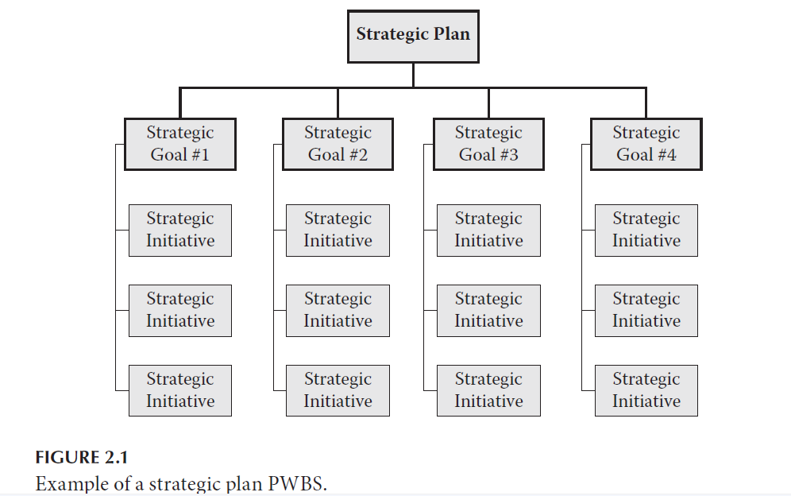
Chapter
02
Program setup

Slide 44
Chapter
02
Program setup
Most program managers will find the creation of the PWBS for an organization’s strategic plan to be an enormous challenge. Why? The reason is that the decomposition process will require the participation of the executive team. As far as the strategic plan is concerned, the executives are the subject matter experts. Program managers may find an enormous challenge in organizing the thoughts of the executive team in a deliverable-based structure.

Slide 45
Chapter
02
Delivery of program benefits
The actual work of delivering the benefits of the strategic plan begins:
At this point in the program’s life cycle, the program has passed another phase-gate review (G3) and the core work of the program-through its components-begins. The phase ends only when the planned benefits of the program have been achieved, delivered and accepted or a decision is made to terminate the program.

Slide 46
Chapter
02
Delivery of program benefits
Now benefits realization within the program benefits management process begins. The work on the strategic initiatives begins, which means that the program components are initiated. Many of the components will be managed as projects, and formal project management processes should be followed.

Slide 47
Chapter
02
Delivery of program benefits
A project manager should be assigned to each component, even if the organization has a different name for that role. Initiative Leader and Point of Contact are common titles. The role of initiative leader is a project manager role. That individual will need to manage initiating, planning, executing, monitoring and controlling, and closing the components for which he or she is responsible.

Slide 48
Chapter
02
Delivery of program benefits
In addition, the leader will need to follow the governance process for reporting benefits realization, managing change requests, and communicating status. Change management, risk management, and control of issues become extremely important because of potential interdependencies with other components and the benefits realization expectations at the program level.

Slide 49
Chapter
02
Delivery of program benefits
The program manager, or some experienced project manager within the program team, may spend a great deal of time mentoring initiative leaders who lack project management knowledge and skills.

Slide 50
Chapter
02
Program closure
In the area of strategic planning, program closure should only happen if the strategic vision changes and if the level strategic goals are replaced. This often will happen when companies merge or where there is a dramatic shift in the type of business the company undertakes. The program closure should happen much like any other program. More than likely, the executive team that creates the new strategy will have little interest in any part of the completed program.

Slide 51
Chapter
02
Program closure
Their main concern along those lines will be to make sure that all work stops on the previous plan’s initiatives. The program manager should work though the discipline of making sure all components go through a closing process. In addition, any benefits that are realized or partially realized should be documented, and a determination should be made as to the transition to operations based on the revised strategy (we do not want to transition anything that has no perceived value in light of the new organizational vision).

Slide 52
Chapter
02
Program closure
Certainly, lessons learned should be accumulated. The program manager and team should attempt to get a final review of overall progress with the executive oversight committee. Finally, the determination should be made regarding the program team and any role they will have in implementing the new strategic vision.

Slide 53
Chapter
02
Program closure
The focus needs to be on how well the program was executed based on the vision and plan that was true at the time. A change in strategic direction should be viewed as a changed end-state vision and not be a negative reflection on the progress toward the old vision.

Slide 54
Chapter
02
Benefits of managing the strategic plan as a program
To the organization: it allows a value-added process to manage the strategic plan and the individual projects or initiatives within the plan. Having a best practices approach to communications significantly increases the chances that more people within the organization will know about where the organization is headed and may allow more individuals to become involved in achieving the desired results.

Slide 55
Chapter
02
Benefits of managing the strategic plan as a program
The strategic planning process now comes under the discipline umbrella of program management. Status reporting will increase the visibility of the progress and potential pitfalls along the way. A systematic process of reviewing the strategic plan can assist in determining if the plan is still valid for the organization.

Slide 56
Chapter
02
Reference
Program Management: A Life Cycle Approach
by Ginger Levin, PMP, PgMP
Chapter 2

