Slide 1
Project Leadership
Dr.Sara Adel

Slide 2
CHAPTER 1
Understanding Leadership

Slide 3
Learning Outcomes
01
What is a project?
02
03
Leadership VS Managment.
Leader vs Manager.
04
Impact of leadership on project

Slide 4
Learning Outcomes
05
Major project leadership skills.
06
Conclusions.

Slide 5

1.1 What is a project??

Slide 6


Project
Projects are used as a means to achieve an organization’s strategic goals.
Projects are a great opportunity for organizations and individuals to achieve their business and non-business objectives more efficiently through implementing change.
Projects help us make desired changes in an organized manner and with reduced probability of failure.

Slide 7


Project
A Project is made to produce some kind of a tangible or intangible result (a unique product, service, benefit, competitive advantage, etc.). It usually includes a series of interrelated tasks that are planned for execution over a fixed period of time and within certain requirements and limitations such as cost, quality, performance, others.
Projects often are associated with unknowns, complexity, and uncertainty.

Slide 8

Characteristics of the project:
Temporary
Defined beginning and end.
Defined scope and resources.
Unique
Specific set of operations designed to accomplish a singular goal.
Not a routine operation.
Product or Service
The output is to create a product or perform a service.
Project Charter
Established with a project charter or a contract.

Slide 9


We aim to….

Slide 10

1.2 Project Management or Project Leadership!!

Slide 11

What Is Management?
The process of getting things done effectively and efficiently, with and through people.
Effectiveness: Doing the right things.
Efficiency: Doing things right.

Slide 12
What Is Management?
“Is the Process of Getting Things Done through the Efforts of Other People”. By Harold Koontz
“Is the processes are based in a simple rule: the POLC rule – Planning, Organizing, Leading and Control. Which interrelated and simultaneously with supervision of other persons. It also involves overseeing projects, resources and business enterprises” According to Mary Cushing Nile.

Slide 13

Project Management:
Project management occurs in a team setting. it concerned with making decisions about processes and functions.
Successful projects depend on both for the effectiveness of the project team, the leadership and management of that team.

Slide 14

Leadership is a soft ability; often more art than science.

Slide 15

Leadership
The process of leading a group and influencing that group to achieve its goals.

Slide 16

Leadership
Leadership is requires the development of specific and unique soft skills along with the more typical hard skills that were listed in your job description. (Soft skills are key traits that often apply to communication, decision making, leadership abilities, attitude, instincts, and work ethics.

Slide 17

Leadership
The word leadership evokes:
Responsibility.
Burden.
Honor.
Duty.
Calling.
Ability.

Slide 18

Importance of Leadership
Create a Vision
• Creating an inspiring vision of the future.
Motivation
• Motivating and inspiring people to engage with that vision.
Managing
• Managing delivery of the vision with providing guidance .
Coaching
• Coaching and building a team, so that it is more effective at achieving the vision with an effective planning.

Slide 19

Being a leader isn’t simply about hitting targets and delivering the goods. It’s also about projecting the right attitude and inspiring others to do their best work.

Slide 20
1.3 Project Manager or Project Leader!!

Slide 21
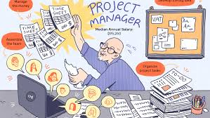
A project manager is responsible for:
Implementing product strategy, including product improvement, feature prioritization, costing.
Setting deadlines and ensuring that projects remain on schedule.
Tracking the deliverables sprint and providing updates to relevant stakeholders.

Slide 22
A project manager is responsible for: (continue)
Ensuring the project is sticking to the agreed-upon budget.
Managing every moving part in relation to milestones, including schedules, documentation, staffing and, sometimes, HR concerns.
Establishment of quality assurance cell to control quality.

Slide 23

A project leader is responsible for:
Communicating with team members, including relaying briefs, connecting daily tasks to larger goals, and providing context and support.
Ensuring the team remains focused and on track, including addressing any conflicts or bottlenecks.

Slide 24
A project leader is responsible for: (continue)
Creating a vision around the project to provide team members with a sense of purpose and motivation.
Offering less tangible and more emotional support to help a team stay focused on the ultimate goal.
Fostering a workplace atmosphere that helps bring out the best in his or her team.

Slide 25
Manager VS Leader
• Goals and objectives
• Telling how and when
• Shorter range
• System, resources and structure
• Autocracy
• Restraining • Maintaining • Conforming • Imitating
• Administrating • Controlling
• Procedures
• Consistency
• Bottom line
• Vision
• Selling what and why
• Longer range
• People and human nature
• Democracy
• Enabling • Developing
• Challenging • Originating
• Innovating
• Directing •
• Flexibility
• Horizon

Slide 26
Not every manager is a leader, and not every leader is a manager.
Leader
Project
Manager

Slide 27
A project without positive leadership :
May well under-perform.
May miss strategic opportunities.
Stifle innovation.
Underutilize team members.
Fall short of its project goals, quality performance and productivity .

Slide 28
Leadership Traits and soft skills
L - Listener, Lovable.
E - Energetic, Effective.
A - Alert, Assertive.
D - Determination, Diligence.
E - Empathy, Eagerness.
R - Responsible, Realistic.
S - Self respect, Self control.
H - Honesty, High hopes.
I - Interest, Impartial.
P- Patience.

Slide 29
Leadership Traits and soft skills(continue)
T – Tolerance.
R – Readiness to listen.
A – Ability to make decisions.
I – Intelligent.
T – Trustworthiness.
S – Sincere.

Slide 30
1.4 Impact of leadership on project.

Slide 31
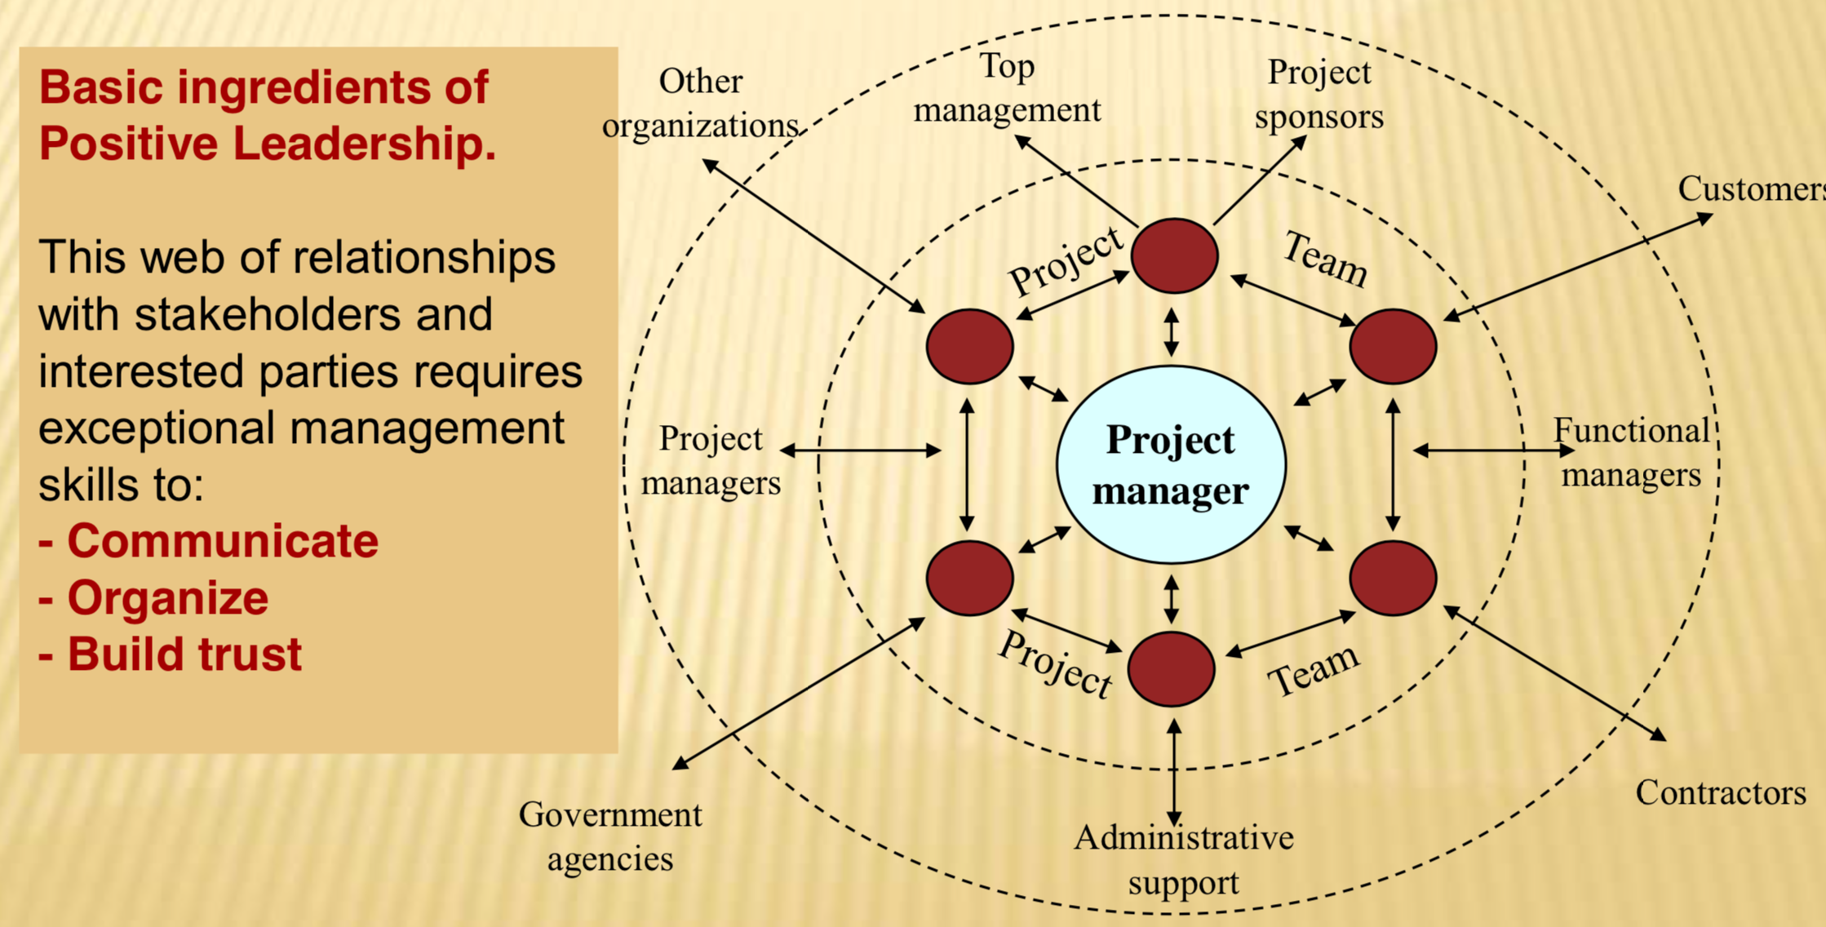
Impact of leadership on project
Leader role is one of the most challenging jobs in any organization, because it requires broad understanding of the various areas that must be coordinated and requires strong interpersonal skills.

Slide 32
1.5 Major project leadership skills.

Slide 33
Major project leadership skills
Effective Project Leadership
Decision making and conflict resolution
Motivation
Team Management
communicating
Visioning
influencing

Slide 34

A Team management:
A successful project leaders are responsible for the daily mechanisms of team harmony.
A successful project leaders make sure the whole team stays focused and works smoothly together towards a shared vision.
A successful project leaders discusses, decides and does real work together .
A successful project leaders, recognizing that thier team has been putting in extra hours on a project, might come up with a special reward—like a special team dinner together, or a day off post-project—to both demonstrate appreciation and incentive continued hard work.

Slide 35

Decision making :
A successful project are A successful Decision-Makers.
A successful project leaders often have to make challenging decisions, such as what direction to move their project in.
A successful project leaders understand how to balance emotion with reason and make decisions that positively impact themselves, their employees, their customers and stakeholders, and the project.
A successful project leaders also know when to move quickly and proceed with the available information, versus when to take more time and gather additional information.

Slide 36

Conflict resolution:
Conflict resolution is at the core of being a successful project leader, it is an ongoing job duty of a leader.
A successful project leaders is patient listener and assess the problem realistically without getting emotional or biased.
The impact of conflict in the workplace can result in a disruption of the effectiveness of the project and slow the achievement of it’s goals.
A successful project leaders beliefs that facing conflict head is the best thing for both sides.

Slide 37

Visioning:
" A successful project leaders can create a vision, articulate the vision, passionately own the vision, and harshly drive it to completion." -Jack Welch.
A successful project leaders has the ability to see the ‘bigger picture’ behind a project and effectively convey that vision to others is an incredibly valuable.
The power of a vision may help a leader to achieve that influence and inspire the team.

Slide 38

Communicating
:
A successful project leaders is an effective listeners.
Communication can include, persuading team members to collaborate in a way they’re not accustomed to, negotiating with project stakeholders on timelines and expectations.
A successful project leaders can adept at transfer ideas, align expectations, inspire and motivate any action, and he can also spread their vision. They can build the values and trust that enable effective working relationships and goal accomplishment.

Slide 39

motivating:
A successful project leaders must be a self-motivated.
A successful project leaders must have a ways of motivational factors for others. they must understand the basic needs of employees, peers and his superiors. Leadership is used as a means of motivating others.

Slide 40

Influencing:
A successful project leaders must have these 4 keys of influencing skills:
Organizational Intelligence: They understand how to get things done and embrace the reality of working within organizational politics to move teams and important initiatives forward.
Team Promotion: Leaders cut through the noise to promote themselves — while also promoting what’s good for the entire organization.
Trust-Building: Because leadership often involves guiding people through risk and change, trust is essential.
Expanding Networks: No leader is an island. They are empowered by their connections with others.

Slide 41
1.6 Conclousion

Slide 42
Conclusion :
There is a common belief that leadership is vital for any successful project.
Leader is expected to have an honest understanding of who in his team, what they know, and what they can do? And what is his duty?
An important thing about leaders is that the followers and the results will decide whether the leader is successful or not.
This chapter developed a picture of the special purpose of leadership for projects, with adapting and spotting the difference between project leader and project manager. And what skills needed by the leader in the project toward his team to keep the project on course.

Slide 43
LEADER IN OUR LIFE :
Andy Grove The "Father of OKRs*” Chief Executive and Chairman of Intel Corporation.
Steve Jobs The charismatic, visionary and a genius. Pioneer of the personal computer era. chairman, chief executive officer (CEO), and co-founder of Apple Inc.
Bill Gates Co-founder of Microsoft Corporation, focused on transformational leadership.
Jeff Bezos The founder, a powerful CEO, and president of the multi-national technology company Amazon, known with his ability to innovate and envision.
Mark Zuckerberg Facebook CEO transformational leader. He is known as being a motivator who inspires his staff of employees with a clear vision of the company's future.
*(Objectives and Key Results)

Slide 44

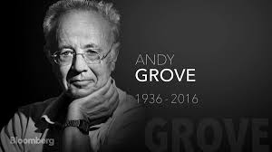



LEADER IN OUR LIFE :

Slide 45

Self Assessment :
Differentiate between a leader and a manager?
What is the different leadership traits and skills?
Match the following :
Networking | The leader looks into the future and creates new ways in which the project can prosper.
Visionary | The leader develops co-operative relations among individuals within and outside the organization.
Communication | The leader facilitates the development of cohesiveness and cooperation among people at work.
Team building | The leader listens closely to people at work, and organizes and clearly presents information both orally.

Slide 46
Self Assessment :
Search more about leaders in our life, and we will discuss it in the upcoming zoom meeting..

Slide 47
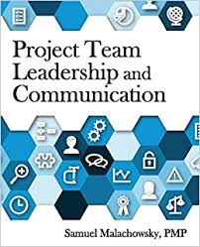
Resources:
Project Team Leadership and Communication by Samuel Malachowsky, 2018.
https://aboutleaders.com/10-great-leadership-skills-of-project-management/#gs.m0ivxk
https://twproject.com/blog/leadership-skills-of-the-project-manager-the-key-elements-of-the-role/

Slide 48
THANKS!

