Slide 1

Mathematics
Prepared by Dr. Israa Lewaa
Lecture 4
MAT 112
Differentiation

Slide 2
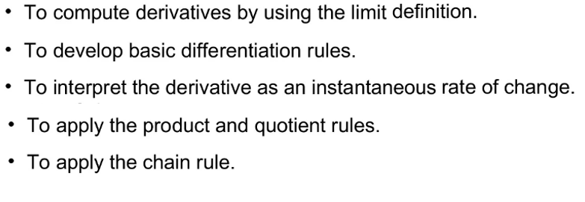

Lecture
04
Lecture Objectives

Slide 3
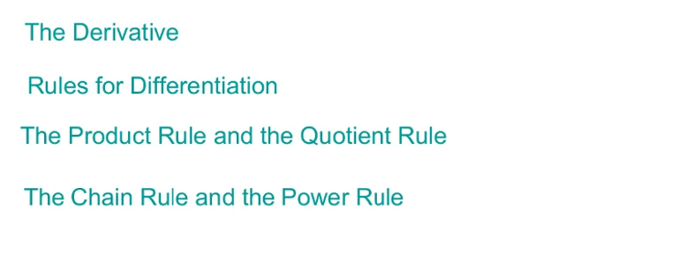
Lecture
04
Lecture Outline

Slide 4
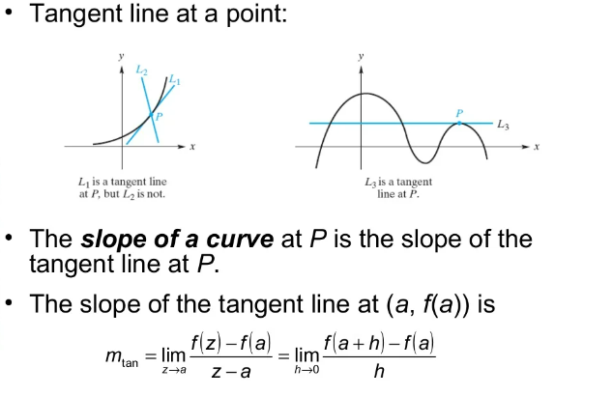
Lecture
04
1- Derivative

Slide 5
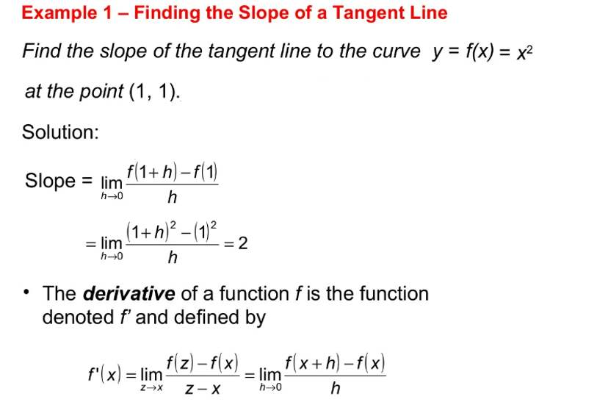
Lecture
04
Example

Slide 6
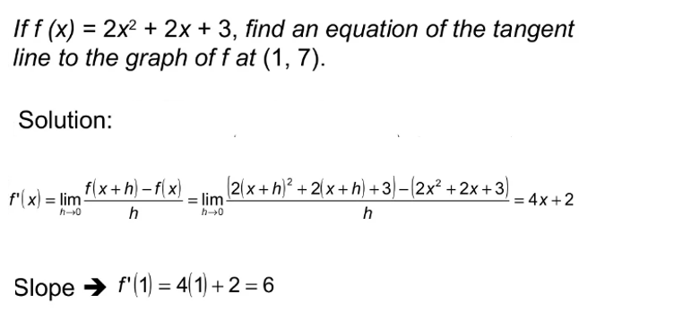
Lecture
04
Example

Slide 7
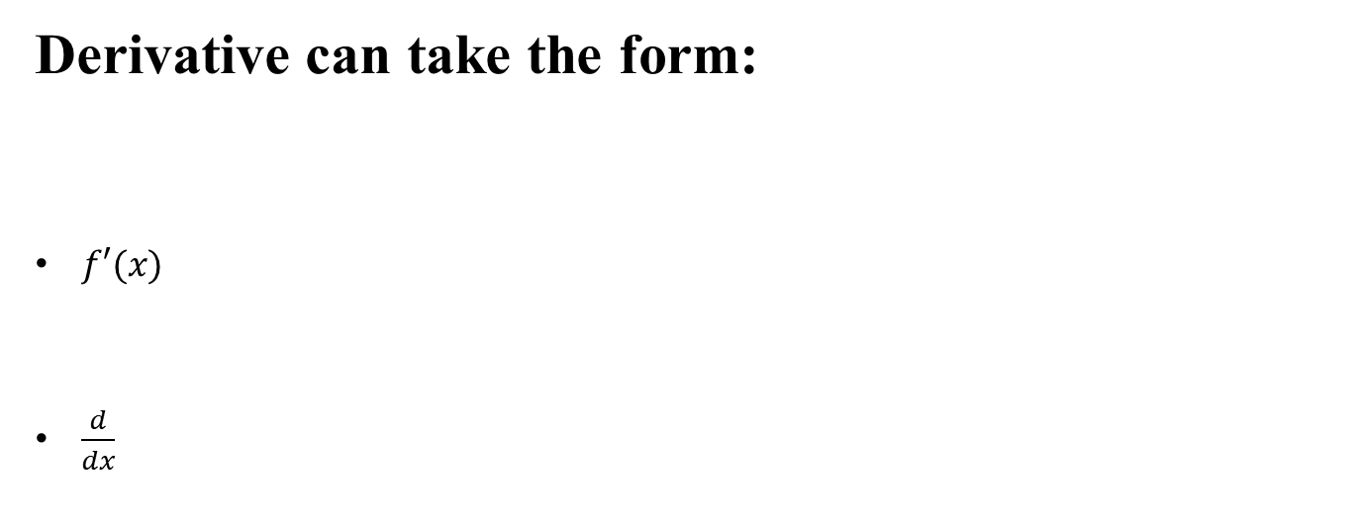
Lecture
04
Derivative
Derivative can take the form:
$f′(x)$
$\frac{d}{dx}$

Slide 8
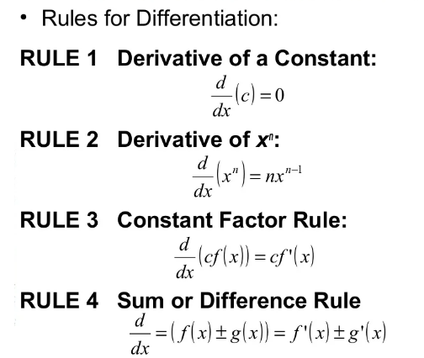
Lecture
04
2- Rules of Differentiation

Slide 9
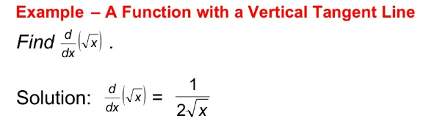
Lecture
04
Example

Slide 10
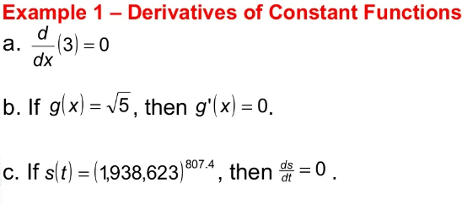
Lecture
04
Example

Slide 11
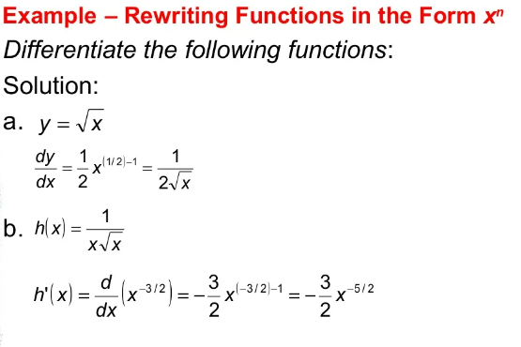
Lecture
04
Solution of Example 2

Slide 12
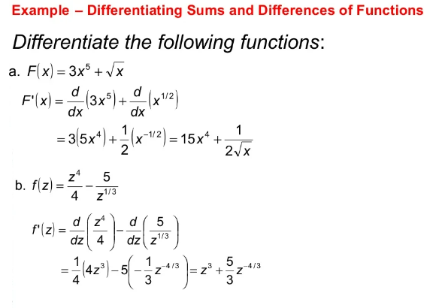
Lecture
04
Example

Slide 13
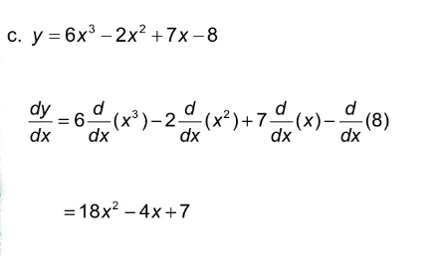
Lecture
04
Example

Slide 14
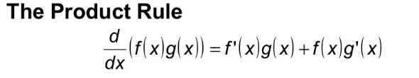
Lecture
04
The Product Rule and Quotient Rule

Slide 15
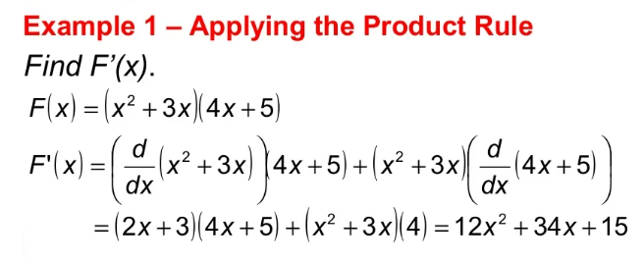
Lecture
04
Example

Slide 16
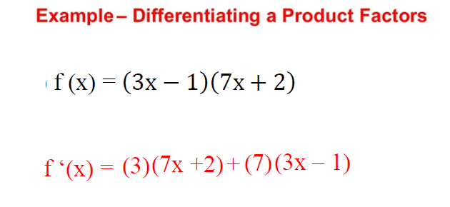
Lecture
04
Example

Slide 17
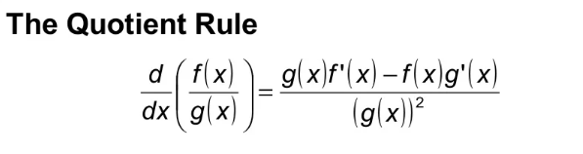
Lecture
04
The Quotient Rule

Slide 18
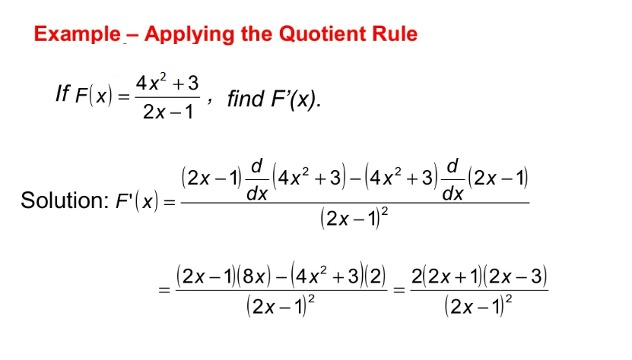
Lecture
04
Example

Slide 19
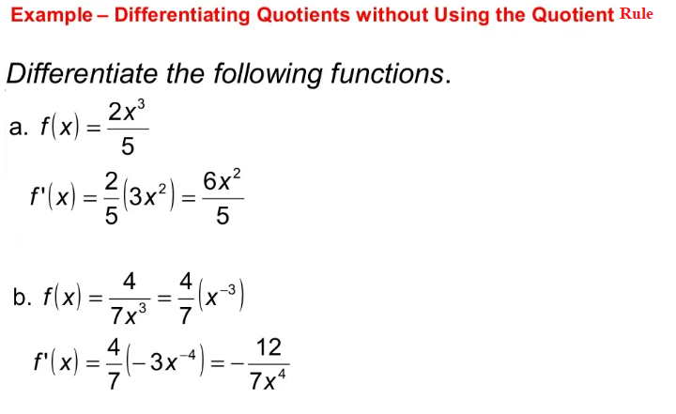
Lecture
04
Example

Slide 20
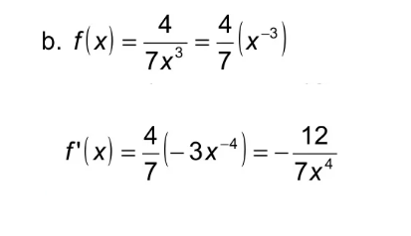
Lecture
04
Example

Slide 21
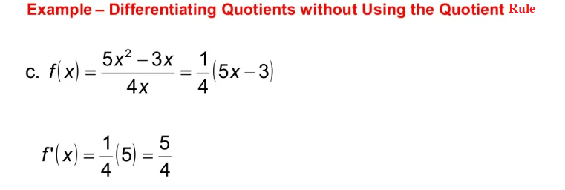
Lecture
04
Example

Slide 22
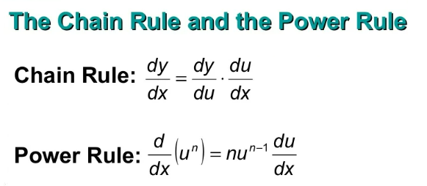
Lecture
04
The Chain Rule and the Power Rule

Slide 23
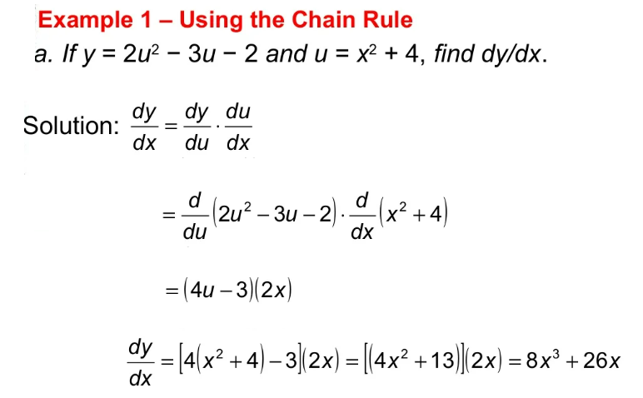
Lecture
04
Example

Slide 24
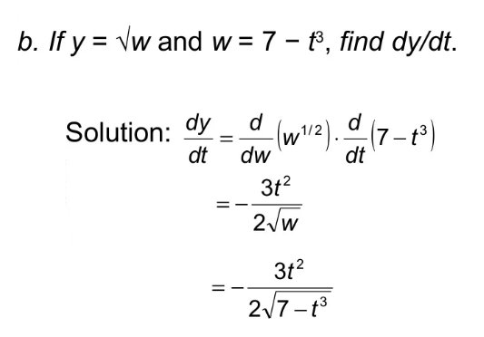
Lecture
04
Example

Slide 25
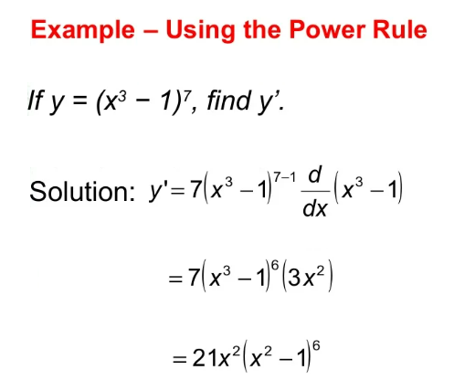
Lecture
04
Example

Slide 26
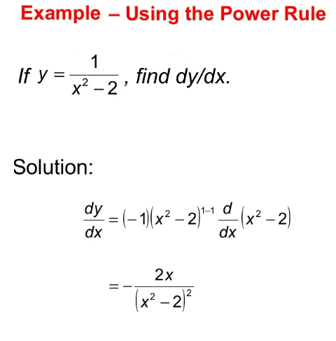
Lecture
04
Example

Slide 27
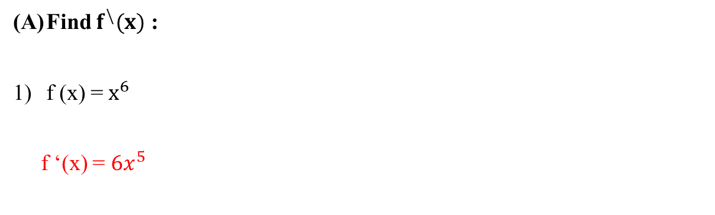
Lecture
04
** EXTRA PRACTISE
Find $f^{\backslash }(x)$ :
f (x) = $x^{6}$
f ‘(x) = $6x^{5}$

Slide 28
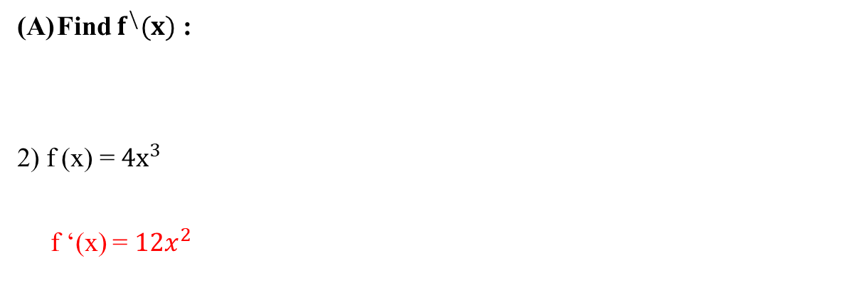
Lecture
04
** EXTRA PRACTISE
Find $f^{\backslash }(x)$ :
2) f (x) = ${4x}^{3}$
f ‘(x) = $12x^{2}$

Slide 29
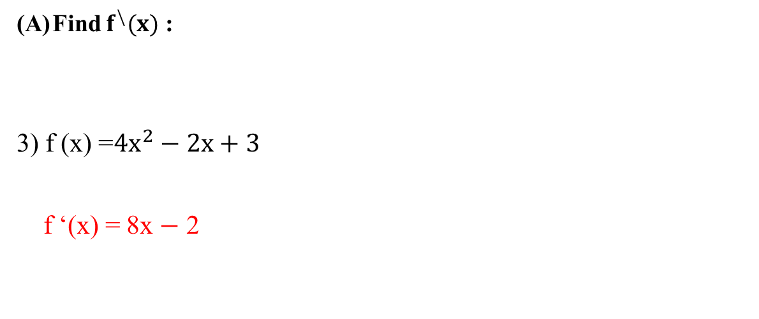
Lecture
04
** EXTRA PRACTISE
Find $f^{\backslash }(x)$ :
3) f (x) =${4x}^{2}−2x+3$
f ‘(x) = 8x $−$ 2

Slide 30
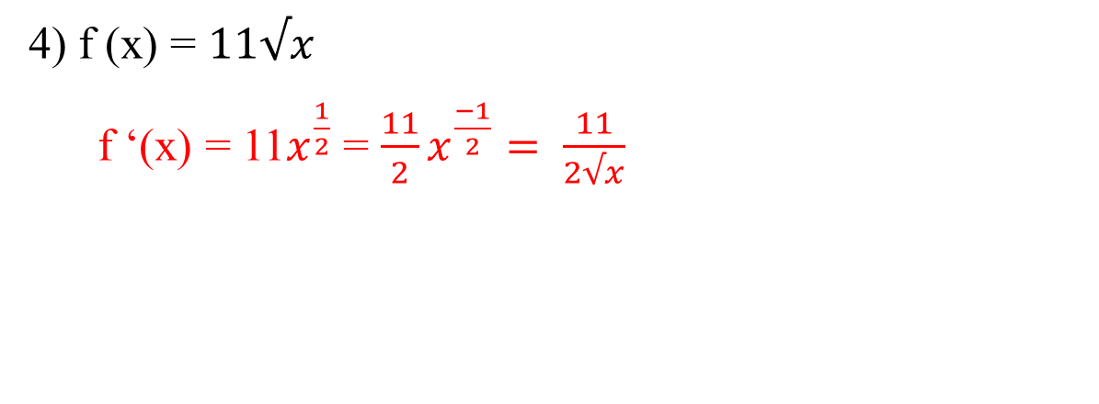
Lecture
04
** EXTRA PRACTISE
4) f (x) = $11√x$
f ‘(x) = 11$x^{\frac{1}{2}}$ = $\frac{11}{2}x^{\frac{−1}{2}}= \frac{11}{2√x}$

Slide 31
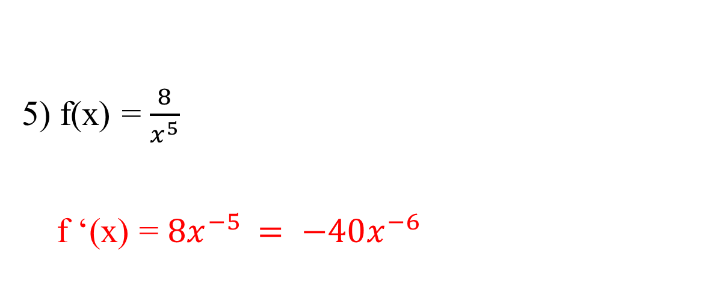
Lecture
04
** EXTRA PRACTISE
5) f(x) = $\frac{8}{x^{5}}$
f ‘(x) = $8x^{−5 }= −40x^{−6}$

Slide 32
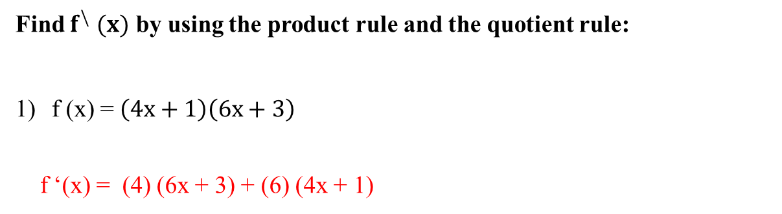
Lecture
04
** EXTRA PRACTISE
Find $f^{\backslash } (x)$ by using the product rule and the quotient rule:
f (x) = $\left(4x+1\right)\left(6x+3\right)$
f ‘(x) = (4) (6x + 3) + (6) (4x + 1)

Slide 33
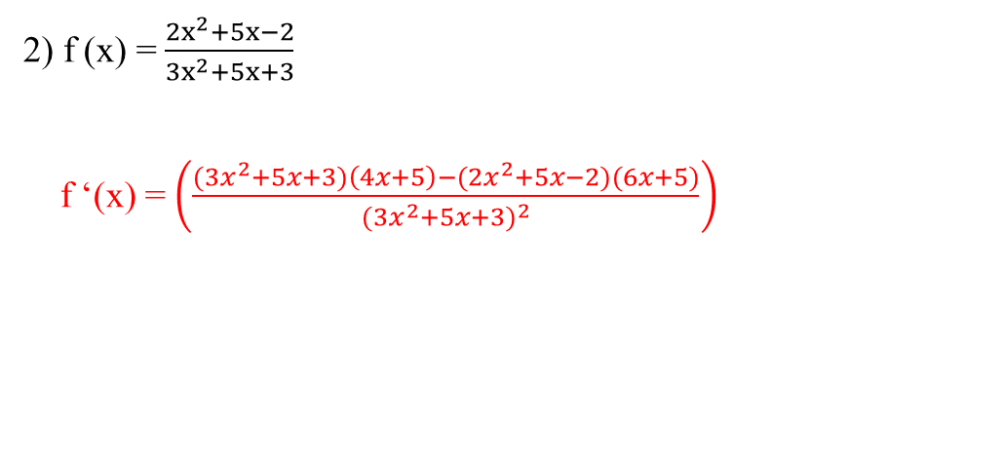
Lecture
04
** EXTRA PRACTISE
2) f (x) = $\frac{{2x}^{2}+5x−2}{{3x}^{2}+5x+3}$
f ‘(x) = $\left(\frac{{(3x}^{2}+5x+3)\left(4x+5\right)−(2x^{2}+5x−2)(6x+5)}{{{(3x}^{2}+5x+3)}^{2}}\right)$

Slide 34
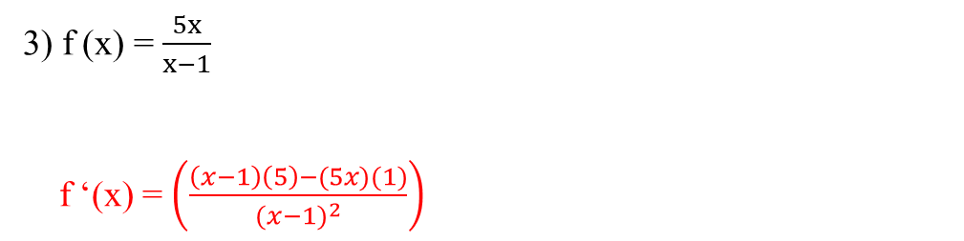
Lecture
04
** EXTRA PRACTISE
3) f (x) = $\frac{5x}{x−1}$
f ‘(x) = $\left(\frac{\left(x−1\right)\left(5\right)−(5x)(1)}{{(x−1)}^{2}}\right)$

Slide 35
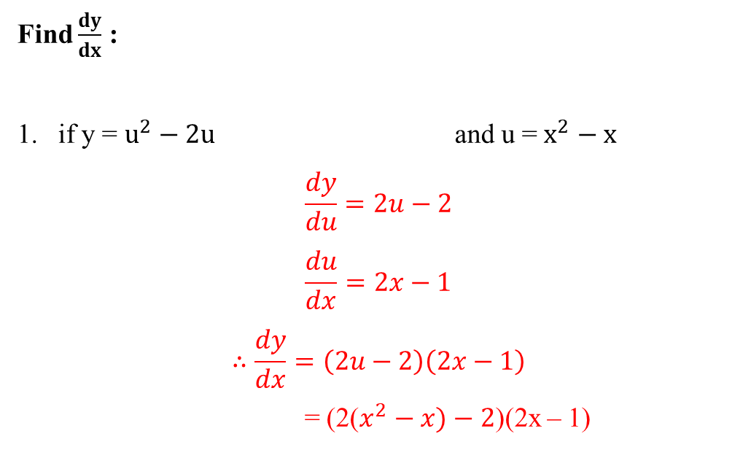
Lecture
04
** EXTRA PRACTISE
Find $\frac{dy}{dx}$ :
if y = $u^{2}−2u$ and u = $x^{2}−x$
$$\frac{dy}{du}=2u−2$$
$$\frac{du}{dx}=2x−1$$
$$∴\frac{dy}{dx}=\left(2u−2\right)\left(2x−1\right)$$
= (2($x^{2}−x)−2$)(2x – 1)

Slide 36

Lecture
04
Lecture Outline

Slide 37
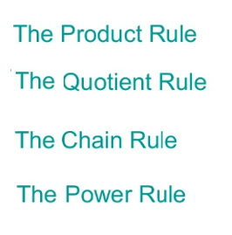
Lecture
04
Lecture Outline

