Slide 1


The Evolving/Strategic
Role of HRM
Prepared by Dr. Sahar Ahmed
Week Four
Lecture 3

Slide 2
Learning Outcome
Understand the fundamental differences between traditional and strategic human resource
01
02
Explain why some organizations still fail to deliver human resource strategically
Describe the outcomes and benefits of strategic human resource
03
Understand how different company strategies might result in the need for human resource to assume different primary roles
04

Slide 3

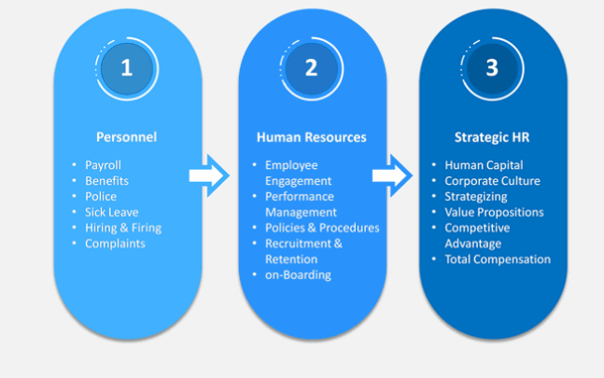
Evolution of HRM
1945-1997
1980-1990
2000-Now

Slide 4

Strategic HR at Netflix
Challenge:
Attract and retain top talent in a competitive market.
Solution:
Cultivate a unique company culture that emphasizes:
  Flexibility: No set work hours, virtual meetings, and freedom to come and go.
  Trust: Employees manage their own vacation time and expenses.
  High Performance: Attracts individuals who thrive in a results-oriented environment.
  Competitive Compensation: High salaries adjusted annually with stock options.
  Self-Directed Development: Employees take ownership of their career growth
Outcome:
Netflix's approach is reflected in its success: significant growth in revenue, profits, and reputation from 2009 to 2011.

Slide 5
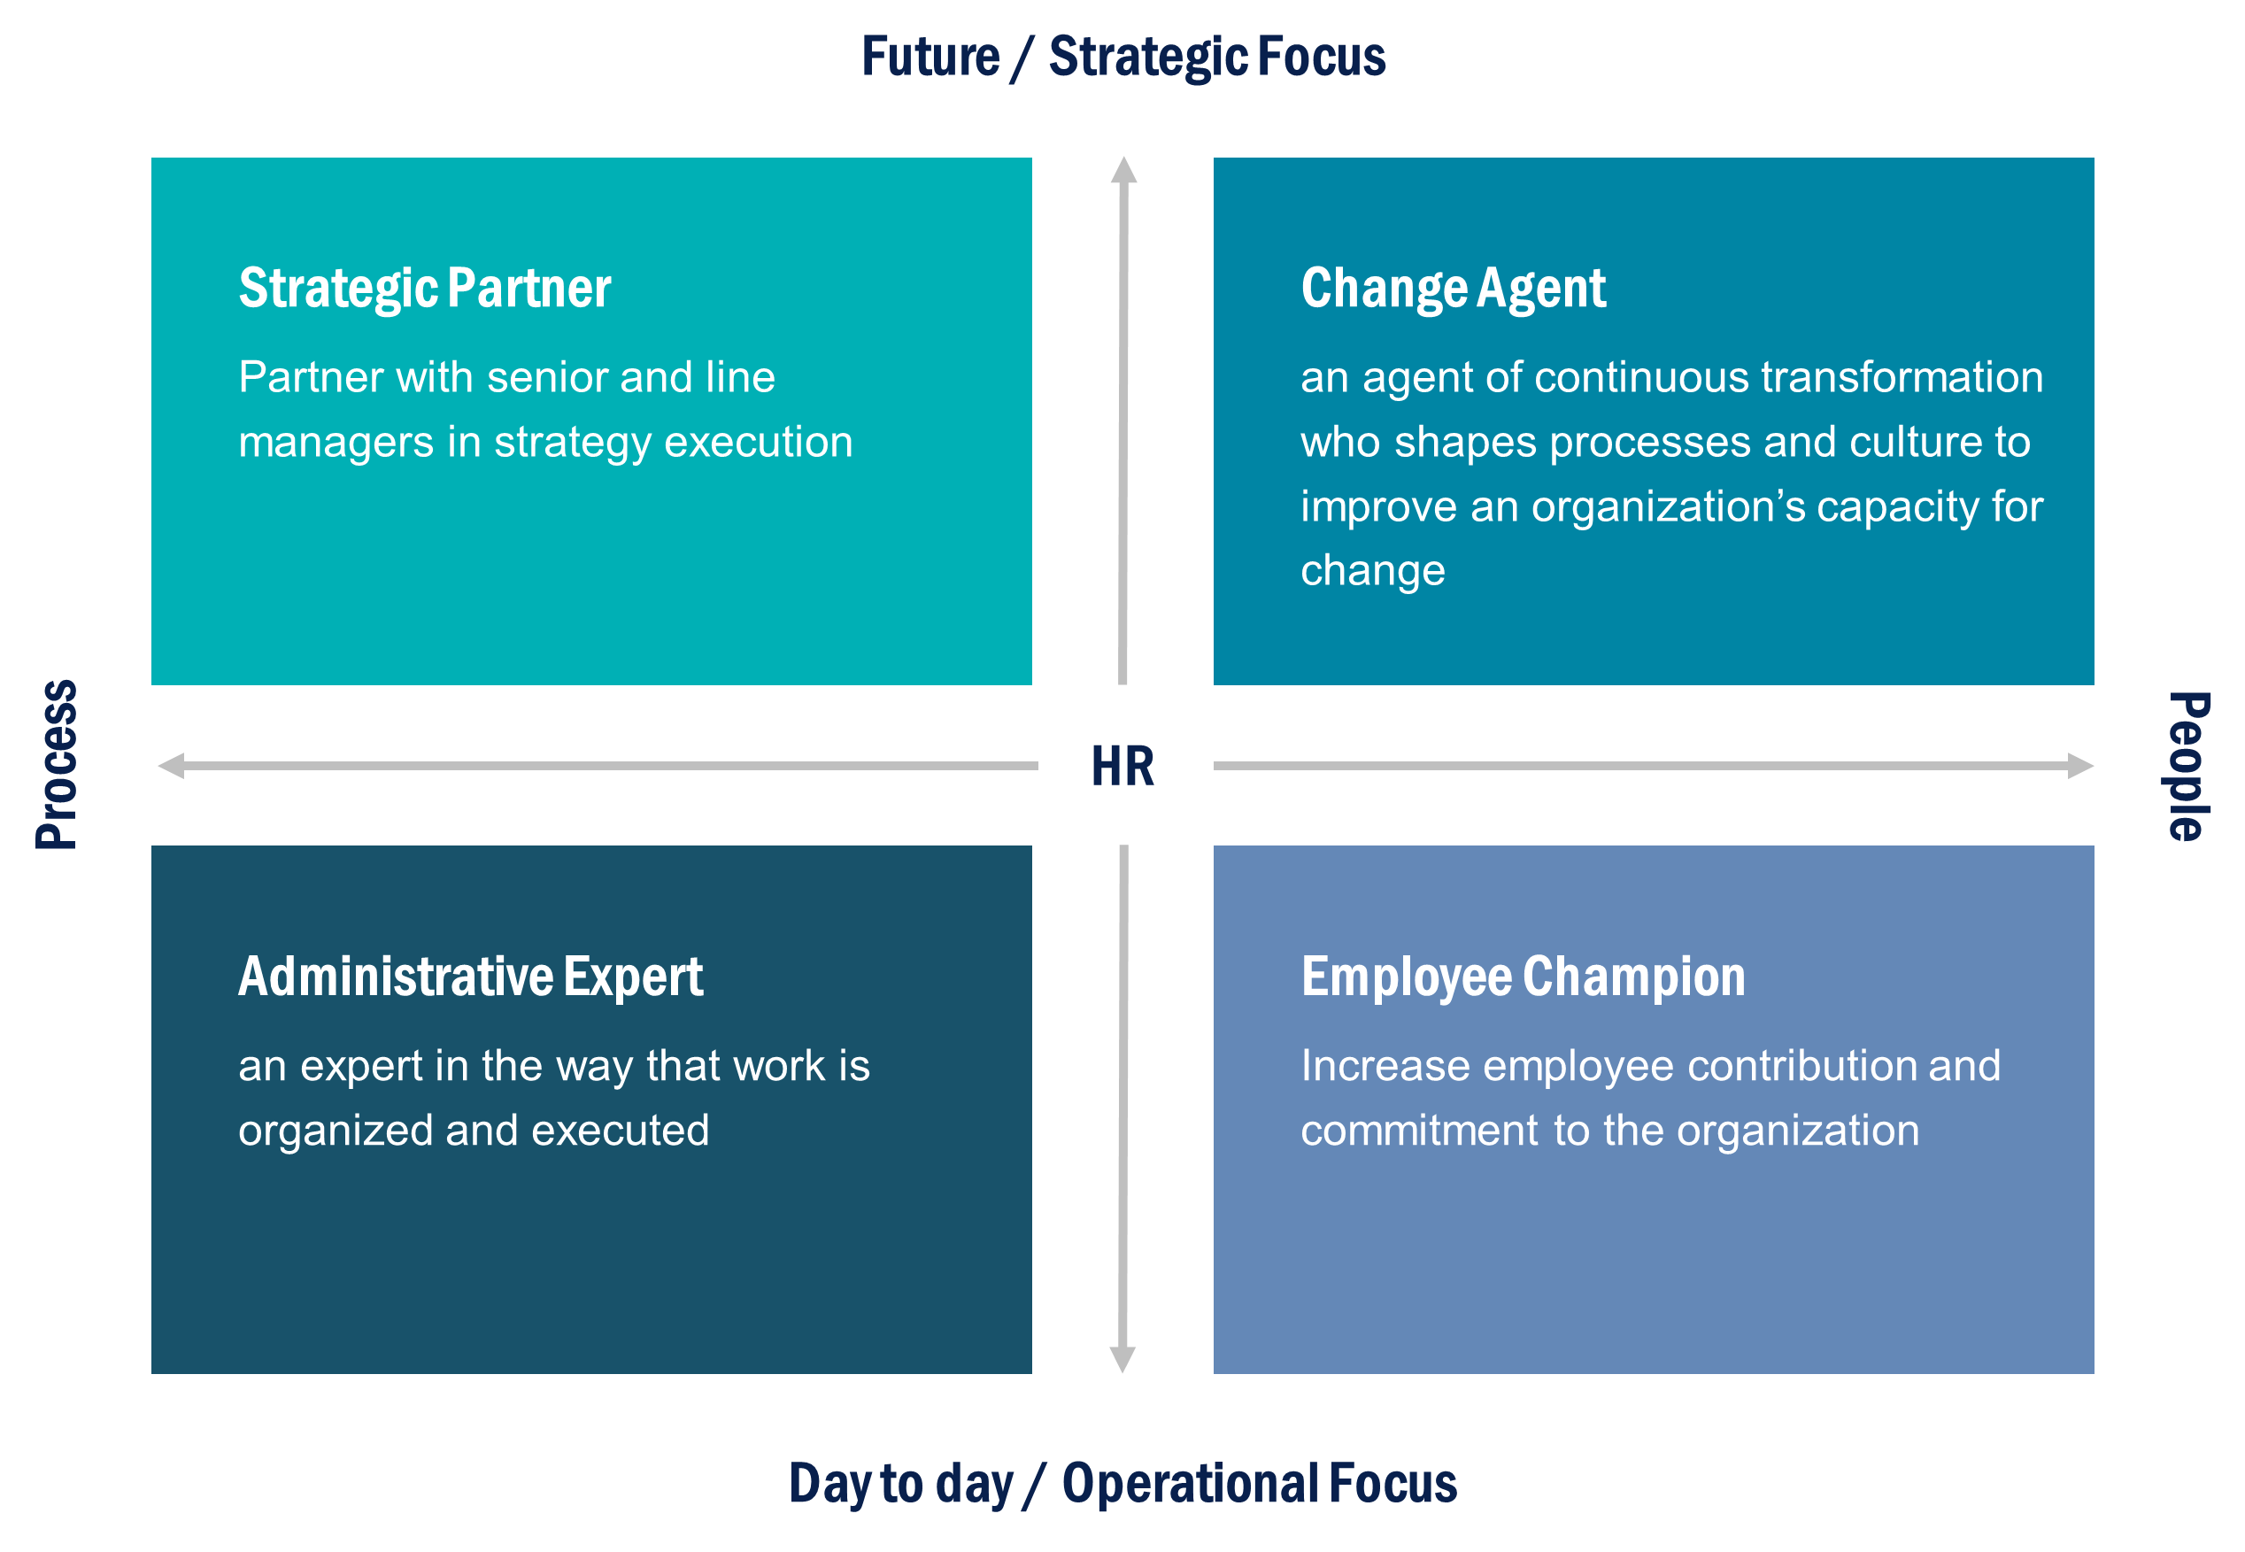
Possible Roles of HR Functions

Slide 6
Strategic HR Versus Traditional HR
Traditional HR Strategic HR can be contrasted to the more traditional administrative focus of HR through an examination of four different roles that HR can play in an organization.
Ulrich developed a framework which proposes an entirely new role and agenda for HR that focuses less on traditional functional activities, such as compensation and staffing, and more on outcomes.
In this scenario, HR would be defined not by what it does but rather by what it delivers. Ideally, HR should deliver results that enrich the organization’s value to its customers, its investors, and its employees.

Slide 7
Possible Roles of HR Functions
1- Strategic Partner
Conduct an organizational audit to help managers identify those components of architecture or structure that need to be changed to facilitate strategy execution.
Identify methods for renovating the parts of the organizational architecture that need it.
Set clear priorities to ensure delivery of results, acquire new skills and capabilities to allow adding value for the executive team.

Slide 8
Week
Possible Roles of HR Functions
2- Administrative Expert
Streamline Administration work, ensure effectiveness and efficiency
Utilize technology to automate HR functions, and hence focusing on its new role as a strategic partner

Slide 9
Week
Possible Roles of HR Functions
3- Employee Champion
Ensuring that employees are fully engaged in and committed to the organization
Partnering with line management to enhance employee morale and training line managers to recognize—and avoid—the causes of low morale, such as unclear goals
Acting as an advocate for employees, representing them and being their voice with senior management

Slide 10
Week
Possible Roles of HR Functions
4- Change Agent
Build the organization’s capacity to embrace and capitalize on new situations
Ensuring that change initiatives are defined, developed, and delivered in a timely manner.
Help the organization plan for and overcome any resistance to change that might present itself.

Slide 11
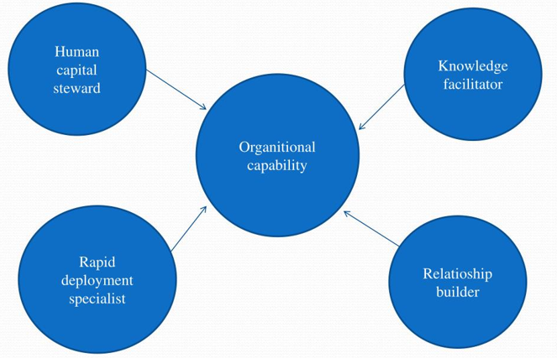
HR Roles in Knowledge-Based Economy

Slide 12
Week
Possible Roles of HR Functions
1- Human Capital Steward
Creating of an environment and culture in which employees voluntarily want to contribute their skills, ideas, and energy.
This is based on the premise that unlike raw materials, plant, and equipment, human capital is not “owned” by the organization; it can move freely from organization to organization
A competitive advantage can be maintained only when the best employees are recruited, duly motivated, and retained

Slide 13
Week
Possible Roles of HR Functions
2- Knowledge Facilitator
Involves the procurement of the necessary employee knowledge and skill sets that allow information to be acquired, developed, and disseminated, providing a competitive advantage.
This process can succeed only as part of a strategically designed employee development plan, whereby employees teach and learn from each other and sharing knowledge becomes valued and rewarded.

Slide 14
Week
Possible Roles of HR Functions
3- Relationship Builder
Involves the development of structure, work practices, and organizational culture that allow individuals to work together, across departments and functions.
To ensure competitiveness, networks need to be developed that focus on the strategic objectives of the organization and how synergies and teamwork that lead to outstanding performance are valued and rewarded

Slide 15
Week
Possible Roles of HR Functions
4- Rapid deployment specialist
Involves the creation of an organization structure and HR systems that are fluid and adaptable to rapid change in response to external opportunities and threats.
The global, knowledge-based economy changes quickly and frequently, and success in such an environment mandates flexibility and a culture that embraces change.

Slide 16
HR Professionals Competencies
Strategic contribution
Development of strategy
01
02
Business knowledge
  understanding nuts & bolts of organization
HR technology
  Using technology to improve organization’s management of people
05
03
Personal credibility
  Measurable value demonstrated in programs & policies
HR delivery
04
  Serving internal customers through effective & efficient programs

Slide 17
Week
HR Professionals Competencies
Strategic contribution—requires the development of strategy, connecting organizations to external constituents, and implementing systems that align employee performance with company strategy.
Business knowledge—involves understanding the nuts and bolts of the organization’s operations and leveraging this knowledge into results.
Personal credibility—requires that measurable value be demonstrated in programs and policies implemented.
HR delivery—involves serving internal customers through effective and efficient programs related to staffing, performance management, and employee development.
HR technology—involves using technology to improve the organization’s management of its people.

Slide 18
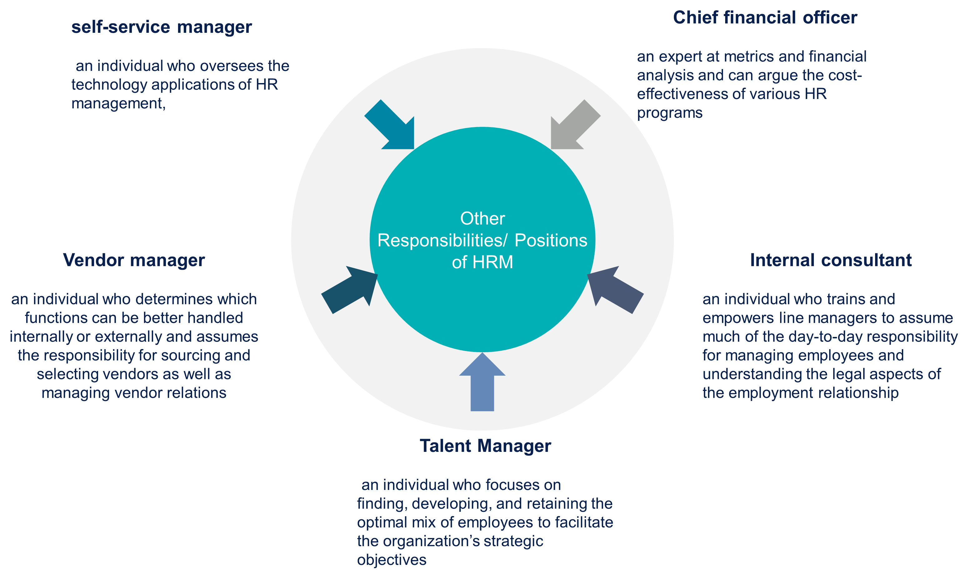
Other Roles/ Competencies of HR Professionals

Slide 19
Lepak & Snell’s Employment Models
Quadrant 4
Alliance/ Partnership
Collaborative- based HRM Configuration
Quadrant 1
Knowledge- based employment
Commitment-based HRM Configuration
High
Uniqueness
Low
Quadrant 2
Job-based Employment
Productivity-based HRM Configuration
Quadrant 3
Contractual Work
Arrangements
Compliance-based HRM Configuration
Low
High
Strategic Value

Slide 20
Week
Lepak & Snell’s Employment Models
Lepak and Snell developed a system that identifies four different employment models and examines the types of HR systems required by each.
They first analyzed the characteristics of human capital by using two dimensions.
1ST Strategic value, or the extent of its potential to improve efficiency and effectiveness, exploit market opportunities, and/or neutralize potential threats.
2nd Uniqueness, or the degree to which it is specialized and not widely available.
These two dimensions form the matrix, which identifies the four types of employment modes

Slide 21
Week
Lepak & Snell’s Employment Models
Quadrant 1: Knowledge-based employment:
Human capital that is unique and has high strategic value to the organization.
This type of employment requires commitment-based HR management.
Commitment-based HR involves heavy investment in training and development, employee autonomy and participation, employment security, and compensation systems that are long term (i.e., stock options) and knowledge based.

Slide 22
Week
Lepak & Snell’s Employment Models
Quadrant 2: Job-based employment
Human capital that has limited uniqueness but is of high strategic value to the organization.
This type of employment requires productivity-based HR management. Less investment will be made in employees, and the organization will seek to acquire individuals with the requisite skills rather than provide training in skills that are generic.
Shorter time frames will be established for performance and rewards, and jobs will be more standardized.

Slide 23
Week
Lepak & Snell’s Employment Models
Quadrant 3: contractual employment
Human capital that is neither unique nor of strategic value to the organization.
This type of employment requires compliance-based HR management.
Structure and direction would be provided for employees and systems established to ensure that employees comply with rules, regulations, and procedures.
Workers would receive little discretion, and any training, performance management, and compensation would be based on ensuring compliance with the set work structures.

Slide 24
Week
Lepak & Snell’s Employment Models
Quadrant 4: Alliance/partnership employment
Human capital that is unique but of limited strategic value to the organization.
This type of employment requires collaborative-based HR management.
Much of the work would be outsourced to an outside vendor based on the sharing of information and establishment of trust.
The organization would select alliance partners who are committed to the relationship as well as the organization’s success. Performance standards and incentives would be established that mutually benefit both partners.

Slide 25
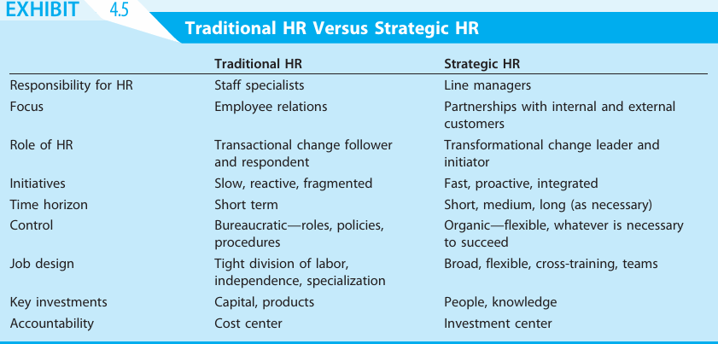

Slide 26
HR Adding Value through effective management of 4 Flows
People Flow
Performance Flow
Information Flow
Work Flow
Consider how employees enter, move through, and eventually leave the organization.
Considers the development of standards and rewards that are consistent with the interests of stakeholders
Considers how employees are made aware of priorities and activities and provided feedback.
Considers the processes in which employees engage and the appropriate responsibility for these processes

Slide 27
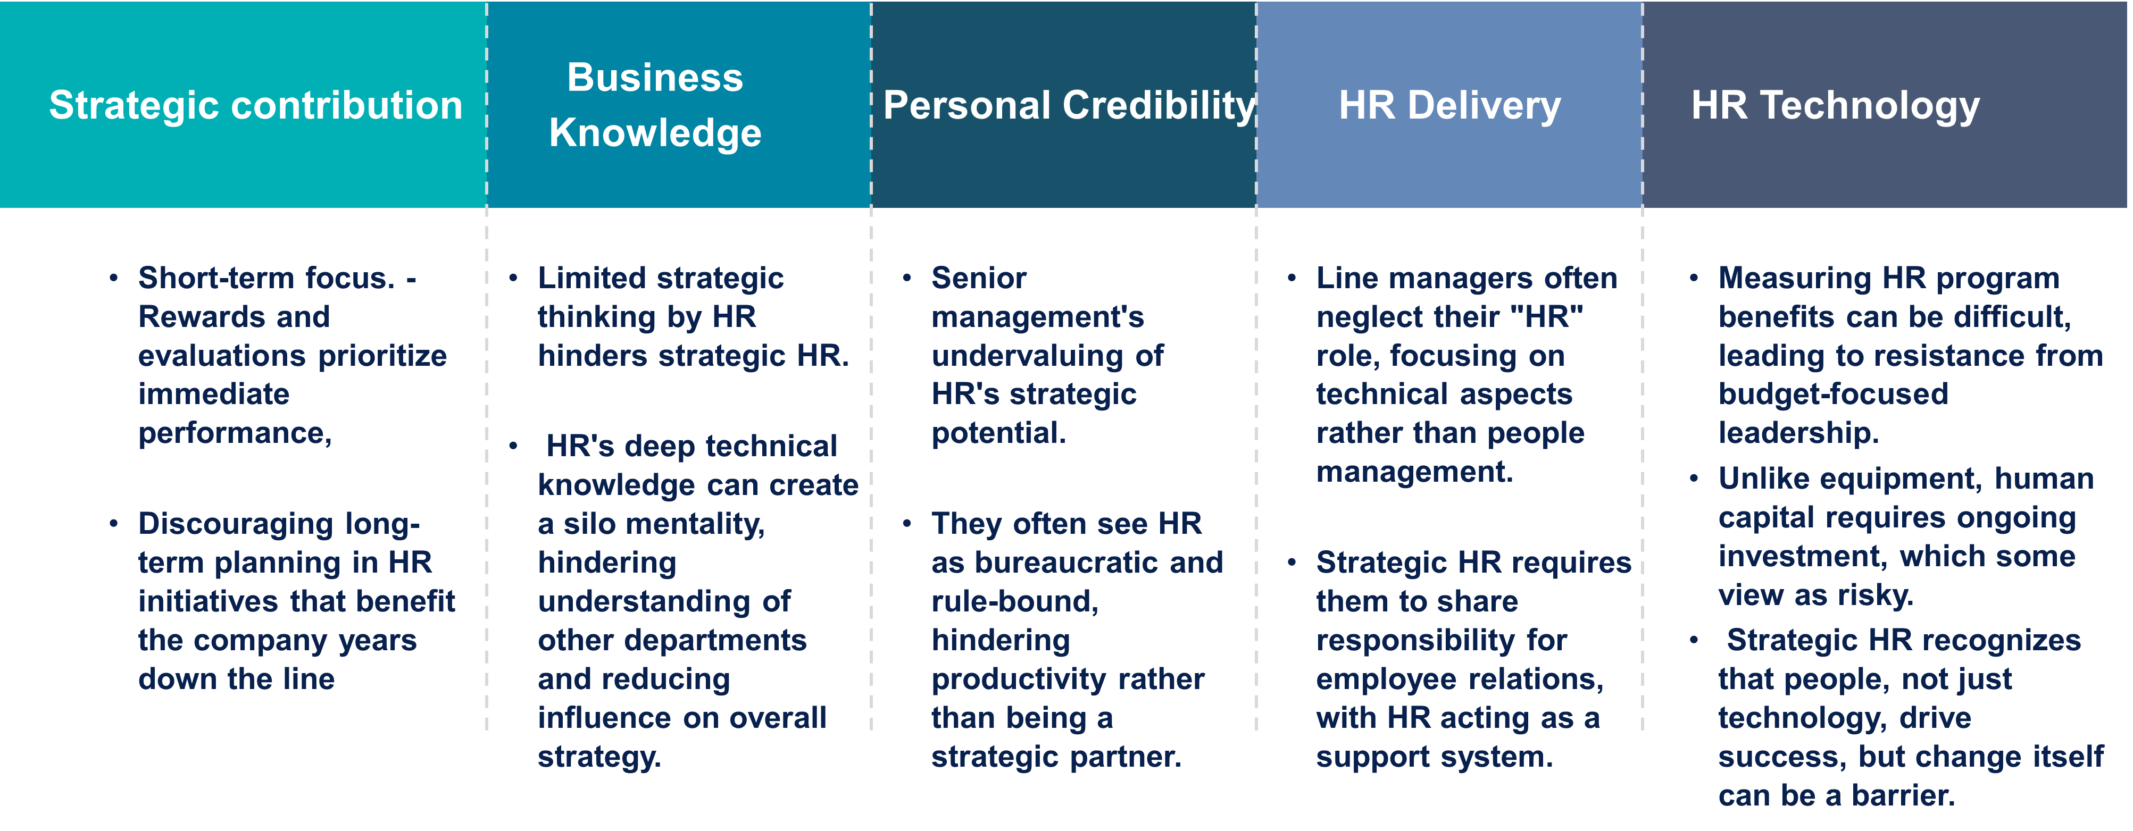
Barriers to Strategic HR

Slide 28
Week
Conclusion
The evolution of SHRM
Differences between HRM & Strategic HRM
Four main new roles of HRM professionals
New competencies for HRM Professionals
Lepak & Snell employment model
HR adding value through effective management of four flows
Barriers to Strategic HRM implementation

Slide 29
Week
01
References
Main Reference
Mello A .Jeffrey (2011). Strategic Management of Human Resources (3rd ed.) South-Western Cengage Learning.
Additional Resources for extra reading.
Boselie, Paul (2014). Strategic Human Resource Management: A Balanced Approach .McGraw Hill Companies.
Millmor, Mike, Philip Lewis, and others (2007), Strategic Human Resource Management Contemporary issues. Ft Prentice Hall.

Slide 30



Thank You

