Slide 1


Human Resources Management
Robert L. Mathis ⏐ John H. Jackson
Prepared by Dr. Samah Abdelfatah
MGM 243
Lecture 02

Slide 2



Strategic Human Resource Management
Chapter
02
Lecture 02
MGM 243
Prepared by
Dr. Samah Abdelfatah
www.midocean.ae

Slide 3

Chapter
Learning Objectives
02
After you read this chapter, you should be able to:
Explain strategic HR management and how it is linked to organizational strategies.
Discuss two possible contributors to competitive advantage and how HR contributes to each.
Define HR planning and outline the HR planning process.
Describe the means for assessing the external and internal environments of HR management.
Discuss several ways of managing a surplus and a shortage of human resources.
Identify why HR metrics must consider both strategic and operational HR measures.
www.midocean.ae

Slide 4
Chapter
NATURE OF STRATEGY AND HR MANAGEMENT
02
Strategic Human Resources Management
Organizational use of employees to gain or keep a competitive advantage against competitors.
Core Competency
A unique capability in the organization that creates high value and that differentiates the organization from its competition.
www.midocean.ae

Slide 5
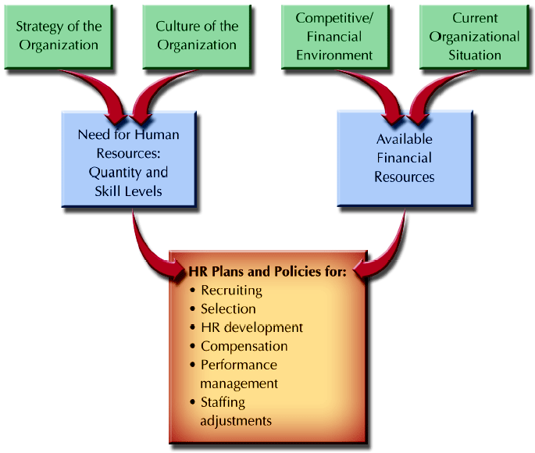
STRATEGIC HR MANAGEMENT PROCESS
Figure 2–1
www.midocean.ae

Slide 6
Chapter
STRATEGIC SUCCESS WITH HR PRACTICES
02
Employment security ■ Selective recruiting ■ High wages/incentives ■ Information sharing/participation ■ Training/cross-training ■ Promotion from within ■ Measuremen
Studies found companies that follow HR best practices have more
than 50% higher market value than those who do not.
Employment security | Training/cross-training
Selective recruiting | Promotion from within
High wages/incentives | Measurement
Information sharing/participation
www.midocean.ae

Slide 7
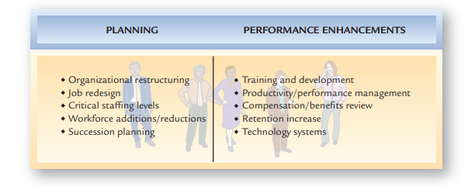
COMMON AREAS FOR HR STRATEGIES
FIGURE 2-2
www.midocean.ae

Slide 8
OPERATIONALIZING HR STRATEGY
of business success are important to understanding the need for certain
strategies.
■ Focus on the key business goals. Programs that have the greatest
relevance to business objectives should get priority.
■ Know what to measure. Metrics are a vital part of assessing success, which
means picking those measures that directly relate to the business goals.
■ Prepare for the future. Strategic thinking requires preparing for the
future, not focusing on the past— except as a predictor of the future.
How specifically can HR professionals provide the perspective and expertise to be a successful part of the strategic planning process?
Understand the business.
Focus on the key business goals.
Know what to measure.
Prepare for the future.
www.midocean.ae

Slide 9
Chapter
02
Using Human Resources As A Core Competency
Some ways in which human resources might become a core competency are through
Attracting and retaining employees with unique professional and technical capabilities
Investing in training and development of those employees, and compensating
www.midocean.ae

Slide 10
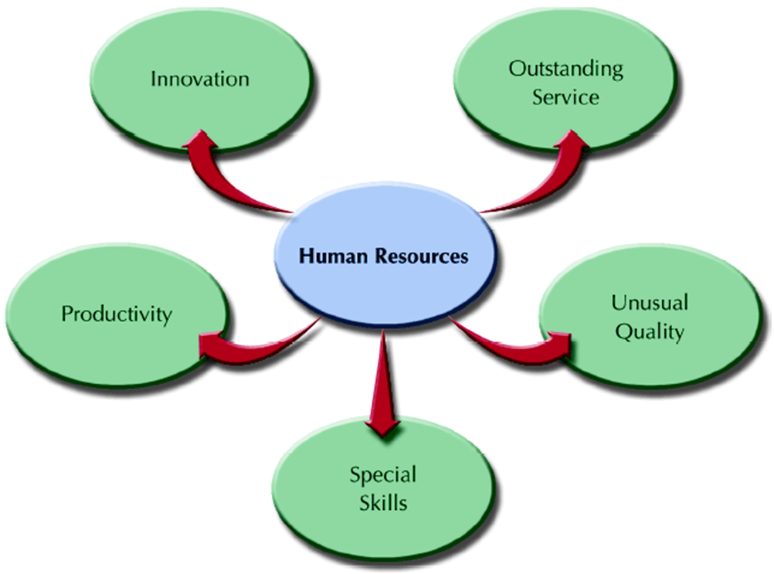
POSSIBLE HR AREAS FOR CORE COMPETENCIES
FIGURE 2–3
www.midocean.ae

Slide 11
Chapter
HR-BASED CORE COMPETENCIES
02
Organizational Culture: The shared values and beliefs of the workforce
Productivity: A measure of the quantity and quality of work done, considering the cost of the resources used. A ratio of the inputs and outputs that indicates the value added by an organization.
Quality Products and Services: High quality products and services are the results of HR-enhancements to organizational performance.
www.midocean.ae

Slide 12
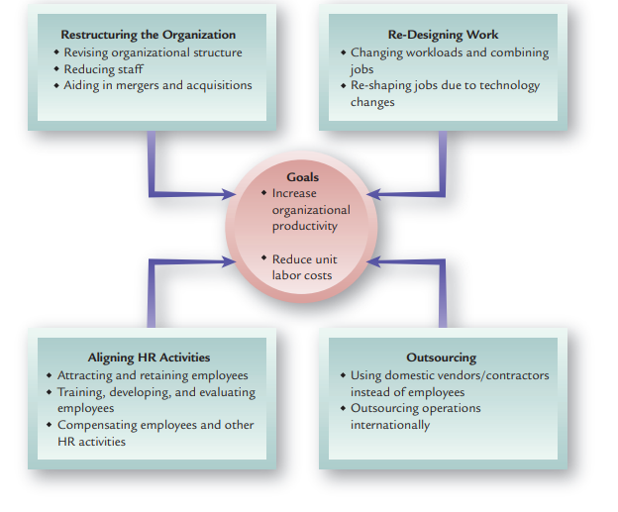
Approaches to Improving Organizational Productivity
FIGURE 2-4
www.midocean.ae

Slide 13
CUSTOMER SERVICE AND QUALITY
LINKED TO HR STRATEGIES
Chapter
02
Service quality is greatly influenced by the individual employees who interact with customers.
For instance, organizations with high employee turnover rates have seen slow sales growth.
Quality Delivering high-quality services and/or products can significantly influence organizational effectiveness.
www.midocean.ae

Slide 14
HR EFFECTIVENESS AND FINANCIAL PERFORMANCE
Chapter
02
Effectiveness for organizations is defined as the extent to which goals have been met.
Efficiency is the degree to which operations are done in an economical manner.
www.midocean.ae

Slide 15
GLOBAL COMPETITIVENESS AND STRATEGIC HR
Chapter
02
The globalization of business has meant that more organizations are operating in multiple countries or have foreign operational links to international suppliers, vendors, and outsourced contributors.
www.midocean.ae

Slide 16
TYPES OF GLOBAL ORGANIZATIONS
Chapter
02
Importing and Exporting The first phase of international interaction consists of importing and exporting.
Multi-national enterprise (MNE) Organization that has operating units located in foreign countries.
Global organization Firm that has corporate units in a number of countries integrated to operate as one organization worldwide
www.midocean.ae

Slide 17
GLOBAL CULTURAL FACTORS
Chapter
02
Culture Societal forces affecting the values, beliefs, and actions of a distinct group of people.
Five dimensions useful in identifying and comparing cultures
Inequality in power
Individualism/group orientation
Masculinity/femininity
Uncertainty avoidance
Long-term/short-term orientation
www.midocean.ae

Slide 18
GLOBAL ECONOMIC FACTORS
Chapter
02
Economic factors are linked to political, legal, and cultural issues, and different countries have different economic systems. In many developed countries, especially in Europe, employment restrictions and wage levels are high.
www.midocean.ae

Slide 19
HUMAN RESOURCE PLANNING
Chapter
02
Human Resource (HR) Planning
  The process of analyzing and identifying the need for and availability of human resources so that the organization can meet its objectives.
HR Planning Responsibilities
  Top HR executive and subordinates gather information from other managers to use in the development of HR projections for top management to use in strategic planning and setting organizational goals
www.midocean.ae

Slide 20
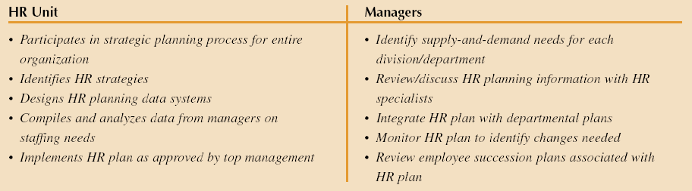
Typical Division of HR Responsibilities in HR Planning
FIGURE 2–5
www.midocean.ae

Slide 21
HUMAN RESOURCE PLANNING (CONT’D)
Chapter
02
Small Business and HR Planning Issues
  Attracting and retaining qualified outsiders
  Management succession between generations of owners
  Evolution of HR activities as business grows
  Family relationships and HR policies
www.midocean.ae

Slide 22

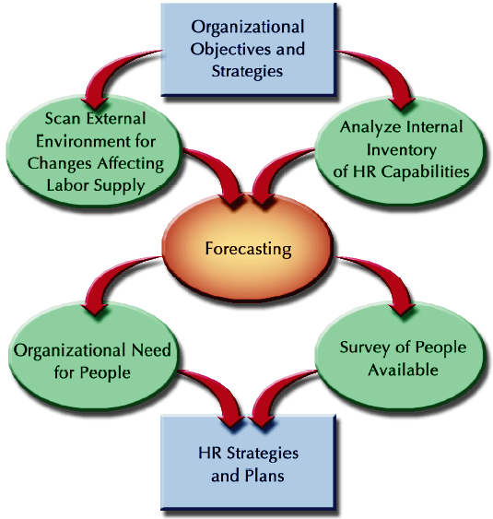
HR PLANNING PROCESS
FIGURE 2-6
www.midocean.ae

Slide 23
HR PLANNING PROCESS
HR Strategies
  The means used to anticipate and manage the supply of and demand for human resources.
    Provide overall direction for the way in which HR activities will be developed and managed.
Overall
Strategic Plan
Human Resources Strategic Plan
HR Activities
www.midocean.ae

Slide 24
BENEFITS OF HR PLANNING
Chapter
02
Better view of the HR dimensions of business decisions
Lower HR costs through better HR management.
More timely recruitment for anticipate HR needs
More inclusion of protected groups through planned increases in workforce diversity.
Better development of managerial talent
www.midocean.ae

Slide 25
Scanning The External Environment
Chapter
02
Environmental Scanning
The process of studying the environment of the organization to pinpoint opportunities and threats.
Environment Changes Impacting HR
Governmental regulations
Economic conditions
Geographic and competitive concerns
Workforce composition
www.midocean.ae

Slide 26
Internal Assessment Of The Organizational Workforce
Chapter
02
Auditing Jobs and Skills
  What jobs exist now?
  How many individuals are performing each job?
  How essential is each job?
  What jobs will be needed to implement future organizational strategies?
  What are the characteristics of anticipated jobs?
www.midocean.ae

Slide 27
Internal Assessment Of The Organizational Workforce
Chapter
02
Organizational Capabilities Inventory
  HRIS databases—sources of information about employees’ knowledge, skills, and abilities
  Components of an organizational capabilities inventory
    Workforce and individual demographics
    Individual employee career progression
    Individual job performance data
www.midocean.ae

Slide 28
Forecasting HR Supply and Demand
Chapter
02
Forecasting
  The use of information from the past and present to identify expected future conditions.
Forecasting Methods
  Judgmental
    Estimates—asking managers’ opinions, top-down or bottom-up
    Rules of thumb—using general guidelines
    Delphi technique—asking a group of experts
    Nominal groups—reaching a group consensus in open discussion
www.midocean.ae

Slide 29
Forecasting HR Supply and Demand
Chapter
02
Forecasting Methods (cont’d)
Mathematical
  Statistical regression analysis
  Simulation models
  Productivity ratios—units produced per employee
  Staffing ratios—estimates of indirect labor needs
Forecasting Periods
  Short-term—less than one year
  Intermediate—up to five years
  Long-range—more than five years
www.midocean.ae

Slide 30
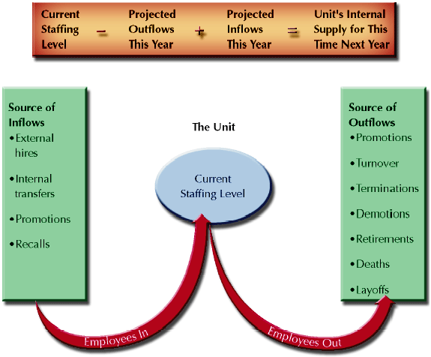
Estimating Internal Labor Supply for a Given Unit
FIGURE 2-7
www.midocean.ae

Slide 31
Managing Human Resource
Surplus Or Shortage
Chapter
02
Workforce Realignment
  “Downsizing”, “Rightsizing”, and “Reduction in Force” (RIF) all mean reducing the number of employees in an organization.
  Causes
    Economic—weak product demand, loss of market share to competitors
    Structural—technological change, mergers and acquisitions
www.midocean.ae

Slide 32
Managing Human Resource
Surplus Or Shortage
Chapter
02
Workforce Realignment (cont’d)
  Positive consequences
    Increase competitiveness
    Increased productivity
  Negative consequences
    Cannibalization of HR resources
    Loss of specialized skills and experience
    Loss of growth and innovation skills
  Managing survivors
    Provide explanations for actions and the future
    Involve survivors in transition/regrouping activities
www.midocean.ae

Slide 33
Managing Human Resource
Surplus Or Shortage
Chapter
02
Downsizing approaches
Attrition and hiring freezes
  Not replacing departing employees and not hiring new employees.
Early retirement buyouts
  Offering incentives that encourage senior employees to leave the organization early.
Layoffs
  Employees are placed on unpaid leave until called back to work when business conditions improve.
  Employees are selected for layoff on the basis of their seniority or performance or a combination of both.
www.midocean.ae

Slide 34
Managing Human Resource
Surplus Or Shortage
Chapter
02
Downsizing approaches (cont’d)
  Outplacement services provided to displaced employees to give them support and assistance:
    Personal career counseling
    Resume preparation and typing services
    Interviewing workshops
    Referral assistance
    Severance payments
    Continuance of medical benefits
    Job retraining
www.midocean.ae

Slide 35
Assessing HR Effectiveness
Chapter
02
Diagnostic Measures of HR Effectiveness
  HR expense per employee
  Compensation as a percent of expenses
  HR department expense as a percent of total expenses
  Cost of hires
  Turnover rates
  Absenteeism rates
  Worker’s compensation per employee
www.midocean.ae

Slide 36
Assessing HR Effectiveness
Chapter
02
HR Audit
  A formal research effort that evaluates the current state of HR management in an organization
  Audit areas:
    Legal compliance (e.g., EEO, OSHA, ERISA, and FMLA)
    Current job specifications and descriptions
    Valid recruiting and selection process
    Formal wage and salary system • Benefits
    Employee handbook
    Absenteeism and turnover control
    Grievance resolution process
    Orientation program • Training and development
    Performance management system
www.midocean.ae

Slide 37
Using HR Research For Assessment
Chapter
02
HR Research
  The analysis of data from HR records to determine the effectiveness of past and present HR practices.
Primary Research
  Research method in which data are gathered first-hand for the specific project being conducted.
Secondary Research
  Research method using data already gathered by others and reported in books, articles in professional journals, or other sources.
www.midocean.ae

Slide 38
HR Performance and Benchmarking
Chapter
02
Benchmarking
  Comparing specific measures of performance against data on those measures in other “best practice” organizations
Common Benchmarks
  Total compensation as a percentage of net income before taxes
  Percent of management positions filled internally
  Dollar sales per employee
  Benefits as a percentage of payroll cost
www.midocean.ae

Slide 39
SUMMARY
Chapter
02
Nature Of Strategy And HR Management
Strategic HR Management Process
Common Areas For HR Strategies
Operationalizing HR Strategy
Using Human Resources As A Core Competency
Approaches To Improving Organizational Productivity
Global Competitiveness And Strategic HR
Human Resource Planning
Managing Human Resource Surplus Or Shortage
Assessing HR Effectiveness
www.midocean.ae

Slide 40



Thank You

