Slide 1


Data Processing & Feature Engineering II
Prepared by Dr. Sumaya Alkubaisi
FNT633
Machine Learning in Finance
Lecture 3

Slide 2

Chapter
Learning Goals
3
By the end of this lecture, you will be able to:
By the end of this lecture, you will be able to:
Integrate financial data from multiple sources.
Normalize and scale variables for fair comparisons.
Detect and handle outliers using residuals.
Apply feature engineering, transformations, and encoding.
Prepare finance-ready datasets in Python.

Slide 3
Chapter
What is Data Integration?
3
Data Integration is the process of combining data from multiple sources into a single, consistent view.
Why it matters in finance?
Customer financial profiles may be spread across different banks, credit bureaus, and transaction logs.
Integrated data = complete view of customer behavior → better predictions.

Slide 4
Chapter
Examples of Data Integration in Finance
3
Merging datasets: Combine loan applications with credit scores.
Concatenating records: Stack transaction logs from different branches.
Joining tables: Link customer IDs with loan payment history.
Example:
Table A: Loan applications (name, income, loan amount).
Table B: Credit bureau (name, credit score).
Integration: Merge both on “name” to get a complete profile.

Slide 5

Python Demo: Data Integration (Merge)
import pandas as pd
# Example loan application dataset
loans = pd.DataFrame({
"Customer": ["Ali", "Sara", "John"],
"Income": [5000, 7000, 4000],
"Loan_Amount": [2000, 3000, 1500]
})
# Example credit bureau dataset
credit = pd.DataFrame({
"Customer": ["Ali", "Sara", "John"],
"Credit_Score": [650, 720, 580]
})
# Merge datasets
merged = pd.merge(loans, credit, on="Customer")
print(merged)

Slide 6

Python Demo: Data Integration (Merge)
Output:
Combined dataset with income, loan amount, and credit score.
merge() : combines two datasets on a shared column (Customer).

Slide 7
Python Demo: Data Integration (Concatentation)
# Concatenate two loan datasets
loans_branchA = pd.DataFrame({
"Customer": ["Ali", "Mona"],
"Loan_Amount": [2000, 2500]
})
loans_branchB = pd.DataFrame({
"Customer": ["John", "Laila"],
"Loan_Amount": [1500, 3000]
})
all_loans = pd.concat([loans_branchA, loans_branchB])
print(all_loans)

Slide 8
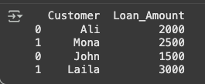
Python Demo: Data Integration (Concatentation)
Output:
Combined records from both branches into one dataset.
concat() : stacks datasets on top of each other (like combining rows).

Slide 9
Chapter
Data Normalization
3
What is Data Normalization?
Rescaling numeric data into a standard range (e.g., 0–1).
Ensures that no single feature dominates simply because of its scale.
Makes features comparable, regardless of their original scale.
Example: Income (70,000) vs Age (35).

Slide 10
Chapter
Why Do We Need It in Finance?
3
Financial features are often on different scales (income, loan amount, credit score, age).
Without normalization → model may give more weight to features with bigger numbers.
Risk: Predictions become biased (unfair and unreliable).

Slide 11
Chapter
What Happens if a Feature Dominates?
3
Algorithm focuses too much on one feature.
Other important variables are ignored.
This causes:
  Biased predictions → the model favors one feature unfairly (e.g., always trusting income more than credit score).
  Skewed results → the predictions are “tilted” in one direction, not balanced.
Example:
If income is very large compared to other features, the model may “think” income alone decides loan approval → unfair to people with lower income but excellent credit scores.

Slide 12
Chapter
Benefits of Normalization
3
Ensures fair comparison among features.
Improves model accuracy and training speed.
Prevents bias from large-scale features (like loan amount overshadowing credit score).
Helps financial predictions become balanced and reliable.

Slide 13
Common Normalization/ Standardization Techniques
Chapter
3
Min-Max Scaling → Rescales values to 0–1.
Formula: (x – min) / (max – min).
Example: Income 70,000 in range (10,000–100,000) → 0.67.
Z-score Standardization → Rescales values based on mean & standard deviation.
Formula: (x – mean) / std.
Example: Credit score 700 with mean 600, std 50 → 2.0 (2 std above mean).

Slide 14

Python Demo: Min-Max Normalization
from sklearn.preprocessing import MinMaxScaler
data = pd.DataFrame({
"Income": [3000, 6000, 9000],
"Loan_Amount": [1000, 2000, 3000]
})
scaler = MinMaxScaler()
normalized = scaler.fit_transform(data)
normalized_df = pd.DataFrame(normalized, columns=data.columns)
print(normalized_df)

Slide 15

Python Demo: Z-score Standardization
from sklearn.preprocessing import StandardScaler
scaler = StandardScaler()
standardized = scaler.fit_transform(data)
standardized_df = pd.DataFrame(standardized, columns=data.columns)
print(standardized_df)
Useful when features have very different ranges (e.g., salary vs. age).

Slide 16
Chapter
Handling Missing Values (Residual Approach)
3
Missing values can distort analysis or model performance.
Residual approach = an advanced method to estimate missing values using other related features.
The residual approach doesn’t just guess missing values. It predicts them using patterns in the data and then fine-tunes the guess with residuals.
It is more accurate than simple mean/median imputation.

Slide 17
Chapter
How the Residual Approach Works?
3
1. Build a model using complete data
Take the rows that don’t have missing values.
Example: We want to fill missing income, so we use customers who have income recorded.
2. Predict missing values
Use other features (like age, education, credit score) to predict income for customers with missing income.
3. Use residuals to adjust the prediction (optional)
Residual = the small difference between the real value and the predicted value (for those customers where we know income).
If we see a pattern in the residuals (like always predicting slightly higher), we can adjust the predicted values to make them more accurate.

Slide 18
Chapter
Residual Approach Example
3
Dataset: Loan applications
Problem: Some customers are missing income data.
Step 1: Train a regression model with Age, Education, Credit Score → Income (using customers with full data).
Step 2: For a customer missing income, predict:
Age = 40, Education = Master’s, Credit Score = 720 → Predicted Income = $75,000.
Step 3: Check residuals from training: If the model usually overestimates by $5,000, adjust to $70,000.

Slide 19
Chapter
Why It’s Useful?
3
Uses relationships between variables to produce more accurate estimates.
Maintains dataset size, unlike deletion.
Reduces bias introduced by simple imputation.
Prepares data better for machine learning models.

Slide 20
Chapter
Variable Transformation
3
Adjusts the distribution or relationship of variables to make data more suitable for modeling.
It is commonly used to normalize skewed data, reduce the influence of extreme values, or reveal hidden patterns.
Examples:
Log transformation: Makes right-skewed data (e.g., income) more normal.
Square root transformation: Reduces the impact of large values.
Polynomial features: Introduces nonlinear relationships for complex patterns.

Slide 21
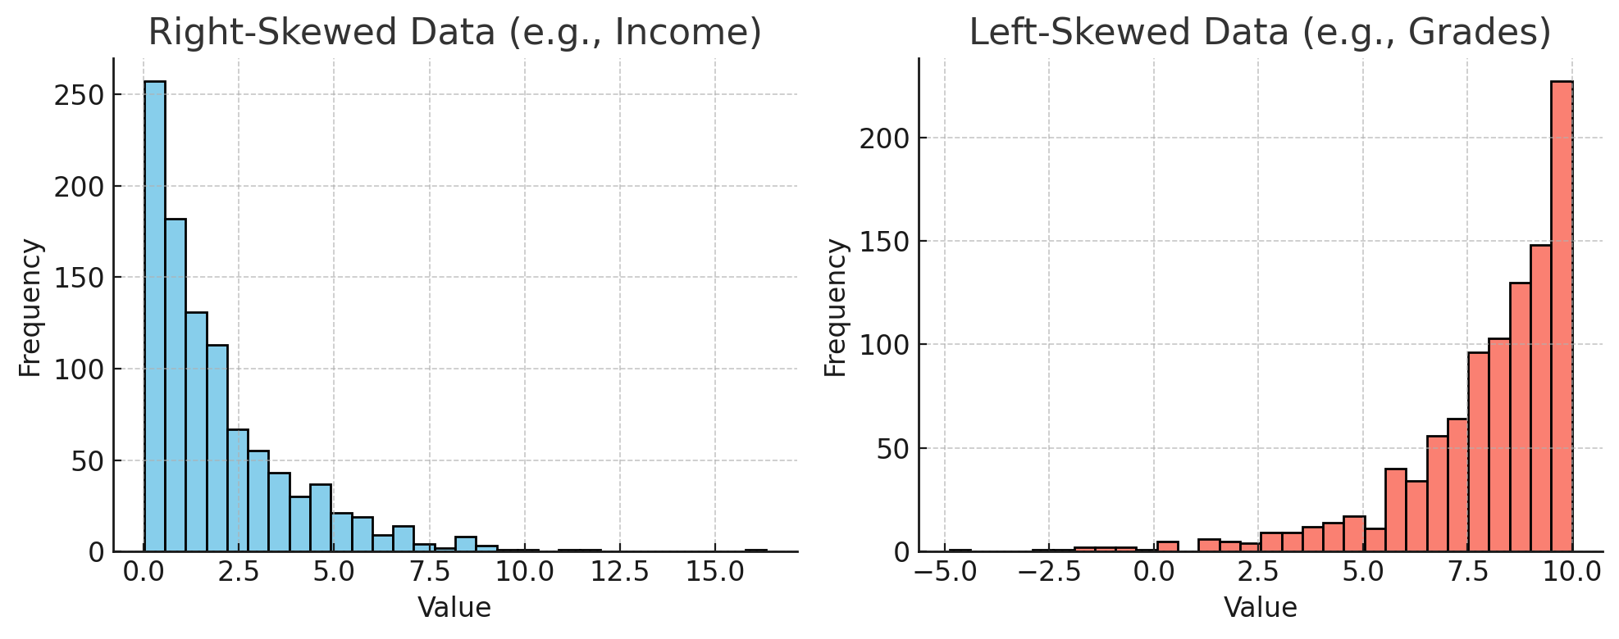
Visual comparison — the right-skewed data has a long tail to the right (few very large values), while the left-skewed data has a long tail to the left (few very small values)

Slide 22
Chapter
Feature Encoding
3
Converts categorical (non-numeric) variables into numeric format so that machine learning algorithms can process them.
Types of Features
1. Numerical (Quantitative):
Values that represent measurable quantities.
Examples: Age, Income, Loan Amount.
Can be continuous (e.g., income = 50,000.75) or discrete (e.g., number of transactions = 7).
2. Categorical (Qualitative):
Values that represent groups or categories.
Nominal: No natural order.
Example: Gender (Male, Female), Country (USA, UK, UAE).
Ordinal: Has a meaningful order or ranking.
Example: Education (High School < Bachelor < Master < PhD), Credit Rating (Low < Medium < High).

Slide 23
Chapter
Why Encoding Is Needed
3
Machine learning models only understand numbers, not text labels.
So, we convert categorical data into numeric form using encoding.
Nominal → One-Hot Encoding
(each category becomes its own binary column)
Bachelor → (1, 0, 0)
Master → (0, 1, 0)
PhD → (0, 0, 1)
Ordinal → Label Encoding
(replace categories with ordered numbers like 1, 2, 3)
Loan Default: Yes/No → 1/0

Slide 24
Lecture
Feature Scaling
3
Adjusts numerical feature values to a common scale, ensuring that no feature dominates others in models sensitive to magnitude (e.g., KNN, SVM).
Scaling Methods:
Standardization (Z-score): Centers data around mean = 0 and standard deviation = 1.
Min-Max Scaling: Rescales data to a fixed range, usually [0, 1].
Example:
Without scaling, Age (20–60) and Loan Amount (10,000–200,000) would have very different ranges, causing imbalance in model learning.

Slide 25
Python Demo: Feature Engineering
# ---- Variable Transformation ----
df['log_salary'] = np.log(df['salary'] + 1)
# ---- Feature Encoding ----
df = pd.get_dummies(df, columns=['education'], drop_first=True)
# ---- Feature Scaling ----
scaler = StandardScaler()
df['loan_scaled'] = scaler.fit_transform(df[['loan_amount']])

Slide 26
Lab Activity: Data preparation 2
# ==============================
# Lecture 3, Feature Engineering & Data Processing
#==============================
# Libraries
import pandas as pd
import numpy as np
import seaborn as sns
import matplotlib.pylab as plt %matplotlib inline from sklearn.preprocessing import StandardScaler, MinMaxScaler
from scipy import stats

Slide 27
Lab Activity: Data preparation 2
# ==============================
# Step 1: Create Example Dataset
# ==============================
data = { "age": [25, 40, None, 35, -5],
"salary": [50000, 60000, 55000, None, 45000],
"loan_amount": [20000, 25000, 22000, 18000, 30000],
"education": ["Bachelor", "Master", "PhD", "Bachelor", "Master"],
"default": ["No", "Yes", "No", "No", "Yes"] }
df = pd.DataFrame(data)
df['customer_id'] = [1, 2, 3, 4, 5]
print("Original Dataset:")
print(df) Dataset:") print(merged)

Slide 28
Lab Activity: Data preparation 2
# ==============================
# Step 2: Data Integration
# ==============================
risk_data = { "customer_id": [1, 2, 3, 4, 5],
"risk_score": [0.2, 0.8, 0.5, 0.1, 0.7] }
risk_df = pd.DataFrame(risk_data)
# Merge both datasets merged = pd.merge(df, risk_df, on="customer_id") print("\nMerged Dataset:")
print(merged)

Slide 29
Lab Activity: Data preparation 2
# ==============================
# Step 3: Handling Missing Values
# ==============================
print("\nMissing values before cleaning:\n",
merged.isnull().sum())
# Fill missing values
merged['age'].fillna(merged['age'].median(), inplace=True) merged['salary'].fillna(merged['salary'].mean(), inplace=True)
print("\nMissing values after cleaning:\n",
merged.isnull().sum()) #

Slide 30
Lab Activity: Data preparation 2
# ==============================
# Step 4: Handling Outliers
# ==============================
plt.figure(figsize=(6,3))
sns.boxplot(x=merged['age’])
plt.title("Age Distribution Before Cleaning")
plt.show()
# Remove unrealistic ages (negative)
merged = merged[merged['age'] > 0]
plt.figure(figsize=(6,3))
sns.boxplot(x=merged['age’])
plt.title("Age Distribution After Cleaning")
plt.show()

Slide 31
Lab Activity: Data preparation 2
# ==============================
# Step 5: Variable Transformation (Log Transformation)
# ==============================
# Histogram before log transformation
sns.histplot(df['salary'], kde=True)
plt.title("Salary Distribution (Before Log)")
plt.show()
# Apply log transformation
df['log_salary'] = np.log(df['salary'] + 1)
# Histogram after log transformation
sns.histplot(df['log_salary'], kde=True, color="orange")
plt.title("Salary Distribution (After Log)")
plt.show()

Slide 32
Lab Activity: Data preparation 2
# ==============================
# Step 6: Feature Encoding
# ==============================
# One-hot encoding “education”
df = pd.get_dummies(df, columns=['education'], drop_first=True)
print(df.head())

Slide 33
Lab Activity: Data preparation 2
# ==============================
# Step 7: Feature Scaling
# ==============================
scaler = StandardScaler()
df['loan_scaled'] = scaler.fit_transform(df[['loan_amount']])
# Plot comparison of original vs scaled loan amounts
fig, axes = plt.subplots(1, 2, figsize=(12, 5))
sns.histplot(df['loan_amount'], kde=True, ax=axes[0])
axes[0].set_title("Original Loan Amount")
sns.histplot(df['loan_scaled'], kde=True, color="green", ax=axes[1])
axes[1].set_title("Scaled Loan Amount")
plt.show()

Slide 34
Lab Activity: Data preparation 2
# ==============================
# Step 8: Final Cleaned Dataset
# ==============================
print("\nFinal Processed Dataset:")
print(df.round(2))

Slide 35
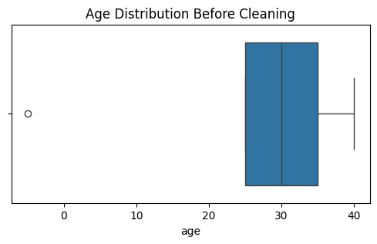
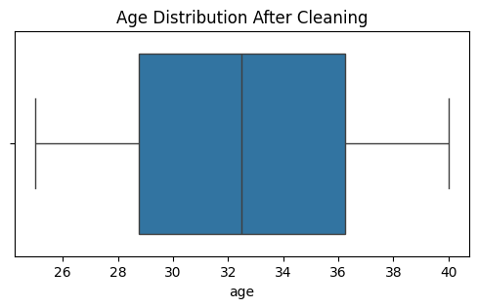
Chapter
1

Slide 36
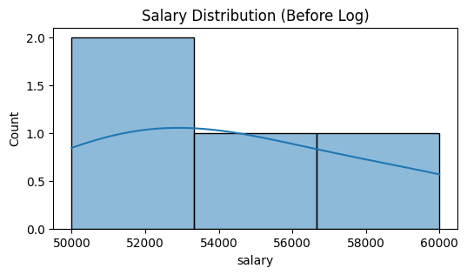
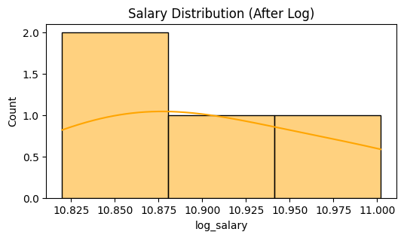
Chapter
1

Slide 37
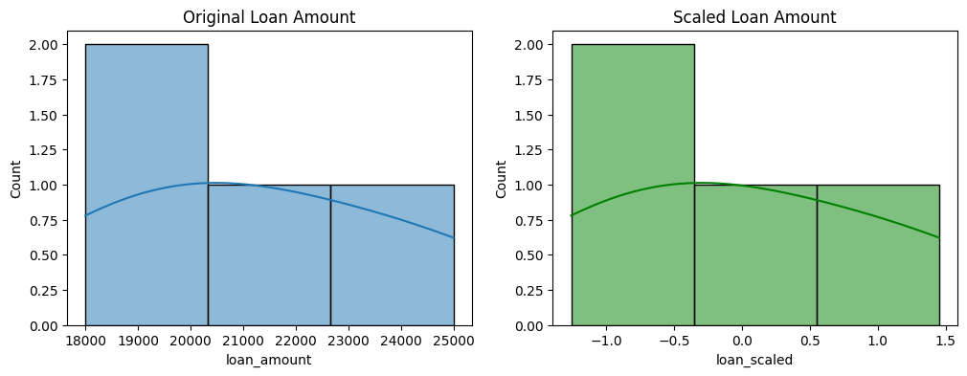
Chapter
1

Slide 38
Lecture
Demo Lab Recap: What We Learned
3
Data Integration
Used pd.merge() to combine datasets by a common key (customer_id).
Integrated risk score data with the main loan dataset.
Handling Missing Values
Identified missing data using isnull().sum().
Filled missing entries with mean or median using fillna().
Outlier Detection and Removal
Used sns.boxplot() to visualize and remove unrealistic values (like negative ages).
Variable Transformation

Slide 39
Lecture
Demo Lab Recap: What We Learned
3
Applied logarithmic transformation np.log() to reduce skewness in salary distribution.
Feature Encoding
Converted categorical data into numerical form using pd.get_dummies() for the education variable.
Feature Scaling
Standardized the loan amount feature using StandardScaler() to normalize the scale of variables.
Visualization
Used Seaborn and Matplotlib to visualize before-and-after transformations for clear understanding.

Slide 40
Chapter
References
3
Han, Kamber, & Pei (2012). Data Mining: Concepts and Techniques.
Géron, A. (2019). Hands-On Machine Learning with Scikit-Learn & TensorFlow.
Scikit-learn Documentation: https://scikit-learn.org/stable/
Pandas Documentation: https://pandas.pydata.org

