Slide 1


Prepared by Dr. Rana Maya
REA617
Real Estate & Urban Economics
Lecture 8

Slide 2



Transportation Economics and Urban Mobility
Lecture 8
REA617
Real Estate & Urban Economics
Prepared by
Dr. Rana Maya

Slide 3

lecture
Abstract
08
Transportation is the circulatory system of the urban economy. It connects people, goods, and ideas, enabling productivity and shaping land use. In cities, mobility is both an economic enabler and a real-estate driver — determining accessibility, land value, and development intensity.

Slide 4

lecture
08
Contents
Introduction
Theoretical Foundations of Transportation Economics
Urban Mobility and Accessibility
Economic Principles Governing Transport Systems
Financing Urban Transport: Models and Mechanisms
Transit-Oriented Development (TOD) and Real Estate
Smart Mobility, Technology, and the Future of Transport
Environmental, Social, and Equity Dimensions
Global Case Studies
Analytical Tools and Graphs
Policy Challenges and Directions
Implications for Real Estate Professionals

Slide 5
lecture
08
  Learning outcomes
By the end of the lecture, you will be able to:
Explain the economic foundations of transport systems and their interaction with urban form.
Apply transport economics to real estate valuation and development analysis.
Evaluate transport investment impacts using CBA frameworks.
Interpret and critique global case studies of transport–land use integration.
Propose sustainable mobility and real estate development strategies

Slide 6
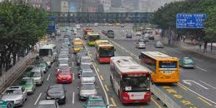
1.Introduction
The relationship between transport and urban development is reciprocal:
Transport enables urban expansion, influencing spatial form and real estate markets.
Urban growth generates transport demand, requiring continuous infrastructure investment.
Why?
As cities pursue sustainability and efficiency, the economics of transportation become crucial in understanding how infrastructure influences property values, urban form, and investment decisions.

Slide 7

2. Theoretical Foundations of Transportation Economics
2.1 Core Concepts
Derived Demand: Transport demand arises from the need to reach other activities (work, shopping, leisure).
Generalized Cost of Travel: The combination of monetary cost, time, reliability, and comfort.
Externalities: Unpriced social costs such as congestion, air pollution, and accidents.
Market Failures: Result from public good characteristics and external effects, justifying government intervention.
Equity vs. Efficiency Trade-offs: Balancing cost recovery with accessibility and fairness.

Slide 8
2. Theoretical Foundations of Transportation Economics
3. Decision Outcome:
Site A offers the lowest total cost despite higher rent, thanks to better accessibility.
This shows how transport accessibility directly affects business location choices, balancing land cost and logistics efficiency.
Example : Firm Mobility Decision
Context:
A logistics company (FastMove Ltd.) must decide where to locate a new distribution warehouse.
They have three potential sites on the outskirts of the city, each with different accessibility and transport costs.
Site | Rent ($/m²/year) | Distance to Highway | Average Delivery Time to City | Fuel Cost per Delivery | Labor Accessibility
A | 90 | 2 km | 25 min | $12 | High
B | 70 | 15 km | 40 min | $20 | Medium
C | 50 | 30 km | 60 min | $30 | Low
1. Firm’s Objective:
Minimize total logistics cost, which includes rent + transport + labor accessibility (measured as potential delay cost).

Slide 9
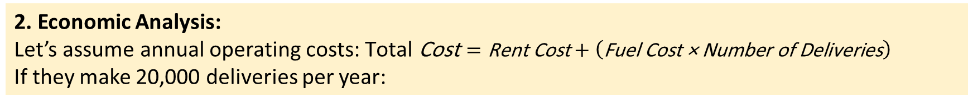
2. Theoretical Foundations of Transportation Economics
2. Economic Analysis:
Let’s assume annual operating costs: $\text{Total} \text{Cost}=\text{Rent} \text{Cost}+\left(\text{Fuel} \text{Cost}\text{ × }\text{Number} \text{of} \text{Deliveries}\right)$
If they make 20,000 deliveries per year:
Site | Rent (for 5,000 m²) | Fuel Cost | Total Cost | Decision
A | $450000 | $240000 | $690000 | ✅ Best Option
B | $350000 | $400000 | $750000
C | $250000 | $600000 | $850000
3. Decision Outcome:
Site A offers the lowest total cost despite higher rent, thanks to better accessibility.
This shows how transport accessibility directly affects business location choices, balancing land cost and logistics efficiency.

Slide 10
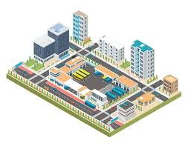
3. Urban Mobility and Accessibility
3.1 Defining Urban Mobility
Urban mobility encompasses all modes of movement — walking, cycling, public transport, and private vehicles — that enable access to urban resources.

Slide 11
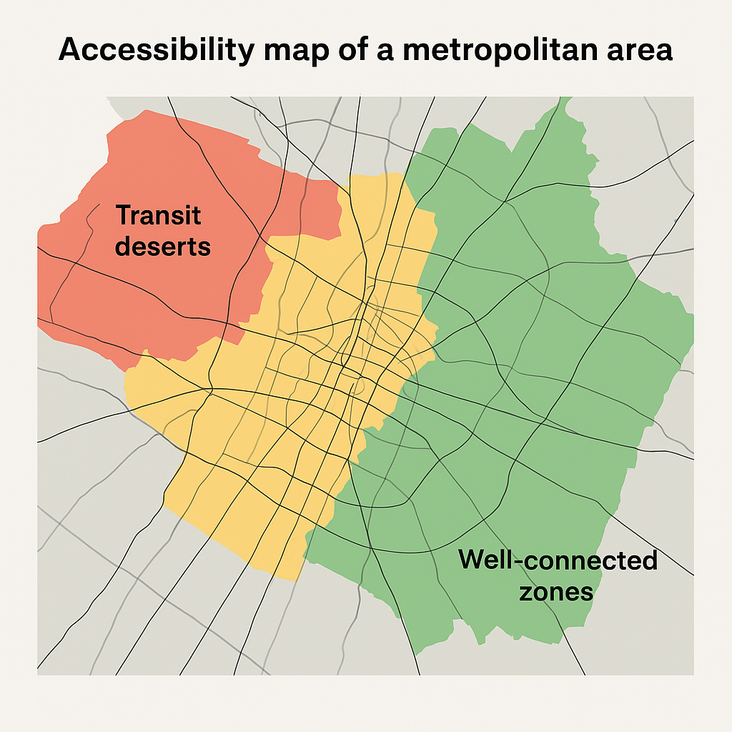
3. Urban Mobility and Accessibility
3.2 Accessibility as a Key Indicator
Accessibility measures the ease with which people can reach destinations within a given time and cost.
It is more informative than “mobility” because it reflects economic opportunity.
Figure :
Accessibility map of a metropolitan area — highlighting “transit deserts” and well-connected zones.

Slide 12
3. Urban Mobility and Accessibility
Example: Accessibility as a Key Indicator – Curitiba, Brazil
Curitiba is known worldwide for its Bus Rapid Transit (BRT) system, designed to make the entire city accessible quickly and affordably.
Indicator Used:
Average travel time to key destinations (jobs, schools, hospitals, and commercial centers) by public transport.
Findings: Before the BRT system (in the 1970s), only 45% of residents could reach downtown Curitiba within 40 minutes by bus.
After implementing the BRT corridors and integrated feeder routes:
85% of residents could reach the city center or a major employment hub within 40 minutes.
Property values along transit corridors increased by 20–30%, showing how improved accessibility boosted real-estate attractiveness.
Low-income neighborhoods gained better access to education and health services, reducing spatial inequality.

Slide 13
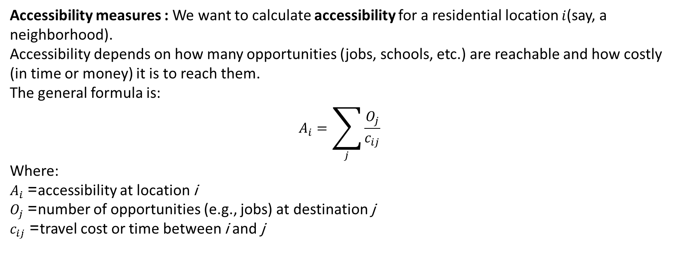
3. Urban Mobility and Accessibility
Accessibility measures : We want to calculate accessibility for a residential location $i$(say, a neighborhood).
Accessibility depends on how many opportunities (jobs, schools, etc.) are reachable and how costly (in time or money) it is to reach them.
The general formula is:
$$A_{i}=\sum_{j}{\frac{O_{j}}{c_{ij}}}$$
Where:
$A_{i}$= accessibility at location i
$O_{j}$= number of opportunities (e.g., jobs) at destination j
$c_{ij}$= travel cost or time between i and j

Slide 14


3. Urban Mobility and Accessibility
tep 1: Apply the formula
$$A_{i}=\frac{10,000}{20}+\frac{8,000}{40}+\frac{6,000}{60}$$
$$A_{i}=500+200+100=800$$
Interpretation
The accessibility index (Aᵢ = 800) summarizes how easily residents at location i can reach available jobs.
If travel times decrease (e.g., through better transit), or if new job centers open nearby, Aᵢ increases, meaning improved accessibility.
Planners can compare different areas:
  A neighborhood with Aᵢ = 1200 has higher accessibility than one with Aᵢ = 500.
Scenario Example
Suppose we have one residential area (i) and three employment centers (j₁, j₂, j₃):
Destination (j) | Opportunities (Oₖ = jobs) | Travel Time from i (cᵢⱼ, minutes)
j₁ – Downtown | 10,000 jobs | 20 min
j₂ – Industrial Zone | 8,000 jobs | 40 min
j₃ – Suburban Center | 6,000 jobs | 60 min
Step 1: Apply the formula
$$A_{i}=\frac{10,000}{20}+\frac{8,000}{40}+\frac{6,000}{60}$$
$$A_{i}=500+200+100=800$$

Slide 15
3. Urban Mobility and Accessibility
Interpretation
The accessibility index (Aᵢ = 800) summarizes how easily residents at location i can reach available jobs.
If travel times decrease (e.g., through better transit), or if new job centers open nearby, Aᵢ increases, meaning improved accessibility.
Planners can compare different areas:
  A neighborhood with Aᵢ = 1200 has higher accessibility than one with Aᵢ = 500.
Policy Insight
This measure helps cities:
Identify “transit deserts” (areas with low Aᵢ).
Evaluate impacts of new transport projects on job accessibility.
Prioritize infrastructure investments where accessibility improvements will benefit more residents.

Slide 16
3. Urban Mobility and Accessibility
Case Study: Accessibility Analysis for a New Hospital
Background
A private healthcare company planned to build a new specialty hospital in Dubai. The goal was to choose a site that maximizes access to residential areas while ensuring short travel times for emergency access.
Approach
Data used: Road network, population density, and travel-time data from Google Maps API.
Method: GIS-based accessibility index using travel-time zones (0–15, 15–30, 30–45 min) weighted by population.
Sites evaluated: Three candidate plots.

Slide 17
3. Urban Mobility and Accessibility
Site | Avg. Travel Time | Population | Accessibility Index | Decision
1 | 22 min | 750000 | 34 | ✅ Selected
2 | 28 min | 640000 | 23 | —
3 | 35 min | 520000 | 15 | —
Outcome
Site 1 selected for its superior accessibility and proximity to major roads.
Accessibility score supported a 15% higher land valuation justified by wider catchment reach and strong market demand.
The project achieved high feasibility ratings from investors and planners.
Key Lesson
➡️ Accessibility directly influences site desirability, property value, and financial success.
Integrating GIS-based accessibility analysis ensures smarter investment and sustainable urban growth.

Slide 18
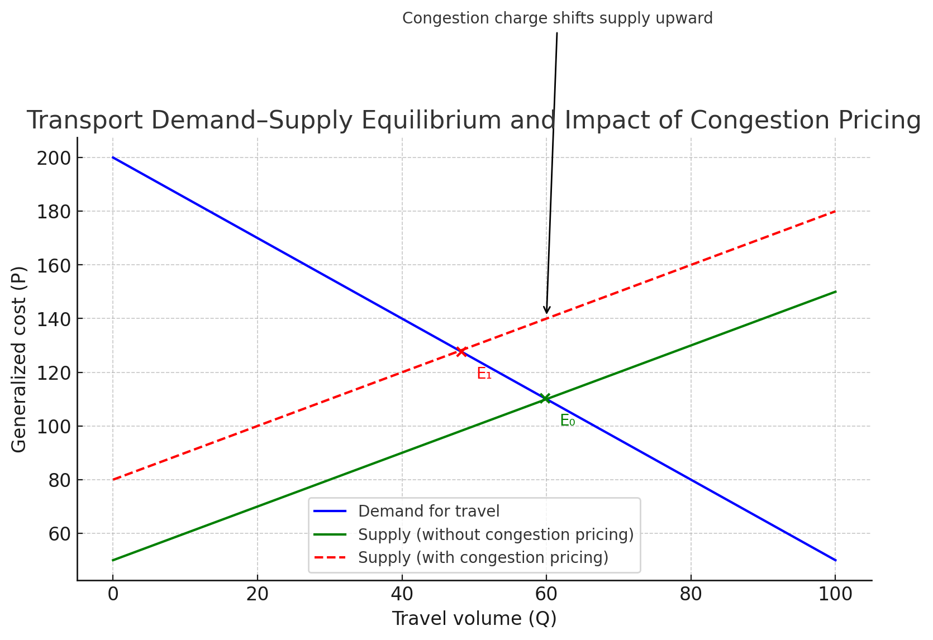
4. Economic Principles Governing Transport Systems
4.1 Supply and Demand in Transport
Supply: Infrastructure capacity, road space, or public transit seats.
Demand: Trips made per person per mode.
Equilibrium occurs where generalized cost equals perceived benefit of travel.
Figure:
Transport demand–supply equilibrium curve showing the impact of congestion pricing.
The red dashed line shows the supply curve with congestion pricing, which shifts upward as travelers face an additional charge, leading to a new equilibrium E₁ with lower traffic volume and higher generalized cost.

Slide 19
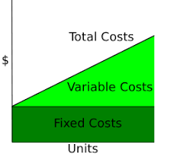
4. Economic Principles Governing Transport Systems
4.2 Cost Structures
1.Fixed Costs:
These are costs that do not change with the number of passengers or trips in the short term.
Examples:
  Construction of bus terminals and depots
  Purchase of buses and ticketing systems
  Maintenance of roads and dedicated bus lanes
  Salaries of administrative staff
➡️ Even if only a few passengers use the service, these costs remain constant.

Slide 20
4. Economic Principles Governing Transport Systems
4.2 Cost Structures
2. Variable Costs
These costs increase with usage—the more buses operate, or the longer the routes, the higher the costs.
Examples:
  Fuel: More kilometers → higher diesel consumption
  Driver wages: More trips → more paid hours
  Vehicle wear and tear: Tires, brakes, and engine parts degrade with distance
  Emissions: More fuel burned → higher pollution cost
➡️ If demand doubles, variable costs roughly double too.

Slide 21
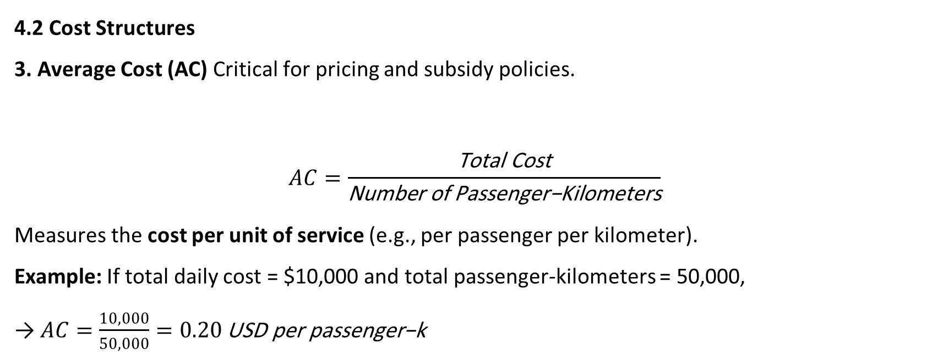
4. Economic Principles Governing Transport Systems
4.2 Cost Structures
3. Average Cost (AC) Critical for pricing and subsidy policies.
$$AC=\frac{\text{Total} \text{Cost}}{\text{Number} \text{of} \text{Passenger}\text{−}\text{Kilometers}}$$
Measures the cost per unit of service (e.g., per passenger per kilometer).
Example: If total daily cost = $10,000 and total passenger-kilometers = 50,000,
→ $AC=\frac{10,000}{50,000}=0.20 \text{USD} \text{per} \text{passenger}\text{−}\text{k}$

Slide 22
4. Economic Principles Governing Transport Systems
4.3 Externalities
1. Congestion (Time Cost to Others)
Description: Each additional vehicle slows down others, increasing travel time for everyone.
Example:
  During morning peak hours in London, average speed may fall from 40 km/h to 15 km/h.
  A single extra car entering a congested route can impose delay costs on hundreds of others.
  Estimated external cost: ~£0.15–£0.30 per vehicle-km (UK Department for Transport, 2023).

Slide 23
4. Economic Principles Governing Transport Systems
4.3 Externalities
2. Emissions and Noise
Description: Cars emit CO₂, NOₓ, and particulates, contributing to air pollution and climate change. Noise also reduces residents’ quality of life.
Example:
  A petrol car emits ~180 g CO₂ per km → adds to greenhouse gas accumulation.
  Health damages from vehicle emissions in urban areas are estimated at €0.10–€0.25 per km (European Environment Agency, 2022).
  Noise pollution near busy roads reduces property values by up to 10% in some neighborhoods.

Slide 24
4. Economic Principles Governing Transport Systems
4.3 Externalities
3. Land Consumption
Description: Roads, parking lots, and highways occupy valuable urban land that could be used for housing, green spaces, or businesses.
Example:
  In Los Angeles, parking spaces occupy nearly one-third of urban land.
  The opportunity cost of land used for car infrastructure may exceed $5–10 million per hectare in central areas.

Slide 25
4. Economic Principles Governing Transport Systems
4.3 Externalities
4. Accident Risks
Description: Road crashes impose costs beyond drivers’ own risks — on victims, emergency services, and healthcare systems.
Example:
  The average social cost of road accidents (fatalities, injuries, property damage) in the EU is about €0.07 per vehicle-km.
  Pedestrians and cyclists often bear the brunt of these externalities.

Slide 26
4. Economic Principles Governing Transport Systems
Summary Table: Typical External Costs of Urban Car Use
Externality Type | Example Cost (per vehicle-km) | Key Impact
Congestion | £0.20 | Lost time for others
Emissions & Noise | €0.15 | Health & environmental damage
Land Consumption | €0.10 | Loss of urban space
Accident Risks | €0.07 | Medical and social costs
Total External Cost | ≈ €0.50 per km | Significant hidden social burden
policy Implications
Because of these external costs, cities implement:
Congestion pricing (e.g., London, Stockholm)
Low-emission zones or electric vehicle incentives
Public transport investment
Road safety campaigns and design improvements

Slide 27
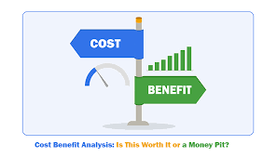
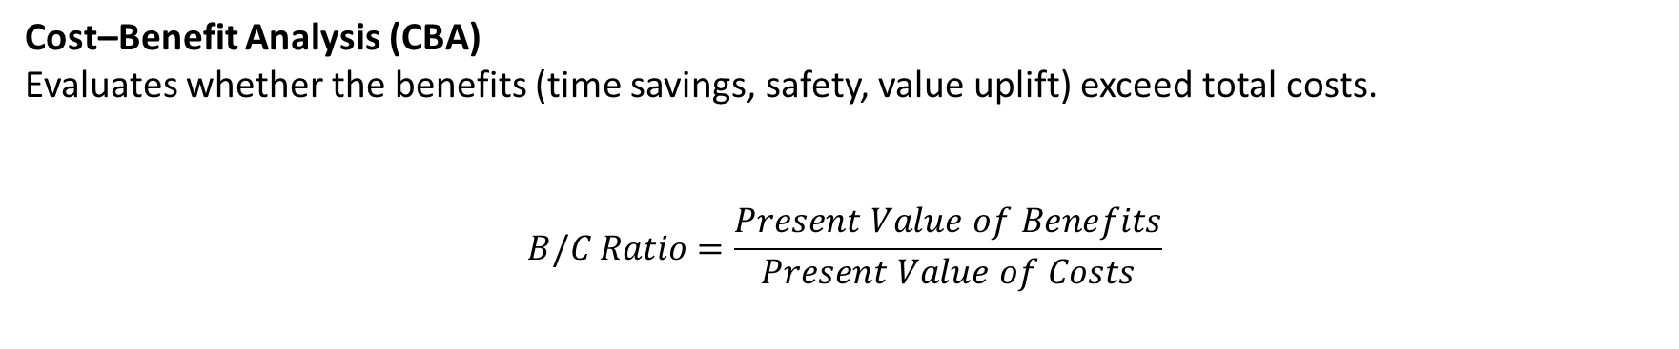
5. Financing Urban Transport Mechanisms
Cost–Benefit Analysis (CBA)
Evaluates whether the benefits (time savings, safety, value uplift) exceed total costs.
$$B/C Ratio=\frac{Present Value of Benefits}{Present Value of Costs}$$
Cost–Benefit Analysis (CBA)
Evaluates whether the benefits (time savings, safety, value uplift) exceed total costs.
$$B/C Ratio=\frac{Present Value of Benefits}{Present Value of Costs}$$

Slide 28
5. Financing Urban Transport Mechanisms
Cost–Benefit Analysis (CBA)
Evaluates whether the benefits (time savings, safety, value uplift) exceed total costs.
$$B/C Ratio=\frac{Present Value of Benefits}{Present Value of Costs}$$
Example: Building a Small Rural Road
1. Project Description
A government plans to pave a 10 km gravel road connecting a rural village to the main highway.
The goal is to reduce travel time, vehicle maintenance costs, and improve access to markets and schools.
Type of Cost | Amount (USD) | When | Notes
Construction | 200000 | Year 1 | Building and paving the road
Annual Maintenance | 100,000 per year | Years 2–10 | Routine repairs and cleaning

Slide 29
5. Financing Urban Transport Mechanisms
| Travel Time Savings | 80 | Faster commuting (15 minutes saved per trip for 200,000 daily | **Type of Benefit** | **Annual Value (USD)** | **Description** |
| ------------------------------ | ---------------------- | ------------------------------------ |
| Travel Time Savings | 150,000 | Farmers reach markets faster |
| Vehicle Operating Cost Savings | 120,000 | Less wear on vehicles |
| Accident Reduction | 30,000 | Smoother and safer road |
| Increased Economic Activity | 100,000 | Easier transport of goods and people |
| **Total Annual Benefit** | **400,000** | |
users) |
| Vehicle Operating Cost Savings | 40 | Fewer private car trips (fuel and maintenance savings) |
| Reduced Congestion for Others | 25 | Road users benefit from reduced car traffic |
| Accident Reduction | 10 | Fewer crashes and fatalities |
| Environmental Benefits | 15 | Lower CO₂ and NOₓ emissions |
| **Total Annual Benefit** | **≈ 170 million** | |
2. Project Benefits
Type of Benefit | Annual Value (USD) | Description
Travel Time Savings | 150000 | Farmers reach markets faster
Vehicle Operating Cost Savings | 120000 | Less wear on vehicles
Accident Reduction | 30000 | Smoother and safer road
Increased Economic Activity | 100000 | Easier transport of goods and people
Total Annual Benefit | 400000

Slide 30
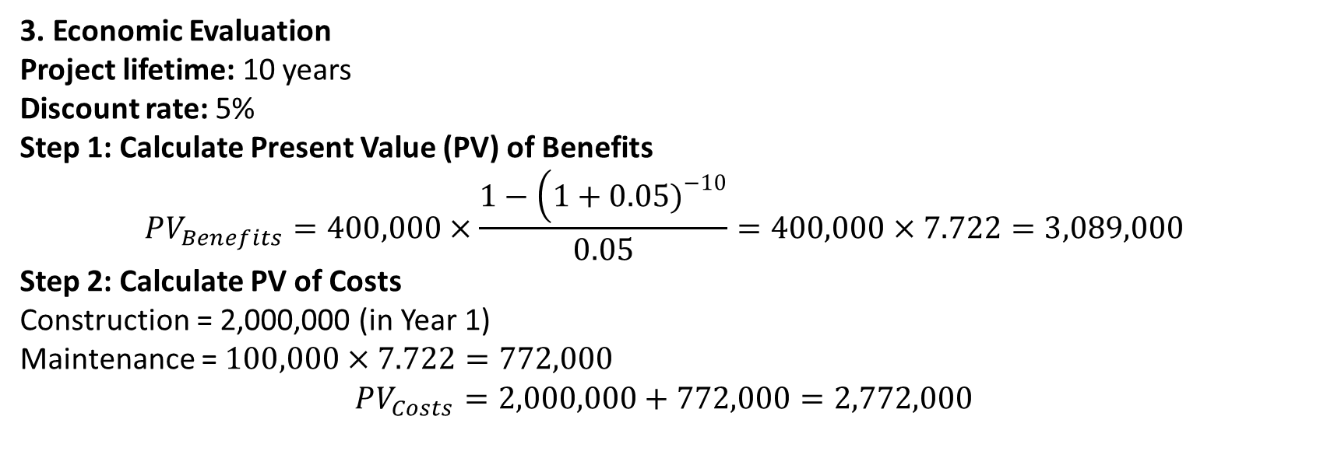
5. Financing Urban Transport Mechanisms
| **Indicator** | **Value** | **Interpretation** |
| --------------------------------- | ----------------- | -------------------------------------------- |
| **Net Present Value (NPV)** | + USD 540 million | Project’s discounted benefits exceed costs |
| **Benefit–Cost Ratio (BCR)** | 1.54 | For every $1 invested, $1.54 in benefits |
| **Internal Rate of Return (IRR)** | 9.2% | Economic return exceeds social discount rate |
3. Economic Evaluation
Project lifetime: 10 years
Discount rate: 5%
Step 1: Calculate Present Value (PV) of Benefits
$$PV_{Benefits}=400,000×\frac{1−\left(1+0.05{\left.)\right.}^{−10}\right.}{0.05}=400,000×7.722=3,089,000$$
Step 2: Calculate PV of Costs
Construction = 2,000,000 (in Year 1)
Maintenance = $100,000×7.722=772,000$
$$PV_{Costs}=2,000,000+772,000=2,772,000$$

Slide 31
5. Financing Urban Transport Mechanisms
Indicator | Calculation | Result | Interpretation
Net Present Value (NPV) | PV(Benefits) – PV(Costs) | 3089000-2772000 = +317000 | Positive → project is worthwhile
Benefit–Cost Ratio (BCR) | PV(Benefits) / PV(Costs) | 3089000/2772000 = 1.11 | Each $1 spent gives $1.11 in benefits
Conclusion | — | Economically viable | Small but positive benefit
Key Takeaways
✅ Easy-to-measure costs and benefits
✅ Positive NPV → good public investment
✅ Simple CBA helps justify funding and prioritization of rural roads

Slide 32
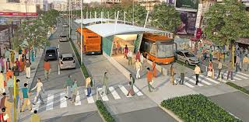
6. Transit-Oriented Development (TOD) and Real Estate
6.1 Concept
TOD promotes compact, mixed-use, pedestrian-friendly communities centered around high-quality transit.
6.2 Benefits
Reduces car dependence
Encourages sustainable urban growth
Enhances real estate value
Improves public health and livability
6.3 Design Principles (Calthorpe, 1993)
High density within 400–800 meters of stations
Mixed-use zoning
Pedestrian-friendly design
Integrated public spaces

Slide 33
6. Transit-Oriented Development (TOD) and Real Estate
| Benefit | Result |
| -------------------- | ---------------------------------------------------------------------- |
| **Economic** | Real estate profits financed most of the metro line construction costs |
| **Social** | Easy access to housing, work, and shopping within one area |
| **Environmental** | Low car use (under 10% ownership), reduced emissions and congestion |
| **Urban Efficiency** | 48% of all daily trips made by MTR; compact, walkable urban form |
Case Study: Hong Kong – MTR Transit-Oriented Development (TOD)
Overview
Benefit | Result
Economic | Real estate profits financed most of the metro line construction costs
Social | Easy access to housing, work, and shopping within one area
Environmental | Low car use (under 10% ownership), reduced emissions and congestion
Urban Efficiency | 48% of all daily trips made by MTR; compact, walkable urban form

Slide 34
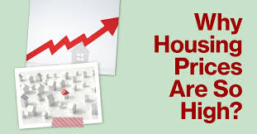
6. Transit-Oriented Development (TOD) and Real Estate
Challenges
High property prices → affordability issues
Need for more mixed-income housing around TOD sites
Lessons Learned
Integrate land-use and transport planning early.
Use value capture (development rights, joint ventures) to finance infrastructure.
Prioritize walkability and mixed-use density near transit hubs.
Maintain social balance to avoid exclusive luxury zones.

Slide 35
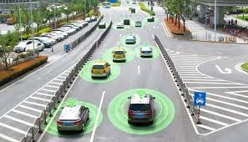
7. Smart Mobility, Technology, and the Future of Transport
7.1 Intelligent Transport Systems (ITS)
Use of sensors, GPS, and real-time data for traffic optimization.
7.2 Mobility-as-a-Service (MaaS)
Integration of multiple transport modes (bus, metro, car-share, bike) through a unified digital platform.
7.3 Electric and Autonomous Vehicles (EV/AV)
Potential to reshape parking demand, urban form, and environmental performance.

Slide 36
7. Smart Mobility, Technology, and the Future of Transport
Example: Singapore’s Intelligent Transport System (ITS)
Overview
Singapore uses an advanced ITS combining sensors, GPS, and real-time data to manage traffic efficiently and reduce congestion.
Technology | Function
Sensors & Cameras | Monitor traffic flow and detect incidents.
GPS Tracking | Used in buses, taxis, and delivery fleets for route optimization and arrival prediction.
Electronic Road Pricing (ERP) | Automatic congestion charge using RFID gantries.
Adaptive Traffic Signals | Adjust green light timing based on real-time traffic.
Traveler Information Systems | Provide live updates via apps and roadside message boards.

Slide 37
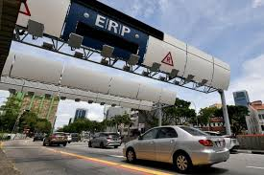
7. Smart Mobility, Technology, and the Future of Transport
Example in Action
Sensors detect congestion on expressways.
ERP rates automatically increase to reduce traffic.
Signals adjust in real time; commuters receive alternative route alerts.
Results
✅ 20% reduction in travel time
✅ Lower emissions and fuel use
✅ Faster accident response

Slide 38
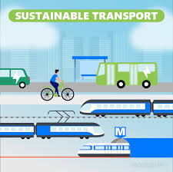
8. Environmental, Social, and Equity Dimensions
Environmental: Transport is responsible for 25% of CO₂ emissions globally.
Social: Mobility inequities reinforce spatial segregation.
Economic: Lack of transport access limits labor participation and productivity.
Sustainable transport policies focus on:
Compact urban form
Non-motorized mobility (walking, cycling)
Public transport enhancement
Inclusive access for low-income groups

Slide 39
9. Global Case Studies
Case 1: London Congestion Charge
Introduced in 2003; charge of £15/day for entering central London.
Results: 15% reduction in traffic, 20% rise in bus ridership.
Revenue reinvested in public transport improvements.
Case 2: Hong Kong MTR “Rail + Property” Model
MTR finances rail expansion by developing property above/around stations.
The model generates sustainable revenue and promotes transit-oriented growth.
Example: Tung Chung Line generated HK$ 20 billion from adjacent property leases

Slide 40
10. Global Case Studies
| Supply Factor | Description |
| ------------------ | ---------------------------------------------- |
| Construction costs | Rising materials/labor costs limit new supply |
| Land availability | Scarcity in CBDs drives densification |
| Regulations | Zoning and permits constrain speed |
| Technology | Modular construction can shorten delivery time |
Case 3: Curitiba BRT, Brazil
Early adopter of integrated bus rapid transit with land-use planning.
High accessibility, low emissions, and equitable transport outcomes.
Case 4: Dubai Metro
Real estate values within 500m of stations increased 15–25%.
Developers capitalize on station proximity for mixed-use projects along Sheikh Zayed Road.
Case 5: Singapore
Integrates transport with land policy through the Urban Redevelopment Authority (URA).
Uses congestion pricing, high parking fees, and transit-oriented zoning.

Slide 41
10. Analytical Tools and Graphs
| Supply Factor | Description |
| ------------------ | ---------------------------------------------- |
| Construction costs | Rising materials/labor costs limit new supply |
| Land availability | Scarcity in CBDs drives densification |
| Regulations | Zoning and permits constrain speed |
| Technology | Modular construction can shorten delivery time |
Tool | Application | Example
Cost–Benefit Analysis | Evaluate project viability | Metro extension
GIS Accessibility Mapping | Identify transport deserts | Real estate site selection
Pricing Model | Estimate impact of transport proximity | Housing price analysis
Elasticity Models | Forecast mode shift | Public transport fare policies

Slide 42
11. Policy Challenges and Directions
Challenge | Impact | Policy Option
Urban congestion | Productivity loss | Congestion pricing, telework incentives
Climate change | Emission targets | Electrification, modal shift
Funding gaps | Infrastructure delays | PPPs, value capture
Inequality | Reduced access | Affordable transit, inclusionary zoning
Coordination failure | Inefficient planning | Integrated land–transport agencies

Slide 43

12. Implications for Real Estate Professionals
Source: United Nations, Department of Economic and Social Affairs, World Urbanization Prospects: The 2018 Revision
Transport investments create location advantages and market differentiation.
Developers must anticipate infrastructure timing and policy changes.
Accessibility analysis supports site selection, valuation, and market feasibility.
Collaborations between real estate developers and transit agencies can unlock mutual benefits through joint development.

Slide 44

Conclusion
The economic concepts of marginal cost pricing, congestion management, accessibility, and value capture reveal how rational planning and sound policy can reduce inefficiencies and align private behavior with social welfare.
Smart transportation systems, digital mobility platforms, and the transition toward low-carbon modes of transport represent not only technological shifts but also economic transformations that redefine urban mobility patterns.
lecture
08
As urbanization continues to accelerate, policymakers and planners must recognize that every transportation decision is also an economic decision, shaping not only mobility but also social equity, competitiveness, and the long-term livability of our urban environments.

Slide 45



Thank You

