Slide 1

RHSA (Admin 1) Red Hat Enterprise Linux 8 Essentials
Prepared by Eng. Taghreed Elsayed
Lecture 1
Red Hat Enterprise Linux 8

Slide 2
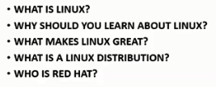

Chapter
01
Red Hat Enterprise Linux 8

Slide 3
Chapter
01
Red Hat Enterprise Linux 8
What exactly is Linux?
Linux is an operating system in much the same way that Windows is an operating system (and there any similarities between Linux and Windows end).
The term operating system is used to describe the software that acts as a layer between the hardware in a computer and the applications that we all run on a daily basis.
When programmers write applications, they interface with the operating system to perform such tasks as writing files to the hard disk drive and displaying information on the screen.
Without an operating system, every programmer would have to write code to directly access the hardware of the system.

Slide 4
Chapter
01
Red Hat Enterprise Linux 8
Without an operating system, every programmer would have to write code to directly access the hardware of the system.
In addition, the programmer would have to be able to support every single piece of hardware ever created to be sure the application would work on every possible hardware configuration. Because the operating system handles all of this hardware complexity, application development becomes a much easier task. Linux is just one of a number of different operating systems available today.

Slide 5
Chapter
01
Red Hat Enterprise Linux 8
Who Created Linux?
The origins of Linux can be traced back to the work and philosophies of two people.
At the heart of the Linux operating system is something called the kernel. This is the core set of features necessary for the operating system to function. The kernel manages the system’s resources and handles communication between the hardware and the applications.
The Linux kernel was developed by Linus Torvalds who needed an operating system but didn’t want to have to buy one. When he had finished the first version of the kernel he released it under an open source license that enabled anyone to download the source code and freely use and modify it without having to pay Linus any money.

Slide 6
Chapter
01
Red Hat Enterprise Linux 8
Around the same time Richard Stallman at the Free Software Foundation, a strong advocate of free and open source software, was working on an open source operating system of his own.
Rather than focusing initially on the kernel, Stallman decided to begin by developing all the tools, utilities and compilers necessary to use and maintain an operating system.
By the time he had finished developing this infrastructure it seemed like the obvious solution was to combine his work with the kernel Linus had written to create a full operating system.
This combination became known as GNU/Linux. Purists insist that Linux always be referred to as GNU/Linux (in fact, at one time, Richard Stallman refused to give press interviews to any publication which failed to refer to 6 A Brief History of Red Hat Linux Linux as GNU/Linux).

Slide 7
Chapter
01
Red Hat Enterprise Linux 8
This is not unreasonable given that the GNU tools developed by the Free Software Foundation make up a significant and vital part of GNU/Linux. Unfortunately, most people and publications simply refer to Linux as Linux and this will probably always continue to be the case.

Slide 8
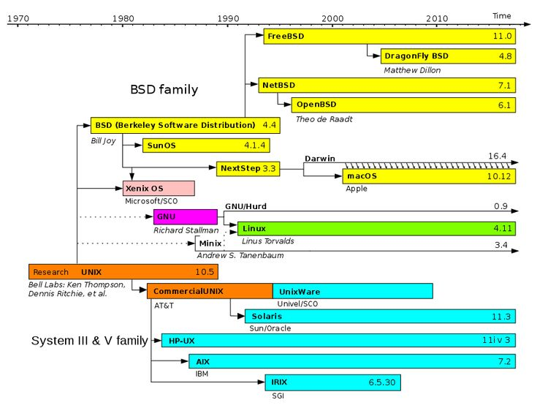
Chapter
01
Red Hat Enterprise Linux 8

Slide 9
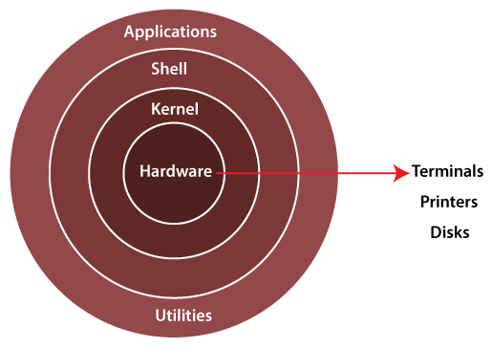
Chapter
01
Red Hat Enterprise Linux 8
Linux Components

Slide 10
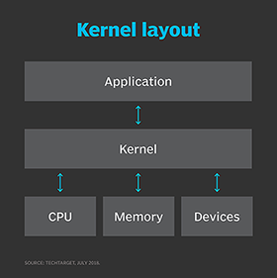
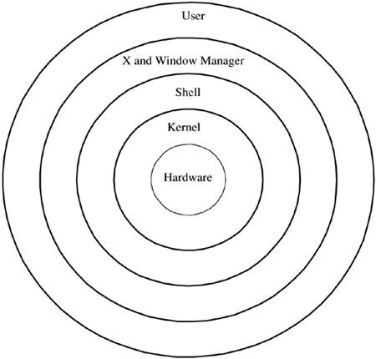
Chapter
01
Red Hat Enterprise Linux 8

Slide 11
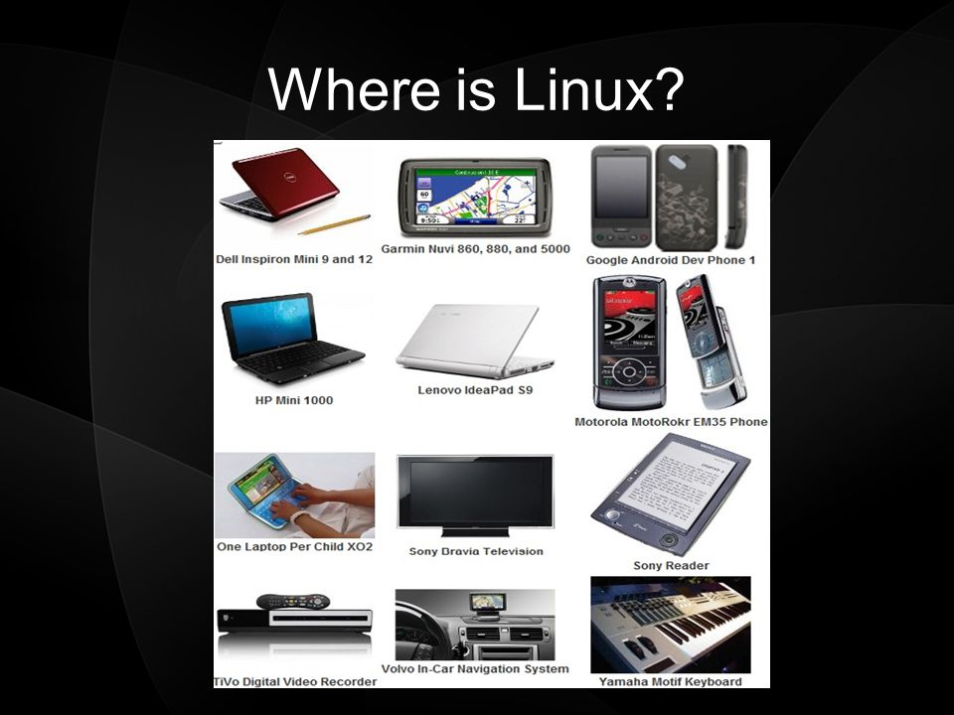
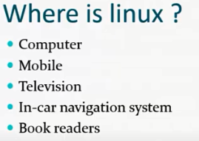
Chapter
01
Red Hat Enterprise Linux 8

Slide 12
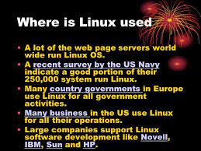
Chapter
01
Red Hat Enterprise Linux 8

Slide 13
Chapter
01
Red Hat Enterprise Linux 8
What Makes LINUX Great and more significant ?
Linux is an open source software
Linux provides easy access to powerful and scriptable command-line interface (CLI).
Linux is a modulator operating system that allows you to easily replace or remove components

Slide 14
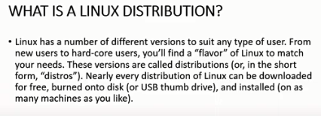
Chapter
01
Red Hat Enterprise Linux 8

Slide 15
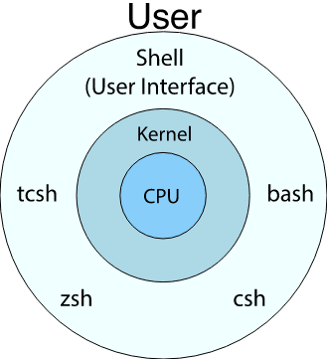
Chapter
01
Red Hat Enterprise Linux 8
Linux distribution
Red Hat
Fedora
Ubuntu
Debian
Suse
Mandriva
Centos
Oracle

Slide 16
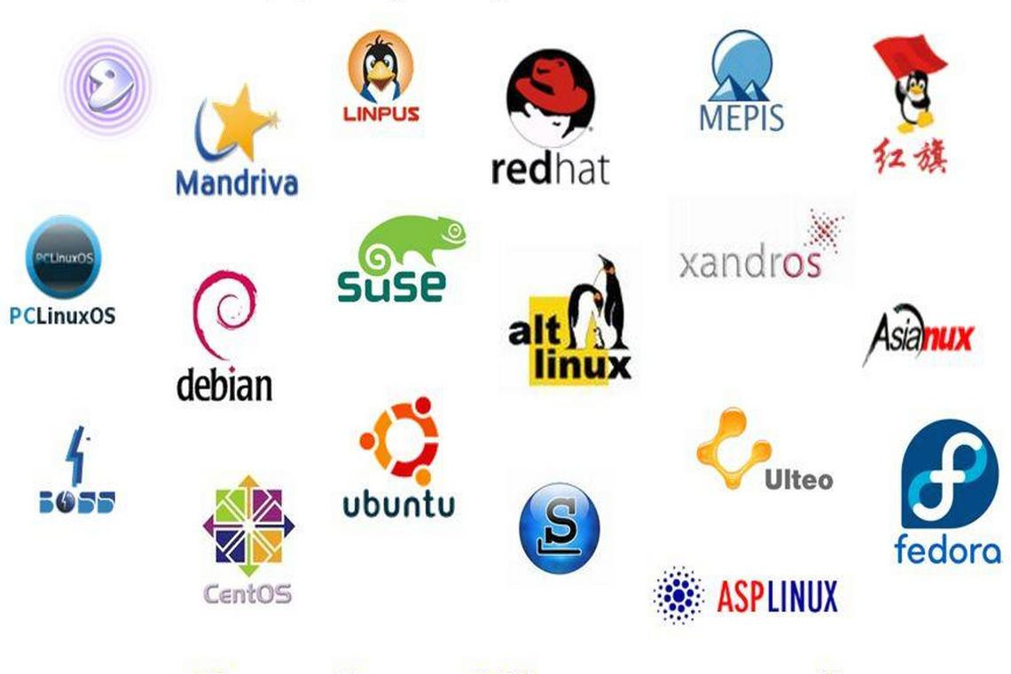
Chapter
01
Red Hat Enterprise Linux 8

Slide 17
Chapter
01
Red Hat Enterprise Linux 8
Who is Red Hat?
The Early Days of Red Hat In 1993 Bob Young created a company named ACC Corporation which, according to Young, he ran from his “wife’s sewing closet”.
The name ACC was intended to represent a catalog business but was also an abbreviation of a small business his wife ran called “Antiques and Collectibles of Connecticut”.
Among the items sold through the ACC catalog business were Linux CDs and related open source software. Around the same time, Marc Ewing had created his own Linux distribution company which he named Red Hat Linux (after his propensity to wear a red baseball cap while at Carnegie Mellon University).

Slide 18
Chapter
01
Red Hat Enterprise Linux 8
In 1995, ACC acquired Red Hat, adopted the name Red Hat, Inc. and experienced rapid and significant growth.
Bob Young stepped down as CEO shortly after the company went public in August of 1999 and has since pursued a number of business and philanthropic efforts including a print-on-demand book publishing company named Lulu and ownership of two Canadian professional sports teams. In 2018, IBM announced plans to acquire Red Hat, Inc. in a deal valued at $34 billion.

Slide 19
Chapter
01
Red Hat Enterprise Linux 8
Red Hat Support Early releases of Red Hat Linux were shipped to customers on floppy disks and CDs (this, of course, predated the widespread availability of broadband internet connections).
When users encountered problems with the software they were only able to contact Red Hat by email. In fact, Bob Young often jokes that this was effective in limiting support requests since, by the time a customer realized they needed help, their computer was usually inoperative and therefore unavailable to be used to send an email message seeking assistance from Red Hat’s support team.
In later years Red Hat provided better levels of support tied to paid subscriptions and now provides a variety of support levels ranging from “self help” (no support) up to premium support.

