Slide 1



Organizational Behavior
and Projects
PMG421
Guidance lecture
Prepared by: Mrs. Deena Ibraheem
www.midocean.ae

Slide 2
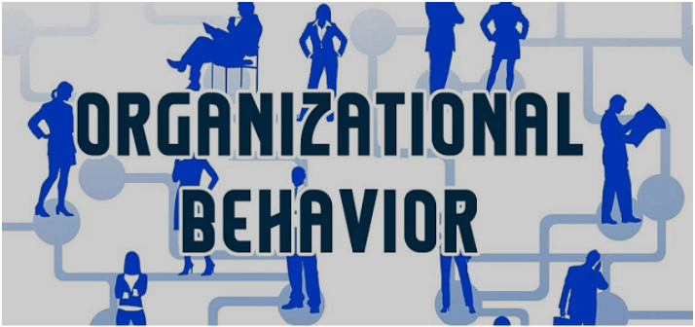
Organizational Behavior
and Projects
PMG421
www.midocean.ae

Slide 3
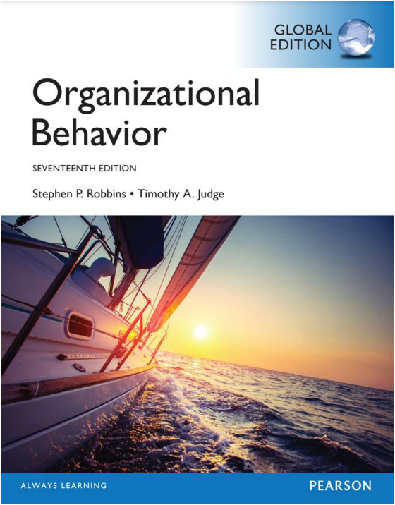


Reference Book:
Judge, Timothy A._ Robbins, Stephen P. - Organizational behavior-Pearson Education Limited (2017) .
www.midocean.ae

Slide 4
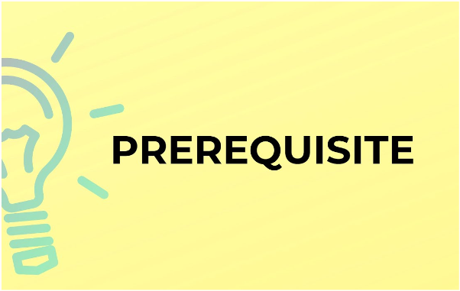
PMG101 Foundations of Project Management
www.midocean.ae

Slide 5

Lect. 6: Understanding Work Teams | Lect. 1: What Is Organizational Behavior?
Lect. 7: Leadership | Lect. 2: Attitudes and Job Satisfaction
Lect. 8: Conflict and Negotiation | Lect. 3: Emotions and Moods
Lect. 9: Organizational Culture | Lect. 4: Personality and Values
Lect. 10: Organizational Change and Stress Management. | Lect. 5 Motivation Concepts
www.midocean.ae

Slide 6
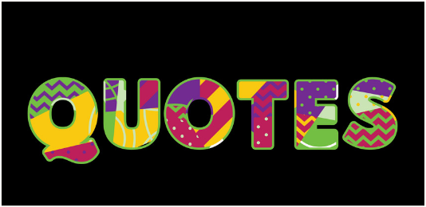
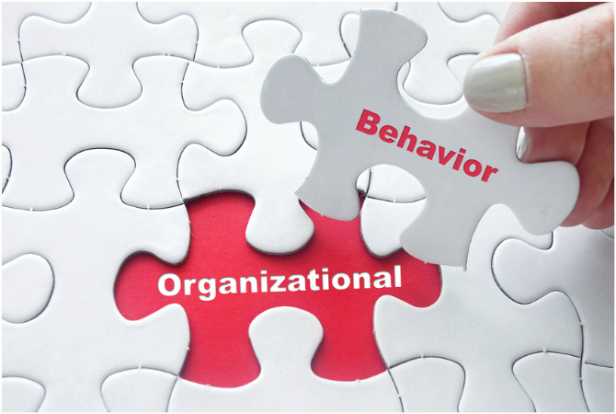
Organizational behavior (OB) is a field of study that looks in the impact of individuals, groups, and structure on behavior within organizations, for the purpose of applying such knowledge toward improving an organization’s effectiveness.
It studies three determinants of behavior in organizations: individuals, groups, and structure.
www.midocean.ae

Slide 7
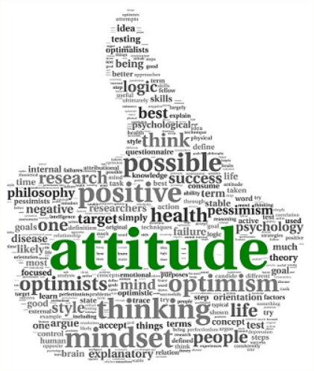
Attitudes are evaluative statements—either favorable or unfavorable—about objects, people, or events. They reflect how we feel about something. When you say “I like my job,” you are expressing your attitude about your work.
Attitudes have three components: cognition, affect, and behavior.
www.midocean.ae

Slide 8

Affect is a generic term that covers a broad range of feelings, including both emotions and moods.
Emotions are intense feelings directed at someone or something.
Moods are less intense feelings than emotions and often arise without a specific event acting as a stimulus.
www.midocean.ae

Slide 9

PERSONALITY is the sum total of ways in which an individual reacts to and interacts with others.
VALUES is a basic convictions that a specific mode of conduct or end-state of existence is personally or socially preferable to an opposite or converse mode of conduct or end-state of existence.
www.midocean.ae

Slide 10

Motivation is the processes that account for an individual’s intensity, direction, and persistence of effort toward attaining a goal.
Motivation is one of the most frequently researched topics in organizational behavior (OB)
www.midocean.ae
Notes:
Henry Mintzberg is a Canadian academic and author on business and management.

Slide 11


Work team is a group whose individual efforts result in performance that is greater than the sum of the individual inputs.
A workgroup is a group that interacts primarily to share information and make decisions to help each member perform within his or her area of responsibility.
www.midocean.ae

Slide 12

Leadership is the ability to influence a group toward the achievement of a vision or set of
goals.
Not all leaders are managers, nor are all managers leaders. Just because an organization provides its managers with certain formal rights is no assurance they will lead effectively.
www.midocean.ae

Slide 13

Conflict is a process that begins when one party perceives that another party has negatively affected, or is about to negatively affect, something that the first
party cares about.
Conflict describes the point in ongoing activity when interaction becomes disagreement.
www.midocean.ae

Slide 14

Organizational culture refers to a system of shared meaning held by members that distinguishes the organization from other organizations.
Dominant culture is a culture that expresses the core values that are shared by a majority of the organization’s members.
www.midocean.ae

Slide 15

Change is Making things different. Planned change: Change activities that are intentional and goal oriented.
Change agents, Persons who act as catalysts and assume the responsibility for managing change activities.
www.midocean.ae

Slide 16


www.midocean.ae

