Slide 1


Slide 2
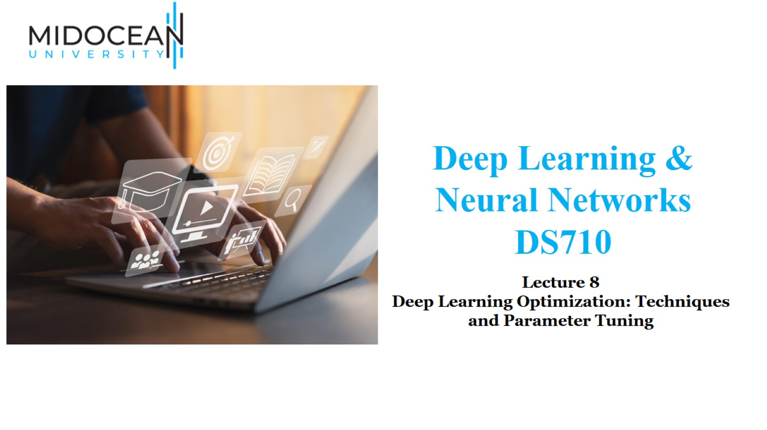

Slide 3
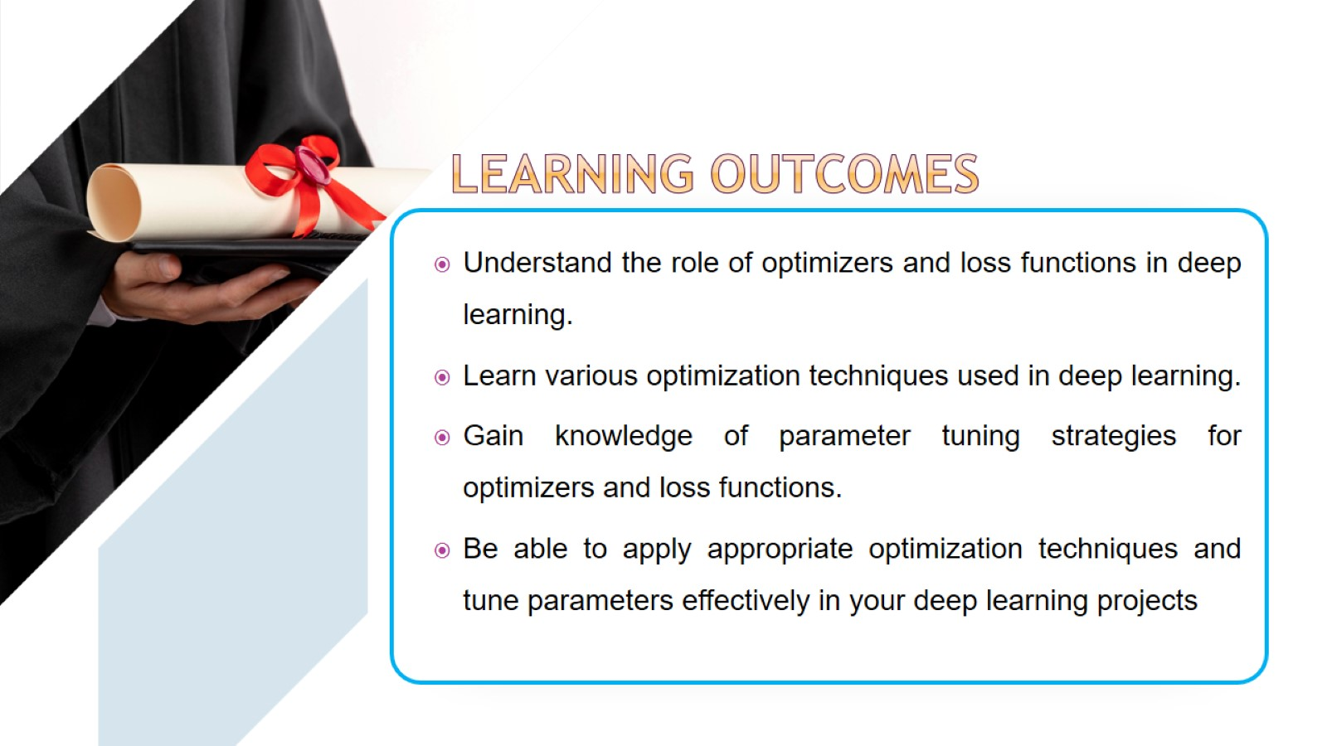

Slide 4
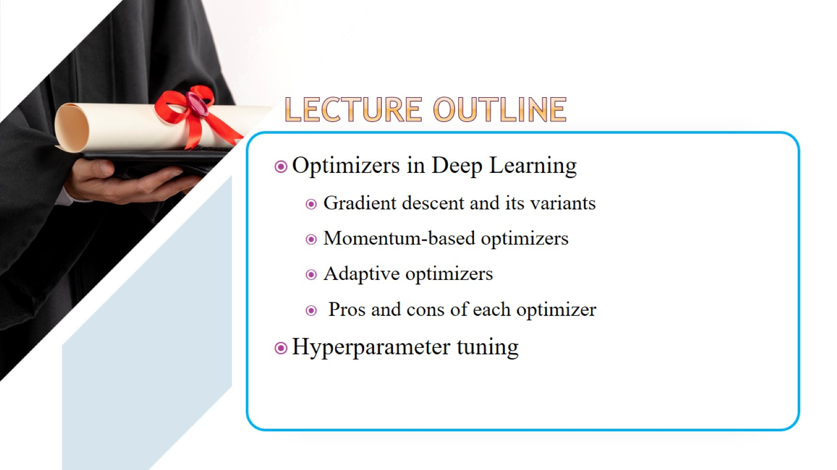

Slide 5
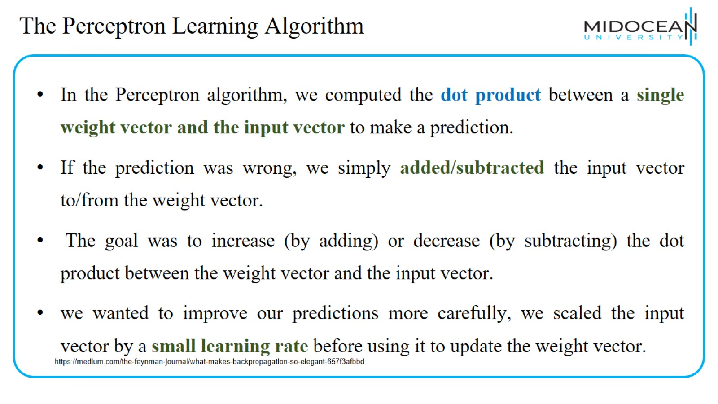
The Perceptron Learning Algorithm

Slide 6
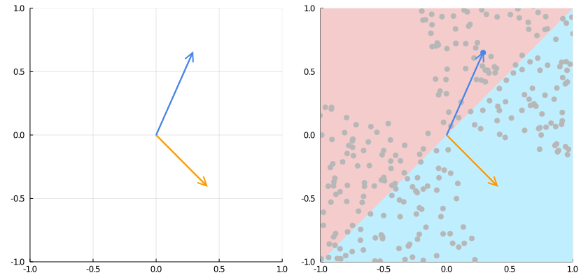
The Perceptron Learning Algorithm
https://medium.com/the-feynman-journal/what-makes-backpropagation-so-elegant-657f3afbbd

Slide 7
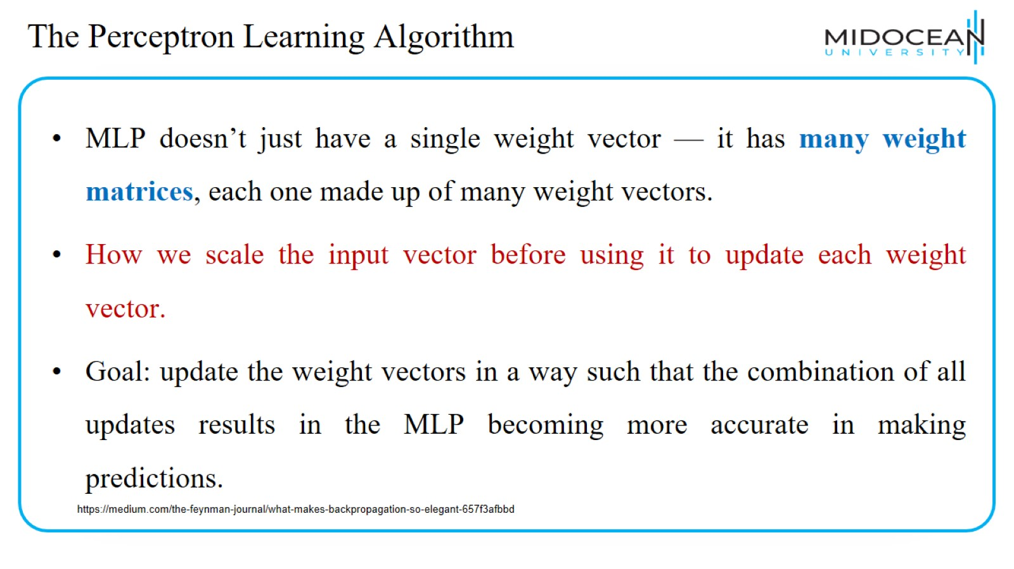
The Perceptron Learning Algorithm

Slide 8
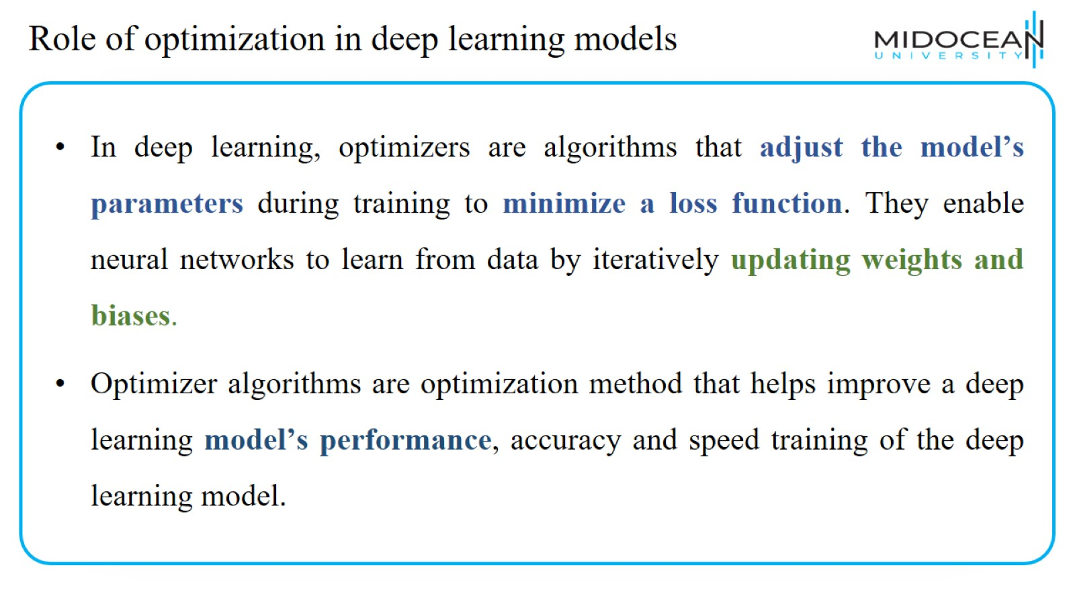
Role of optimization in deep learning models

Slide 9
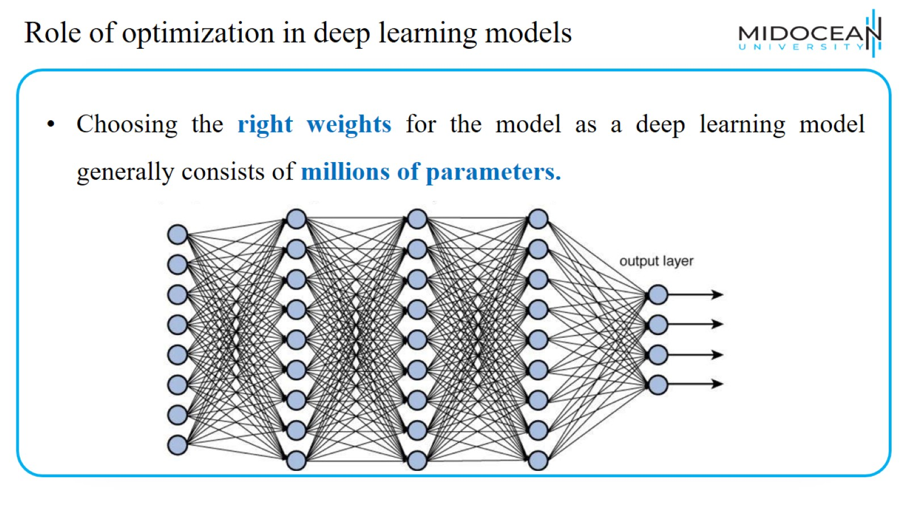
Role of optimization in deep learning models

Slide 10
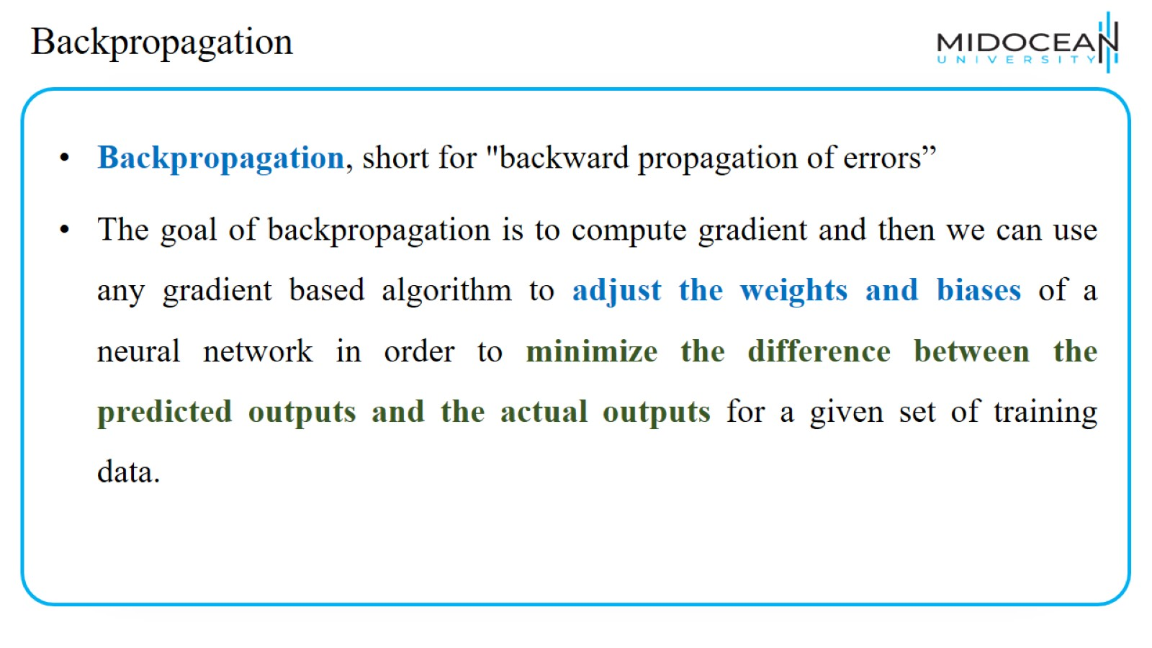
Backpropagation

Slide 11
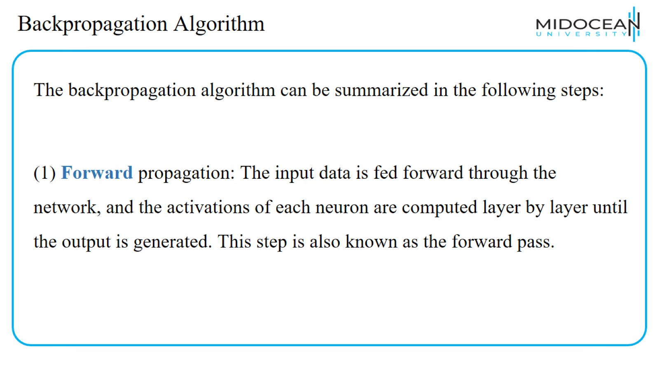
Backpropagation Algorithm

Slide 12
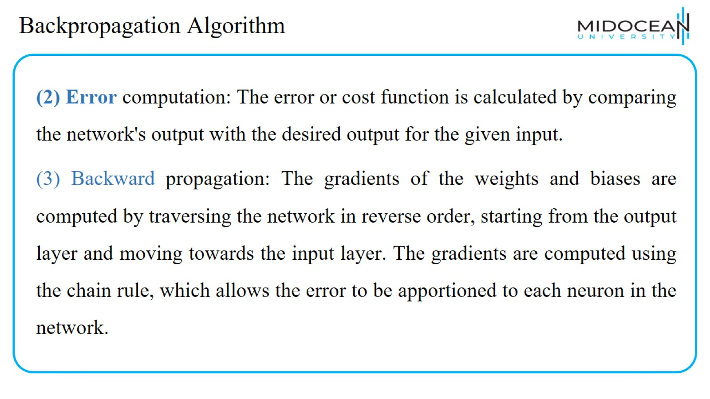
Backpropagation Algorithm

Slide 13
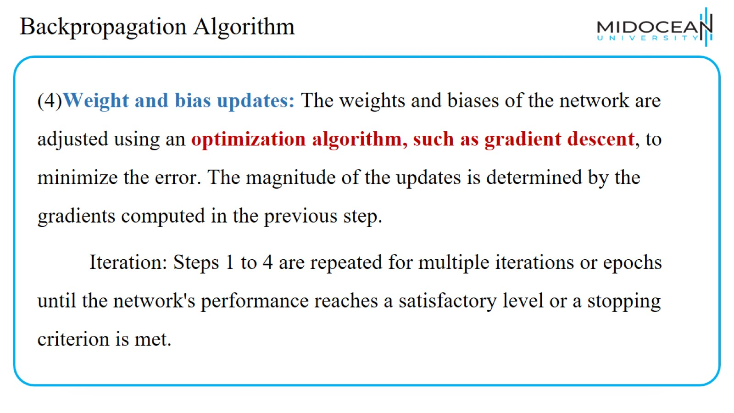
Backpropagation Algorithm

Slide 14

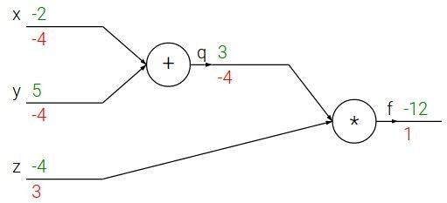
Backpropagation: a simple example
e.g. x = -2, y = 5, z = -4
http://cs231n.stanford.edu/slides/2017/cs231n_2017_lecture4.pdf

Slide 15
Backpropagation: a simple example
e.g. x = -2, y = 5, z = -4
Forward pass
http://cs231n.stanford.edu/slides/2017/cs231n_2017_lecture4.pdf

Slide 16
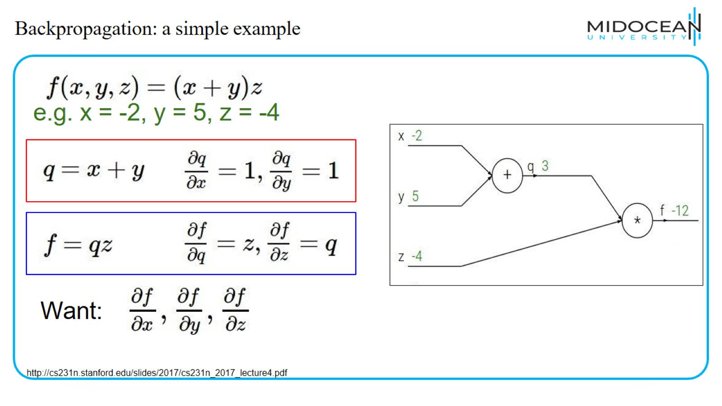
Backpropagation: a simple example

Slide 17
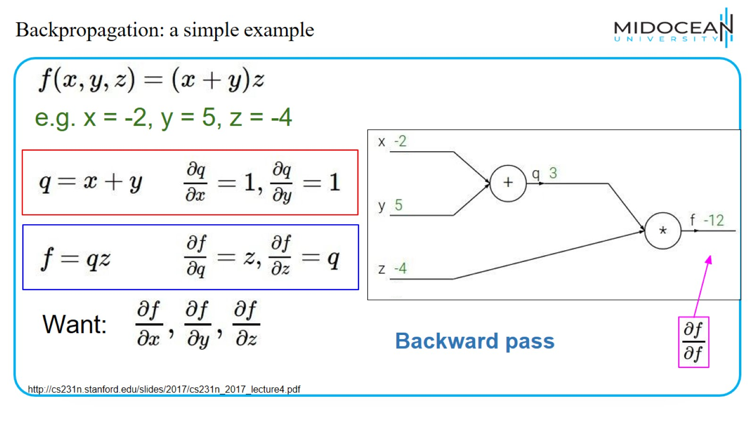
Backpropagation: a simple example

Slide 18
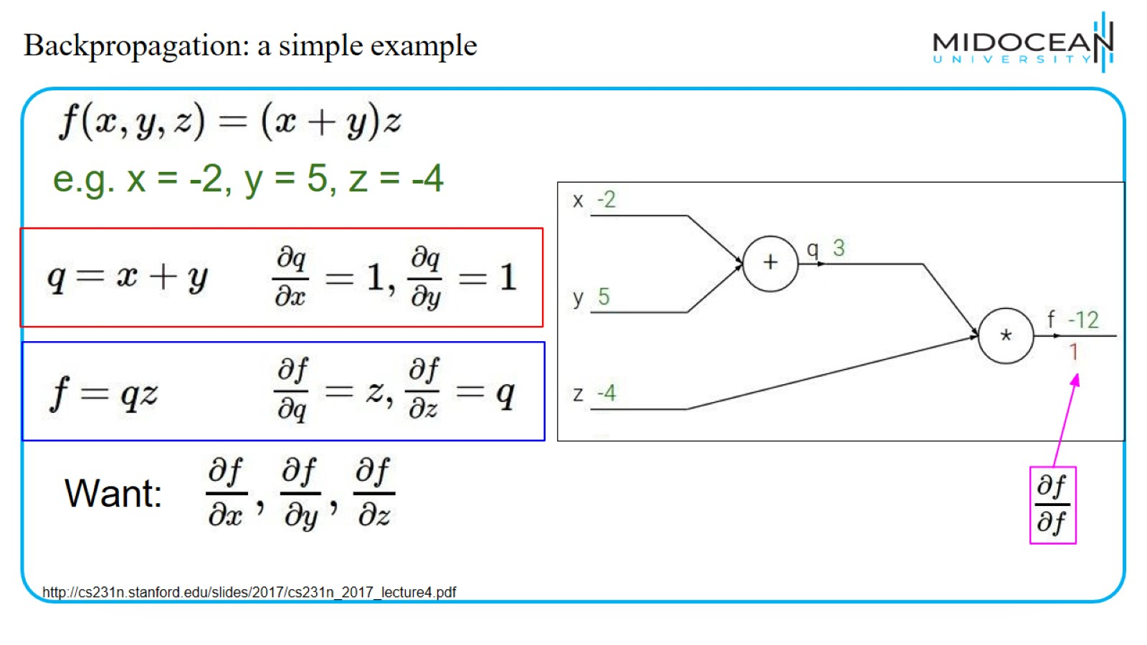
Backpropagation: a simple example

Slide 19
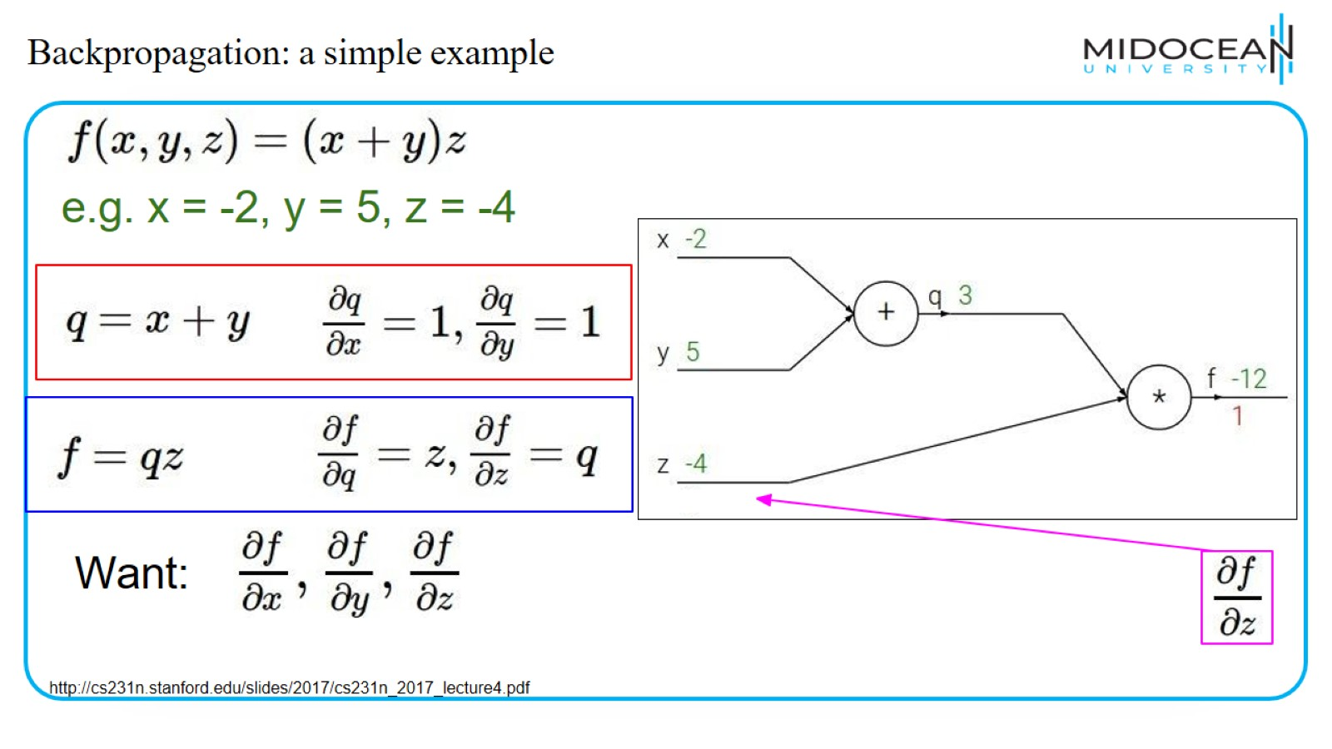
Backpropagation: a simple example

Slide 20
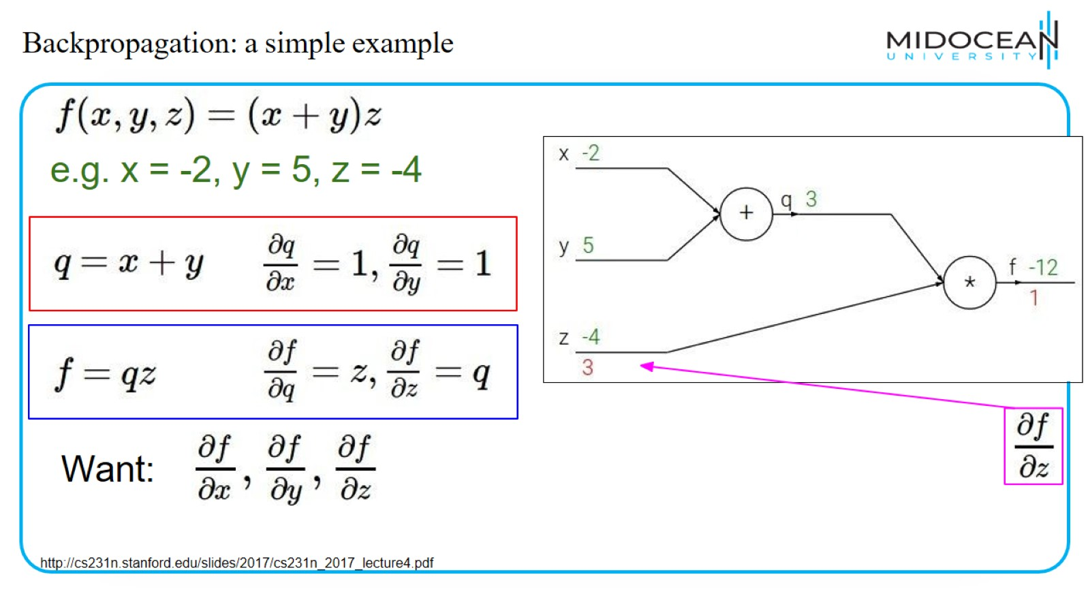
Backpropagation: a simple example

Slide 21
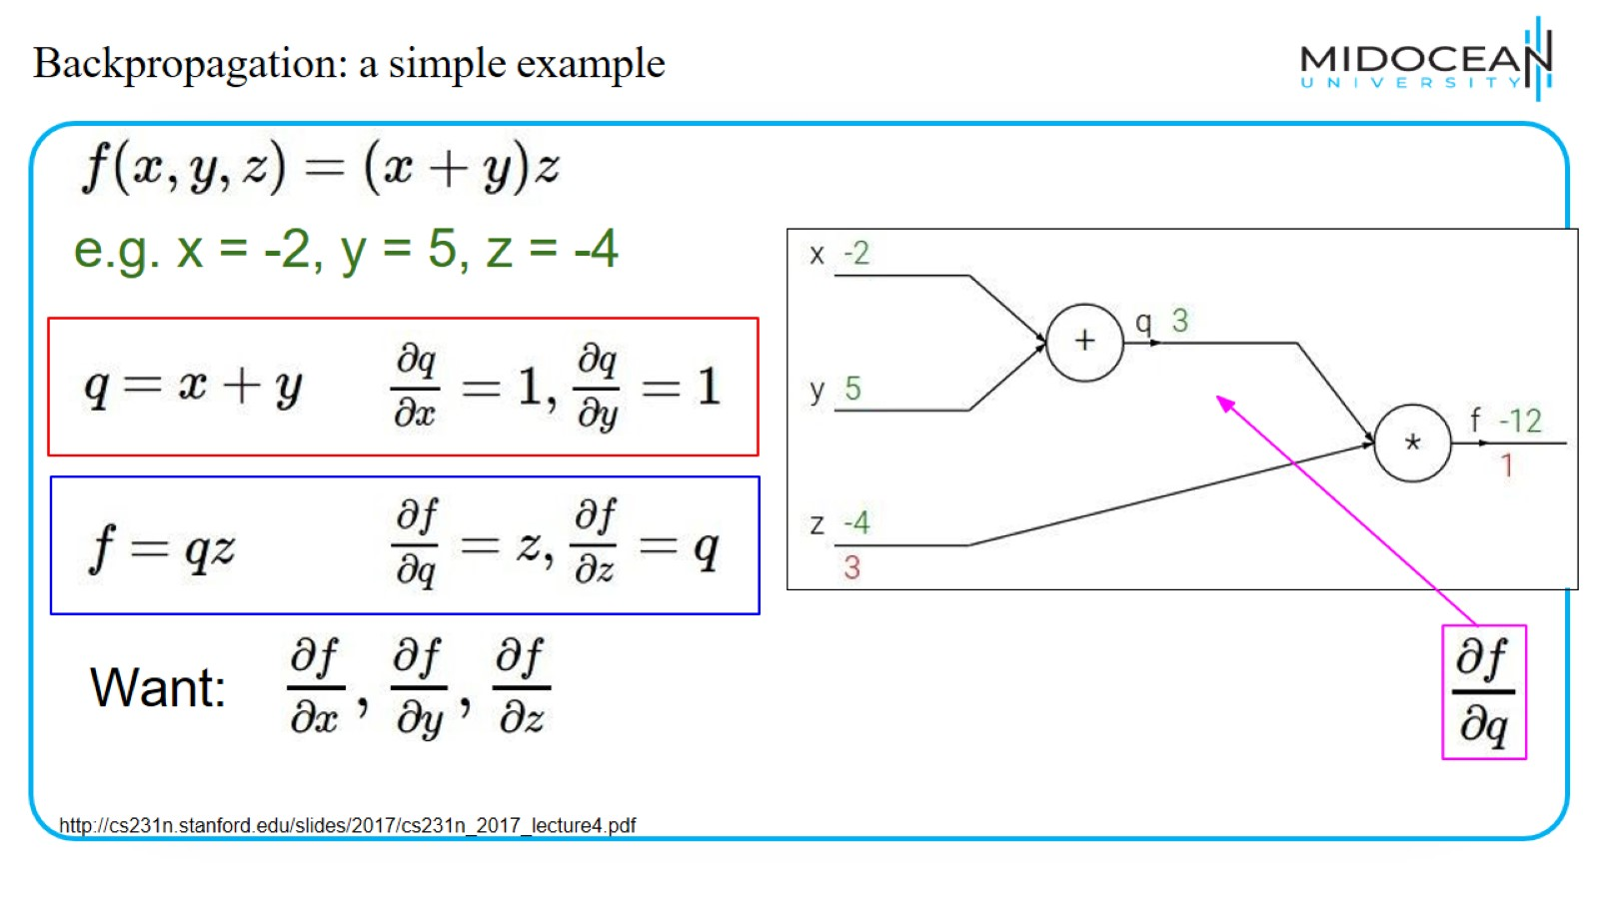
Backpropagation: a simple example

Slide 22
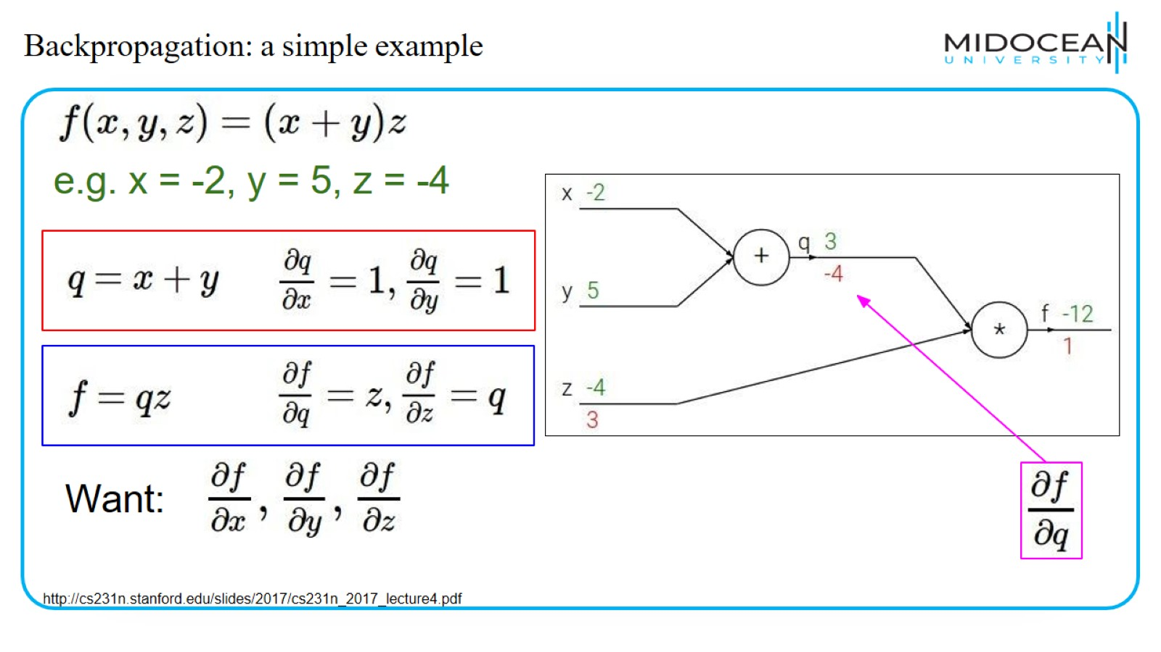
Backpropagation: a simple example

Slide 23
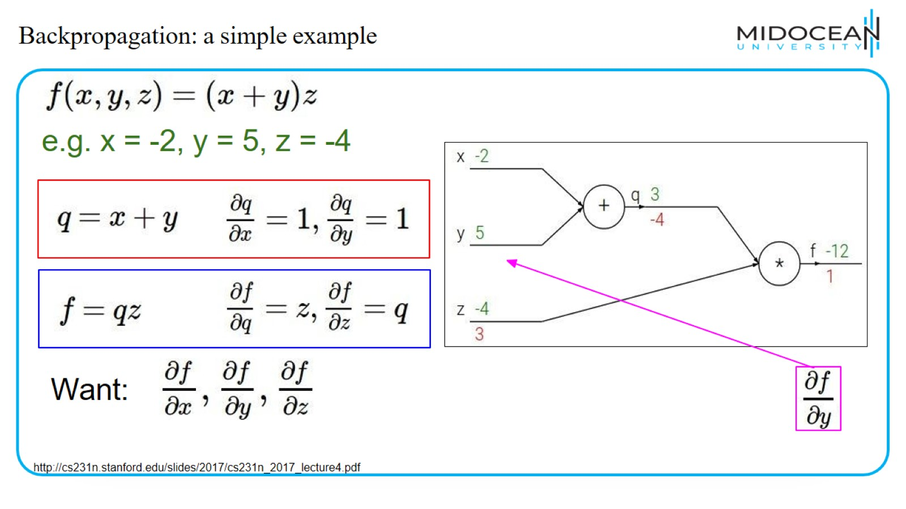
Backpropagation: a simple example

Slide 24
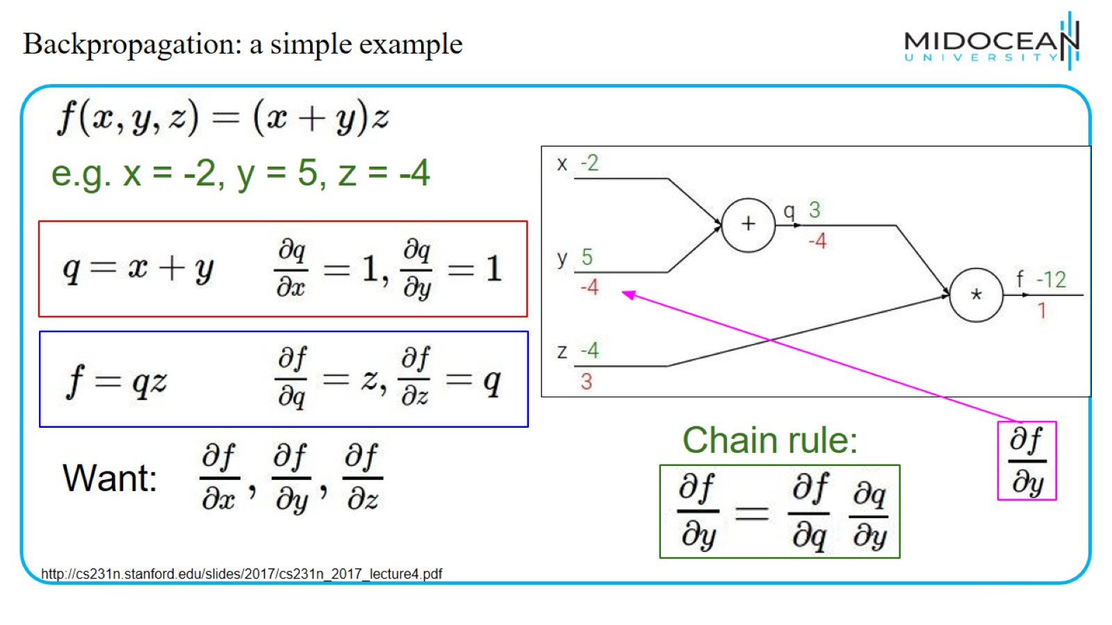
Backpropagation: a simple example

Slide 25
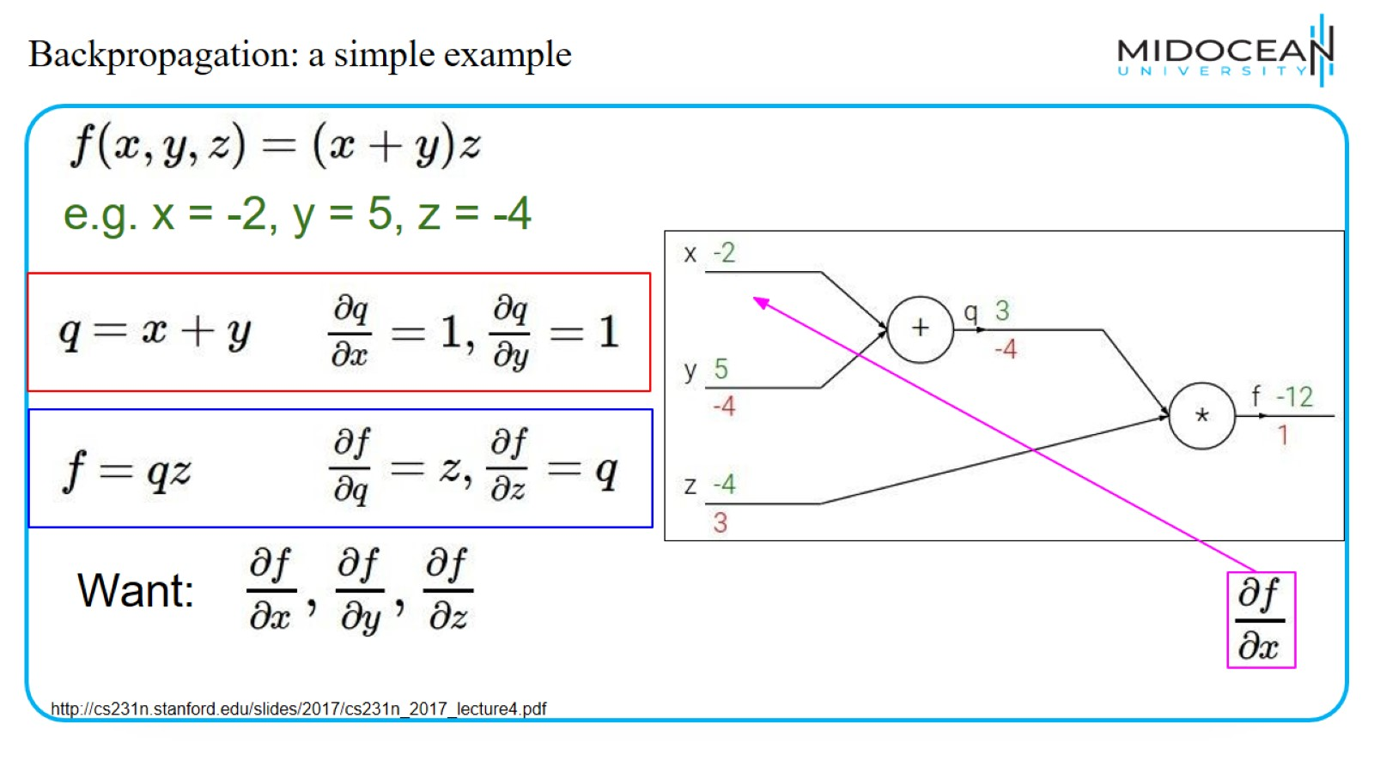
Backpropagation: a simple example

Slide 26
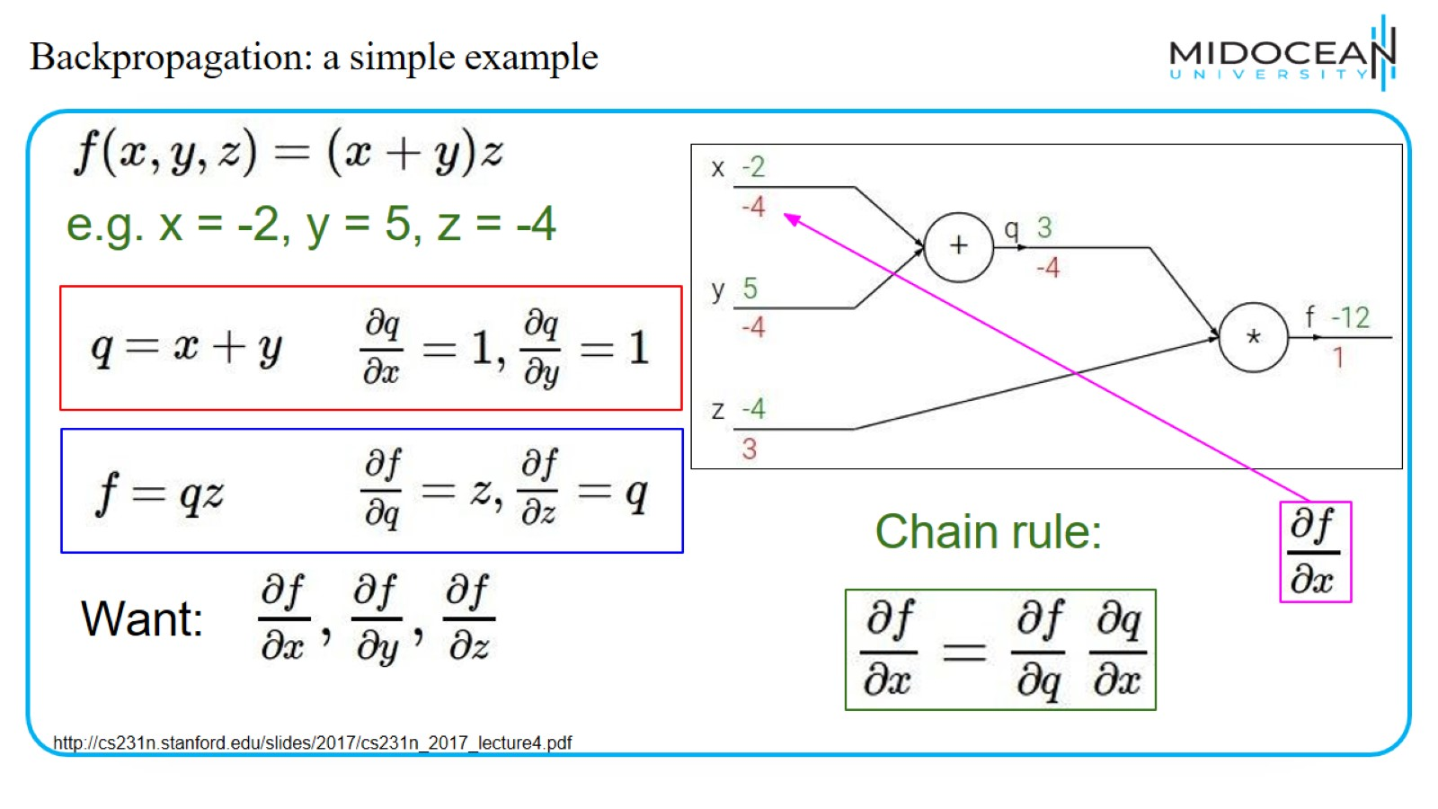
Backpropagation: a simple example

Slide 27
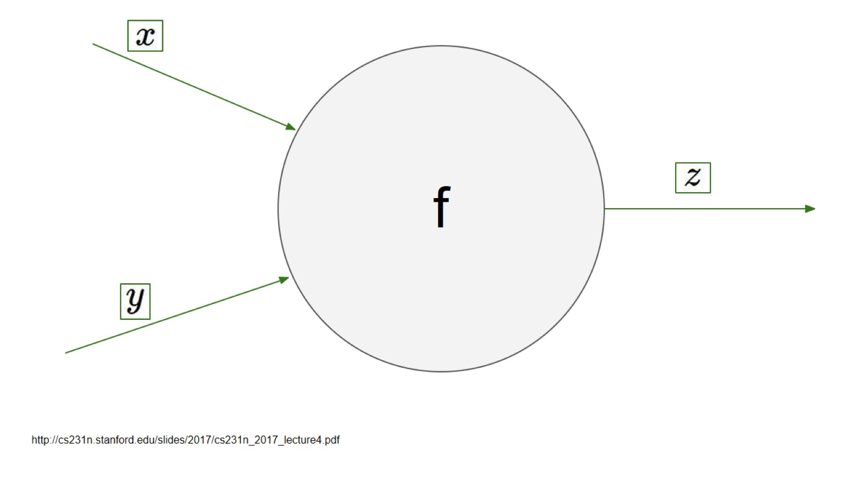

Slide 28
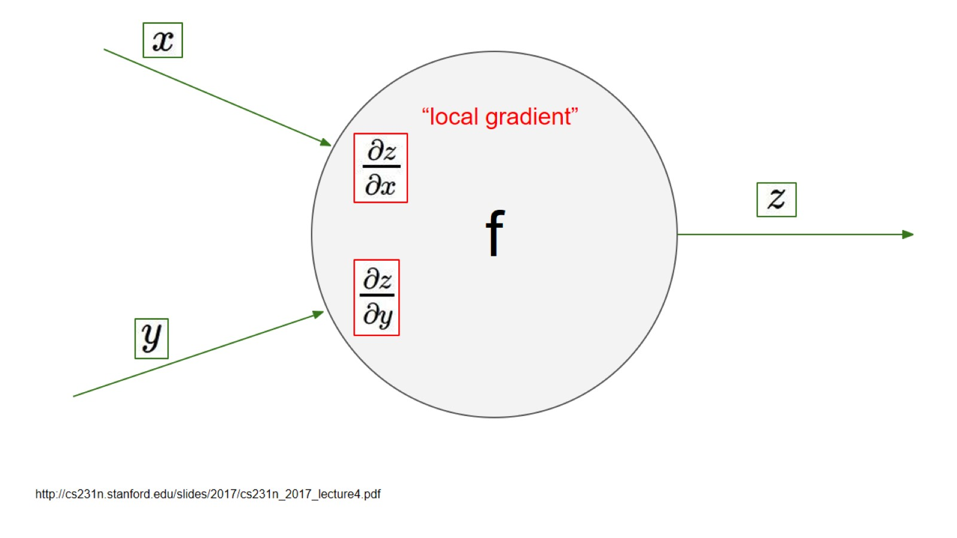
f

Slide 29
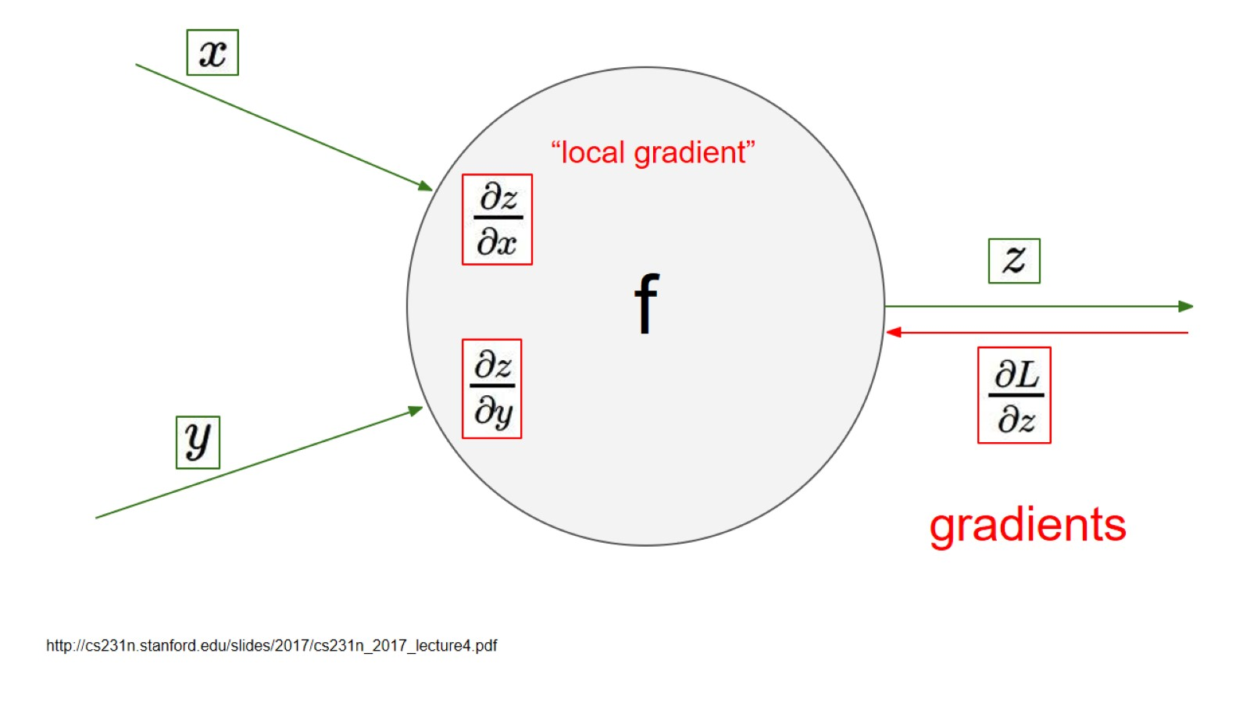

Slide 30
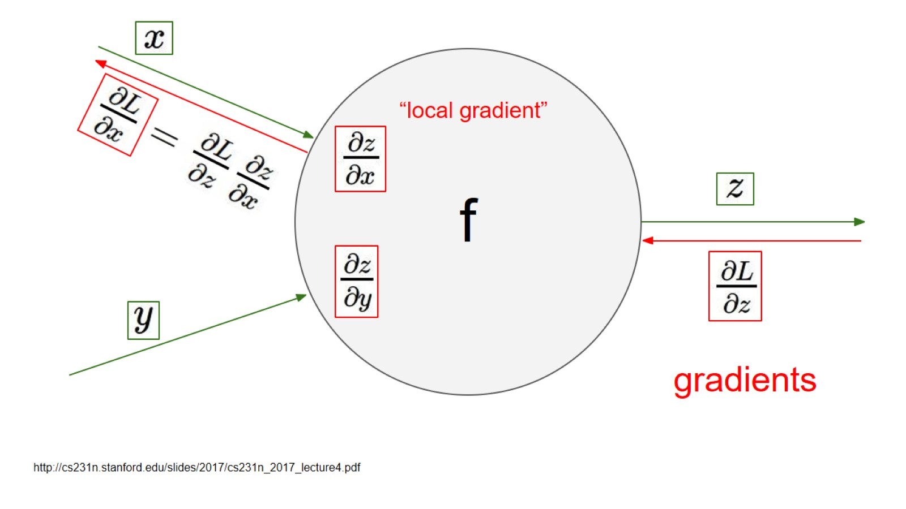

Slide 31
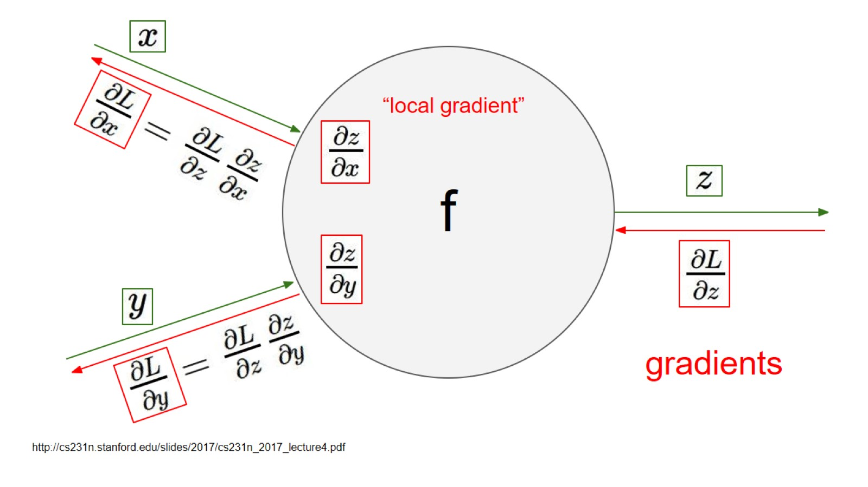

Slide 32
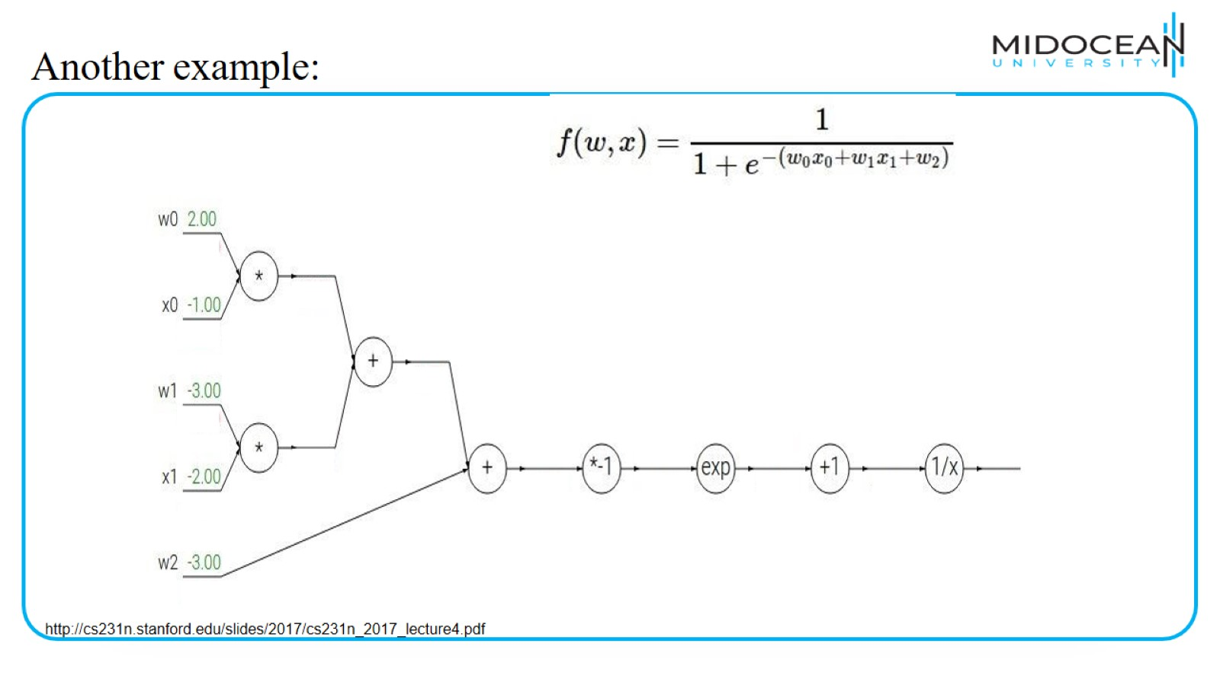
Another example:

Slide 33
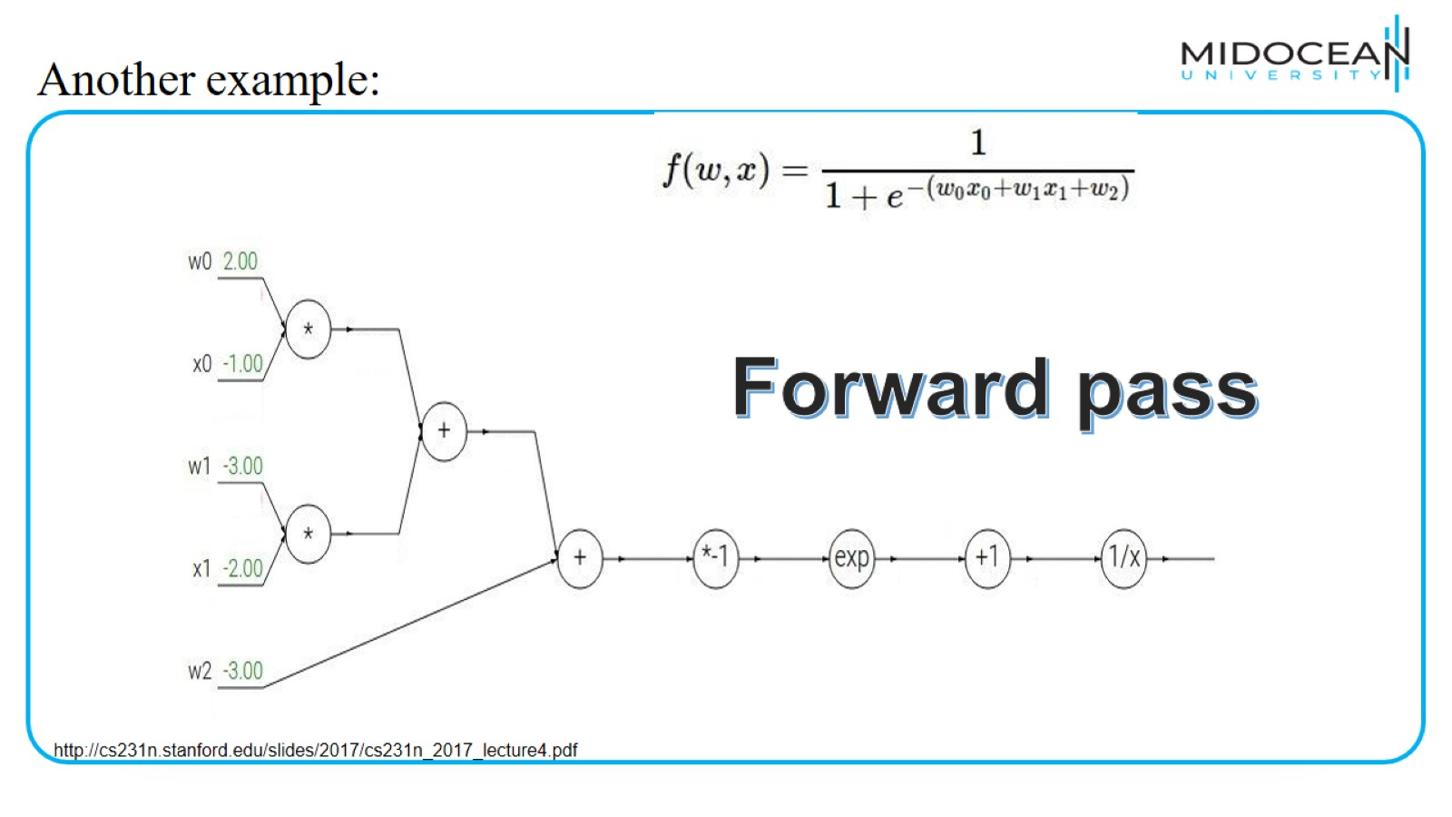
Another example:

Slide 34
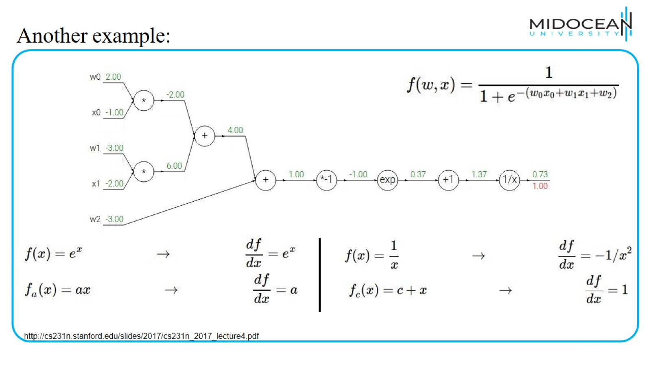
Another example:

Slide 35
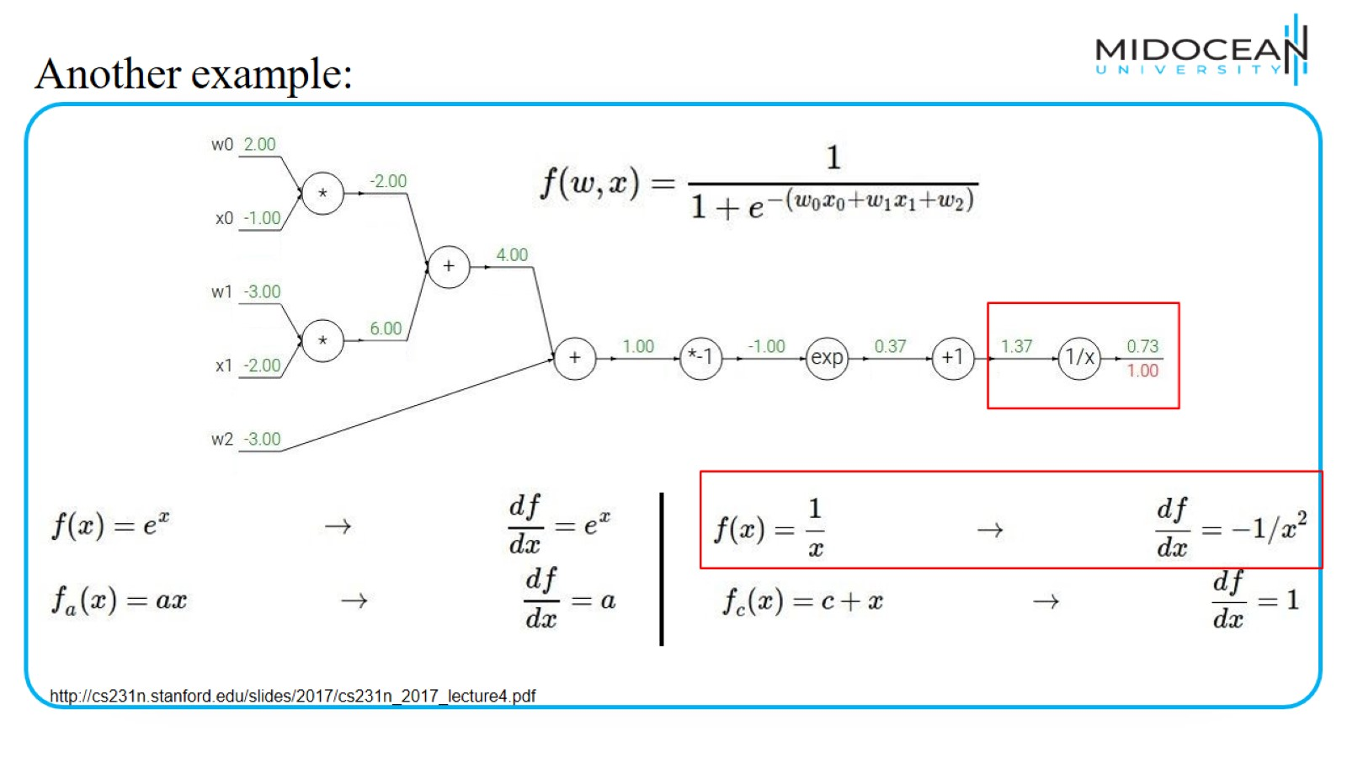
Another example:

Slide 36
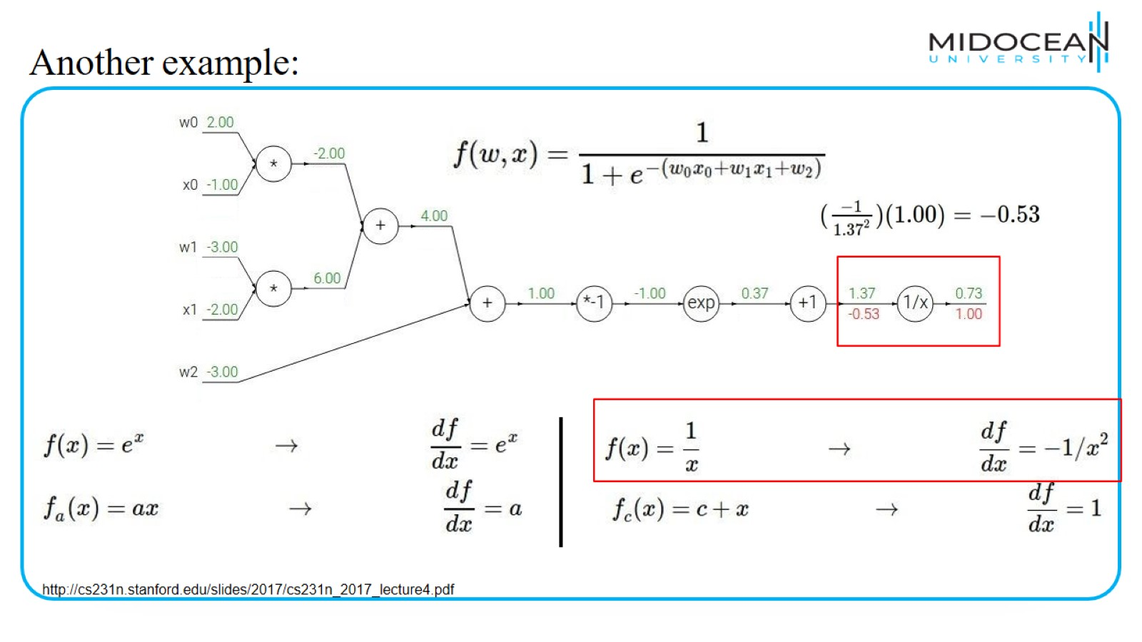
Another example:

Slide 37
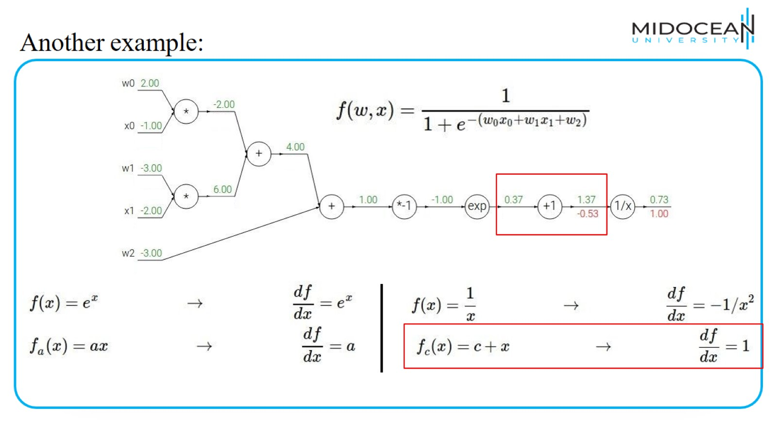
Another example:

Slide 38
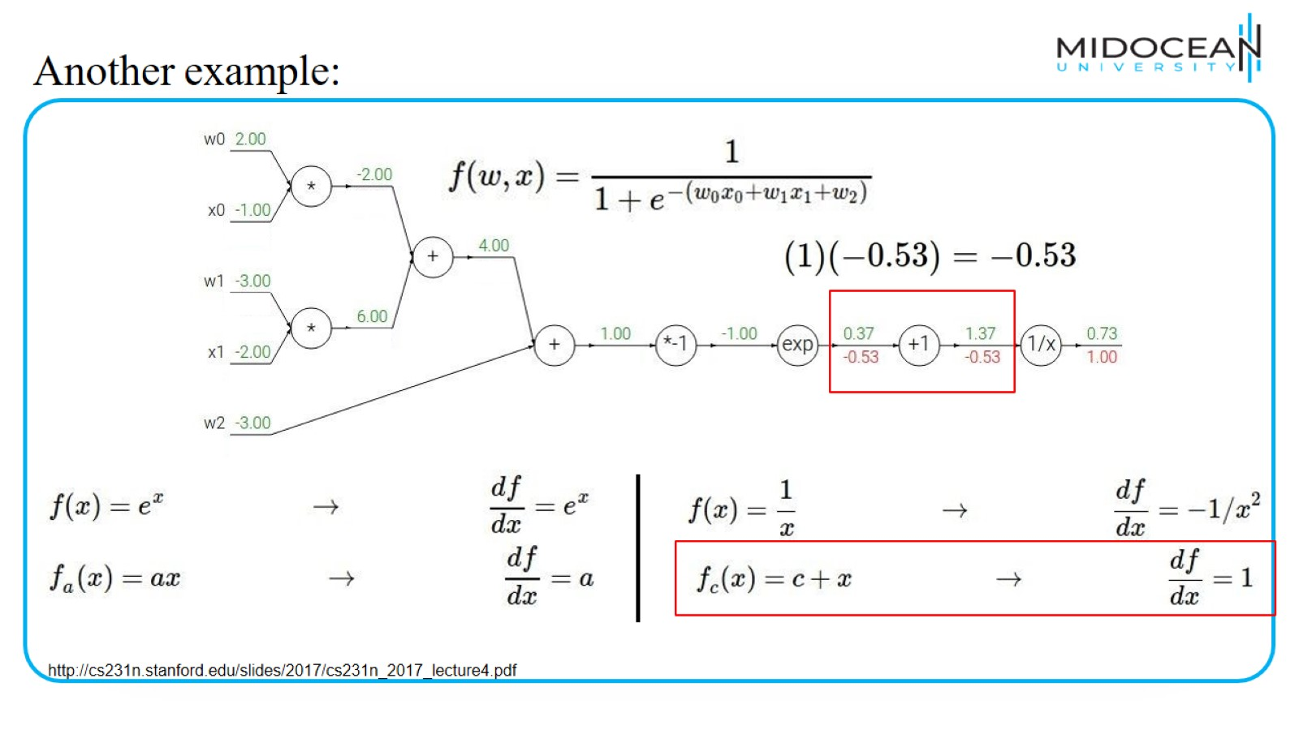
Another example:

Slide 39
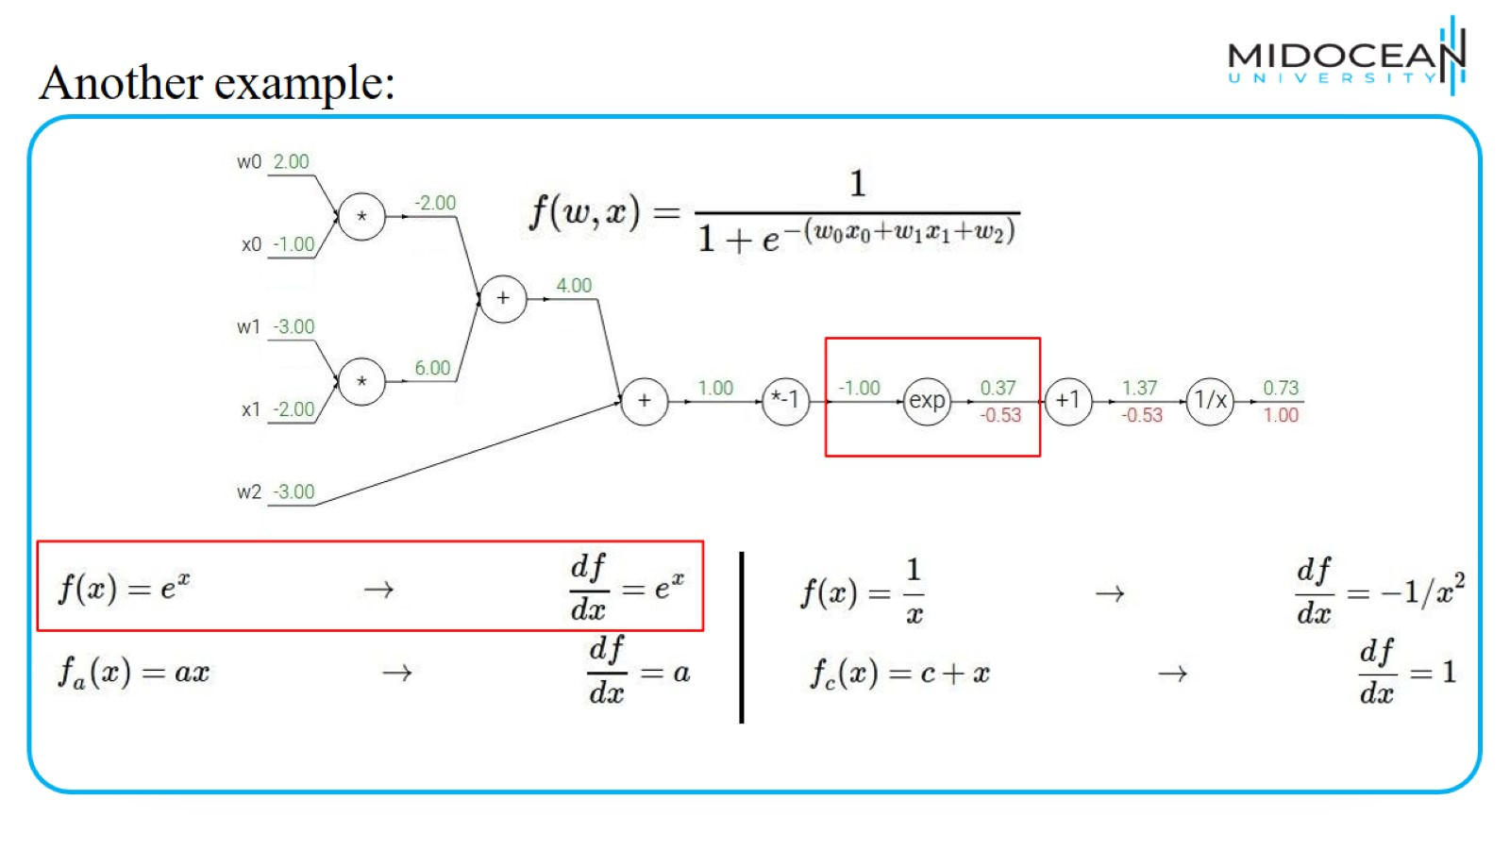
Another example:

Slide 40
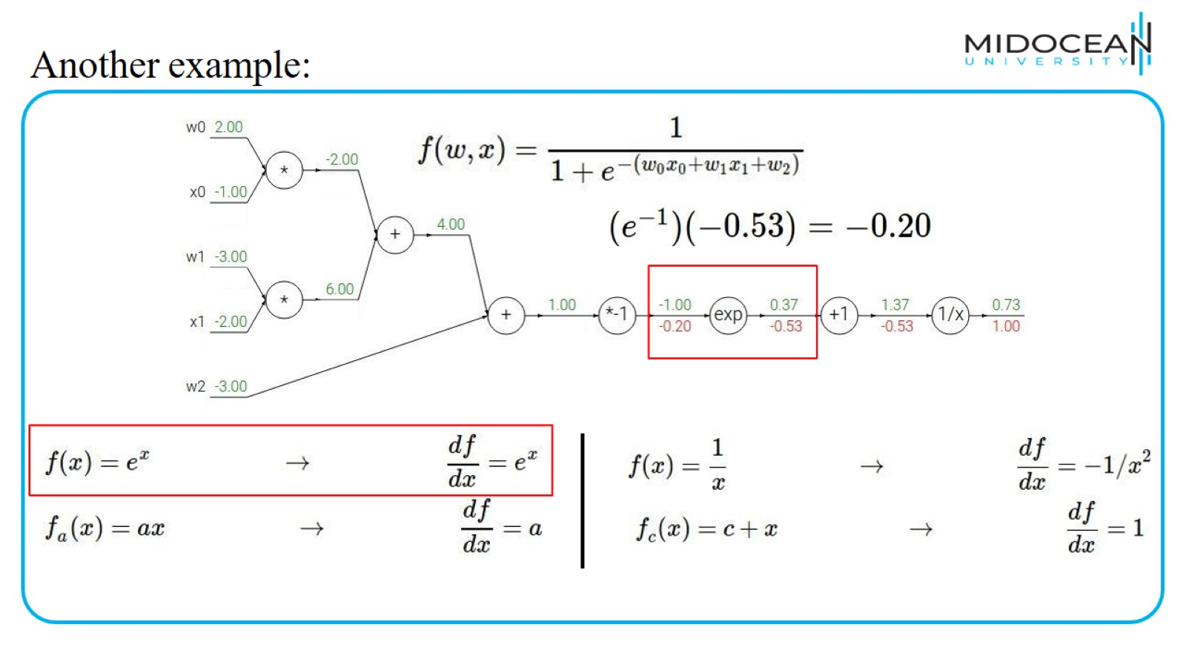
Another example:

Slide 41
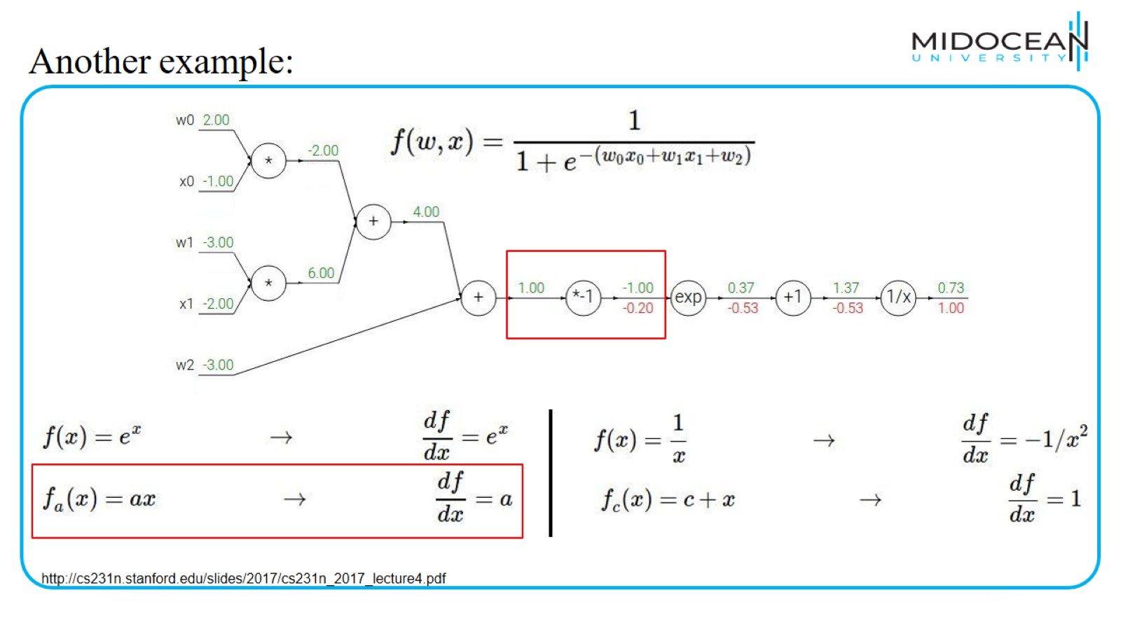
Another example:

Slide 42
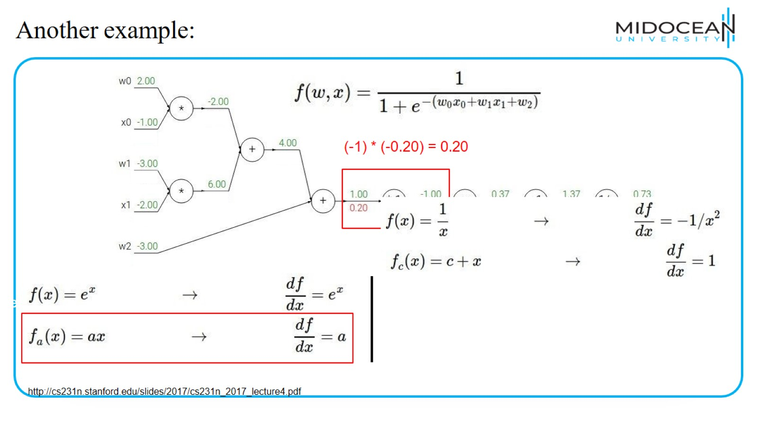
Another example:

Slide 43
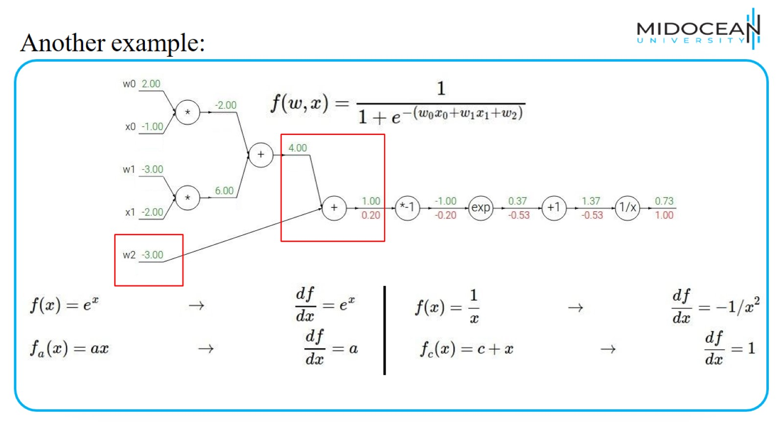
Another example:

Slide 44
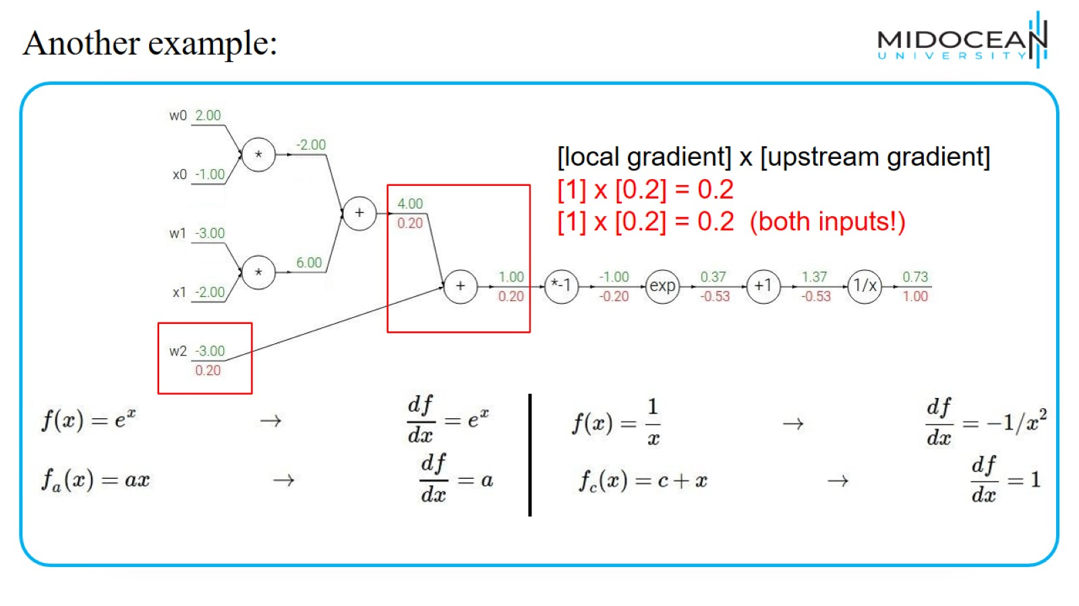
Another example:

Slide 45
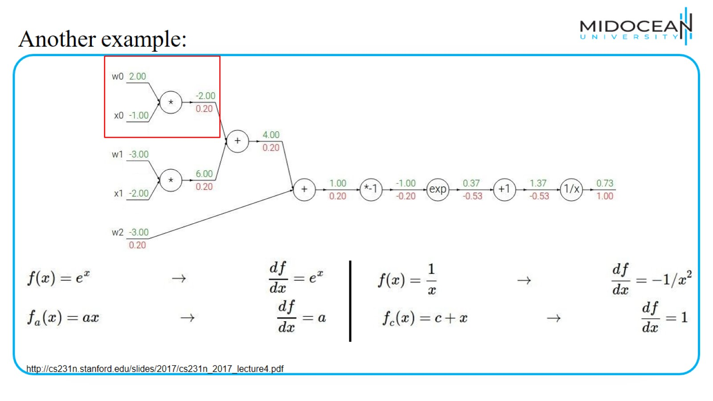
Another example:

Slide 46
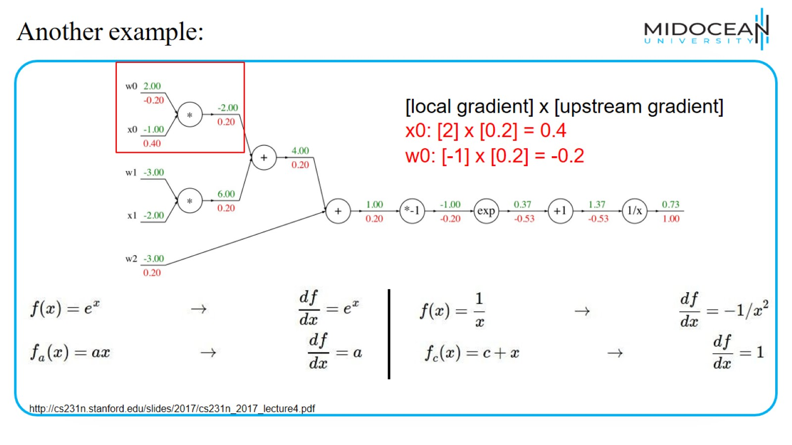
Another example:

Slide 47
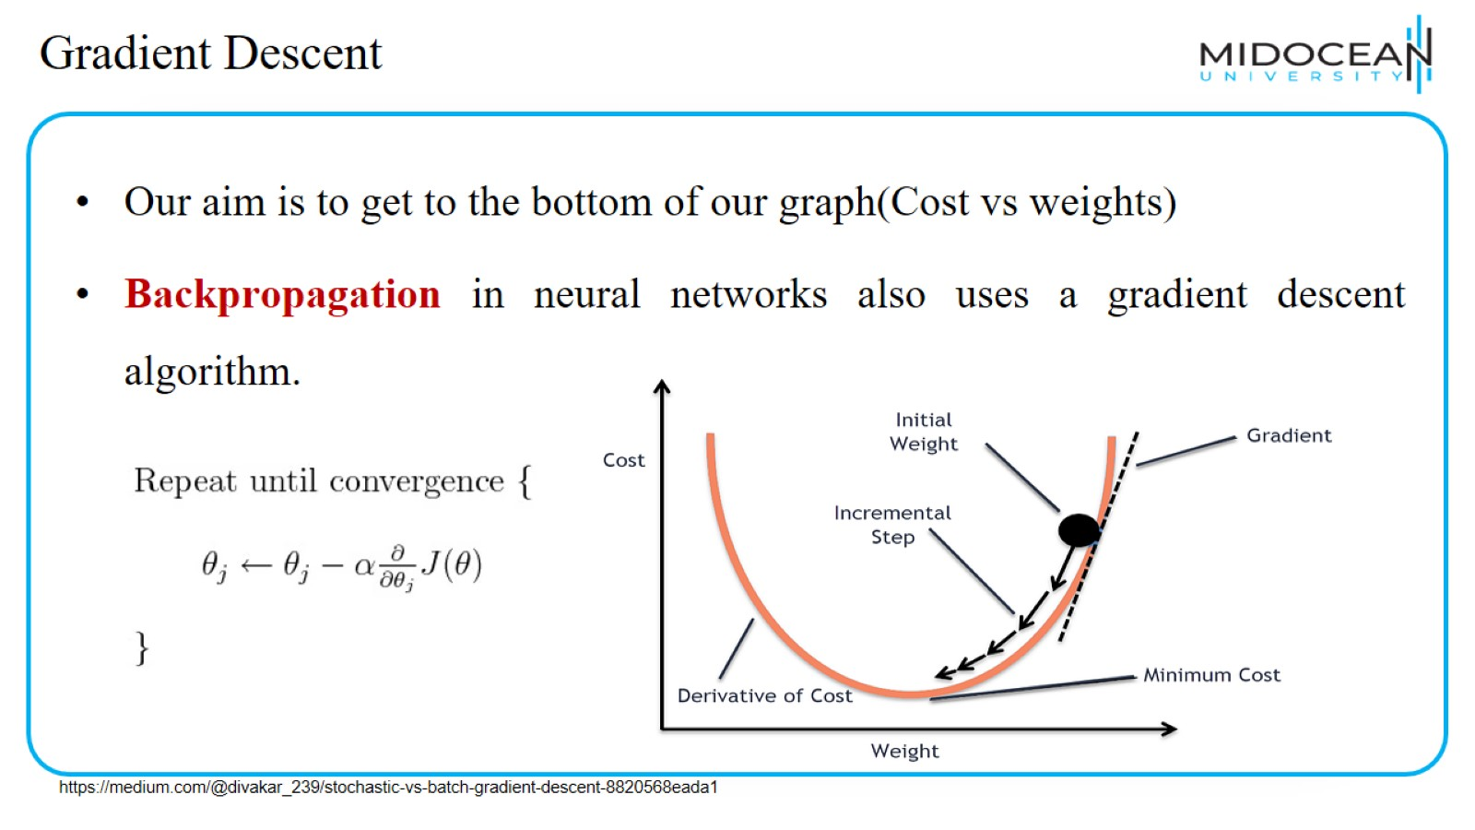
Gradient Descent

Slide 48
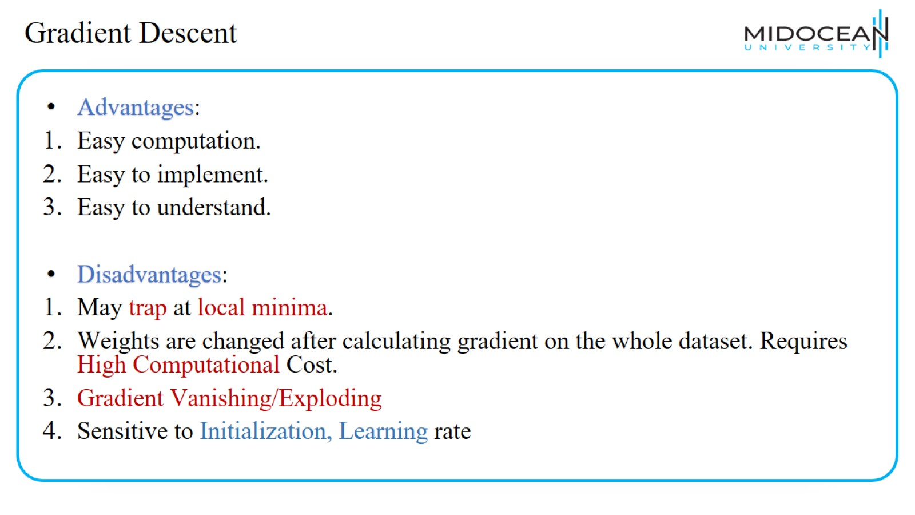
Gradient Descent

Slide 49
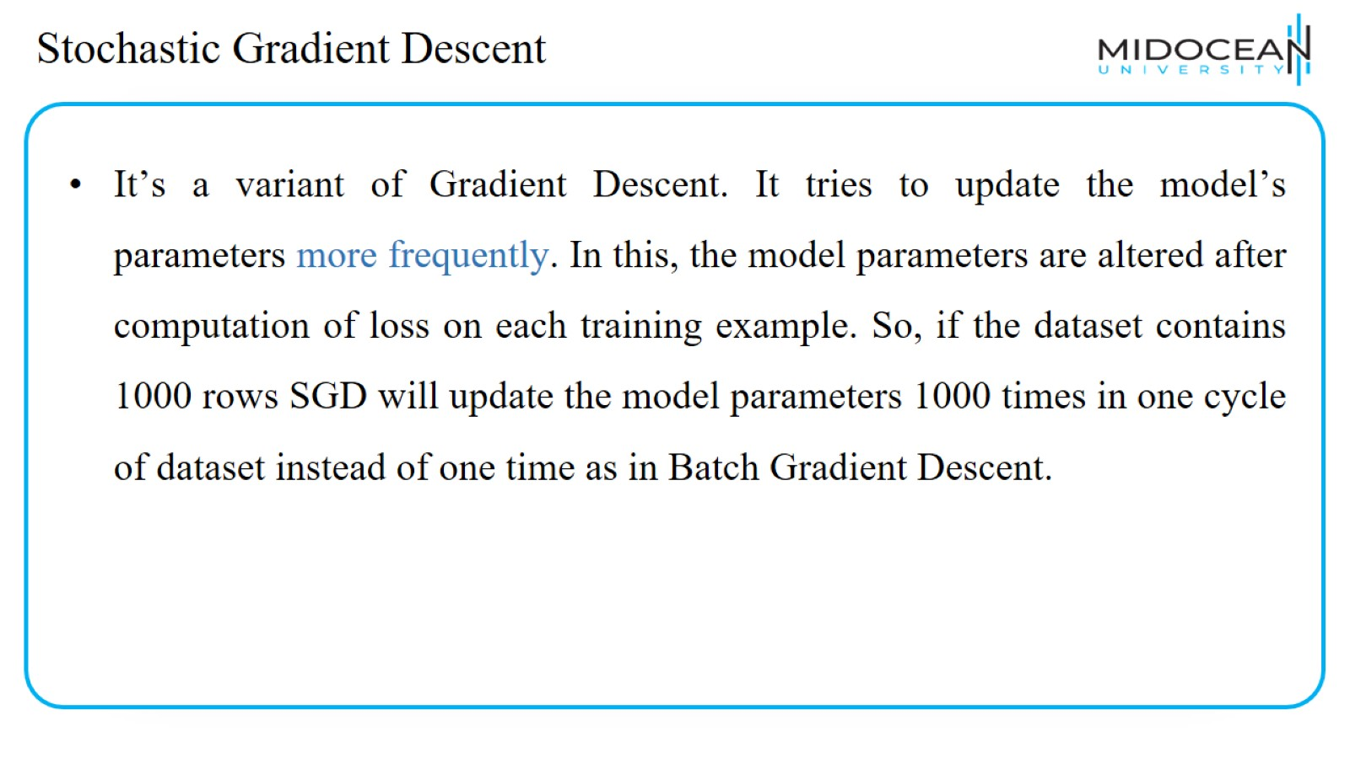
Stochastic Gradient Descent

Slide 50
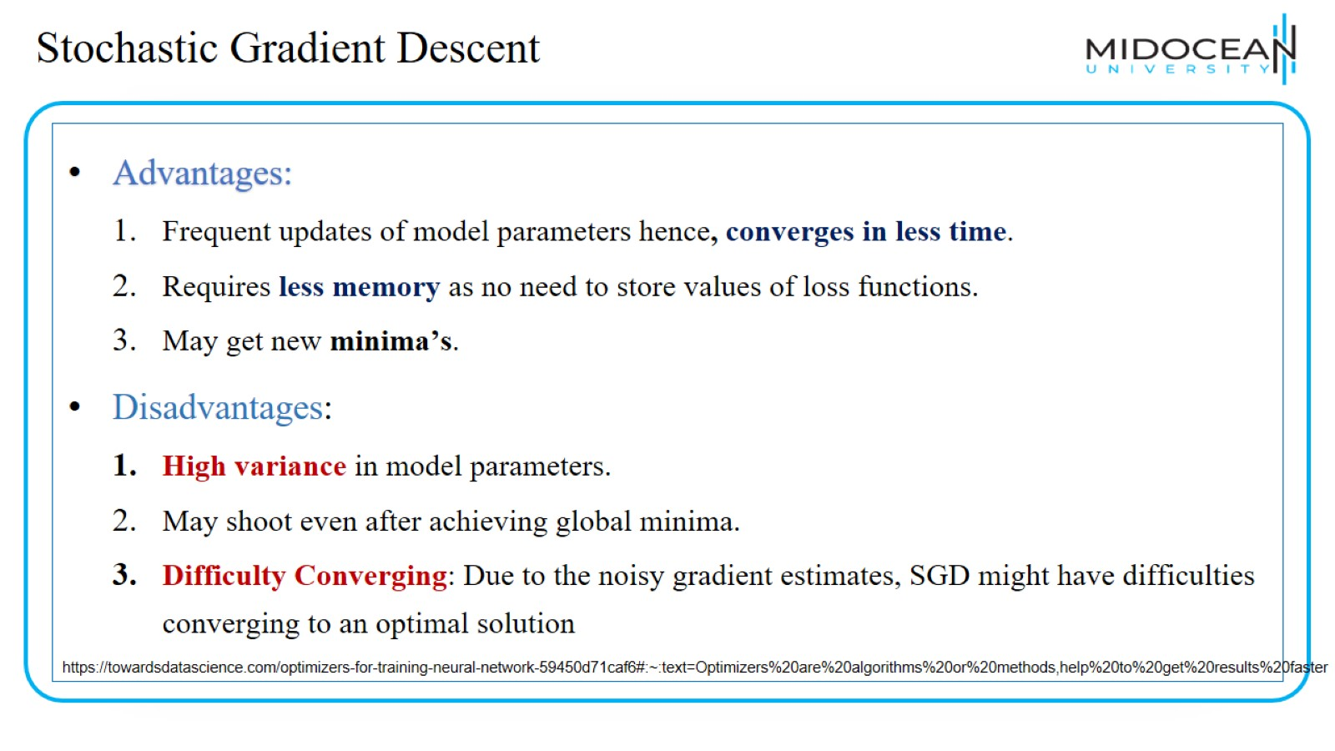
Stochastic Gradient Descent

Slide 51
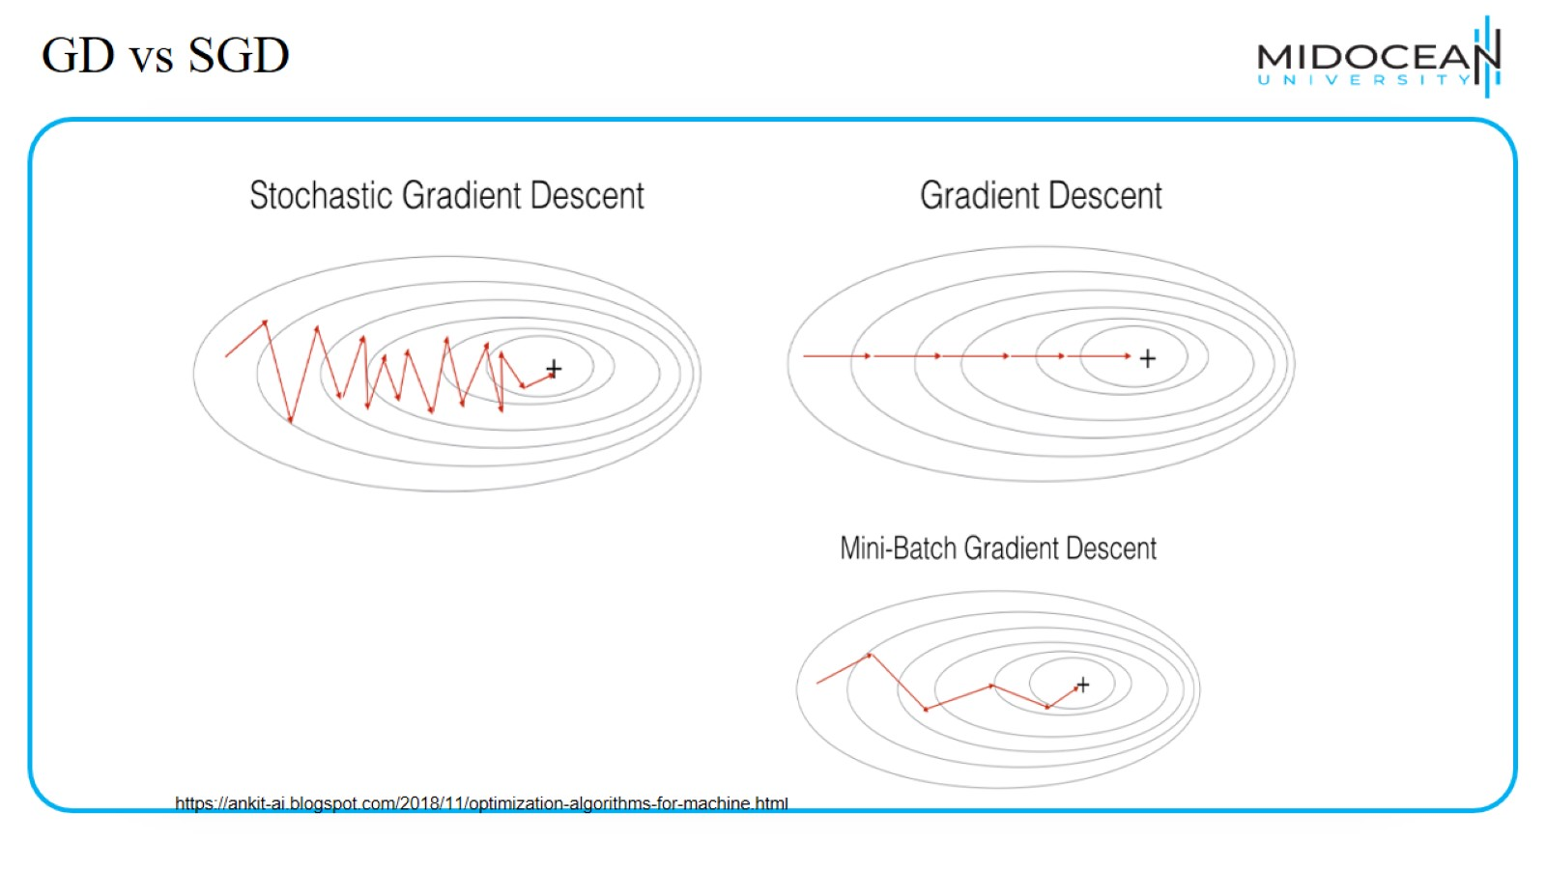
GD vs SGD

Slide 52
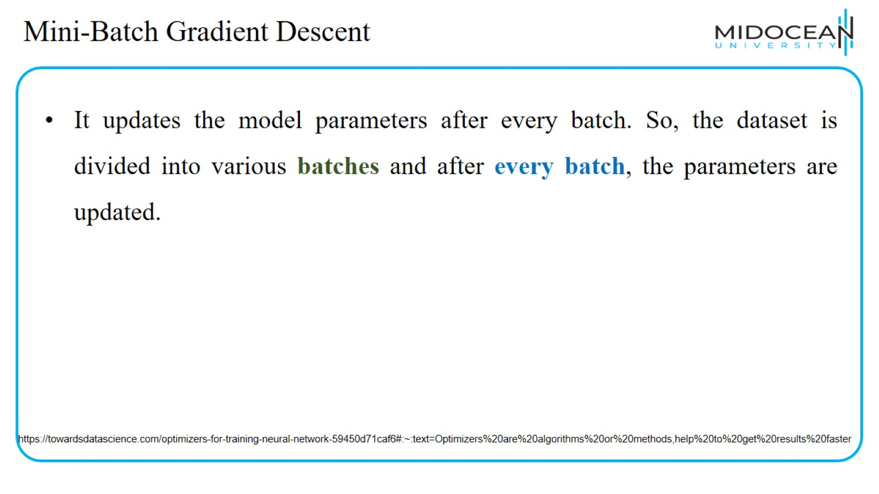
Mini-Batch Gradient Descent

Slide 53

Mini-Batch Gradient Descent

Slide 54

Vanilla Gradient Descent
https://towardsdatascience.com/a-visual-explanation-of-gradient-descent-methods-momentum-adagrad-rmsprop-adam-f898b102325c

Slide 55

Momentum
Momentum do some additional processing of the gradients to be faster and better.
https://towardsdatascience.com/a-visual-explanation-of-gradient-descent-methods-momentum-adagrad-rmsprop-adam-f898b102325c

Slide 56

Momentum
https://towardsdatascience.com/a-visual-explanation-of-gradient-descent-methods-momentum-adagrad-rmsprop-adam-f898b102325c

Slide 57

Momentum

Slide 58

Momentum

Slide 59

Momentum

Slide 60

Momentum

Slide 61

Nesterov Accelerated Gradient

Slide 62

SGD vs Momentum vs NAG

Slide 63

SGD vs Momentum vs NAG

Slide 64

Nesterov Accelerated Gradient

Slide 65

Nesterov Accelerated Gradient

Slide 66

Adagrad (Adaptive Gradient Descent)

Slide 67

RMSProp

Slide 68

Adam(Adaptive Moment Estimation)

Slide 69

LAB 1:
Optimizers in Keras

Slide 71

LAB 2:
Hyperparameters tunning in Keras

Slide 72


Slide 73


Slide 74


