Slide 1





Network Security
Prepared by Dr. Mohammed Anbar
Lecture 1
Network Infrastructure Security
(part one)

Slide 2



Chapter
01
Disclaimer
Some of the contents in this presentation is adopted from the resources provided by the authors of the following book:
Wong, Angus, and Alan Yeung. Network infrastructure security. Springer Science & Business Media, 2009.

Slide 3
Chapter
01
Learning objectives
Explain Network Infrastructure and its security,
Differentiate between Information Security and Network Infrastructure security,
Explain Network Infrastructure components ,
Explain switch security,
Explain Dynamic Host Configuration Protocol (DHCP) security ,
Explain Domain Name System (DNS) security .

Slide 4
Chapter
01
Network Infrastructure
Network infrastructure refers to resources that enable network connectivity, communication, operation, and management.
Typically, it includes networking hardware, software, and services.
If your network is not secure, it presents a significant vulnerability to various attacks such as denial-of-service, malware, spam, and unauthorized access.

Slide 5
Chapter
01
Information security vs Network Infrastructure security
Information security
Information security is a set of strategies or procedures which are designed and implemented to prevent and protect digital and non-digital information or any other sensitive information or data from unauthorized access.
Confidentiality, integrity, and availability (CIA triad), is a model designed to guide policies for information security within an organization.
CIA is usually present because these are typically viewed as the primary goals and objectives of a security infrastructure.

Slide 6
Chapter
01
Three key principles (the CIA triad)
Information Security
Confidentiality
  Assures that confidential information is not disclosed to unauthorized individuals
Integrity
  Assures that information and programs are changed only in a specified and authorized manner
Integrity
Confidentiality
Overall, an information security mechanism should precisely address
each of these CIA triad principles.
Availability
Availability
Assures that systems and services are not denied to authorized users

Slide 7




Chapter
01
Confidentiality
A
B
C

Slide 8
Chapter
01
Integrity
A
B
C

Slide 9
Chapter
01
Non-repudiation
A
B

Slide 10
Chapter
01
Information security vs Network Infrastructure security
Network Infrastructure Security (cont.)
While the provision of information is important, it becomes meaningless if the data, no matter how secure its content, cannot be correctly delivered through the infrastructure of the Internet to its intended destination.
On the other hand, if the infrastructure is attacked, a large area (or even the entire) Internet will be affected, causing economical damages. Therefore, in recent years, much concern has been drawn to how securing the Internet infrastructure is.

Slide 11
Chapter
01
Information security vs Network Infrastructure security
Network Infrastructure Security (cont.)
Unlike network information security which focuses on information protection, infrastructure security focuses on the protection of the network infrastructure itself.
The protection of the network infrastructure focuses on how to detect network attacks and how to prevent routers or other network devices from being compromised.
The approach to infrastructure security includes the use of secure Internet protocols, traffic monitoring, and firewalls.

Slide 12
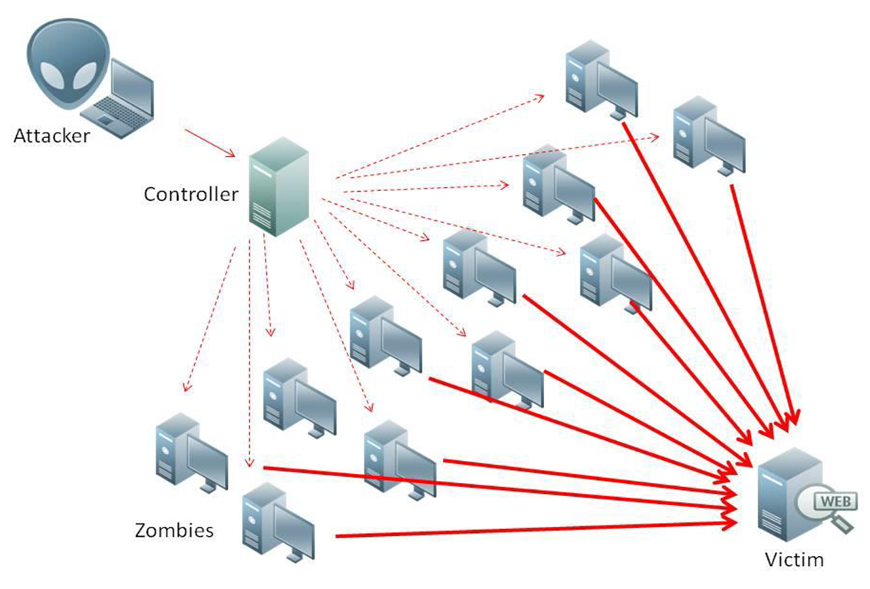
Chapter
01
Importance of Network Infrastructure Security
The attack on Network Infrastructure would affect a large portion of the Internet and create a large amount of service disruption.
Since our daily operations highly depend on the availability and reliability of the Internet, the security of its infrastructure has become a high-priority issue.
An example of Network Infrastructure is Distributed Denial of Service (DDoS) attacks.

Slide 13
Chapter
01
Difficulties of Securing the Infrastructure
Internet infrastructure is vulnerable
  Many network devices and protocols were designed without security concerns in mind at the beginning. Unfortunately. those protocols now form part of the Internet infrastructure, making it vulnerable to various kinds of attacks.
Security and performance trade-off
  Security usually requires extra processes to run or more CPU cycles to execute the security process. It certainly reduces the performance of current devices.

Slide 14
Chapter
01
Difficulties of Securing the Infrastructure (cont)
Attacks can be easily launched and difficult to be traced
Anyone with a computer and an Internet connection can reach any point on the Internet, making it possible to launch an attack from anywhere in the world. Compounding the problem, a general computer can easily pretend itself as a switch or router (by running a special software package) and broadcast malicious information to mislead the real network devices to perform abnormally.

Slide 15
Chapter
01
Open Systems Interconnection (OSI) model basics
The Open Systems Interconnection (OSI) model demonstrates how networks operate in terms of hardware and software.
Each layer in the model performs different tasks for network communication and is useful to analyse the security properties of protocols and devices.
More importantly, this type of model helps build a multi-layered “defense-in-depth” to provide maximum network security.

Slide 16
Chapter
01
Open Systems Interconnection (OSI) model basics (cont.)
OSI 7-layer stack
TCP/IP stack
OSI 7-layer stack
Data
7 Application
Application
(e.g., FTP)
7 Application
Data
6 Presentation
6 Presentation
Data
5 Session
5 Session
Data
4 Transport
Transmission Control Protocol
4 Transport
Segments
3 Network
Internet
Protocol
3 Network
Packets
2 Data Link
Link
(e.g., Ethernet, Wireless LAN)
2 Data Link
Frames
1 Physical
1 Physical
Bits

Slide 17
Chapter
01
Examples of Protocols at various levels
Layer | Name | Protocols
Layer 7 | Application | SMTP, HTTP, FTP, POP3, SNMP
Layer 6 | Presentation | MPEG, ASCH, SSL, TLS
Layer 5 | Session | NetBIOS, SAP
Layer 4 | Transport | TCP, UDP
Layer 3 | Network | IPV5, IPV6, ICMP, IPSEC, ARP, MPLS.
Layer 2 | Data Link | RAPA, PPP, Frame Relay, ATM, Fiber Cable, etc.
Layer 1 | Physical | RS232, 100BaseTX, ISDN, 11.

Slide 18
Chapter
01
Open Systems Interconnection (OSI) model
basics (Cont.)
Here are the different layers of this model and how it can best be implemented:
Physical layer: Defines physical and electrical characteristics of the network, such as cable types and signals used to transmit data.
  Devices: Repeater, hub, and network interface controller (NIC).
  Vulnerabilities: Loss of power, physical theft, damage, and modification of data and hardware.
  Prevention controls: Employ video/audio surveillance, lock your perimeter, use biometric/PIN and password authentication systems.

Slide 19
Chapter
01
Open Systems Interconnection (OSI) model
basics (Cont.)
Data link layer: Defines how shared communication channels can be accessed and data frames can be reliably transmitted.
  Devices: switches and bridges.
  Vulnerabilities: Media Access Control (MAC) addresses spoofing and flooding, unauthorized access due to weak authentication, and encryption in the wireless environment.
  Prevention controls MAC address filtering, strong wireless security, physical separation of layers with firewalls, and other IDS (Intrusion Detection Systems).

Slide 20
Chapter
01
Open Systems Interconnection (OSI) model
basics (Cont.)
Network layer: Handles the task of routing network messages from one node to another and determines which path it needs to take to reach its destination.
  Devices: Router.
  Vulnerabilities: Route and IP address spoofing.
  Prevention controls: Anti-spoofing and filter policy, firewalls, broadcast monitoring.

Slide 21
Chapter
01
Open Systems Interconnection (OSI) model
basics (Cont.)
Transport layer: Ensures that packets are transported reliably and without errors.
  Vulnerabilities: Spoofing of transmission mechanisms, overloading of transport layer mechanisms, fingerprinting.
  Prevention controls: Limit specific transmission protocols, implement stateful inspection on the firewall.

Slide 22
Chapter
01
Open Systems Interconnection (OSI) model basics (Cont.)
  Session layer: Establishes conversations (sessions) between networked devices.
  Vulnerabilities: weak authentication mechanisms, passing Personally Identifiable Information (PII) in clear text, spoofed session identification information, brute force attacks.
  Prevention controls encryption when passing personal information, adequate account policy with expiration and authorization, limited failed timing and session attempts.

Slide 23
Chapter
01
Open Systems Interconnection (OSI) model
basics (Cont.)
Presentation layer: Responsible for how data is presented to applications.
  Vulnerabilities: Crashed applications, remote manipulation, and execution, information leakage.
  Prevention controls: Employ cryptography and input validation.
Application layer: Deals with the techniques that applications use to communicate with the network.
  Vulnerabilities: Program flaws causing crashing and abnormal behavior, inadequate and complex security controls, and application design flaws.
  Prevention controls: Access control for applications should be detailed, flexible, and straightforward; review application code, implement a firewall, and IDS to monitor applications.

Slide 24
Chapter
01
Network components
Networking Hardware:
  Routers
  Switches
  LAN cards
  Wireless routers
  Cables
Network Services:
  DSL
  Satellite
  Wireless protocols
  IP addressing
Networking Software:
  Network operations and management
  Operating systems
  Firewall
  Network security applications
Notes:
Digital subscriber line (DSL; originally digital subscriber loop) is a family of technologies that are used to transmit digital data over telephone lines.

Slide 25
Chapter
01
Network Infrastructure Security -- Switching
Layer 2 of the seven-layer OSI model is the data link layer which is on top of the physical layer (layer 1).
Since the physical layer is only concerned with the transmission of a raw bit stream over a physical medium, the data link layer attempts to provide reliable data transfer across the physical link.
The services provided by the link layer include flow control, acknowledgment, error recovery, and maintenance (activation and deactivation) of the link.
Switch is the most used layer 2 device in today’s local area networks.

Slide 26

Chapter
01
Network Infrastructure Security -- Switching (cont.)
A network switch connects devices within a network (often a local area network, or LAN*) and forwards data packets to and from those devices. Unlike a router, a switch only sends data to the single device it is intended for (which may be another switch, a router, or a user's computer), not to networks of multiple devices.
B
A
C
switch
D

Slide 27
Chapter
01
What is a layer 2 switch? What is a layer 3 switch?
Network switches can operate at either OSI layer 2 (the data link layer) or layer 3 (the network layer).
Layer 2 switches forward data based on the destination MAC address (see below for definition), while layer 3 switches forward data based on the destination IP address. Some switches can do both.
Most switches, however, are layer 2 switches. Layer 2 switches most often connect to the devices in their networks using Ethernet cables. Ethernet cables are physical cables that plug into devices via Ethernet ports.

Slide 28
Chapter
01
Switch Filtering/Forwarding
When switch receives a frame:
index switch table using MAC dest address
if entry found for the destination
then{
if dest on a segment from which frame arrived
then drop the frame
else forward the frame on the interface indicated
}
else flood
forward on all but the interface
on which the frame arrived

Slide 29
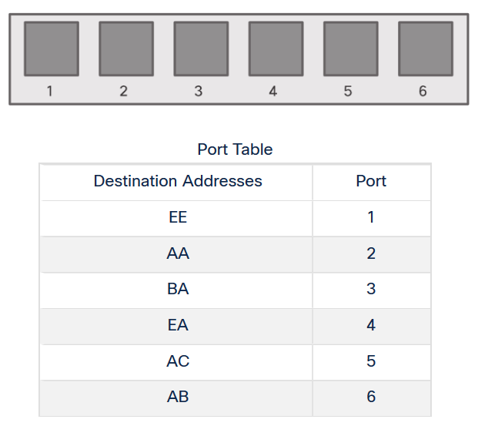
Chapter
01
Frame Forwarding - Switching in Networking
Two terms are associated with frames entering or leaving an interface:
  Ingress – entering the interface
  Egress – exiting the interface

Slide 30
Chapter
01
Frame Forwarding - Switching in Networking
A switch forwards based on the ingress interface and the destination MAC address.
A switch uses its MAC address table to make forwarding decisions.
Note: A switch will never allow traffic to be forwarded out the interface it received the traffic.
A MAC (Media Access Control) address, sometimes referred to as a hardware or physical address, is a unique, 12-character alphanumeric attribute that is used to identify individual electronic devices on a network. An example of a MAC address is: 00-B0-D0-63-C2-26

Slide 31
Chapter
01
Frame Forwarding
The Switch MAC Address Table
A switch will use the destination MAC address to determine the egress interface.
Before a switch can make this decision, it must learn what interface the destination is located.
A switch builds a MAC address table, also known as a Content Addressable Memory (CAM) table, by recording the source MAC address into the table along with the port it was received.

Slide 32
Chapter
01
Frame Forwarding
The Switch Learn and Forward Method
The switch uses a two-step process:
  Step 1. Learn – Examines Source Address
  Adds the source MAC if not in table.
  Resets the time out setting back to 5 minutes if source is in the table.
  Step 2. Forward – Examines Destination Address
  If the destination MAC is in the MAC address table, it is forwarded out the specified port.
  If a destination MAC is not in the table, it is flooded out all interfaces except the one it was received.

Slide 33
Chapter
01
Frame Forwarding
Switch Forwarding Methods
A switch will use one of two methods to make forwarding decisions after it receives a frame:
Store-and-forward switching
Cut-through switching

Slide 34
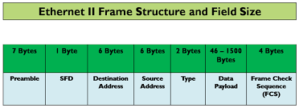
Chapter
01
Ethernet II Frame Structure

Slide 35
Chapter
01
Ethernet II Frame Structure (cont.)
Preamble – informs the receiving system that a frame is starting and enables synchronization.
SFD (Start Frame Delimiter) – signifies that the Destination MAC Address field begins with the next byte.
Destination MAC – identifies the receiving system.
Source MAC – identifies the sending system.
Type – defines the type of protocol inside the frame, for example, IPv4 or IPv6.
Data and Pad – contains the payload data. Padding data is added to meet the minimum length requirement for this field (46 bytes).
FCS (Frame Check Sequence) – contains a 32-bit Cyclic Redundancy Check (CRC) which allows the detection of corrupted data.

Slide 36
Chapter
01
Frame Forwarding
Switch Forwarding Methods
Store-and-forward switching - Receives the entire frame and ensures the frame is valid. Store-and-forward switching is Cisco’s preferred switching method.
Cut-through switching – Forwards the frame immediately after determining the destination MAC address of an incoming frame and the egress port.

Slide 37
Chapter
01
Switch Security
The security of the Ethernet switch is essential since it is the most commonly used layer 2 device in current LANs. Unfortunately, the security of switches is often disregarded.
Network administrators rarely monitor or investigate the operation of layer 2 infrastructures until there is a connectivity issue since they normally consider layer 2 networks can be trusted.
Securities measures typically concentrate on layer 3. For instance, to detect any suspicious activity, intrusion detection systems often inspect layers 3 and 4 communications, particularly TCP/IP packets.

Slide 38
Chapter
01
How Switches can be Attacked ?
Switch attacks are difficult to detect. One of the reasons is that detecting such attacks requires a thorough understanding of how data link protocols work.
For example, to exploit the spanning tree protocol (STP), one must first understand the
roles of a switch port (can be a root, designated, or blocked port) and their possible states (such as forwarding, listening, and learning) in an STP network.

Slide 39
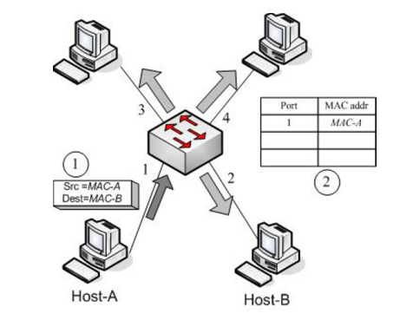
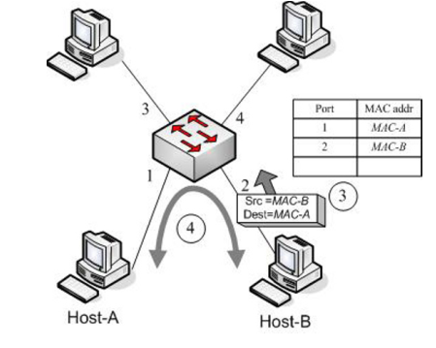
Chapter
01
How Switches can be Attacked?
MAC Flooding
As can be seen, a new entry for the new address will be added to the CAM table whenever a frame arrives with a source MAC address that the switch has never encountered. The table's size is limited. The switch, unlike a hub, will broadcast all the frames to all outbound ports when the table is overloaded rather than relying on it.

Slide 40
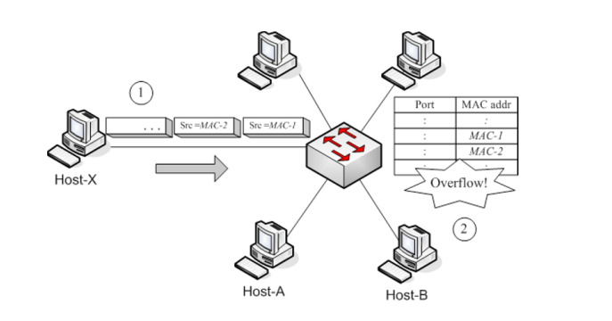
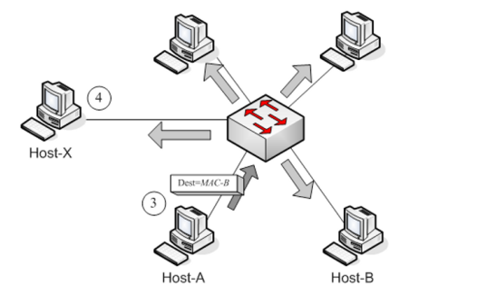
Chapter
01
MAC Flooding mitigation
Limiting the amount of MAC addresses that can be connected to a switch port is a frequent strategy for preventing the MAC flooding attack. High-end switches have a feature called port security that does this. The administrator can determine how many MAC addresses can be linked to a switch port or which MAC addresses are allowed to access a particular port.

Slide 41
Chapter
01
How Switches can be Attacked?
ARP spoofing
When a host wants to send an IP packet to another host on an Ethernet/IP network, simply knowing the destination IP is insufficient. To build and send Ethernet packets into the network, it also needs to know the destination host's MAC address. Therefore, a procedure is needed to determine a host's MAC address from its IP. For this, the Address Resolution Protocol (ARP) is employed.
When Host-A wants to interact with Host-B, in a typical ARP operation, Host-A broadcasts an ARP Request packet asking Host-B, "If you have IP-B, please give your MAC to me.“
The only device that would reply to Host-A directly with an ARP Reply packet in unicast declaring, "I am Host-B, and my MAC is MAC-B," is the device with the given IP address, IP-B.

Slide 42
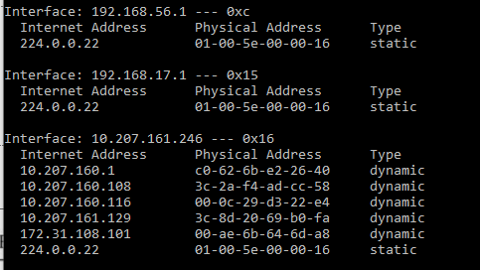
Chapter
01
ARP spoofing (cont. )
Operating systems typically cache resolved addresses for a brief period to minimize the number of ARP requests. A host will examine the ARP cache to see if the required IP-MAC mapping is present before sending an ARP request. If the mapping is present, it won't need to send another ARP request to obtain the corresponding MAC address from the cache. For viewing, adding, or removing items from the ARP cache, Windows has the ARP command which is arp -a
The result of execution of arp –a command

Slide 43
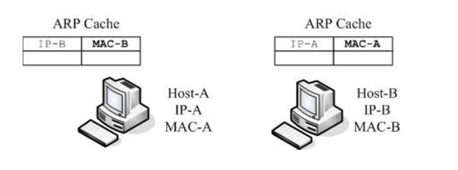
Chapter
01
ARP spoofing (cont. )
Since ARP does not require authentication, whenever a computer receives an ARP reply, it will update its cache regardless of whether it has sent out an ARP request. Therefore, one can easily poison other hosts by sending out an ARP Reply packet with wrong information. Fig. 2.5 shows an example where Host-X is attacking Host-A and Host-B.
Before the attack, the ARP caches of Host-A and Host-B contain the correct mappings

Slide 44
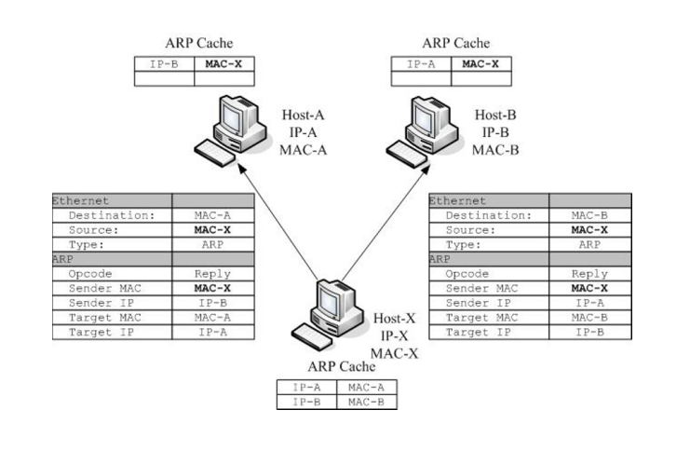
Chapter
01
ARP spoofing (cont. )
To poison the ARP cache of Host-A, Host-X sends Host-A an ARP Reply packet with the wrong mapping: IP-B-to-MAC-X.
Similarly, Host-X sends to Host-B an ARP Reply with the wrong mapping: IP-A-to-MAC-X.
Since ARP does not require authentication, Host-A and Host-B believe that the mappings are valid and update their ARP tables as usual. Now, their ARP caches are poisoned.
Source: [1]

Slide 45
Chapter
01
ARP spoofing (cont. )
As a result, the traffic between Host-A and Host B will be redirected to flow through Host-X first, instead of directly to each other. In this case, Host-x can intercept the traffic between them, even though they are connected using a switch.

Slide 46
Chapter
01
ARP spoofing (cont. )
The attacker can perform the following attack with its cache poisoning.
Man-in-the-middle attack: If Host-X re-routes packets to the correct destination in both directions, Host-A and Host-B will not be aware that the traffic between them is being monitored (or modified) by Host-X.
DoS attack: If Host-X chooses not to re-route packets, it will launch a Denial of Service (DoS) attack because Host-A and Host-B could not communicate with each other anymore. However, since no traffic happens to Host-A and Host-B, the corresponding entries in the ARP caches will be timeout. To keep denying of the service, Host-X
has to continue poisoning their ARP caches (i.e., repeat the above process) regularly.

Slide 47
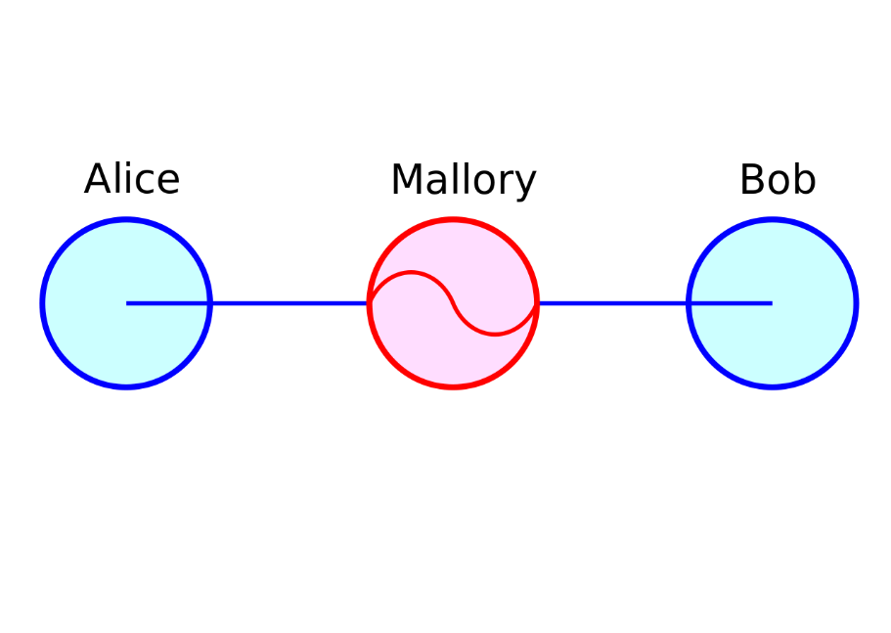
Chapter
01
Overview of MITM
A man-in-the-middle (MITM) attack is a general term for when an attacker positions himself in a conversation between a user and an application—either to eavesdrop or to impersonate one of the parties, making it appear as if a normal exchange of information is underway. The goal of an attack is to steal personal information, such as login credentials, account details, and credit card numbers

Slide 48
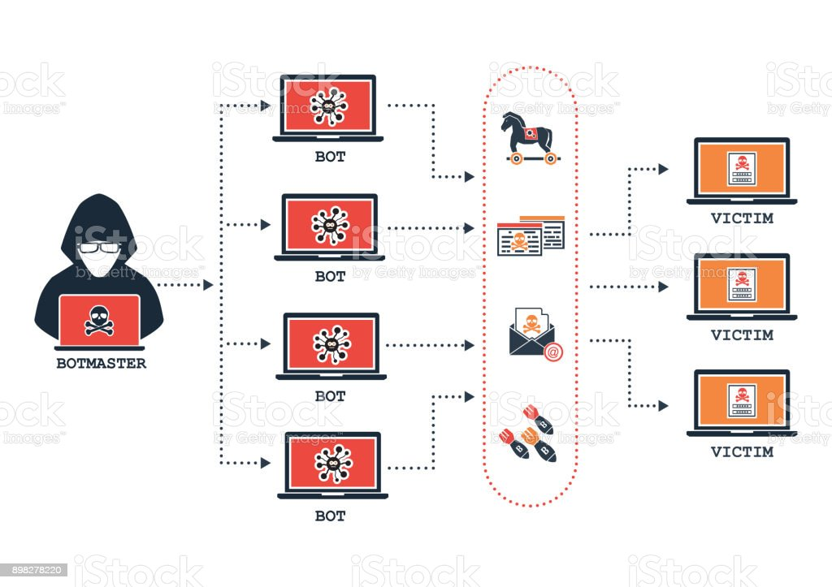
Chapter
01
Overview of DoS and DDoS
A denial-of-service (DoS) attack floods a server with traffic, making a website or resource unavailable. A distributed denial-of-service (DDoS) attack is a DoS attack that uses multiple computers or machines to flood a targeted resource. Both types of attacks overload a server or web application with the goal of interrupting services.

Slide 49
Chapter
01
DoS vs DDoS
There are other differences, however, involving either their nature or detection, including:
1. Ease of detection/mitigation:
Since a DoS comes from a single location, it is easier to detect its origin and sever the connection. In fact, a proficient firewall can do this. On the other hand, a DDoS attack comes from multiple remote locations, disguising its origin.
2. Speed of attack:
Because a DDoS attack comes from multiple locations, it can be deployed much faster than a DoS attack that originates from a single location. The increased speed of attack makes detecting it more difficult, meaning increased damage or even a catastrophic outcome.

Slide 50
Chapter
01
DoS vs DDoS (cont. )
3. Traffic volume:
A DDoS attack uses multiple remote machines (zombies or bots), which enables it to deliver significantly more traffic from various places at once and quickly overload a server while evading detection.
4. Manner of execution:
Multiple hosts that have been infected with malware (bots) are coordinated by a DDoS attack to form a botnet that is controlled by a command-and-control (C&C) server. A DoS attack, on the other hand, usually employs a script or tool to execute the attack from a single machine.
5. Tracing of source(s):
The use of a botnet in a DDoS attack means that tracing the actual origin is much more complicated than tracing the origin of a DoS attack.

Slide 51
Chapter
01
ARP spoofing mitigation
Static ARP Entries:
  To prevent spoofing, the ARP cache can store static IP-MAC mappings. As the entries are non-changing, any spoofed ARP replies will be ignored. This concept works; however, requiring the ARP cache to always keep up-to-date IP-MAC mappings of every computer on the network makes this solution impractical for
  most networks.
Detection:
  To detect possible ARP spoofing-based attack, the IP-MAC mappings for the machines on the network can be monitored. There are programs, such as ARPWatch (http://www.securityfocus.com/tools/142), to do that. When any suspicious changes of the mappings occur, the program will notify the administrator to investigate.

Slide 52
Chapter
01
ARP mitigation (cont. )
No Cache Update:
  A simple and practical solution is to only accept ARP replies and update the entries in the cache when they are expired (after the timeout period). In this case, in order to poison the ARP cache, the attacker must send an ARP reply packet faster than the legitimate host do, making the spoofing process difficult.

Slide 53
Chapter
01
Network Infrastructure Security -- DHCP
Dynamic Host Configuration Protocol (DHCP) is used to automatically configure client machines with a dynamically assigned IP address and other network configuration parameters, such as the default gateway and DNS server addresses, during their boot time. It eliminates the need for network administrators to keep track of individual client IP addresses.
Network administrators used to statically assign an IP address to each client machine in the past (before DHCP), and users had to manually set up their machines with the provided IP address. This technique makes incorrect configuration common and necessitates educated users.

Slide 54
DHCP Operations
The proper functioning of DHCP is essential. Users may be configured with false network information, such as the incorrect name server address if it is exploited, posing a security risk.
1. The network administrator only needs to set up the DHCP server with the required network configuration data and a pool of IP addresses.
2. If DHCP is enabled, a client computer will automatically request the DHCP server for an IP address when it boots up.
3. The server will then select an available address from the pool and response the
client with the selected address and other network configuration information.

Slide 55
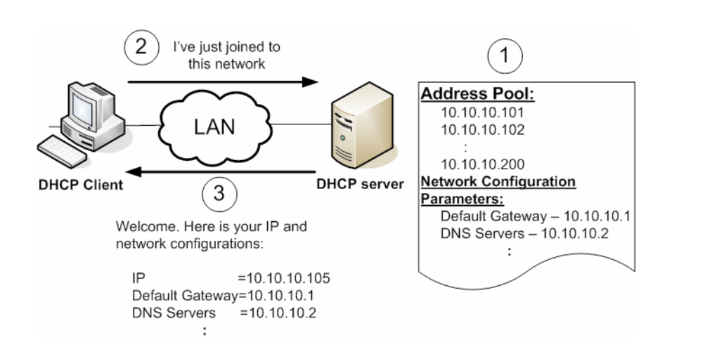
DHCP Operations (cont.)

Slide 56
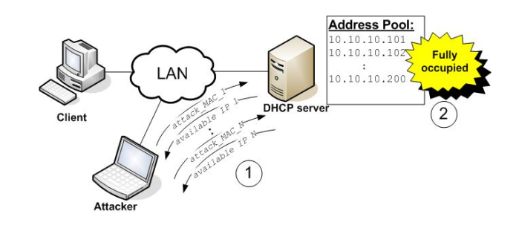
Chapter
01
Denial of Service Attack using Address Starvation
The attacker can carry out this attack by repeatedly sending DHCP requests to the DHCP server with different (forged) MAC addresses.
Since the server treats each request with a new MAC as a new network client and assigns it an IP address, the address pool will eventually be fully allocated after the attacker sends a significant number of requests.
Any new valid client won't be able to get an IP address as a result because there are no more addresses accessible. It is a kind of denial of service attack -- denial of clients from having DHCP service.

Slide 57
Chapter
01
Man-in-the-middle Attack using Rogue DHCP server
There is no DHCP server authentication and DHCP clients do not know the DHCP server address when they are booted up. Therefore, an attacker can set up its own DHCP server pretending to be the legitimate one and return the client with a fake default gateway address. It can allow the attacker to intercept all network traffic.
The attacker first grabs an IP address from the legitimate DHCP server for future use. It runs its rogue DHCP server.
When a DHCP client broadcast a DHCP DISCOVERY packet, both the legitimate and the rogue servers send a DHCPOFFER to the client.

Slide 58
Chapter
01
Man-in-the-middle Attack using Rogue DHCP server (cont. )
The client accepts the response from whichever DHCP responds first. If the client uses the one from the legitimate server, this attack will be in failure. To ensure the client accepts the response from the rogue server, the attacker can first deny the service from the legitimate server using the address starvation attack mentioned above.
In the rogue server's response, the default gateway address points to the attacker's own machine.
5. Then, whenever the client has packets to the destinations outside the local network, the packets will be sent to the rogue default gateway that would capture the content of the packets.

Slide 59
Chapter
01
Man-in-the-middle Attack using Rogue DHCP server (cont. )
The rogue default gateway needs to rewrite the packets and forward them to the correct default gateway so that the destination will not know there is a "man" in the middle intercepting the packets.
However, the packets from the destination will go through the correct default gateway, which will forward the packets directly to the attacked client.
Therefore, the rogue gateway cannot see any incoming packets, which is the limitation of this attack.

Slide 60
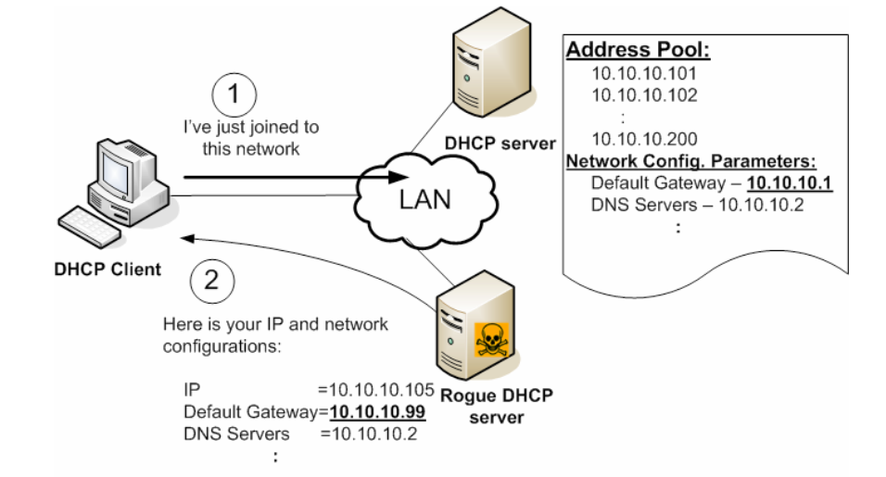
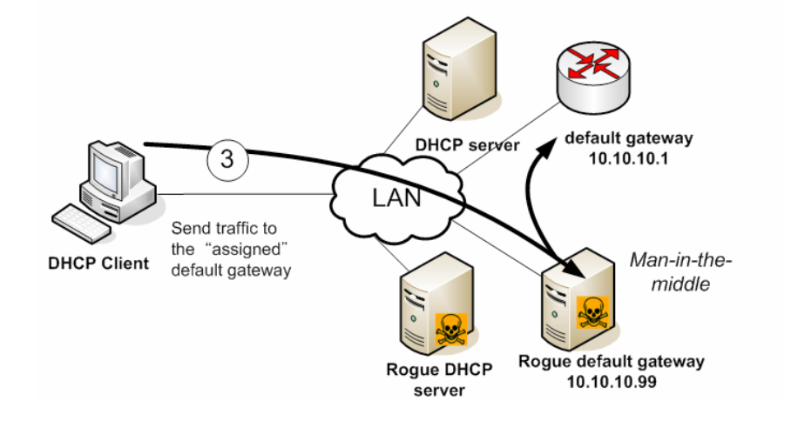
Chapter
01
Man-in-the-middle Attack using Rogue DHCP server (cont. )
Man-in-the-middle attack using a rogue DHCP server

Slide 61
Chapter
01
Man-in-the-middle Attack using Rogue DHCP server (cont. ) – mitigation
Some Cisco switches have a DHCP security feature to prevent this exploit. The switch can be informed of which ports are attached to a DHCP server using a feature known as DHCP snooping.
These are known as trusted ports. The switch disables DHCP answers on untrusted ports and only permits those ports to respond to DHCP queries. It stops client computers from pretending as DHCP servers when they are not connected to trusted ports.

Slide 62
Network Infrastructure Security -- DNS
The Domain Name System (DNS) is the phonebook of the Internet. Humans access information online through domain names, like nytimes.com or espn.com. Web browsers interact through Internet Protocol (IP) addresses.
DNS translates domain names to IP addresses so browsers can load Internet resources. Each device connected to the Internet has a unique IP address that other machines use to find the device.
DNS servers eliminate the need for humans to memorize IP addresses such as 192.168.1.1 (in IPv4), or more complex newer alphanumeric IP addresses such as 2400:cb00:2048:1::c629:d7a2 (in IPv6).
Source : Cloudflare
Notes:
The Internet Protocol (IP) is a protocol, or set of rules, for routing and addressing packets of data so that they can travel across networks and arrive at the correct destination.

Slide 63
Chapter
01
Network Infrastructure Security – DNS (cont)
What is DNS security?
DNS security is the practice of protecting DNS infrastructure from cyberattacks in order to keep it performing quickly and reliably.
An effective DNS security strategy incorporates a number of overlapping defenses, including establishing redundant DNS servers, applying security protocols like DNSSEC, and requiring rigorous DNS logging.
Source : Cloudflare

Slide 64
Why is DNS security important?
Like many Internet protocols, the DNS system was not designed with security in mind and contains several design limitations.
These limitations, combined with advances in technology, make DNS servers vulnerable to a broad spectrum of attacks, including spoofing, amplification, DoS (Denial of Service), or the interception of private personal information. And since DNS is an integral part of most Internet requests, it can be a prime target for attacks.
In addition, DNS attacks are frequently deployed in conjunction with other cyberattacks to distract security teams from the true target. An organization needs to be able to quickly mitigate DNS attacks so that they are not too busy to handle simultaneous attacks through other vectors.
Source : Cloudflare

Slide 65
DNS -based attacks
DNS spoofing/cache poisoning: This is an attack where forged DNS data is introduced into a DNS resolver’s cache, resulting in the resolver returning an incorrect IP address for a domain. Instead of going to the correct website, traffic can be diverted to a malicious machine or anywhere else the attacker desires; often this will be a replica of the original site used for malicious purposes such as distributing malware or collecting login information.
DNS tunneling: This attack uses other protocols to tunnel through DNS queries and responses. Attackers can use SSH, TCP, or HTTP to pass malware or stolen information into DNS queries, undetected by most firewalls.
Source : Cloudflare

Slide 66
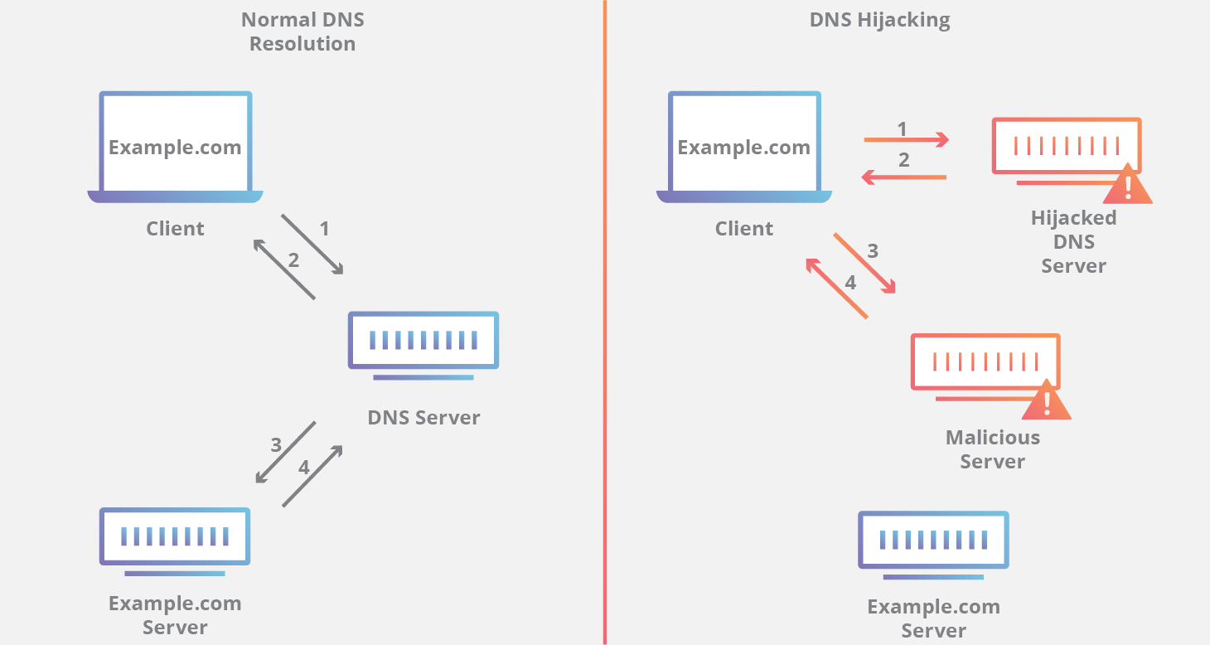
DNS -based attacks (cont.)
DNS hijacking: In DNS hijacking the attacker redirects queries to a different domain name server. This can be done either with malware or with the unauthorized modification of a DNS server. Although the result is similar to that of DNS spoofing, this is a fundamentally different attack because it targets the DNS record of the website on the nameserver, rather than a resolver’s cache.

Slide 67
DNS Security Extensions (DNSSEC)- mitigation
What is DNSSEC?
DNS Security Extensions (DNSSEC) is a security protocol created to mitigate this problem. DNSSEC protects against attacks by digitally signing data to help ensure its validity. In order to ensure a secure lookup, the signing must happen at every level in the DNS lookup process.
This signing process is similar to someone signing a legal document with a pen; that person signs with a unique signature that no one else can create, and a court expert can look at that signature and verify that the document was signed by that person. These digital signatures ensure that data has not been tampered with.

Slide 68
DNS Security Extensions (DNSSEC)- mitigation
DNSSEC implements a hierarchical digital signing policy across all layers of DNS.
For example, in the case of a ‘google.com’ lookup, a root DNS server would sign a key for the.COM nameserver, and the.COM nameserver would then sign a key for google.com’s authoritative nameserver.
While improved security is always preferred, DNSSEC is designed to be backward-compatible to ensure that traditional DNS lookups still resolve correctly, albeit without the added security. DNSSEC is meant to work with other security measures like SSL/TLS as part of a holistic Internet security strategy.

Slide 69
Chapter
01
Refences
[1] Wong, Angus, and Alan Yeung. Network infrastructure security. Springer Science & Business Media, 2009.
[2] Vincent Nestler, Gregory White, wm. Arthur Conklin, Principles of Computer Security: CompTIA Security+ and Beyond – Lab Manual, ISBN: 978-0-07-174856-8, MHID: 0-07-174856-3, McGraw Hill, 2011

Slide 70

Thank you

