Slide 1



Operational & Strategic Risk Management
PMG630
Lecture 1
Prepared by
Dr. Nael Zabel
www.midocean.ae

Slide 2
Introduction to operational risk
Brief History Of Operational Risk:
In the early 1990s, the term operational risk was first officially used in
the finance industry with the purpose of identifying fraudulent financial
reporting. However, by the early 2010s, operational risk, and the
management thereof, has acquired a broader description and acceptance.
Nowadays, it can be broadly described as having the goal to reduce or
mitigate the possibility of something going wrong in any type of operation
including, but not limited to, financial operations.

Slide 3
Operational Risk
What Is Operational Risk?
Operational risk is the risk of loss resulting from ineffective or failed internal processes, people, systems, or external events that can disrupt the flow of business operations.
Operational risk can refer to both the risk in operating an organization and the processes management uses when implementing, training, and enforcing policies.

Slide 4
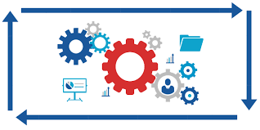
Operational Risk Goal
The goal in the operational risk management function is to focus on the risks that have the most impact on the organization and to hold accountable employees who manage operational risk.

Slide 5
Hazards, Risks, and Accidents
Hazards, Risk, and Accidents:
These three terms—accidents, hazards, and risks—are very important, related, but distinct concepts that form the foundation of operational risk management.

Slide 6
Hazards, Risks, and Accidents
A hazard is any source of potential damage, harm or adverse health effects on something or someone.
Basically, a hazard is the potential for harm or an adverse effect (for example, to people as health effects, to organizations as property or equipment losses, or to the environment).

Slide 7
Hazards, Risks, and Accidents
Risk is the chance or probability that a person will be harmed.
or experience an adverse health effect if exposed to a hazard. It may also apply to situations with property or equipment loss, or harmful effects on the environment.

Slide 8
Hazards, Risks, and Accidents
Accidents:
An unforeseen and unplanned event or circumstance Their meeting was an accident.
Lack of intention or necessity : chance They met by accident rather than by design.
An unfortunate event resulting especially from carelessness or ignorance was involved in a traffic accident.

Slide 9
Examples of operational
Operational Risk Include:
  Employee conduct and employee error.
  Breach of private data resulting from cybersecurity attacks.
  Technology risks tied to automation, robotics, and artificial intelligence.
  Business processes and controls.
  Physical events that can disrupt a business, such as natural catastrophes.
  Internal and external fraud.

Slide 10
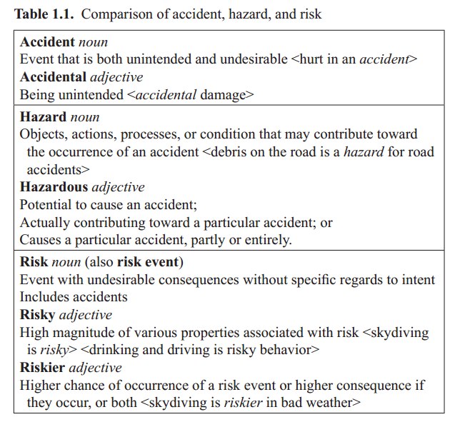

Slide 11
Importance Of systems approach
What is a system?
  A system can be described as a collection of interrelated elements contributing toward a common goal.
  As an example, an automobile can be described as a system made up of a collection of elements (transmission, power, electronics, and other elements) all contributing toward the common goal of transporting passengers and cargo.

Slide 12
ways to characterize a system
2. What are the ways to characterize a system?
  A system can be characterized by the means of the elements that make them up, their objectives, or the nature of their interrelationships.
  For example, a modern automobile can be characterized by its automatic transmission, four-wheel drivetrain, electronic ignition, six cylinder engines, antilock brakes, and other elements that make up the particular automobile.
  This same system can also be characterized by how its elements work together.

Slide 13
systems approach
3.What is a systems approach?
  A systems approach pertains to the approach of analyzing an entity by recognizing the elements that make it up, their objectives and their interrelationships. This approach is often employed by analysts in various fields or disciplines of applied sciences, for example, engineering, pure sciences, and social sciences.

Slide 14
Recognizing goals And objectives
4.What is the importance of recognizing goals And objectives?
  For the purpose of operational risk management, recognizing goals and objectives of elements as individuals and the system that they form as a whole would lend credibility to an analyst’s statement of whether the events are intentional or not and if the consequences are desirable or undesirable. As the previous section emphasized, intent and consequences are important in describing accidents, hazards, and risks, which can be separately viewed as obstacles or impediments to the achievement of goals and objectives.

Slide 15
recognizing interrelationships among elements of a system
5.What is the importance of recognizing interrelationships among elements of a system?
  Part of effective operational risk management is understanding the sequence of events that eventually lead to accidents. This sequence of events, in many ways, is within the realm of how various elements of the system are interrelated. This recognition of sequence of events is import-ant in any attempt to prevent the occurrence of a risk event or reduce the consequence if it does occur.

Slide 16
recognizing system boundaries
6.What is the importance of recognizing system boundaries?
  Part of operational risk management, particularly the management aspect, implies some degree of control on how elements of a system will behave or relate to each other. Recognizing system boundaries is an acknowledgement of the degree of control one may have over these elements. Elements that, for some reason or another, do not lend themselves to control and are often designated as outside the system boundary.

Slide 17
Operational Risk and Operational Risk Management
1 . what is operation?
  In the context of a systems approach, operation can be described as a sequence of processes designed to attain the objectives of the elements or the system as a whole. The operation of an automobile may be described as processes in the following sequence:
All these processes are part of operating an automobile to transport passengers and cargo. In a production system, operations may pertain to the sequence of processes—obtaining raw materials, performing mechanical and chemical processes, storage, inspection, movement, and eventual delivery to the users—all designed to attain the goals of the production system.

Slide 18
operations management
2. What is operations management?
  Operations management pertains to the design and control of the operations, usually in the area of production and providing services. As an example, in building a new production line, part of operations management is the design (or procurement) of the machines that will be needed, the identification of needed skills and the hiring of personnel with these skills, the raw materials needed, and a multitude of other items. Once this production line is physically installed, part of operations management is the control of the production line to produce the product that it is designed to produce at the right quantity and quality and at the right time.

Slide 19
objectives of operations management
3. What are the objectives of operations management?
  The overall objective of operations management on a particular system is to design and control operations to attain the system goals. For a production system, some of these goals are possibly the following:
    • Minimize total cost of production.
    • Minimize disruption in delivery of finished products.
    • Minimize the number of defective products.
    • Maximize return (e.g., profit).

Slide 20
operational risk management
4. What is operational risk management?
  The concept of risk has been described earlier, simply as potential events with undesirable consequences (noun). The following are some of the ways of describing operational risks:
  “the risk of loss resulting from inadequate or failed internal
  processes, people, and systems or from external events”
  “a measure of the link between a firm’s business activities and
  the variation in its business results.

Slide 21
Examples of operational
Operational Risk Include:
  Employee conduct and employee error.
  Breach of private data resulting from cybersecurity attacks.
  Technology risks tied to automation, robotics, and artificial intelligence.
  Business processes and controls.
  Physical events that can disrupt a business, such as natural catastrophes.
  Internal and external fraud.

Slide 22
classification Of Operational Risk events
  Operational risk events are often classified in some manner to help analysts and managers to better address the risks. The manner of categorization depends on the field of application and industry. One way to categorize operational risks is by identifying distinct elements of the system that can be construed as the primary cause of the risk event.

Slide 23
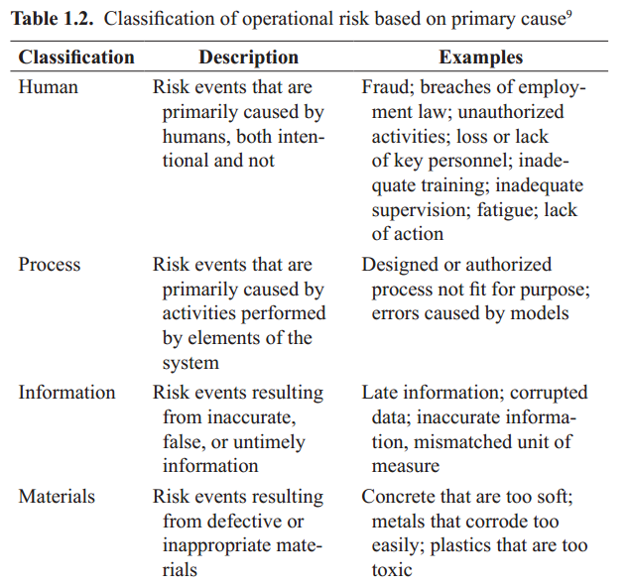

Slide 24
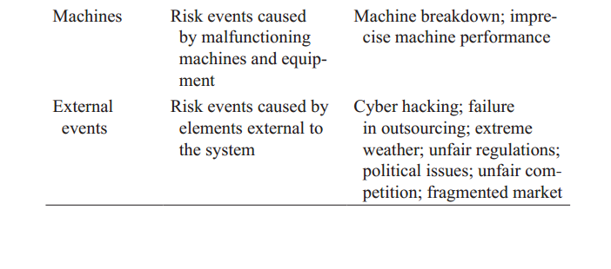

Slide 25
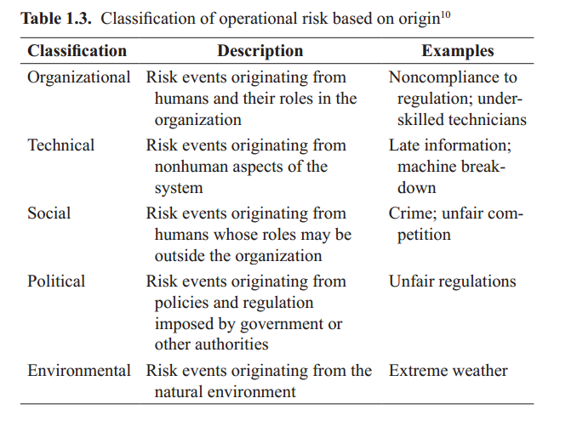

Slide 26
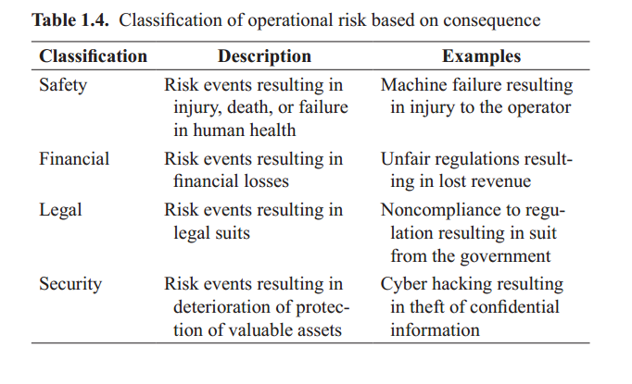

Slide 27
References
Resources:
Operational Risk Management
C. Ariel Pinto
Luna Mylene Magpili
Raed M. Jaradat
Chapter 1

