Slide 1


Slide 2


Slide 3
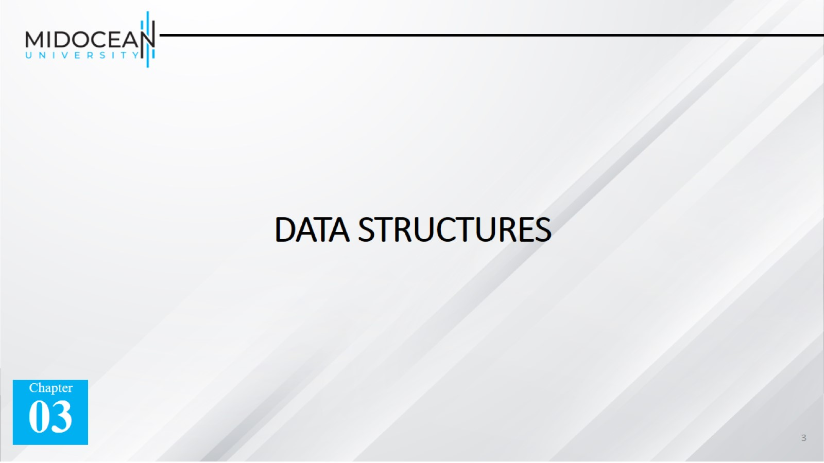
DATA STRUCTURES

Slide 4
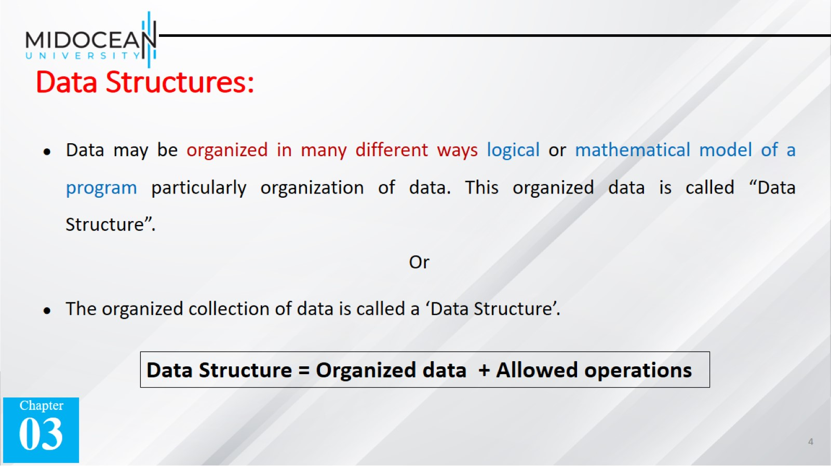
Data Structures:

Slide 5


Slide 6
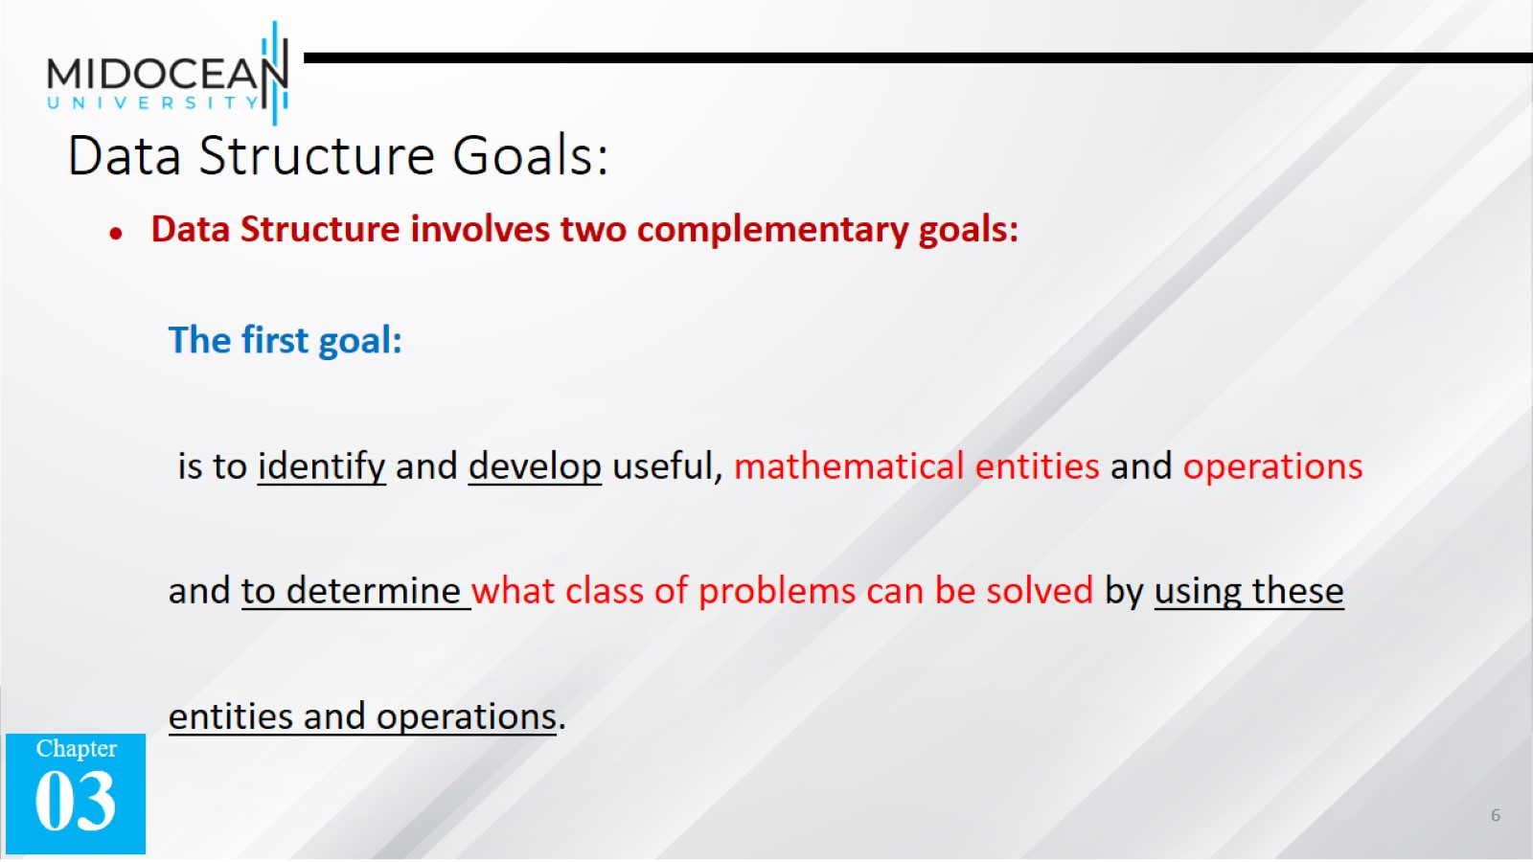
Data Structure Goals:

Slide 7
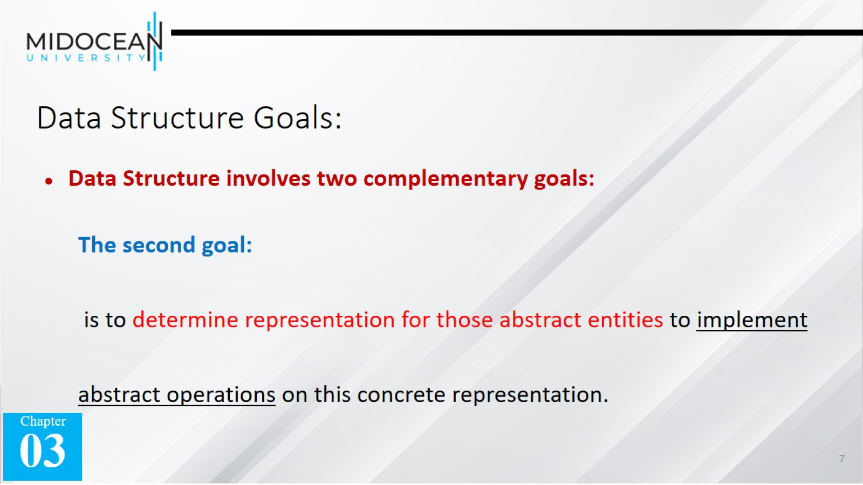
Data Structure Goals:

Slide 8
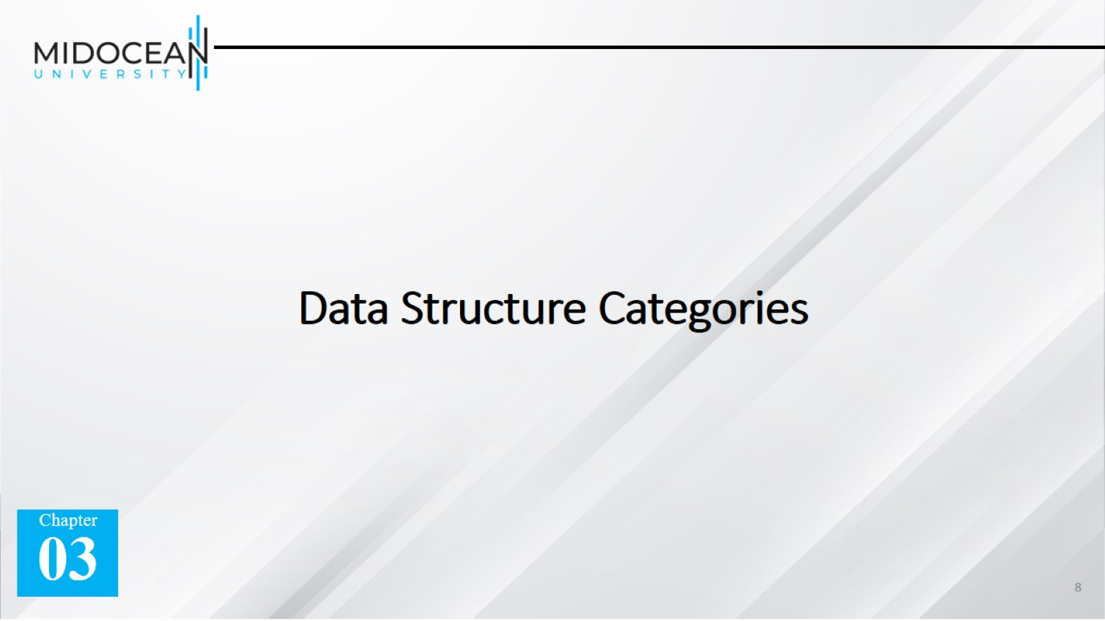
Data Structure Categories

Slide 9
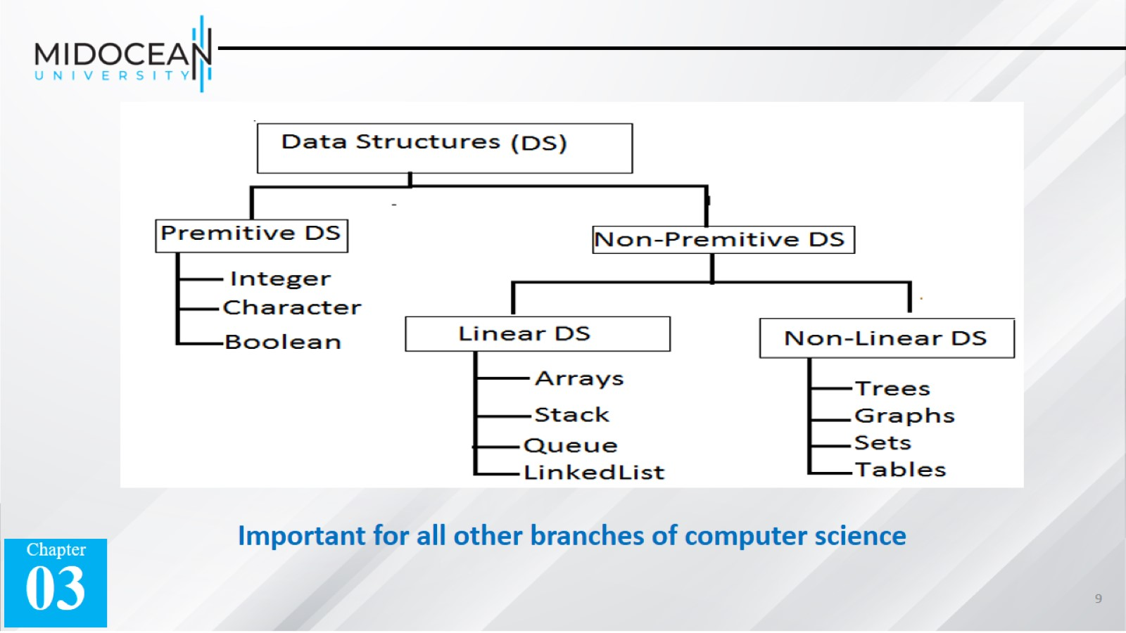

Slide 10
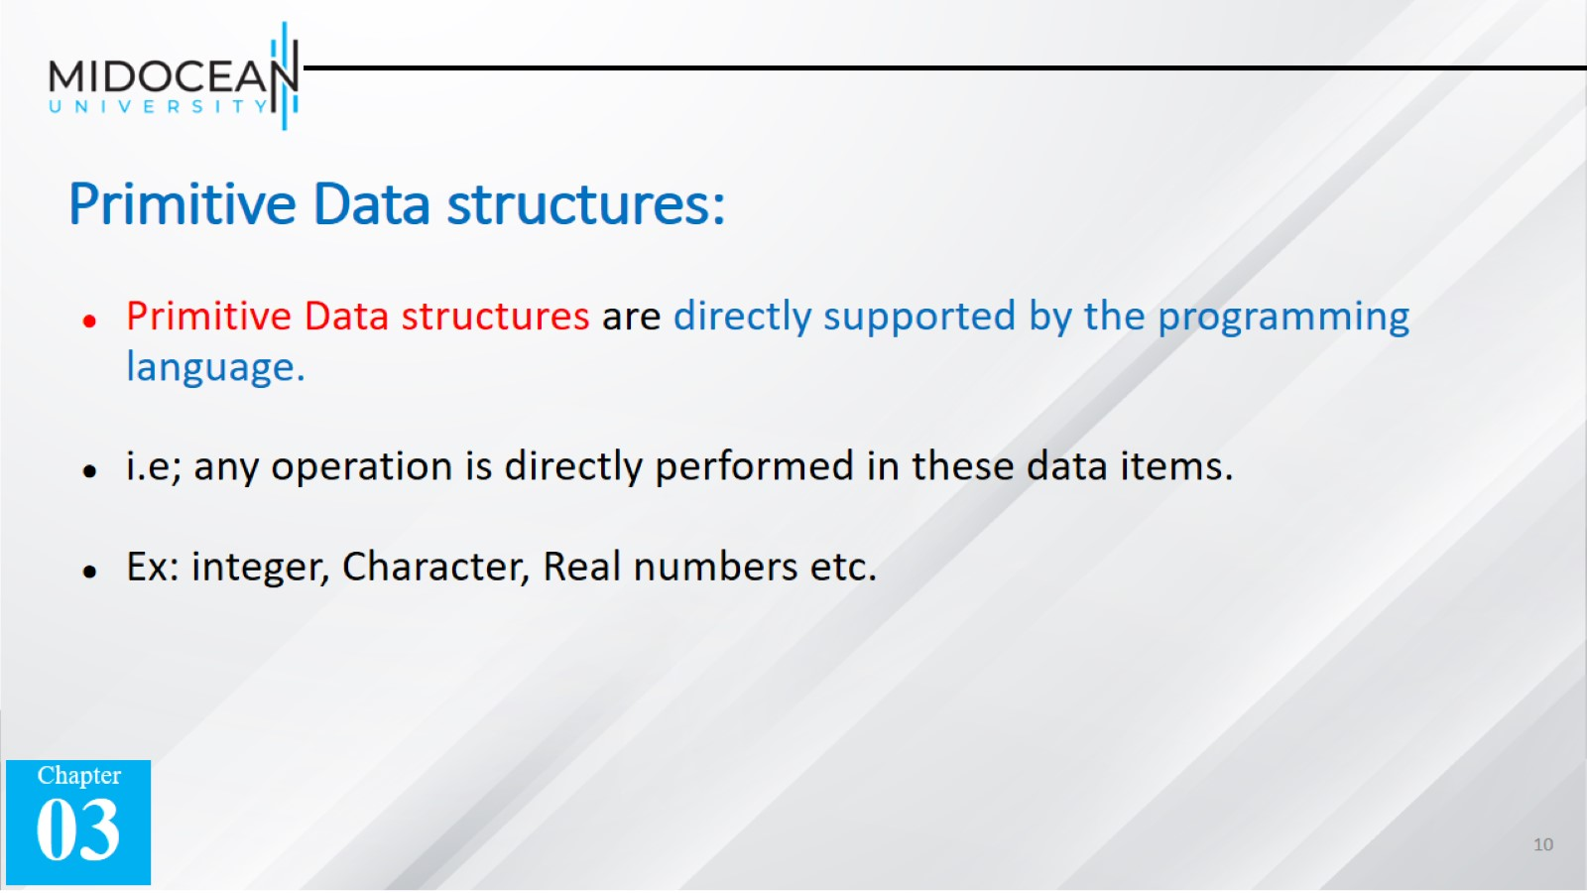
Primitive Data structures:

Slide 11
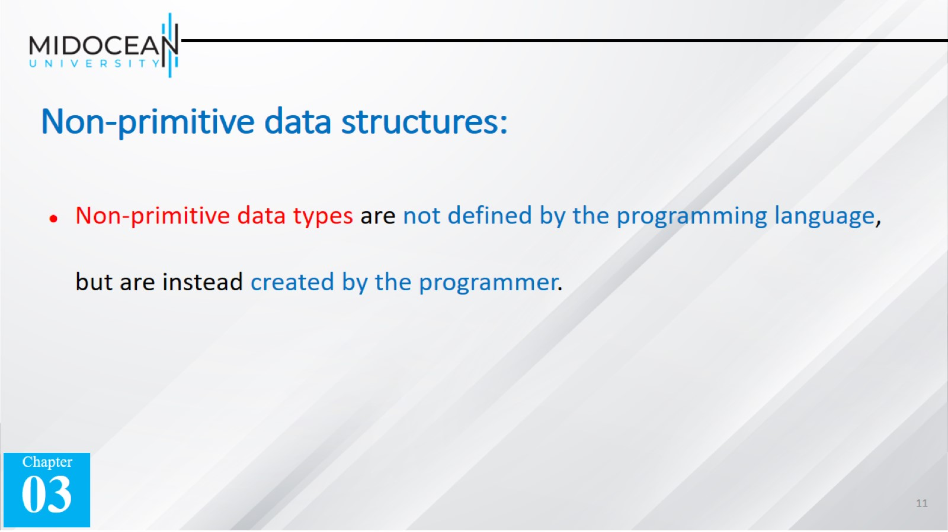
Non-primitive data structures:

Slide 12
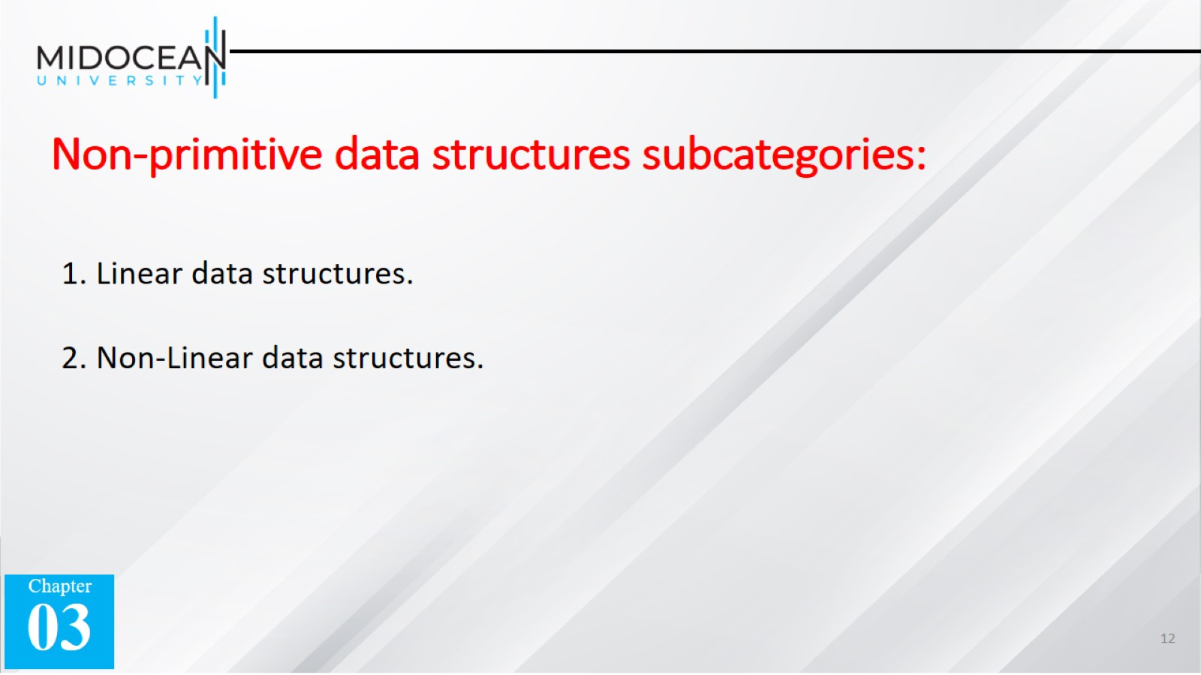
Non-primitive data structures subcategories:

Slide 13
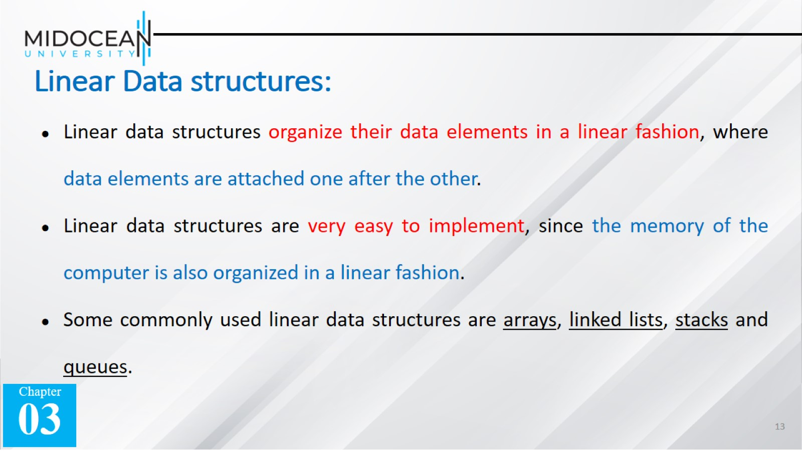
Linear Data structures:

Slide 14
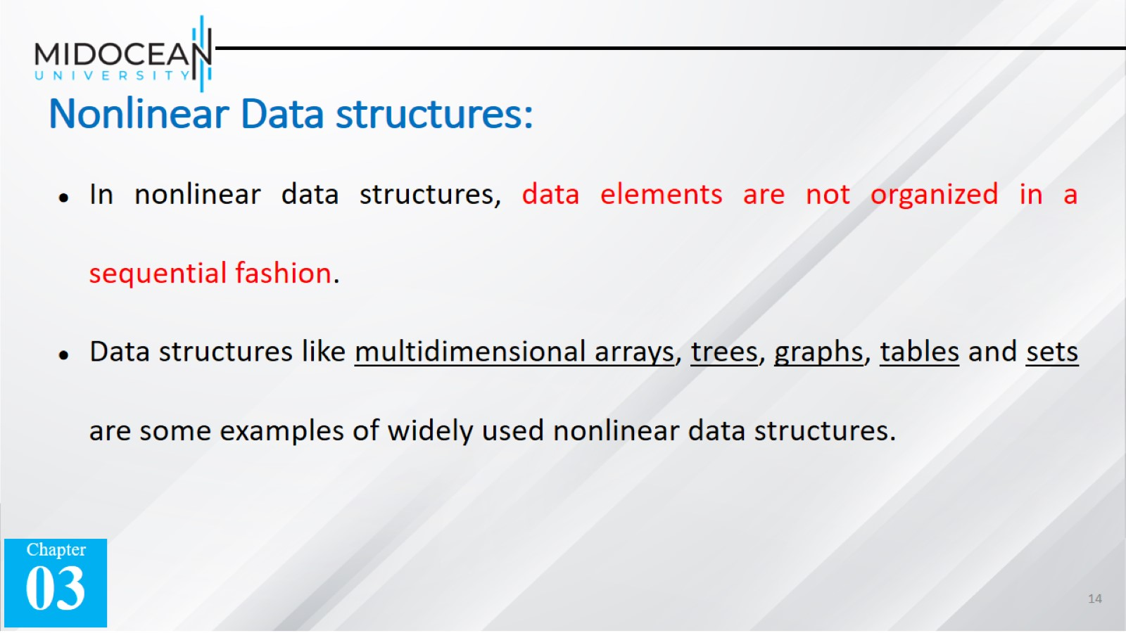
Nonlinear Data structures:

Slide 15


Slide 16
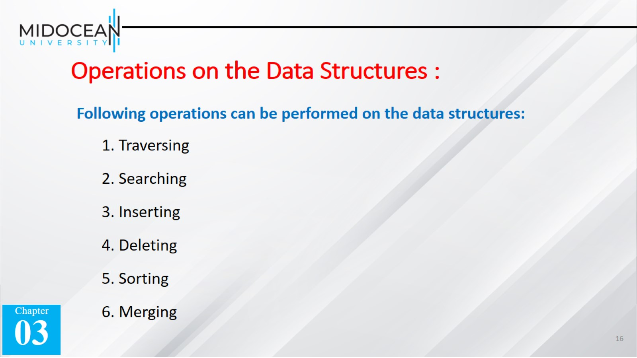
Operations on the Data Structures :

Slide 17
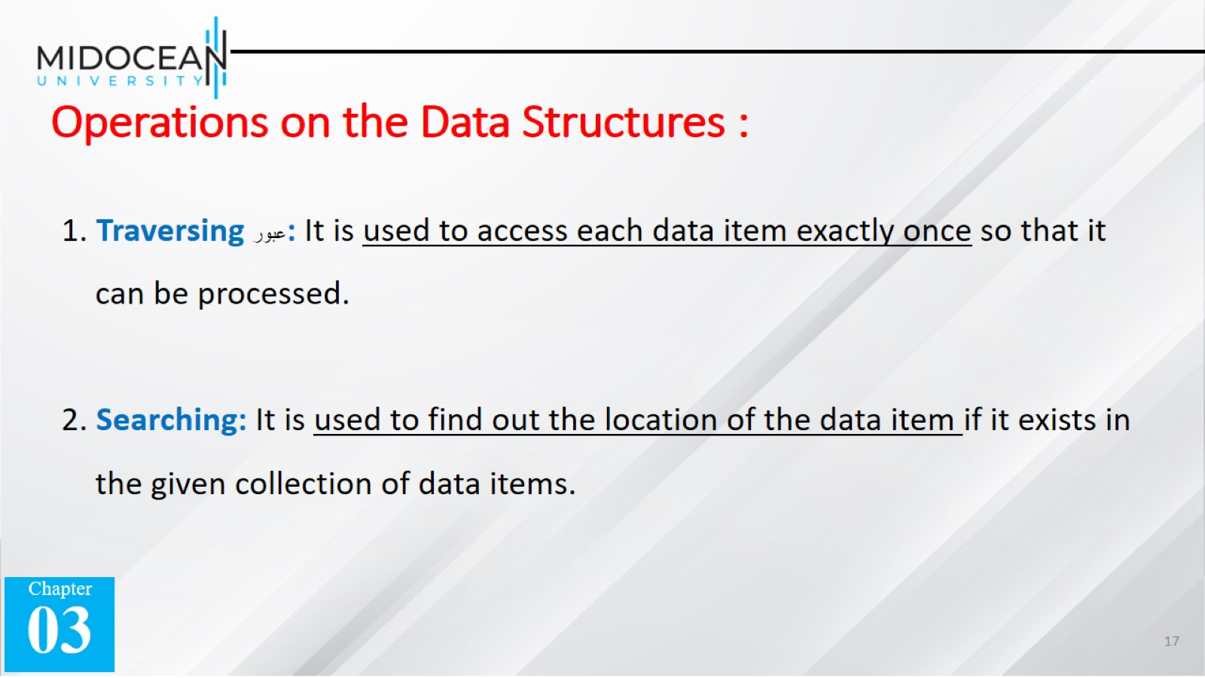
Operations on the Data Structures :

Slide 18
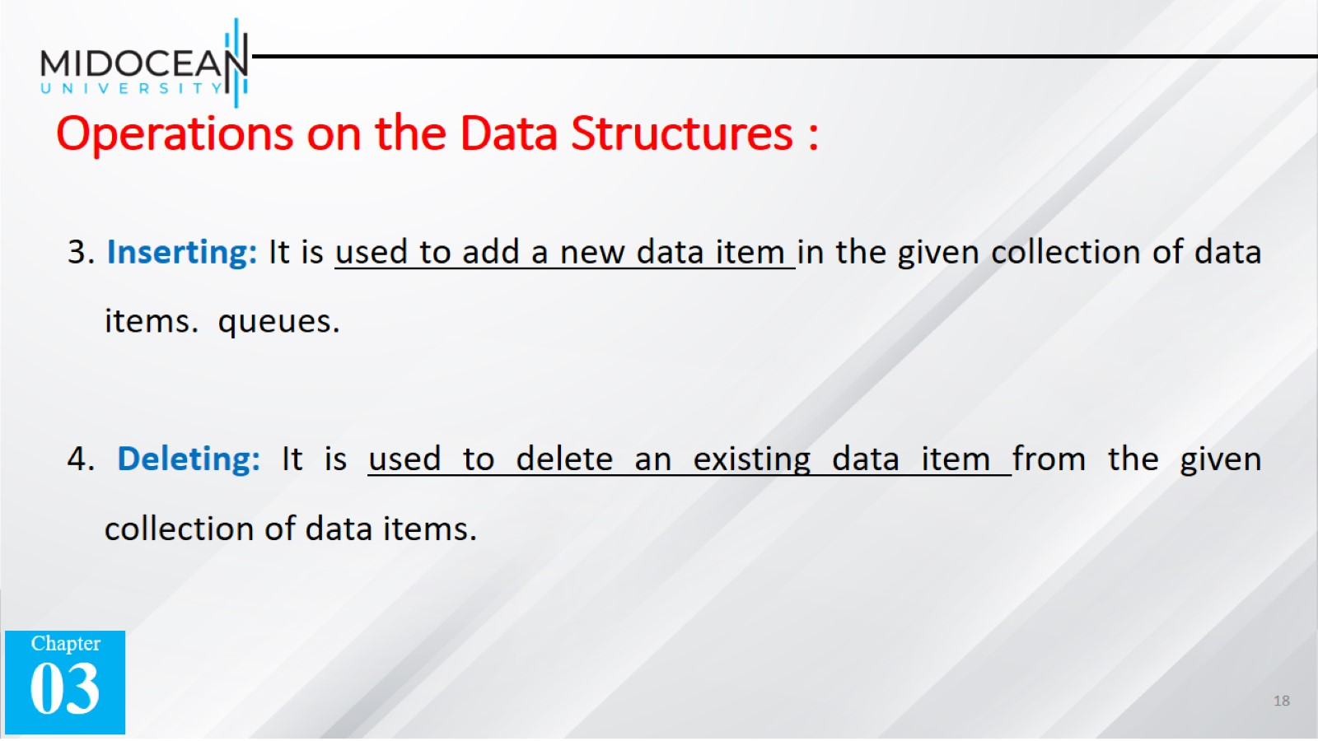
Operations on the Data Structures :

Slide 19
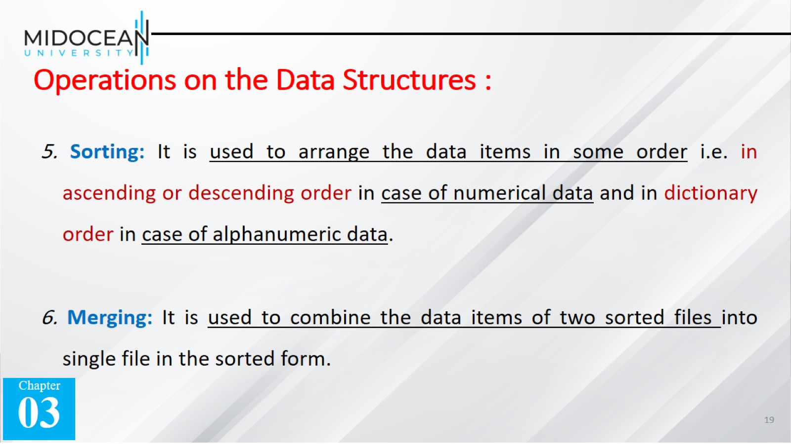
Operations on the Data Structures :

Slide 20
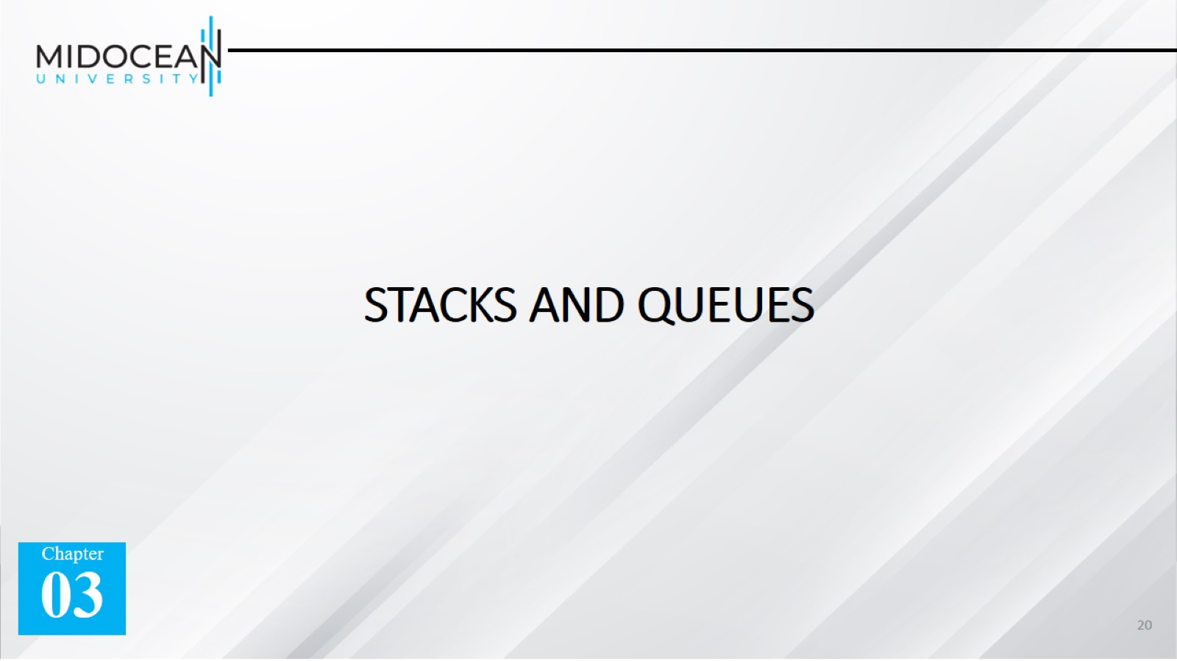
STACKS AND QUEUES

Slide 21


Slide 22
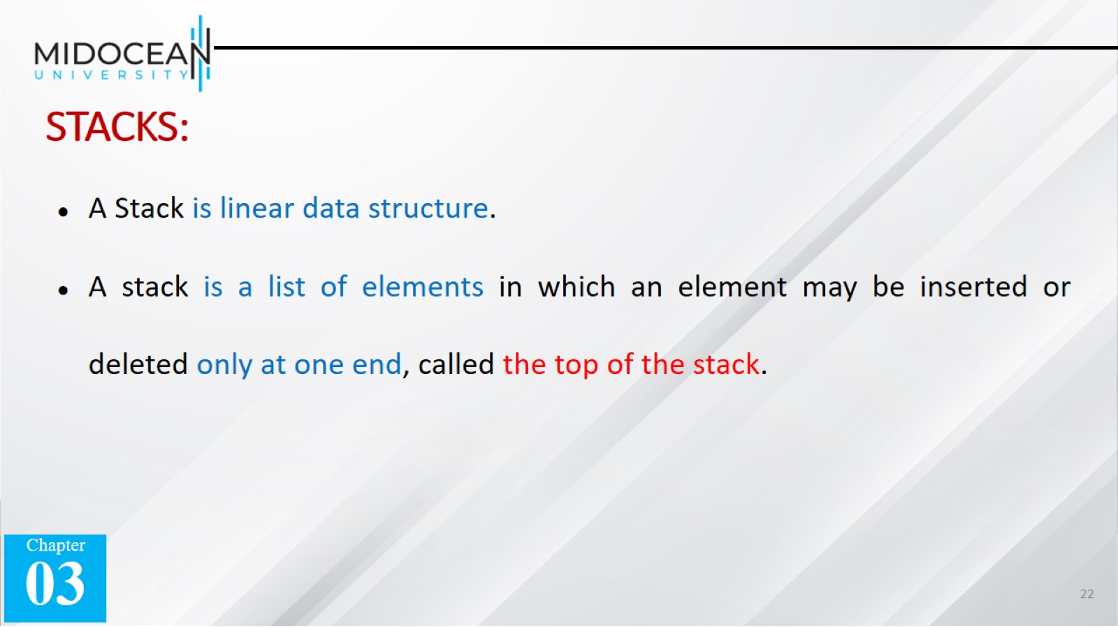
STACKS:

Slide 23
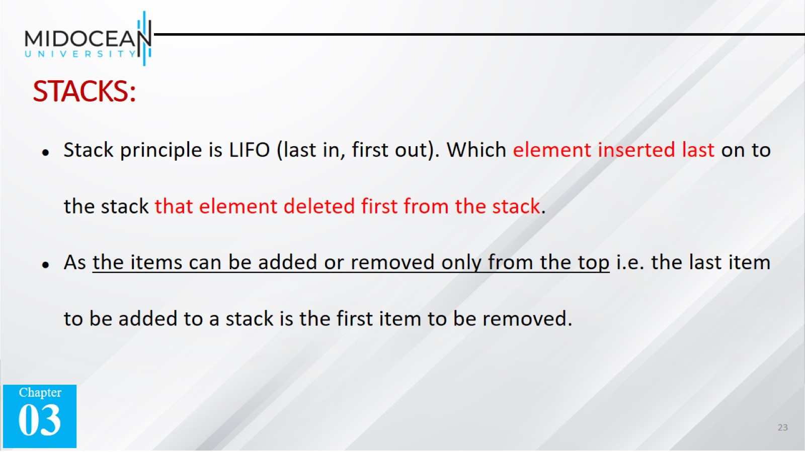
STACKS:

Slide 24
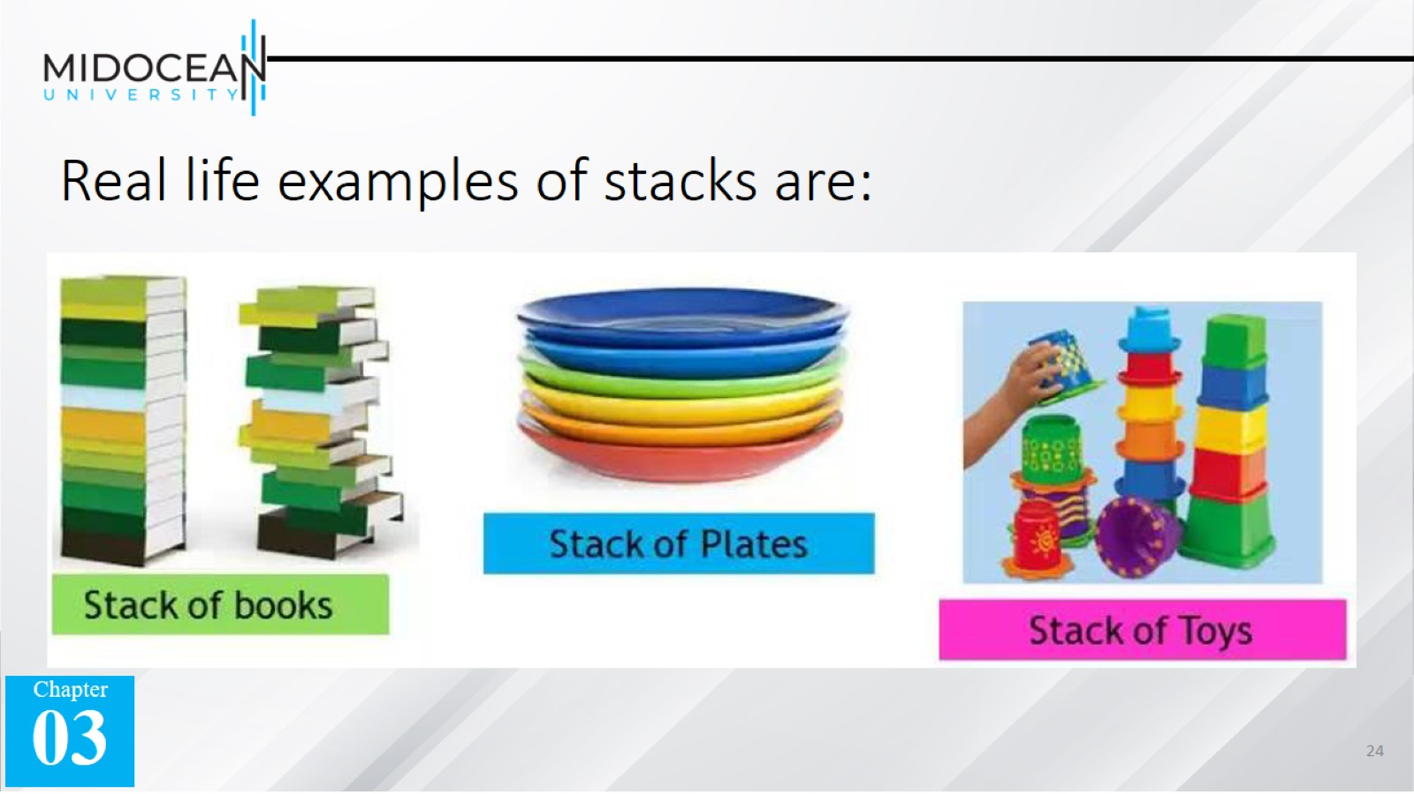
Real life examples of stacks are:

Slide 25
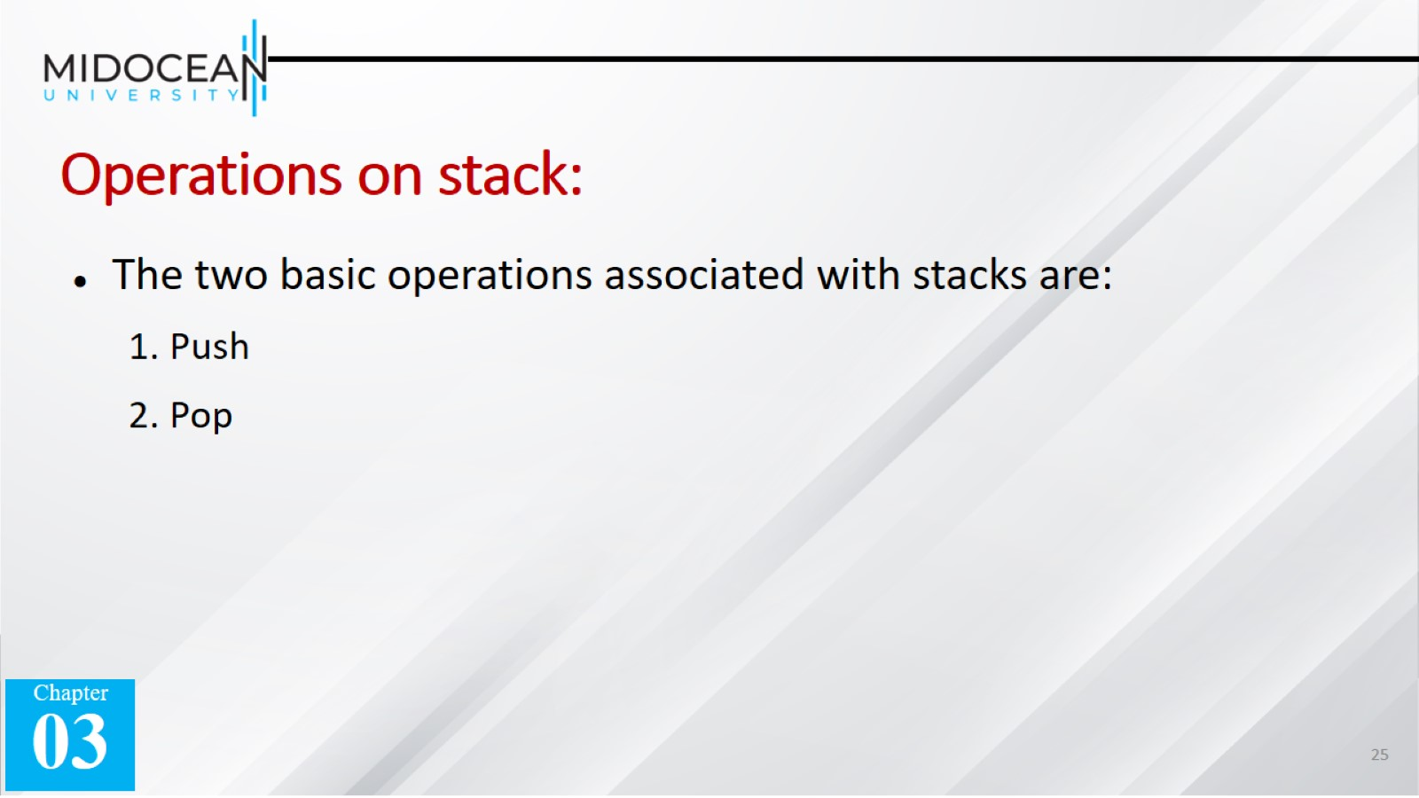
Operations on stack:

Slide 26
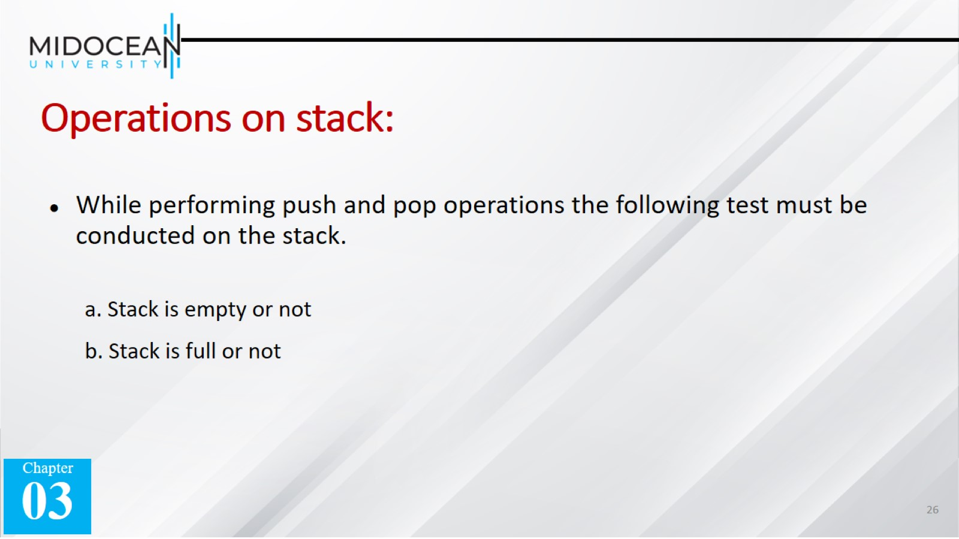
Operations on stack:

Slide 27
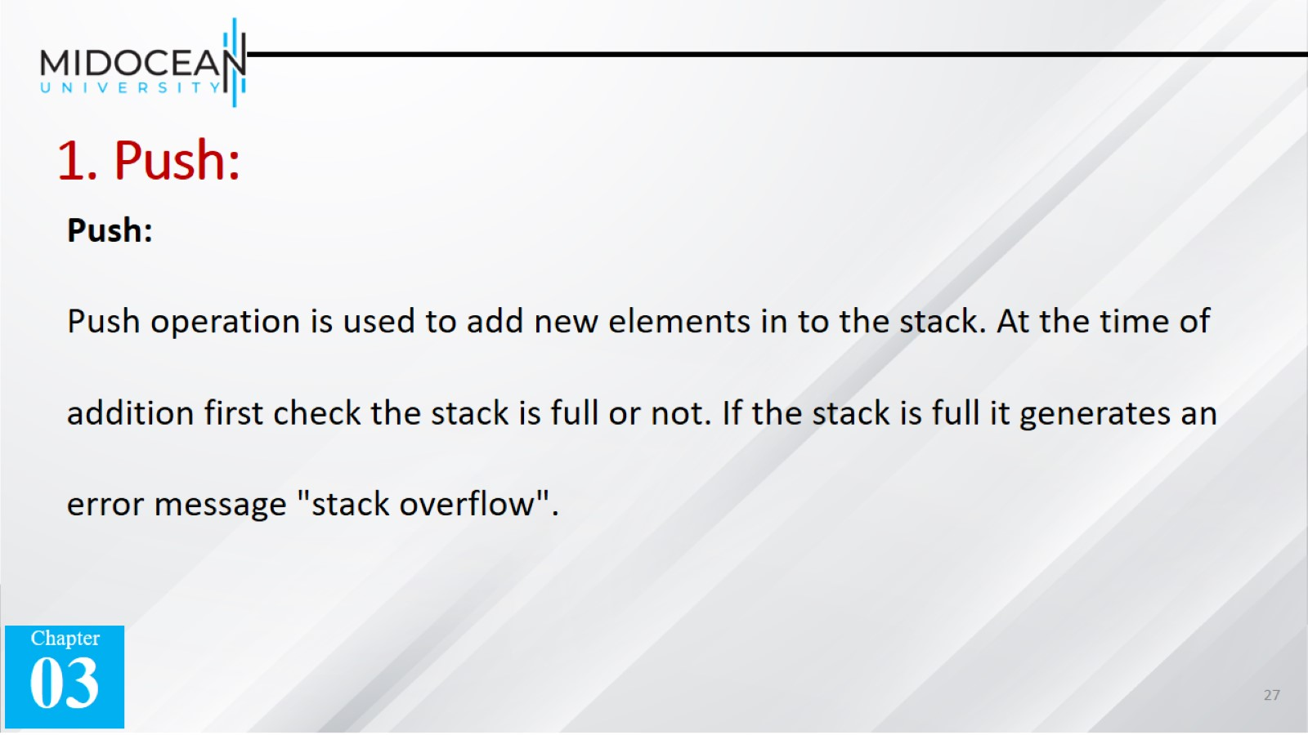
1. Push:

Slide 28
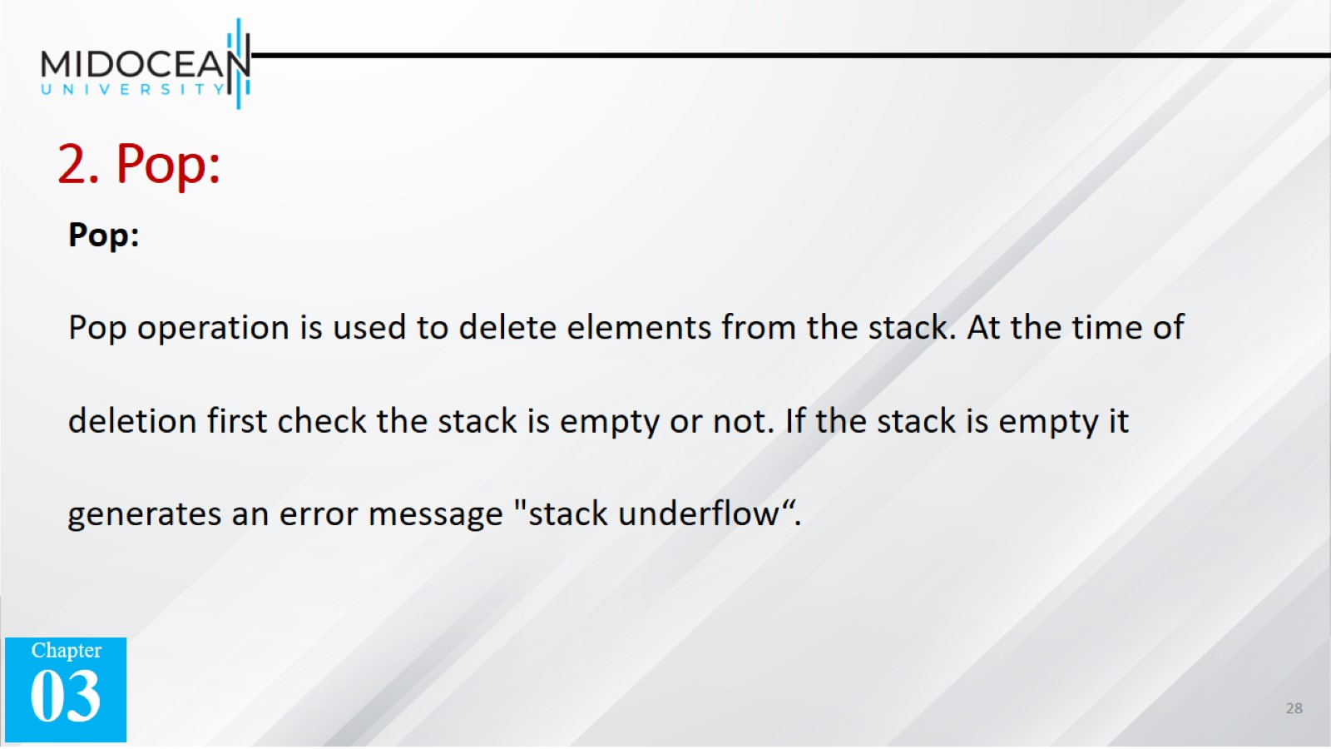
2. Pop:

Slide 29
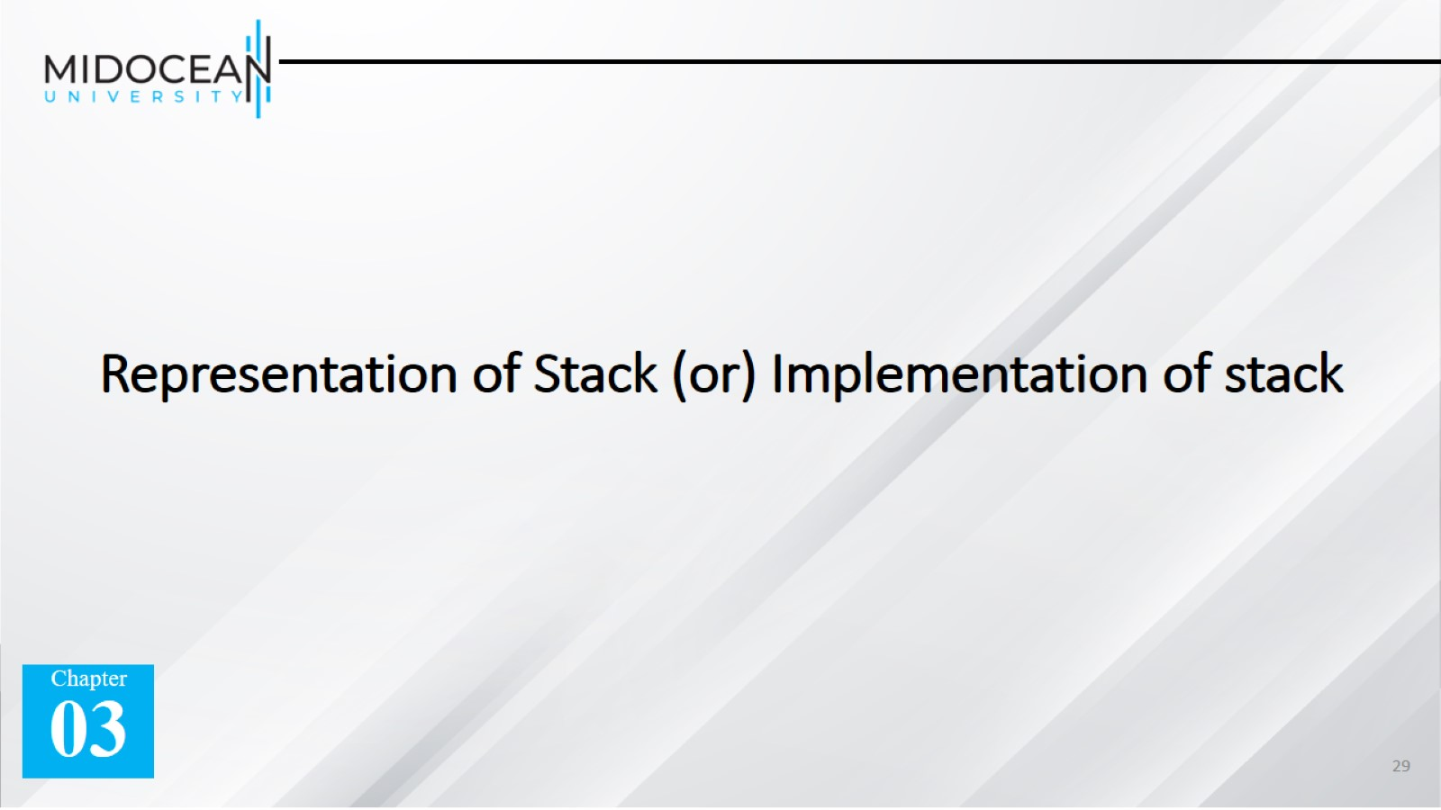
Representation of Stack (or) Implementation of stack

Slide 30
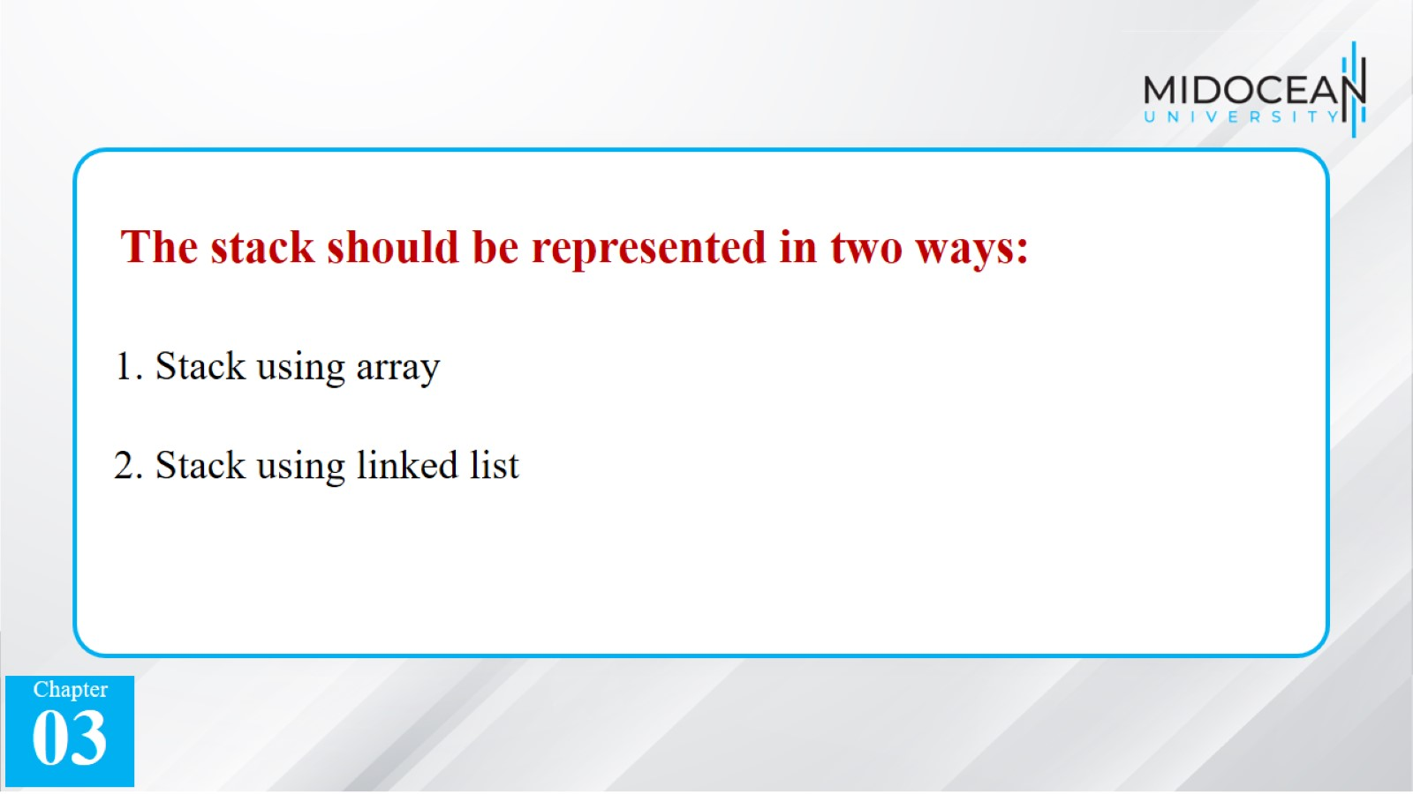

Slide 31
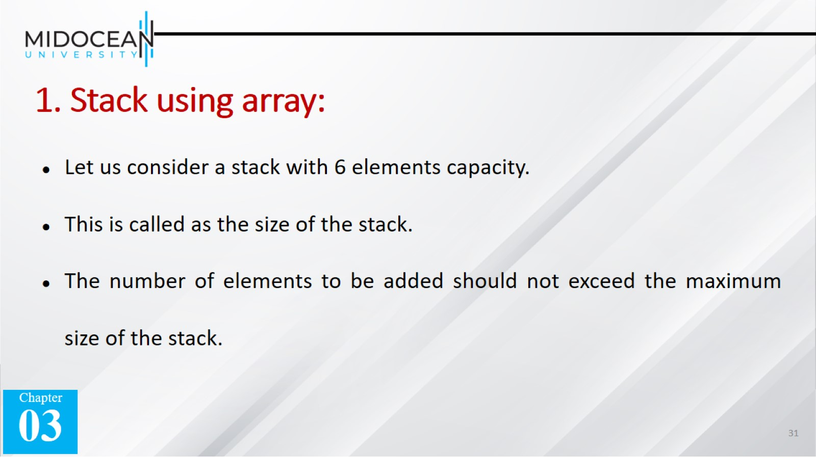
1. Stack using array:

Slide 32

1. Stack using array:

Slide 33
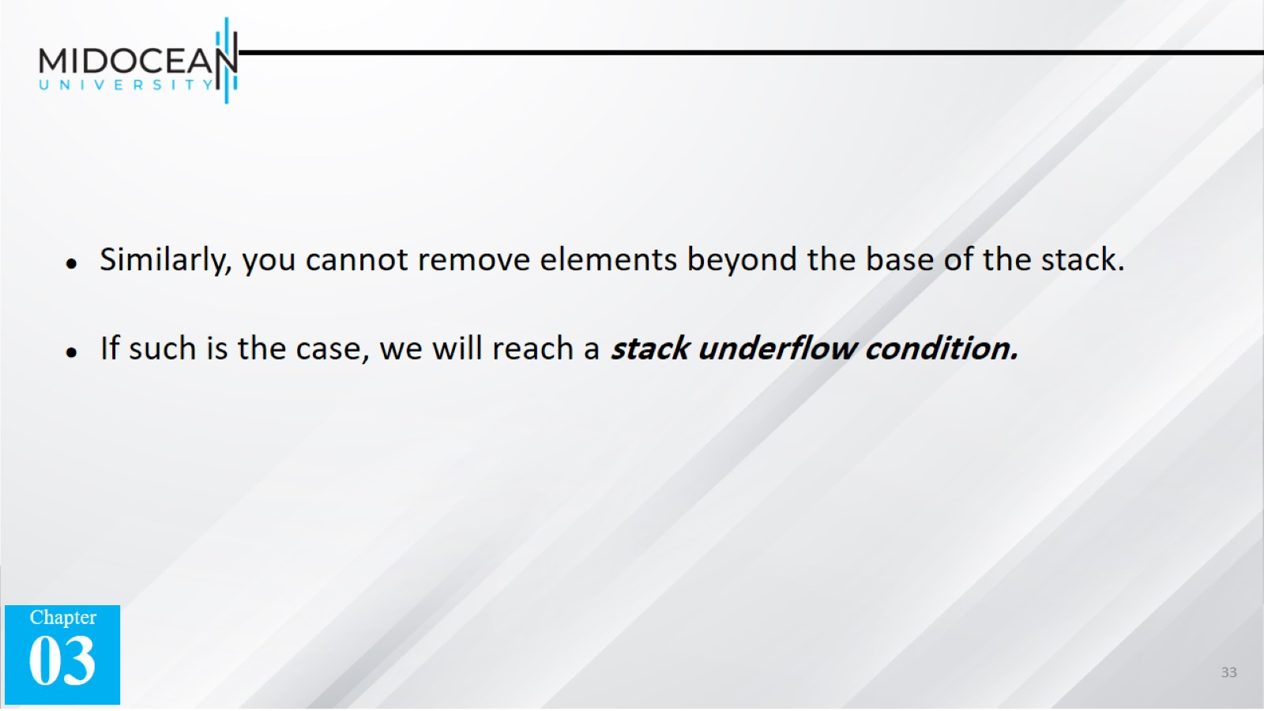

Slide 34
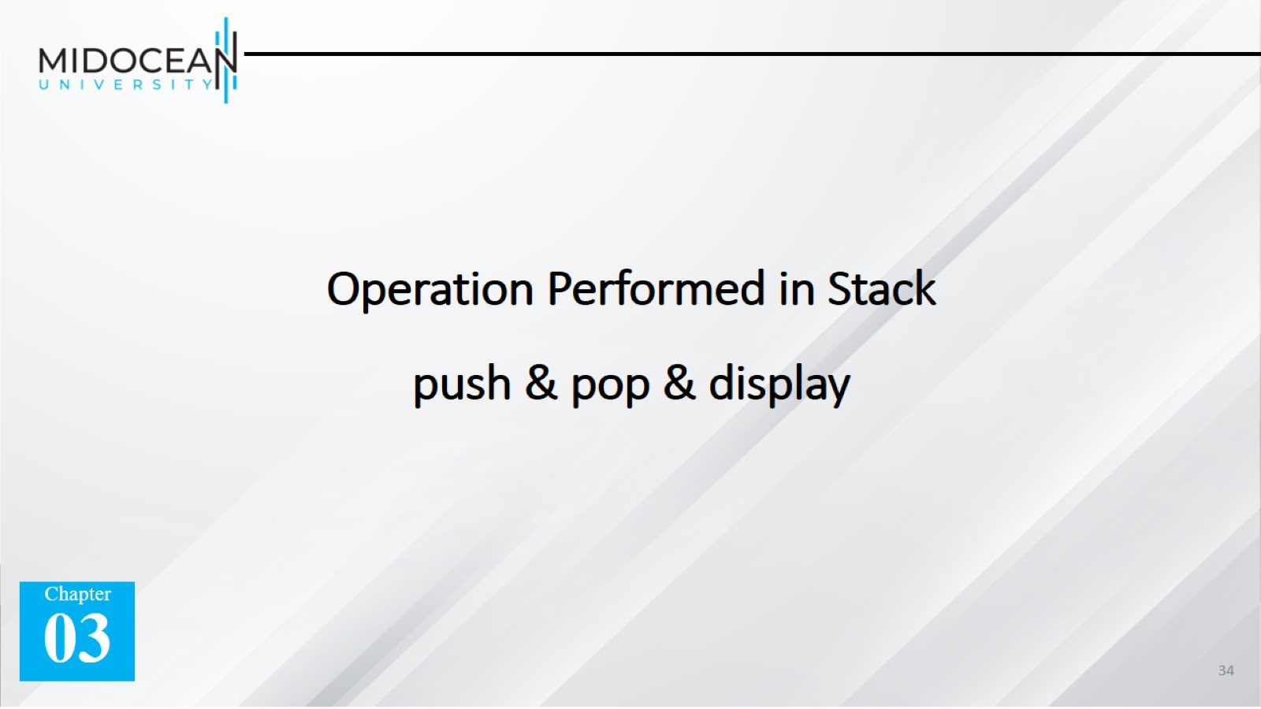
Operation Performed in Stack push & pop & display

Slide 35
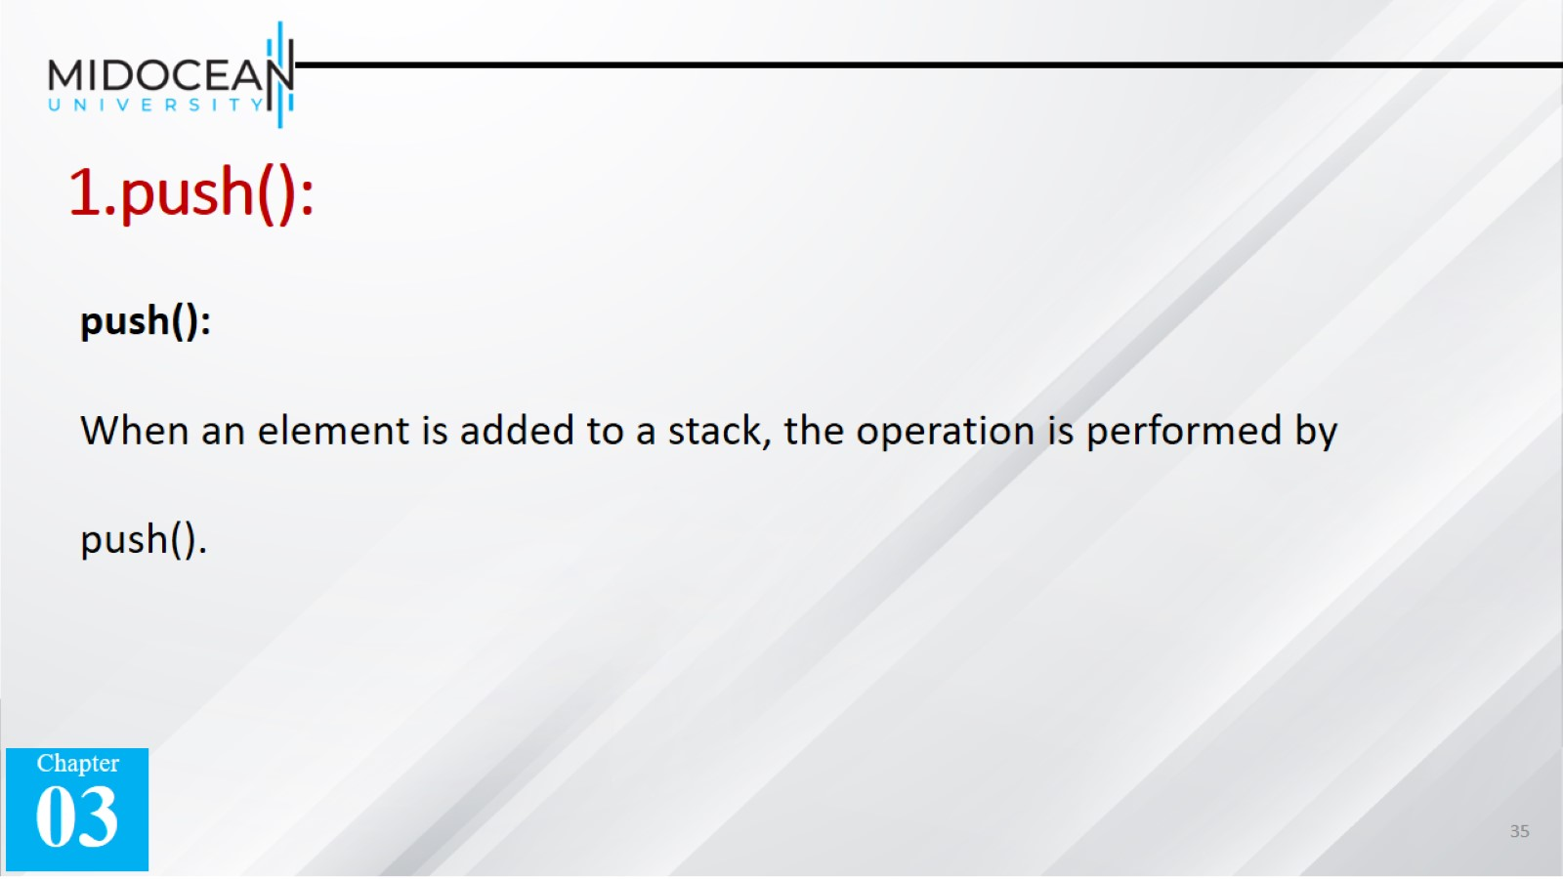
1.push():

Slide 36
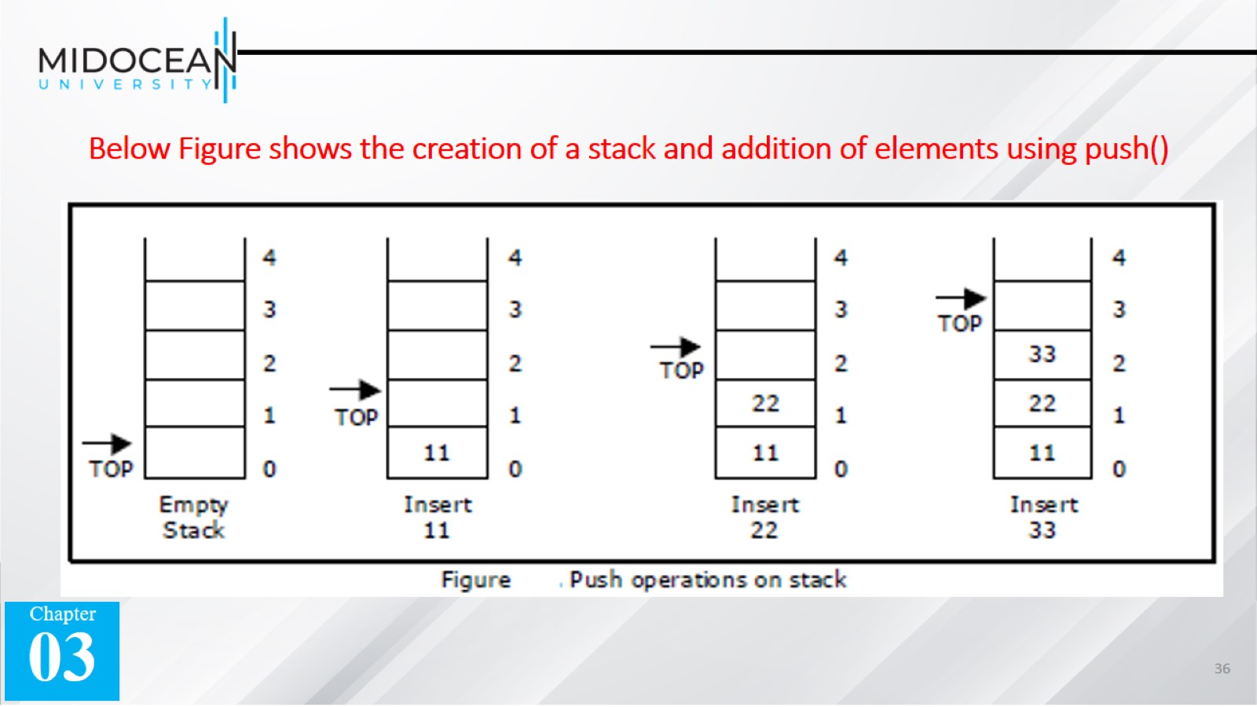
Below Figure shows the creation of a stack and addition of elements using push()

Slide 37

2.pop():

Slide 38
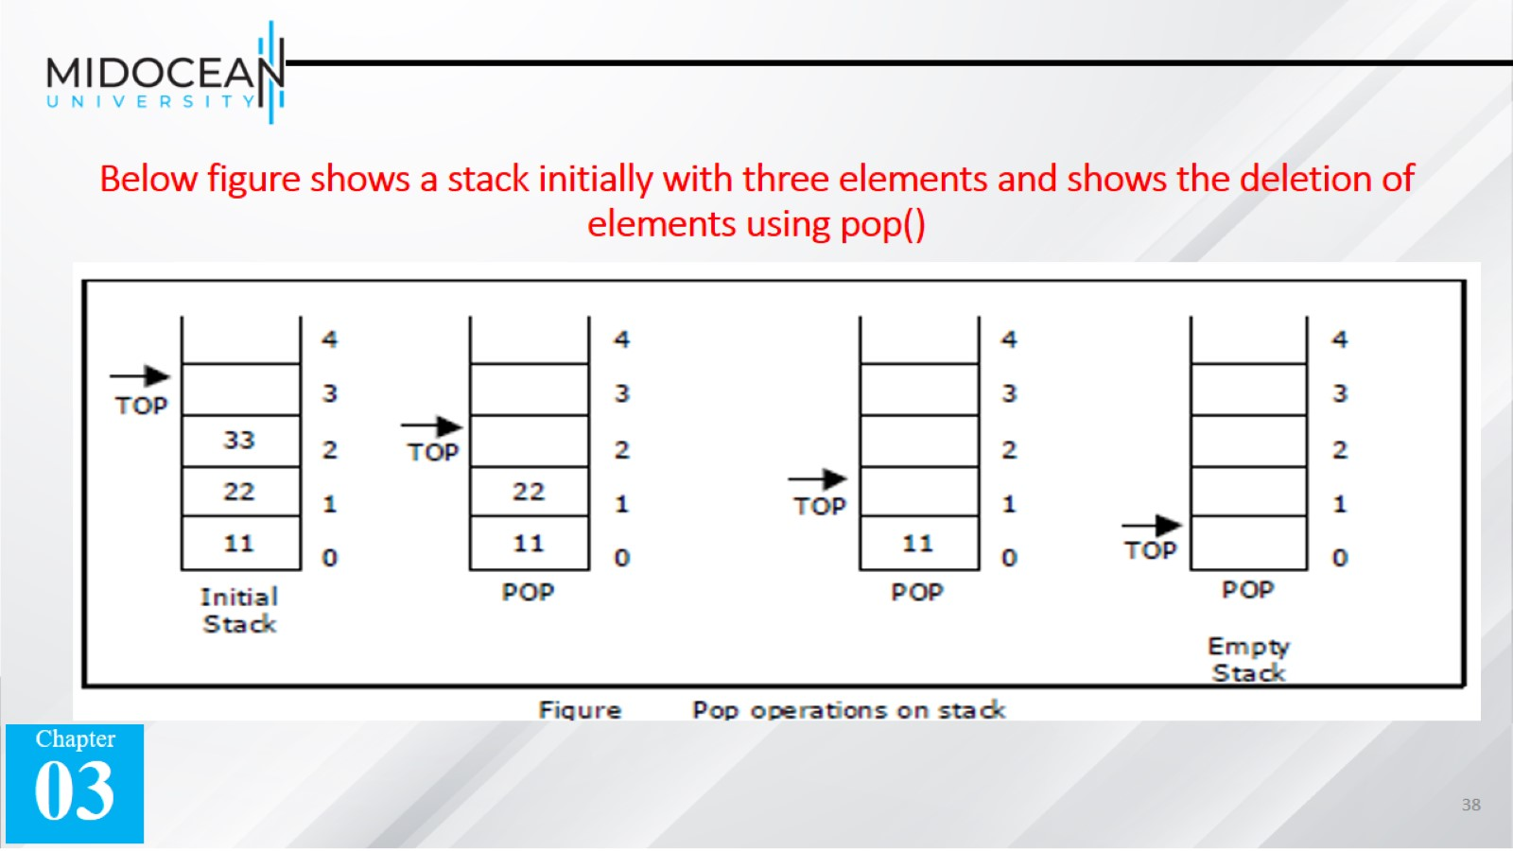
Below figure shows a stack initially with three elements and shows the deletion of elements using pop()

Slide 39
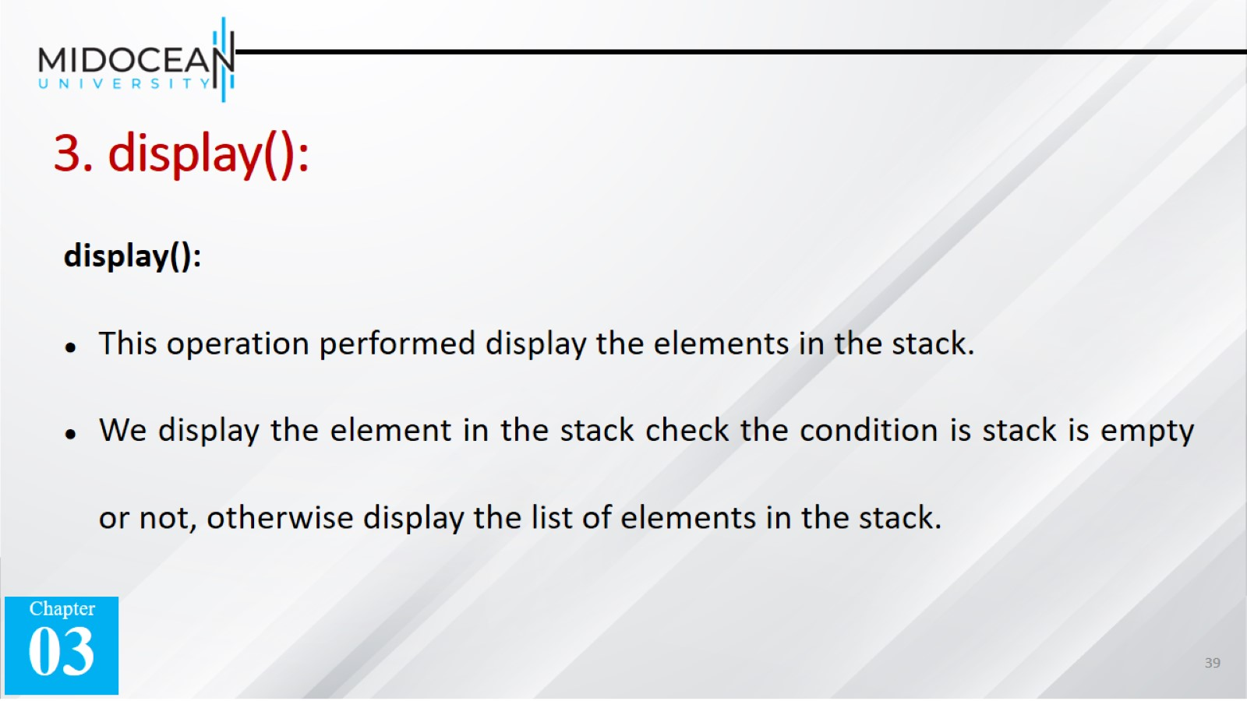
3. display():

Slide 40
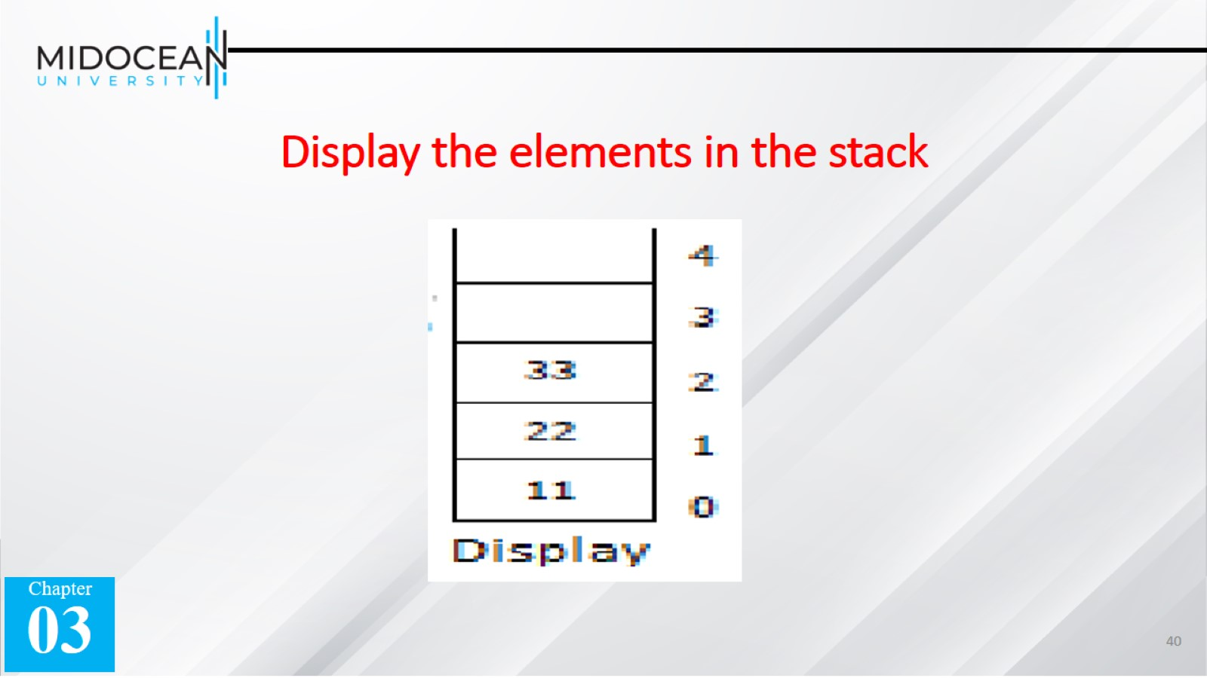
Display the elements in the stack

Slide 41


