Slide 1


Project Team and Stakeholder Management
Competencies:
Developing Team Skills for High Performance
Prepared by Dr. Nourhan Sayed
PGM 341
5th Lecture
Lecture (5)

Slide 2



Project Team and Stakeholder Management
Competencies:
Developing Team Skills for High Performance
Lecture (5)
PGM 341
5th Lecture
Prepared by
Dr. Nourhan Sayed
www.midocean.ae

Slide 3
Lecture 5
Course Outline
Lecture 1: Determining the Direction and Initial Specifications of a Project.
Lecture 2: the search for the high-performing team.
Lecture 3: Context: Laying the Foundation for Team Success.
Lecture 4: Composition: Getting the Right People on the Bus.
Lecture 5: competencies: Developing Team Skills for High Performance.
Lecture 6: Change: Devising More Effective Ways of Working Together.
Lecture 7: The Project Team’s Environment (Stakeholders, Developing and Using Project Networks).
Lecture 8: Leading Project Teams.
Lecture 9: Managing Conflict in the Team.
Lecture 10: Writing Project Reports.

Slide 4
Lecture Outline
Lecture 5
1. Developing the Competencies of High-Performing Teams.
2. Team Leader as Educator.
3. Team Leader as Coach.
4. Team Leader as Facilitator.
5. Measurement of Team Competencies.

Slide 5
Lecture 5
Competencies: Developing Team Skills for High Performance
Introduction:
Once team context and team composition support team effectiveness, the next step is to develop team competencies.
Such competencies are not solely the attributes of individual team members but are competencies that are developed and shared by members of the team.

Slide 6
Lecture 5
Competencies: Developing Team Skills for High Performance
1. Developing the Competencies of High-Performing Teams:
Most managers and supervisors have worked with their subordinates primarily in boss–staff (subordinate) relationships. Such relationships typically are based on the assumption that the boss should set the direction and lead, and the subordinates’ role is to carry out the directives of the supervisor.
However, we have found that to develop effective teams, managers need to think of their subordinates as being members of a team rather than merely seeing them as members of their staff.

Slide 7
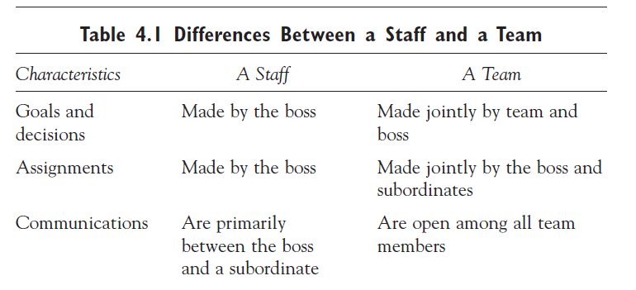
Lecture 5
Competencies: Developing Team Skills for High Performance
A staff differs from a team in a number of significant ways. Managers and team leaders who are making the transition from staff to a team must first understand these differences (see table 4.1).

Slide 8
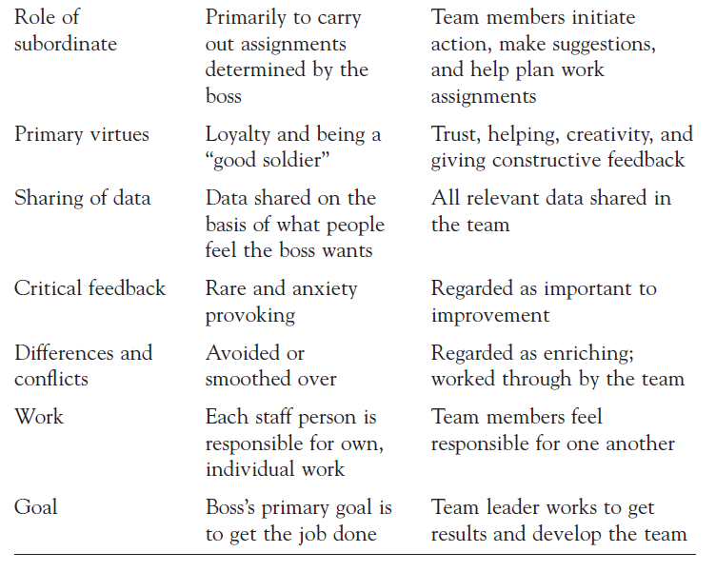
Lecture 5
Competencies: Developing Team Skills for High Performance

Slide 9
Lecture 5
Competencies: Developing Team Skills for High Performance
To achieve this shift from a staff to a team, managers or team leaders need to move more power and responsibility to team members and redefine their leadership role.
Figure 4.1 shows how power and roles need to shift to change a staff, or any immature team, into an effective team.

Slide 10
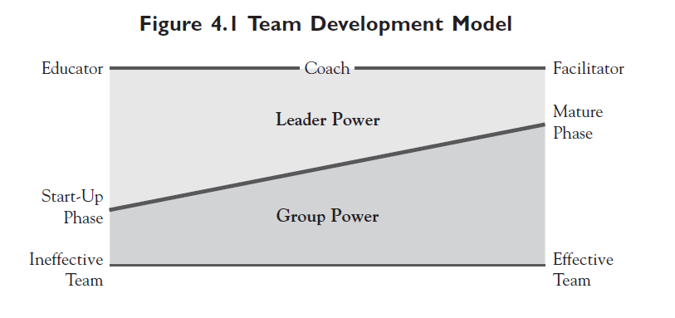
Lecture 5
Competencies: Developing Team Skills for High Performance

Slide 11
Lecture 5
Competencies: Developing Team Skills for High Performance
In the beginning of this change from a staff to a team, the superior is usually in a traditional leadership role. Ultimate authority resides with “the boss,” and a minimal amount of real power or authority is delegated to subordinates.
The boss must be helped (trained, oriented, educated) to see the leadership role in an effective team in a radically new way. The boss who is to become a leader must experience a true paradigm shift in order for the development of the team to take place.

Slide 12
Lecture 5
Competencies: Developing Team Skills for High Performance
2. Team Leader as Educator:
Assuming that the leader is committed to leading a high performing team, the first task for the leader in the team development model in
figure 4.1 is to understand the competencies needed for this type of team and educate the team regarding those competencies.
This model describes how the role of the team leader and team dynamics change as a team matures and develops new competencies.

Slide 13
Lecture 5
Competencies: Developing Team Skills for High Performance
Although there are several theories about which competencies high-performing teams (see, for example, McGregor) possess, we have found the following five task-related competencies and five relationship- or process-related competencies to be the most important.

Slide 14
Lecture 5
Competencies: Developing Team Skills for High Performance
Task-Related Competencies:
1. The team sets clear, measurable goals and generates the commitment of all members to team goals by all team members.
2. The team knows how to make assignments clear and shows team members how their work contributes to the goals of the entire team.
3. The team has clear processes for making decisions, and team members influence decisions through appropriate participation (typically through a process of consensus).

Slide 15
Lecture 5
Competencies: Developing Team Skills for High Performance
4. The team knows how to establish high performance standards and hold members mutually accountable for results.
5. The team knows how to run effective meetings so that time spent together is productive.

Slide 16
Lecture 5
Competencies: Developing Team Skills for High Performance
Relationship- or Process-Related Competencies:
1. The team knows how to build trust and support among team members so that they are committed to each other and to the team.
2. The team develops open lines of communication, and members are willing to share information, express feelings, and provide feedback to the others.

Slide 17
Lecture 5
Competencies: Developing Team Skills for High Performance
3. The team has a process for managing conflicts. Conflicts are recognized and managed, not brushed aside or ignored.
4. Team members show mutual respect and collaborate with one another to accomplish their work.
5. Team members are willing to take risks to bring innovative ideas that will improve the team.

Slide 18
Lecture 5
Competencies: Developing Team Skills for High Performance
Ideally, the team leader should educate the team members about the key competencies and the important roles of team members and the leader.
If the leader feels inadequate to conduct these education sessions, an outside facilitator or consultant might help in the education of the team, though not in running the team meetings—because that’s still the role of the team leader.

Slide 19
Lecture 5
Competencies: Developing Team Skills for High Performance
In this education phase, the leader:
• Demonstrates a willingness to share power and responsibility with team members.
• Encourages team members to become more active in sharing leadership responsibilities.
• Develops with team members the basic competencies of an effective team and their acceptance as goals for the Team.

Slide 20
Lecture 5
Competencies: Developing Team Skills for High Performance
• Develops team performance metrics and guidelines on how the team will function in the future to achieve those performance goals.
• Presents and practices the key competencies that the team needs: being trusting and trustworthy, fostering open communications (sharing all relevant data), giving and receiving feedback, making decisions that have the commitment of all, and observing and critiquing group processes.

Slide 21
Lecture 5
Competencies: Developing Team Skills for High Performance
We examine the fifth in more detail.
1. Sharing Power
The team leader shows commitment to the new paradigm or philosophy of management by sharing power with team members. This can be done in a variety of ways:
asking a team member to build a team meeting agenda by contacting all of the other members for agenda items;
allowing a member to chair a team meeting;
asking members for their ideas, suggestions, or criticisms of proposals on the table;
setting goals and making decisions that require full participation;
or delegating significant work to team members without continually checking up on them.

Slide 22
Lecture 5
Competencies: Developing Team Skills for High Performance
2. Sharing Leadership
The concept to be taught and practiced is that leadership is not something deposited in a position but is instead a process that can be shared with others. A person who shares in the leadership process sees an action that is needed to move the team ahead and then has the initiative to take the action. Leadership is truly shared when every team member tries as much as possible to initiate an action whenever he or she sees the team struggling or getting bogged down.

Slide 23
Lecture 5
Competencies: Developing Team Skills for High Performance
3. Developing the Competencies of an Effective Team
Although the eleven characteristics of high-performing teams can provide guidance, each team should identify its own set of competencies that it will need to achieve success, since certain competencies are more important than others given a team’s unique mission and task.

Slide 24
Lecture 5
Competencies: Developing Team Skills for High Performance
4. Developing Team Guidelines and Metrics
What guidelines does the team need to become effective according to its own criteria and to avoid pitfalls? Again with the leader participating but not dominating, the team develops its own set of guidelines.
The leader might say, “We need guidelines that will promote open discussion on how we will make decisions and how we will deal with disagreements among team members.

Slide 25
Lecture 5
Competencies: Developing Team Skills for High Performance
5. Developing Team Competencies
In this educative phase of team development, team members should discuss and practice competencies that seem to be imperative if the team is to improve. In this section,
we briefly discuss some of the important issues surrounding the development of each of the eleven competencies.

Slide 26
Competencies: Developing Team Skills for High Performance
Lecture 5
1- Setting Clear, Measurable Goals: High-performing teams develop the competency to set clear and measurable goals to which all team members are highly committed. Clear goals are those that are realistic, prioritized, and measurable.

Slide 27
Lecture 5
Competencies: Developing Team Skills for High Performance
2- Making Assignments Clear and Ensuring Competence: Once clear goals are set, the team then must have a process for making individual assignments so that everyone knows exactly what they are supposed to do and how it contributes to the team goals. This means clearly documenting who is to do what and by when. It also means identifying the skills and resources each team member needs to fulfill his or her assignment.

Slide 28
Lecture 5
Competencies: Developing Team Skills for High Performance
3- Using Effective Decision-Making Processes: Making effective decisions that have the commitment of all of the team members is another key competency. Teams must make a wide range of decisions—about goals, programs, use of resources, assignments, schedules, and so forth.

Slide 29
Lecture 5
Competencies: Developing Team Skills for High Performance
4- Establishing Accountability for High Performance: High-performance teams encourage high-performance standards, and team members hold each other accountable for performance. Once individual assignments are made, the team needs a process for periodically checking up on team members and holding them accountable for fulfilling their assignments in a way that is acceptable to the team.

Slide 30
Lecture 5
Competencies: Developing Team Skills for High Performance
5- Running Effective Meetings:
The team also needs to be competent in meetings. The general approach to effective meeting management has the following steps:
1. Set out a clear purpose and goal for each meeting.
2. Develop an agenda before the meeting, and send it to team members.
3. Structure the items on the agenda to follow a logical sequence.

Slide 31
Lecture 5
Competencies: Developing Team Skills for High Performance
4. Identify when the discussion is moving off the subject and into areas unrelated to the goals of the meeting.
5. Summarize and record the actions, decisions, and assignments made at the meeting and disseminate them to team members after the meeting, usually by e-mail.
6. Make it clear that all team members have the responsibility (and obligation) to call for a meeting if the meeting will help improve the team’s performance.

Slide 32
Lecture 5
Competencies: Developing Team Skills for High Performance
6- Building Trust:
One of the most important team competencies is trust behavior—trusting and being trustworthy. This is sometimes referred to as creating “psychological safety” within the team so that team members are willing to express opinions, acknowledge mistakes, and have confidence that they can engage in risky, learning-related behaviors without punishment. The fundamental emotional condition in a team is not “liking” but “trusting.”

Slide 33
Lecture 5
Competencies: Developing Team Skills for High Performance
7- Establishing Open Communication Channels:
Another needed competency is open communications. This involves some risk if the norm has been to keep quiet and say only what you think the boss wants to hear. It is helpful if the team leader, consistent with the new team philosophy, can say, “I honestly want every person to speak up and share his or her thinking, regardless of whether it is in agreement.”

Slide 34
Competencies: Developing Team Skills for High Performance
Lecture 5
8- Managing Conflict:
Effective teams learn how to give and receive constructive feedback (as opposed to “critical” feedback) without becoming defensive or combative. This is an important competency because continuous improvement requires that team members frequently give and receive constructive feedback so that change is possible. However, when team members give feedback to each other, conflict often results.

Slide 35
Lecture 5
Competencies: Developing Team Skills for High Performance
9- Creating Mutual Respect and Collaboration:
Another competency of effective teams is that they know how to collaborate in a spirit of cooperation and mutual respect. This requires that team members understand the need to collaborate and understand that they are each better off if they all help each other. High-performing teams develop a norm of reciprocity that involves quickly helping each other when asked.

Slide 36
Lecture 5
Competencies: Developing Team Skills for High Performance
10- Encouraging Risk Taking and Innovation:
We have found that team members in high-performing teams are willing to take risks and encourage innovation to help make their teams better. Unfortunately, most teams tend to put down or punish team members who come up with new ways of working together or new solutions to old problems.

Slide 37
Lecture 5
Competencies: Developing Team Skills for High Performance
11- Engaging in Team Building:
Most organizational team members are not going to become skilled group observers or facilitators of team-building sessions. But they can become skilled at observing and critiquing group processes. They can build a set of processes that will allow them to deal with most problems that occur as the team works together. These processes should include setting a time for the team to stop and critique how it has been functioning.

Slide 38
Competencies: Developing Team Skills for High Performance
Lecture 5
3. Team Leader as Coach:
As the team matures and the leader shifts more power and responsibility for team functioning from his or her shoulders to the team, the leader’s role begins to change from educator to coach. This should not occur until team members understand the team orientation and have developed some competence in the new skills. Team members also should have experienced the willingness of the team leader to share responsibility and authority with them.

Slide 39
Lecture 5
Competencies: Developing Team Skills for High Performance
4. Team Leader as Facilitator:
In this final phase in making the transition to a high-performing team, the leader may function as a facilitator. Here his or her primary role is to intervene in the group’s actions only when attention needs to be focused on a matter the team has not dealt with. Like coaches, facilitators often get more mileage out of asking questions than giving answers.

Slide 40
Lecture 5
Competencies: Developing Team Skills for High Performance
5. Measurement of Team Competencies:
In addition to following a process for turning an immature group or staff into a competent, mature team, an ongoing team can use an assessment tool to examine its processes to see what level of competence it has achieved. Members of the team should fill out the scale, compute an average for the total team, and identify which areas they believe need improvement.

Slide 41
Lecture 5
Competencies: Developing Team Skills for High Performance
One should think of this scale in connection with the model in figure 4.1. Think of the power line in the middle of the model in this figure as representing a scale from 1 (less competent or immature team) to 5 (a mature, competent team), with 3 being the midpoint.

Slide 42

Lecture 5
Competencies: Developing Team Skills for High Performance
References:
Team Building
Proven Strategies for Improving Team Performance.
Fifth Edition
By:
W. Gibb Dyer Jr.
Jeffrey H. Dyer
William G. Dyer
chapter 4

Slide 43



Thank You

