Slide 1

PMG 202
Project Planning
Prepared by Dr. Maryam ZORGUI
PART III :
Closing Phase
Lecture 10
Project Closure

Slide 2
In the previous lessons…
The project life cycle includes the steps required for Project Managers to successfully manage a Project from start to finish. There are 5 phases to the Project Life Cycle (also called the 5 Process Groups)—Initiating, Planning, Executing, Monitoring/Controlling, and Closing. Each of these Project phases represents a group of interrelated processes that must take place:
The Initiating Phase: consists of just two separate processes: the Project charter and Stakeholder Register. The point of this phase is to determine the vision for your Project, document what you hope to accomplish, and secure approvals from a sanctioning Stakeholder.
Lecture 10

Slide 3
In the previous lessons…
The Planning Phase process group is where you build the project infrastructure that will enable you to achieve your Goal within your predetermined time and budget constraints, starting with a Project Management Plan, Project Scope, Work Breakdown Structure and more—and wrapping up with qualitative and quantitative Risk Analyses and Risk Responses.
The Executing Phase is where the rubber hits the road—where most of the Budget is allocated and most of the Project Deliverables are produced.
You take your Project Plan and put it into action, whether that takes weeks, months, or even years.
Lecture 10

Slide 4
In the previous lessons…
The Monitoring and Controlling Phase involves keeping an eye on the actual progress of the project against your plan and taking corrective action where necessary. No amount of perfect planning will exempt you from the need to be constantly vigilant with tracking and reporting.
We reach the last phase of the Project Life Cycle……

Slide 5
Syllabus
.
III- The Project Closure Elements
II- The 3 phases of the Project Closure
I- What is the Project Closure?
IV- The Project Closure Objectives and Scope
V- Project Closure Best Practicies
Lecture 10

Slide 6
I- What Is Project Closure?
Many practitioners overlook the Project Closing Process group.
To them, successful Project Closing, also called Project Delivery, is defined by the completion of Deliverables as per the Objectives of time and cost.
Little do these practitioners know that the Project Closing Process Group is as impactful and significant as the Initiation, Planning, Executing, and Monitoring and Controlling Process Groups.
As further explained in this lesson, the impact of Project Closing can be extensive, both to the Project and to the Organization.

Slide 7
I- What Is Project Closure?
I-1-Definition
According to A Guide To The Project Management Body of Knowledge (PMBOK® Guide) – Fifth Edition,
“The Project Closing Process Group consists of those processes performed to conclude all activities across all Project Management Process Groups to formally complete the project, phase, or contractual obligations.
This Process Group, when completed, verifies that the defined processes are completed within all of the Process Groups to close the Project of Phase, as appropriate, and formally establishes that the Project or Project Phase is complete” (2013, p. 57).

Slide 8
I- What Is Project Closure?
Project closure defines a project’s success.
Project closure is the critical last phase in the project management lifecycle. During project closure, the team reviews the deliverables, then compares and tests its quality to the intended project outcome. Then they share the deliverables with the project’s client.
In other words, Project Closing is the combination of the following when applied to a project:

Slide 9
I- What Is Project Closure?
Assurance that all the work has been completed,
Assurance that all agreed upon project management processes have been executed, and
Formal recognition of the completion of a project—everyone agrees that it is completed.
4. Making sure all the work that needed to be has been done.
5. Obtaining approval by the project's sponsor and customer (whether internal or external) for the work completed.
6. Reviewing whether or not all organizational governance processes have been executed.

Slide 10
I- What Is Project Closure?
7. Assessing whether or not the necessary project management processes have been applied.
8. Administrative closing of any and all procurements, reviewing that all work on the contract has been completed and that both parties have completed their contractual obligations toward each other.
9. Formally recognizing the completion of a project and its transition to operations.
10. Validating that the project achieved benefits identified in the business case.

Slide 11
I- What Is Project Closure?
11. Capturing of lessons learned: What was done well, and should be documented so it can be repeated in the future? What could have been done better? And if so, how can it have been done better?
12. Disbanding project resources, freeing them to perform other projects and undertake other tasks as required within the organization.
13. Transitioning project deliverables to the customer organization in a manner that warrants seamless operations and support.

Slide 12
I- What Is Project Closure?
A Project Manager will close a Project for many reasons.
Those include completing a Project on time and finishing it early.
Projects can also get cancelled or fail completely.

Slide 13
I- What Is Project Closure?
I-2-Why Is Project Closure Important?
Just as any of the other project Life Cycle Phases (Initiation, Planning, Execution, Monitoring and Controlling), Project Closing serves an important purpose for the organization and helps it avoid unfavorable and adverse scenarios.
Effective project closure helps define a team’s and an organization’s culture. Approaching project closure as fundamental to building success leads to better-quality work and makes clients happy.
Learning is a critical outcome of project closure.
The process sets the stage for more successful and satisfying projects in the future.

Slide 14
I- What Is Project Closure?
It’s essential to review what you’ve done and what you’ve learned.
Determine how that learning could benefit the Team, so you don’t limit the growth of each individual team member or the Organization as a whole.
Project Closure is important because the process allows you to:

Slide 15
I- What Is Project Closure?
Tie Up Loose Ends:
You’ve already delivered project outcomes to the client, but be sure to report all outcomes internally.
Make sure all contracts are signed, paid, and finalized, and clean up your files.
Ensure you’ve reviewed your progress and determined if you delivered the project on time and on budget.
You’ll also want to attend to logistics details, as well as relinquished physical space, digital equipment, and resources to responsible departments. These technical aspects of project closure allow you to close the project cleanly.

Slide 16
I- What Is Project Closure?
Take Stock of Lessons Learned:
Take the time to have an open discussion about lessons you learned throughout the Project’s Lifecycle.
Make a list, a Timeline, or a visual that helps to spark ideas and refresh Team Members’ memory of the Project from Initiation to the transfer to Project Deliverables to the Client.
This Process should include a review of the Project Budget and actual expenses.
Find tips on how to run a meeting on Lessons Learned.

Slide 17
I- What Is Project Closure?
Move On with a Clear Sense of Accomplishment:
When done well, project closure signals to each Team Member that the Project was meaningful and, simply, the job is complete.
Project Closure provides a technical stoppage to any loose ends and enables you to inventory the Lessons learned.
These steps also provide an emotional Closure for each Team Member, including the Project Manager.
Focus on individual and team learning processes, and move on to the next great thing in store for each of you.
Celebrate your team, too.

Slide 18
I- What Is Project Closure?
Archive the Project’s Learning for the Benefit of the Team and Organization:
The final step in Project Closure is to finalize the Project Closure Report and archive it so that it’s accessible to all Relevant Parties.
It’s important to notify Team Members on where to find the Report for formal presentation to Upper Management.

Slide 19
I- What Is Project Closure?
I-3- What Happens if a Project Isn’t Closed Properly
When you don’t properly close a Project, you lose the potential to learn from the current Project’s Process and Outcomes.
The next time you start a Project, you’re more likely to encounter the same Issues and potentially less motivated Teams.
When you don’t close a Project correctly, Lessons aren’t learned and Team contributions are not acknowledged and celebrated.
Whether the Project is for an in-house audience or an outside organization, it’s also possible that your client will be less satisfied with the Results.
This is true regardless of how well it may meet Project Specifications and how timely your Deliverables reach the hands of your Client.

Slide 20
I- What Is Project Closure?
Failure to conduct thorough Project Close out could potentially:
(a) put the organization at a considerable amount of Risk,
(b) prevent the organization from realizing the anticipated benefits from the deliverables of the project,
(c) result in significant losses to the organization, and
(d) undermine the project manager and project management team's credibility

Slide 21
II- The 3 Phases of the Project Closure Process
The three phases of project closure are technical, learning, and people.
During the technical phase, clean up loose ends. For the learning phase, evaluate what did and didn’t work, as well as how to improve. In the people phase, appreciate team members.
Take these steps during each phase of closing a project.
By following this quick and easy guide to project closure steps and related activities, you’re building a stronger future for yourself, your team, and your organization.

Slide 22
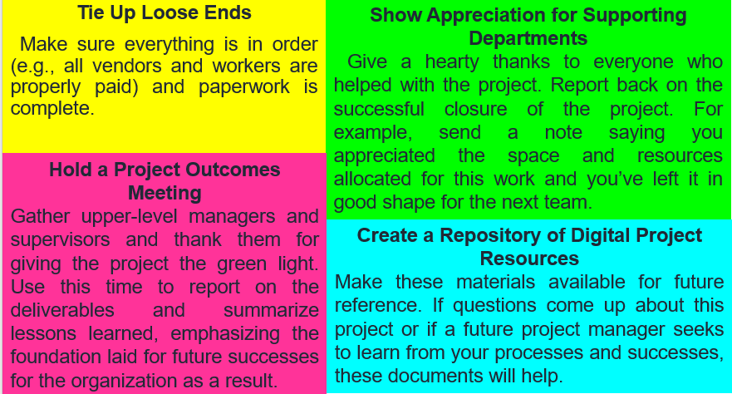
II- The 3 Phases of the Project Closure Process
II-1-Technical Phase
The technical phase, while a bit on a bureaucratic side, creates a true sense of finality (and success) among the team and for the organization. A great project lifecycle enables you to do the following:

Slide 23
II- The 3 Phases of the Project Closure Process
II-2-Learning Phase
We want all projects to be both challenging and manageable, but sometimes not everything goes as planned. Occasionally you encounter a glitch along the way.
No matter what happens during a project’s lifecycle, learning is always present.
The learning phase of project closure is time dedicated to team reflection on what you’ve done, how you’ve done it, and what you’ve learned now that the project is complete.
There are multiple ways to focus project closure on learning and growth, both for the organization as a whole and for individual team members. Doing so will likely lead to greater satisfaction and meaning associated with doing project work.

Slide 24
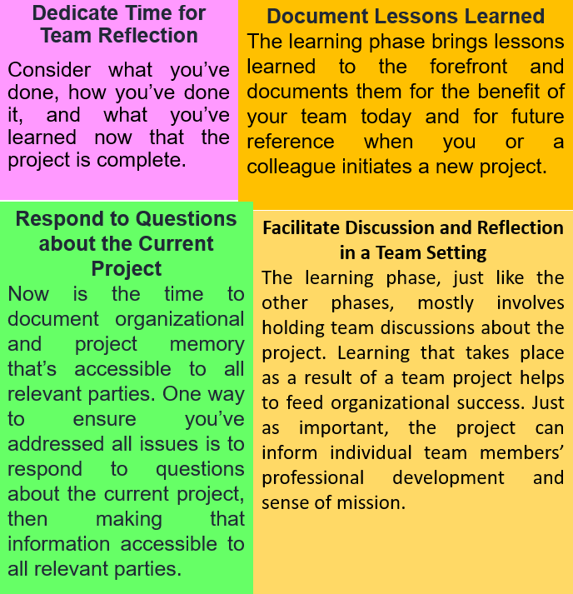

Slide 25
II- The 3 Phases of the Project Closure Process
II-3- People Phase
Take the time to commemorate what you’ve accomplished as a team. You’ve come to know the team well and have a good sense of the team’s personality.
Make the most of the camaraderie you’ve developed to celebrate in a way that’s right for your team within your organization.
Remember, the team made the project deliverables possible, and recognizing those efforts and the need for emotional closure will leave everyone feeling good and ready to move on, whatever comes next.

Slide 26
II- The 3 Phases of the Project Closure Process
Depending on the context, it may be appropriate to invite the Upper-Level Supervisor who gave the green light for the Project to participate, too.
Each Project Closure phase helps to create an Organizational Culture of appreciation, gratitude, and accomplishment.
Take the time to do this right, in ways meaningful to your specific circumstances, and you’ve set the stage not just to move on but also to take a step forward.

Slide 27
III- The Project Closure Elements
III-1- The Project Closure Activities
Project Closure activities are things you do to seal the professional tone of your work. These also include celebrating accomplishments and identifying ways to build toward the future.
Project Closure activities are based on the three phases and include these options:
Facilitate Team meetings both to tie up loose ends and review lessons learned. You’ve been working as a team to produce high-quality deliverables. Now, you’ve come back as a Team to close out your work in a clear, productive manner.
The Project Closure Elements

Slide 28
III- The Project Closure Elements
Schedule one-on-one Team Member meetings to identify individual learning and professional development.
Review contracts and human talent-related duties to ensure all vendor contracts are fulfilled and all people are paid.
Hold Team Meetings to review the Project’s learning arc and overall learning outcomes of benefit to the Team and to future project Teams.
The Project Closure Elements

Slide 29
III- The Project Closure Elements
Conduct a project manager meeting with the upper-level supervisor to bring the project to a formal close from an organizational perspective. This meeting may also be a good time to share specific contributions and skill sets identified among team members.
Delegate responsibilities for tying up loose ends and provide clear instructions about how to report back.
Host a celebratory gathering to acknowledge and show gratitude to team members for their accomplishments. Be sure to have fun in a manner that is appropriate for your team and in alignment with the organization’s culture. Now is the time to acknowledge contributions of each team member and those of supporting departments or supervisors.
The Project Closure Elements

Slide 30
III- The Project Closure Elements
Prepare the project closure report that incorporates text from each phase of the project, from initiation to closure, with an emphasis on process, deliverables, lessons learned, and overall outcomes. While the project manager prepares this report, it’s important to include team feedback.
This document serves as a critical reference for the immediate project supervisor who gave the green light; for the current project manager if any questions about the project arise; for team members and for future project managers to review before initiating a new project. Archive this document in an accessible location for the benefit of the organization.
The Project Closure Elements

Slide 31
III- The Project Closure Elements
III-2- Project Closure Deliverables
Project closure deliverables are items identified as the outputs of the project. Deliverables may take many forms, depending on the project at hand, including the following:
Competitor market share analysis, including opportunities for growth
New, streamlined team or resource management processes
Processes for matching and maximizing talent and organizational needs
Software for tracking new leads and existing client contacts
The Project Closure Elements

Slide 32
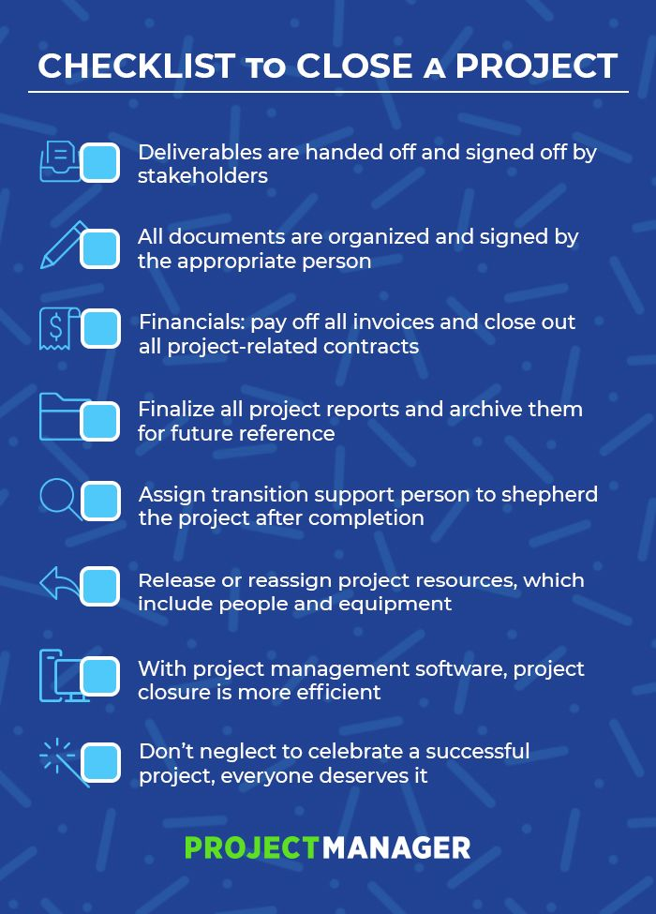
III- The Project Closure Elements
III-3- Project Closure Checklist
A Project Closure checklist is a tool to help Project Managers verify that the Project fulfilled its outcomes before they close the Project.
They can document any challenges, lessons learned, and any outstanding deliverables.
The Project Closure Elements

Slide 33
IV- The project Objectives and Scope
IV-1- The objectives of the Project Closing process are to:
Ensure project deliverables are approved and transferred to the assigning party.
Assess whether the project was done in accordance with the plan
Make sure that all project plans and documentation are transferred to the client and archived
Release project team members involved in the project
Determine the lessons learned throughout the project

Slide 34
IV- The project Objectives and Scope
IV-2- The Scope of the Project Closing Process includes:
Approval and acceptance of Project Deliverables and reviewing if they meet the Requirements.
Transferring Project Documentation and plans to the assigning partly for archiving.
Issue Management, financial, and Risk Management Closure.
Gathering the Lessons Learned from the Project.
Conducting Project Closure meeting and releasing the Project Team.

Slide 35
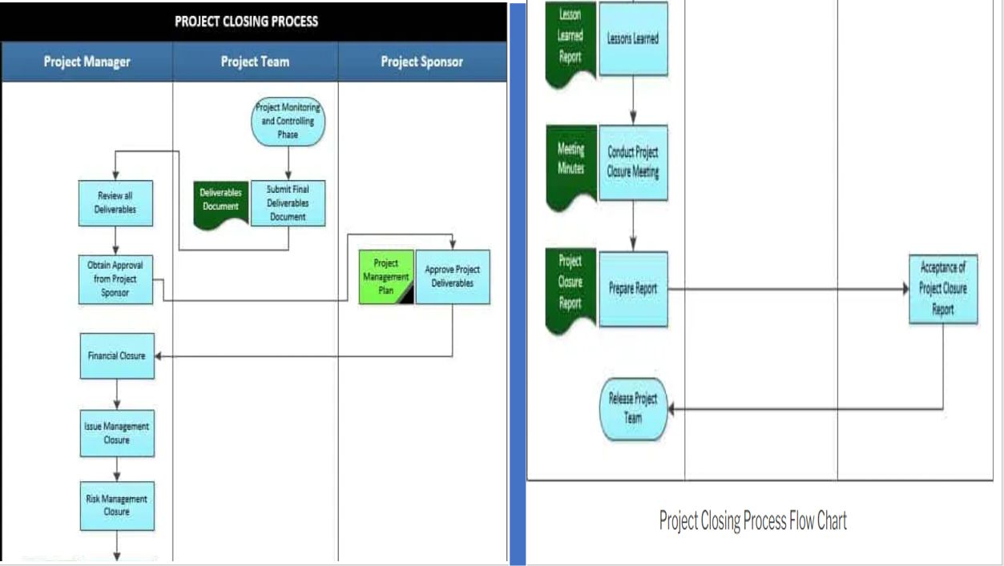

Slide 36
V-Project Closure Best Practices
Below is a Gguideline that Project Managers could use to close their Projects comprehensively:
Ensure those operations and any and all other departments/units/parties who will use the product(s) of the project have the necessary training, tools, documentation, and capability to perform their role.
Ensure that the Project has satisfied the Strategic Goal(s) for which it was undertaken.
Ensure that the whole Scope of Work has been completed, and make sure to receive formal documented acceptance from the Client and Sponsor.

Slide 37
V-Project Closure Best Practices
4-Review all Contracts with the Project Team and Suppliers. Make sure that all parties have satisfied their contractual obligations—that the Suppliers have delivered all of the products or services required of them and that the Organization has made all pertinent payments. Release bonds if necessary, and make sure the Supplier provides all supplementary Deliverables, which may include, but may not be limited to Product Documentation, Drawings, Warranties, Service Contracts, Lien Waivers, and so forth.
5- Review Project Management Practices.
6- Document Lessons Learned for future reference.
7- Disband the Project Team and officially return Resources to their functional locations.

Slide 38
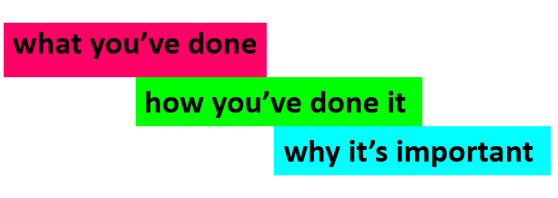
V-Project Closure Best Practices
Successful Project Closure ties every aspect together:
Don’t be shy about tapping into your best technical expertise and human-centered, celebratory self to this critical phase of every project.
Here’s a handy list of Project Closure best practices:

Slide 39
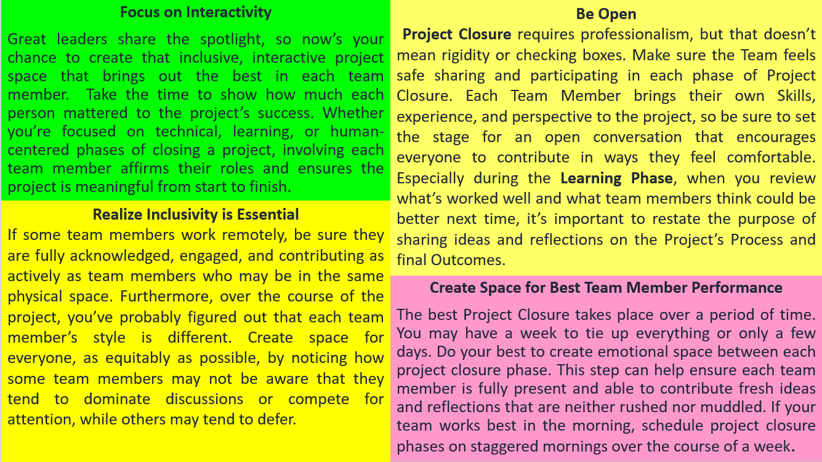

Slide 40
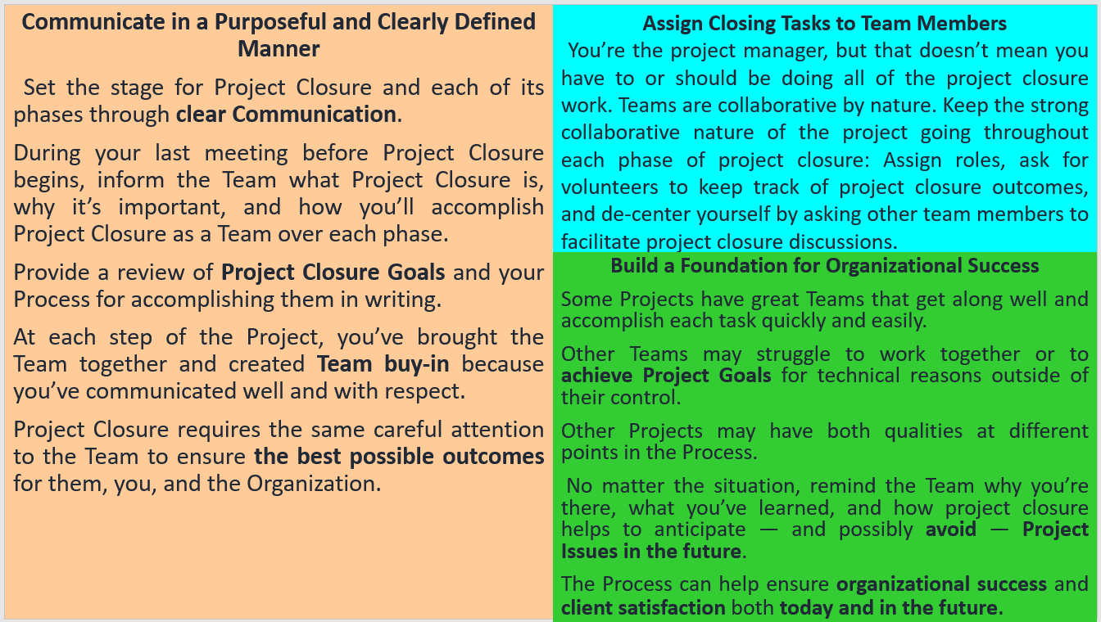

Slide 41
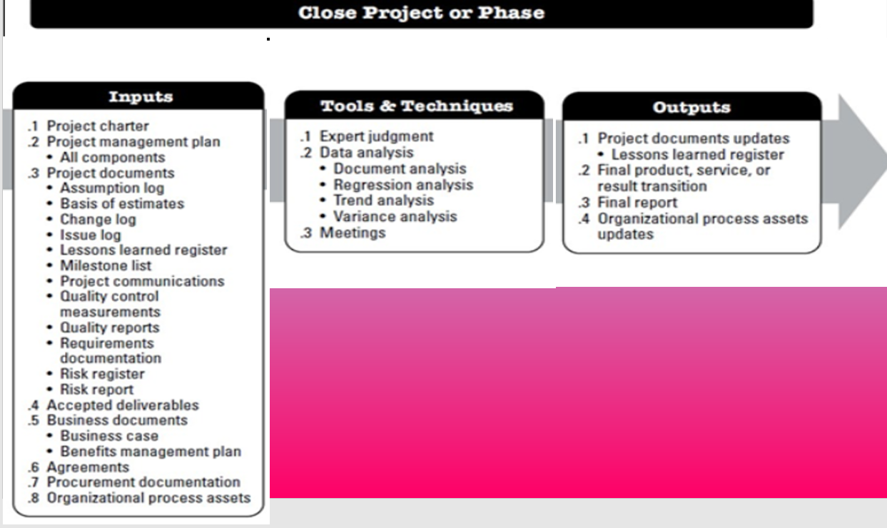

Slide 42


Slide 43
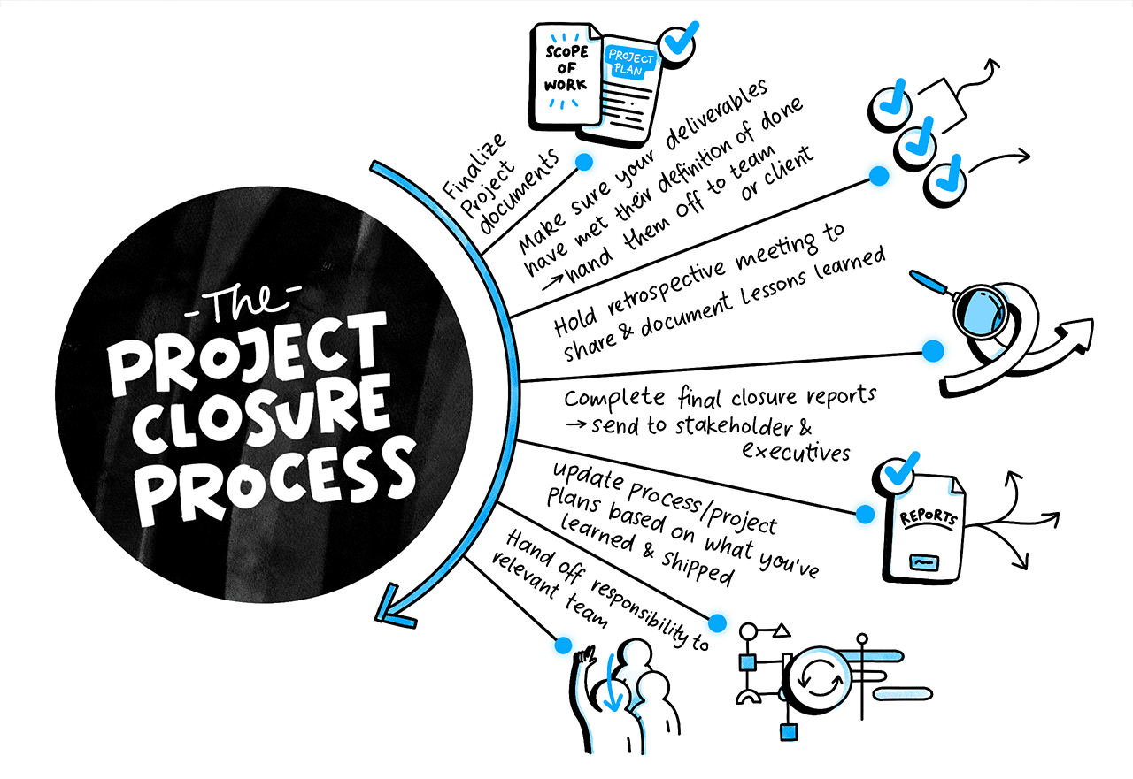

Slide 44
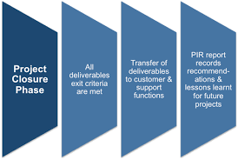

Slide 45
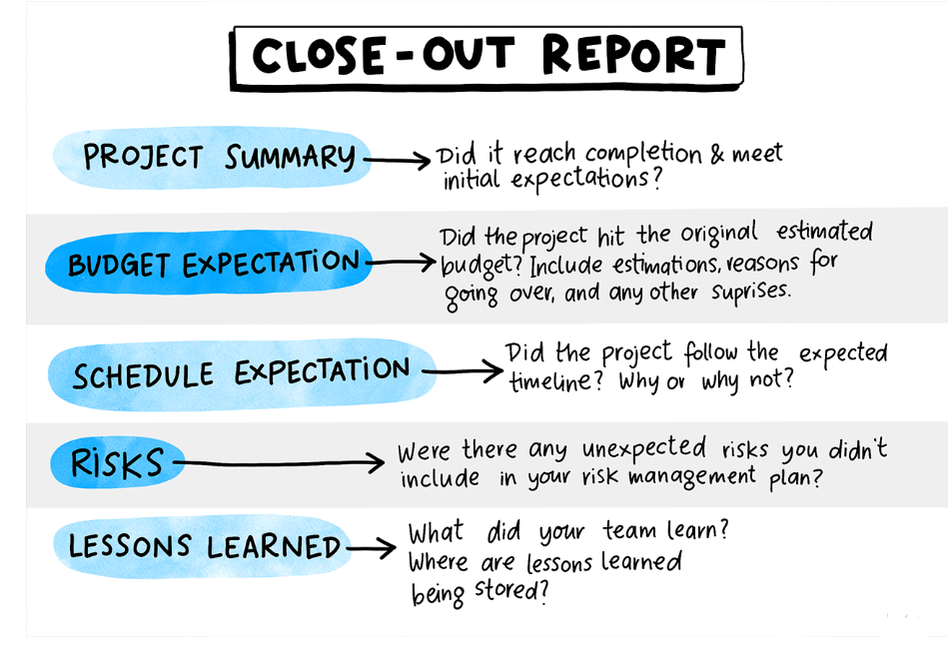

Slide 46


