Slide 1





Introductory lecture
Prepared by Dr. Walaa Mohamed
MGM 237
Introduction to Finance

Slide 2
Finance: The Science and art of money management
What is finance?
Finance is concerned with the study of operations, institutions, markets and various financial instruments associated with the transfer of funds in the form of individuals, companies and governments.

Slide 3
Financing for individuals
Finance is concerned with studying the decisions of individuals to invest their wealth in the following:
• Amount of spending
• the amount of savings
• How to invest their savings

Slide 4
Financing for companies
Finance is concerned with studying the decisions of companies to invest their wealth in the following:
• How does the company provide the necessary funding?
• How does the company invest the funds available to it to achieve the largest possible profit?
• How to take a decision to reinvest the profits of the company or distribute it to the investors?

Slide 5
Definition of Financial system
Financial system is a system that facilitates the movement of capital in the form of individuals and institutions within the economy through providing various financial means and mechanisms for exchanging money, such as investors, lenders, and debtors.

Slide 6
Financial system elements
• Financial institutions
• Financial Markets
• Financial Instruments

Slide 7
These elements work together to facilitate the transfer of capital in the various components of the financial system, the financial system exists at the local, regional and state levels, and the financial system plays an effective role in the process of economic development by connecting savers with investors, which contributes to the creation and maximization of capital gains.
• The money system provides tools to transfer money from savers who have idle money and redistribute them effectively to investors who are able to create investments and achieve profits.

Slide 8
Risk
There is always a risk incorporated in every investment like shares or debentures. The two major components of risk systematic risk and unsystematic risk, which when combined results in total risk. The systematic risk is a result of external and uncontrollable variables, which are not industry or security specific and affects the entire market leading to the fluctuation in prices of all the securities.

Slide 9
On the other hand, unsystematic risk refers to the risk which emerges out of controlled and known variables, that are industry or security specific.
Systematic risk cannot be eliminated by diversification of portfolio, whereas the diversification proves helpful in avoiding unsystematic risk. Take a full read of this article to know about the differences between systematic and unsystematic risk.

Slide 10
Portfolio Diversification
Most people have heard the old saying, "Don't put all your eggs in one basket.
Diversification is a risk management strategy that mixes a wide variety of investments within a portfolio. A diversified portfolio contains a mix of distinct asset types and investment vehicles in an attempt at limiting exposure to any single asset or risk.
The rationale behind this technique is that a portfolio constructed of different kinds of assets will, on average, yield higher long-term returns and lower the risk of any individual holding or security.

Slide 11

صيغ التمويل في المصارف الإسلامية
تقوم المصارف التجارية بعمليات القروض والسلفيات لعملائها مقابل فائدة ربوية محددة مقدماً. أما في المصارف الإسلامية فيتم استخدام الأموال عن طريق صيغ التمويل المتعددة والمشروعة والتي تناسب كافة الأنشطة سواء أكانت تجارية، صناعية، زراعية، عقارية، مهنية، حرفية. ويعد نشاط التمويل من أهم الأنشطة بالمصارف الإسلامية حيث تمثل عوائده أهم مصدر للأرباح.
وهناك العديد من صيغ التمويل الإسلامية، منها: التمويل بالمرابحة، والتمويل بالمشاركة، والتمويل بالمضاربة، والتمويل بالاستصناع، والتمويل بالسَلَم، والتمويل بالإجارة والتمويل بالبيع الآجل.

Slide 12
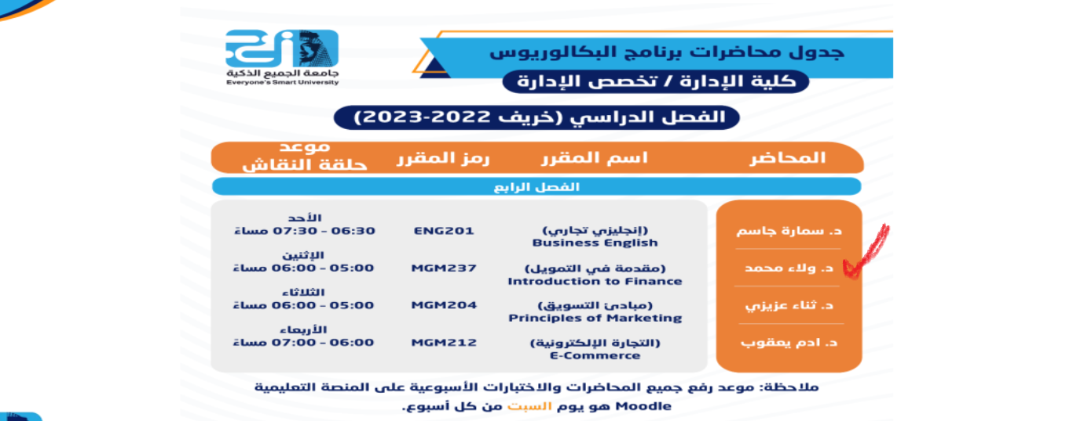

حساب اللينك ان الخاص بي
https://www.linkedin.com/in/walaa-mohamed-95a402122/

