Slide 1


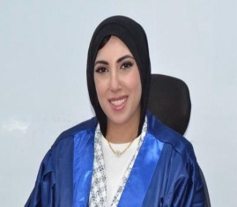
Change Management
Prepared by Dr. Ranya Mahfouz
MGM323
Orientation Lecture

Slide 2

Change Management
Orientation Lecture
MGM323
Prepared by
Dr. Ranya Mahfouz

Slide 3
    الخبــــرات :
    حاصلة على درجة الدكتوراة في الأقتصاد والمالية العامة – جامعة طنطا
    مديرة ادارة الجودة, و مدربة معتمدة.
    لدى أكثر من 10 سنوات من الخبرة في التدريس الإكاديمي / و التقييم المالى
    خبيرة في التفكير الإبداعي وحل المشكلات المعقدة
    استشاري تحليلات اقتصادية وساسية –المجلس المصري للشئون الخارجية و وزارة الخارجية المصرية
    عضو الجمعية الملكية للاقتصاد السياسي والإحصاء والتشريع - بالقاهرة
    لدى أيضا العديد من الابحاث الدولية والمحلية
    شاركت بالعديد من المؤتمرات الدوليه والمحلية

Slide 4


Slide 5


Change Management: A Beginner's Guide to a Changing World
What is Change Management? It's how we understand and deal with changes around us, at work or in daily life.
Why does it matter now?
Because change is happening faster than ever!
Examples of daily changes:
Science, Technology And Economy.
But there are challenges too:
--Growing gaps between countries - Negative impacts on some social groups
--New problems like cyber security and climate change

Slide 6

Change Management
How to handle this?
1-Understand change: Stay curious and informed
2- Adapt: Keep learning new skills
3-Benefit: Turn challenges into opportunities
Remember: "Change isn't good or bad by itself - what matters is how we handle it!"

Slide 7
Change Management
Understanding Change Management is designed for anyone eager to grasp the reasons behind change, the process of change, and the actions necessary to create a more positive view of change. Specifically, we aspire for leaders and organizational managers to recognize a change that may not provide a singular solution but instead offers valuable perspectives on various frameworks and methods for tackling change on individual, team, and organizational levels.
We are aware of the significant demands and priorities that managers face in both the public and private sectors, and Understanding Change Management seeks to simplify their experiences a bit. It also aims to persuade them that confronting the underlying issues that lead to poor management of change in organizations will result not only in more gratifying experiences for themselves but also in richer lives for their employees.

Slide 8
Dimensions of Change Management
Why Change Happens
How Change Happens
Change
Management
What Needs to Be Done
Individual Level
Team Level
Organizational Level

Slide 9

Content
1 Individual change
Learning and the process of change
2 Team change
What is a group and when is it a team?
3 Organizational change
How organizations really work
4 Leading change
Roles that leaders play
5 The change agent
Models of change agency

Slide 10
Content
6 Mergers and acquisitions
The purpose of merger and acquisition activity
7 Cultural change
Guidelines for achieving successful cultural change
8 IT-based process change
The role of IT management
9 Complex change
When is change complex?
10 Leading Digital Transformation & AI-Driven Change

Slide 11

Orientation
الفترة الزمنية التعليمية في الفصل الدراسي الصيف تكون مدة ١٣أسبوع
( منهم أسبوعين للاختبار النهائي)
تعتمد أوقات المحاضرات وحلقات النقاش علي توقيت مكة المكرمة لجميع البرامج.
مدة المحاضرة المسجلة ٧٠- ٩٠ دقيقة ترفع على منصة
Moodle
ترفع المحاضرة الأسبوعية على المنصة التعليمية Moodle يوم السبت من كل أسبوع.
حلقات النقاش وهي حلقات أسبوعية اختيارية للطالب وغرضها مناقشة ما تم طرحه في المحاضرة المسجلة لهذا الاسبوع. (يرجي مراجعة الموعد والمدة الزمنية لكل مقرر حسب الجدول)
حلقات النقاش اختيارية.
Notes:
Accountants prepare reports for both external and internal users. External users of accounting information are not directly involved in running the organization. Examples of external users are lenders, shareholders (investors), governments, consumer groups, customers, and the external auditors.
Internal users of accounting information are those directly involved in managing and operating an organization. They use the information to help improve the efficiency and effectiveness of an organization. Examples of internal users are managers, officers/directors, internal auditors, sales staff, budget officers and controllers.

Slide 12
Orientation
الأسبوع الأول هو أسبوع توجيهي
ويتم رفع كل ما يخص الفصل الدراسي على صفحة المودل.
يرفع اختبار قصير به أسئلة عامة للطلاب من السهل حلها ويكون هذا الاختبار القصير بمثابة تدريب للطلاب على التوقيت وعدد الأسئلة.
Notes:
Accountants prepare reports for both external and internal users. External users of accounting information are not directly involved in running the organization. Examples of external users are lenders, shareholders (investors), governments, consumer groups, customers, and the external auditors.
Internal users of accounting information are those directly involved in managing and operating an organization. They use the information to help improve the efficiency and effectiveness of an organization. Examples of internal users are managers, officers/directors, internal auditors, sales staff, budget officers and controllers.

Slide 13

Orientation
Notes:
Accountants prepare reports for both external and internal users. External users of accounting information are not directly involved in running the organization. Examples of external users are lenders, shareholders (investors), governments, consumer groups, customers, and the external auditors.
Internal users of accounting information are those directly involved in managing and operating an organization. They use the information to help improve the efficiency and effectiveness of an organization. Examples of internal users are managers, officers/directors, internal auditors, sales staff, budget officers and controllers.

Slide 14
Orientation
اللغة الأساسية في المحاضرات هي اللغة الإنجليزية واللغة العربية.
-- الاختبارات : اللغة العربية. اللغة الإنجليزية
Notes:
Accountants prepare reports for both external and internal users. External users of accounting information are not directly involved in running the organization. Examples of external users are lenders, shareholders (investors), governments, consumer groups, customers, and the external auditors.
Internal users of accounting information are those directly involved in managing and operating an organization. They use the information to help improve the efficiency and effectiveness of an organization. Examples of internal users are managers, officers/directors, internal auditors, sales staff, budget officers and controllers.

Slide 15

Orientation
Notes:
Accountants prepare reports for both external and internal users. External users of accounting information are not directly involved in running the organization. Examples of external users are lenders, shareholders (investors), governments, consumer groups, customers, and the external auditors.
Internal users of accounting information are those directly involved in managing and operating an organization. They use the information to help improve the efficiency and effectiveness of an organization. Examples of internal users are managers, officers/directors, internal auditors, sales staff, budget officers and controllers.

Slide 16
Orientation
الاختبارات القصيرة (الأسبوعية)
يرفع الاختبار القصير أسبوعيا في نفس موعد رفع المحاضرة يوم السبت من كل أسبوع في تمام الساعة العاشرة مساءً ويترك لمدة أسبوع ، ثم يغلق في يوم السبت الذي يليه تمام الساعة التاسعة مساءً.
أسئلة الاختبار القصير MCQ / true & false / أسئلة صوتية
تعد الإجابة على الاختبار القصير بمثابة الحضور للطالب.
الاختبار القصير من ٨ درجة / ٨ اسئلة. كل سؤال بدرجة
فترة السماحية للاختبار القصير 30دقيقة
Notes:
Accountants prepare reports for both external and internal users. External users of accounting information are not directly involved in running the organization. Examples of external users are lenders, shareholders (investors), governments, consumer groups, customers, and the external auditors.
Internal users of accounting information are those directly involved in managing and operating an organization. They use the information to help improve the efficiency and effectiveness of an organization. Examples of internal users are managers, officers/directors, internal auditors, sales staff, budget officers and controllers.

Slide 17
Orientation
الاختبار النهائي
الاختبار النهائي سيكون من خلال المودل.
أسئلة الاختبار النهائي /Matching / true & false MCQ / أسئلة صوتية + مسائل
الاختبار النهائي من ٢٠ درجة.
Notes:
Accountants prepare reports for both external and internal users. External users of accounting information are not directly involved in running the organization. Examples of external users are lenders, shareholders (investors), governments, consumer groups, customers, and the external auditors.
Internal users of accounting information are those directly involved in managing and operating an organization. They use the information to help improve the efficiency and effectiveness of an organization. Examples of internal users are managers, officers/directors, internal auditors, sales staff, budget officers and controllers.

Slide 18
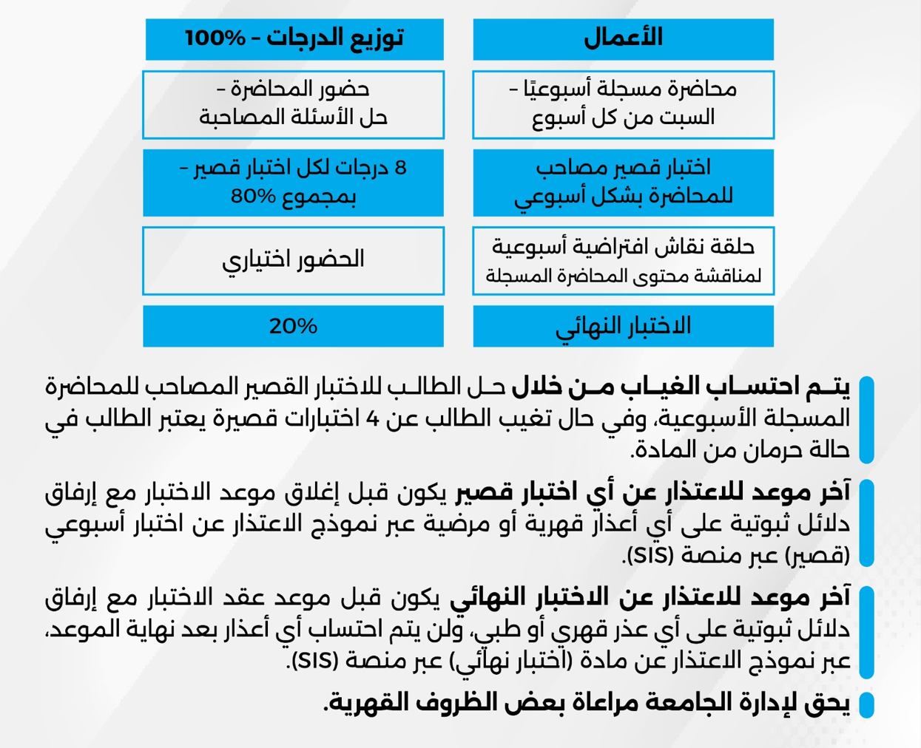
Orientation

Slide 19
Required Textbook:
MAKING SENSE OF CHANGE MANAGEMENT: A complete guide to the models, tools and techniques of organizational change, 3rd edition, by Esther Cameron and Mike Green.

Slide 20


Slide 21

Thank You

