Slide 1




Fundamentals of
Risk Management
Lecture 2
PMG510
Prepared by
Dr. Usama Al-Fendi

Slide 2

Lecture 2
Course Outlines
Levels of risk
Impact of risk on organizations
Risk Reward Relationship
Scope of risk management
Bow Tie Model for Risk Analysis

Slide 3
Lecture 2
Level of risk:
By taking a proactive approach to risk and risk management, organizations will be able to achieve the following four areas of improvement: Strategy Tactics Operations Compliance

Slide 4
Lecture 2
Level of risk:
Strategy, because the risks associated with different strategic options will be fully analyzed and better strategic decisions will be reached. Strategic risk refers to the internal and external events that may make it difficult, or even impossible, for an organization to achieve their objectives and strategic goals. These risks can have severe consequences that impact organizations in the long term.

Slide 5
Lecture 2
Level of risk:
Tactics, because consideration will have been given to selection of the tactics and the risks involved in the alternatives that may be available. Tactical risks is the chance of loss due to changes in business conditions on a real time basis. Tactics differ from strategy in that they handle real time conditions.

Slide 6
Lecture 2
Level of risk:
Operations, because events that can cause disruption will be identified in advance and actions taken to reduce the likelihood of these events occurring, limit the damage caused by these events and contain the cost of the events. Operational risks is the inadequate or failed internal procedures, employee errors, cybersecurity events, or external events such as weather disasters.

Slide 7
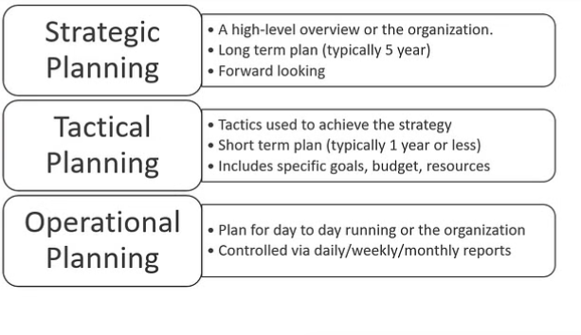
Lecture 2
Level of risk:

Slide 8
Lecture 2
Level of risk:
Compliance will be enhanced because the risks associated with failure achieve compliance with statutory and customer obligations will be recognized Compliance risk is an organization's legal, financial and criminal exposure if it does not follow industry laws and regulations. The goal of many regulations is to protect people and sensitive data.

Slide 9
Lecture 2
Impact of risk on organizations
Stakeholders now expect that organizations will take full account of the risks that may cause disruption within operations, late delivery of projects or failure to deliver strategy, incompliance with the adapted rules, regulations, and policies.

Slide 10
Lecture 2
Impact of risk on organizations
Inherent risk vs residual risk Inherent Risk is typically defined as the level of risk in place in order to achieve an entity’s objectives and before actions are taken to alter the risk’s impact or likelihood (risk controlling techniques).

Slide 11
Lecture 2
Impact of risk on organizations
Inherent risk vs residual risk Residual Risk is the remaining level of risk following the development and implementation of the entity’s response (risk controlling techniques).

Slide 12
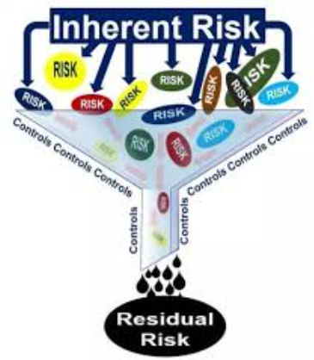
Lecture 2
Impact of risk on organizations

Slide 13
Lecture 2
Impact of risk on organizations
The risk level should be compared with the risk attitude or risk appetite or risk tolerance of the organization for the said risks of that type. Catastrophic and unacceptable level of risk for some organizations can be normal and acceptable level for other organizations.

Slide 14
Lecture 2
Impact of risk on organizations
Risk appetite is best described as the amount of different types of risk a firm is willing to accept to achieve its objectives. Organizations recognize that they cannot remove all risks from their business. Achieving our business goals requires accepting some of those risks while taking actions to mitigate, avoid or transfer other risks. Governing body who set risk appetite.

Slide 15
Lecture 2
Impact of risk on organizations
Risk tolerance is the amount of acceptable deviation from an organization's risk appetite. While risk appetite is a broad, strategic philosophy that guides an organization's risk management efforts, risk tolerance is a much more tactical concept that identifies the risk associated with a specific initiative and compares it to the organization's risk appetite.

Slide 16
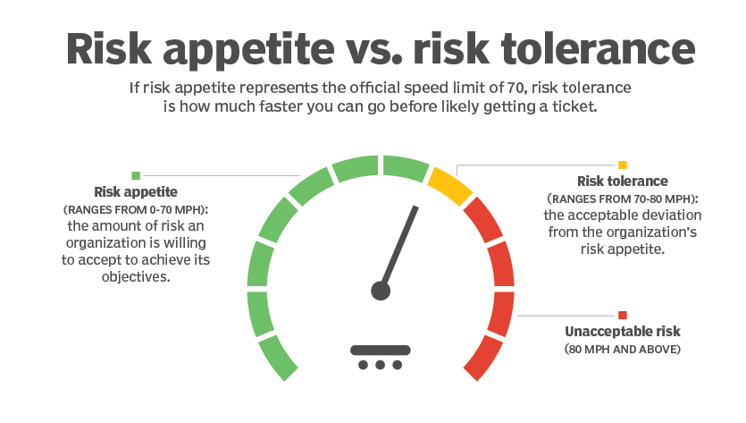
Lecture 2
Impact of risk on organizations

Slide 17
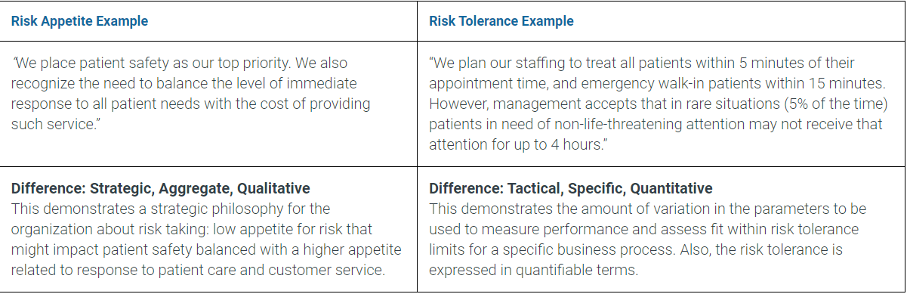
Lecture 2
Impact of risk on organizations

Slide 18
Lecture 2
Impact of risk on organizations
Risk attitude indicates the long-term view of the organization to risk and risk appetite indicates the short-term willingness to take risk. This is similar to the difference between the long-term or established attitude of an individual towards the food they eat and their appetite for food at a particular moment in time.

Slide 19
Lecture 2
Impact of risk on organizations
Example on inherent risk Lack of security software or device – Standardizing the employee’s guidelines and creating password rules for how the employees should cater to their devices are quite examples of controls that can assist in securing the company software and hardware. If these controls are nonexistent or too lax, data breaches will likely happen.

Slide 20
Lecture 2
Impact of risk on organizations
Example on residual risk Third-party cyber-attack – Such cyber-attacks usually happen when there is an external intent within the organization’s company network to disable, disrupt or control the stored information. As the attacks are carried out by third parties, it is highly impossible to know if and when an attack is bound to happen. Even with proper controls and checks in order, this still remains a residual risk.

Slide 21
Lecture 2
Impact of risk on organizations
I is impossible for organizations or projects to achieve their goals without taking any risk. Zero risk means zero return, “No Pain – No Gain” You can balance your position at the level that suits your risk appetite

Slide 22
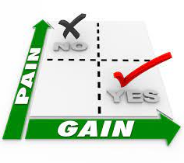
Lecture 2
Risk Reward Relationship

Slide 23
Lecture 2
Risk Reward Relationship
In launching a new product, the organization will put resources at risk because it has decided that a certain amount of risk taking is appropriate. Penetrating new market through opening new branches is putting resources at risk intentionally, hoping this will generate profits later on.

Slide 24
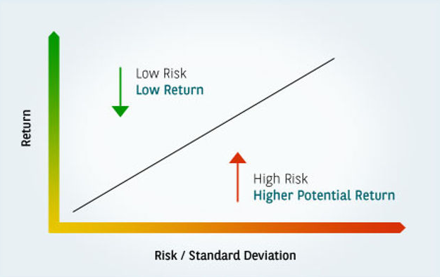
Lecture 2
Risk Reward Relationship

Slide 25
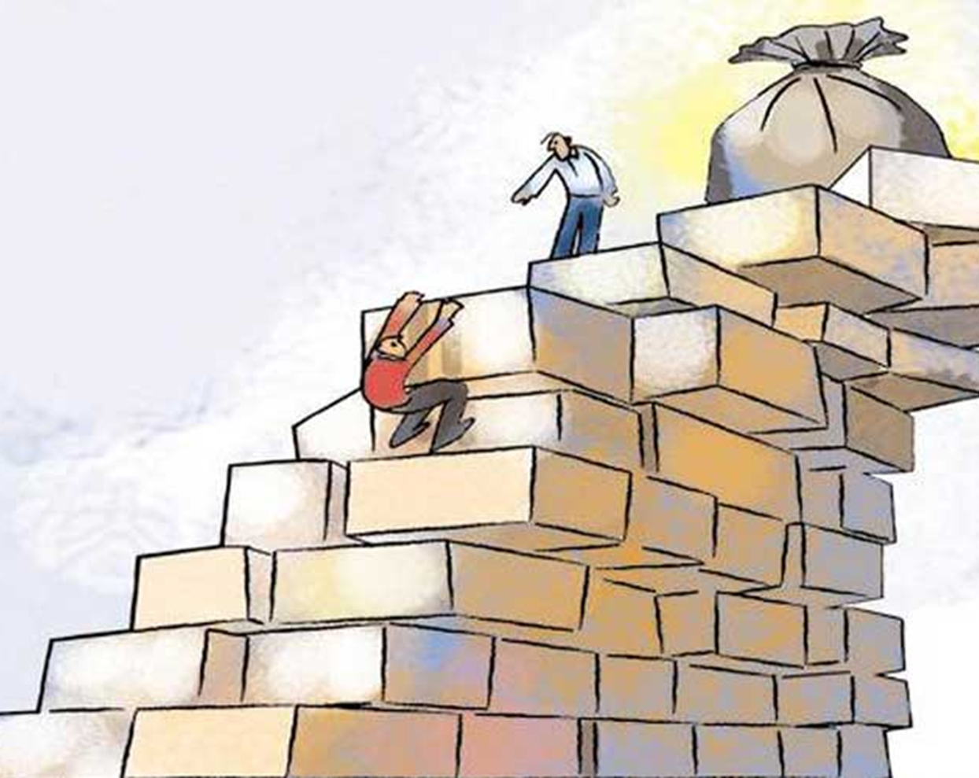
Lecture 2
Risk Reward Relationship

Slide 26
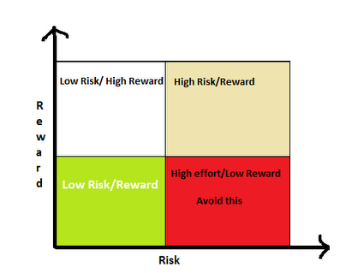
Lecture 2
Risk Reward Relationship

Slide 27
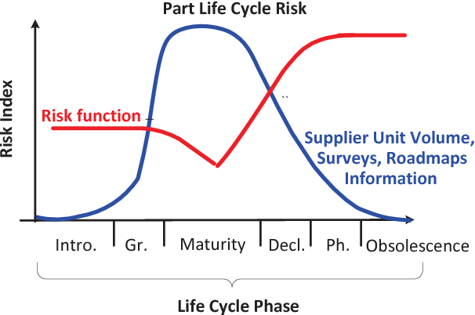
Lecture 2
Risk Reward Relationship

Slide 28
Lecture 2
Risk Reward Relationship
For an organization that is in the start-up phase, a more aggressive attitude to risk is required than for an organization that is enjoying growth or one that is a mature organization in a mature marketplace. Where an organization is operating in a mature marketplace and is suffering from decline, the attitude to risk will be much more risk averse.

Slide 29
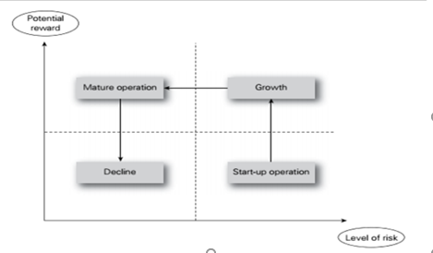
Lecture 2
Risk Reward Relationship

Slide 30
Lecture 2
Risk Reward Relationship
Different organizations will have different attitudes to risk. Some organizations may be considered to be risk averse, whilst others will be risk aggressive. To some extent, the attitude of the organization to risk will depend on the sector and the nature and maturity of the marketplace within which it operates, as well as the attitude of the individual board members.

Slide 31
Lecture 2
The Risk Reward Relationship
Contribution of Risk Management on Decision Making However, the fact that the opportunity entails high risk may not have been fully considered. One of the major contributions from successful risk management is to ensure that strategic decisions that appear to be high risk are actually taken with all of the information available.

Slide 32
Lecture 2
Risk Reward Relationship
Contribution of Risk Management on Decision Making Improvement in the robustness of decision-making activities is one of the key benefits of risk management. Attitude to risk is a complex subject and is closely related to the risk appetite of the organization, but they are not the same.

Slide 33
Lecture 2
Risk Reward Relationship
Other key factors that will determine the attitude of the organization to risk include the stage in the maturity cycle. It is because the attitude to risk has to be different when an organization is a startup operation rather than a mature organization, that it is often said that certain high-profile businessmen are very good at entrepreneurial start-up but are not as successful in running mature businesses.

Slide 34
Lecture 2
Risk Reward Relationship
Risk and triggers: Risk is sometimes defined as uncertainty of outcomes. This is a somewhat technical, but nevertheless useful, definition and it is particularly applicable to the management of control risks.

Slide 35
Lecture 2
Risk Reward Relationship
Risk and triggers: Control risks are the most difficult to identify and define, but are often associated with projects. The overall intention of a project is to deliver the desired outcomes on time, within budget and to specification, quality or performance.

Slide 36
Lecture 2
Risk Reward Relationship
Risk and triggers: Given this uncertainty, these risks should be considered to be control risks and the overall management of the project should take account of the uncertainty associated with these different types of risk.

Slide 37
Lecture 2
Bow tie analysis
Bow tie analysis Bow tie analysis is a simple process for identifying where new or enhanced controls may be worthwhile. It is a core part of risk treatment planning, particularly where there is a high level of risk or where control effectiveness is assessed as low.

Slide 38
Lecture 2
Bow tie analysis
The start of any bowtie is the ‘hazard'. A hazard is something in, around or part of the organization which has the potential to cause damage. Driving a car or storing sensitive data are for instance hazardous aspects of an organization. The idea of a hazard is to find the things that are part of your organization and could have a negative impact if control over that aspect is lost. They should be formulated as normal aspects of the organization.

Slide 39
Lecture 2
Bow tie analysis
Once the hazard is chosen, the next step is to define the ‘top event. This is the moment when control is lost over the hazard. There is no damage or negative impact yet, but it is imminent. This means that the top event is chosen just before events start causing actual damage.

Slide 40
Lecture 2
Bow tie analysis
Consequences’ are the result from the top event. There can be more than one consequence for every top event. events like ‘car roll over', ‘oil spill into sea’ or ‘toxic cloud forms'. Besides containing more specific information, this will help in more specific thinking when coming up with barriers. Think how you want to prevent ‘environmental damage’ versus ‘oil spill into sea'. The second is an actual scenario which makes it much easier to come up with specific barriers.

Slide 41
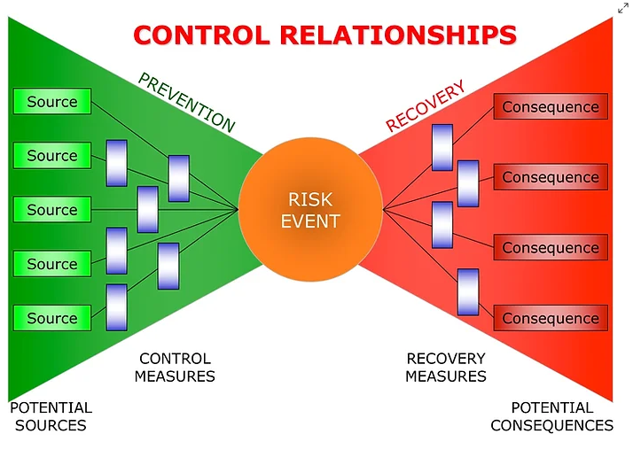
Lecture 2
Bow tie analysis

Slide 42
Lecture 2
Bow tie analysis
The left-hand side of the bow-tie represents the source of a particular hazard and will indicate the classification system used by the organization for sources of risk. these sources of risk used are the high-level sources of strategic, tactical, operational and compliance (STOC) risks.

Slide 43
Lecture 2
Bow tie analysis
The right-hand side of the bow-tie sets out the impact should the risk events occur, we usually use the high-level components of financial, infrastructure, reputational and marketplace (FIRM) impact of a risk materializing.

Slide 44
Lecture 2
Bow tie analysis
In the center of the bow-tie is the risk event that indicates the categories of disruption that can affect organizations, and the same categories of people, premises, processes and products are used here.

Slide 45
Lecture 2
Bow tie analysis
The purpose of using the bow-tie illustration is to demonstrate the risk classification systems used by the organization and the potential range of impacts should a risk materialize. Controls (control techniques) can be put in place to prevent the event occurring and these can be represented by vertical lines on the left-hand side of the bow-tie.

Slide 46
Lecture 2
Bow tie analysis
The causes of the risk then need to be recorded along with the preventive controls to stop the risk occurring. The impact of the risk is also considered through loss reduction techniques. This enables the identification of response controls to lessen the impact of the risk should it occur

Slide 47
Lecture 2
Bow tie analysis
In a similar manner, recovery controls (Financing techniques or Transferring techniques) can be represented on the right-hand side of the bow-tie. The bow-tie representation of the risk management process can be used in many ways, including the representation of opportunity risks

Slide 48
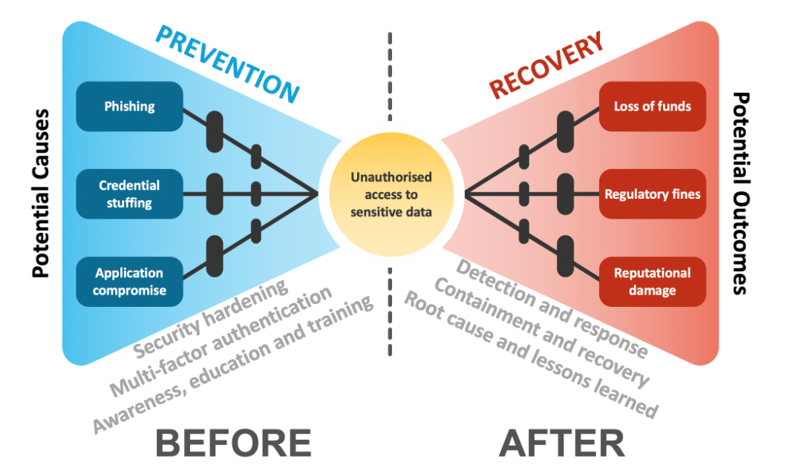
Lecture 2
Bow tie analysis

Slide 49
Lecture 2
Conclusion

Slide 50


Thank You

