Slide 1




Organizational Behavior and Projects
PMG421
Prepared by Mrs. Deena Ibrahim
Lecture 5
Project Quality Control
and Quality Improvement

Slide 2


Quality Control 1.2 Role of Inspection 1.3 Quality Control Tools
2. Quality Improvement 2.1 Reasons for Quality Improvement 2.2 Hurdles 2.3 Improvement Methodology
3- Summary

Slide 3
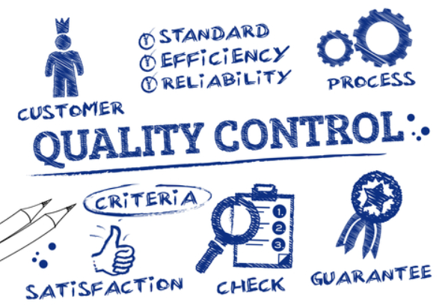
1- What is the meaning of Quality Control

Slide 4
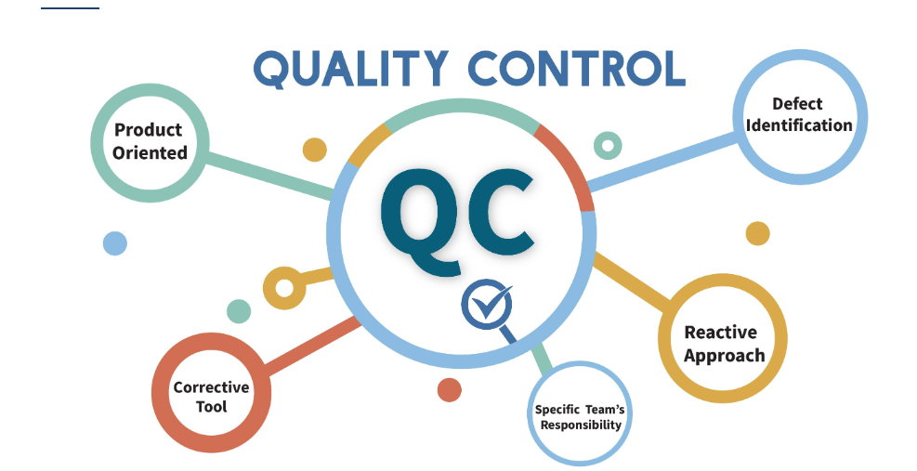
The PMBOK® Guide defines quality control as “…monitoring specific project results to determine if they comply with relevant quality standards and identifying ways to eliminate causes of unsatisfactory performance.”
This is an action process in which the project team looks at results and determines necessary corrective action.

Slide 5
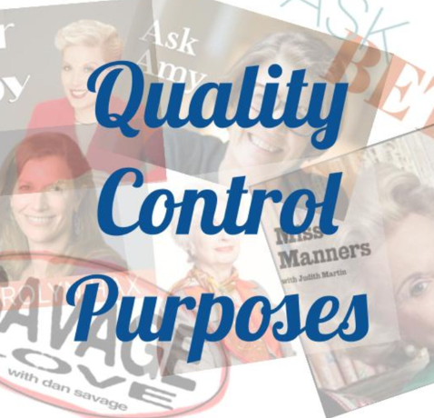
Quality Control purposes:
◆ Results may confirm that all is well. If results are within specifications (no variance from specifications is indicated), the project team knows that performance is proceeding according to plan.
◆ Results may provide the basis for corrective action. If results do not conform to specifications (some degree of variance is indicated), the project team knows that something has gone wrong or is going wrong.

Slide 6
◆ Results provide feedback to the quality assurance process. Results obtained during quality control provide data that are examined during quality audits. Performance that does not conform to specifications indicates that the quality assurance activities associated with that performance are not having the desired effect.

Slide 7
◆ The project team must take corrective action to fix the existing variance from the plan. The team must also identify the source of the variance and take corrective action to prevent it from recurring.
◆ Quality assurance activities are intended to ensure conforming performance. The project team must analyze the data, determine the shortcoming, improve the quality assurance activities, and update the quality assurance plan.

Slide 8
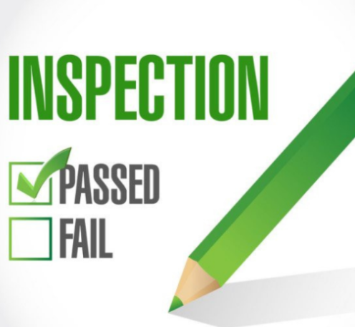
1.2 Role of Inspection:
Inspection plays a significant role in quality management, but it is a role that is different from that in the traditional approach to quality. Products must be inspected at the end of a process to ensure that they conform to specification. Products must be checked before they are delivered to the paying customer. Results of the inspection allowed delivery of the product or required rework or discard of the defective items.

Slide 9
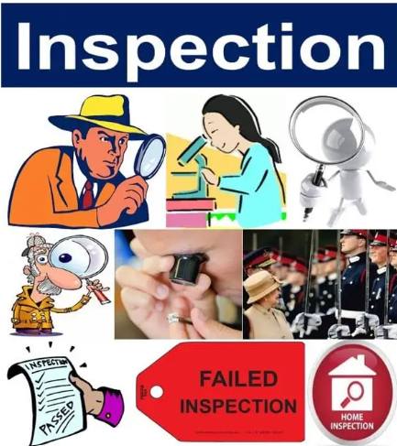
In the contemporary view of quality, inspection plays a very broad role across and throughout the process. Small, frequent inspections ensure that the process is performing as planned, with the result being fewer nonconforming products at the end of the process. In-process inspection may reveal deficiencies that can be corrected before they cause costly scrap and rework.

Slide 10

Inspections may include several kinds of activities, such as:
◆ Measuring physical characteristics of products.
◆ Examining products for completeness or correct assembly.
◆ Testing products for performance.

Slide 11
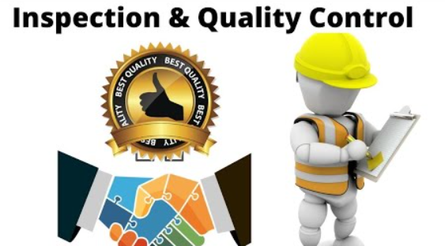
9 important functions for inspection:
Documenting product quality standards to be referenced at the time of Inspections.
Developing easy-to-understand and follow inspections workflows.
Defining the containment procedures for products quality issues that can be fixed by reworking.
Calibrating the inspection equipment and devices at regular intervals to ensure error-free inspections.
Streamlining inspection process at source to reduce scrap and low-quality products.

Slide 12
6. Training the inspection teams on the best practices to manage production challenges.
7. Reporting incidents and their action plan to management.
8. Standardizing inspections for pre, post, and inline production in adherence to compliance requirements.
9. Ensuring the inspection process changes have minimal or no impact on production cycle time.

Slide 13

What is the purpose of inspections?
Inspections are important as they allow you to:
Listen to the concerns of workers and supervisors.
Gain further understanding of jobs and tasks.
Identify existing and potential hazards.
Determine underlying causes of hazards.
Recommend corrective action.
Monitor the steps taken to eliminate hazards or control the risk.
Meet regulatory and management system requirements.
Notes:
https://www.ccohs.ca/oshanswers/prevention/effectiv.html

Slide 14
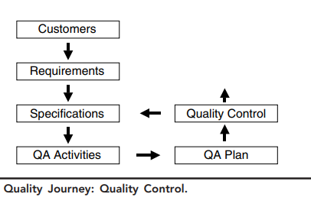

1.3 Quality Control Tools:
Many quality control tools are available to the project team. Ishikawa’s seven basic tools are a comprehensive set, but many others exist beyond these. Quality control may be a simple matter of checking something. It may involve the application of complex tools that require some expertise. Many of the tools of quality control are also tools of quality improvement. This completes the sixth step in the quality journey .

Slide 15
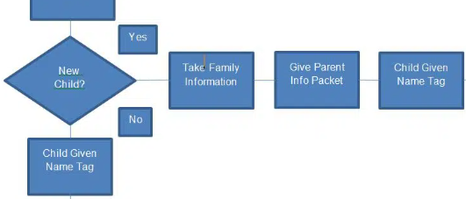
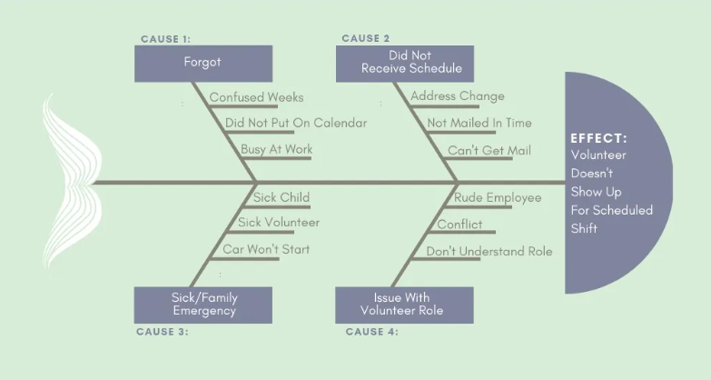
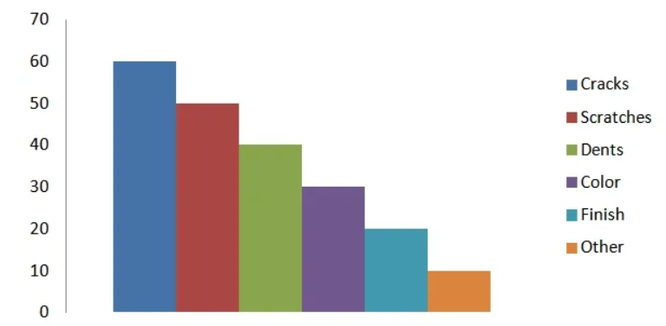
7 Management Tools For Quality Control:
1. Flowchart.
2. Check Sheet.
3. Cause and Effect (fish bone) Diagram.
4. Pareto Chart.
5. Control Charts.
6. Histograms.
7. Scatter Diagrams.

Slide 16
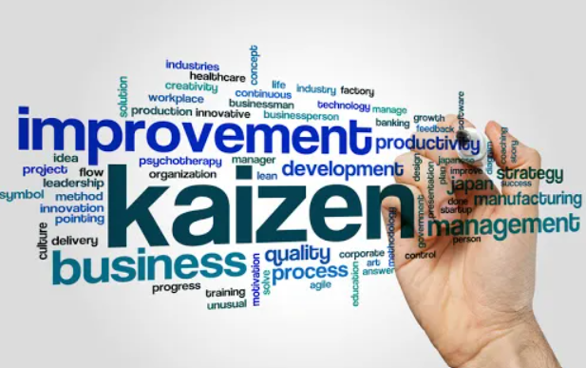
2- Quality Improvement
The loop from quality control back to specifications is not the end of the quality journey, however. Juran defines quality improvement as “…the organized creation of beneficial change; the attainment of high levels of performance …breakthrough.”
Quality improvement is a deliberate process that uses objective measurement and data. All quality improvement begins with data collection. The Japanese word kaizen (meaning continual, incremental improvement) is widely used in quality related activities.

Slide 17
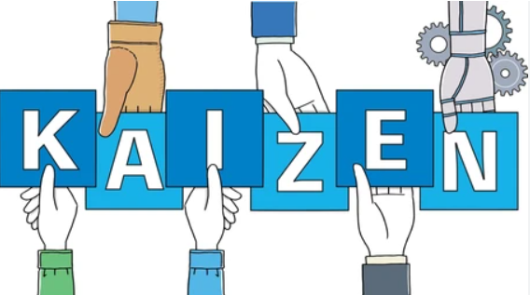
Kaizen means continuous improvements in the daily working life, home life, personal life, and social life. And involving everyone for continuing improvement.
It is a Japanese word made by the combination of two words:
Kai – means to Modify or Change
Zen – means Good ( for the Better)
Therefore, Kaizen can be defined as the “change for better”.
Kaizen is one of the important tools of Lean Manufacturing and TQM.

Slide 18
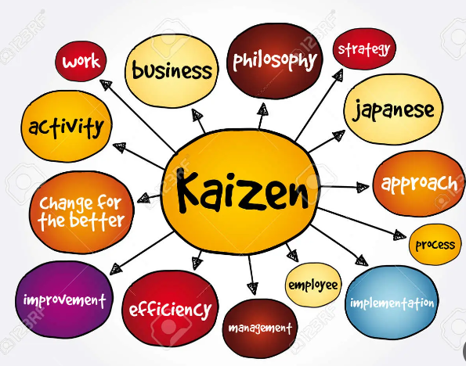
Kaizen Philosophy:
Developing a culture for people engagement in improving the organization through small-small continuous improvement in daily work rather than one large improvement at once. Kaizen’s belief is that the small-small improvements in large numbers at lower cost are generally better than some large improvements at a higher cost.

Slide 19

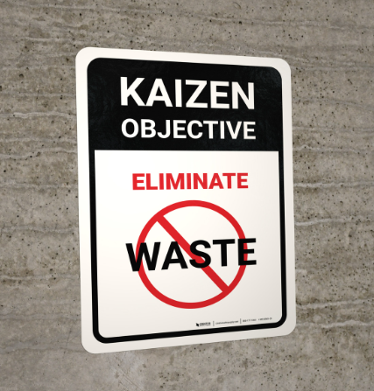
- The kaizen objective is the continuous improvement in the product and process quality by eliminating waste from the process or services by identifying values and involving everyone.
- Continuous improvement in product and process quality by identifying values.
- Eliminate Muda or Waste.
- Lower rejection/defects and cost.
- Increase Productivity.
Promote Innovation.
Increase worker’s morale and accountability through effective participation.

Slide 20
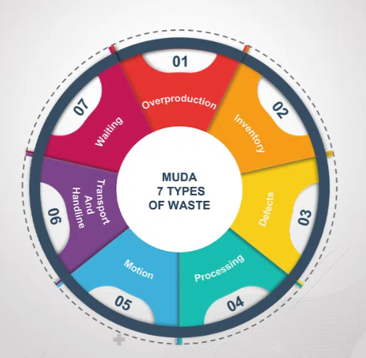
What is MUDA?
The operation/activity of an organization or manufacturing industries normally includes both value-added work and non-value added work. The non-value-added activities are called MUDA that leads to increase production costs.

Slide 21

2.1 Reasons for Quality Improvement
Quality improvement is not just a good idea. Many practical reasons exist, demanding that organizations continually improve their
quality of product or service.
◆ A basic reason is to improve products or reduce deficiencies. Better products or fewer deficiencies will improve customer satisfaction, improve reputation, and increase competitiveness.
◆ Recall that products are not things unto themselves; they meet some kind of customer need.
◆ Another reason for quality improvement is to produce better products for customers. This, too, will increase customer satisfaction and may increase deliveries to existing customers and generate sales to new customers

Slide 22
Reasons for Quality Improvement Cont.
◆ Better processes may result in more efficient use of time, less waste, or fewer defects.
◆ Customers can be a frustrating lot. Give them what they want and they ask for more. Dynamic customer needs and requirements demand that we continually improve to meet the new needs and requirements.
◆ Quality improvement may reduce costs. Lower costs can increase competitiveness through lower prices or result in delivery of more product or service for the existing price.

Slide 23
Reasons for Quality Improvement Cont.
◆ Global competition is a cold, hard fact of business life. Quality improvement can make products more competitive in the face of low-cost labor markets.
◆ New technologies and the pace of technology development require change and enable quality improvement. We must improve to keep up, and the continual changes allow us to improve continually and provide better products and services to our customers

Slide 24

3.1 Hurdles
Quality improvement can be difficult for many reasons.
- Members of the project team may be disillusioned by past failures.
- Past efforts at improvement may not have produced any results, or at least not the results that the team expected or considered to be worth the effort.
- Members of the team or members of external management may believe, wrongly, that improved quality costs more.

Slide 25
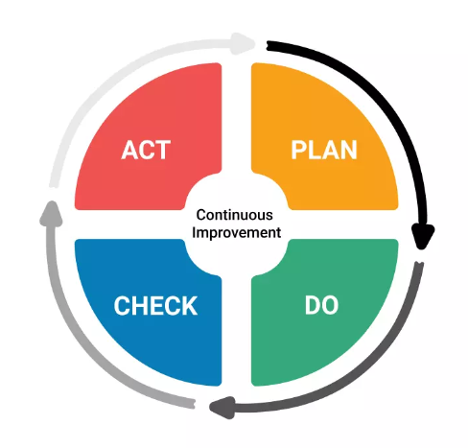
3.2 Improvement Methodology
The plan-do-check-act cycle is a proven, disciplined approach to quality improvement. It was developed by Walter, Statistical Method from the Viewpoint of Quality Control. Deming and others applied it as the “Shewhart cycle.”
In Japan, it is known as the “Deming cycle” because Dr. Deming introduced it in his lectures to the Japanese Union of Scientists and Engineers in 1950.

Slide 26
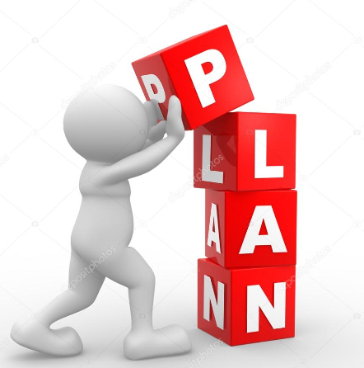
A- Plan: This is the starting point. Select a process for improvement. It may be the process that suggests the greatest payback, or the process that suggests the greatest opportunity for success, or the process the boss wants. Initially, it may be beneficial to select a process that shows the greatest potential for successful improvement, maybe the “easiest” one. The team will have less difficulty working through the model the first time, and both the team and management will be encouraged by success. After selecting the right process, analyze it and plan a change that will have beneficial effect

Slide 27

B- Do: Apply the change on a small scale, a test case. This is a critical step and the hallmark of the approach. Do not announce the plan as a mandatory change across the entire system. That can lead to “knee jerking” the work force. If the plan does not have the desired effect, or even makes things worse, the project team and management may lose confidence in the model and perhaps in those who tried to apply it. Both results can be fatal to further quality improvement.

Slide 28
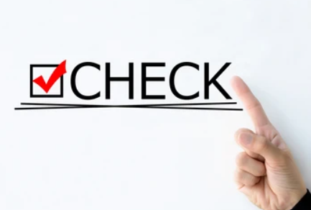
C- Check: Observe the effects of the change. This is more than casual observation. It is a careful and comprehensive study of the results. The project team must fully understand the effects of the change, why they occurred, and how they might affect some other process in the system.

Slide 29
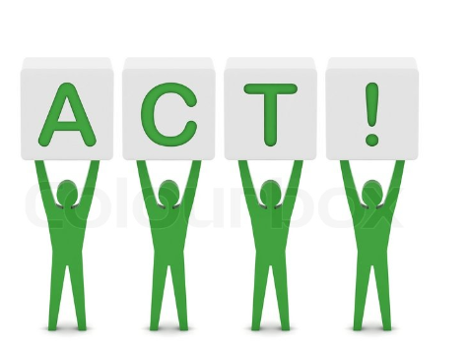
D- Act: The test case shows that the change will probably work as planned, so there is little risk of knee-jerking the work force. Then, because this is a cycle supporting continual improvement, move on to the next aspect of the process or another process that might be the basis for a beneficial change and start the cycle again. If the results are not as expected, move forward in the cycle to the plan step and revisit the process to analyze it again and prepare a new plan. This new plan will be based on better information, knowledge about what did not work.

Slide 30
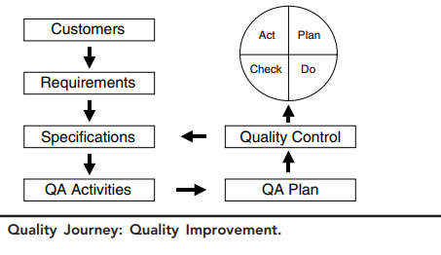

This completes the last step in the quality journey .The quality journey provides a framework for project quality management. Its seven steps prescribe specific things that project managers and project teams can do to manage quality in their projects. While some projects may have domain-unique quality considerations and techniques, the framework is fundamentally applicable to any project in any domain. Project managers need never again ask “What am I supposed to do?” regarding quality. The framework shows the way.

Slide 31

3-
◆ Quality control is a process that monitors specific project results to determine if they conform to specifications and identify ways to eliminate the causes of unsatisfactory results.
◆ Quality control is the sixth step in a seven-step quality journey that provides a general framework for quality management.
◆ Quality control results provide feedback to quality assurance; results disclose effectiveness of assurance activities.
◆ In-process inspection plays a key role in quality control. Inspection activities may include measuring, examining, or testing.
◆ Quality control tools are well defined. They are also applied to quality improvement.
◆ Quality improvement is the organized creation of beneficial change.

Slide 32
◆ Quality improvement is the last step in the quality journey.
◆ All quality improvement begins with data collection.
◆ Quality improvement is necessary for many reasons, all associated with customer satisfaction and competitiveness.
◆ Quality improvement is not easy. Hurdles include disillusionment with past efforts, belief that better quality costs more, delegation, and resistance to change.
◆ The plan-do-check-act cycle is a proven model for quality improvement. It includes: plan a change that will have beneficial effect, do the plan on a small scale, check the result to determine effectiveness, act to implement the change system-wide if it is effective, or return to the plan step and start over with better information.

Slide 33


Slide 34


