Slide 1
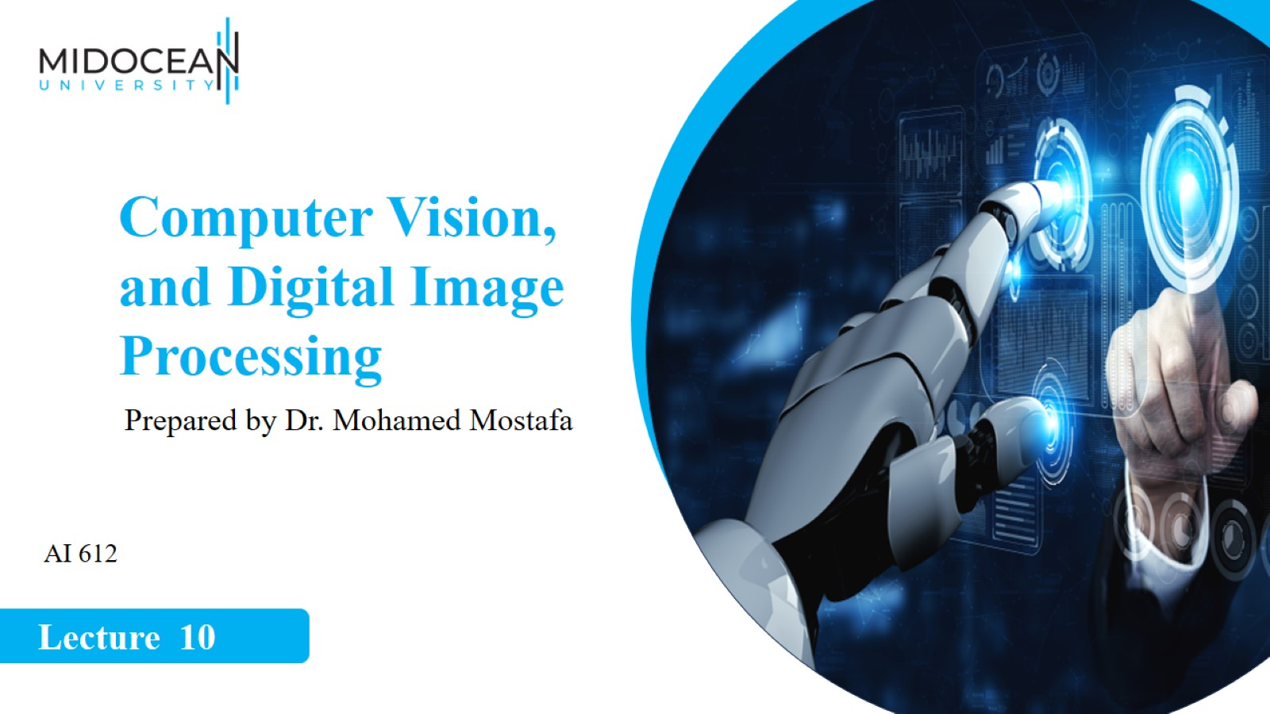

Slide 2


Slide 3


Slide 4
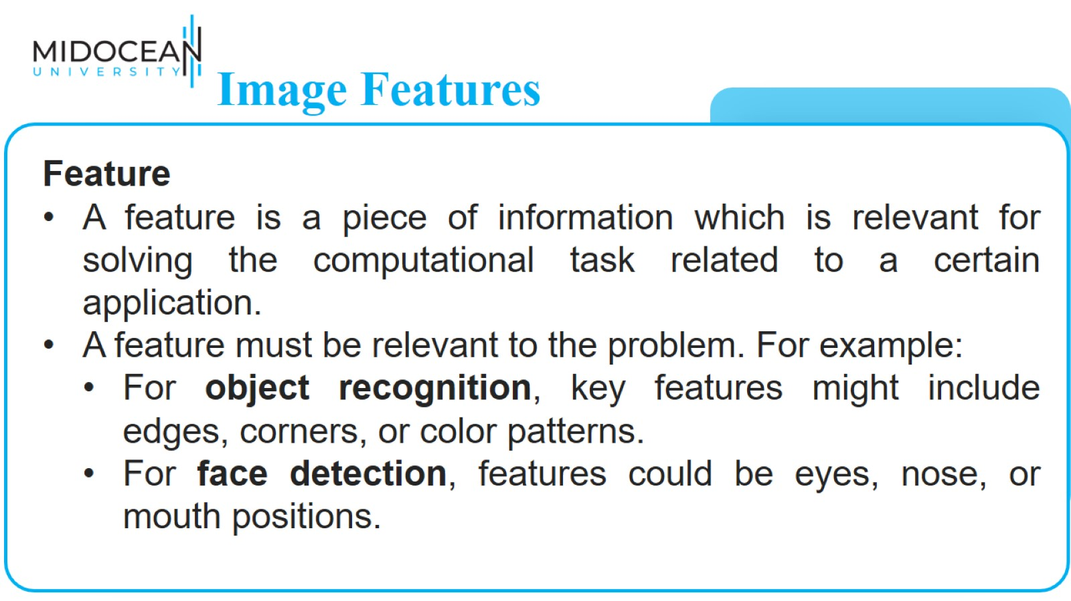
Image Features

Slide 5
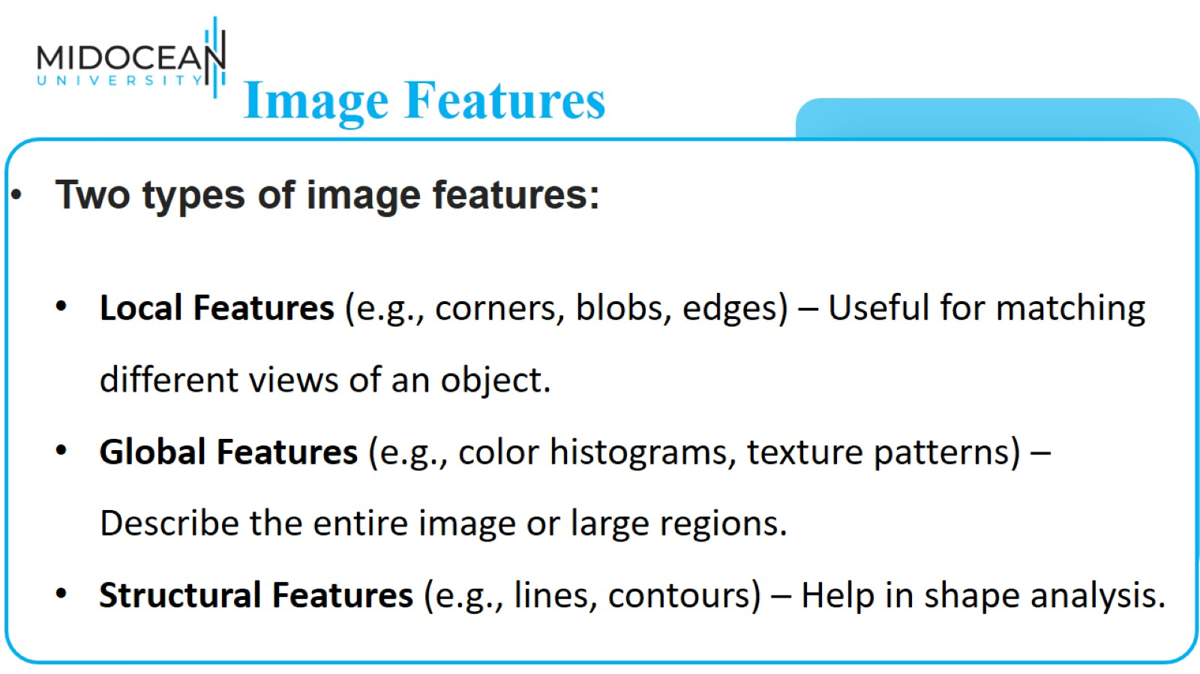
Image Features

Slide 6
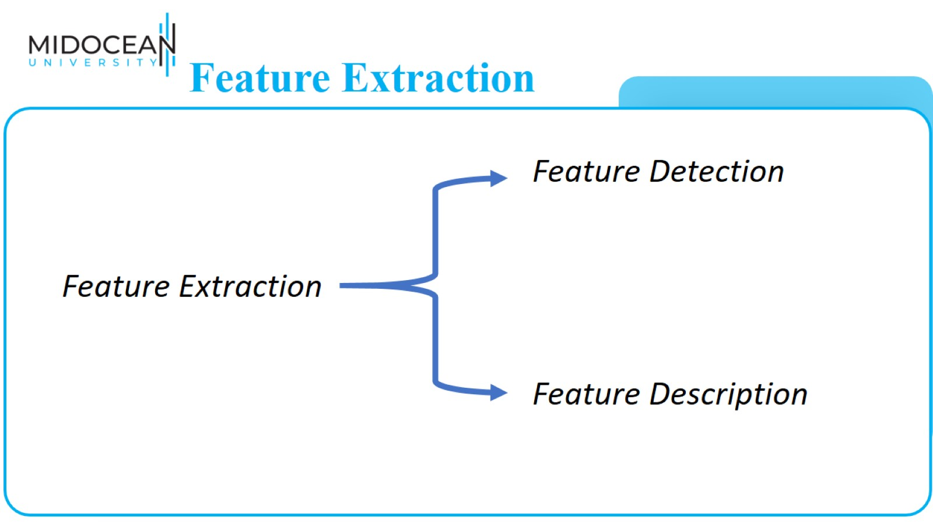
Feature Extraction

Slide 7
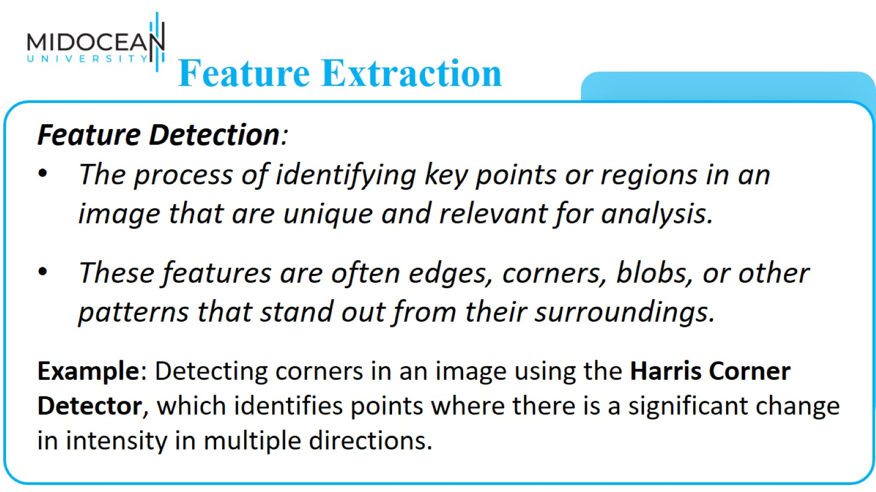
Feature Extraction

Slide 8
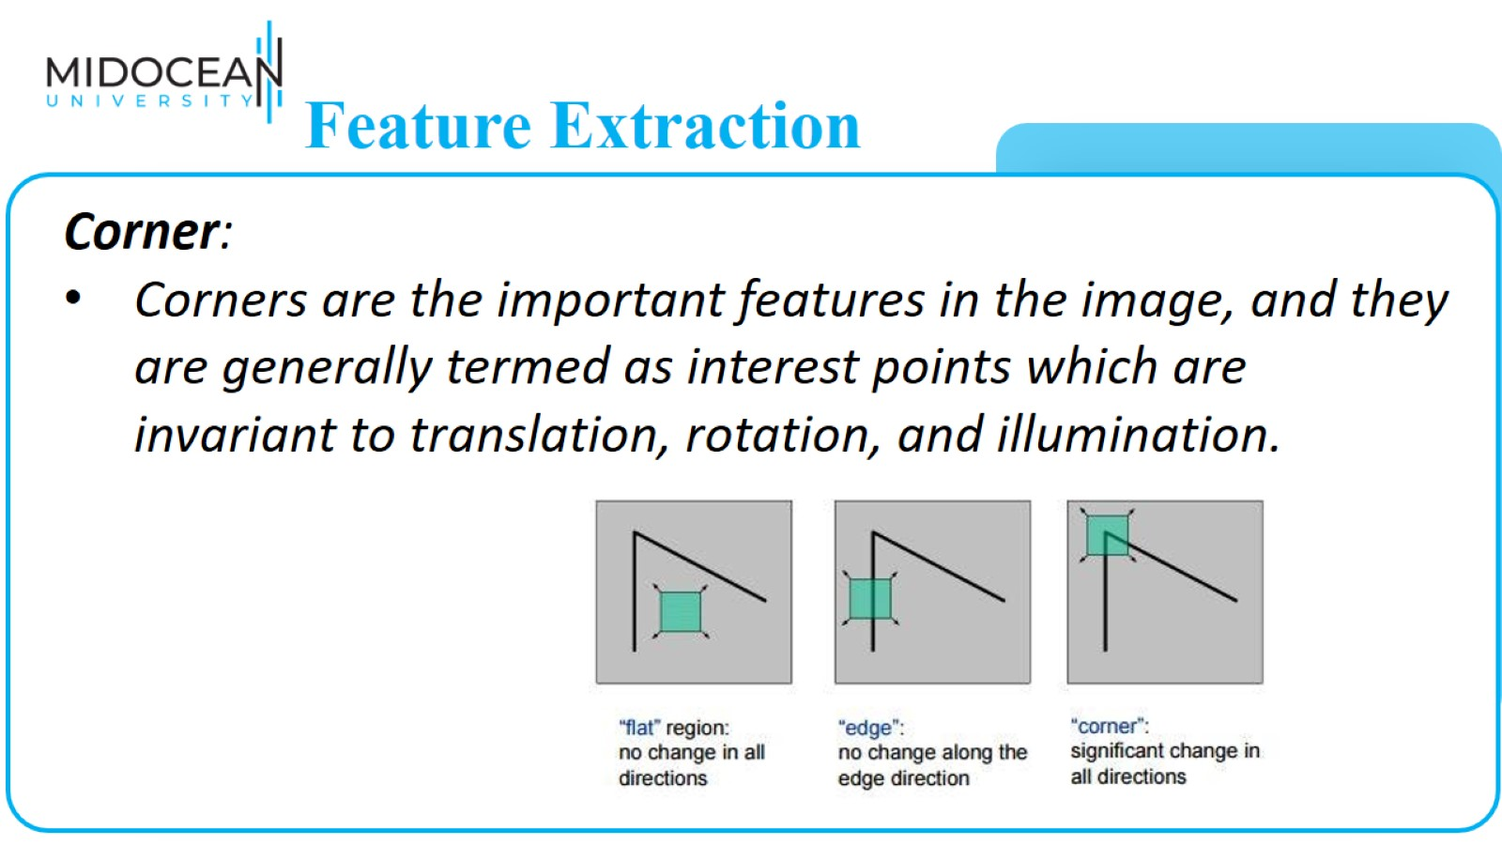
Feature Extraction

Slide 9
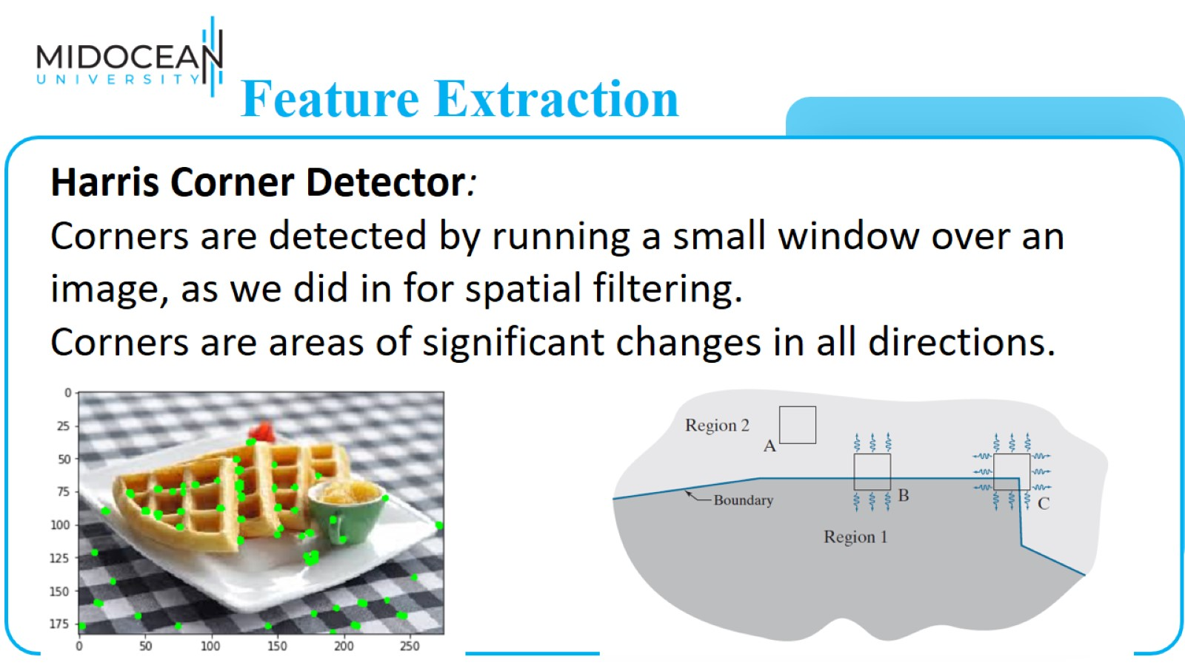
Feature Extraction

Slide 10
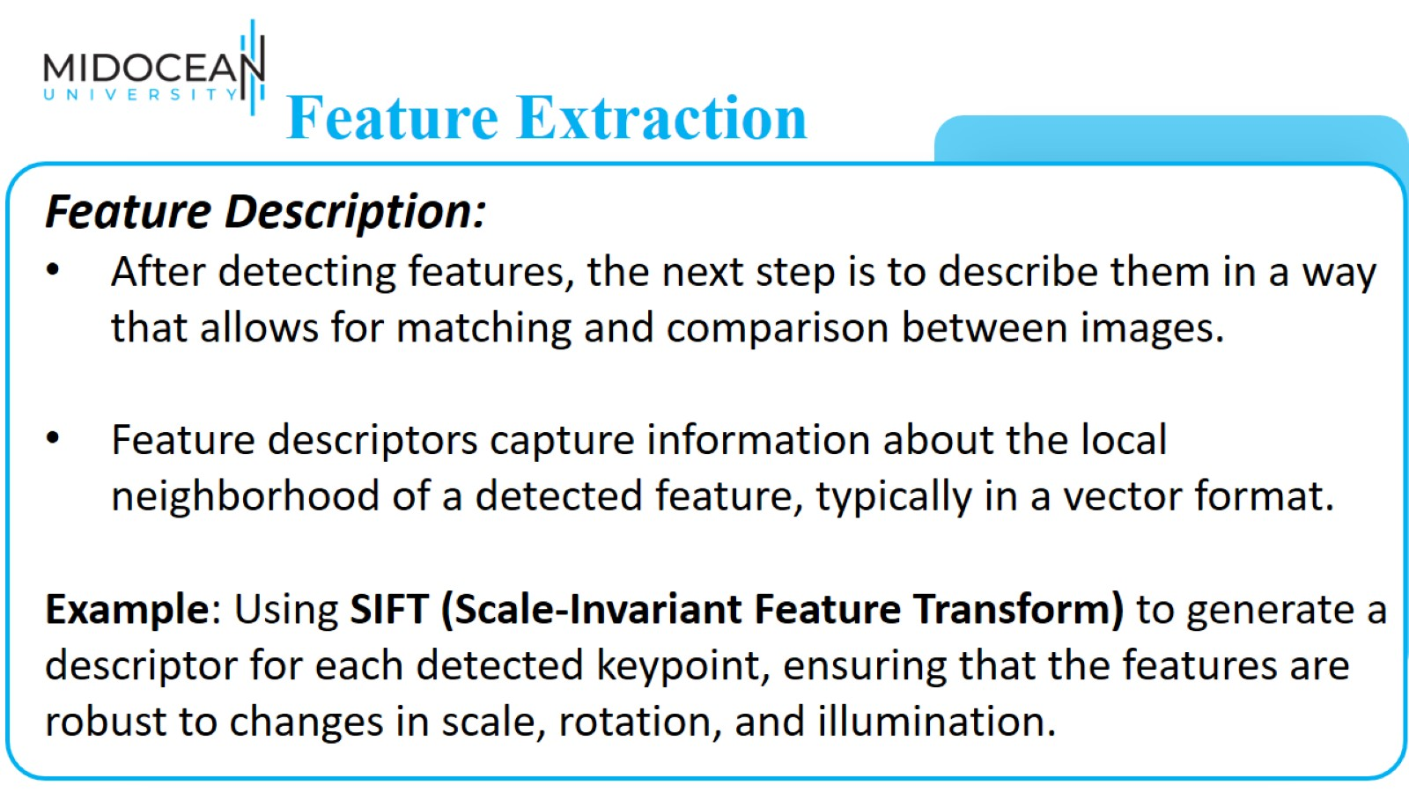
Feature Extraction

Slide 11
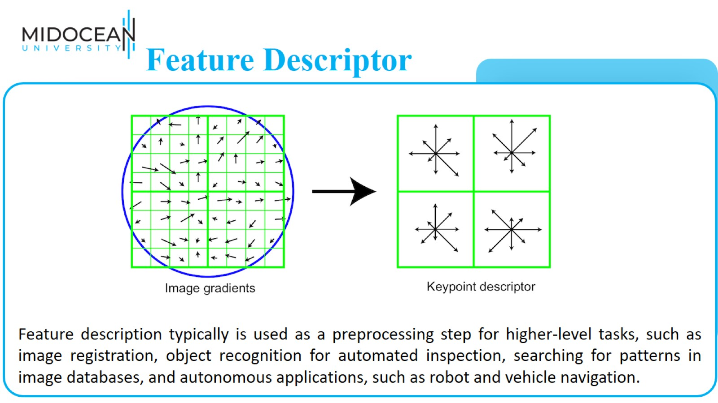
Feature Descriptor

Slide 12
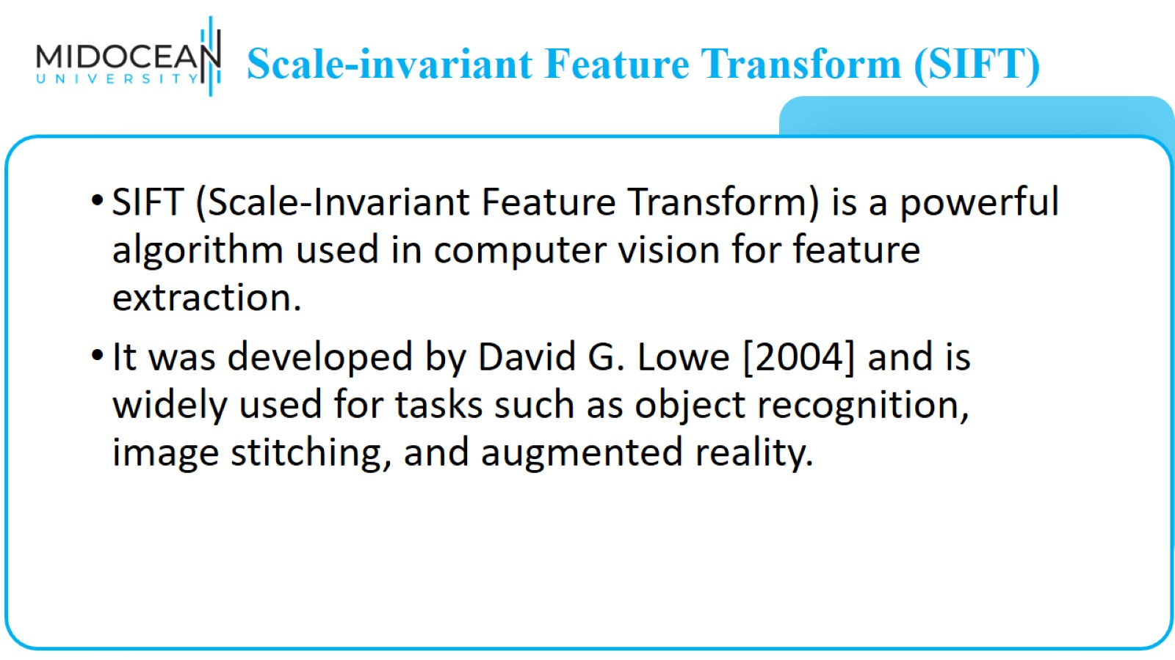
Scale-invariant Feature Transform (SIFT)

Slide 13
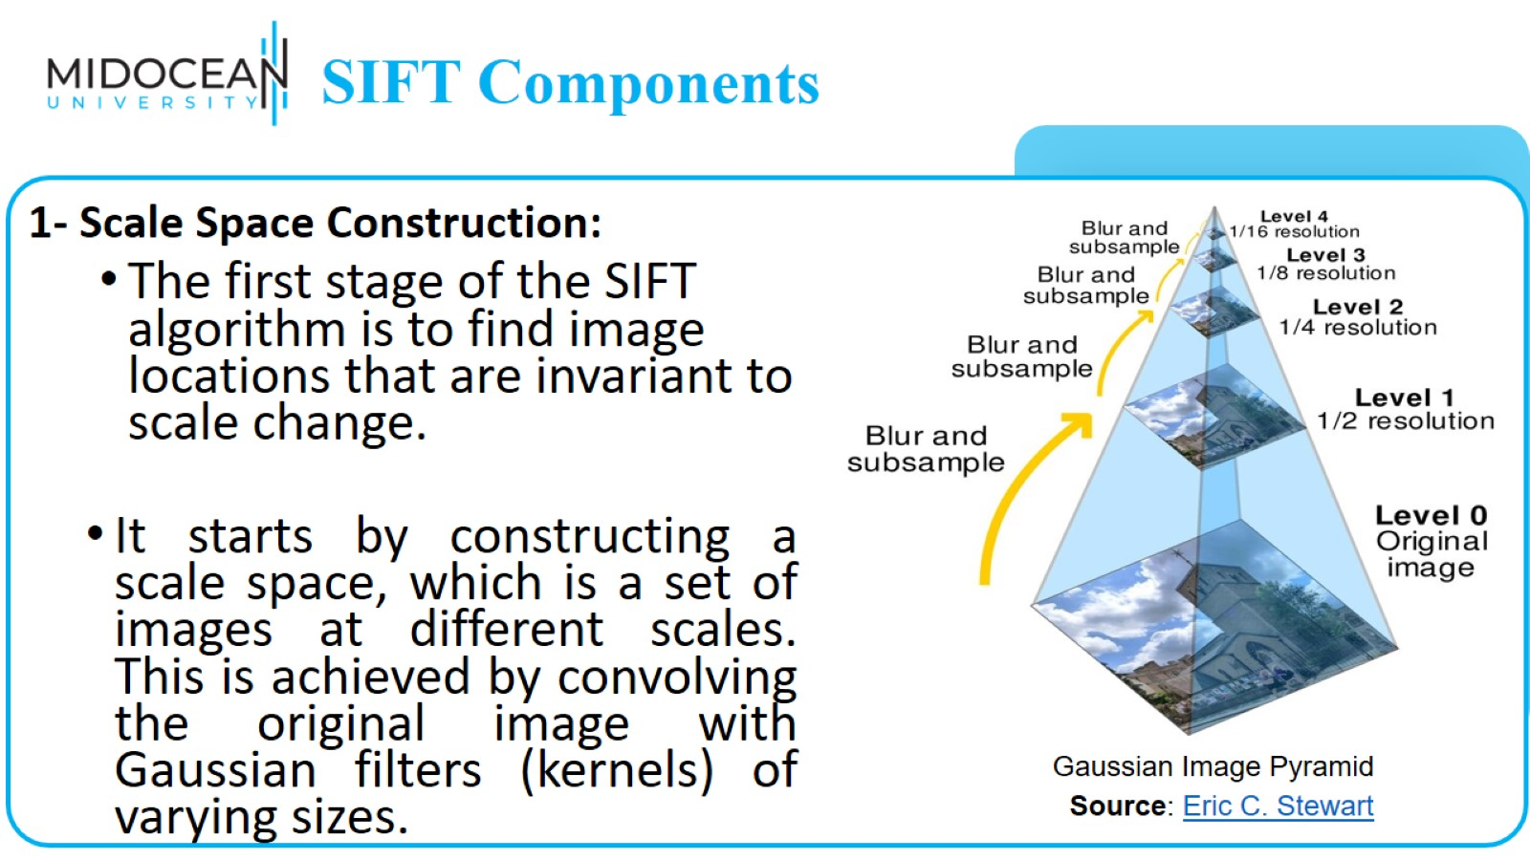
SIFT Components

Slide 14
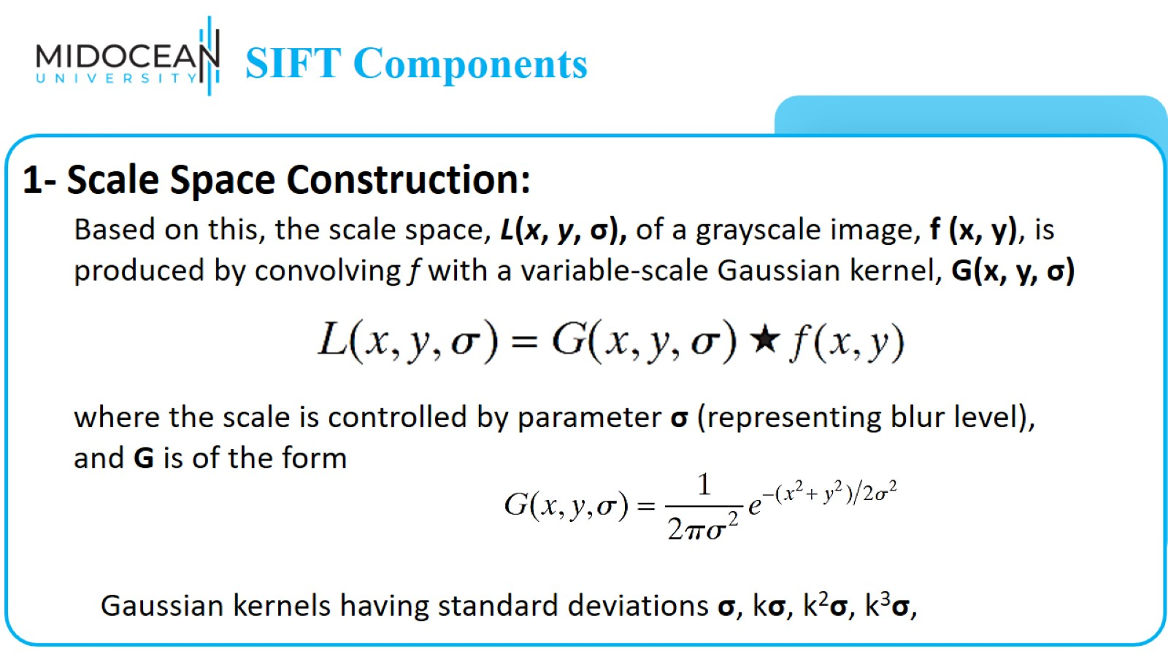
SIFT Components

Slide 15
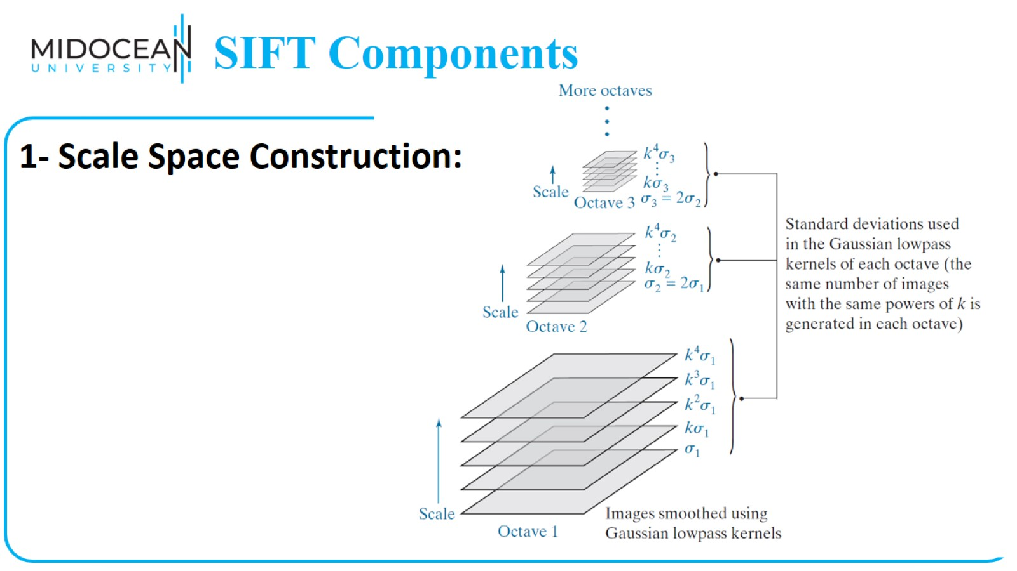
SIFT Components

Slide 16
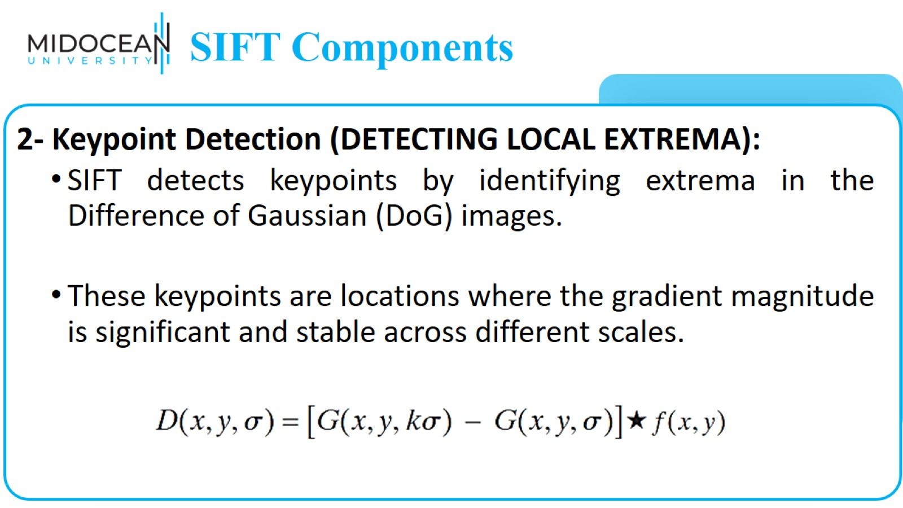
SIFT Components

Slide 17
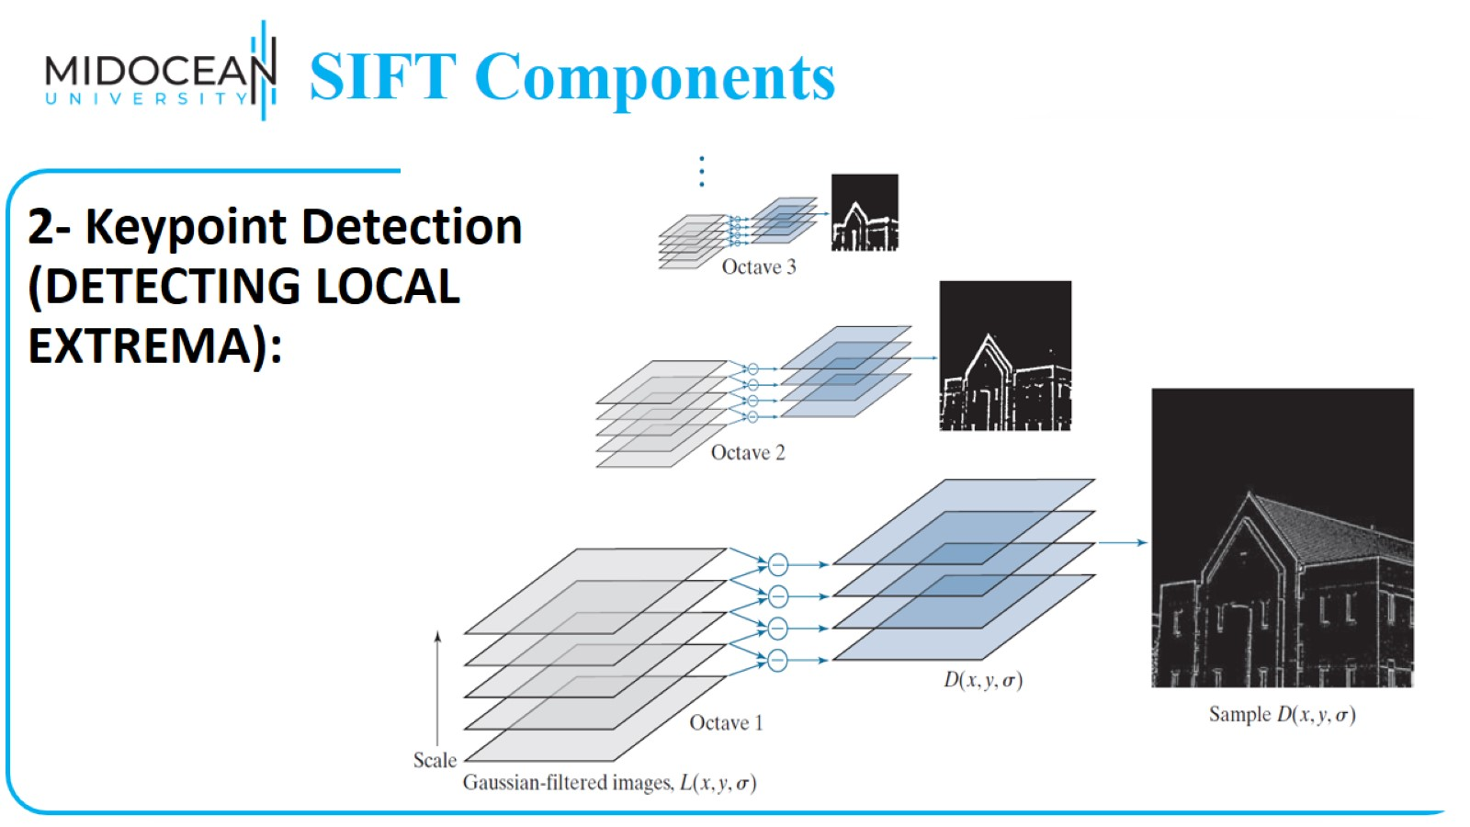
SIFT Components

Slide 18
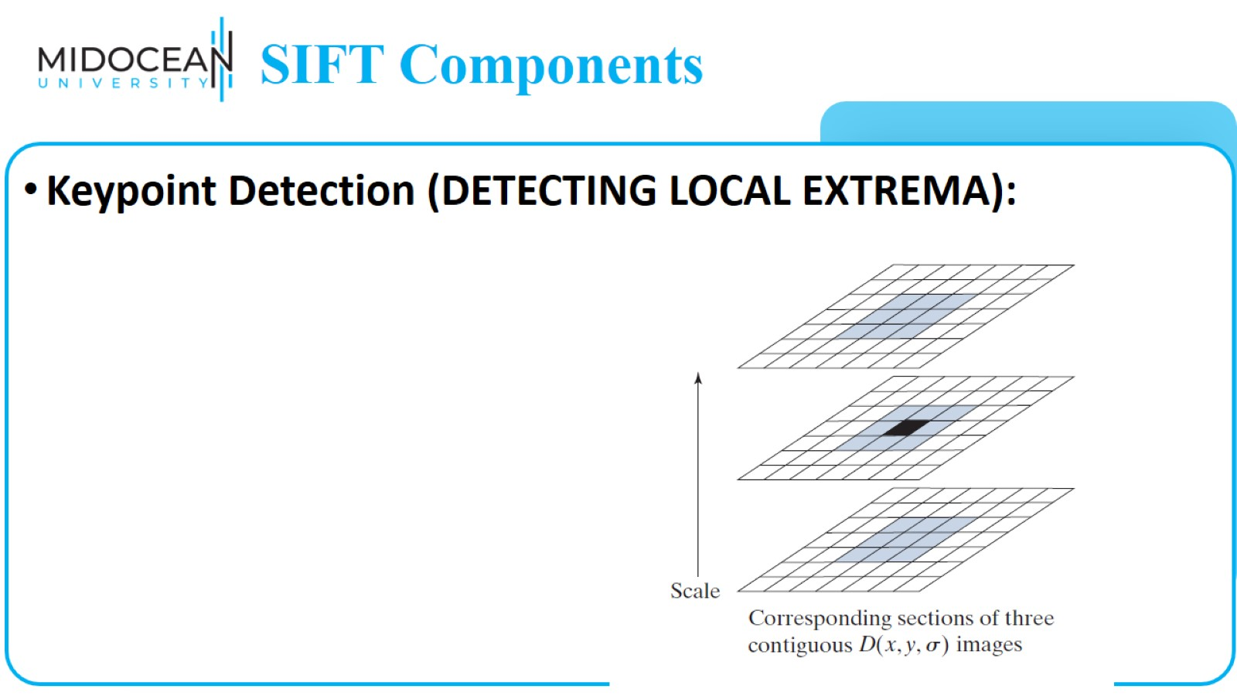
SIFT Components

Slide 19
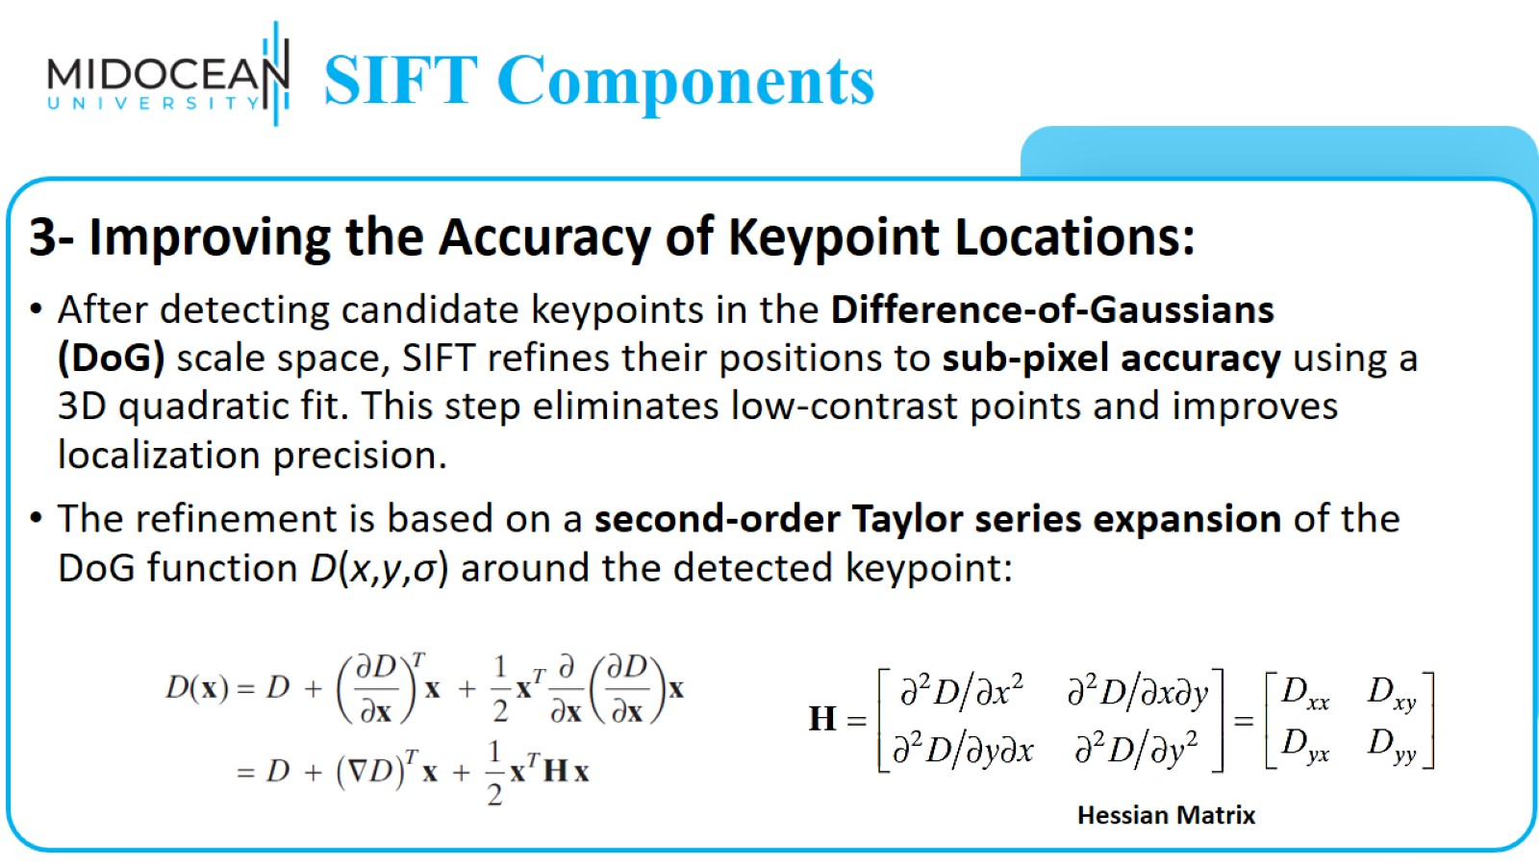
SIFT Components

Slide 20
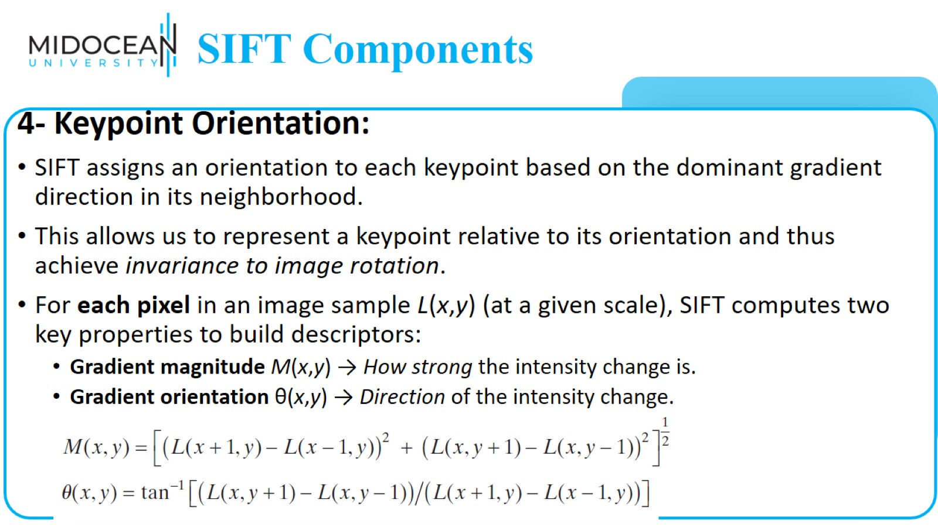
SIFT Components

Slide 21
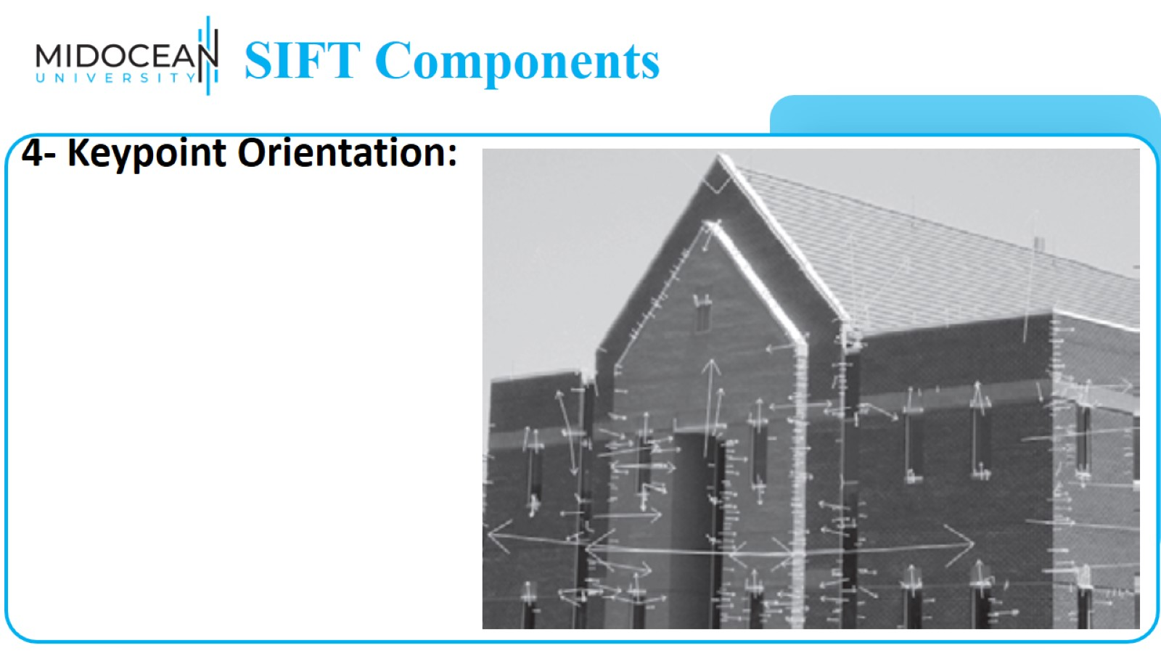
SIFT Components

Slide 22
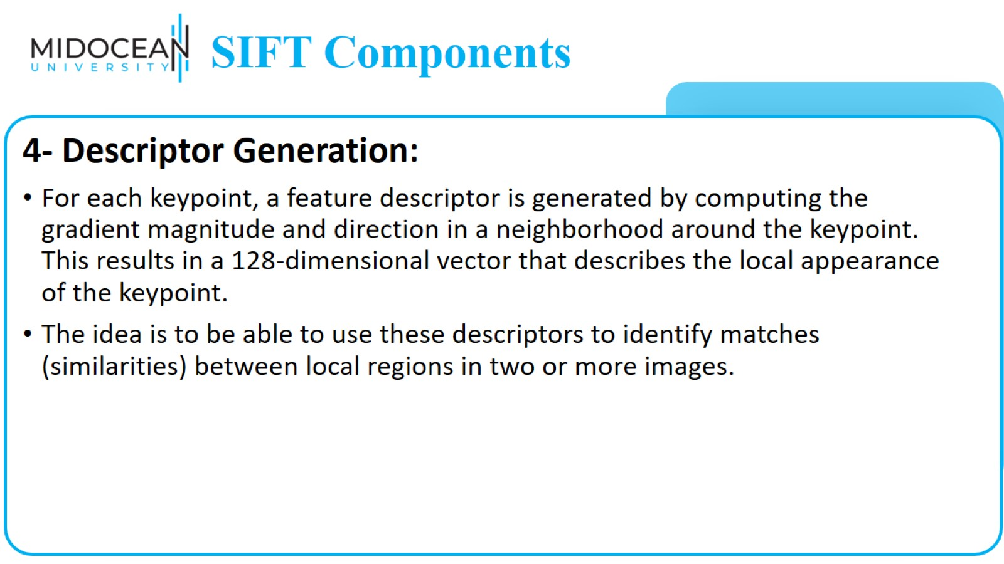
SIFT Components

Slide 23
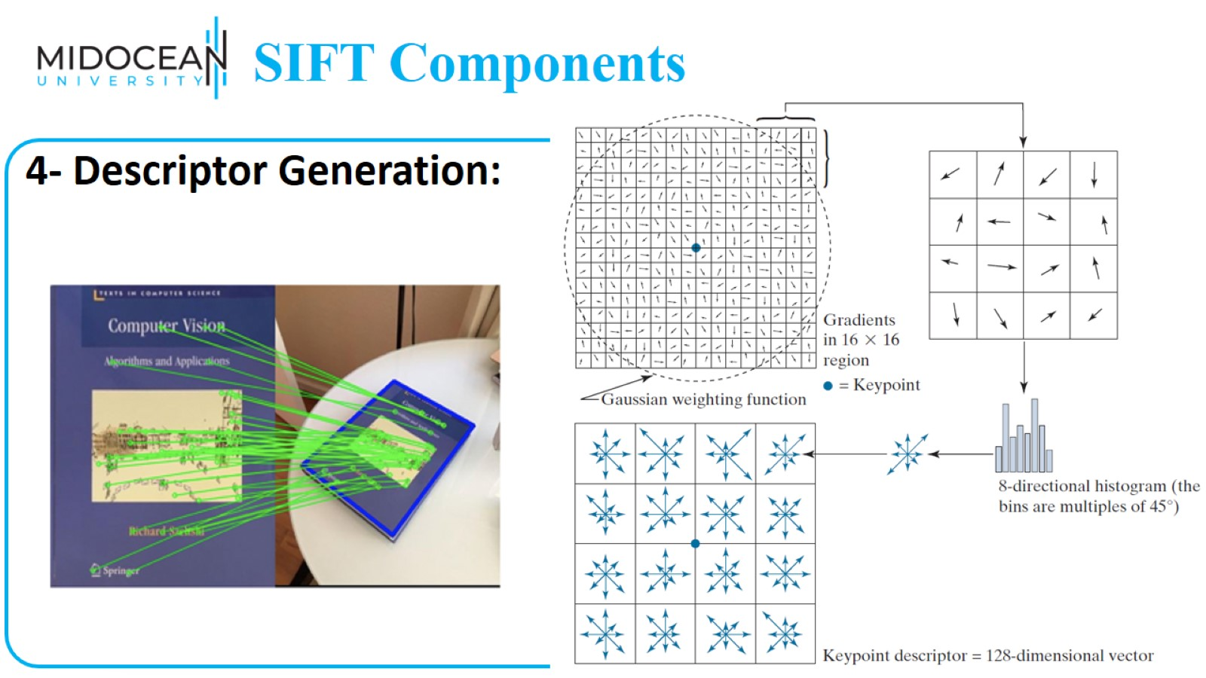
SIFT Components

Slide 24

SURF (Speeded Up Robust Features) Feature Extraction

Slide 25
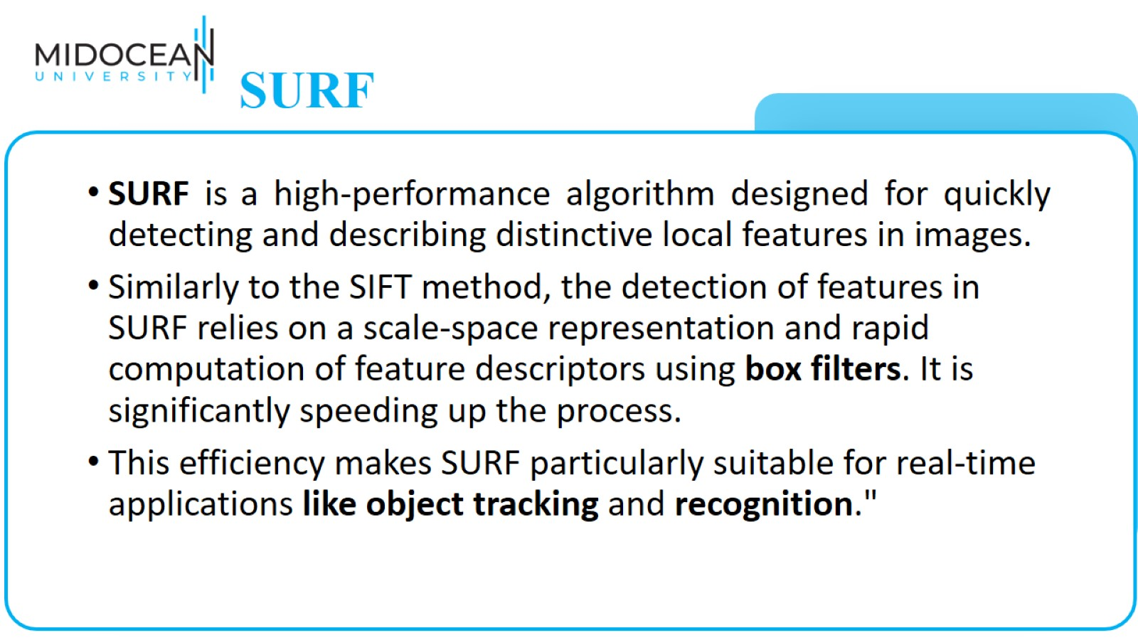
SURF

Slide 26
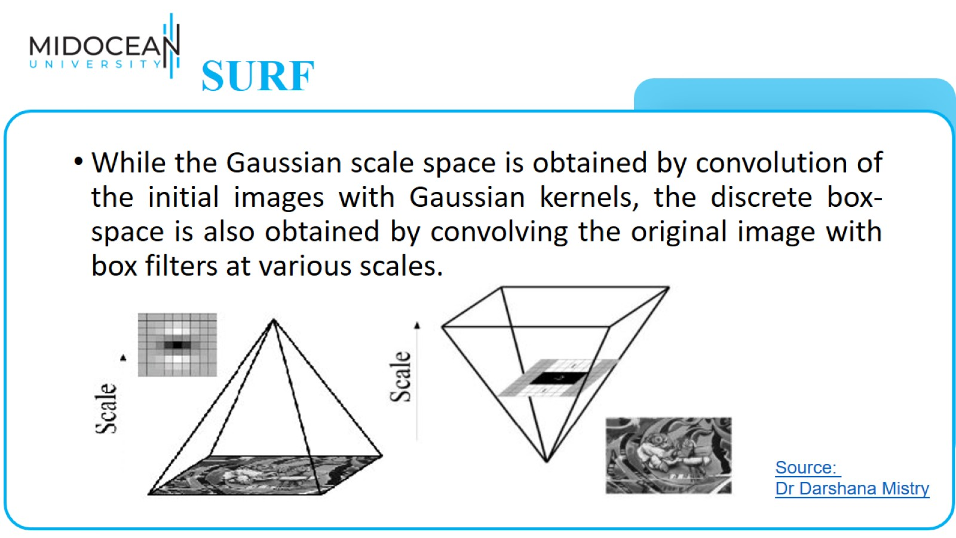
SURF

Slide 27
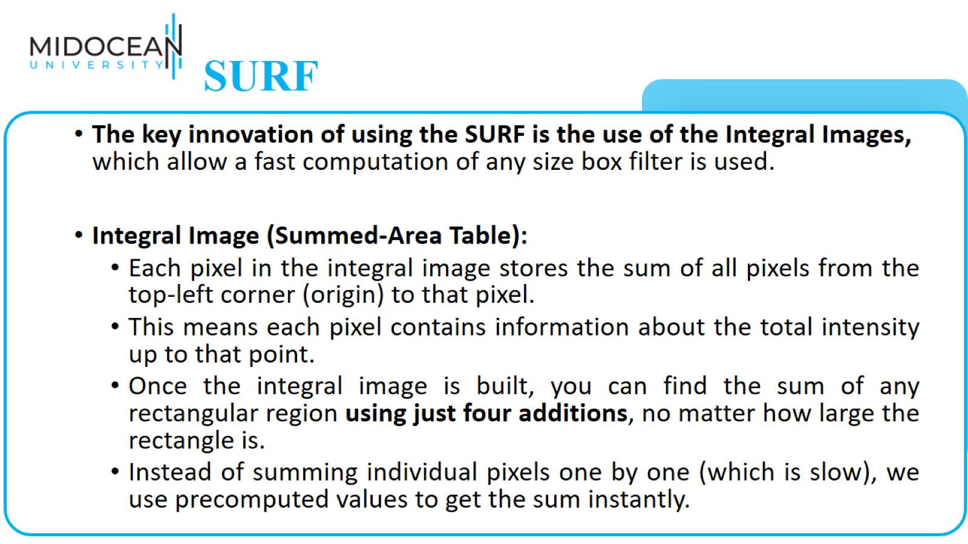
SURF

Slide 28
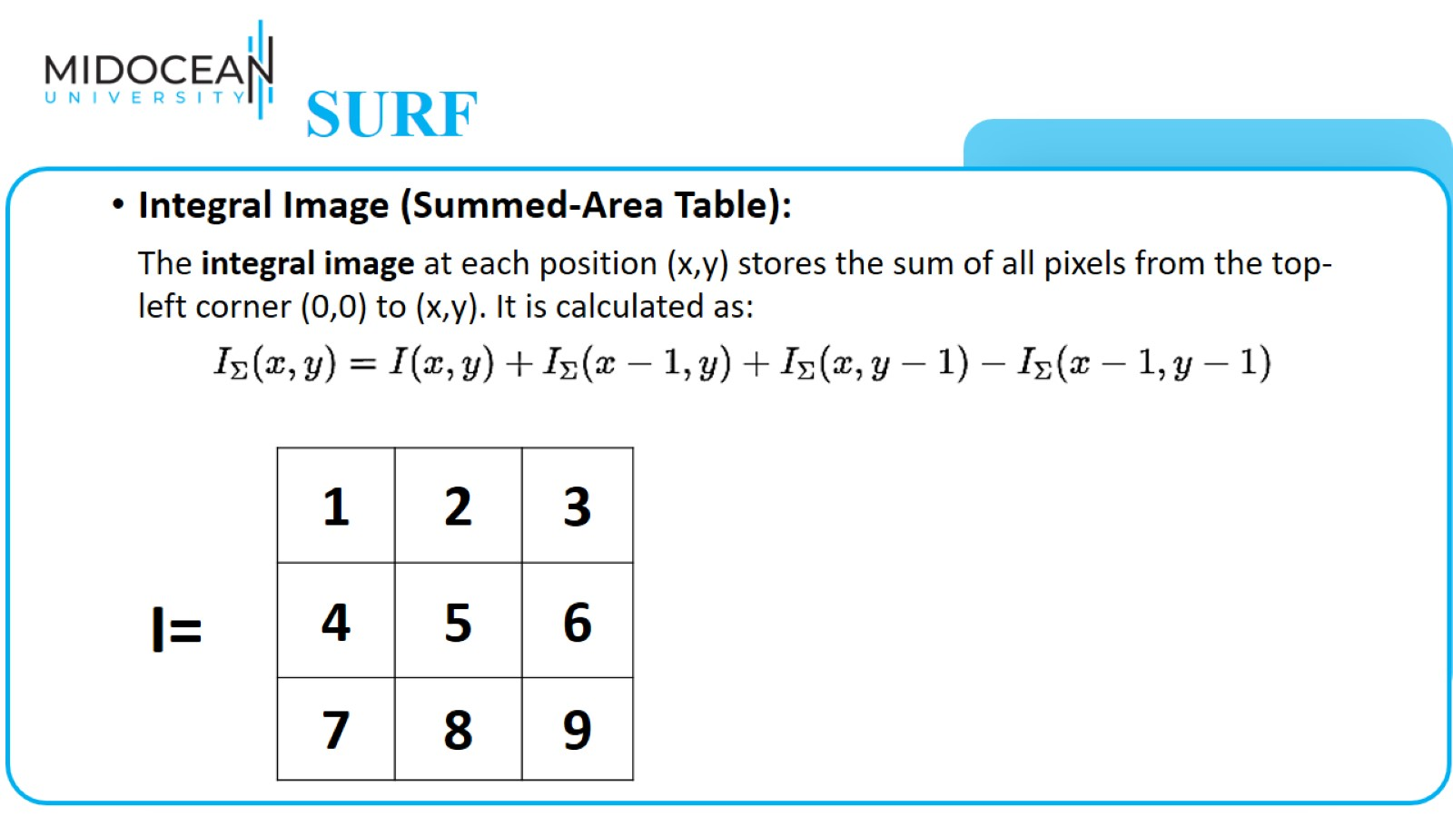
SURF

Slide 29
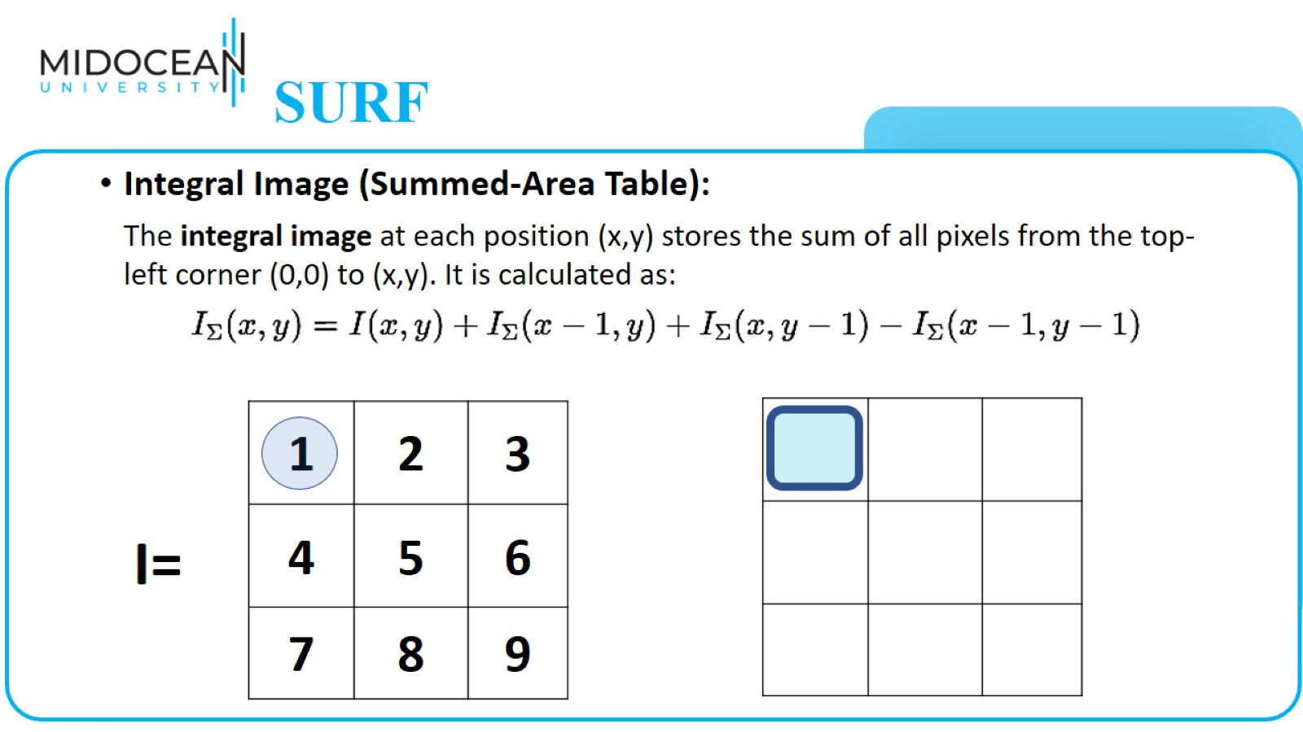
SURF

Slide 30
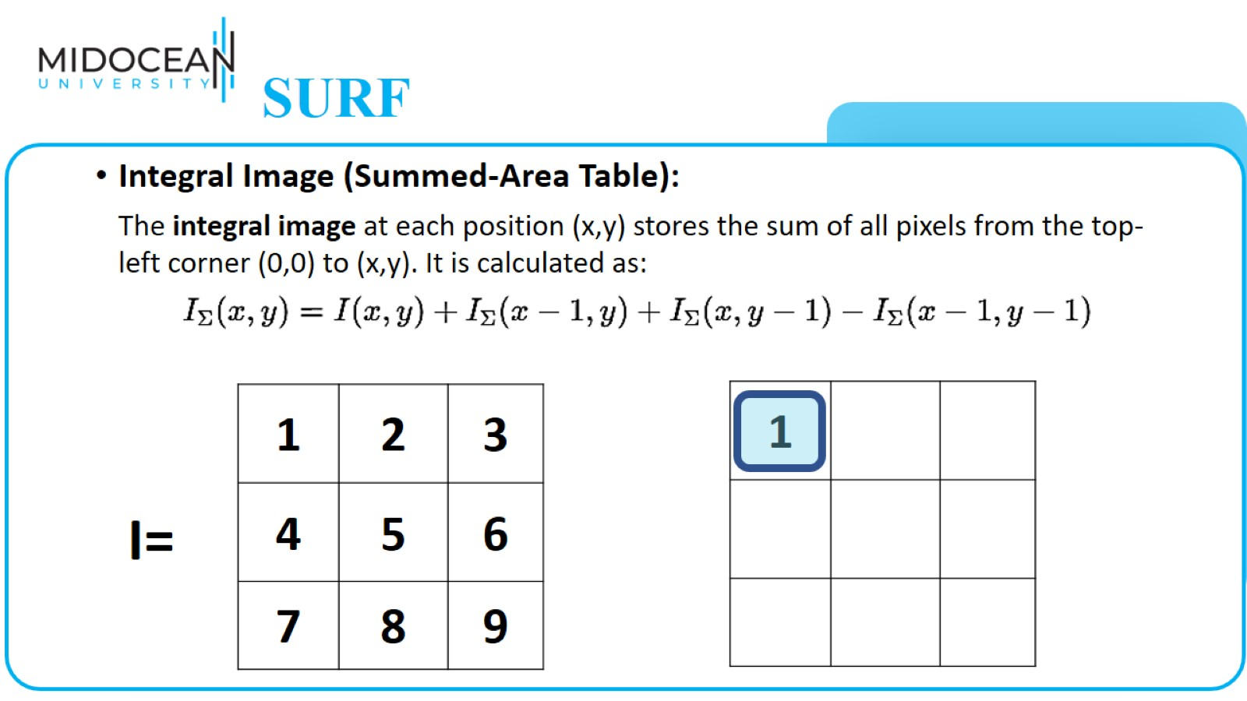
SURF

Slide 31
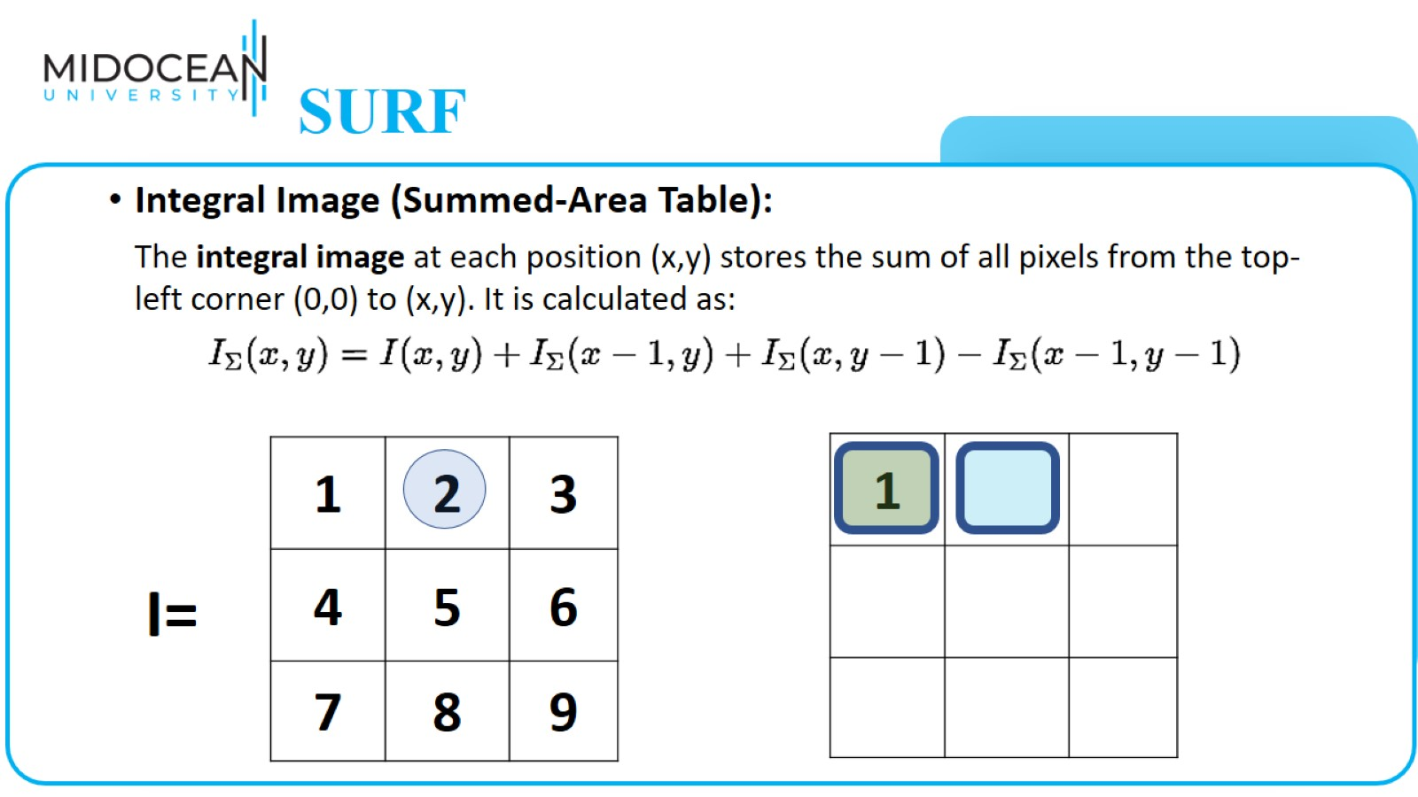
SURF

Slide 32
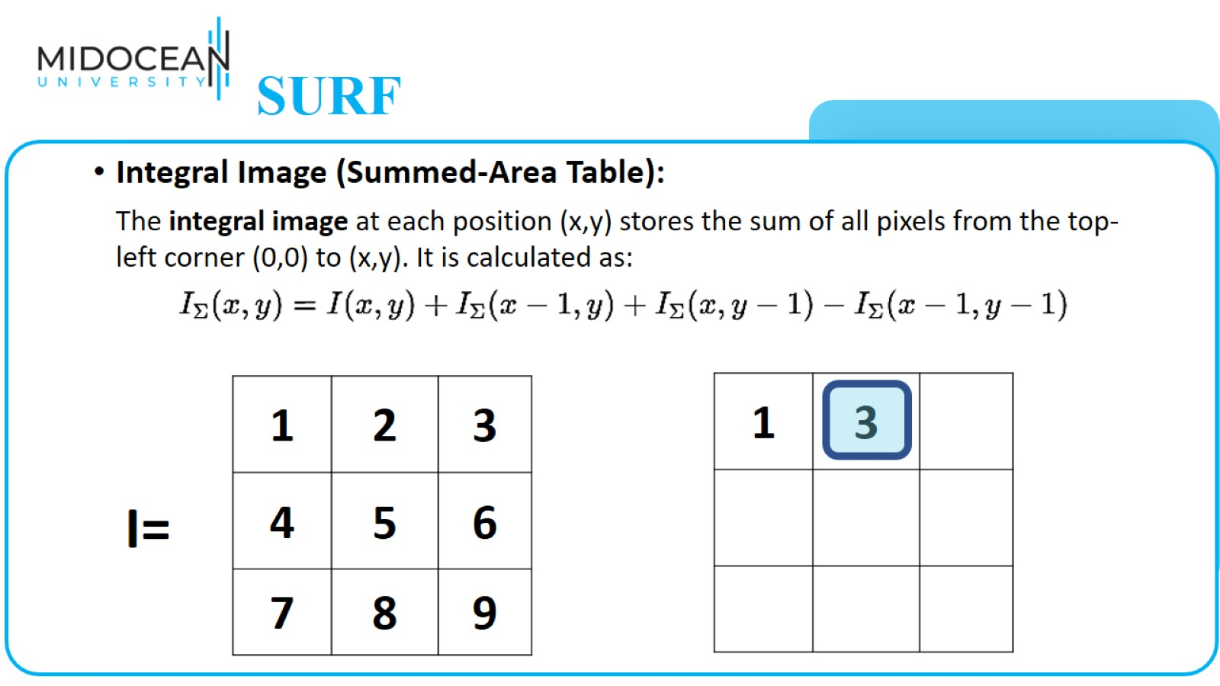
SURF

Slide 33
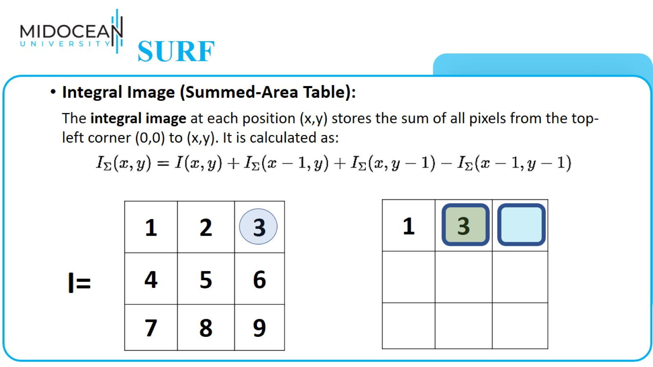
SURF

Slide 34
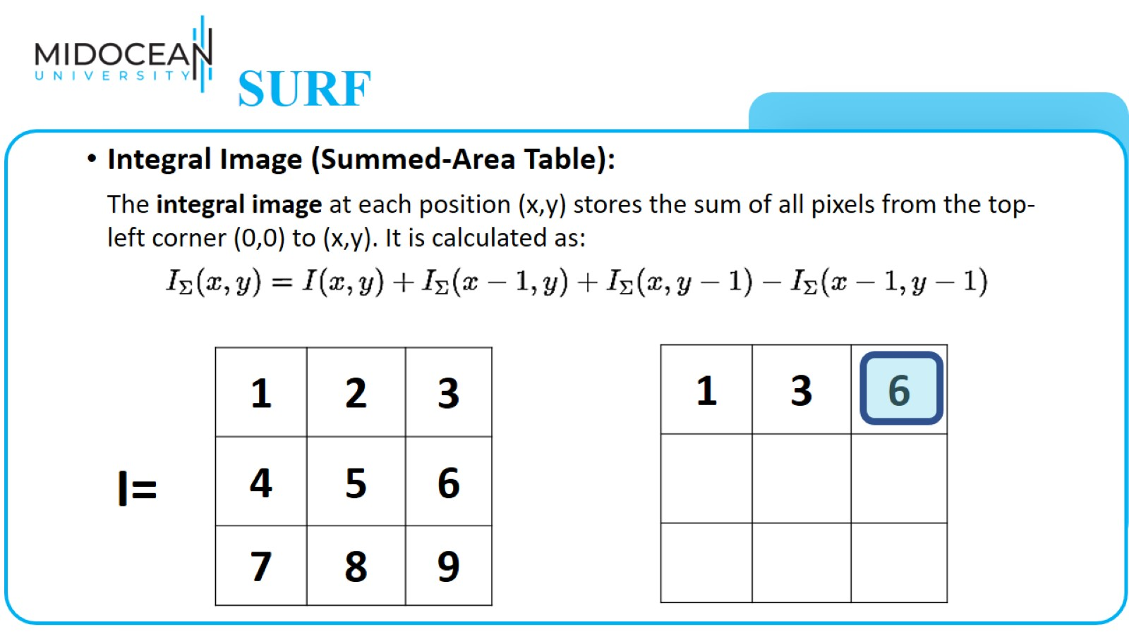
SURF

Slide 35
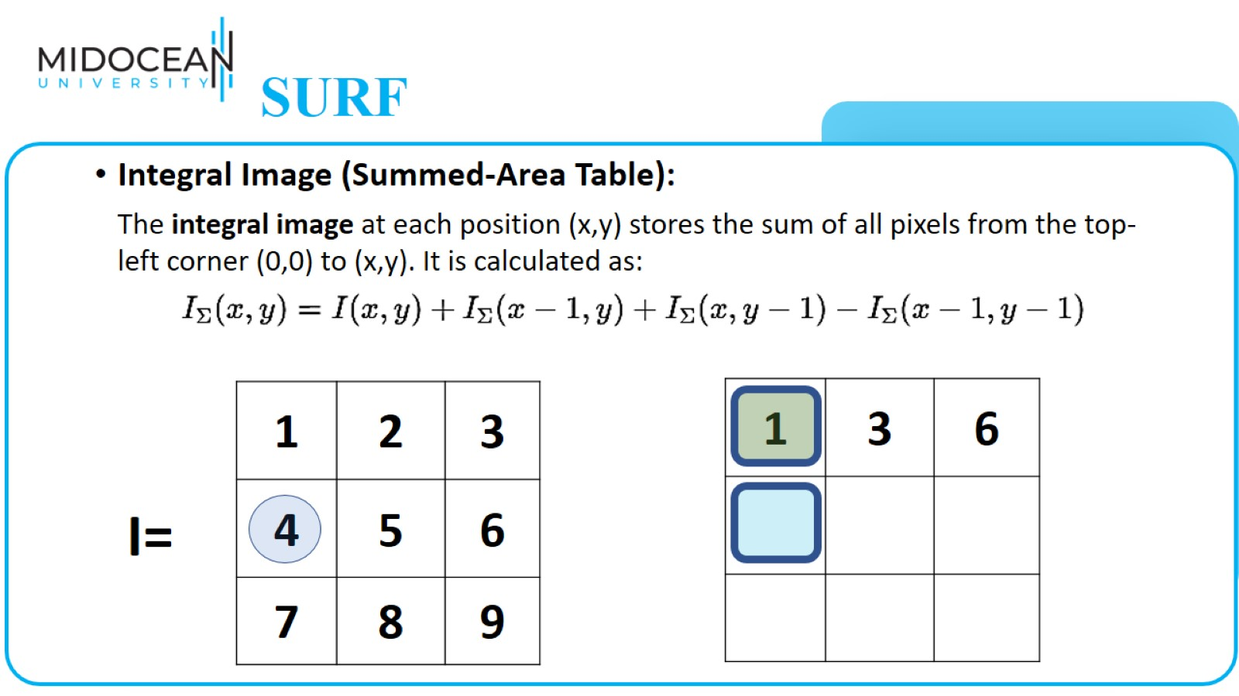
SURF

Slide 36
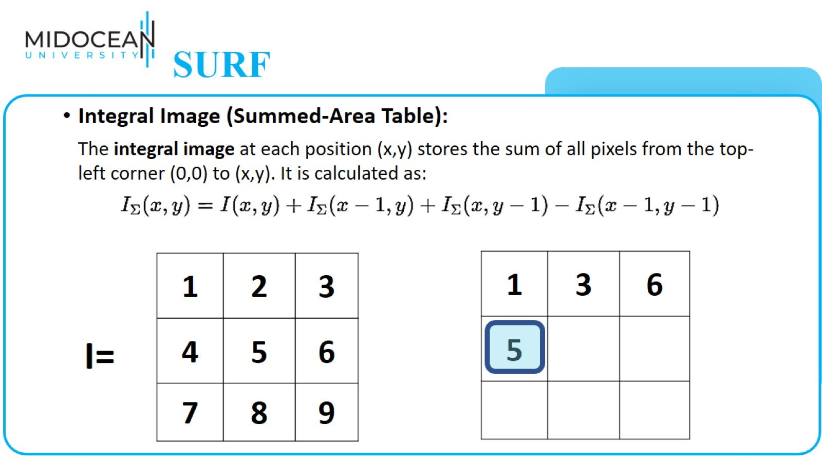
SURF

Slide 37
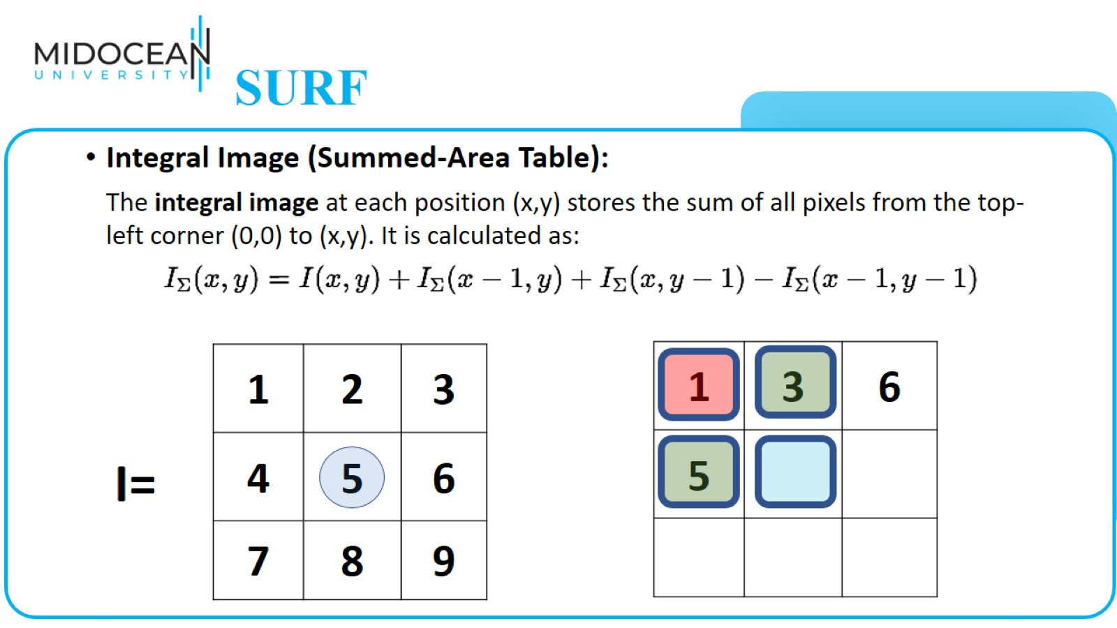
SURF

Slide 38
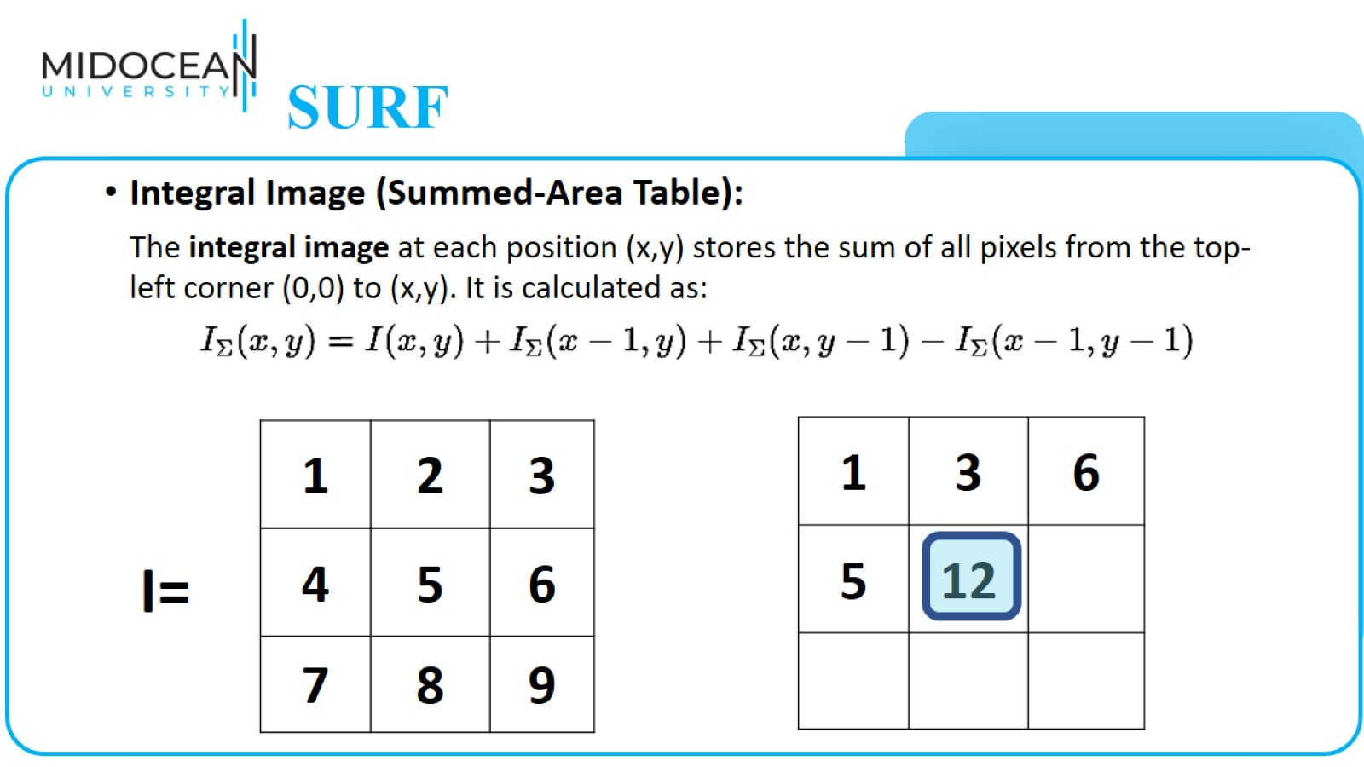
SURF

Slide 39
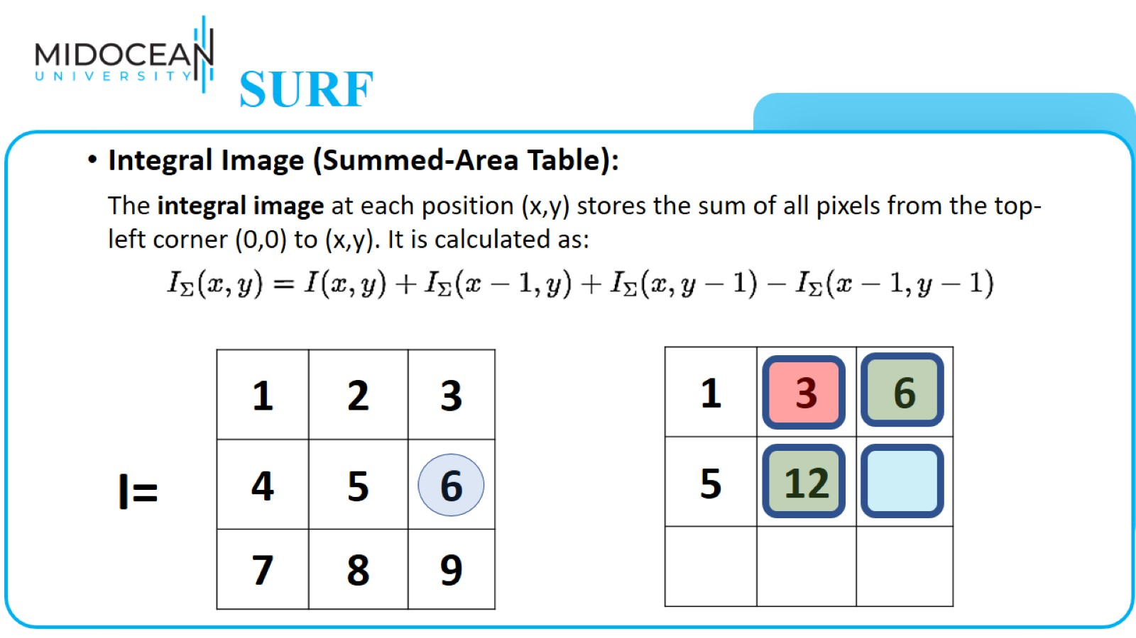
SURF

Slide 40
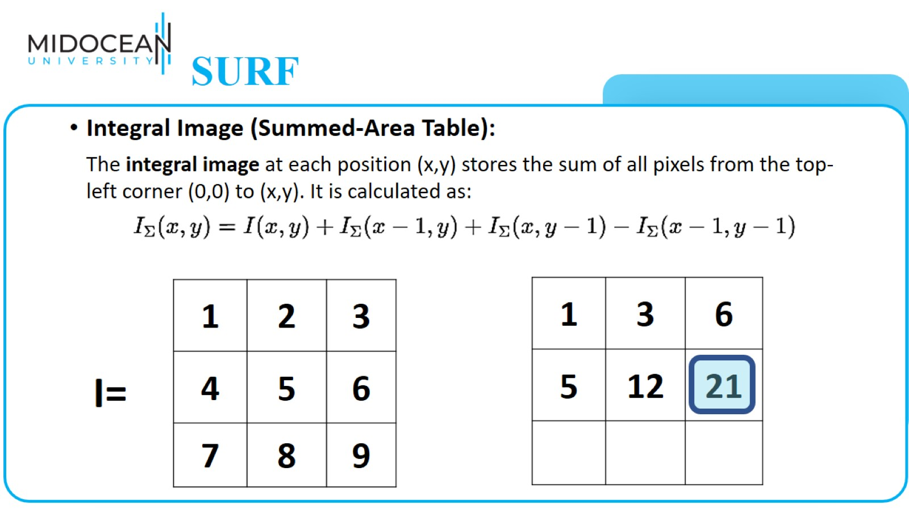
SURF

Slide 41
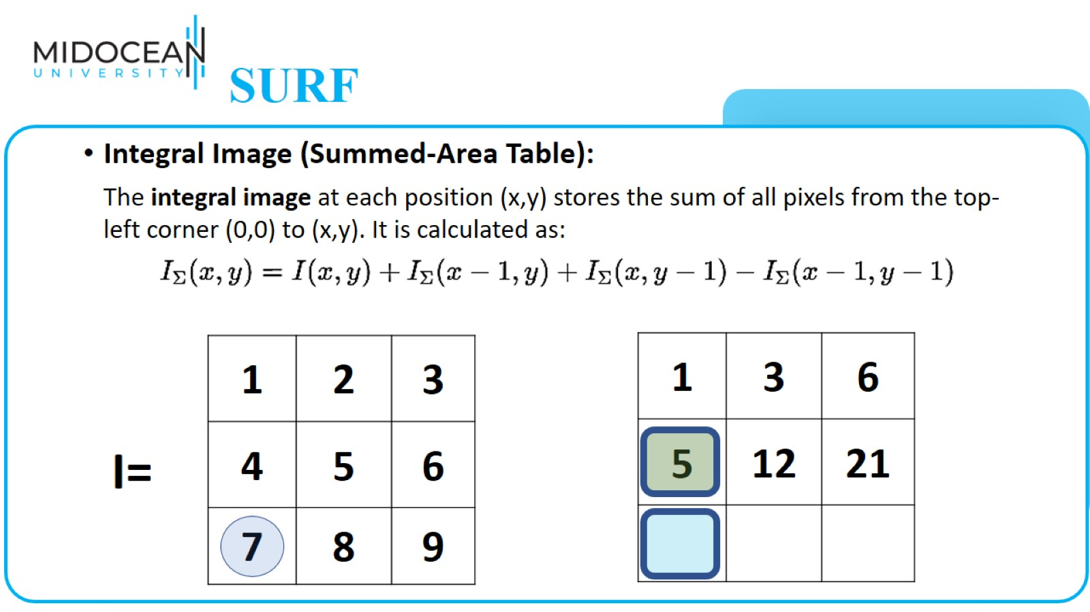
SURF

Slide 42
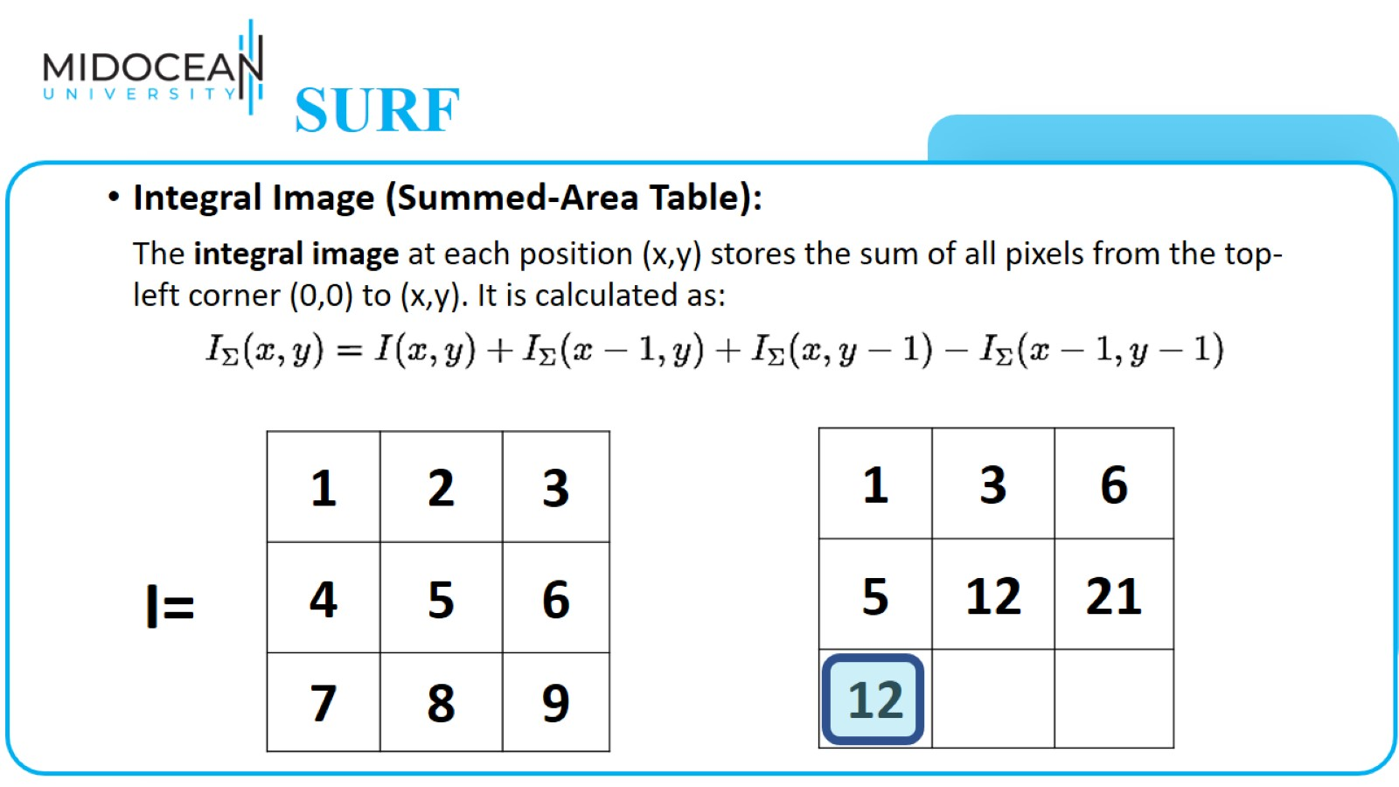
SURF

Slide 43
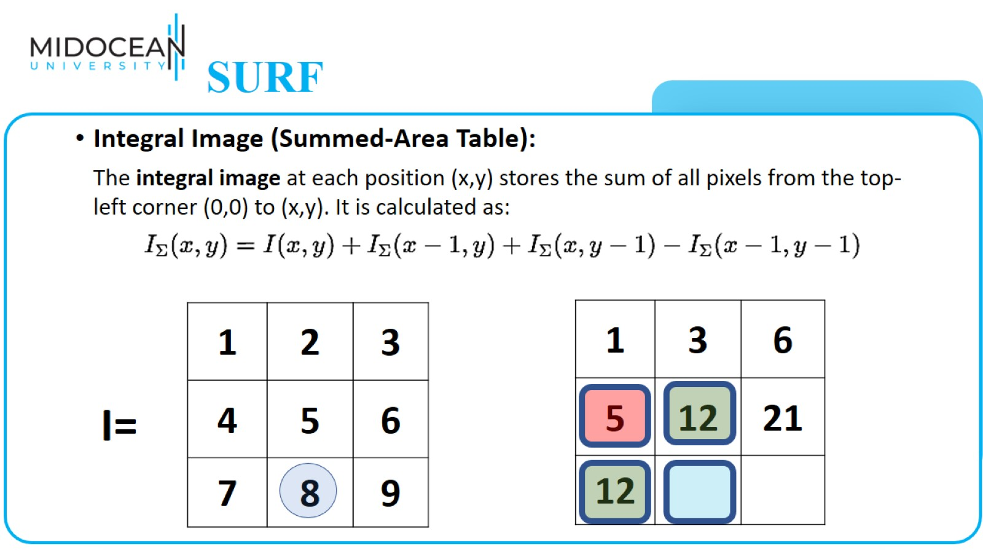
SURF

Slide 44
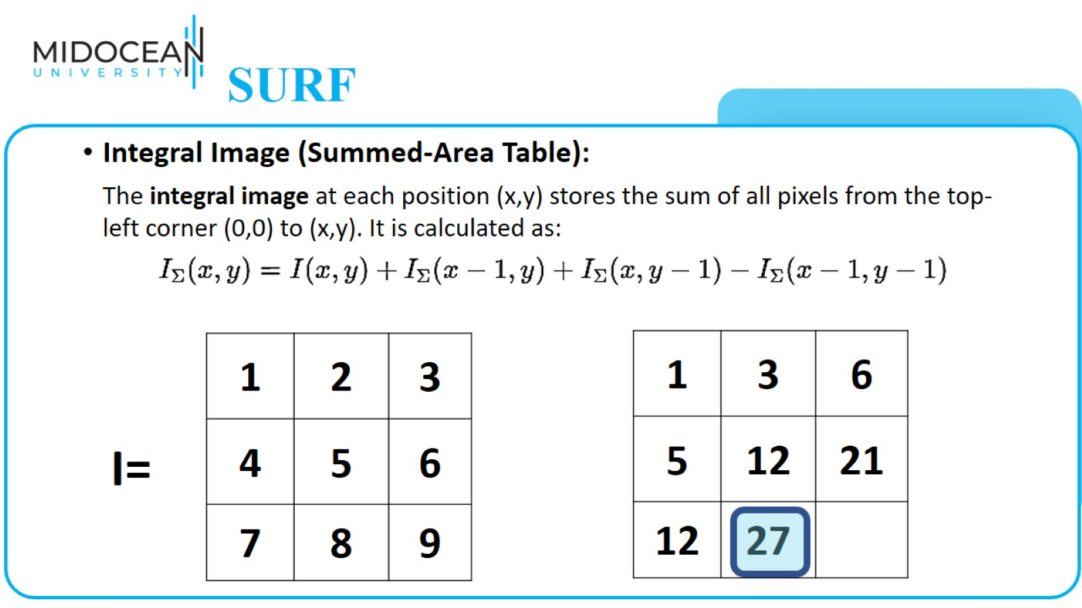
SURF

Slide 45
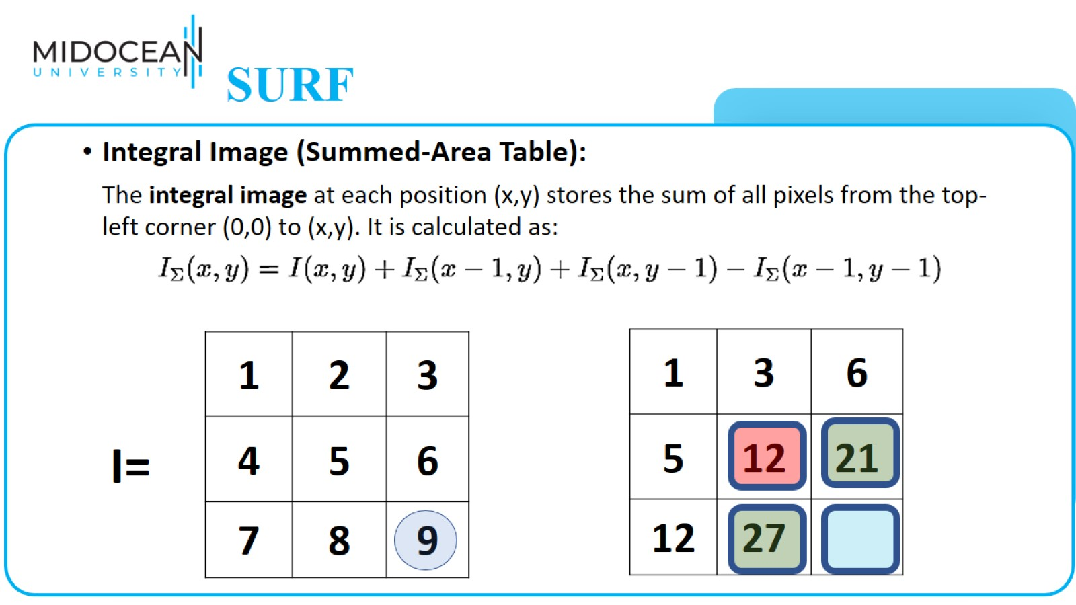
SURF

Slide 46
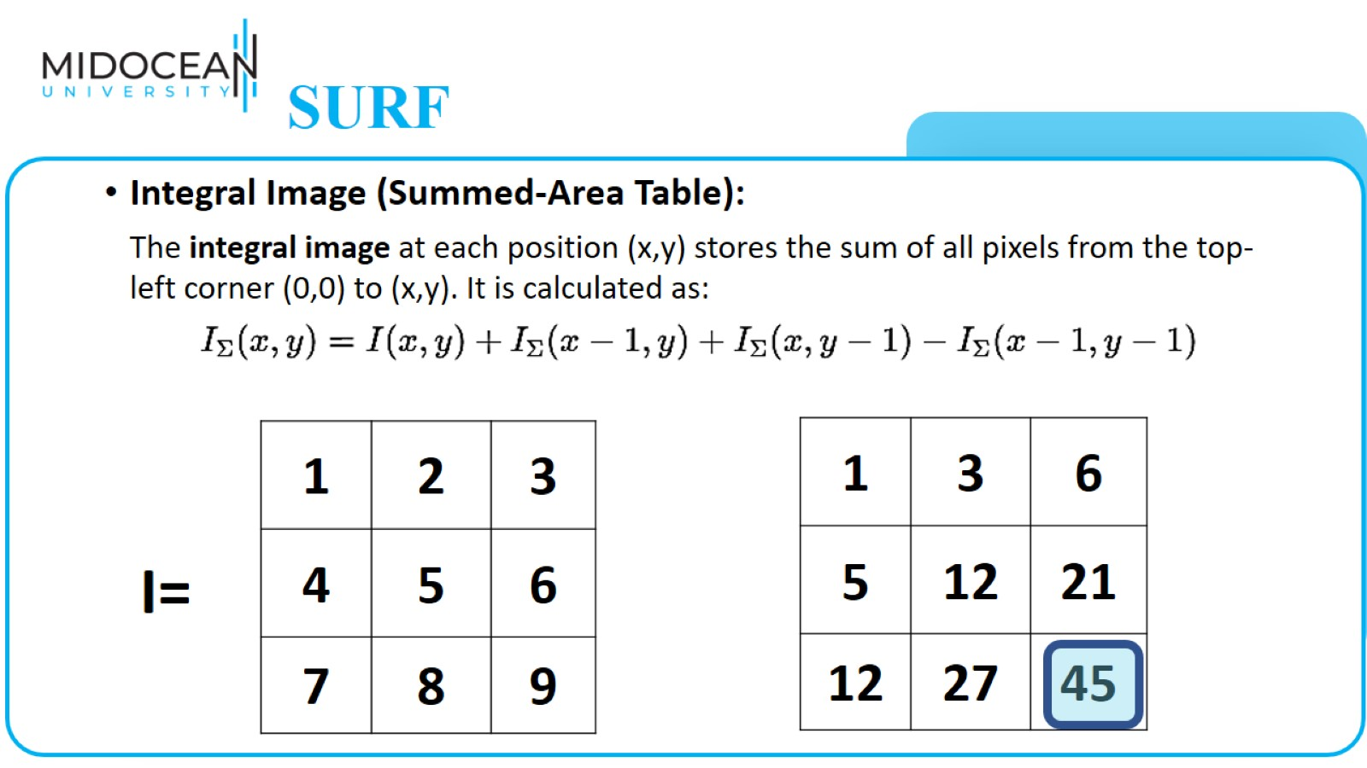
SURF

Slide 47
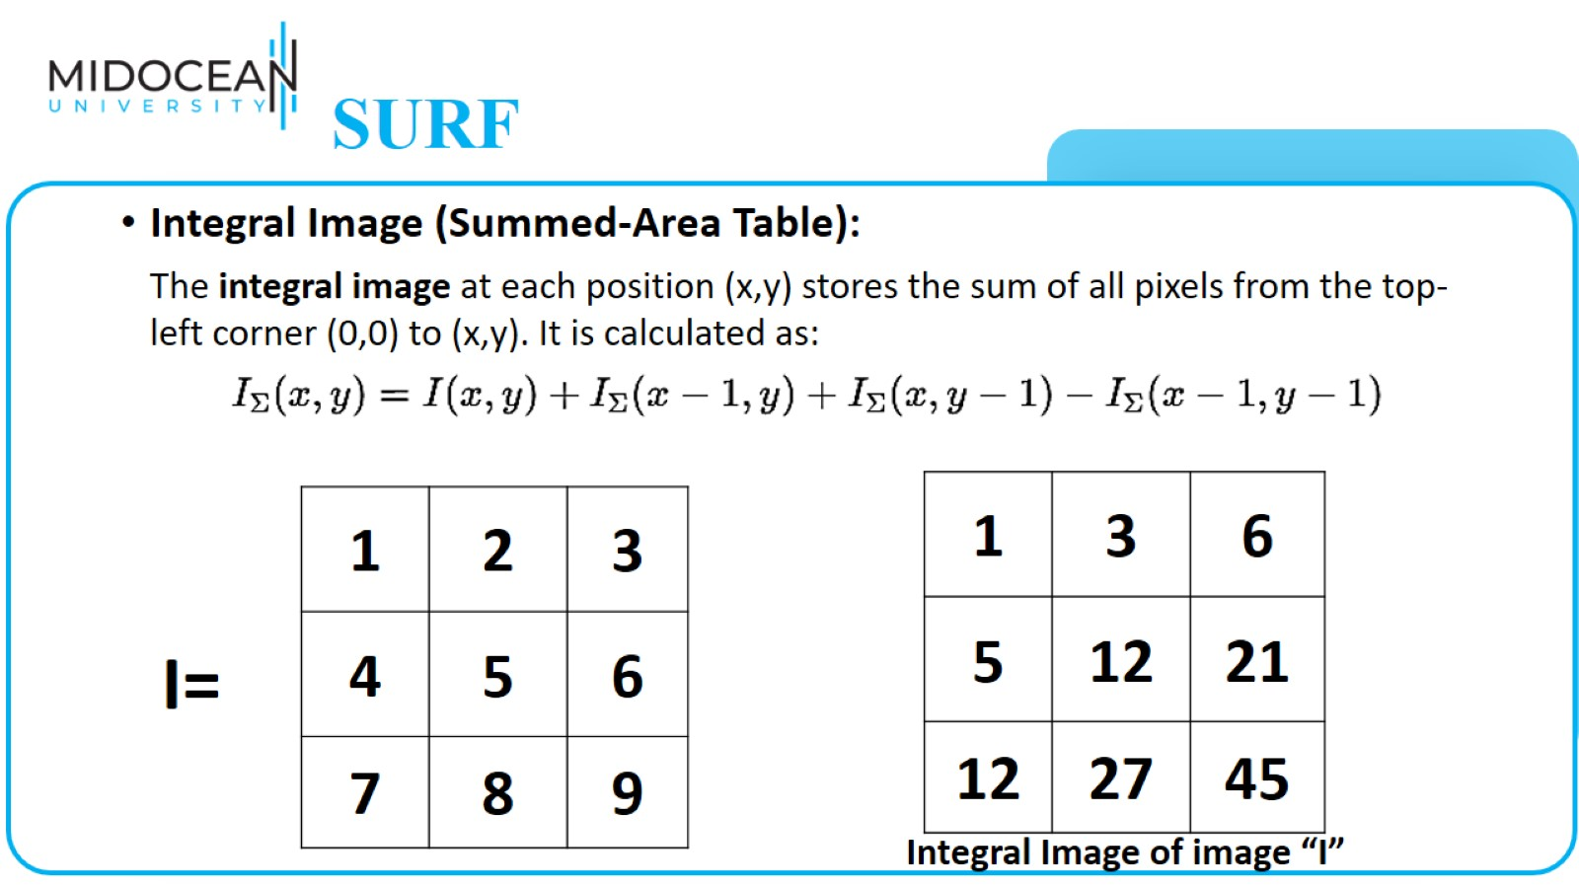
SURF

Slide 48
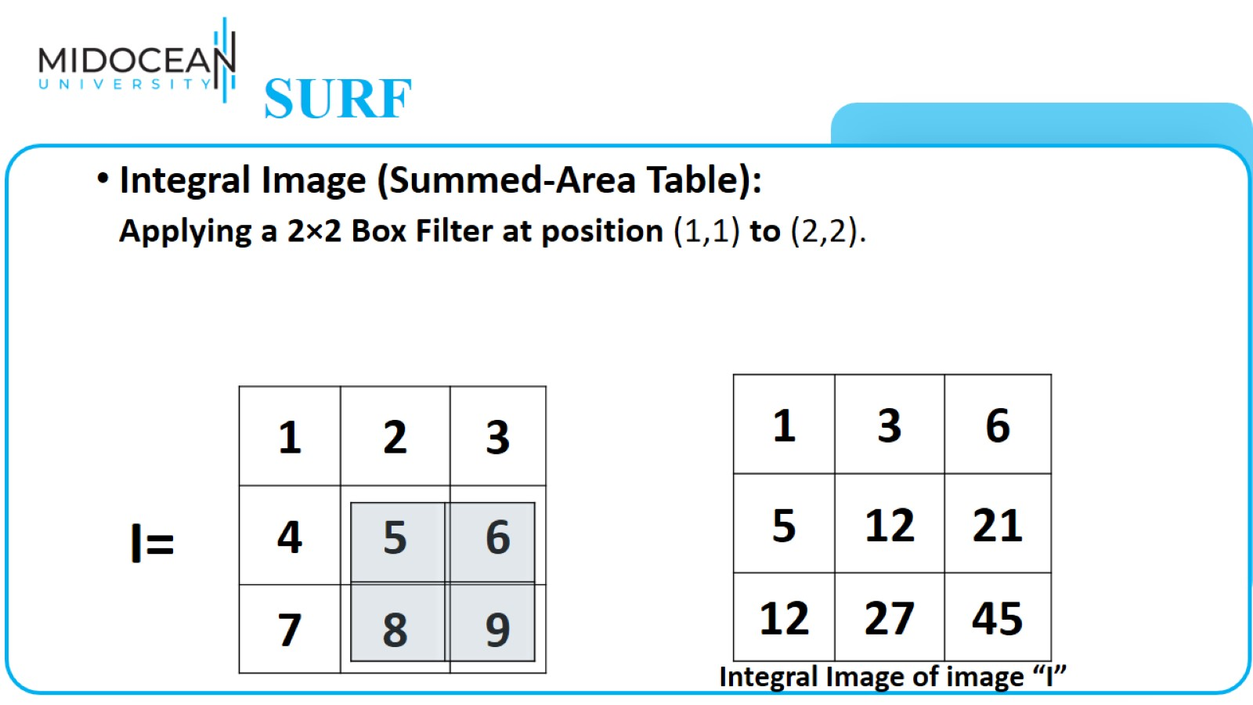
SURF

Slide 49
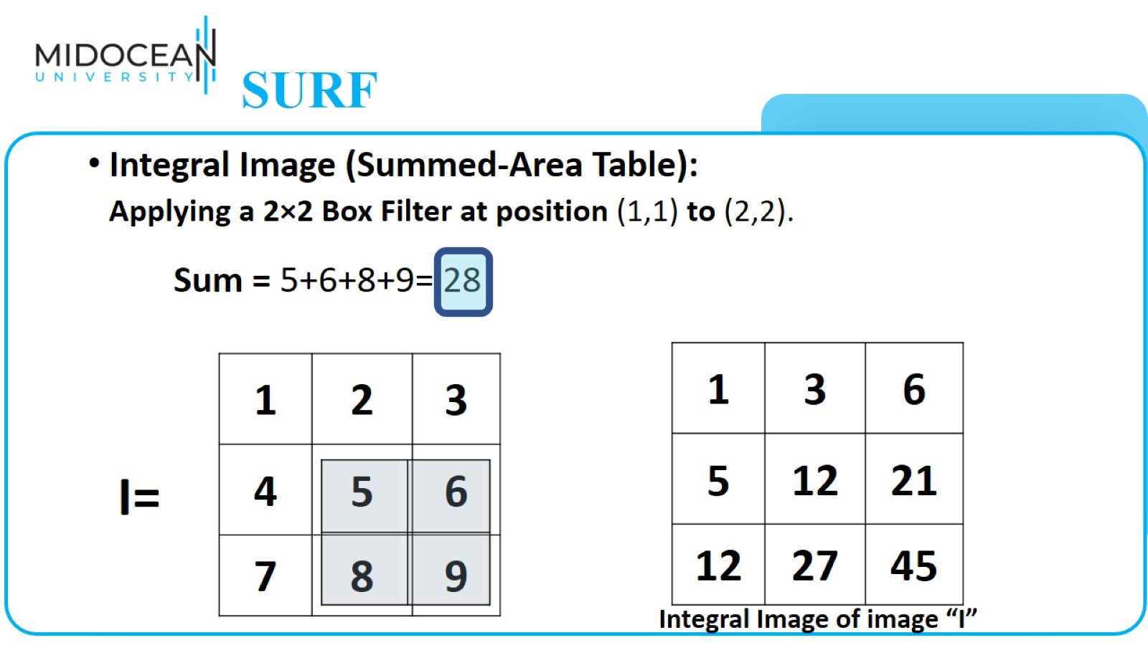
SURF

Slide 50
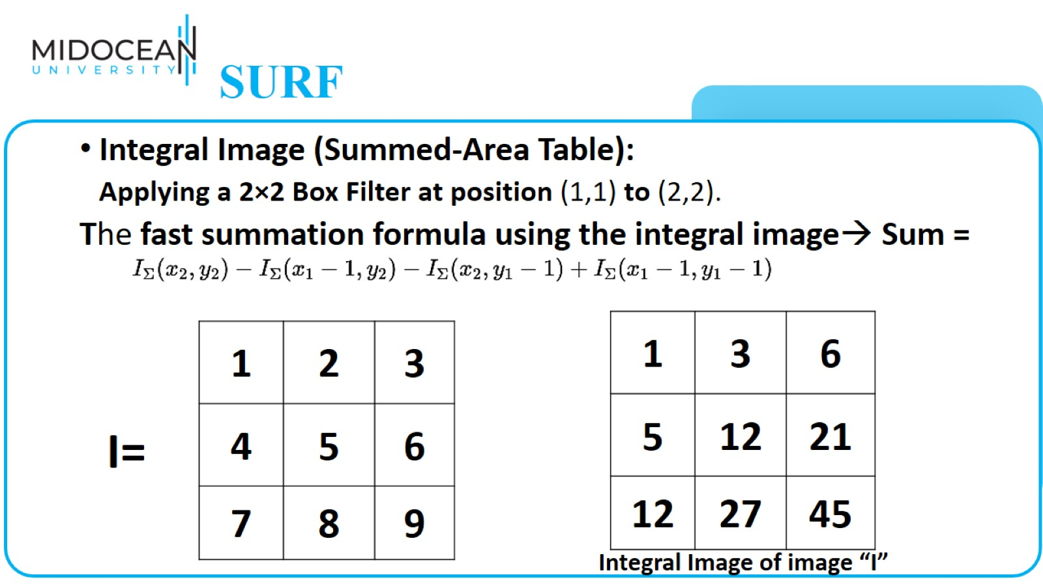
SURF

Slide 51
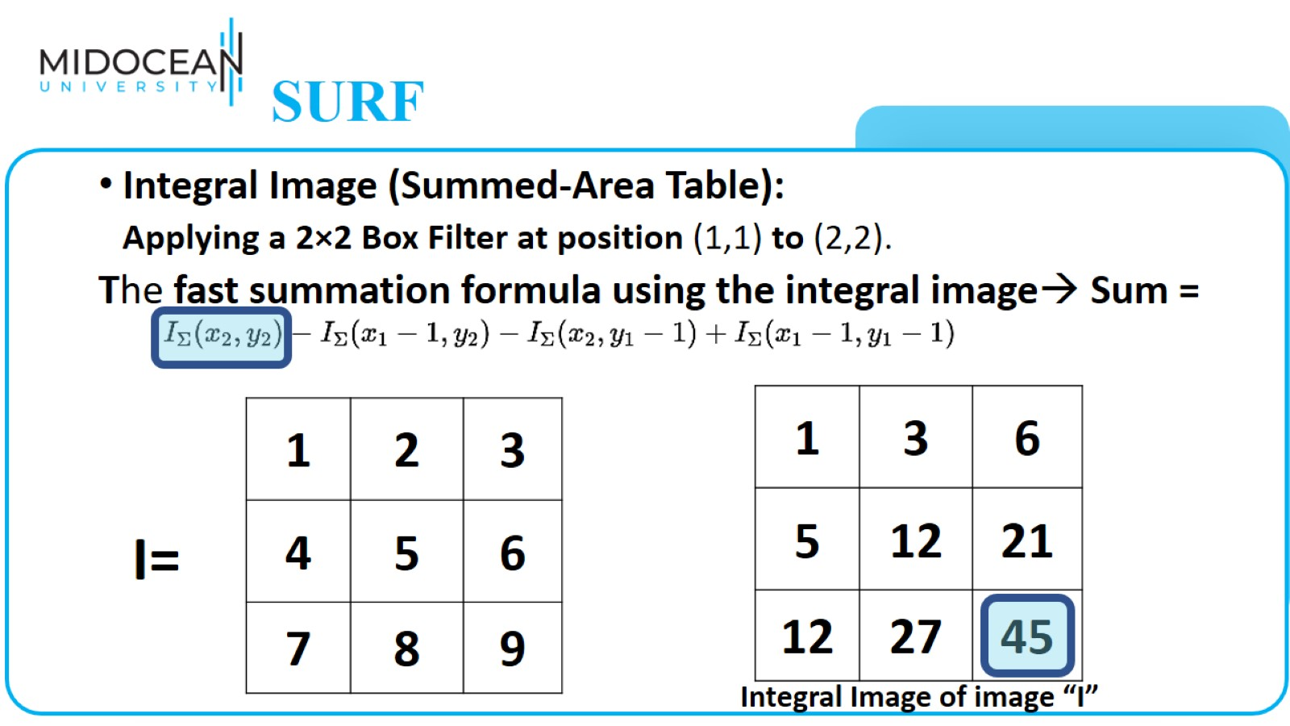
SURF

Slide 52
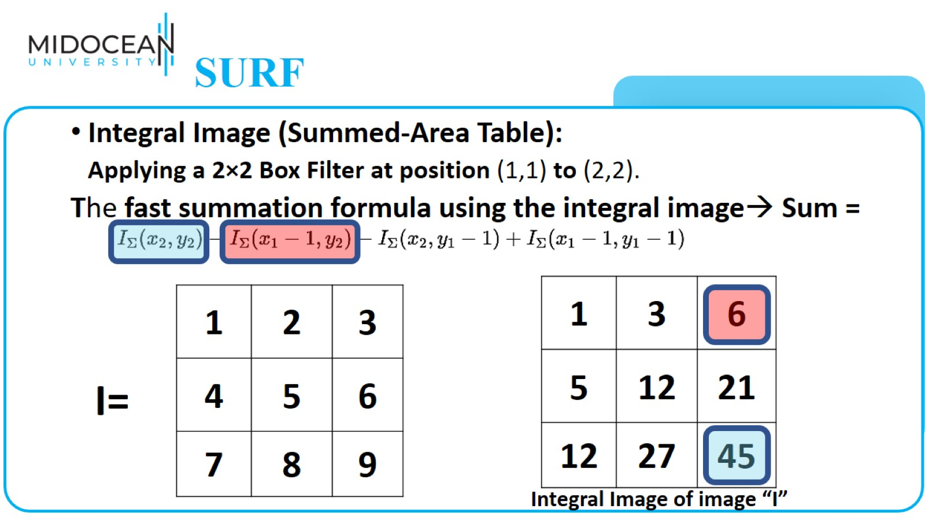
SURF

Slide 53
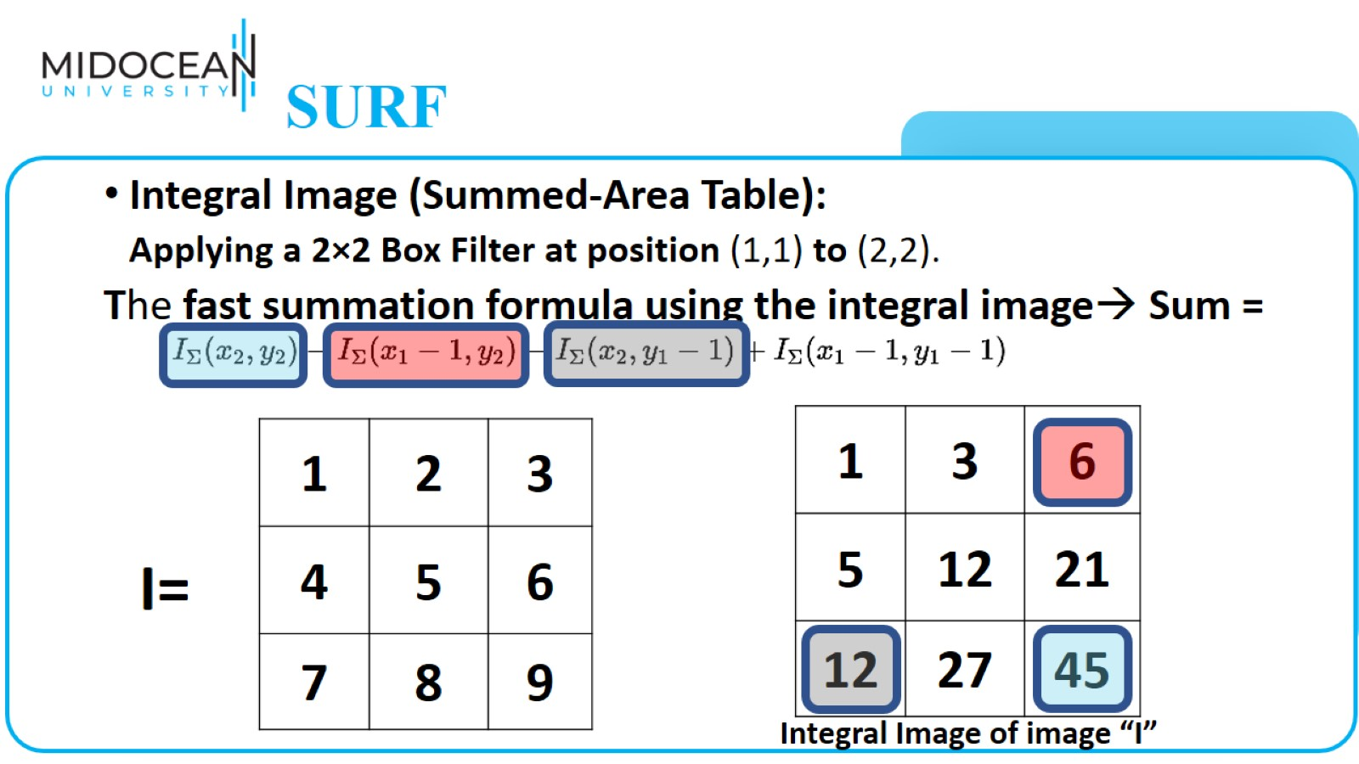
SURF

Slide 54

SURF

Slide 55

SURF

Slide 56

Key Steps in SURF

Slide 57

Key Steps in SURF

Slide 58

Key Steps in SURF

Slide 59

Key Steps in SURF

Slide 60

Key Steps in SURF

Slide 61

Face Detection Using SURF

Slide 62


Slide 63

Bag of Words

Slide 64

Bag of Visual Words (BoVW)

Slide 65

Bag of Visual Words

Slide 66

Bag of Visual Words

Slide 67

Bag of Visual Words

Slide 68

Bag of Visual Words

Slide 69

Bag of Visual Words

Slide 70

Application –
Image Classification

Slide 71


Slide 72


Slide 73


Slide 74


Slide 75


Slide 76


Slide 77


Slide 78


Slide 79


Slide 81


Slide 82


Slide 83

Object Tracking Example

Slide 84

What is Large Language Models?

Slide 85

What is a Language Models?

Slide 86

What is Large Language Models?

Slide 87


Slide 88


Slide 89


Slide 90

How LLMs Work?
Attention Is All You Need

Slide 91

How LLMs Work?
Attention Is All You Need

Slide 92

Word Embedding

Slide 93

Word Embedding

Slide 94

Static Word Embedding

Slide 95

Static Word Embedding

Slide 96

Static Word Embedding

Slide 97

Contextual Embedding

Slide 98

Contextual Embedding

Slide 99

Attention Mechanism

Slide 100

Without Attention Mechanism

Slide 101

Attention Mechanism

Slide 102

Attention Mechanism

Slide 103

Attention Mechanism

Slide 104

Transformer

Slide 105

Transformer

Slide 106

Transformer

Slide 107

Transformer

Slide 108
Transformer

Slide 109

Transformer

Slide 110

Transformer

Slide 111

Transformer

Slide 112

Transformer

Slide 113

Transformer

Slide 114

List of important Large Language Models

Slide 115

A Vision Transformer (ViT): A Transformer for computer vision tasks

Slide 116

A Vision Transformer (ViT)

Slide 117


