Slide 1

Human Resources Management
Prepared by Dr. Ibrahem Aboelseod
Lecture 1
Changing Nature of Human
Resource Management

Slide 2
Human Resource
Management
TENTH EDITON
Robert L. Mathis ⏐ John H. Jackson
Chapter 1
Changing Nature of Human Resource Management

Slide 3
Learning Objectives
After you have read this chapter, you should be able to:
  Define HR management and explain why managers and HR staff must work together.
  List and define the seven categories of of HR activities.
  Identify three challenges facing HR today.
  Describe the four roles of HR management.
  Discuss why ethical issues affect HR management.

Slide 4
Nature of Human Resource Management
Human Resource Management
  The design of formal systems in an organization to ensure effective and efficient use of human talent to accomplish organizational goals.
Who Is an HR Manager?
  In the course carrying out their duties, every operating manager is, in essence, an HR manager.
  HR specialists design processes and systems that operating managers help implement.

Slide 5
Typical Division of HR Responsibilities
HR Unit
  Develops legal, effective interviewing techniques
  Trains managers in conducting selection interviews
  Conducts interviews and testing
  Sends top three applicants to managers for final review
  Checks references
  Does final interviewing and hiring for certain job classifications
Managers
  Advise HR of job openings
  Decide whether to do own final interviewing
  Receive interview training from HR unit
  Do final interviewing and hiring where appropriate
  Review reference information
  Provide feedback to HR unit on hiring/rejection decisions
Figure 1–1

Slide 6
HR Activities
HR Planning and Analysis
Equal Employment Opportunity
Staffing
HR Development
Compensation and Benefits
Health, Safety, and Security
Employee and Labor/Management Relations

Slide 7
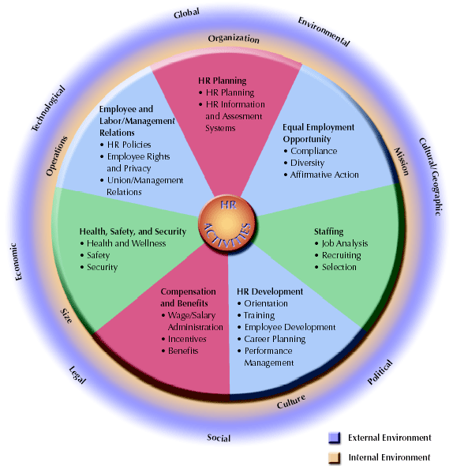
Figure 1–2

Slide 8
HR Management Challenges
Economic and Technological Changes
  Shift in jobs for manufacturing and agriculture to service industries and telecommunications.
  Pressures of global competition causing firms to adapt by lowering costs and increasing productivity.
  Growth of information technology (Internet).

Slide 9
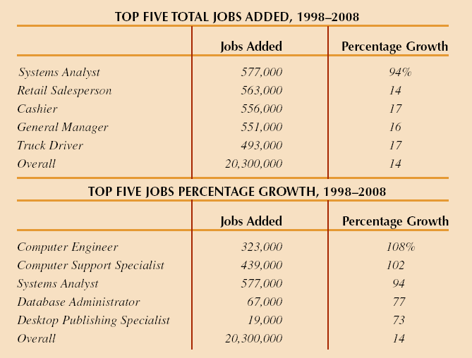
Jobs of the Future
Source: U.S. Department of Labor, Bureau of Labor Statistics, 2001.
Figure 1–3

Slide 10
HR Management Challenges
Workforce Availability and Quality
  Inadequate supply of workers with needed skills for “knowledge jobs”
  Education of workers in basic skills
Growth in Contingent Workforce
  Increases in temporary workers, independent contractors, leased employees, and part-timers caused by:
    Need for flexibility in staffing levels
    Increased difficulty in firing regular employees.
    Reduced legal liability from contract employees

Slide 11
HR Management Challenges
Demographics and Diversity Issues
  More diversity of race, gender, age, and ethnicity in the U.S. workforce
Balancing Work and Family
  Dual-career couples
  Single-parent households
  Decline in the “traditional family”
  Working mothers and family/childcare
  Single employee “backlash” against family-oriented programs.

Slide 12
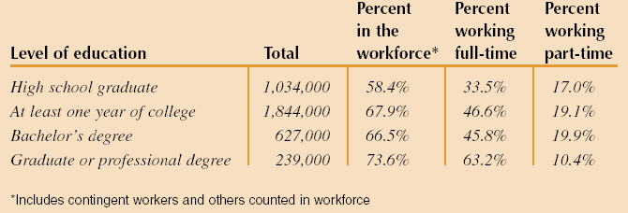
New Moms in the Workforce
Figure 1–4

Slide 13
HR Management Challenges
Organizational Restructuring, Mergers, and Acquisitions
  “Right-sizing”—eliminating of layers of management, closing facilities, merging with other organizations, and outplacing workers
    Intended results are flatter organizations, increases in productivity, quality, service and lower costs.
    Costs are survivor mentality, loss of employee loyalty, and turnover of valuable employees.
  HR managers must work toward ensuring cultural compatibility in mergers.

Slide 14
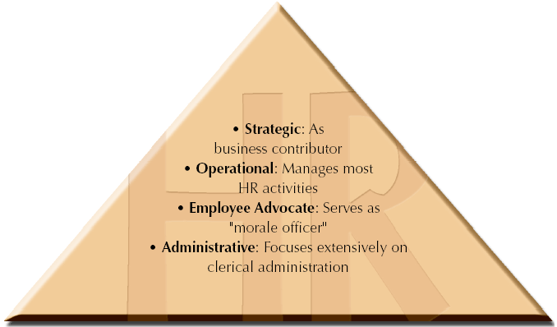
Different Roles for HR Management
Figure 1–5

Slide 15
HR Management Roles
Administrative Role
  Clerical and administrative support operations (e.g., payroll and benefits work)
Employee Advocate Role
  “Champion” for employee concerns
    Employee crisis management
    Responding to employee complaints
Operational Role
  Identification and implementation of HR programs and policies—EEO, hiring, training, and other activities that support the organization.

Slide 16
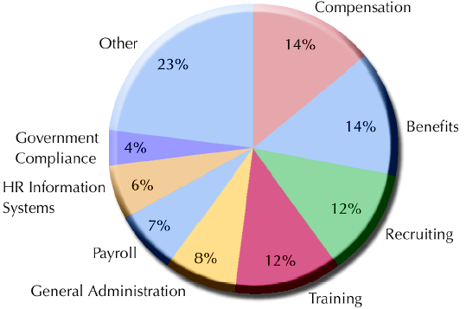
How HR Spends Its Time
Source: Adapted from “How Much Time Should Your HR staff Spend on Recruiting?” Human Resources Department Management Report, June 2000, p. 6.
Figure 1–6

Slide 17
Strategic Role for HR
HR becomes a strategic business partner by:
  Focusing on developing HR programs that enhance organizational performance .
  Involving HR in strategic planning at the onset.
  Participating in decision making on mergers, acquisitions, and downsizing.
  Redesigning organizations and work processes
  Accounting and documenting the financial results of HR activities.

Slide 18
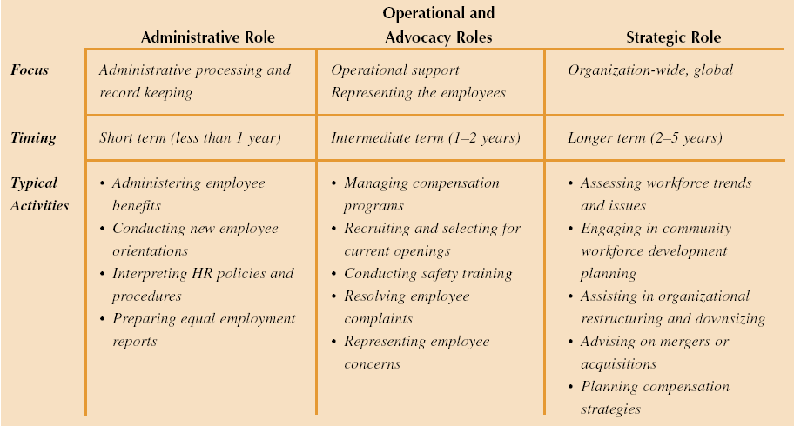
Overview of HR Management Roles
Figure 1–7

Slide 19
Ethics and HR
What is Ethical Behavior?
  What “ought” to be done.
  Dimensions of decisions about ethical issues in management:
    Extended consequences
    Multiple alternatives
    Mixed outcomes
    Uncertain consequences
    Personal effects

Slide 20
Ethics and HR (cont’d)
Responding to Ethical Situations
  Guided by values and personal behavior “codes” that include:
    Does response meet all applicable laws, regulations, and government codes?
    Does response comply with all organizational standards of ethical behavior?
    Does response pass the test of professional standards for ethical behavior?

Slide 21
Ethical Issues in Management
Most Common Forms of Unethical Conduct
  Lying to supervisors
  Employee drug use or alcohol abuse
  Falsification of records
International Ethical Issues
  Gift giving and bribery
  Discrimination in hiring and treatment
Addressing Ethical Issues
  Code of ethics
  Training managers and employees

Slide 22
HR Management Competencies and Careers
HR Generalist
  A person with responsibility for performing a variety of HR activities.
HR Specialist
  A person with in-depth knowledge and expertise in a limited area of HR.
Important HR Capabilities:
  Knowledge of business and organization
  Influence and change management
  Specific HR knowledge and expertise

