Slide 1


English Course- Intermediate Level
Prepared by
Ahmed Soliman

Slide 2



Lecture 6
www.midocean.ae

Slide 3
Listening: Leisure Activities
Grammar: Present Perfect Tense
www.midocean.ae

Slide 4
Listening
Leisure Activities
www.midocean.ae

Slide 5
Vocabulary
catch a movie (verb): watch
– Let’s catch a movie this afternoon after school is over.
cram (verb): study hard
– I had to cram all night for the final text in my biology class.
blast (noun): fun time
– Thanks for inviting me to the party yesterday. It was a real blast.
throw a party (verb): have
– My parents are throwing a big party for my brother who just got married.
midnight (adverb): 12 o’clock at night, the middle of the night
– I have to be back home by midnight. It’s a family rule.
www.midocean.ae

Slide 6
Listen to a conversation between John and Sally and choose the correct answer.
https://www.esl-lab.com/intermediate/leisure-activities/
1- Stuart is going to ______ with his friends.
see a movie and have dinner
go for a drive and have a picnic
watch a football game
2- Why can't Amy go with her friends?
She has to study for an exam.
She already has plans to attend a party.
She doesn't have any spending money.
www.midocean.ae

Slide 7
3- At the end of the evening, the friends are going to ____.
play some games
watch a video
have a party
4- How is Amy getting to the activity?
She's taking the bus.
Stuart is giving her a ride.
She's taking the subway.
www.midocean.ae

Slide 8
5- Amy wants to be home at ____.
10:30 p.m.
11:30 p.m.
midnight
www.midocean.ae

Slide 9
Listening Script
Stuart: Amy. So, how (are) you doing?
Amy: Oh, hi Stuart. School is so crazy these days, and when I’m not at school, I’m at work.
Stuart: Hey, listen. I’m getting together with Sara and Paul tonight, and a few of our other friends are going to join us. [Oh.] And, we’re . . . well, we’re going out to eat and then catch a movie. Why don’t you come with us?
Amy: Hey, I’d love to, but I have to cram for a test tomorrow.
Stuart: Ah, come on. We’re planning on having dinner around 6:30 and then seeing a movie at 7:30. We should be home by 10:30 . . . 11:30 at the latest. I mean you’re always saying that you don’t have any friends . . . and that your love life . . . well, that you don’t have one. Come on!
Amy: I . . . I don’t think I’d better. I haven’t been feeling well lately.
www.midocean.ae

Slide 10
Stuart: Yeah, because you study too much. Well, we’ll have a blast. Come on! Relax. [Well . . .] And it’s Sara’s birthday, too. And we’re throwing her a small birthday party after the movie. Come on. Best friends always stick together.
Amy: Oh. Okay.
Stuart: Great. I’ll pick you up at 6:00.
Amy: Okay. See you then, but I have to be back by 10:30.
Stuart: Ah, 10:30 . . . Midnight. It’s all the same. See you at 6:00.
www.midocean.ae

Slide 11
Grammar
(Present Perfect Tense)
www.midocean.ae

Slide 12
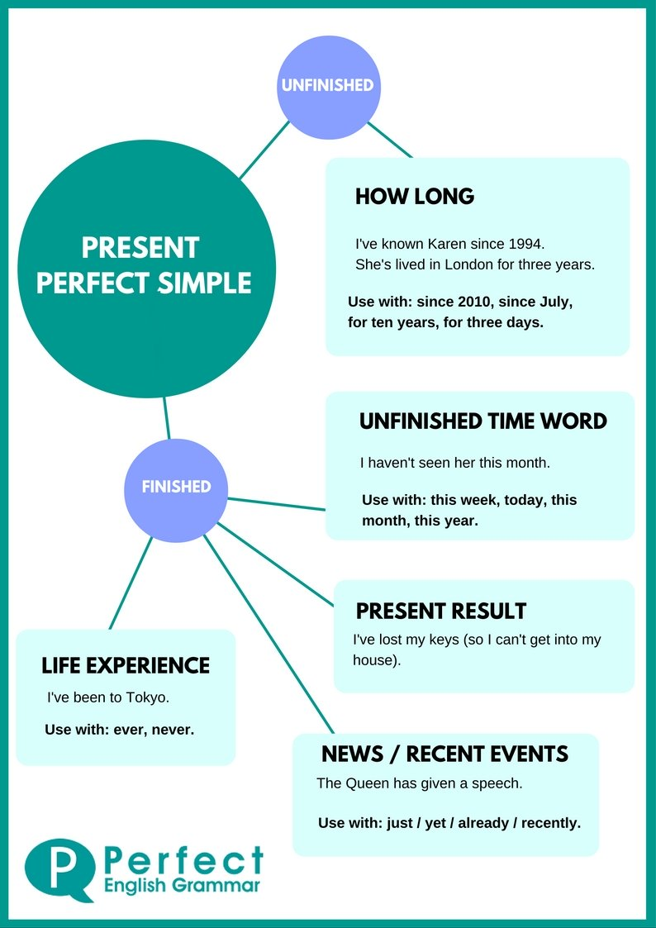
www.midocean.ae

Slide 13
Actions started in the past and continuing in the present
They haven't lived here for years.
She has worked in the bank for five years.
We have had the same car for ten years.
Have you played the piano since you were a child?
www.midocean.ae

Slide 14
When the time period referred to has not finished
I have worked hard this week.
It has rained a lot this year.
We haven't seen her today.
www.midocean.ae

Slide 15
Actions repeated in an unspecified period between the past and now.
They have seen that film six times
It has happened several times already.
She has visited them frequently.
We have eaten at that restaurant many times.
www.midocean.ae

Slide 16
Actions completed in the very recent past (+just)
Have you just finished work?
I have just eaten.
We have just seen her.
Has he just left?
www.midocean.ae

Slide 17
When the precise time of the action is not important or not known
Someone has eaten my soup!
Have you seen 'Gone with the Wind'?
She's studied Japanese, Russian, and English.
www.midocean.ae

Slide 18
The Form
Has
Subject + Have + P.P
They have seen that film six times
She has visited them frequently.
www.midocean.ae

Slide 19
Interrogative
Have / has + Subject + P.P?
Wh question + have / has + Subject + P.P?
Have you called your mom yet?
Has Anthony played basketball yet?
Have you travelled to Aswan?
Have you ever ridden a camel?
www.midocean.ae

Slide 20
Negative
Subject + hasn’t / haven’t + p.p.
They haven't lived here for years.
He hasn’t finished his homework yet.
www.midocean.ae

Slide 21




Thank You

