Slide 1




Research Methodology in Computer Science (AI800)
Lecture 7
Research Proposal Writing
Prepared by
Dr. Mohammed Anbar
www.midocean.ae

Slide 2

Outlines
Learning Outcomes
What is a research proposal?
Computer Science Research Essential Ingredients
Making Research Proposals
Writing Research Proposals
Formatting Research Proposals
Research Proposal Structure and Tips to Write each content.
www.midocean.ae

Slide 3
Learning Outcomes
To cover the essential components of a research proposal, including the introduction, literature review, methodology, and expected outcomes.
To help you to gain an understanding of the importance of clearly stating the research objectives and research questions in a proposal.
To help you learn how to structure their proposal in a logical and coherent manner to effectively communicate their research ideas.
To help you learn how to write a research proposal effectively and efficiently.
www.midocean.ae

Slide 4

What is a research proposal?
A research proposal is a document that outlines the objective, methodology, and significance of a research project.
A research proposal serves as a blueprint for conducting the study and provides a clear plan for data collection, analysis, and interpretation.
A research proposal highlights the potential contribution of the research to the existing body of knowledge in a particular field.
www.midocean.ae

Slide 5

What is a research proposal? (cont. )
Statement of intent
  prepared academically to complete the research.
  audience: coworkers, managers, and examiners
"Your PLAN is a research proposal."
  It thoroughly describes your study.
  Decisions about your study are made based on how well the proposal was written.
  approvals from the Institutional Review Board to move forward
www.midocean.ae

Slide 6
What is a research proposal? (cont. )
Research proposal describe the research proposed plan
  The scope and research questions
    What you intend to study?.
  The Research methodology.
    How you intend to study your research?
  The importance of research.
    Why this topic needs to be studied ?
  The Research duration
    When you plan to finish the research?.
www.midocean.ae

Slide 7

Computer Science Research Essential Ingredients
Issue
Which problem are you attempting to solve with your research?
Design: What methods will be used to accomplish the research's goals?
Benefit: What will this research add to the field of computer science?
Three Building Blocks of Research Proposals
www.midocean.ae

Slide 8
Making Research Proposals Allows You To:
OUTLINE the steps in the research you propose.
Put yourself in a scholarly CONTEXT
VALIDATE your research
Be INNOVATIVE
CONSIDER your test results.
Be aware of potential issues
Expect a reasonable TIMETABLE
www.midocean.ae

Slide 9

Writing Research Proposals
Writing Research Proposals
www.midocean.ae

Slide 10
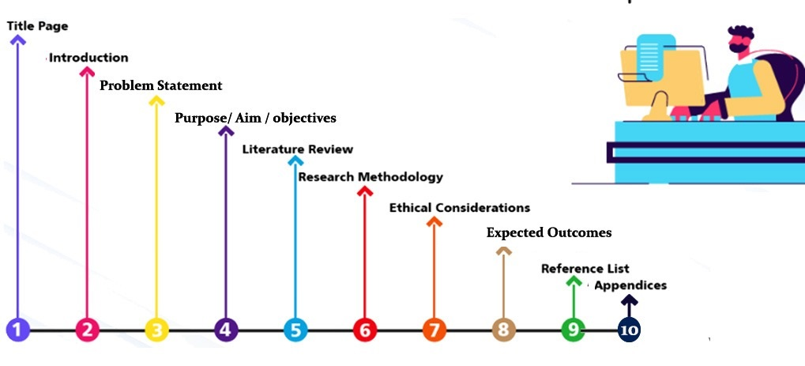
Formatting Research Proposals
www.midocean.ae

Slide 11


Research Proposal Title
Title should be concise and descriptive.
  Orient your readers to your research topic.
Title accurately reflects the focus and objectives of the proposed research.
  Indicate the type of study you will conduct.
Title should be engaging and capture the interest
of potential readers or reviewers.
www.midocean.ae

Slide 12
Title Page
The research title is required to appear on the title page of a research proposal but may be revised after being reviewed by the supervisors.
The title page must include a separate page declaring:
  Name & Surname of the Researcher
  Date of Submitting the Research Proposal
  Course Applied for the Research
www.midocean.ae

Slide 13
Research Proposal Abstract
Begin by clearly stating the purpose of your research and the problem you aim to address.
  This will help readers understand the significance of your study and its potential impact.
Summarize important elements:
  Introduction, Statement of the Problem, Background of the Study, Research Questions, and Methods and Procedures.
Include a brief description of your expected results or findings, emphasizing their potential implications and contributions to the field.
www.midocean.ae

Slide 14
Introduction/ Background
Begin by providing a concise overview of the current state of computer science research.
Introduce the specific problem or gap in knowledge that your research aims to
  Address
  emphasizing its importance
Consider including a brief discussion on any previous studies or existing literature related to your research topic
  highlighting their limitations or areas that have not been adequately explored.
www.midocean.ae

Slide 15
Introduction
Introduction
Background Overview
Identified Problem
Aim and Objectives
Research Relevance
Research Question/ Hypotheses
Research Structure
What is the major research problem?
How is the study’s topic related to that problem?
Why care about the outcomes of the study?
Why this research is important?
What is its significance?
What methods must be used to analyze the research problem?
www.midocean.ae

Slide 16
Tips to Write Introduction/ Background
Determine the broad subject area.
Describe the main principles of your research.
  give readers enough background information.
Give a brief description of each section that will be included in your proposal (optional).
Keep readers interested.
www.midocean.ae

Slide 17

Problem Statement
What is present issue or business problem?
Why has no one approached the problem?
Why is the present research novel?
Purpose:
Blueprint for your literature review
Focus your committee at the beginning
Keep them on track throughout your proposal
www.midocean.ae

Slide 18
Tips to Write Problem Statement
Explain What is the gap that needs to be filled ? as well as "What issue needs to be resolved?“
Clearly state the issue at the beginning of the paragraph.
Keep the variables you mention in your problem statement to a minimum.
www.midocean.ae

Slide 19
Purpose/ Aim / objectives
The purpose of a research proposal is to outline the objectives and goals of a research study.
  It serves as a blueprint for the research project, providing a clear direction and focus.
The aims of the proposal are to identify the specific research questions that will be addressed and to justify why these questions are important and relevant.
Research proposal objectives refer to the specific goals and outcomes that a researcher aims to achieve through their study.
  By defining these objectives, researchers can establish a framework for their research, ensuring that their efforts are focused and aligned with their intended outcomes.
www.midocean.ae

Slide 20
Rationale and context
The rationale of a research proposal refers to the underlying reasons and justifications for conducting the proposed research.
  It explains why the research is important, what gaps or problems it aims to address, and how it contributes to existing knowledge in the field.
The context of a research proposal refers to the background information and circumstances that frame the proposed research.
  It includes relevant literature, theories, methodologies, and any other factors that provide a framework for understanding the research topic.
Understanding the rationale and context of a research proposal is essential for evaluating its potential impact and feasibility.
www.midocean.ae

Slide 21
Research Questions
Research questions are specific inquiries that a researcher aims to answer through their study.
Researcher provide a clear focus and direction for the research, guiding the collection and analysis of data.
These questions should be well-defined, concise, and aligned with the objectives of the study.
By formulating research questions, researchers can explore various aspects of a topic and contribute to existing knowledge in their field.
www.midocean.ae

Slide 22
Tips to Write Purpose/Aims/Rationale/Research Questions
Describe the study's aims and objectives.
Show your study's original contributions, if applicable.
Give a more thorough explanation of the ideas outlined in the introduction.
Provide a sound rationale for the study.
Clearly state the topics that your study will not cover.
Describe the study's research questions.
Add a section that defines key terms.
Describe the research's constraints.
Give a justification for the study's specific subjects.
www.midocean.ae

Slide 23
Review of Literature
This is NOT just a summary of literature
Show how your research study:
  Literature SUPPORTS your hypothesis
  EXTENDS previous work
  AVOIDS previous mistakes
  IS UNIQUE to previously followed paths
www.midocean.ae

Slide 24
Review of Literature (cont.)
By writing the literature review, you can understand:
How other academics have discussed your topic.
The various theories that have been used to examine materials or data.
The most effective research methodologies and techniques for your specific topic.
www.midocean.ae

Slide 25
Background vs Review of Literature
Background of the Study
About the research area
What is the present scenario about the topic
If the research is about an industry, kindly be more specific about the industry
Elaborate on the key statistics evident
Review of Literature
Concepts and definitions
Theories
Related works
Research gap
www.midocean.ae

Slide 26
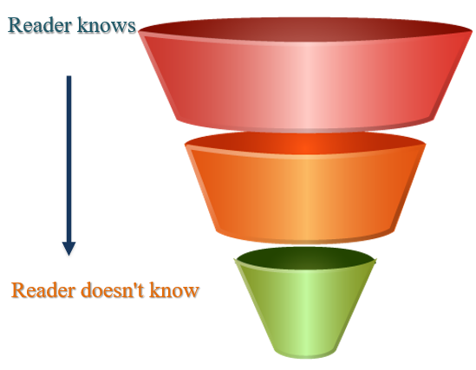
Tips to Write Review of Literature
Places the current study in the context of a larger disciplinary discussion to show where your research stands within the existing body of knowledge and ongoing conversations in your field.
Demonstrates the significance, and
necessity of your specific project.
Supports methodological decisions.
Exhibits familiarity with the subject and appropriate methods of study.
Introduce the field:
broad focus
Focus on certain aspects in field
End with
Gap
Analysis
www.midocean.ae

Slide 27
Methodology
Methodology section involves outlining the steps, procedures, and tools that will be employed to collect and analyze data, as well as the rationale behind their selection.
Methodology section address any potential limitations or challenges that may arise during the research process to ensure the validity and reliability of the findings.
Methodology section is divided into several sections:
  Study groups
  Ethics
  Access to samples
  Infrastructure
  Data analysis.
www.midocean.ae

Slide 28
Tips for Writing Methodology
Clearly define the research objectives and the problem statement that the methodology aims to address.
  This will provide a clear framework for designing and implementing the methodology.
Choose appropriate research methods and techniques that align with the objectives of your study.
  Consider factors such as data collection, analysis, and evaluation methods that are commonly used in computer science research.
Provide a detailed description of each step involved in your methodology, ensuring that it is logical and coherent.
www.midocean.ae

Slide 29
Tips for Writing Methodology (cont.)
Discuss any potential limitations or challenges that may arise during the implementation of your methodology and propose strategies to mitigate them.
  This will help ensure the feasibility and effectiveness of your research approach.
Finally, consider the ethical implications of your methodology and address any potential risks or concerns related to data privacy, participant consent, or any other ethical considerations relevant to your study.
  By incorporating these elements into your methodology, you can enhance the rigor and credibility of your research findings.
www.midocean.ae

Slide 30
Research Design and Methods
This section of a research proposal aims to convince the reader that the research design and methods will solve the identified research problem and accurately interpret the results, The section should be:
  Well-written, clear, and logically organized, demonstrating the researcher's knowledge and ability to complete the study in a timely manner.
  Tied to the study's objectives and include examples from the literature review related to the design and methods.
  Demonstrate how the study utilizes and builds upon past studies, considering both existing and potential methods.
The methods section is not just a list of tasks, but also an argument for why and how the tasks will help investigate the research problem and answer the research question(s).
www.midocean.ae

Slide 31
Tips for Writing Research Design and Methods
Indicate which methodological strategies you plan to use to gather information and which techniques you will apply to the data analysis.
Indicate the types of research operations you plan to conduct and how you plan to interpet the findings in relation to the research problem.
When conducting your research, be prepared for and aware of any possible obstacles you may run into. Then, plan how you will overcome these obstacles.
Describe the areas you anticipate facing difficulties in gathering data, such as gaining
access to participants and data.
www.midocean.ae

Slide 32
Significance/ Implications
The significance of the research proposal in computer science lies in its:
  Potential to advance technological innovations.
  Address current challenges within various fields:
    Artificial intelligence.
    Cybersecurity
    Data analytics
    Software engineering.
Exploring different aspects of computer science through a research proposal, researchers can contribute to the development of cutting-edge technologies that have practical applications across industries and societal domains.
Investigating the implications of the proposed research project is crucial for understanding how it could impact existing systems or introduce novel solutions.
www.midocean.ae

Slide 33
Significance/ Implications (cont. )
The Significance and Implications may include the following items:
Reference to overall aims of the study and a summary of the major findings.
Reference to key results
Discussion of the significance of the study and results (what they mean)
Discussion of the implications of the study and results (how they affect the wider field)
Limitations of the results.
Discussion of changes, if any, in research design for the main study.
www.midocean.ae

Slide 34
Overview of Chapters
The research proposal will consist of several chapters that provide a comprehensive overview of the study.
The first chapter will introduce the research topic and its significance, highlighting the gaps in existing literature.
This will be followed by a review of relevant theories and concepts in the second chapter, which will serve as the foundation for the study.
The third chapter will outline the research methodology and data collection techniques to be used.
Finally, the last chapter will present the expected findings and their implications for future research and practice.
www.midocean.ae

Slide 35
Plan of work
The research proposal plan of work includes a breakdown of the team members' responsibilities and timelines; therefore, a Gantt chart and a Division of Work chart are necessary.
The plan of work includes a detailed description of the research objectives, methodology, data collection methods, and analysis techniques.
The plan of work provides a clear outline of the resources needed, such as equipment, software, and personnel.
The project's phases and their deadlines are shown in a Gantt chart.
www.midocean.ae

Slide 36
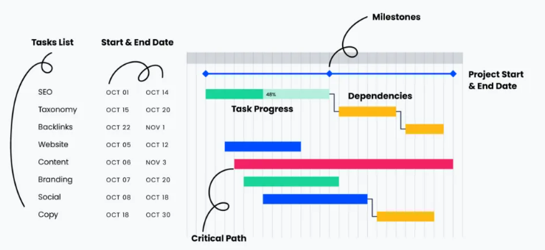
Plan of work: Gantt Chart
The start date and end date of each task
Important milestone dates within the project’s timeline
what are the activities required for project completion?
The start date and end date for the entire project
how do the tasks relate to one another?
The progress made toward the completion of each task: is the task on track, at risk, or delayed?
The set of tasks that take the longest time to complete in a project and so provide an estimate of project duration
www.midocean.ae

Slide 37

Timeline
The research proposal timeline outlines the projected schedule for completing the research project.
The research proposal timeline includes key milestones and deadlines that need to be met throughout the research process.
  Avoids “dead” time.
The research proposal timeline provides a clear overview of the time required for each phase of the study, such as literature review, data collection, analysis, and report writing.
The timeline ensures that the research project stays on track and allows for effective planning and allocation of resources.
www.midocean.ae

Slide 38
Resources / Support
Exploring the availability and accessibility of resources for research proposal development:
  This could involve investigating various online platforms, libraries, academic institutions, or other sources that provide support materials such as guidelines, templates, examples, or workshops to help researchers craft effective proposals.
Evaluating the effectiveness of different support systems for research proposal writing:
  This topic could delve into analyzing the outcomes and impact of existing support structures designed to assist researchers in their proposal writing process. It may involve examining case studies or conducting surveys
www.midocean.ae

Slide 39
Outcomes
The outcome expect that the findings will contribute to the existing body of knowledge and fill gaps in current understanding.
The results may have practical implications and can potentially inform decision-making processes in relevant fields.
What do you expect the results to be?
Measurable
  E.g. you will get a degree
  New patent / paper
Qualitative
  Contribute understanding to subject / new technology / application
www.midocean.ae

Slide 40
Reference list
The importance of a well-structured and comprehensive reference list in any research proposal.
Different citation styles commonly used in academic writing and how to appropriately format the reference list accordingly.
Strategies for conducting thorough literature reviews and identifying relevant sources to include in the reference list.
The role of primary and secondary sources, including scholarly articles, books, reports, and credible online resources, in building a strong reference list for a research proposal.
www.midocean.ae

Slide 41
References
VanderMey, R., Meyers, V., Van Rys, J., Kemper, D., & Sebrank, P. (2011). The college writer: A guide to thinking, writing, and researching (4th ed.). Boston: Houghton Mifflin.
Abd Karim Alias (2010). A brief guide to doing a literature review. Retrieved from http://www.slideshare.net/akarim717/doing-a- literature-review6432447?qid=ea37aecb-065c- 4ac3-8975-03bd20e0a570&v=&b=&from_search=1
Teoh Yew Heng. Seminar on how to write a research plan & tackling a literature review
www.midocean.ae

Slide 42



Thank You

