Slide 1


Flutter & Dart Complete Guide
Prepared by Eng. Yousef Salah Kassem
DAFL 2
Practical Lecture
Lecture 4

Slide 2

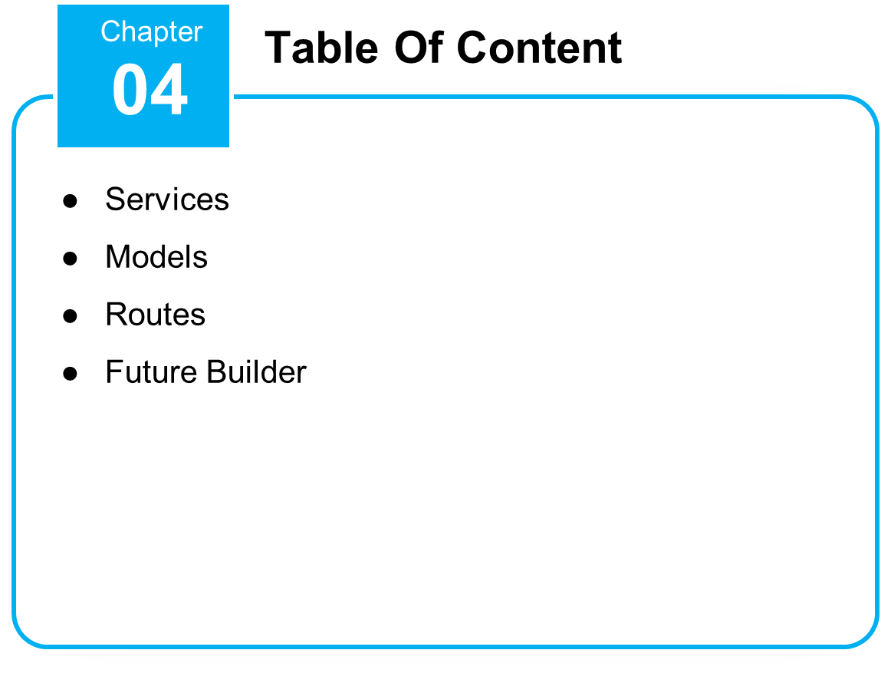


Slide 3
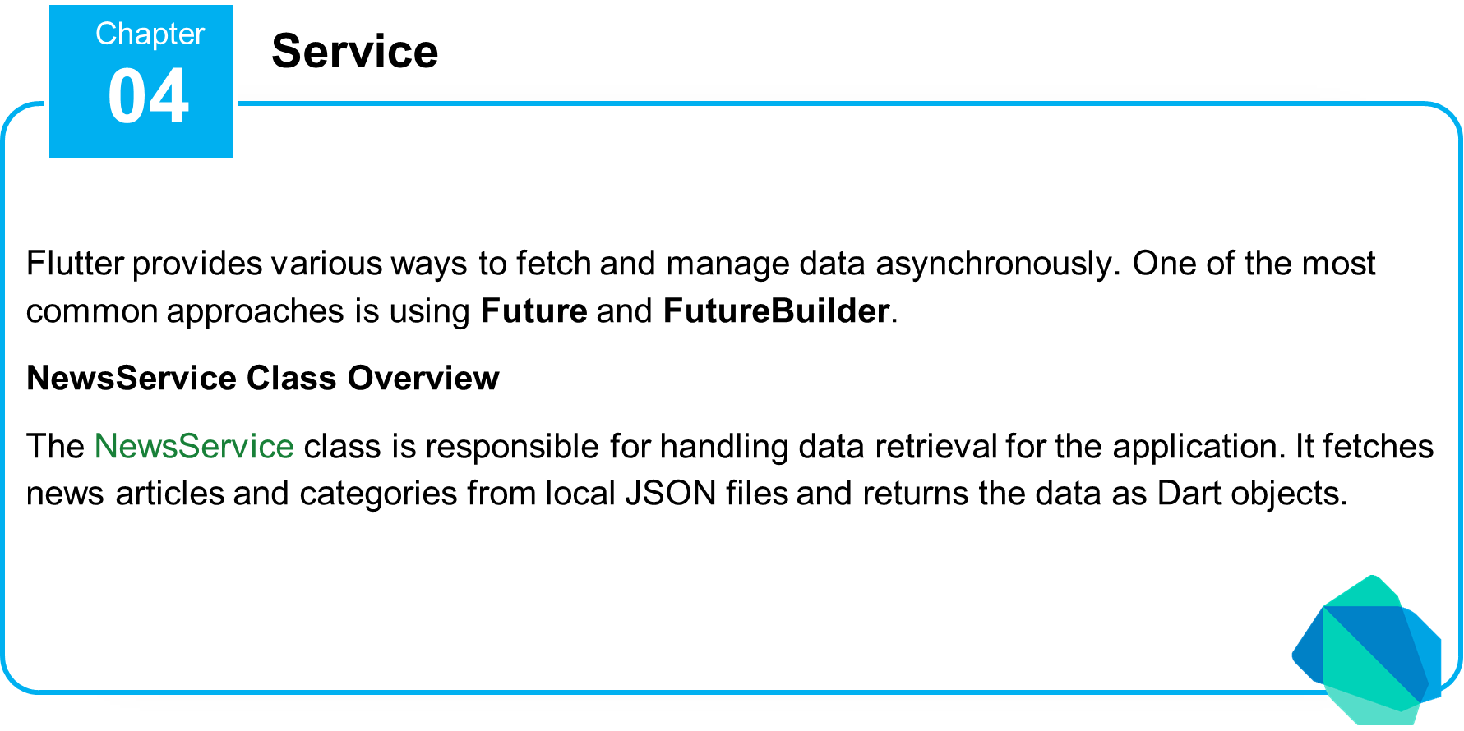

Slide 4
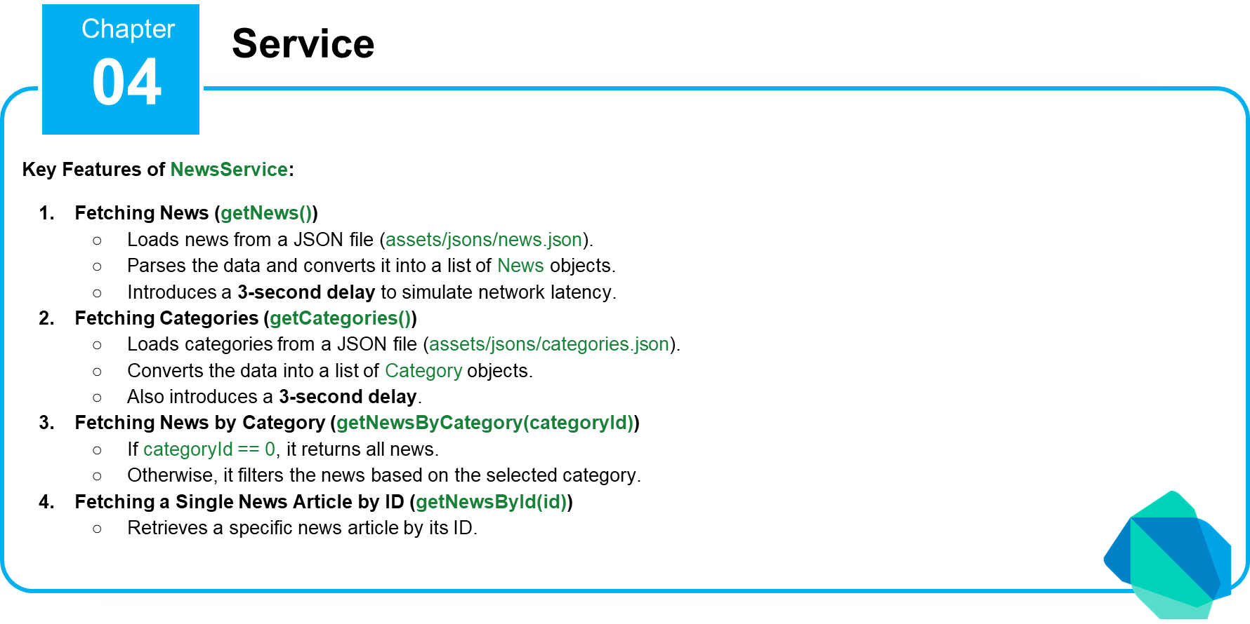

Slide 5


Slide 6
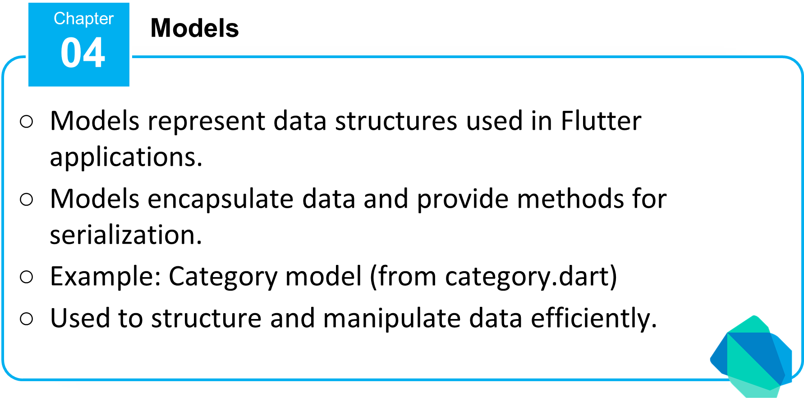

Slide 7
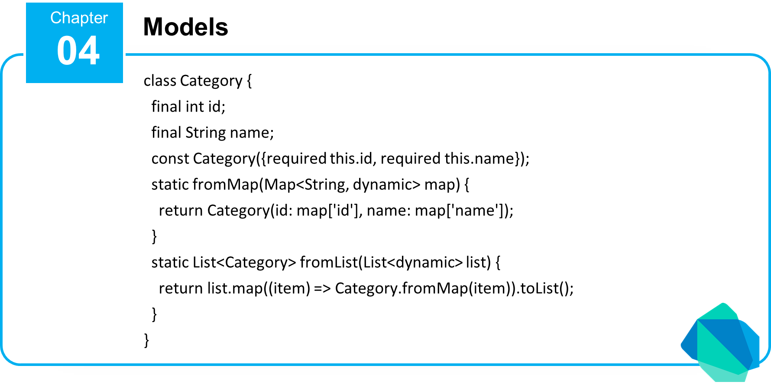

Slide 8


Slide 9
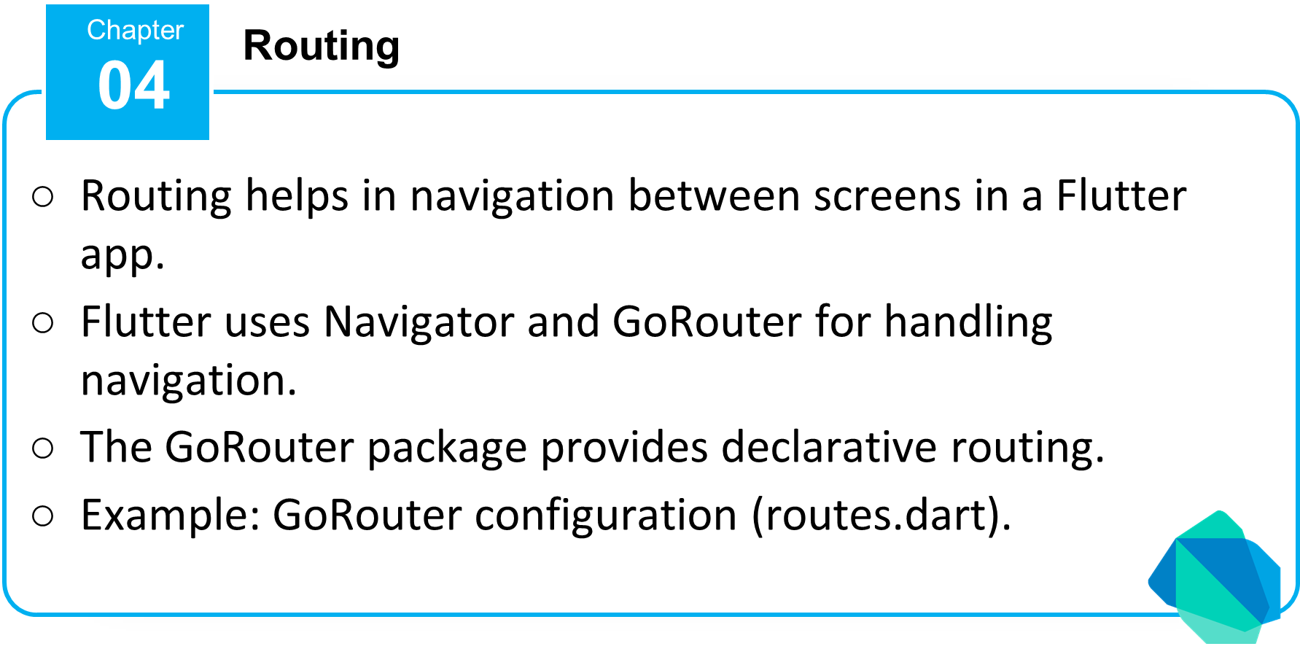

Slide 10
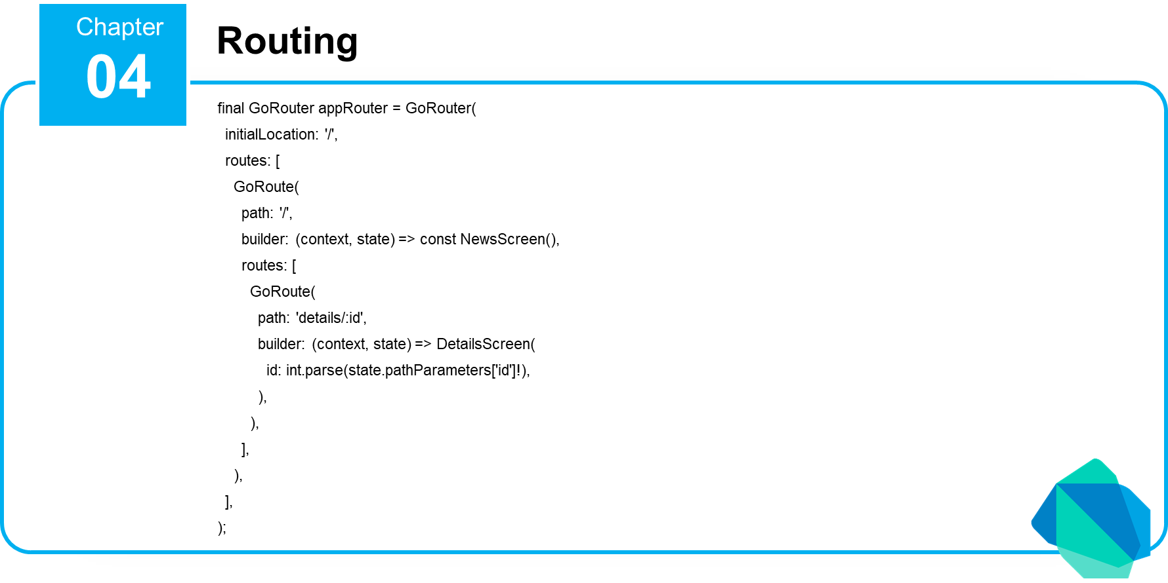

Slide 11


Slide 14
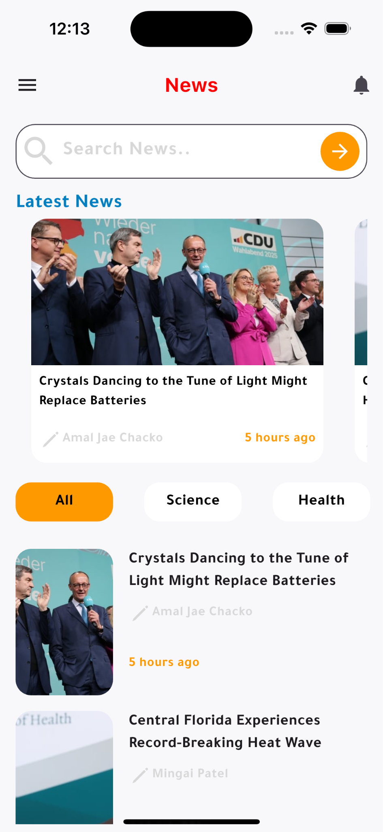

Slide 15
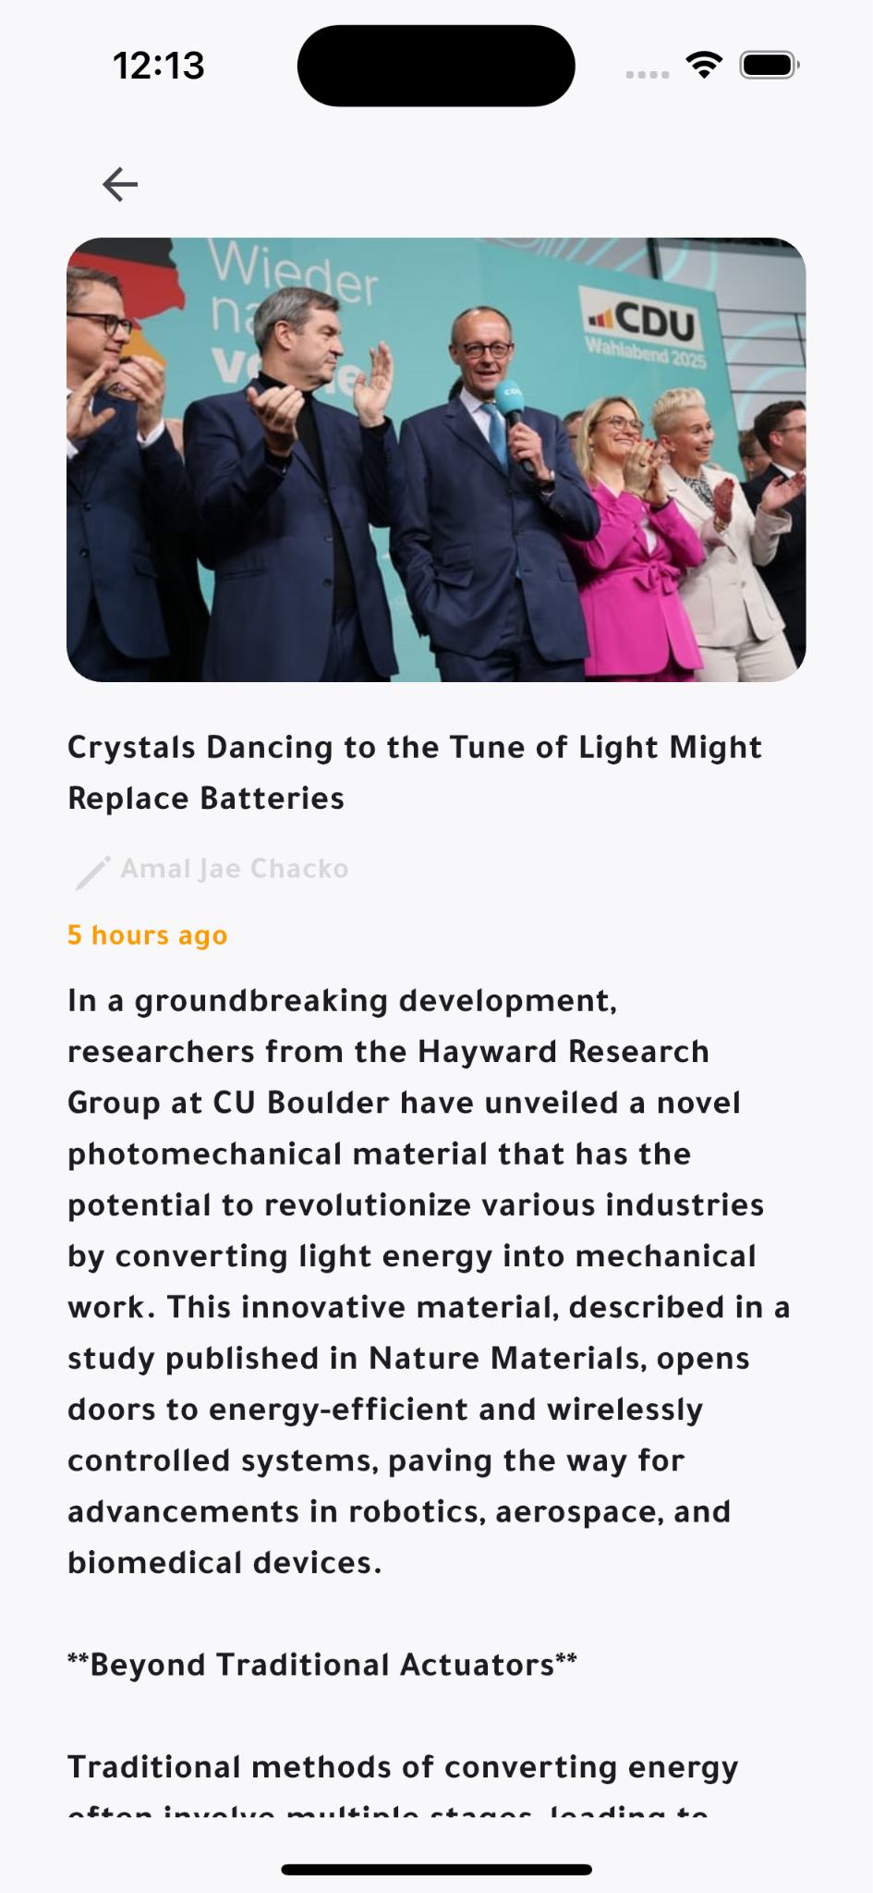

Slide 16


Slide 17


Slide 18



Thank You

