Slide 1




Research Methodology in Computer Science (AI800)
Lecture 6
Research Methods in Computer Science – part 2
Prepared by
Dr. Mohammed Anbar
www.midocean.ae

Slide 2

Outlines
Learning Outcomes
Research Design
Research Design Parts
Important Features of a Research Design
FEATURES OF A GOOD DESIGN
Research Design Concepts
Research Design in Research process
Data Collection Definition and Terms
Primary Data Vs Secondary Data
Primary Data Collection
Quantitative Data Collection
Qualitative Data Collection
Secondary Data Collection
Rules for Collecting Data
Developing a Data Collection Plan
Strategies for Rapid Reporting
Data Analysis Definition, important and Types
Techniques for data analysis
Data Analysis Methods and Process
Tools to support data analysis
Results Interpretation and Discussion
How to Organize the Results Section
Tips to Write the Results Section
How to Organize the Discussion Section
Tips to Write the Discussion Section
www.midocean.ae

Slide 3
Learning Outcomes
To understand the research design parts, features and concepts.
To Understand the importance of data collection in computer Science research.
To Learn about different methods and techniques used for data collection.
To Gain knowledge on how to design and implement effective data collection strategies.
To Understand the process and Rules for Collecting Data
To Understand the basic concepts and principles of data analysis.
To Learn various methods and techniques used in data analysis.
To Gain knowledge on different types of statistical analyses and when to use them.
To Understand the importance of interpreting and discussing research results.
To Learn how to effectively interpret and discuss research findings.
www.midocean.ae

Slide 4
Research Design
A research design is the planning of data collection and analysis in a way that seeks to balance efficiency with relevance to the research purpose.
  Comprises a schedule outlining the researcher's steps, from formulating the hypothesis to considering its operational ramifications to conducting the final data analysis.
In more precise terms, the design choices pertain to:
What?
the study about?
type of data is required?
Where?
will the study be carried out?
can the required data be found?
Why?
the study being made?
periods of time will the study include?
will be the sample design?
techniques of data collection will be used?
style will the report be prepared?
www.midocean.ae

Slide 5
Research Design Parts
Sampling Design
Observational Design
Statistical Design
Operational Design
Concerned with the procedure for selecting elements to be observed
Elaborate on the different types of sampling techniques : random sampling, or cluster sampling.
Relates to the conditions under which the observations are to be made.
Includes various factors such as the location, time, and environment
Concerns with the question of how many items are to be observed and how the information and data gathered are to be analyzed.
Considers with practical considerations such as time, resources, and feasibility of data collection methods.
Translates the theoretical framework into practical actions and procedures.
Involves determining the specific tools, techniques, and resources needed to carry out the sampling, statistical, and observational designs effectively.
www.midocean.ae

Slide 6
Important Features of a Research Design
(i) It is a strategy outlining the kinds and sources of data pertinent to the research
issue.
(ii) It is a plan outlining the methodology for collecting and analyzing the data.
(iii) It also includes the time and cost budgets.
www.midocean.ae

Slide 7
FEATURES OF A GOOD DESIGN
There are several key features that define a good design in computer science research Should be:
  Clear and concise, ensuring that it is easily understandable to both experts and non-experts in the field.
  Flexible and adaptable, allowing for modifications and improvements as new technologies and methodologies emerge.
  Well-documented, providing thorough explanations of the research process and methodology used, enabling others to replicate or build upon the findings.
www.midocean.ae

Slide 8
Research Design Concepts
Dependent and independent variables:
  Dependent variables refer to the outcomes or results that are being measured or observed.
  Independent variables refer to the factors or conditions that are manipulated or controlled by the researcher.
  Identifying and understanding the relationship between dependent and independent variables to effectively design experiments and analyze data to draw meaningful conclusions in computer science research.
Extraneous variable:
  refers to any variable that may influence the relationship between the independent and dependent variables in a research study.
Control:
  refers to the ability to manipulate and regulate variables to observe their effects on the outcome of an experiment or study.
www.midocean.ae

Slide 9
Research Design Concepts (cont.)
Confounded relationship
  The framework and methodology used to conduct studies and gather data.
  These concepts help researchers establish clear objectives, identify variables, and determine the most appropriate research methods
Research hypothesis:
  A statement that proposes a relationship between variables or predicts an outcome based on existing knowledge or theories.
Experimental and non-experimental hypothesis-testing research
  Experimental research design involves manipulating variables and measuring their effects on the outcome.
  Non-experimental hypothesis-testing research design does not involve manipulation of variables but rather focuses on observing and analyzing existing data to test hypotheses.
www.midocean.ae

Slide 10
Research Design Concepts (cont..)
Experimental and control groups
  Experimental groups are exposed to a specific treatment or intervention, while control groups do not receive the treatment and serve as a baseline for comparison.
Treatments
  The different conditions under which experimental and control.
Experiment
  The process of examining the truth of a statistical hypothesis, relating to some research problem.
Experimental unit(s):
  The pre-determined plots or the blocks, where different treatments are used.
www.midocean.ae

Slide 11
Research Design in Research process
Formulate hypotheses
Collect data
Analyze data
Design research (including sample design)
www.midocean.ae

Slide 12
In summary
A research design must include :
  a statement of the research problem;
  the methods and techniques to be used in data collection;
  the study population; and
  a plan for processing and analyzing the data
www.midocean.ae

Slide 13

Data Collection
Data Collection
www.midocean.ae

Slide 14
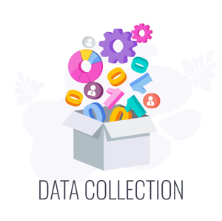
What is Data Collection?
Data collection is the process of gathering information for a specific purpose
  Collecting, quantifying, and evaluating precise research insights through standard, validated methods.
This involves various methods such as surveys, experiments, observations, or existing datasets.
The collected data serves as the foundation for analysis and drawing meaningful conclusions to contribute to the advancement of computer science knowledge and innovation.
www.midocean.ae

Slide 15
Data Collection Terms
  Data Collection Strategies:
  There is no one ideal strategy; the choice depends on
  1. What you should know: narratives or numbers 2. Where the environment, files, and people contain the data 3. Time and resources available 4. Difficulty of the information to be gathered
  5. How often data is collected ?
www.midocean.ae

Slide 16
Data Collection Terms(cont.)
Data sources:
  A data source is a location where information is gathered.
  Include academic journals, conference proceedings, and online databases.
  Provide researchers with valuable information and insights into various topics such as algorithms, artificial intelligence, data mining, software engineering.
Data sources divided into two groups based on technology:
  Machine data sources.
  File data sources.
Data sources classified into two types:
  Primary data.
  Secondary data.
www.midocean.ae

Slide 17
Data Collection Terms(cont.)
Data Collection Methods:
  Techniques and procedures used to gather information for research purposes.
  Involve either quantitative or qualitative approaches to data gathering.
Data Collection Methods categorized into two :
  Primary Data Collection Methods divided into two categories:
    Quantitative methods
    Qualitative methods.
  Secondary Data Collection Methods include data collected from previous experiments or studies conducted:
    Internal data sources.
    External data sources.
www.midocean.ae

Slide 18
Primary Data vs Secondary Data
Primary data refers to the original data that is collected firsthand by the researcher for a specific research project.
  In computer science research, primary data can be obtained through various methods such as surveys, experiments, observations, or interviews.
  Allows researchers to have control over the data collection process and ensures that the data is specific to their research needs.
Secondary data refers to existing data that has been collected by someone else for a different purpose but can be utilized by researchers for their own studies.
  Include sources like books, articles, databases, or previous research studies.
  Readily available and can save time and resources.
www.midocean.ae

Slide 19
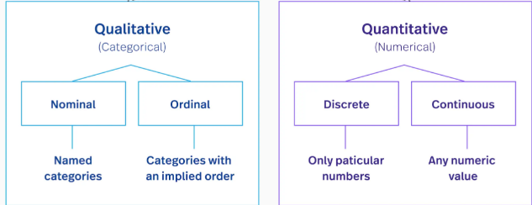
Primary Data Collection
Quantitative methods involve the collection and analysis of numerical data, often through surveys or experiments, to measure and quantify variables.
Qualitative methods focus on gathering non-numerical data, such as interviews or observations, to gain in-depth insights and understand complex phenomena.
www.midocean.ae

Slide 20
Quantitative Data Collection
Quantitative Data
Collection
Methods
Probability Sampling
Simple random sampling.
Cluster sampling.
Systematic sampling
Stratified sampling.
Interviews
Telephone interviews
Face-to-face interviews
Computer-Assisted Personal Interviewing (CAPI)
Surveys/Questionnaires
Web-based questionnaire
Mail Questionnaire
Observations
Naturalistic observation
Structured observation
Document Review
Public Records
Personal Documents
Physical Evidence
www.midocean.ae

Slide 21
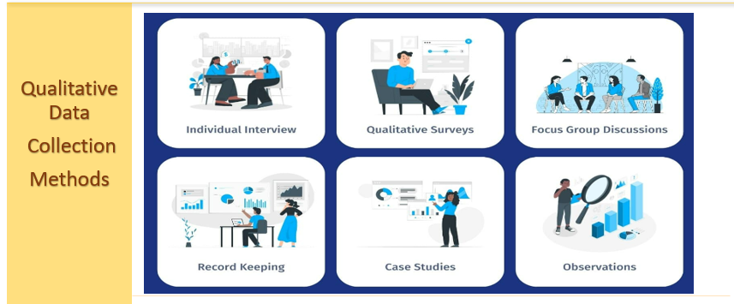
Qualitative Data Collection
www.midocean.ae

Slide 22
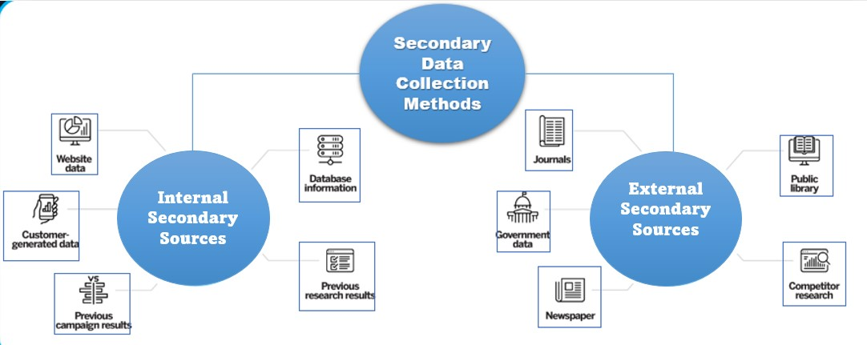
Secondary Data Collection
www.midocean.ae

Slide 23
Rules for Collecting Data
Apply a variety of data collection techniques.
Utilize the data at hand, but be aware that:
  The definition of the measures.
  How the information was gathered and cleansed.
  The amount of data missing.
  How the data's accuracy was guaranteed.
If real data collection is required:
  Establish protocols and adhere to them.
  keep up-to-date definition and coding data.
  Check the data entry and coding accuracy.
www.midocean.ae

Slide 24
Developing a Data Collection Plan
A crucial step in ensuring the accuracy and reliability of the collected data.
Developing a Data Collection Plan involves
  Identifying the variables to be measured.
  Determining the appropriate data collection methods.
  Establishing a timeline for data collection.
Important to consider ethical considerations and potential biases that may impact the results of the research.
www.midocean.ae

Slide 25
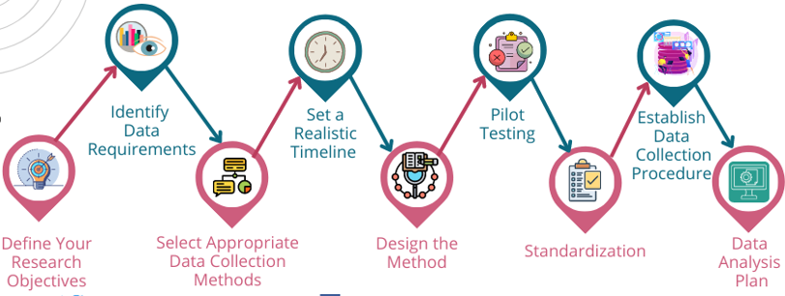
Developing a Data Collection Plan (cont.)
www.midocean.ae

Slide 26
Developing a Data Collection Plan (cont.)
The importance of developing a clear research question and objectives before creating a data collection plan in computer science research.
Techniques for identifying the most appropriate data sources and variables to include in a data collection plan, considering the specific requirements and goals of the study.
Methods for efficiently collecting large amounts of data in computer science research, such as utilizing automated tools or leveraging existing datasets.
Best practices for ensuring data quality and accuracy during the collection process, including techniques for validating collected data.
www.midocean.ae

Slide 27

Data Analysis
Data Analysis
www.midocean.ae

Slide 28
What is Data Analysis?
Data analysis is the process of inspecting, cleaning, transforming, and modeling data to discover useful information, draw conclusions, and support decision-making.
In computer science research, data analysis plays a crucial role in extracting meaningful insights from large datasets and identifying patterns or trends that can contribute to the advancement of knowledge in various domains.
Data analysis involves applying statistical techniques and computational algorithms to analyze data and uncover valuable findings that can be used for further research or practical applications.
www.midocean.ae

Slide 29
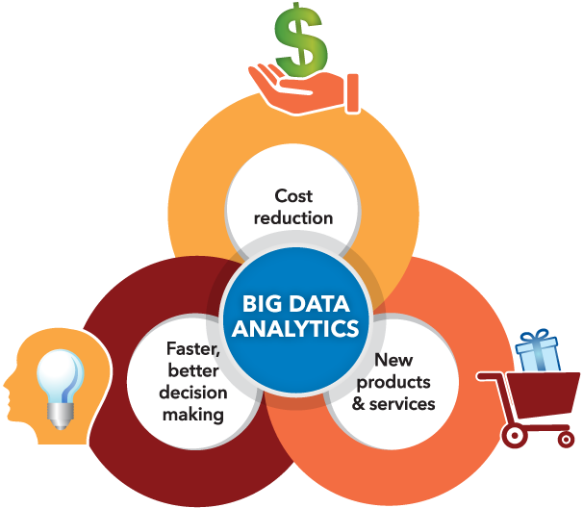
Why is data analytics important?
Informed decision-making
Identifying opportunities and challenges.
Improving efficiency and productivity
Customer understanding and personalization
Competitive advantage
Performance tracking and evaluation
Predictive analytics
Data-driven innovation
Fraud detection and security
Regulatory compliance
www.midocean.ae

Slide 30
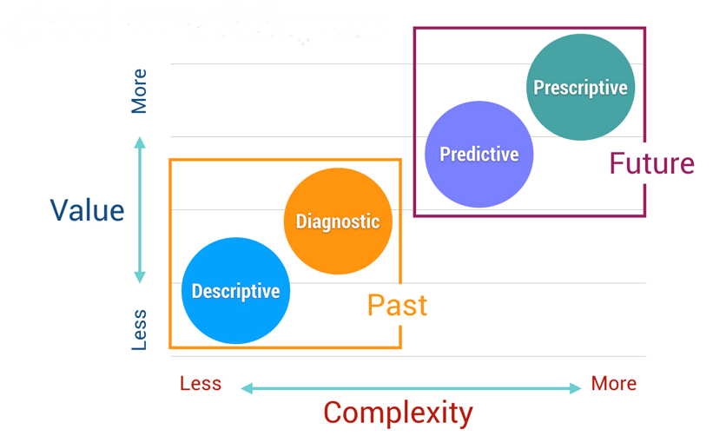
Data Analysis Types
Descriptive Analysis: a method used to analyze and interpret data collected during experiments or studies in the field of computer science.
Descriptive Analysis: a method used to analyze and interpret data collected during experiments or studies.
Diagnostic analysis: a process used to identify and understand problems or issues within computer systems or software.
Predictive Analysis: a field that involves using historical data and statistical models to make predictions about future events or behaviors.
Prescriptive analysis: refers to the use of advanced algorithms and models to provide recommendations and make informed decisions.
www.midocean.ae

Slide 31
Techniques for data analysis
Descriptive Analysis: a method used to analyze and interpret data collected during experiments or studies in the field of computer science.
Data analysis techniques that depend on the type of information collected:
  Qualitative data:
    The underlying emotions, body language, and expressions are the sources of qualitative data for researchers.
    The most popular methods for gathering this data are focus groups, open-ended interviews, and observation groups.
    During the data collecting stage, researchers typically examine trends in the observations made by the participants.
  Quantitative data: Numerical data is how quantitative data is shown. It emphasizes observable outcomes.
www.midocean.ae

Slide 32
Data Analysis Methods
Descriptive Analysis: a method used to analyze and interpret data collected during experiments or studies in the field of computer science.
Descriptive Statistics
Inferential Statistics
Data Visualization
Exploratory Data Analysis (EDA)
Time Series Analysis
Cluster Analysis
Factor Analysis and Principal Component Analysis (PCA)
Text Mining and Natural Language Processing (NLP)
Qualitative Data Analysis
Quantitative Data Analysis
Data Mining
Regression Analysis
www.midocean.ae

Slide 33
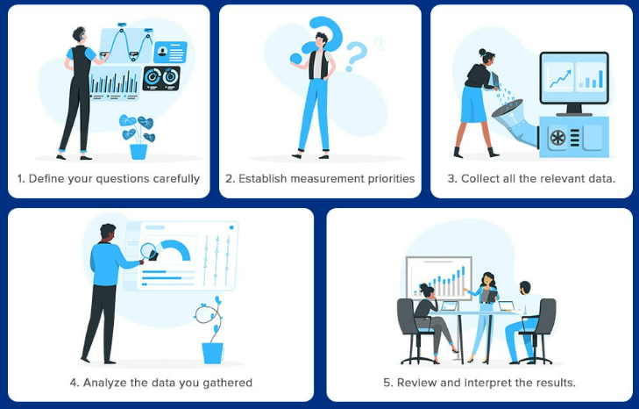
Data Analysis Process
Descriptive Analysis: a method used to analyze and interpret data collected during experiments or studies in the field of computer science.
www.midocean.ae

Slide 34
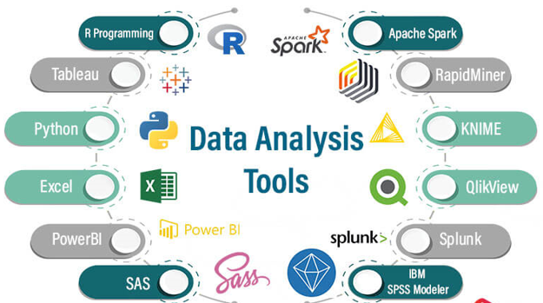
Tools to support data analysis
Descriptive Analysis: a method used to analyze and interpret data collected during experiments or studies in the field of computer science.
There are a variety of tools available to support data analysis range from spreadsheet software like Microsoft Excel to more advanced statistical software such as R or Python.
These tools allow analysts to manipulate and visualize data, perform complex calculations, and generate meaningful insights from large datasets.
Some tools offer machine learning capabilities that can help identify patterns and make predictions based on the data.
www.midocean.ae

Slide 35
Results Interpretation and Discussion
Descriptive Analysis: a method used to analyze and interpret data collected during experiments or studies in the field of computer science.
The results section contains a description about the main findings of your research.
The discussion section interprets the results for readers and provides the significance of the findings and should not repeat the results.
The interpretation and discussion of results play a crucial role in advancing knowledge and understanding.
The interpretation and discussion processes involve analyzing the data collected, identifying patterns or trends, and drawing meaningful conclusions.
Researchers often compare their findings with existing literature to validate their results and contribute to the broader scientific community.
www.midocean.ae

Slide 36
How to Organize the Results Section
Descriptive Analysis: a method used to analyze and interpret data collected during experiments or studies in the field of computer science.
Organizing the results section is crucial for effectively presenting the findings of a study.
One common approach is to start by summarizing the main results and highlighting any significant findings.
  This can be followed by presenting the results in a logical and coherent manner, using tables, graphs, or figures to enhance clarity and understanding.
    Text: to explain about the research data
    Figures: to display the research data and to show trends or relationships.
    Tables: to represent a large data and exact value.
Provide sufficient details about the methodology used and any limitations or assumptions made during the study to ensure transparency and reproducibility of the results.
www.midocean.ae

Slide 37
Tips to Write the Results Section
Descriptive Analysis: a method used to analyze and interpret data collected during experiments or studies in the field of computer science.
Clearly outline the key findings and contributions of your research in a concise and structured manner.
Provide a summary of the main results, highlighting their significance and relevance to the field of computer science.
Present your results in a logical and organized manner, using tables, graphs, or visualizations when appropriate to enhance clarity and understanding.
Make sure to include relevant statistical analyses or metrics to support your findings.
Discuss any limitations or potential biases that may have influenced the results, acknowledging any challenges
www.midocean.ae

Slide 38
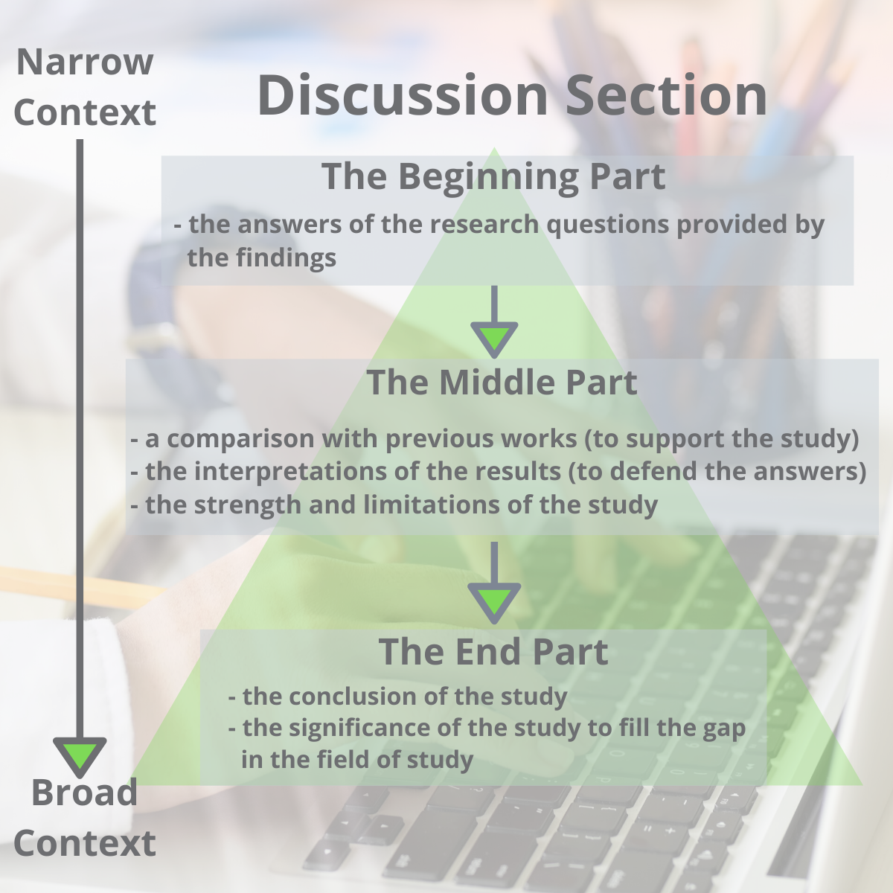
How to Organize the Discussion Section
Descriptive Analysis: a method used to analyze and interpret data collected during experiments or studies in the field of computer science.
Summarize the main results and their significance in relation to the research objectives.
Provide a clear context for readers to understand the implications of the study.
Discuss any limitations or potential biases that may have affected the results
Demonstrates a thorough understanding of the research process and promotes transparency in scientific inquiry.
www.midocean.ae

Slide 39
How to Organize the Discussion Section (cont.)
Descriptive Analysis: a method used to analyze and interpret data collected during experiments or studies in the field of computer science.
A list of questions to guide you when organizing the structure of your discussion section (Viera et al., 2018):
What experiments did you conduct and what were the results?
What do the results mean?
What were the important results from your study?
How did the results answer your research questions?
Did your results support your hypothesis or reject your hypothesis?
What are the variables or factors that might affect your results?
What were the strengths and limitations of your study?
What other published works support your findings?
What other published works contradict your findings?
What possible factors might cause your findings different from other findings?
What is the significance of your research?
What are new research questions to explore based on your findings?
www.midocean.ae

Slide 40
Tips to Write the Discussion Section
Descriptive Analysis: a method used to analyze and interpret data collected during experiments or studies in the field of computer science.
Begin by summarizing the main findings and contributions of your research.
Analyze and interpret your results in relation to existing literature and previous studies.
Consider any limitations or constraints that may have influenced your results. Discuss potential sources of bias, data collection
Highlight the significance of your findings
Mention how the study filled a gap in knowledge.
Indicate the implication of your research.
Avoid generalizing, misinterpreting your results, drawing a conclusion with no supportive findings from your results.
www.midocean.ae

Slide 41
References
Sheperis, C.J., Young, J.S. & Daniels M.H. (2017). Counseling research: Quantitative, qualitative, and mixed methods (2nd ed.). Boston, MA: Pearson. ISBN-13: 978-0-13-402509-4
VanderMey, R., Meyers, V., Van Rys, J., Kemper, D., & Sebrank, P. (2011). The college writer: A guide to thinking, writing, and researching (4th ed.). Boston: Houghton Mifflin.
Robert Day (1995): How to write and publish a scientific paper. 4th Edition, Cambridge University Press
Prof. Mani Maran Ratnam – How to write a report in journal format
Kingsley, D. A. (2014). Paying for publication: Issues and challenges for research support services. Australian Academic & Research Libraries, 45(4), 262-281.
Cuthbert, D., & Spark, C. (2008). Getting a GRiP: Examining the outcomes of a pilot program to support graduate research students in writing for publication. Studies in Higher Education, 33(1), 77-88.
www.midocean.ae

Slide 42



Thank You

