Slide 1
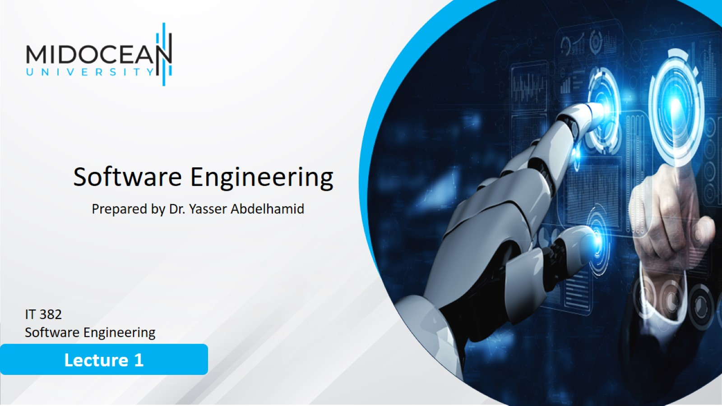

Slide 2
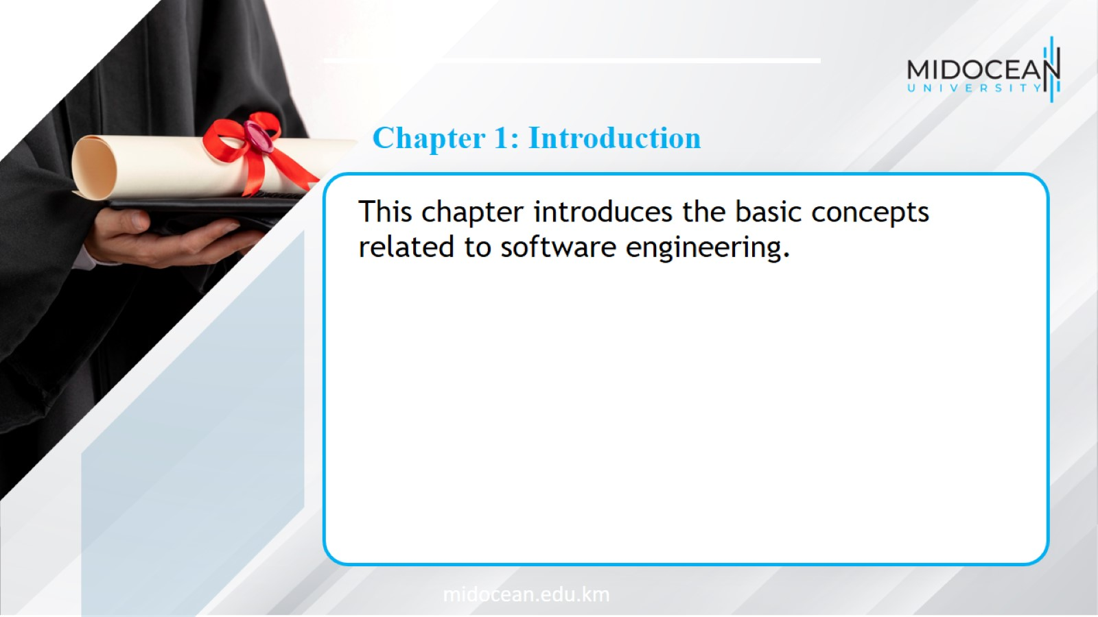

Slide 3
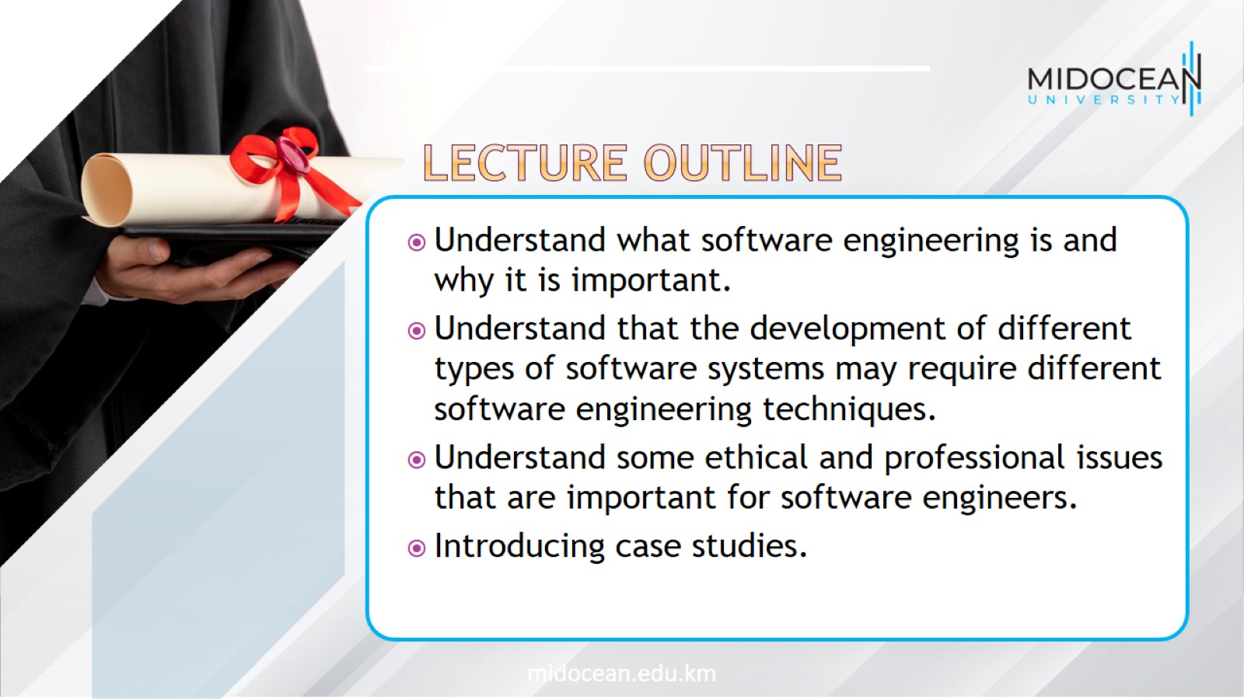

Slide 4
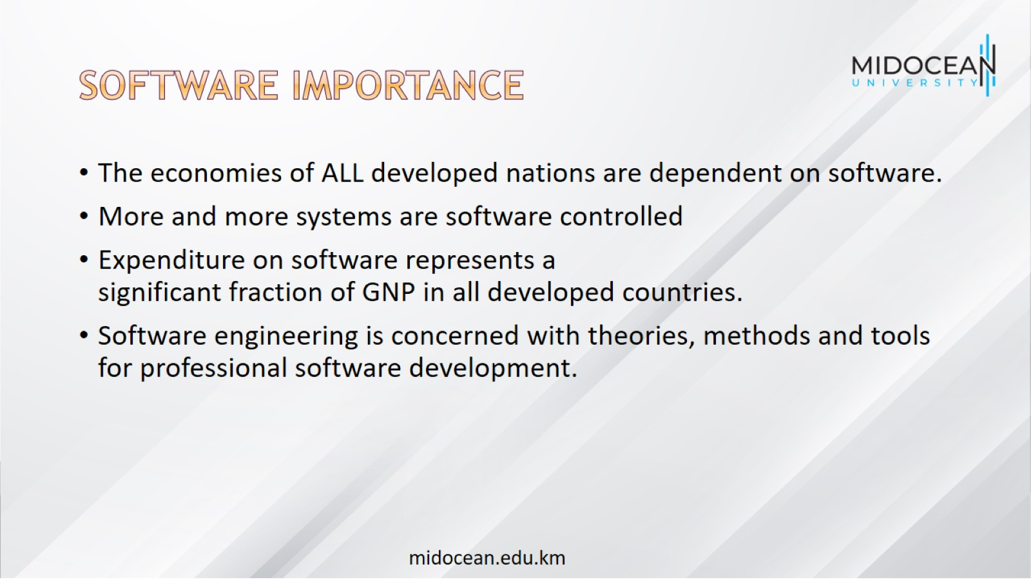
Software Importance

Slide 5
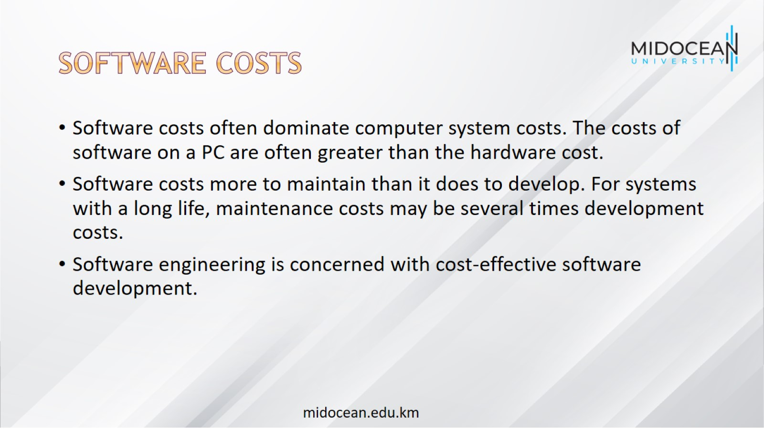
Software costs

Slide 6
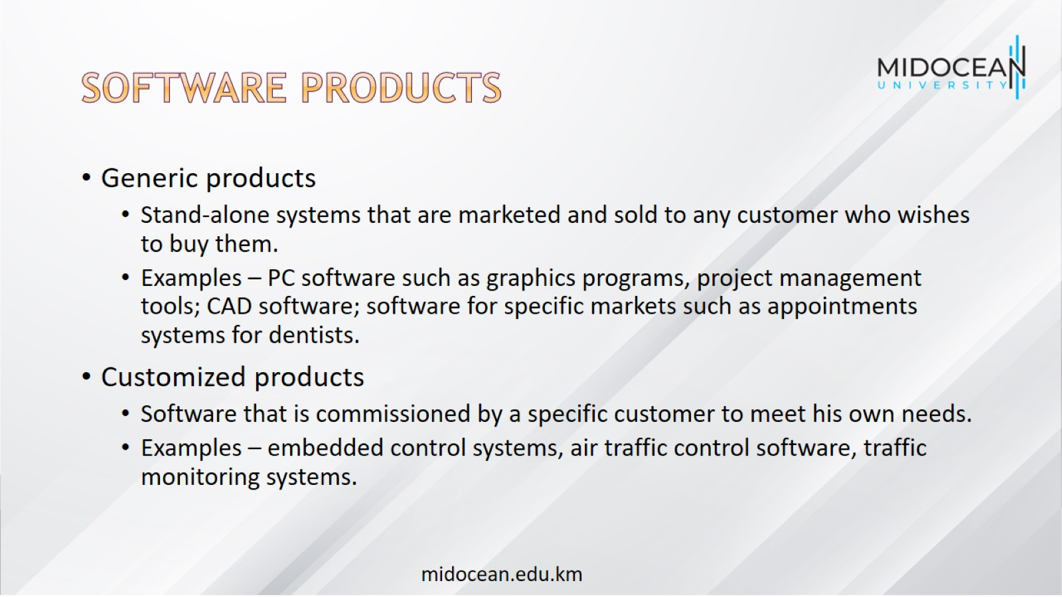
Software products

Slide 7
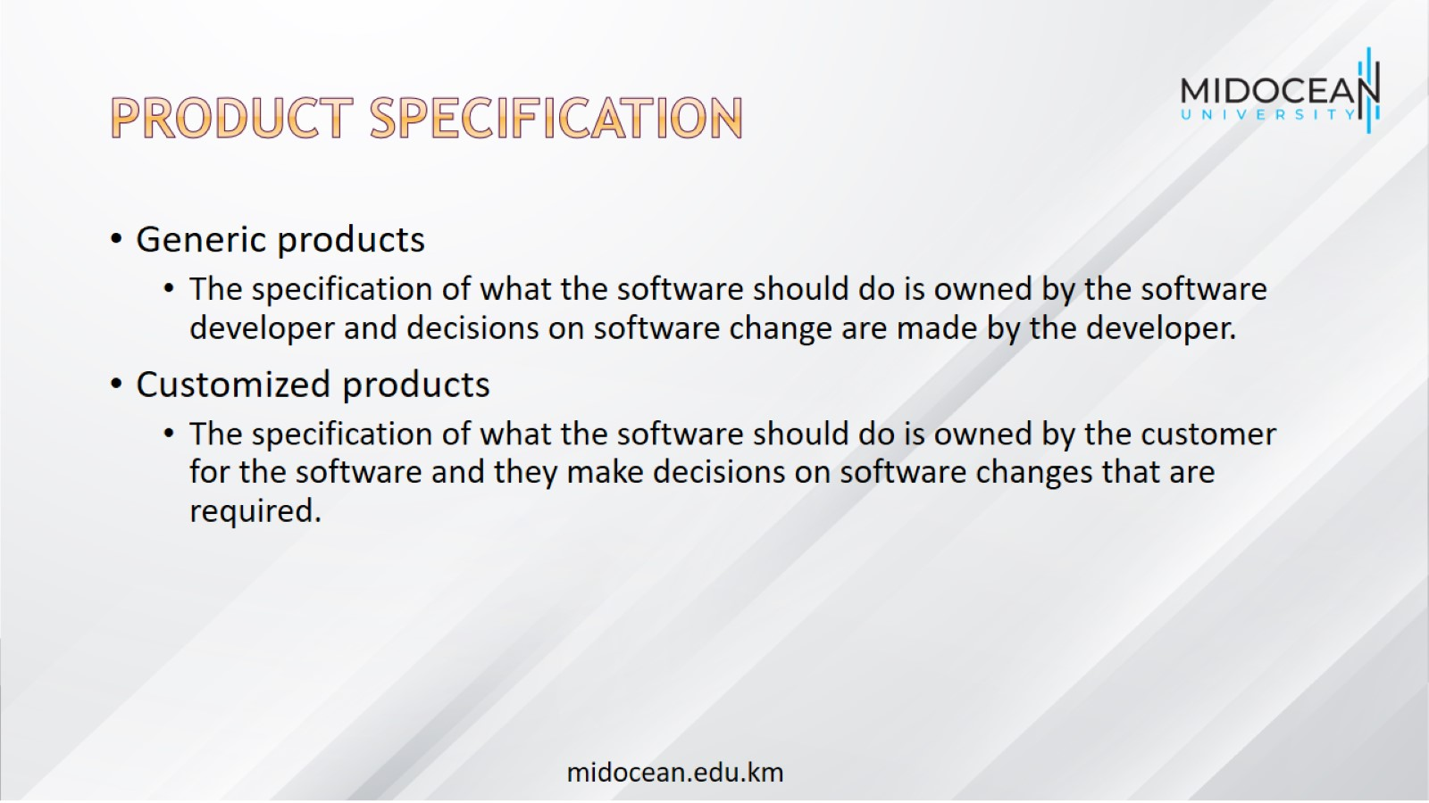
Product specification

Slide 8
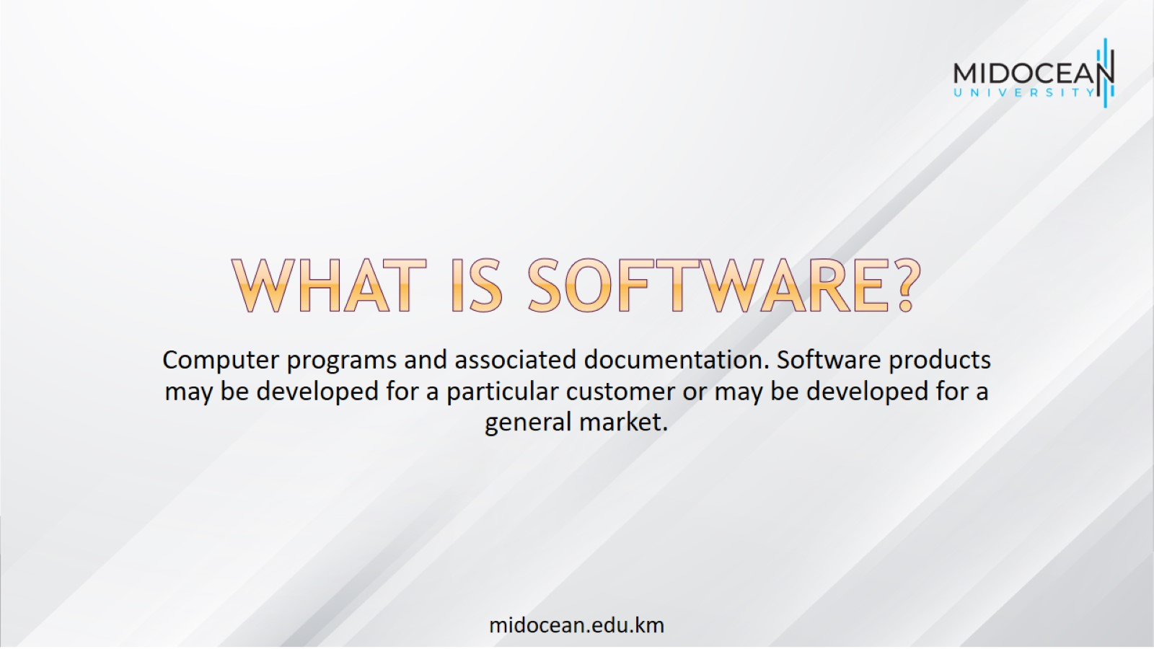
What is software?

Slide 9
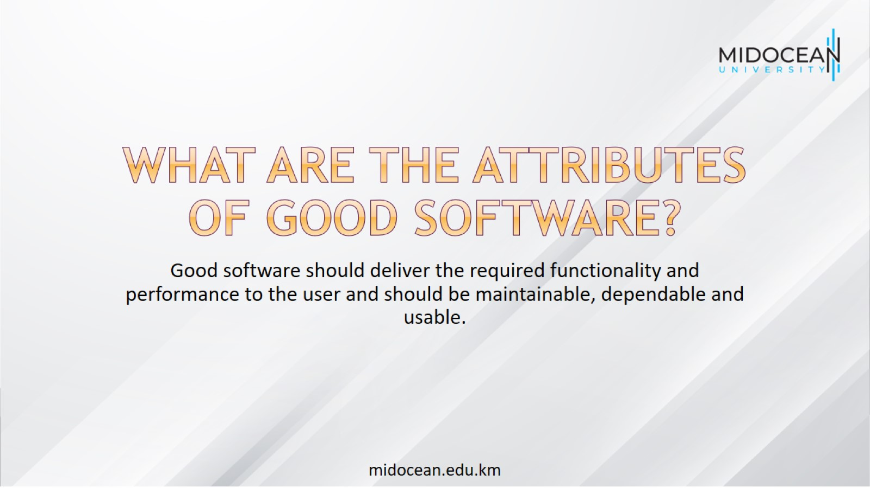
What are the attributes of good software?

Slide 10
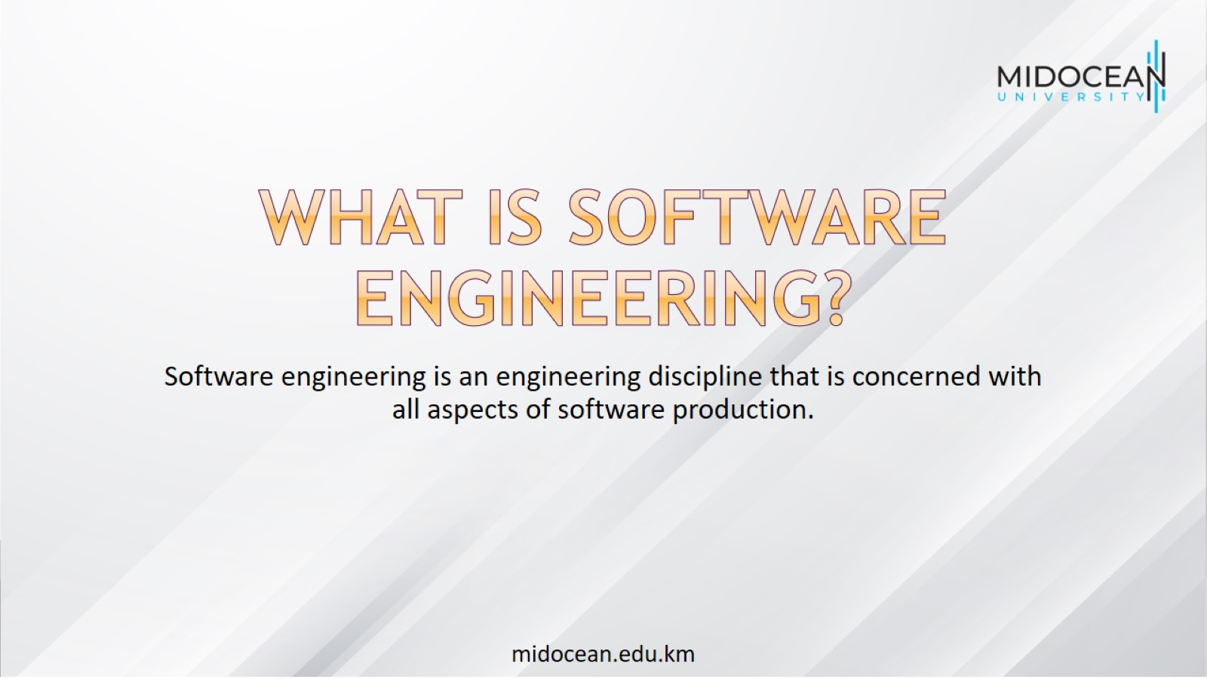
What is software engineering?

Slide 11

What are the fundamental software engineering activities?

Slide 12
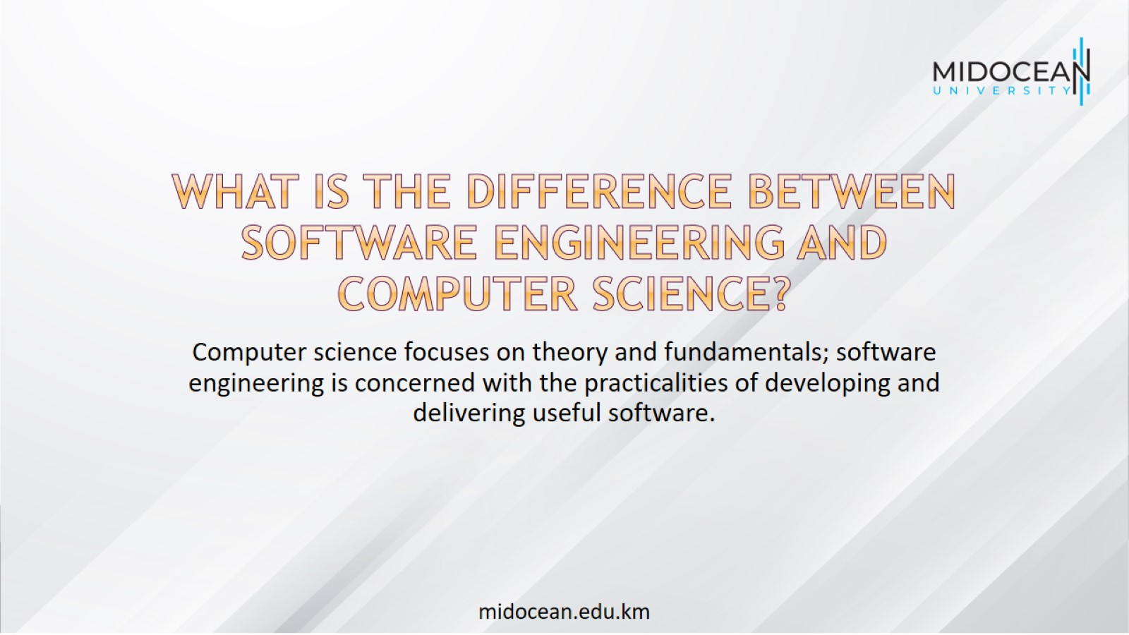
What is the difference between software engineering and computer science?

Slide 13
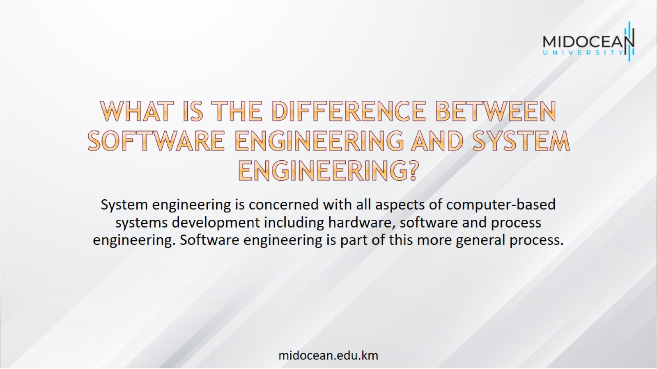
What is the difference between software engineering and system engineering?

Slide 14

What are the key challenges facing software engineering?

Slide 15
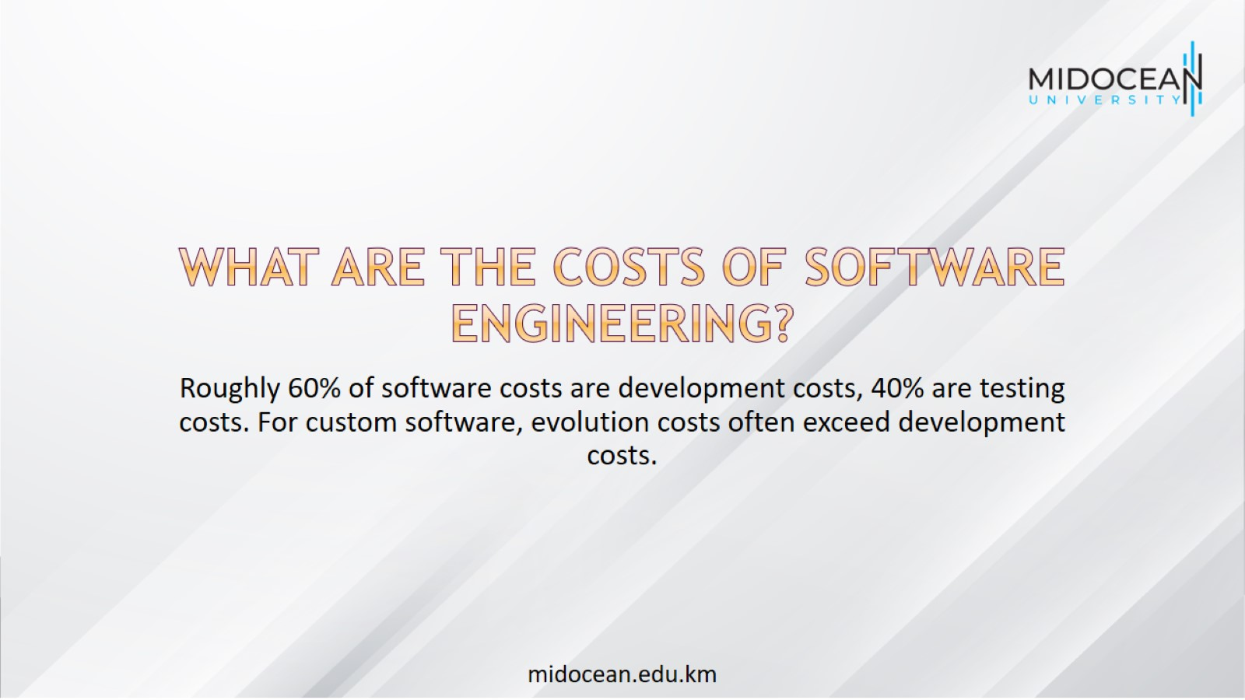
What are the costs of software engineering?

Slide 16
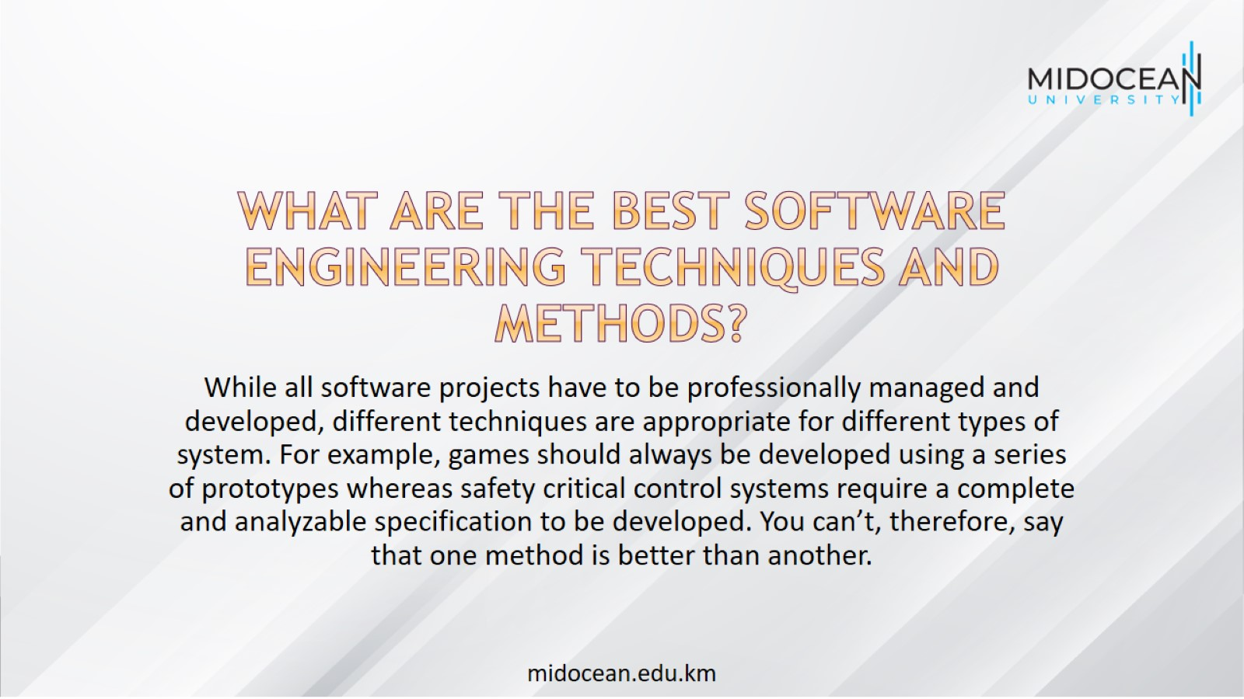
What are the best software engineering techniques and methods?

Slide 17
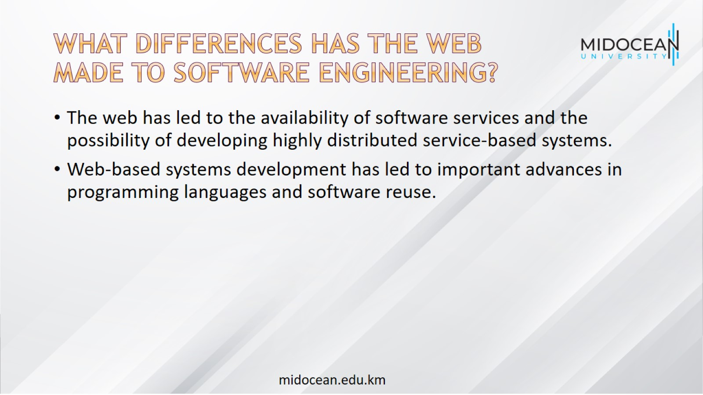
What differences has the web made to software engineering?

Slide 18
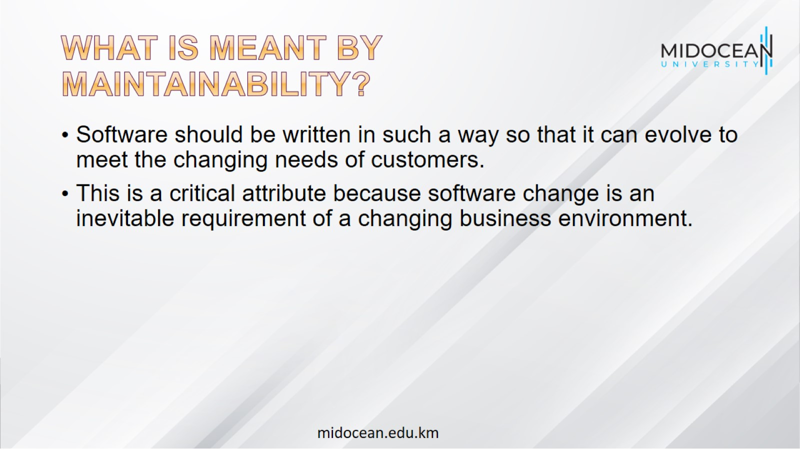
What is meant by
Maintainability?

Slide 19
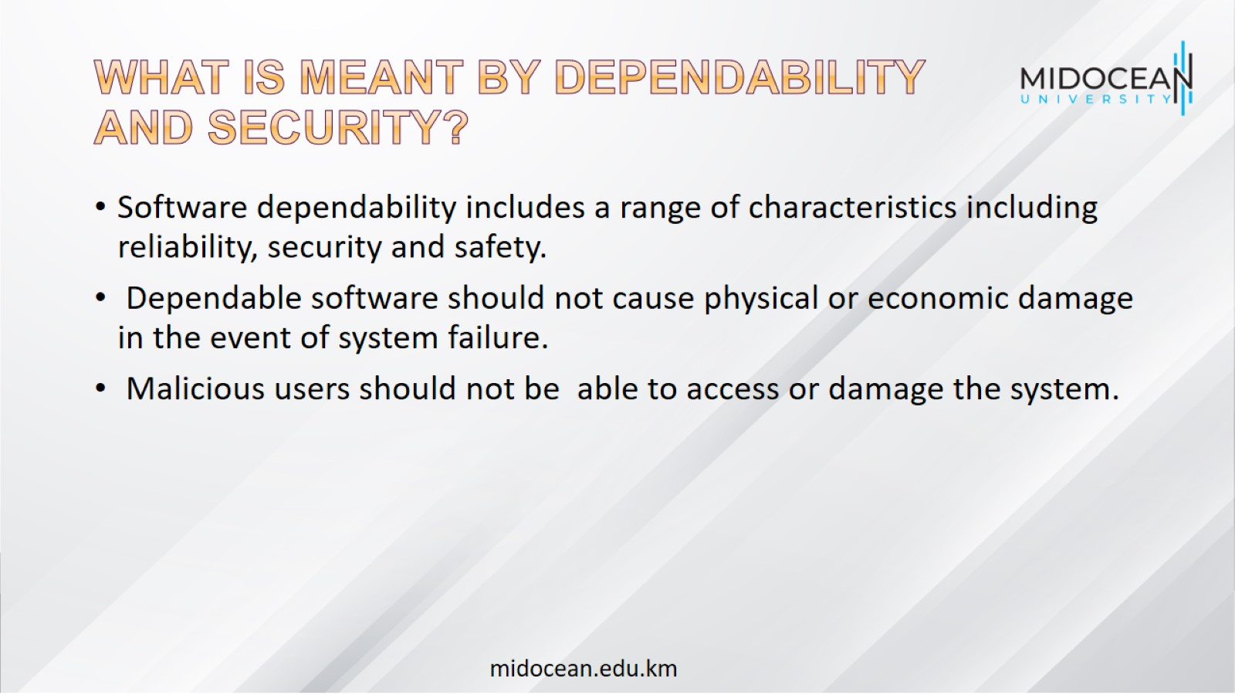
What is meant by Dependability and security?

Slide 20
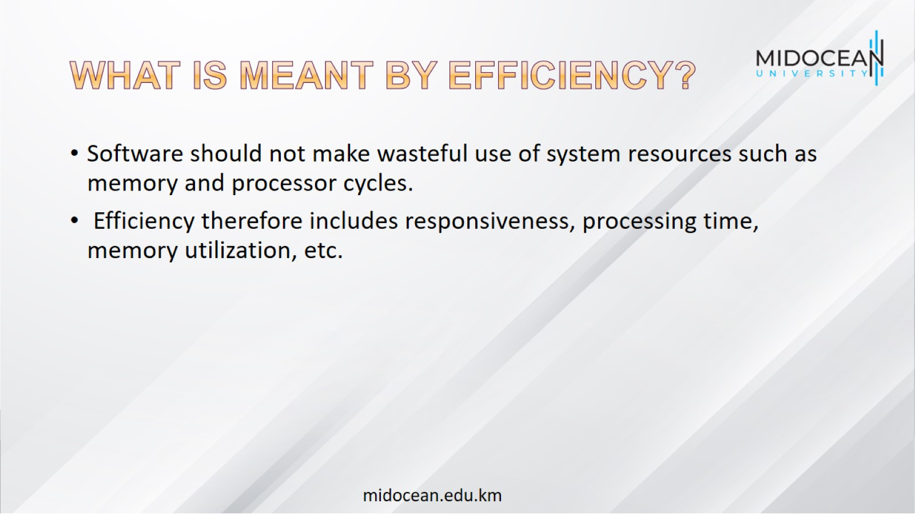
What is meant by Efficiency?

Slide 21
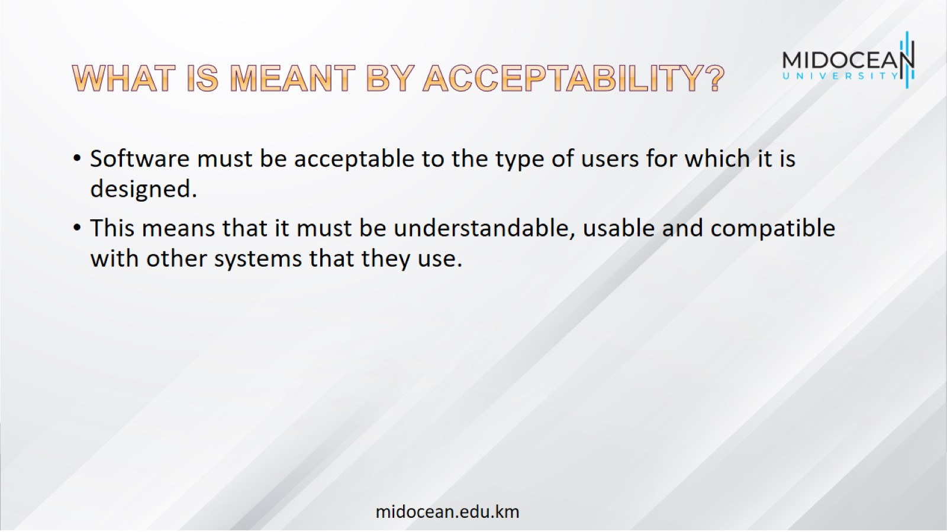
What is meant by Acceptability?

Slide 22
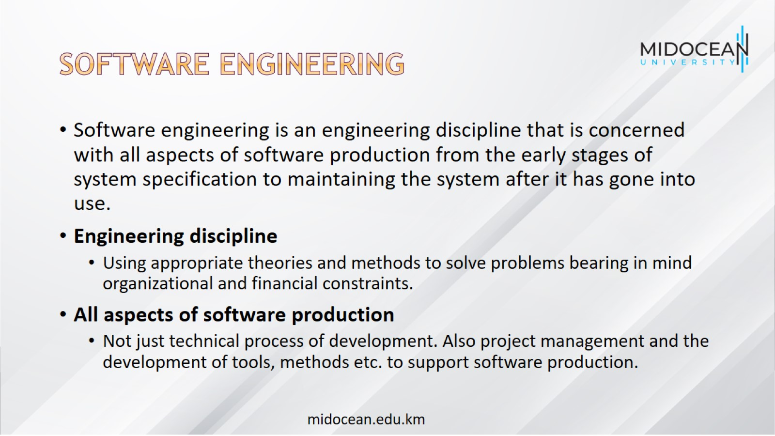
Software engineering

Slide 23
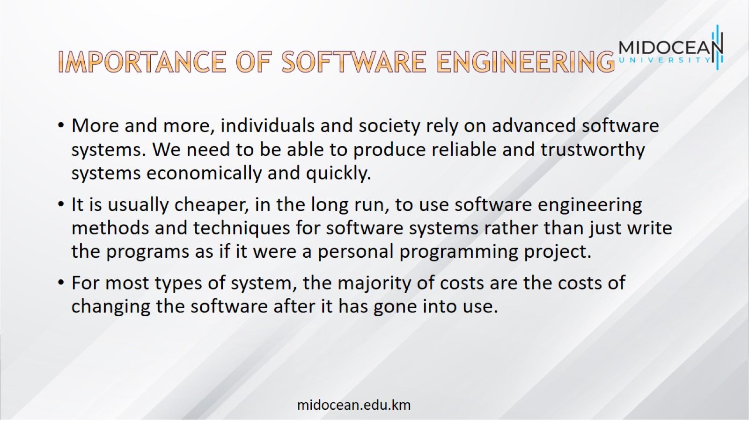
Importance of software engineering

Slide 24
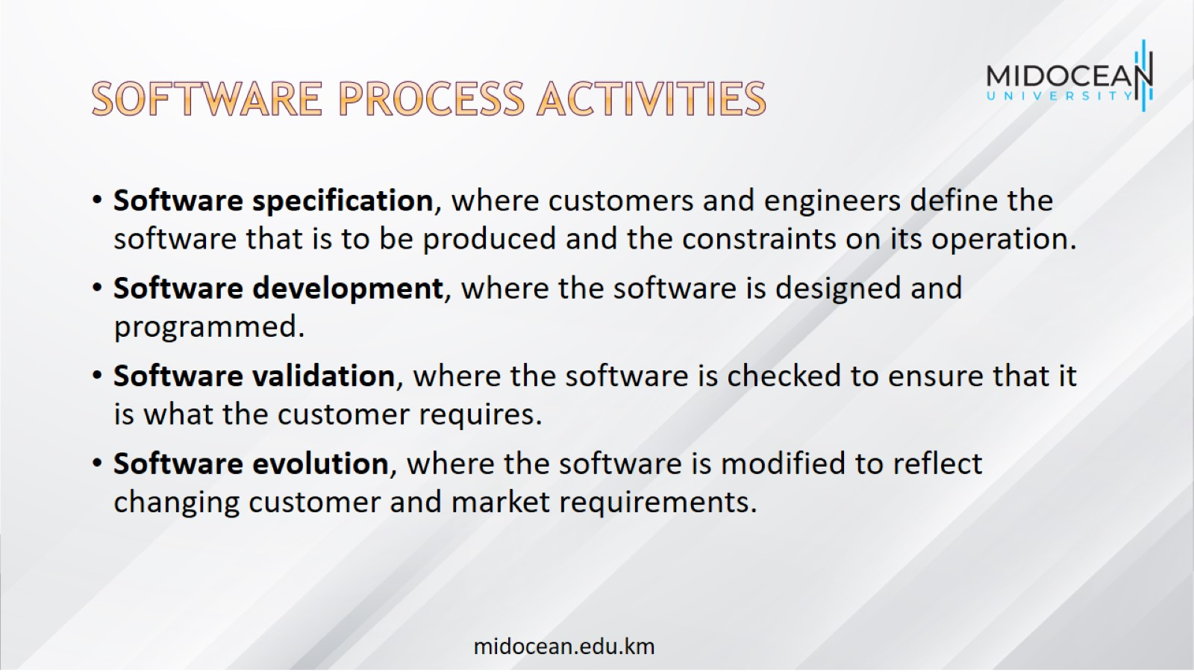
Software process activities

Slide 25
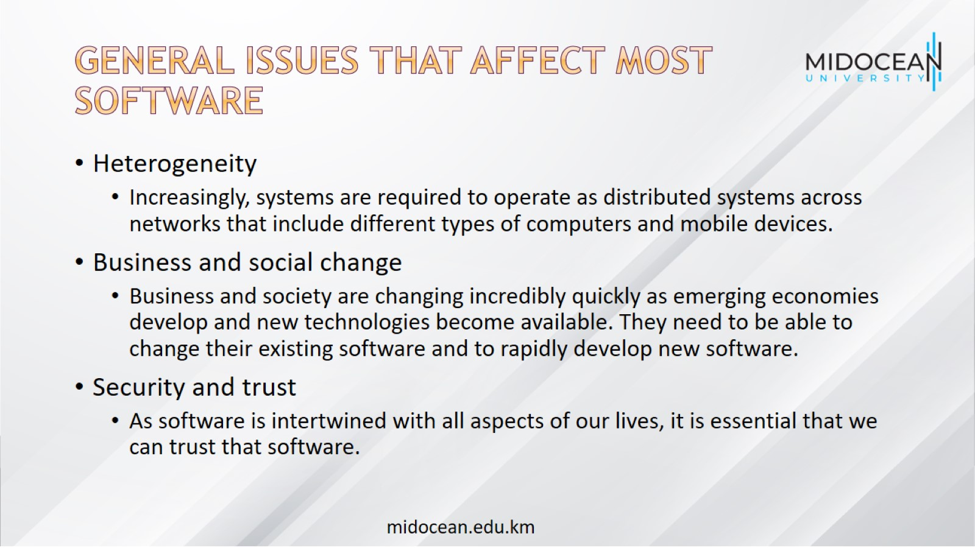
General issues that affect most software

Slide 26
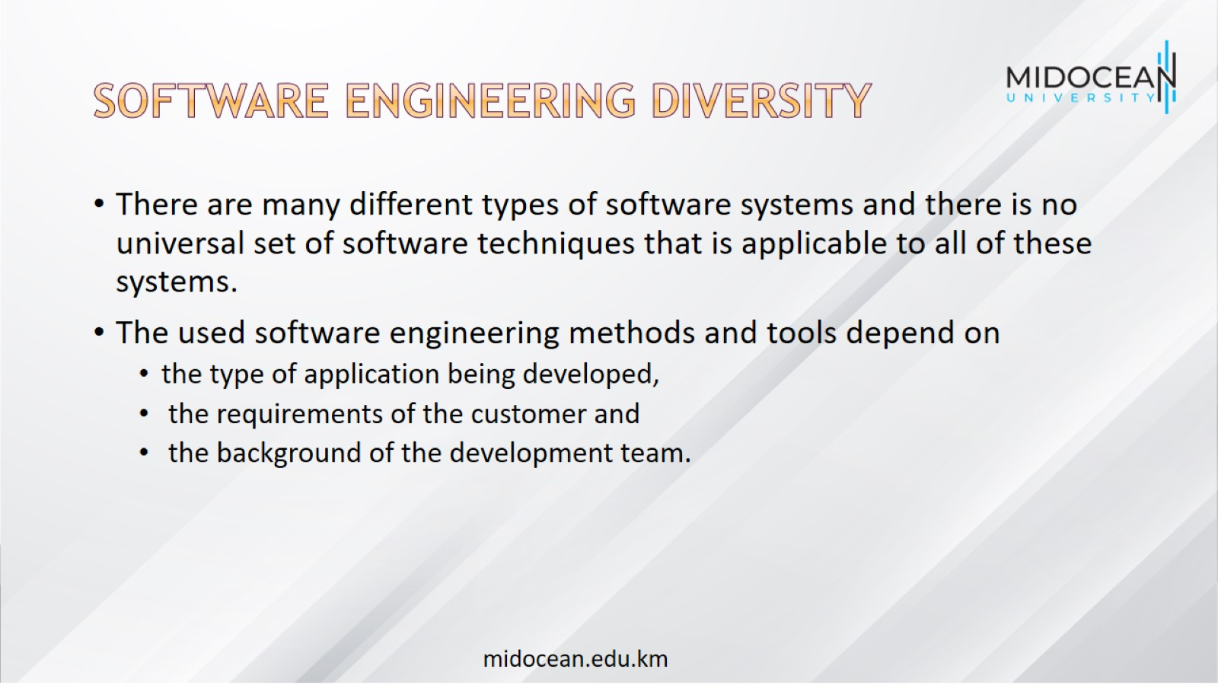
Software engineering diversity

Slide 27
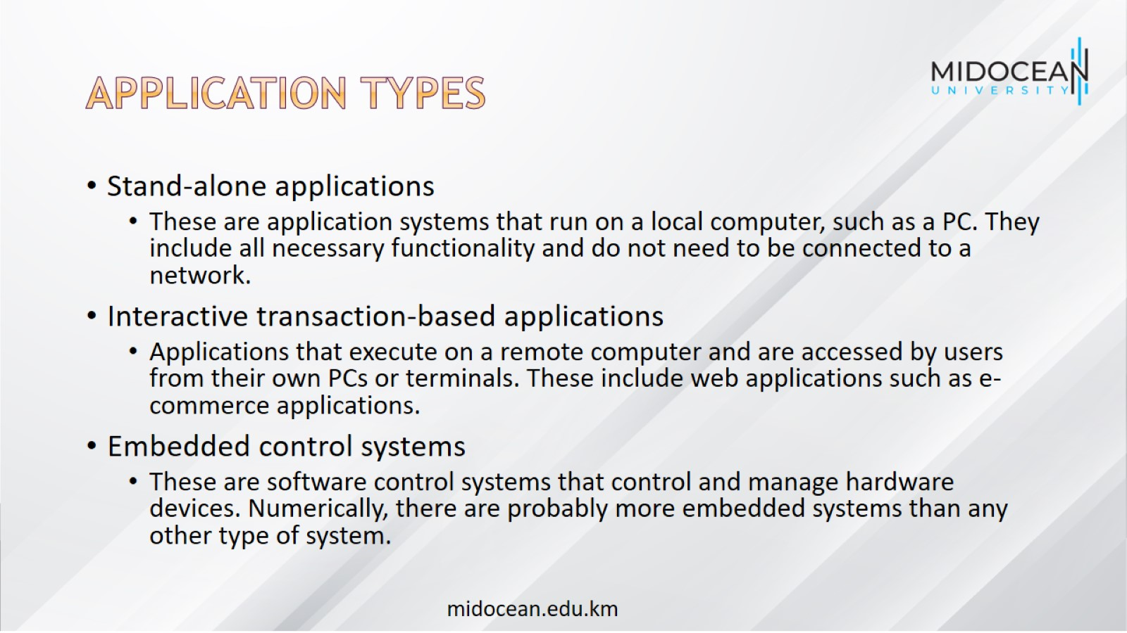
Application types

Slide 28
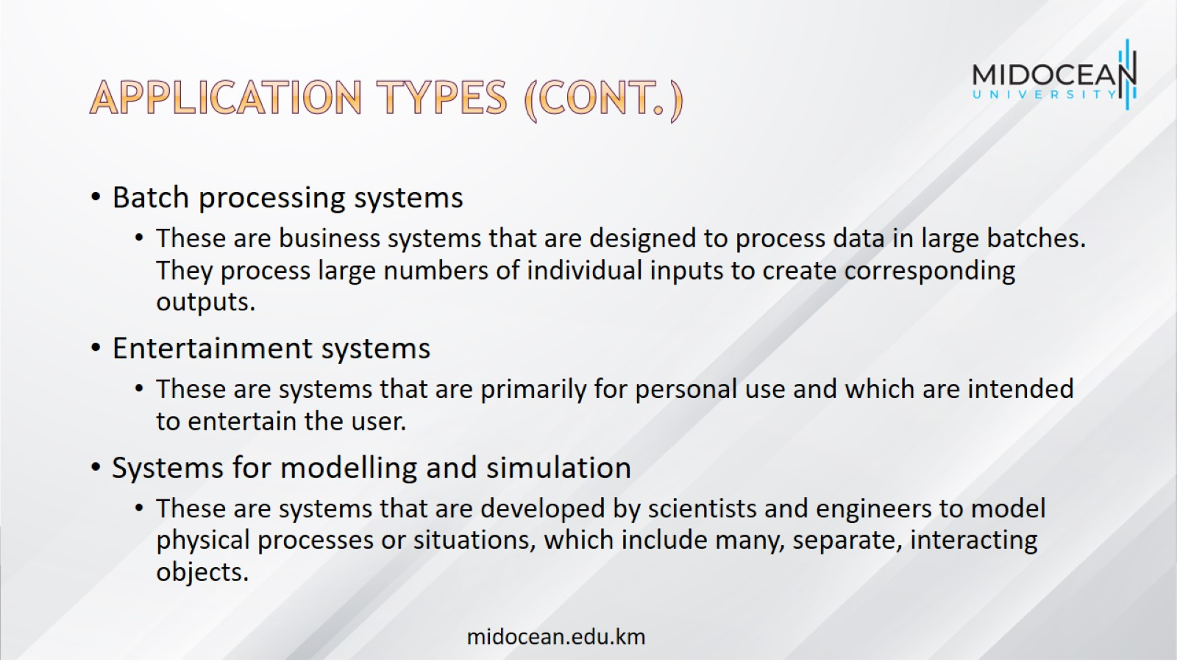
Application types (Cont.)

Slide 29
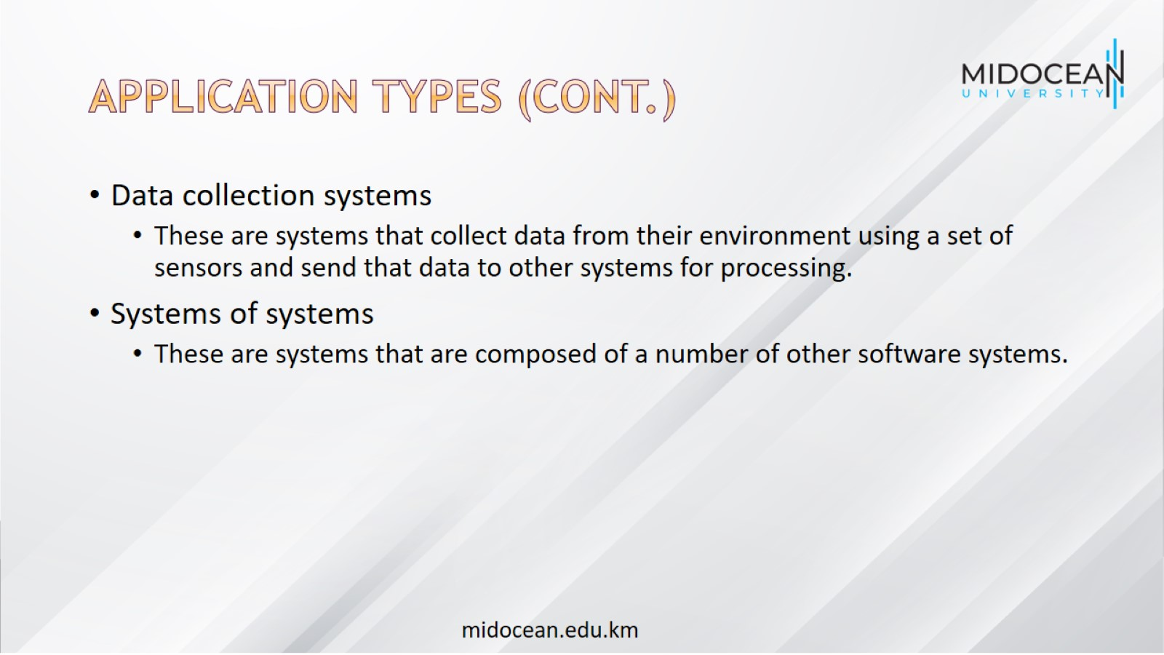
Application types (Cont.)

Slide 30
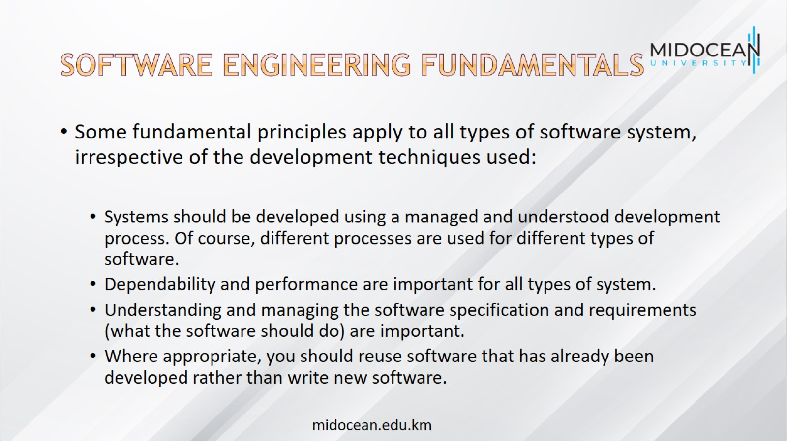
Software engineering fundamentals

Slide 31
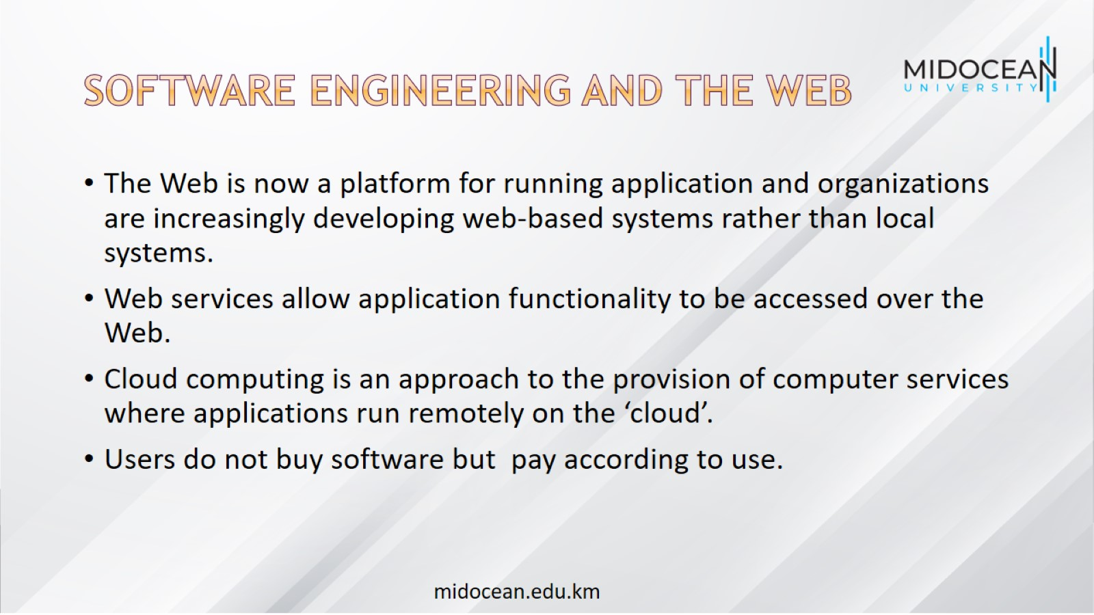
Software engineering and the Web

Slide 32
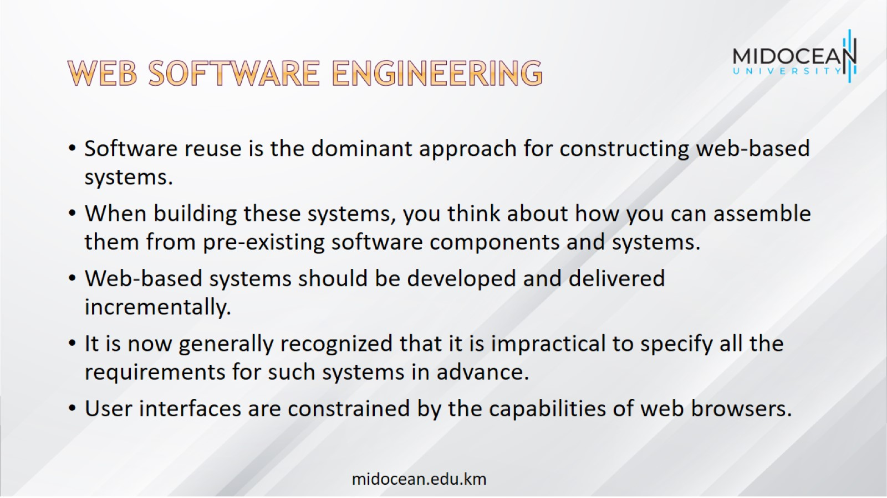
Web software engineering

Slide 33
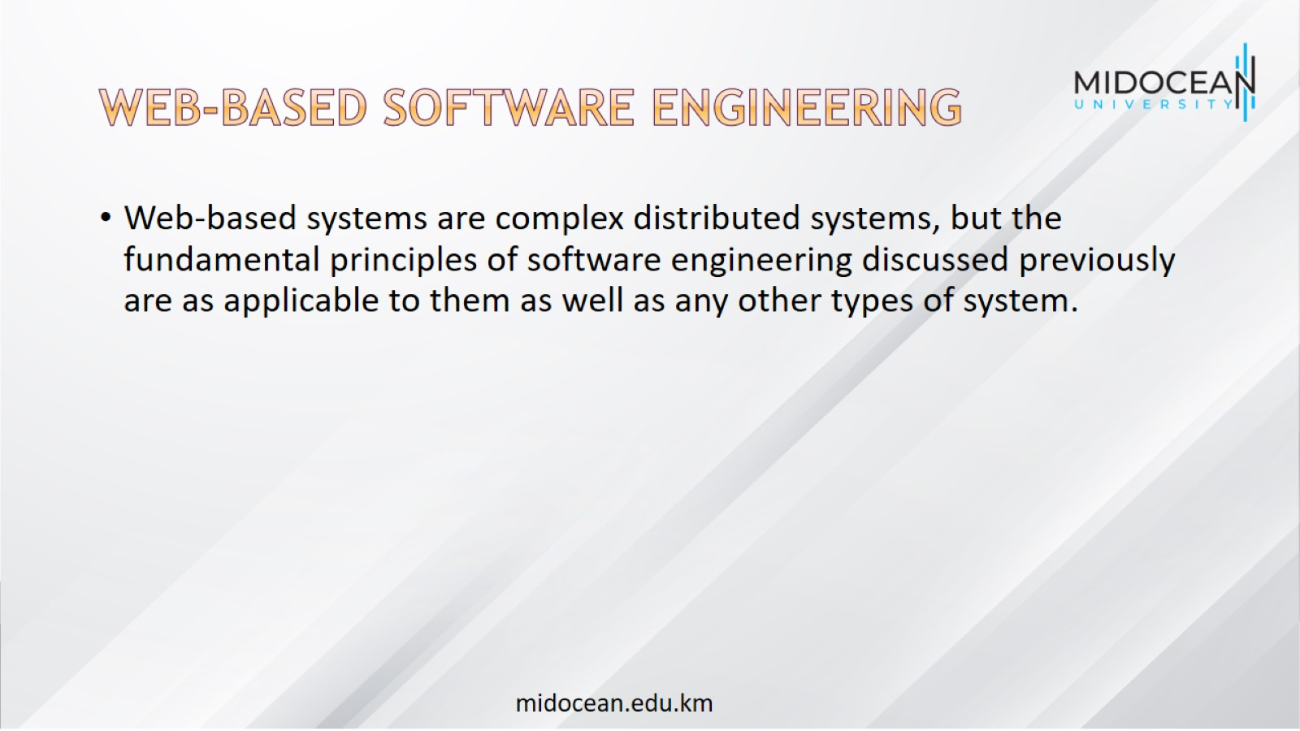
Web-based software engineering

Slide 34
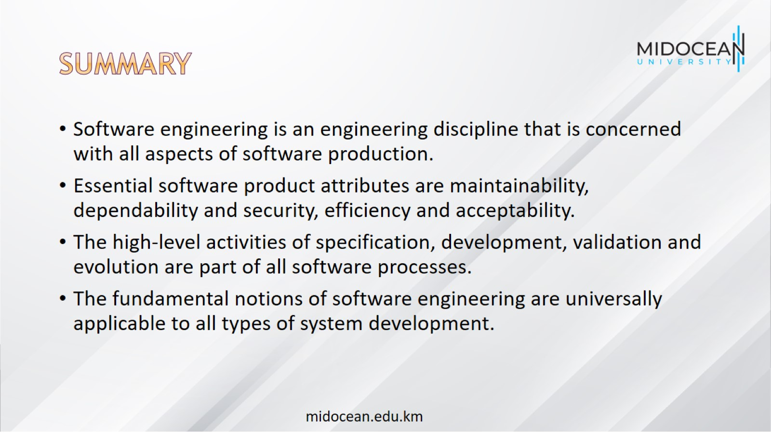
summary

Slide 35
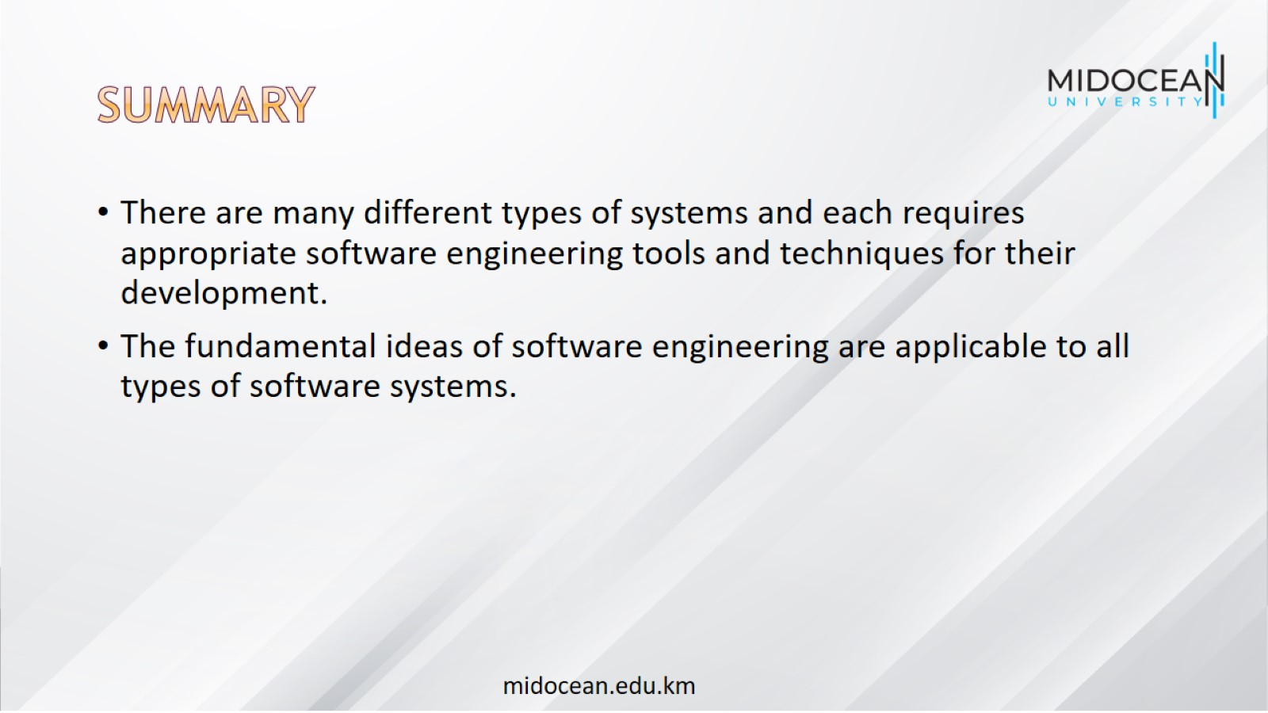
summary

Slide 36


