Slide 1


Foundation of Artificial Intelligence
Dr. Mohamed Mostafa
AI 511
Course Introduction & Plan
Lecture 0

Slide 2

About the Instructor
01
Short Bio:
Dr. Mohamed Mostafa received his M.Sc. and PhD in Computer Science from Helwan University in the Arab Republic of Egypt's Faculty of Computers and Information. He also did a post-doctoral scientific mission in the Europe Union in an IT4Innovation Project. He is currently employed as an Associate Professor. Palo Alto International has qualified Dr. Mohamed as a Cyber Security Trainer. He is also a certified artificial intelligence trainer from the French College of Engineering and Applications, as part of the Egyptian Ministry of Communications' drive to localize artificial intelligence technology. His research interests include; AI algorithms optimization, AI applications in different domains, WBNs, and Wireless Sensor Networks security.
www.midocean.ae

Slide 3
Sources
Lectures are based on their counterparts in the following courses:
  Introduction to Artificial Intelligence Course,. Dr. Amr S. Ghoneim
Intelligent Systems, University of British Columbia (Dept. of Computer Science)
Introduction to Artificial Intelligence, University of Wisconsin-Madison
Artificial Intelligence, University of Illinois at Urbana-Champaign
Artificial Intelligence, University of California, Berkeley
www.midocean.ae

Slide 4
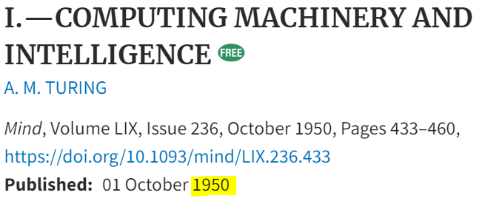
Definition of Artificial Intelligence (AI) :
AI is a branch of computer science that aims to create machines capable of intelligent behavior, mimicking human cognitive functions.
Birth of AI: 1950-1956
1950: Alan Turing : ‘Can machines think?’
Source: Tableau
www.midocean.ae

Slide 5

Definition of Artificial Intelligence (AI) :
AI is a branch of computer science that aims to create machines capable of intelligent behavior, mimicking human cognitive functions.
Birth of AI: 1950-1956
1952: Arthur Samuel developed a program to play checkers, which is the first to ever learn the game independently.
Source: Tableau
www.midocean.ae

Slide 6

Definition of Artificial Intelligence (AI) :
AI is a branch of computer science that aims to create machines capable of intelligent behavior, mimicking human cognitive functions.
Birth of AI: 1950-1956
1955: John McCarthy held a workshop at Dartmouth on “artificial intelligence”.
AI boom: 1980-1987
1986: Ernst Dickmann and his team created and demonstrated the first driverless car
Source: Tableau
www.midocean.ae

Slide 7
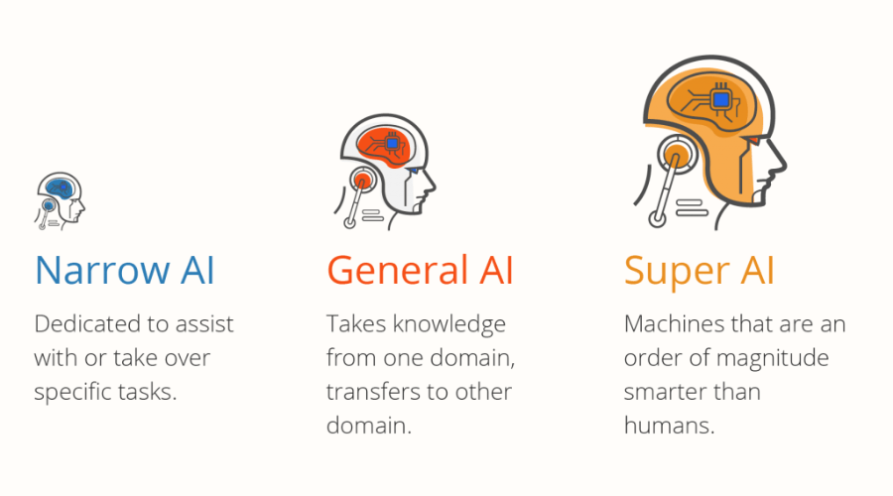
Types of Artificial Intelligence (AI) :
Source: AHT Tech
www.midocean.ae

Slide 8
Introduction to Human Intelligence
Introduction to AI
Introduction to Machine Learning
Intelligent Agents
Problem Solving
AI Topics
Introduction to Decision Trees
Knowledge Representation
Blind vs. Heuristic Search Strategies
The Perceptron, & the Perceptron Learning Algorithm (PLA)
Adversarial Search
Introduction to SVMs
www.midocean.ae

Slide 9

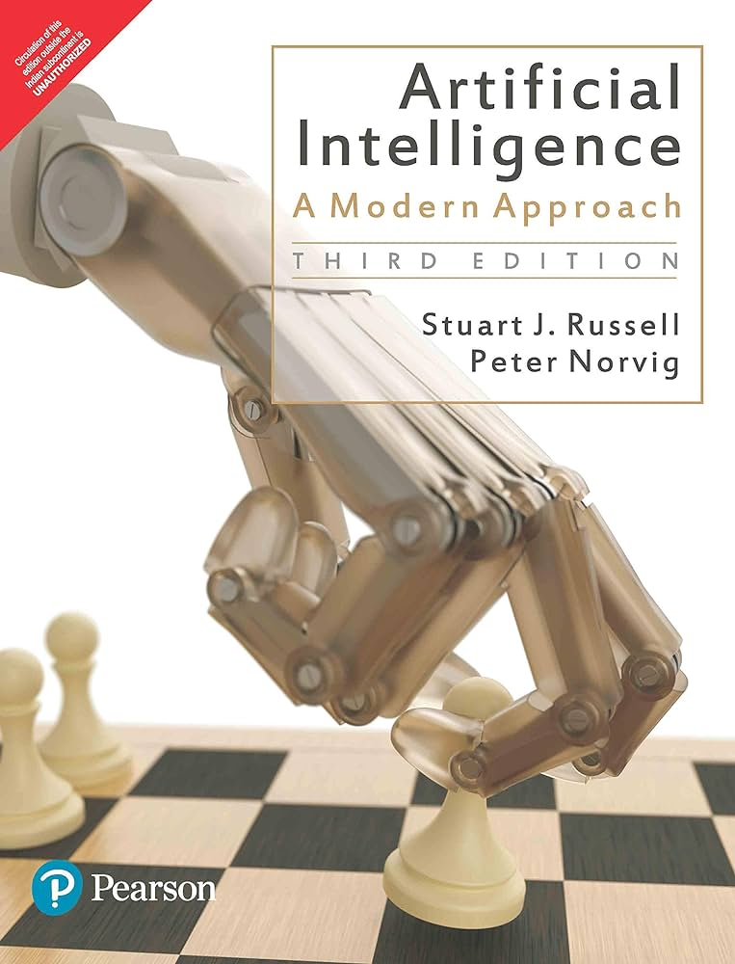
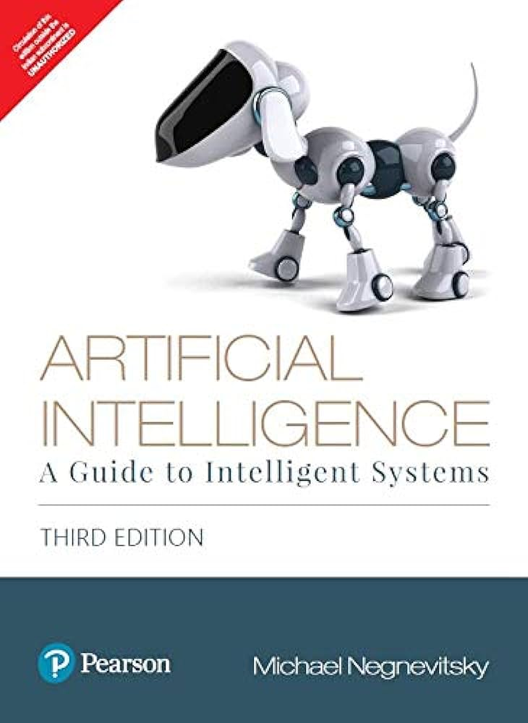
www.midocean.ae
Indicative Reading List
Stuart J. Russell and Peter Norvig, "Artificial Intelligence: A Modern Approach," Third Edition (2015), by Pearson Education Inc.
Negnevitsky M. Artificial intelligence: a guide to intelligent systems. Pearson education; 2005.

Slide 10
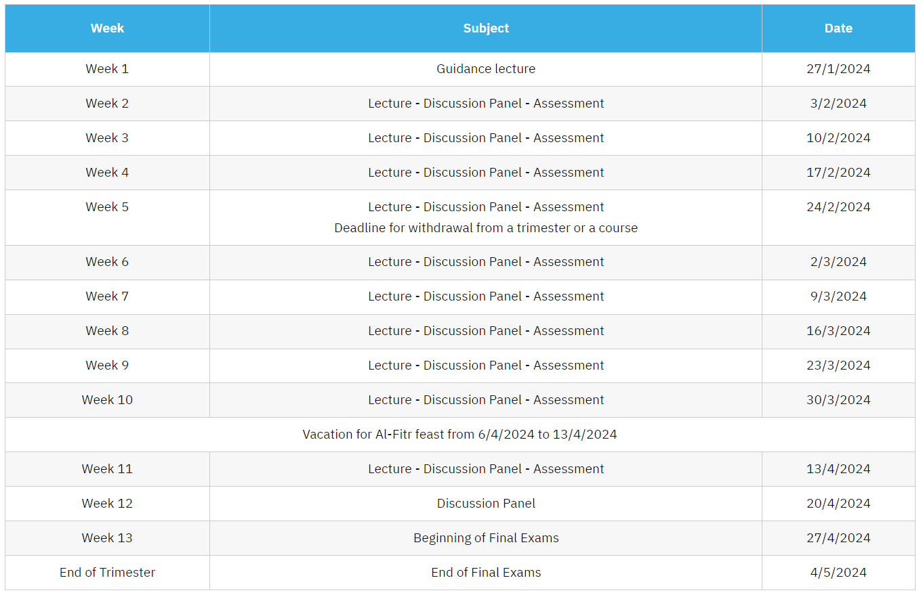
Academic Calendar
www.midocean.ae

Slide 11
Grading
80% Short Exams
20% Final Exam
www.midocean.ae

Slide 12

What does the future hold?
www.midocean.ae

Slide 13



Thank You

