Slide 1

Project Time Management
Prepared by Dr. Nael Zabel
Lecture 1
PMG 212
UNDERSTANDING PROJECT MANAGEMENT

Slide 2

Lecture 1
Agenda
Understanding Project Management
Meaning of “ Project “
Project Management Life Cycle
Successful project management
Benefits of project management
Obstacles of project management
Project Management
Project Manager's Role
Functional Manager’s Role

Slide 3
Lecture 1
Agenda
Understanding Project Management
Meaning of “ Project “
Project Management Life Cycle
Successful project management
Benefits of project management
Obstacles of project management
Project Management
Project Manager's Role
Functional Manager’s Role

Slide 4
Lecture 1
Understanding Project Management
In order to understand project management, one must begin with the definition of a project.
A project can be any series of activities and tasks.

Slide 5
Lecture 1
Agenda
Understanding Project Management
Meaning of “ Project “
Project Management Life Cycle
Successful project management
Benefits of project management
Obstacles of project management
Project Management
Project Manager's Role
Functional Manager’s Role

Slide 6
Lecture 1
Meaning of “ Project “
A project: is a temporary endeavor undertaken to create a unique product, service, or result.
Project characteristic:
  Projects are temporary.
  Has definite beginning and end, the end is reached when the project’s objective have been achieved.
  Projects are unique.
  Every project creates a unique product, service, or results.
  Progressively elaborated.
  Progressively: proceeding in steps.
  Elaborated: worked with care and detail.

Slide 7

Lecture 1
Meaning of “ Project “
The temporary nature of projects indicates that a project has a definite beginning and end.
Temporary does not necessarily mean a project has a short duration.
The end of the project is reached when one or more of the following is true:
  The project’s objectives have been achieved;
  The objectives will not or cannot be met;

Slide 8
Lecture 1
Project Ending
  Funding is exhausted or no longer available for allocation to the project;
  The need for the project no longer exists (e.g., the customer no longer wants the project completed, a change
  in strategy or priority ends the project, the organizational management provides direction to end the project);
  The human or physical resources are no longer available; or
  The project is terminated for legal cause or convenience.

Slide 9
Lecture 1
Agenda
Understanding Project Management
Meaning of “ Project “
Project Management Life Cycle
Successful project management
Benefits of project management
Obstacles of project management
Project Management
Project Manager's Role
Functional Manager’s Role

Slide 10
Lecture 1
Project Management Life Cycle
Project Management Process Groups
Initiation
Planning
Execution
Controlling
Closeout

Slide 11
Lecture 1
1st PM Process Group
Project initiation
● Selection of the best project given resource limits
● Recognizing the benefits of the project
● Preparation of the documents to sanction the project
● Assigning of the project manager

Slide 12
Lecture 1
2nd PM Process Group
Project planning
● Definition of the work requirements
● Definition of the quality and quantity of work
● Definition of the resources needed
● Scheduling the activities
● Evaluation of the various risks

Slide 13
Lecture 1
3rd PM Process Group
Project execution
● Negotiating for the project team members
● Directing and managing the work
● Working with the team members to help them improve

Slide 14
Lecture 1
4th PM Process Group
Project monitoring and control
● Tracking progress
● Comparing actual outcome to predicted outcome
● Analyzing variances and impacts
● Making adjustments

Slide 15
Lecture 1
5th PM Process Group
Project closure
● Verifying that all of the work has been accomplished
● Contractual closure of the contract
● Financial closure of the charge numbers
● Administrative closure of the papework

Slide 16
Lecture 1
Agenda
Understanding Project Management
Meaning of “ Project “
Project Management Life Cycle
Successful project management
Benefits of project management
Obstacles of project management
Project Management
Project Manager's Role
Functional Manager’s Role

Slide 17
Lecture 1
Successful project management
Successful project management can then be defined as having achieved the project objectives:
● Within time
● Within cost
● At the desired performance/technology level
● While utilizing the assigned resources effectively and efficiently
● Accepted by the customer

Slide 18
Lecture 1
Agenda
Understanding Project Management
Meaning of “ Project “
Project Management Life Cycle
Successful project management
Benefits of project management
Obstacles of project management
Project Management
PROJECT MANAGER’S ROLE
Functional MANAGER’S ROLE

Slide 19
Lecture 1
Benefits of project management
● Identification of functional responsibilities to ensure that all activities are accounted for, regardless of personnel turnover
● Minimizing the need for continuous reporting
● Identification of time limits for scheduling

Slide 20
Lecture 1
Benefits of project management
● Identification of a methodology for trade-off analysis
● Measurement of accomplishment against plans
● Early identification of problems so that corrective action may follow
● Improved estimating capability for future planning
● Knowing when objectives cannot be met or will be exceeded

Slide 21
Lecture 1
Agenda
Understanding Project Management
Meaning of “ Project “
Project Management Life Cycle
Successful project management
Benefits of project management
Obstacles of project management
Project Management
Project Manager's Role
Functional Manager’s Role

Slide 22
Lecture 1
Obstacles of project management
● Project complexity
● Customer’s special requirements and scope changes
● Organizational restructuring
● Project risks
● Changes in technology
● Forward planning and pricing

Slide 23
Lecture 1
Agenda
Understanding Project Management
Meaning of “ Project “
Project Management Life Cycle
Successful project management
Benefits of project management
Obstacles of project management
Project Management
Project Manager's Role
Functional Manager’s Role

Slide 24
Lecture 1
Project Management
Project management can mean different things to different people.
Quite often, people misunderstand the concept because they have ongoing projects within their company and feel that they are using project management to control these activities.

Slide 25
Lecture 1
Project Management
In such a case, the following might be considered an appropriate definition:
Project management is the art of creating the illusion that any outcome is the result of a series of predetermined, deliberate acts when, in fact, it was dumb luck.

Slide 26
Lecture 1
Project Management
Project management is designed to make better use of existing resources by getting work to flow horizontally as well as vertically within the company.

Slide 27
Lecture 1
Project Management
Project management is the planning, organizing, directing, and controlling of company resources for a relatively short-term objective that has been established to complete specific goals and objectives.

Slide 28
Lecture 1
Project Management
Classical management is usually considered to have five functions or principles:
● Planning
● Organizing
● Staffing
● Controlling
● Directing

Slide 29
Lecture 1
Project Management
Today, the definition of project success has been modified to include completion:
● Within the allocated time period
● Within the budgeted cost
● At the proper performance or specification level
● With acceptance by the customer/user

Slide 30
Lecture 1
Project Management
Today, the definition of project success has been modified to include completion:
● With minimum or mutually agreed upon scope changes
● Without disturbing the main work flow of the organization
● Without changing the corporate culture

Slide 31
Lecture 1
Agenda
Understanding Project Management
Meaning of “ Project “
Project Management Life Cycle
Successful project management
Benefits of project management
Obstacles of project management
Project Management
Project Manager's Role
Functional Manager’s Role

Slide 32
Lecture 1
PROJECT MANAGER’S ROLE
The project manager is responsible for coordinating and integrating activities across multiple, functional lines.
The integration activities performed by the project manager include:
● Integrating the activities necessary to develop a project plan

Slide 33
Lecture 1
PROJECT MANAGER’S ROLE
The integration activities performed by the project manager include:
● Integrating the activities necessary to execute the plan
● Integrating the activities necessary to make changes to the plan

Slide 34
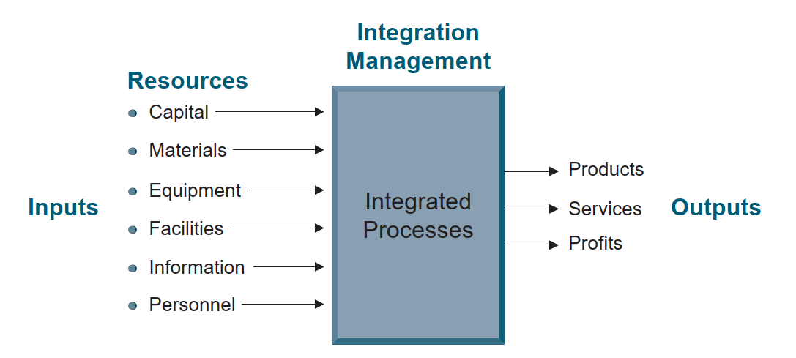
Lecture 1
Integration management.

Slide 35
Lecture 1
Agenda
Understanding Project Management
Meaning of “ Project “
Project Management Life Cycle
Successful project management
Benefits of project management
Obstacles of project management
Project Management
Project Manager's Role
Functional Manager’s Role

Slide 36
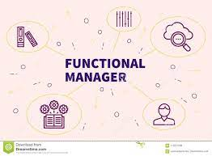
Lecture 1
FUNCTIONAL MANAGER’S ROLE
● The functional manager has the responsibility to define how the task will be done and where the task will be done (i.e., the technical criteria).

Slide 37
Lecture 1
FUNCTIONAL MANAGER’S ROLE
● The functional manager has the responsibility to provide sufficient resources to accomplish the objective within the project’s constraints (i.e., who will get the job done).

Slide 38


Lecture 1
FUNCTIONAL MANAGER’S ROLE
● The functional manager has the responsibility for the deliverable.

Slide 39
Lecture 1
Thank You

