Slide 1

PMG 506
Advanced Project Management
LECTURE 11: PMOs, and; OPM
Everyone’s Smart
University
دكتور مهندس استشاري ادارة المشروعات
Eng. Dr. Akram Mustafa Suliman Ali,
PhD. AU, BEng. & MSc. AAST, CEng CMarEng MIMarEST, PE, PMP®,
ASQ CSSBB, ISO Lead Auditor, NDT Level II,

Slide 2
PMG506
Advanced Project Management (APM)
Introduction:
Lecture 1 Introduction to APM and Initial Project Strategy
Lecture 2 Project Quality Management
Project planning
Lecture 6 Initial project coordination and the project Charter
Lecture 7 Starting the project plan: The WBS
Lecture 8 Project risk management
Lecture 9 Budgeting, Estimating times and costs
Project Initiation:
Lecture 3 Project Communication and team Management
Lecture 4 Managing conflicts and the art of communication
Lecture 5 Strategic Management and project selection
Project Integration
Lecture 10 Monitoring and Controlling
Lecture 11 PMOs and OPM
Lecture 12 Social and Professional Responsibility
Lecture 13 Open Discussion

Slide 3
PMOs

Slide 4
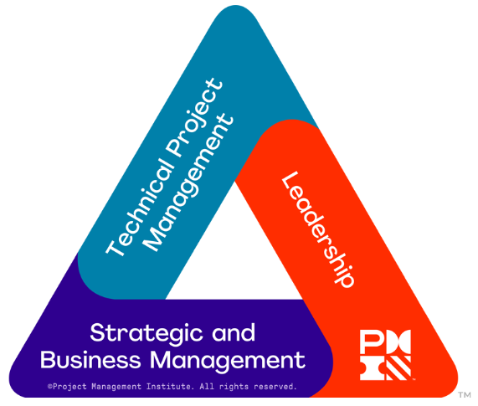
Project manager competency triangle
Project management is the application of:
Practices
Tools and techniques
Knowledge and skills
To realize project objectives.

Slide 5
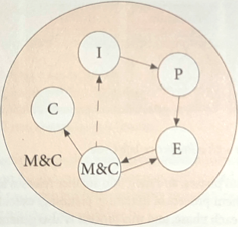
Project management life cycle processes
KEY
I = Initiating
P = Planning
E = Executing
M&C = Monitoring and Controlling
C = Closing

Slide 6
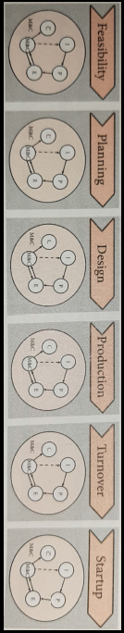
Large project with a predictive life cycle
PREDICTIVE is another name for WATERFALL
ADAPTIVE or ITERATIVE is another name for AGILE
You should have a large project in mind. Think of a project that is new in the organization, utilizes resources from many countries, has more than 200 people on the team, lasts longer than one year and has a budget of over U$ 10M>

Slide 7
Introduction
If your boss walked into your office today and said, “The system is broken. Can you figure out what is wrong and fix it?”
  Would this be a project?
    You must take what you are given and organize the work into appropriate projects.
      The project planning process will produce schedules and budgets
There are at least two projects in the previous story
What are the 2 projects?
Notes:
Skill set: Apply project definition.

Slide 8
The Top 10 Reasons Projects Fail [1/2]
Inadequately trained and/or inexperienced project managers;
Failure to set and manage expectations;
Poor leadership at any and all levels;
Failure to adequately identify, document and track requirements;
Poor plans and planning processes;

Slide 9
The Top 10 Reasons Projects Fail [2/2]
Poor effort estimation;
Cultural and ethical misalignment;
Inadequate or misused methods; and
Inadequate communication, including progress tracking and reporting;
Misalignment between the project team and the business or other organization it serves.

Slide 10
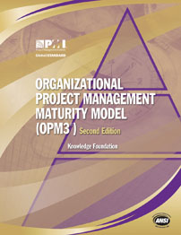
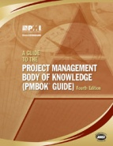

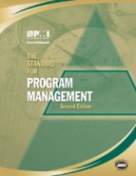
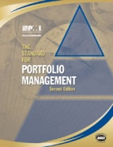

What Do I Need to Succeed?
It takes the right people,
the right processes, the right information,
and an integrated approach to get things done the right way.
People
Integrated approach
Information
Processes

Slide 11
Six Principles for Effective PM
First Principle: Inputs to PM are:
  Information
  Resources
  Material
  Site planning, facilities and utilities
  Plan and schedule
Second Principle: Management is divided into: Administration & Leadership
Third Principle: Maintain Visibility Using: S curves & EVA
Fourth Principle: Differentiate between Project Life Cycle and PM Life Cycle
Fifth Principle: Differentiate between Project Deliverables and PM Deliverables
Sixth Principle: Use PM Software for all projects proficiently

Slide 12
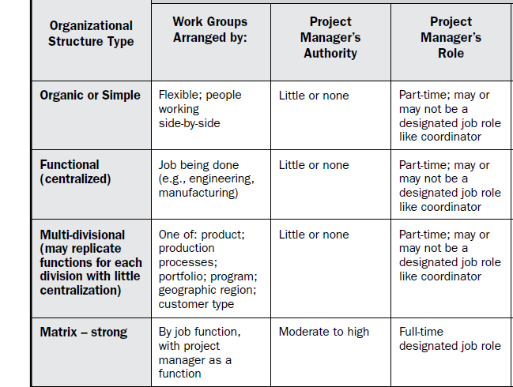
Organizational Structure Types [1/2]

Slide 13
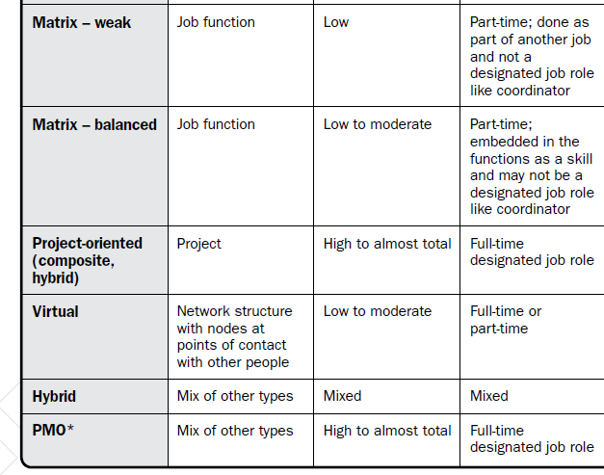
Organizational Structure Types [2/2]

Slide 14
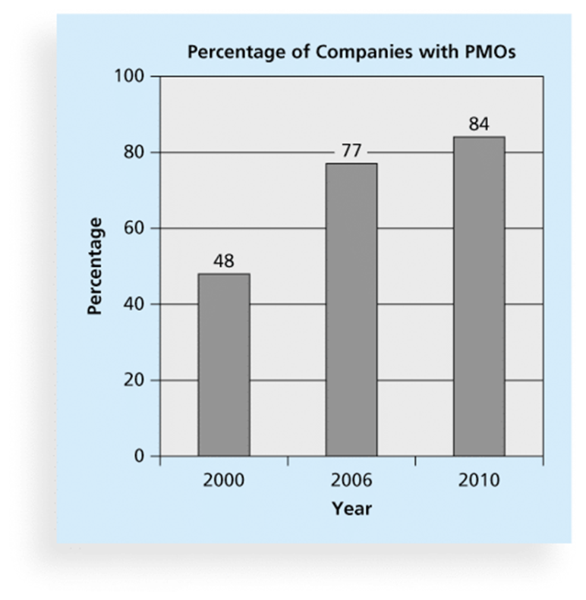
Project Management Offices
A Project Management Office (PMO) is an organizational group responsible for coordinating the project management function throughout an organization

Slide 15
PMO Definition
A PMO is an organizational body or entity assigned various responsibilities related to the centralized and coordinated management of those projects under its domain - PMBOK
Other responsibilities include:
  Manage shared resources across all projects
  Identify and develop a project management methodology, best practices, and standards
  Coach, mentor, train, and provide oversight
  Monitor compliance with project management standards, policies, procedures, and templates via project audits
  Develop and manage project policies, procedures, templates, and other shared documentation
  Coordinate communication
A strategic driver for organizational excellence

Slide 16
Project Management Office Role and FUNCTION
A project Management Office (PMO):
is a structure that standardizes the project-related governance processed and facilities of sharing resources, methodologies, tools and techniques among an organizations.
Its role may be supportive (consultative),Controlling or Directive (higher degree of control).
PMO’s Primary function is to support PM in :
  Managing shared resources across projects in its domain
  Developing Project Management methodology, practices and standards
  Coaching ,mentoring, training and oversight
  Auditing compliance with Project policies, procedures and templates
  Coordinating communications across projects

Slide 17
PMO Templates
Project Charter
Feasibility Study
Business Case
Project Management Plan
Change Management
Communications Management
Cost Management
HR Management
Procurement Management
Quality Management
Risk Management
Risk Register
Schedule Management
Work Breakdown Structure
Scope Management
Transition Out Planning
Lessons Learned
Project Acceptance

Slide 18
PMO Frameworks [1/3]
Organizational Unit PMO/Business Unit PMO/Divisional PMO/Departmental PMO
  Provides project-related services to support a business unit or division within an organization including, but not limited to, portfolio management, governance, operational project support and human resources utilization.
Project-Specific PMO/Project Office/Program Office
  Provides project-related services as a temporary entity established to support a specific project or program. May include supporting data management, coordination of governance and reporting, and administrative activities to support the project or program team.

Slide 19
PMO Frameworks [2/3]
Project Support/Services/Controls Office or PMO
  Provides enabling processes to continuously support management of project, program or portfolio work throughout the organization. Uses the governance, processes, practices, and tools established by the organization and provides administrative support for delivery of the project, program or portfolio work within its domain.
Enterprise/Organization-wide/Strategic/Corporate/Portfolio/Global PMO
  The highest-level PMO in organizations having one, this PMO is often responsible for alignment of project and program work to corporate strategy, establishing and ensuring appropriate enterprise governance, and performing portfolio management functions to ensure strategy alignment and benefits realization.

Slide 20
PMO Frameworks [3/3]
Center of Excellence/Center of Competency
  Supports project work by equipping the organization with methodologies, standards and tools to enable project managers to better deliver projects. Increases the capability of the organization through good practices and a central point of contact for project managers.

Slide 21
PMO Benefits
Projects Align with Organizational Goals:
Project Success Rates Increase:
Project Management Competence Increases:
Standards and Templates are Developed and Improved:

Slide 22
opm

Slide 23
Organizational Project Management (OPM)
OPM is a framework for keeping the organization as a whole focused on the overall strategy.
OPM provides direction for how portfolios, programs, projects, and other organizational work should be prioritized, managed, executed and measured to best achieve the strategic goals.

Slide 24
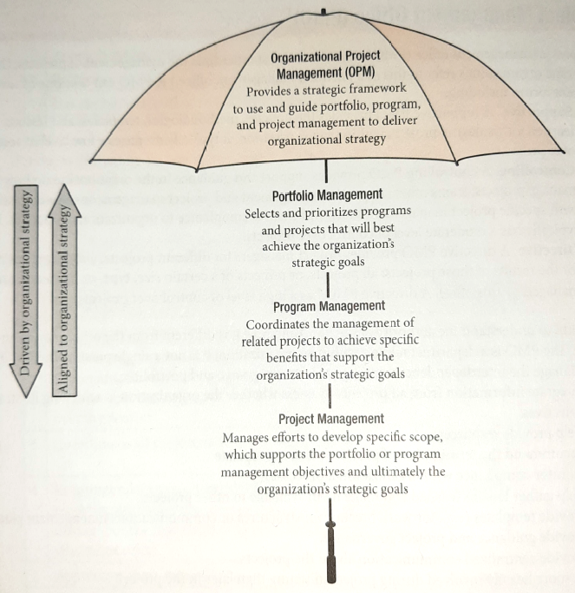
Organizational Project Management (OPM)

Slide 25
Program and Project Portfolio Management
  A program is “a group of related projects managed in a coordinated way to obtain benefits and control not available from managing them individually” (PMBOK® Guide, Fifth Edition, 2012)
  A portfolio includes a group of programs, individual projects, and other related operational work that are prioritized to achieve a specific business goal

Slide 26
Project and Program Managers
Project managers work with project sponsors, project team, and other people involved in a project to meet project goals
A program manager provides leadership and direction for the project managers heading the projects within the program

Slide 27
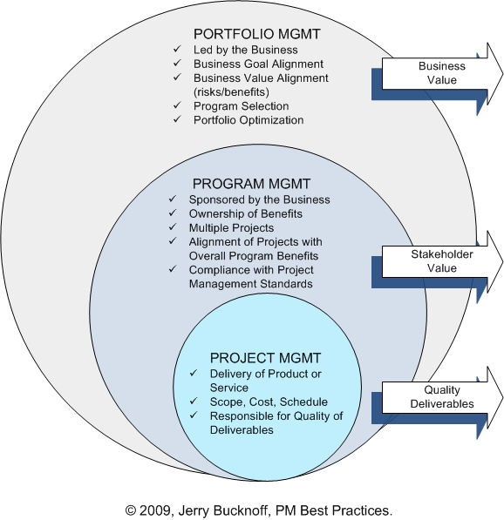
Project Portfolio Management
Organizations group and manage projects and programs as a portfolio of investments that contribute to the entire enterprise’s success

Slide 28
Opm3 Bridges the gap between organizational strategy and successful projects

Slide 29
WHAT IS OPM3?
OPM3 is an acronym for the
Organizational Project Management Maturity Model
a standard developed under the stewardship of the Project Management Institute.

Slide 30
The purpose of this standard
is to provide a way for organizations to understand organizational project management and to measure their maturity against a comprehensive and broad-based set of organizational project management Best Practices.
OPM3 also helps organizations wishing to increase their organizational project management maturity to plan for improvement.

Slide 31
Organizational Maturity Levels
Level 5 – Optimizing | Processes and performance continually improved through quantitative measures and analysis.
Level 4 – Quantitatively Managed | Product quality and process performance are quantitatively measured. A repository of measures exists to support fact-based decision-making.
Level 3 – Defined | Processes are defined, understood, and consistently applied from an organizational perspective. Processes are proactively managed and improved.
Level 2 – Managed | Repeatable processes are practiced on a project level. Process discipline is maintained through times of stress. Visibility to Status and delivery of work products at defined intervals.
Level 1 - Initial | Processes are ad hoc. Results are unpredictable. Success is dependent on heroics of the project team.

Slide 32
OPM3 WHAT FOR?
PMI’s Organizational Project Management Maturity Model or OPM3 is designed to guide organizations in the development of the Capabilities necessary to achieve Best Practices in Organizational Project Management (OPM). OPM combines portfolio, program, and project management to achieve the goals/strategies of an organization through projects.

Slide 33
OPM3 SPECIFICALLY ADDRESSES THE FOLLOWING 10 AREAS:
1. Standardization and Integration of Processes
2. Utilization of Performance Metrics
3. Commitment to the Project Management Process
4. Alignment and Prioritization of Projects
5. Implementation of Continuous Improvement Processes
6. Using Success Criteria for results analysis
7. Understanding People and Competence
8. Allocation of Resources to Projects
9. Organizational Fitness
10. Teamwork.

Slide 34
HOW DOES OPM3 WORKS?
There are three basic elements to applying OPM3 in an organization:
Knowledge
Assessment
Improvement

Slide 35
Knowledge
OPM3 is the first iteration of a body of knowledge on the subject of organizational project management and a subset of the larger project Management Body of Knowledge (PMBOK). Because this standards will form the basis of an organization's maturity assessment, familiarity with the contents of the standard is essential.

Slide 36
Assessment
In Assessment, the organization uses an assessment tool to determine areas of strength and weakness in relation to the body of best practices. This assessment process will help the organization decide which Best Practices or groups of Best Practices to investigate further, either to confirm competency in an area or to identify constituent Capabilities of one or more Best Practices that need attention. OPM3 outlines how to conduct this detailed investigation in the most helpful way for the organization, through the use of the Directories.

Slide 37
Improvement
The results of the Assessment will include a list of capabilities not yet fully developed in the organization. OPM3 provides guidance in placing these in order of importance, and this sequence forms the basis for any subsequent plans for improvement. The actual process of implementing improvements in an organization, which may involve organizational development, change management, restructuring, retaining, and other initiatives, is beyond the scope of this standard.

Slide 38
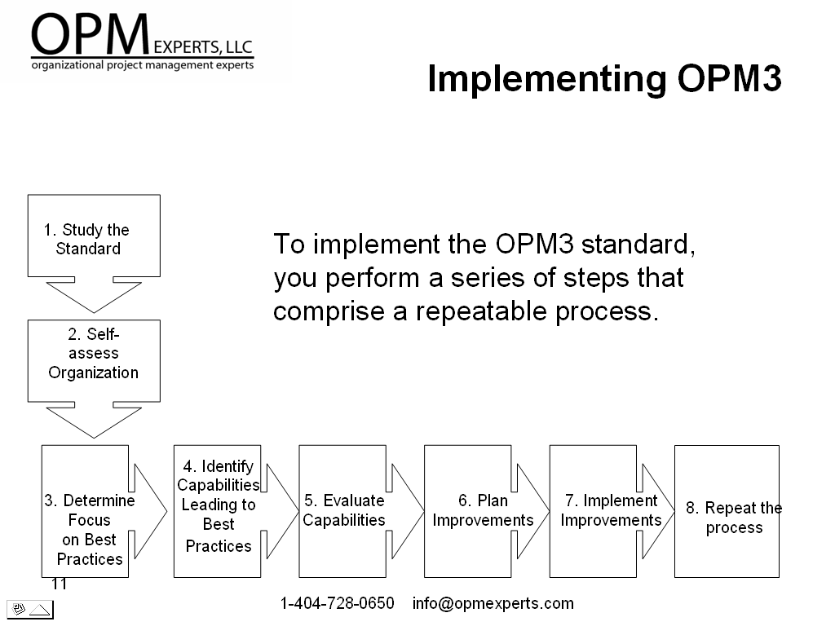
Implement opm3

Slide 39
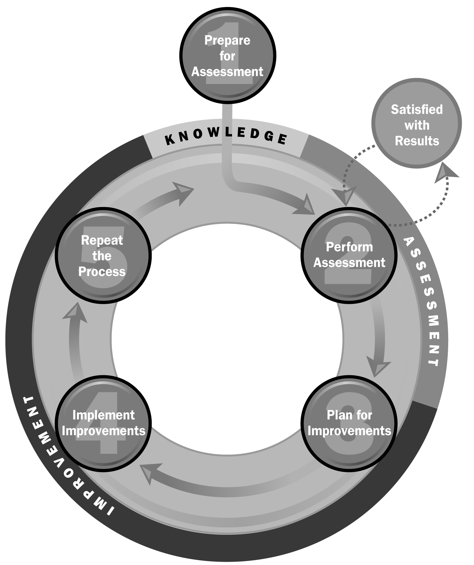

The OPM3® Cycle
1
Prepare to assess the organizational project management maturity in relation to the model.
5
2
Reassess where the organization is currently on the continuum of organizational project management maturity by repeating the Assessment (Step Two) or…
Return to plan for improvements (Step Three) to begin working toward other Best Practices identified in an earlier assessment, but not acted upon.
High Level:
Compare characteristics of the organization’s current maturity state with the model.
Assess the organizational project management maturity in relation to the model.
Comprehensive:
Determine which of the identified Capabilities already exist within the organization.
4
3
Execute requisite organizational development activities to attain the needed Capabilities and advance on the path to increased organizational project management maturity.
Develop a specific plan to achieve the Outcomes associated with the Capabilities of targeted Best Practices.
Notes:
Project Management Institute, OPM3® – Second Edition, 2008, p. 16

Slide 40
OPM3 Benefits [1/3]
Help organizations understand current project management, program management and portfolio management.
Enable executives to assess their own organization or partner’s ability to achieve strategic priorities through projects.
Identify areas for improvement and ways to make coordinated improvements by increments.
Help all level of management understand how to create an environment for successful project activity.

Slide 41
OPM3 Benefits [2/3]
Help those responsible for project management, identify drivers of project results and set standards for excellence.
Enable organizations to achieve consistent implementation of project management work methods through standardization and institutionalization.
Demonstrate relationships between executive functions and project management functions.
Explain how to make project management measurable within an organization.

Slide 42
OPM3 Benefits [3/3]
Rally an organization or its partners to focus on project management improvements.
Facilitate organizational change associated with developing projects, program, and portfolio management functions.
Develop consistency and predictability in project delivery.
Distinguish your own organization from competitors.

Slide 43
Popular project management maturity models

