Slide 1


Probability and
Statistics
Prepared by Dr. Alfaisal Hasan
STA 201
Probability and Statistics
Lecture NO 9

Slide 2



Probability and
Statistics
Lecture NO 9
STA 201
Probability and Statistics
Prepared by
Dr. Alfaisal Hasan
www.midocean.ae

Slide 3

Chapter
Topics
Chapter 1: Introduction To Statistics
Chapter 2: Descriptive Statistics
Chapter 3: Probability
Chapter 4: Discrete Probability Distributions
Chapter 5: Normal Probability Distributions
Chapter 6: Confidence Intervals
Chapter 7: Hypothesis Testing with One Sample
Chapter 8: Hypothesis Testing with Two Samples
Chapter 9: Correlation And Regression
Chapter 10: Chi-Square Tests and The F-Distribution
www.midocean.ae

Slide 4
Chapter
Chapter Outline
9.1 Correlation
9.2 Linear Regression
9.3 Measures of Regression and Prediction Intervals
9.4 Multiple Regression
www.midocean.ae

Slide 5
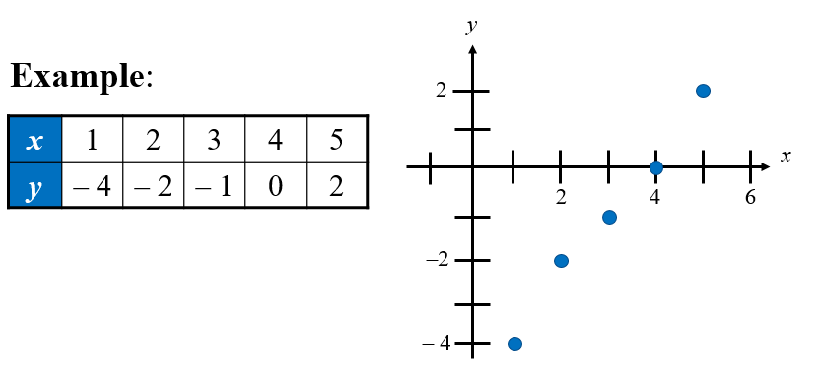
Section 9.1: Correlation
Chapter
A relationship between two variables. The data can be represented by ordered pairs (x, y)
  x is the independent (or explanatory) variable
  y is the dependent (or response) variable
  A scatter plot can be used to determine whether a linear (straight line) correlation exists between two variables.
www.midocean.ae

Slide 6
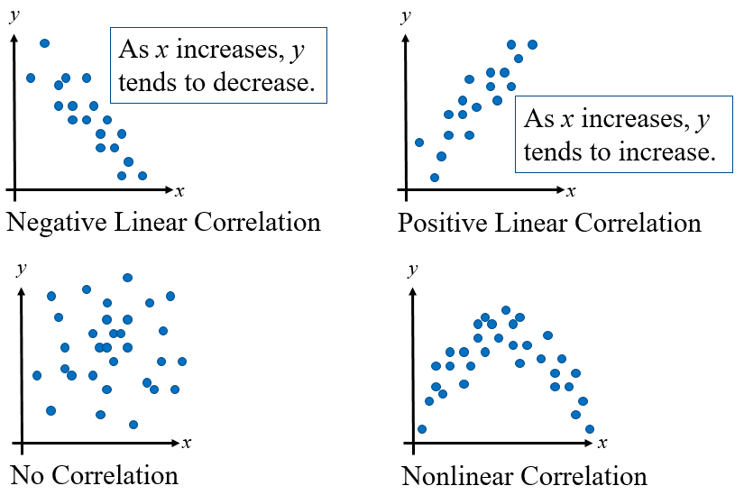
Types of Correlation
Chapter
www.midocean.ae

Slide 7
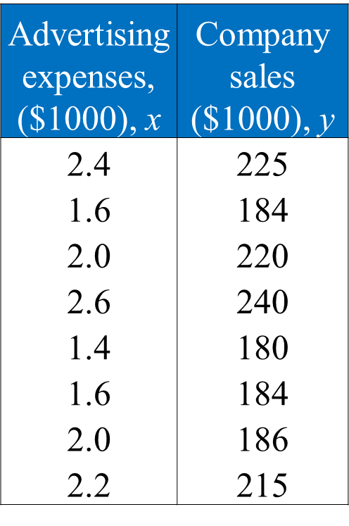
Example: Constructing a Scatter Plot
  A marketing manager conducted a study to determine whether there is a linear relationship between money spent on advertising and company sales. The data are shown in the table.
  Display the data in a scatter plot and determine whether there appears to be a positive or negative linear correlation or no linear correlation.
www.midocean.ae

Slide 8
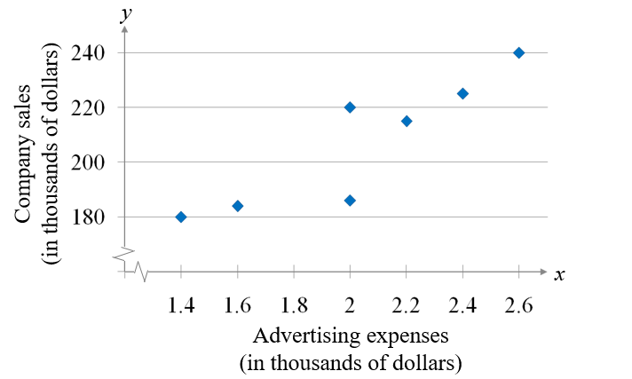
Solution: Constructing a Scatter Plot
Appears to be a positive linear correlation. As the advertising expenses increase, the sales tend to increase.
www.midocean.ae

Slide 9
Correlation coefficient
Correlation coefficient
A measure of the strength and the direction of a linear relationship between two variables.
The symbol r represents the sample correlation coefficient.
A formula for r is
The population correlation coefficient is represented by ρ (rho).
n is the number of data pairs
www.midocean.ae

Slide 10
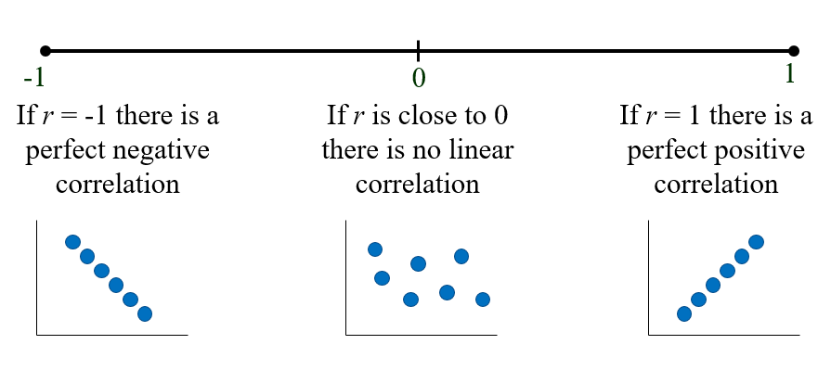
Correlation coefficient
The range of the correlation coefficient is -1 to 1.
www.midocean.ae

Slide 11
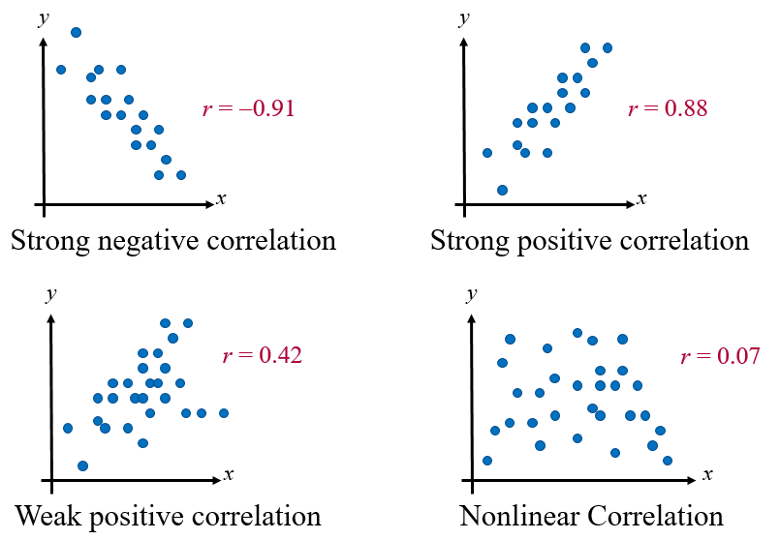
Linear Correlation
www.midocean.ae

Slide 12
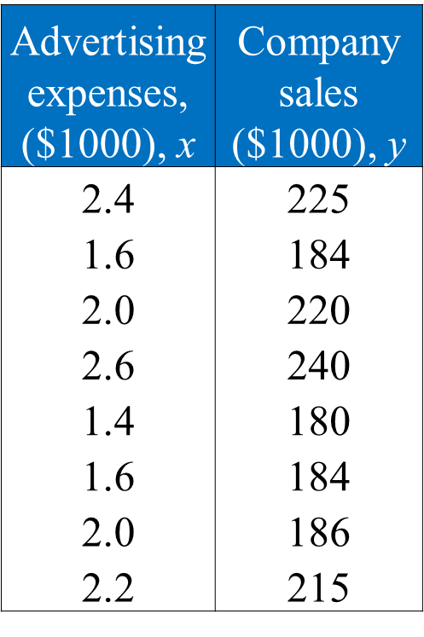
Example: Finding the Correlation Coefficient
Calculate the correlation coefficient for the advertising expenditures and company sales data. What can you conclude?
www.midocean.ae

Slide 13
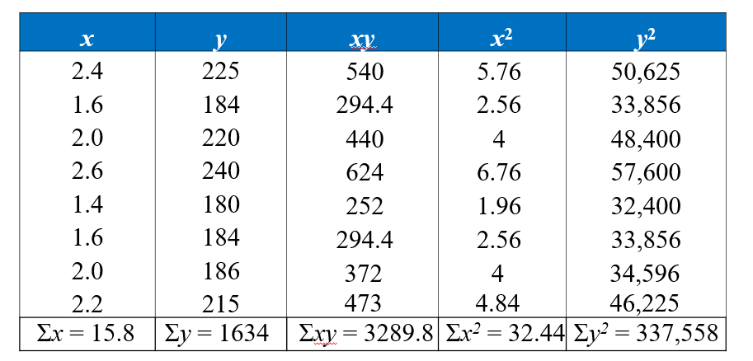
Solution: Finding the Correlation Coefficient
www.midocean.ae

Slide 14
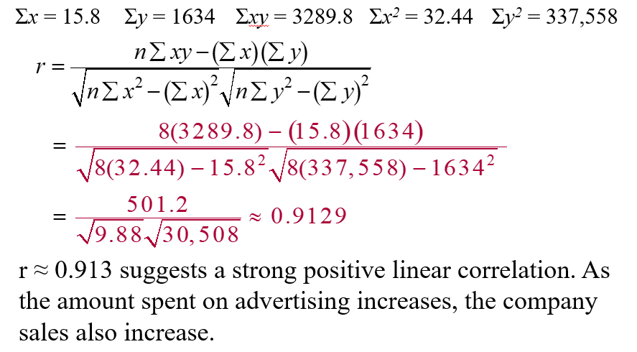
Solution: Finding the Correlation Coefficient
www.midocean.ae

Slide 15
Section 9.2: Linear Regression
Find the equation of a regression line
Predict y-values using a regression equation
www.midocean.ae

Slide 16
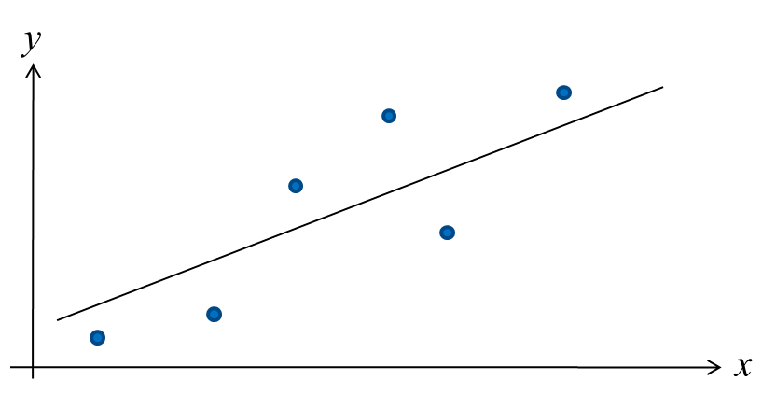
Regression Line
After verifying that the linear correlation between two variables is significant, next we determine the equation of the line that best models the data (regression line).
Can be used to predict the value of y for a given value of x.
www.midocean.ae

Slide 17
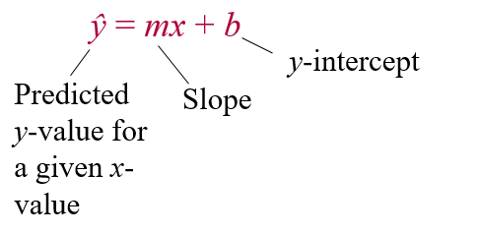
Regression Line
Regression line (line of best fit)
The line for which the sum of the squares of the residuals is a minimum.
The equation of a regression line for an independent variable x and a dependent variable y is
www.midocean.ae

Slide 18
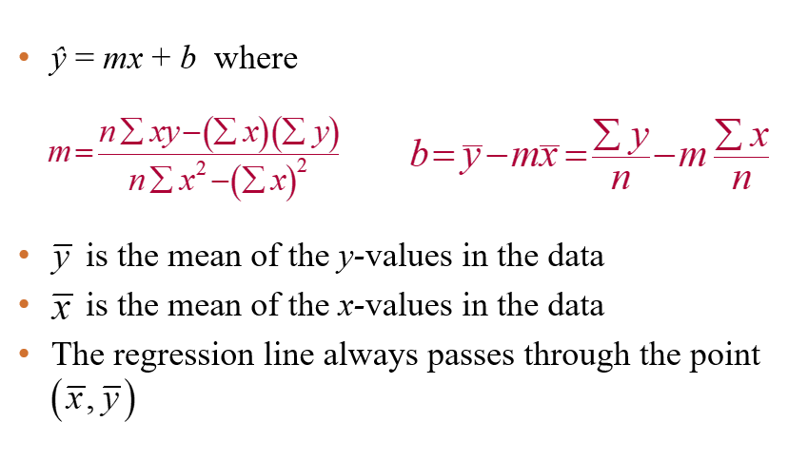
The equation of Regression Line
www.midocean.ae

Slide 19
Example: Finding the Equation of a Regression Line
Advertising expenses, ($1000), x | Company sales ($1000), y
2.4 | 225
1.6 | 184
2.0 | 220
2.6 | 240
1.4 | 180
1.6 | 184
2.0 | 186
2.2 | 215
Find the equation of the regression line for the advertising expenditures and company sales data.
www.midocean.ae

Slide 20
Solution: Finding the Equation of a Regression Line
Recall from section 9.1:
www.midocean.ae

Slide 21
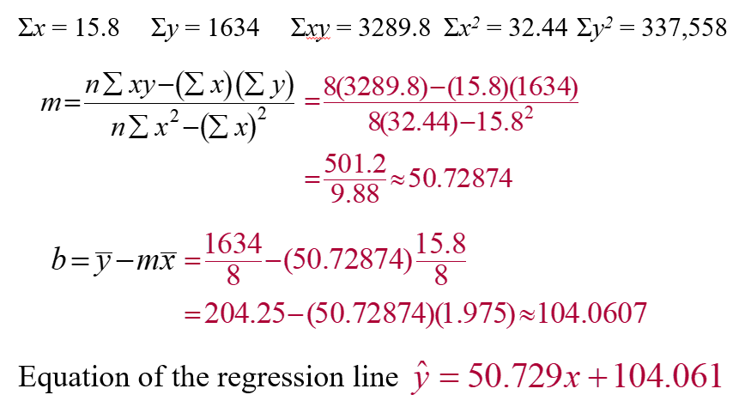
Solution: Finding the Equation of a Regression Line
www.midocean.ae

Slide 22
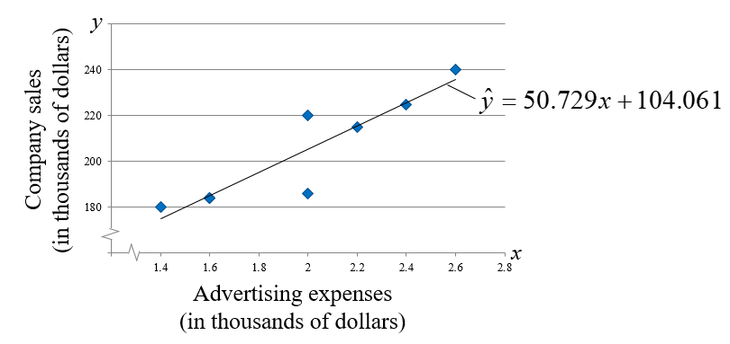
Example: Predicting y-Values Using Regression Equations
To sketch the regression line, use any two x-values within the range of the data and calculate the corresponding y-values from the regression line.
www.midocean.ae

Slide 23
Solution: Predicting y-Values Using Regression Equations
The regression equation for the advertising expenses (in thousands of dollars) and company sales (in thousands of dollars) data is ŷ = 50.729x + 104.061. Use this equation to predict the expected company sales for the following advertising expenses. (Recall from section 9.1 that x and y have a significant linear correlation.)
1.5 thousand dollars
1.8 thousand dollars
2.5 thousand dollars
www.midocean.ae

Slide 24
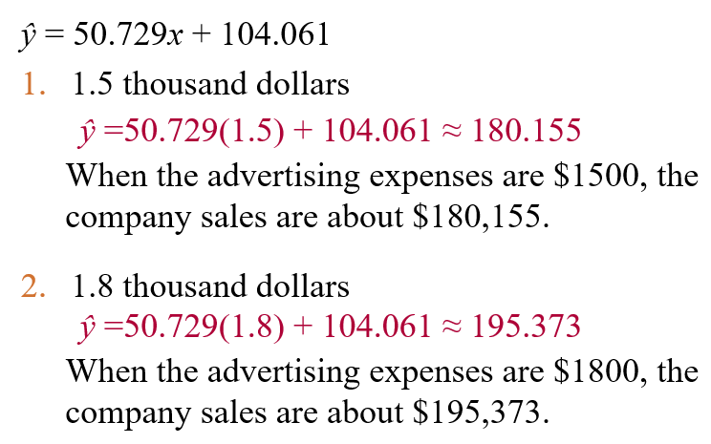
Solution: Predicting y-Values Using Regression Equations
www.midocean.ae

Slide 25
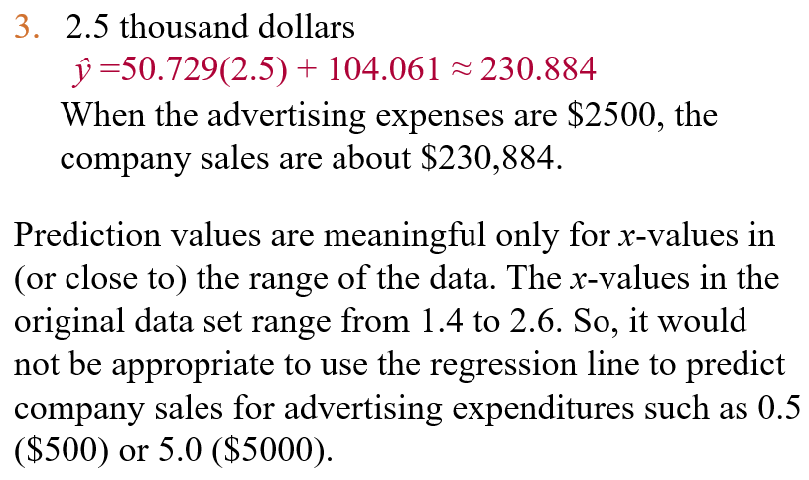
Solution: Predicting y-Values Using Regression Equations
www.midocean.ae

Slide 26
Section 9.3: Measures of Regression and Prediction Intervals
Variation About a Regression Line
Three types of variation about a regression line
  Total variation
  Explained variation
  Unexplained variation
To find the total variation, you must first calculate
  The total deviation
  The explained deviation
  The unexplained deviation
www.midocean.ae

Slide 27
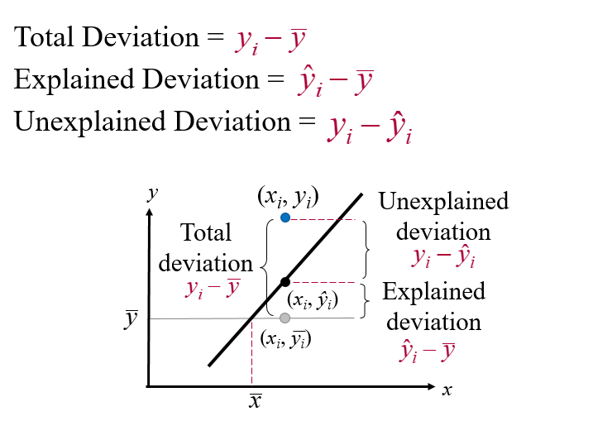
Variation About a Regression Line
www.midocean.ae

Slide 28
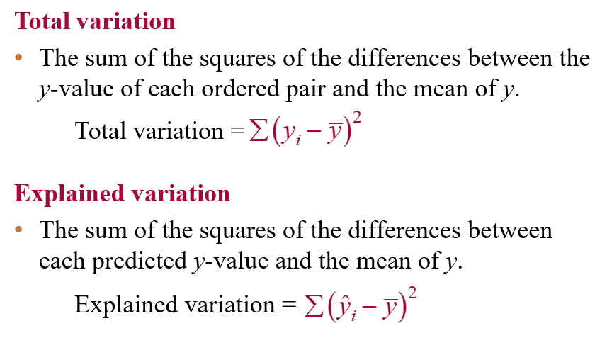
Variation About a Regression Line
www.midocean.ae

Slide 29
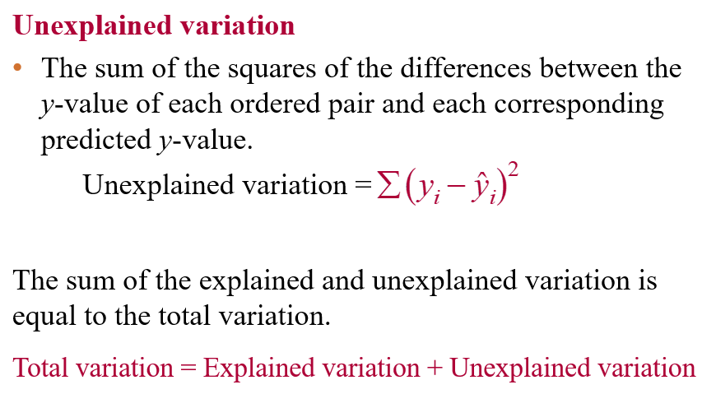
Variation About a Regression Line
www.midocean.ae

Slide 30
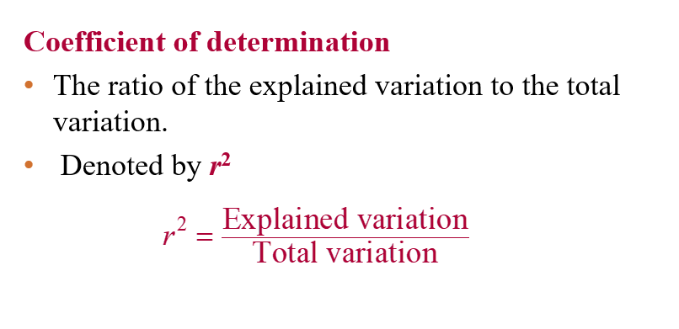
Coefficient of Determination
www.midocean.ae

Slide 31
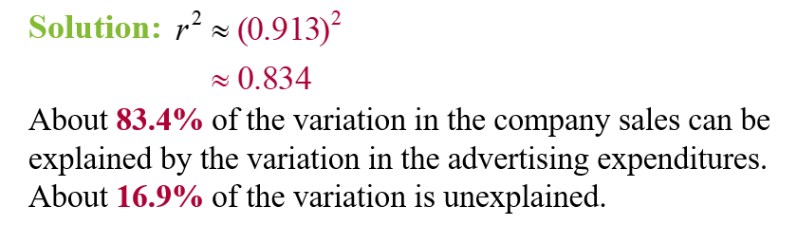
Example: Coefficient of Determination
The correlation coefficient for the advertising expenses and company sales data as calculated in Section 9.1 is r ≈ 0.913. Find the coefficient of determination. What does this tell you about the explained variation of the data about the regression line? About the unexplained variation?
www.midocean.ae

Slide 32
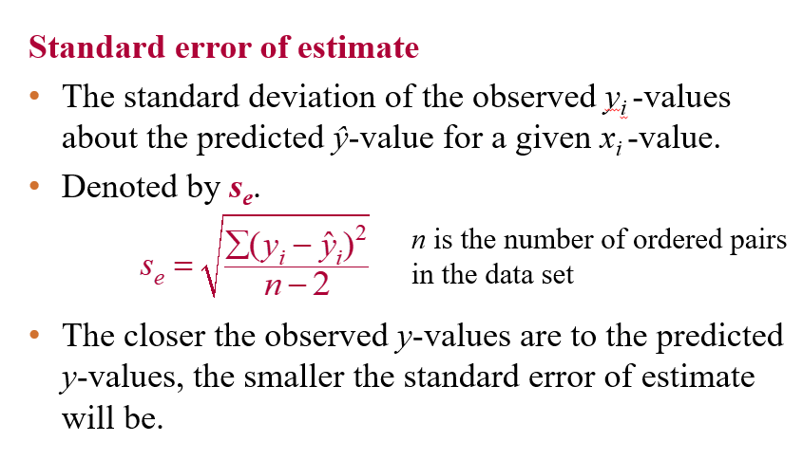
The Standard Error of Estimate
www.midocean.ae

Slide 33
Example: The Standard Error of Estimate
The regression equation for the advertising expenses and company sales data as calculated in section 9.2 is
ŷ = 50.729x + 104.061
Find the standard error of estimate.
Solution:
Use a table to calculate the sum of the squared differences of each observed y-value and the corresponding predicted y-value.
www.midocean.ae

Slide 34
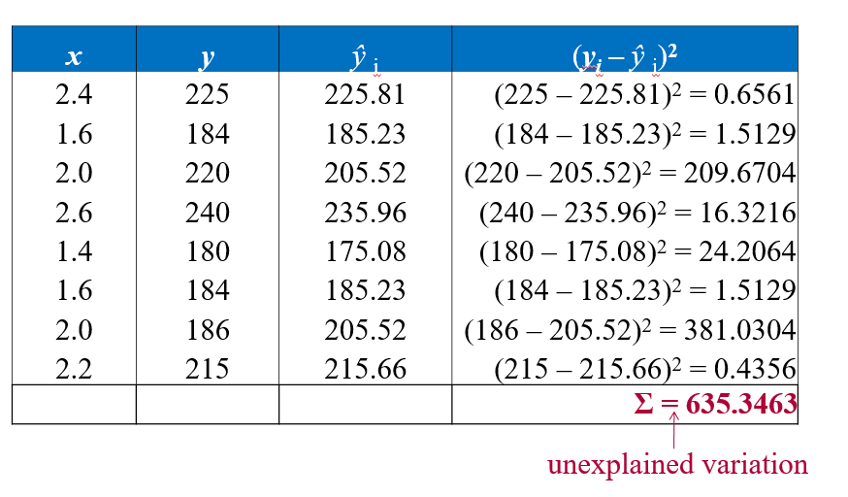
Solution: The Standard Error of Estimate
www.midocean.ae

Slide 35
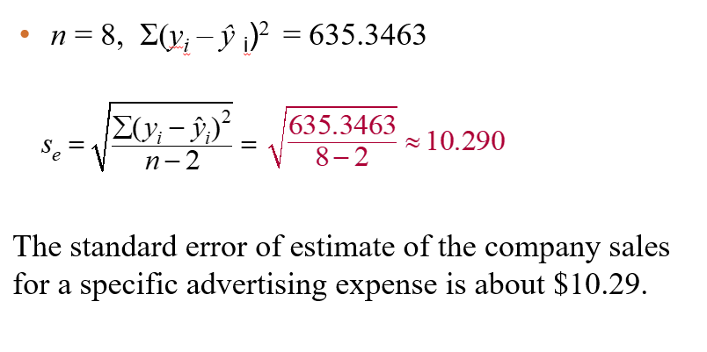
Solution: The Standard Error of Estimate
www.midocean.ae

Slide 36
Section 9.4: Multiple Regression
Multiple regression equation
ŷ = b + m₁x₁ + m₂x₂ + m₃x₃ + … + m_{k}x_{k}
x₁, x₂, x₃,…, x_{k} are independent variables
b is the y-intercept
y is the dependent variable
* Because the mathematics associated with this concept is complicated, technology is generally used to calculate the multiple regression equation.
www.midocean.ae

Slide 37
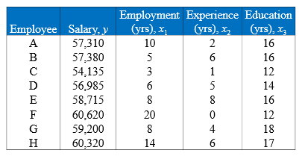
Example: Finding a Multiple Regression Equation
  A researcher wants to determine how employee salaries at a certain company are related to the length of employment, previous experience, and education. The researcher selects eight employees from the company and obtains the data shown on the next slide. Use Minitab to find a multiple regression equation that models the data.
www.midocean.ae

Slide 38
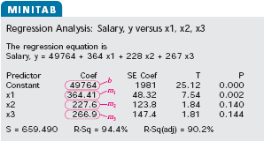
Solution: Finding a Multiple Regression Equation
The regression equation is
ŷ = 49,764 + 364x₁ + 228x₂ + 267x₃
www.midocean.ae

Slide 39
Example: Predicting y-Values
  Use the regression equation:
  ŷ = 49,764 + 364x₁ + 228x₂ + 267x₃
  to predict an employee’s salary given 12 years of current employment, 5 years of experience, and 16 years of education.
Solution:
ŷ = 49,764 + 364(12) + 228(5) + 267(16)
= 59,544
The employee’s predicted salary is $59,544.
www.midocean.ae

Slide 40
Chapter Summary
Chapter
9.1 Correlation
9.2 Linear Regression
9.3 Measures of Regression and Prediction Intervals
9.4 Multiple Regression
www.midocean.ae

Slide 41
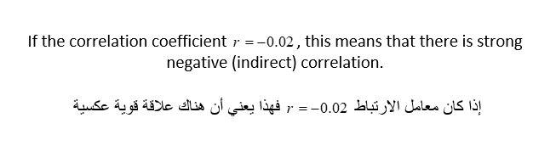
Un Solved Examples
Chapter
www.midocean.ae

Slide 42
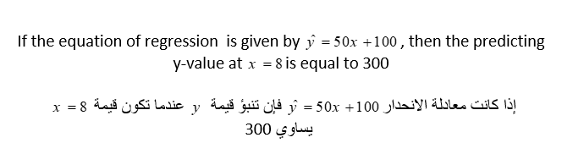
Un Solved Examples
Chapter
www.midocean.ae

Slide 43


Thank You

