Slide 1

MGM 112
Introduction to Economics
Prepared by Dr. Maryem ZORGUI
Lecture 4
Theory of Consumer Choice

Slide 2
Syllabus
I- The Budget Constraint
III- Impact of Income on Consumer Choices
IV- Impact of Price on Consumer Choices
II- Mapping Preferences with Indifference Curves

Slide 3
Session Outline
I- Introducing the Budget Constraint
I-1- Trade-offs
I-2- Budget Curves
I-3- Indifference Curves
II- Mapping Preferences with Indifference Curves
II-1- The infifference curves
II-2- Implications of Indifference Maps
III-Impact of Income on Consumer Choices
III-1- Income from a Consumer Theory Perspective
III-2- Effects of Income on Different Goods
IV- Impact of Price on Consumer Choices
IV-1- Deriving Overall Demand
IV-2- Price Elasticity

Slide 4
I- Introducing the Budget Constraint
I-1- Trade-offs
I-2- Budget Curves
I-3-Indifference Curves

Slide 5
I- The Budget Constraint -1-
I-1-Trade-offs
To expand upon this definition further, the business concept of opportunity cost via trade-offs is a central building block in understanding budget constraints.
An opportunity cost is defined as the foregone value of the next best alternative in a given action.

Slide 6
I- The Budget Constraint -2-
I-2- The concept of budget constraint
The idea is that a given consumer is limited in consumption relative to the amount of capital they possess.
As a result, consumers analyze the optimal way in which to leverage their purchasing power to maximize their utility and minimize opportunity costs.
This is achieved through using budget constraints, which represent the plausible combinations of products and/or services a buyer is capable of purchasing with its capital on hand.

Slide 7
I- The Budget Constraint -3-
I-3- The Budget line
It indicates the relationship between two goods relative to
opportunity costs, which defines the value of each good relative to one
another.
Budget line: A line curve demonstrates the relationship between two goods relative to opportunity costs, essentially deriving the relative value of each good based on quantity and utility.

Slide 8
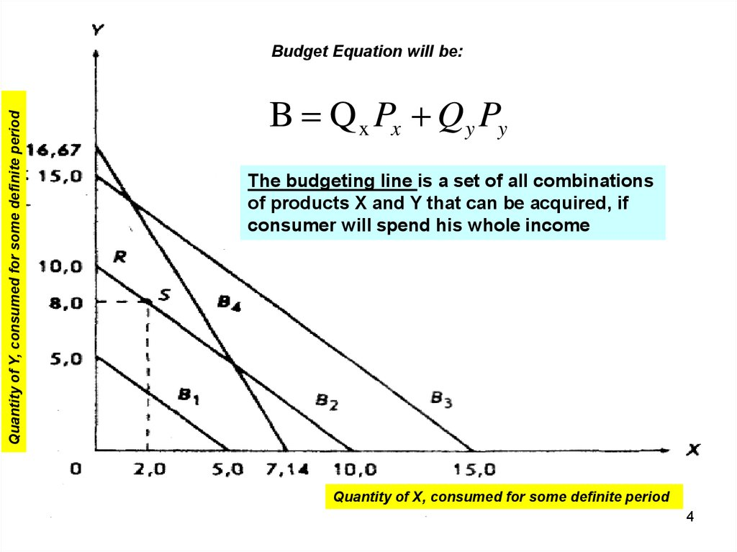
  .
P_{X} = Price of good X
Q_{X} = Quantity of good X
P_{Y} = Price of good Y
Q_{Y} = Quantity of good Y
B = Budget

Slide 9
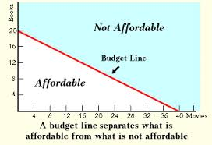
I-4- The Budget line
Budget Set implies the set of all the possible combinations of two goods that the consumer can afford or buy, which his/her income, at the existing market prices. Basically, it contains all those combinations in the positive quadrant, fall under or on the budget line. It can be expressed as:
P_{X}Q_{X} + P_{Y}Q_{Y} ≤ B
Where,
P_{X} = Price of good x
Q_{X} = Quantity of good x
P_{Y} = Price of good y
Q_{Y} = Quantity of good y
B = Income

Slide 10
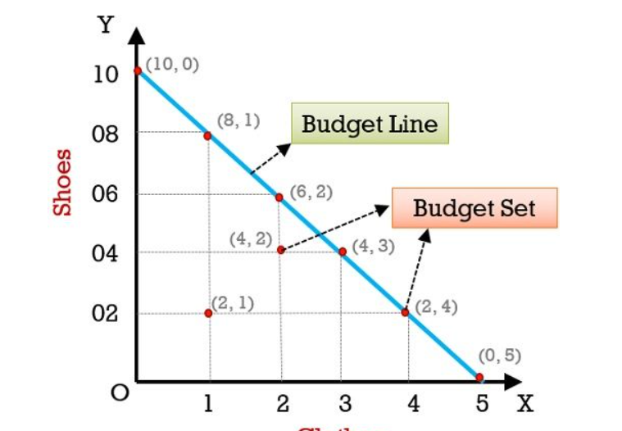
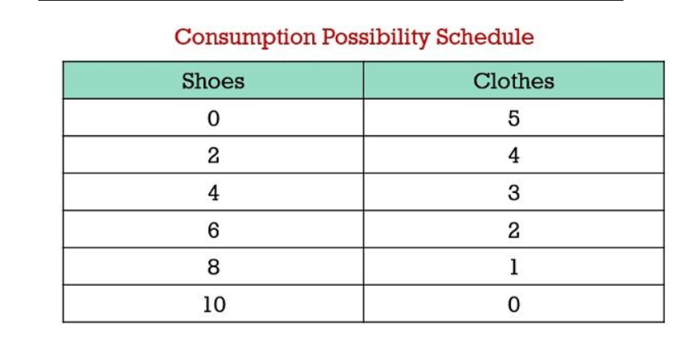
Exercise:
The Budget line and
The Budget Set
The table represented below highlights the bundles of
clothes (P_{x =}$ 200) and shoes (P_{y =}$100) a consumer can buy,
spending his income ( budget), i.e $ 1000.
Conclusion
Basically, Budget Line shows the price ratio between two goods, i.e. X and Y or the rate at which one commodity can be exchanged for the other, where the prices of the two goods are given. Budget line depends on the consumer’s income and price of the commodities.
Now let’s take a look at the graph representing Budget Line and Budget Set:

Slide 11
I- The Budget Constraint -3-
I-4- The Indifference Curves
Indifference curves: Indifference curves underline the way in which a given consumer interprets the value of each good relative to one another, demonstrating how much of ‘good xx‘ is equivalent in utility to a certain quantity of ‘good yy‘ (and vice versa).
Any point along the indifference curve will represent indifference to the consumer, or simply put equivalent preference for one combination of goods or the other. In the figure it is clear that the budget curve has been included in conjunction with the indifference curves, which allows insight as to the ideal actual quantity of each good is optimal for this specific consumer.

Slide 12
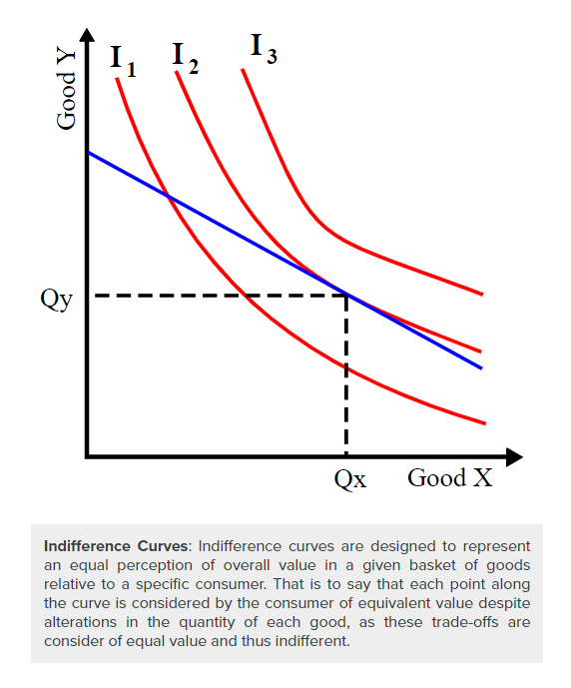
Through utilizing these economic tools, economists can predict consumer behavior and consumers can maximize their overall utility based upon their budget constraints.

Slide 13
II- Mapping Preferences with Indifference Curves
II-1- The indifference Maps
II-2- Implications of Indifference Maps

Slide 14
II- Mapping Preferences with
Indifference Curves -1-
II-1- The Indifference Maps
Economists mapping consumer preferences use indifference curves to illustrate series of goods that represent equivalent utility.
A critical input to understanding consumer purchasing behaviors and the general demand present in a given market or economy for specific goods and services is the identification of consumer preferences. Consumer preference varies substantially from individual to individual and market to market, requiring comprehensive economic observation of consumer choices and behaviors

Slide 15
II- Mapping Preferences with
Indifference Curves -2-
These indifference curves, when mapped graphically alongside other curves, is called an indifference map that allow us to compare more than two products/services, each specific standard indifference map will be about creating a benchmark between two.
For example one could compare relatively similar goods/services (i.e. apples vs. oranges) or dramatically different goods/services (i.e. university training vs. automobile purchasing). These two items being compared represent the x and y axis of a indifference map.
A consumer will always prefer to be on the indifference curve farthest from the origin.

Slide 16
II- Mapping Preferences with
Indifference Curves -3-
II-2-Implications of Indifference Maps
After constructing the required inputs to generate a comprehensive indifference map, an economist can derive conclusions based upon the properties of the illustration.
In framing these implications it is useful to identify the two potential extremes that can be outlined via with indifference curves.

Slide 17
II- Mapping Preferences with
Indifference Curves -4-
Combining an understanding of these inputs with the extremes demonstrated an indifference map, economists are able to draw meaningful conclusions regarding consumer choices and purchasing behaviors in the context of two goods.
The comparison between the goods demonstrates the relative utility one has compared to another, and the way in which consumers will act when posed with a decision between various products and services.

Slide 18
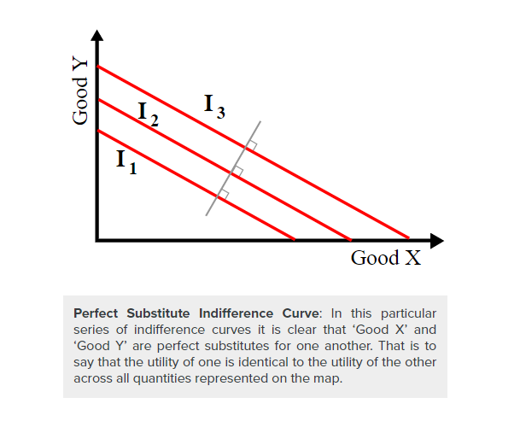
Perfect Substitutes:
A perfect substitute is a situation where two goods are viewed as identical.
When products are perfect substitutes, indifference curves will will look the graph. These lines are essentially perfectly straight, and that demonstrates that the relative utility of ‘Good X’ compared to that of ‘Good Y’ is equivalent regardless of the amount in question

Slide 19
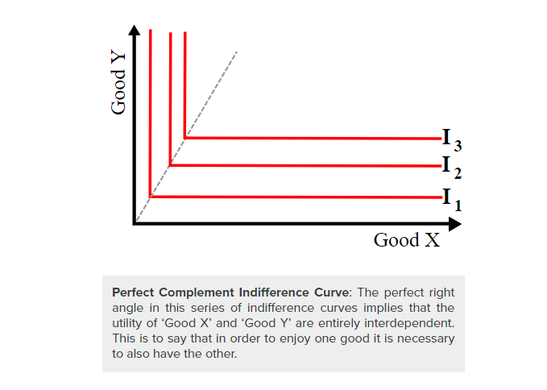
Perfect Complements: The opposite of a perfect substitute is a perfect complement, which is illustrated graphically through curves with perfect right angles at the center. These right angles, and the subsequent straight horizontal and vertical lines, demonstrate that ‘Good X’ and ‘Good Y’ are inherently tied to one another and that the consumption of one is dependent upon the consumption of the other

Slide 20
III-Impact of Income on Consumer Choices
III-1- Income from a Consumer Theory Perspective
III-2- Effects of Income on Different Goods

Slide 21
III- Impact of Income on Consumer
Choices -1-
Consumer choices are predicated on various economic circumstances, and recognizing the relationship between these circumstances and an individual’s purchasing behavior allows economists to recognize and predict consumer choice trends.
One of the central considerations for a consumer in deciding upon their purchasing behaviors is their overall income or wage levels, and thus their budgetary constraints. These budgetary constraints, when applied to a series of products and services, can be optimized to capture the most utility for the consumer based on their purchasing power.

Slide 22
III- Impact of Income on Consumer
Choices -2-
III-1- Income from a Consumer Theory Perspective
The simplest way to demonstrate the effects of income on overall consumer choice, from the viewpoint of Consumer Theory, is via an income-consumption curve for a normal good.
The basic premise behind this curve is that the varying income levels (as illustrated by the green income line curving upwards) will determine different quantities and balanced baskets along the provided indifference curves for the two goods being compared in this graph.
These differences in quantity reflect the increase or decrease an a given individual’s purchasing power, thus the income effect could be summarized as the increase in relative utility captured by a consumer with more monetary power.

Slide 23
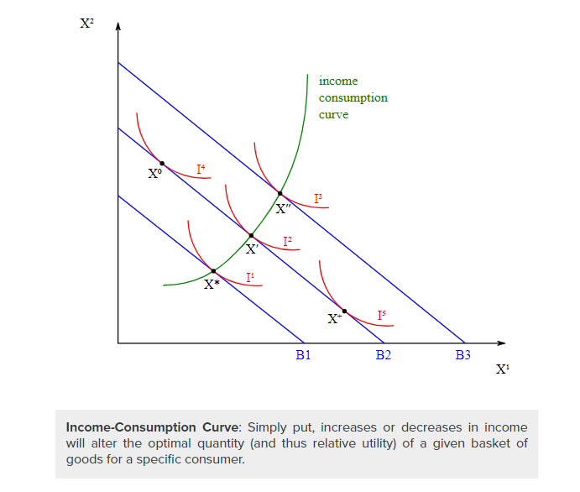

Slide 24
III- Impact of Income on Consumer
Choices -3-
The wealth effect differs slightly from the income effect:
The wealth effect reflects changes in consumer choice based on perceived wealth, not actual income.
For example, if a person owns a stock that appreciates in price, they perceive that they are wealthier and may spend more, even though they have not realized those gains so their income has not increased.

Slide 25
III- Impact of Income on Consumer
Choices -4-
III-2- Effects of Income on Different Goods
Income effects on consumer choice grow more complex as the type of good changes, as different product and services demonstrate different properties relative to both other products/services and a consumers preferences and utility.
As a result, it is useful to outline the differences in income effects on normal, inferior, complementary and substitute goods:

Slide 26
III- Impact of Income on Consumer
Choices -5-
Normal: A normal good is a good with incremental increases or decreases in utility as quantity changes, demonstrating a predictable and simple linear relationship as income increases or decreases. demonstrates a graphical representation of the effects of income changes upon preference map.
Inferior: Inferior goods, or goods that are less preferable, will demonstrate inverse relationships with income compared to normal goods.
That is to say that an increase in income will not necessarily result in an increase in quantity for the inferior good, as the consumer derives minimal utility in purchasing the inferior good compared to other goods.
Inferior goods are often sacrificed as income rises and consumers gain more choice/options.
This can be represented in.

Slide 27
III- Impact of Income on Consumer
Choices -6-
Complementary: Complementary goods are goods that are interdependent in consumption, or essentially goods that require simultaneous consumption by the consumer. An example of this would be like purchasing an automobile and car insurance, the consumption of one requires the consumption of the other. As income increases, these will increase relative to one another (as a ratio). demonstrates this concept in graphical form
Substitutes: Perfect substitutes are essentially interchangeable goods, where the consumption of one compared to another has no meaningful impact on the consumer’s utility derived.
Substitutes are goods that a consumer cannot differentiate between in terms of the need being filled and the satisfaction obtained.
Income increases will thus affect the consumption of these goods interchangeably, resulting in increase in the quantity of either or both.

Slide 28
III- Impact of Income on Consumer
Choices -7-
In merging Consumer Theory and consumer choices with income level, the primary takeaway is that an increase in income will increase the prospective utility that consumer can acquire in the market.
Understanding how this applies in a general fashion, alongside the specific circumstances dictating specific types of goods, it becomes fairly straight-forward to predict consumer purchasing behaviors at differing income levels.

Slide 29
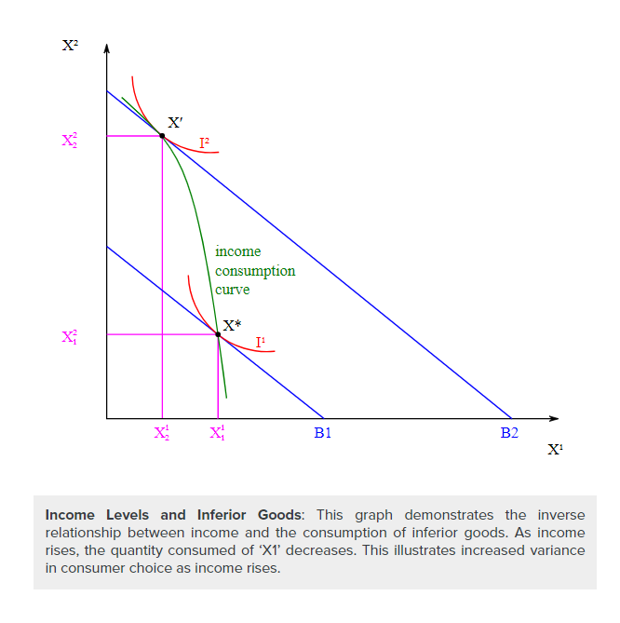
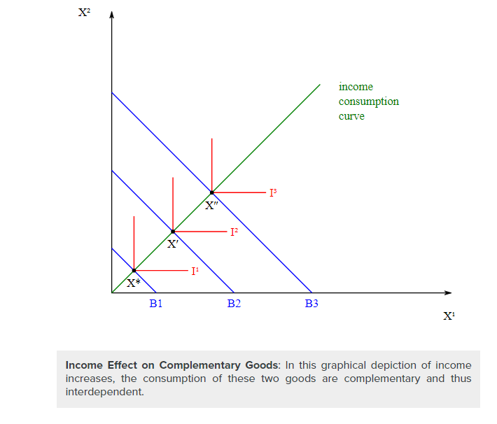

Slide 30
IV- Impact of Price on Consumer Choices
IV-1- Deriving Overall Demand
IV-2- Price Elasticity

Slide 31
IV- Impact of Price on Consumer Choices
-1-
The demand curve shows how consumer choices respond to changes in price.
In almost all cases, consumer choices are driven by prices. As price goes up, the quantity that consumers demand goes down. This correlation between the price of goods and the willingness to make purchases is represented clearly by the generation of a demand curve (with price as the y-axis and quantity as the x-axis).
The construction of demand, which shows exactly how much of a good consumers will purchase at a given price, is defining of consumer choice theory.

Slide 32
IV- Impact of Price on Consumer Choices-2-
IV-1- Deriving Overall Demand
The generation of a demand curve is done by calculating what price consumers are willing to pay for a given quantity of a good or service.
For normal goods or services, demand is illustrated with a downward sloping curve, where the quantity on the x-axis will generally increase as the price on the y-axis decreases (and vice versa).
The quantity demanded may change in response to both to shifts in demand (and the creation of a new demand curve, as demonstrated in) and movements along the established demand curve.

Slide 33
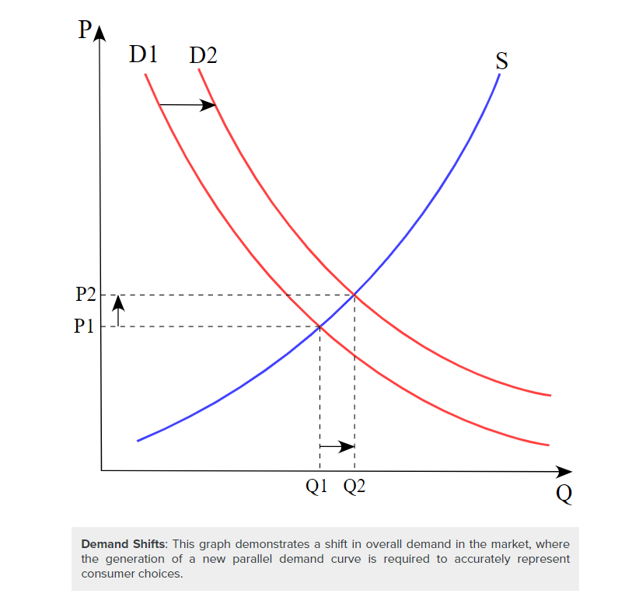
As the demand curve implies, price is often the central driving force behind a decision to purchase a given product or service. Consumers must weigh the overall utility they can capture by making a purchase and benchmark that against their overall monetary resources to optimize their purchasing decisions.

Slide 34
IV- Impact of Price on Consumer Choices -3-
VI-2- Price Elasticity
A critical consideration of product/service pricing is the price elasticity of a given good, which indicates how responsive demand is to a change in price.
Price elasticity is essentially a measurement of how much any deviations in price will drive the overall quantity purchased up or down, underlining to what extent consumer purchasing decisions will be dictated by pricing.
A highly elastic good will see consumers much less likely to purchase when prices are high and much more likely to purchase when prices are low, while a good with low elasticity will see consumers purchasing the same quantity regardless of small price changes.

Slide 35
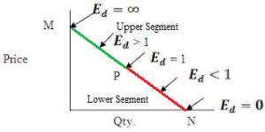
Using demand curves, economists can project the impact of a price change on the consumer choices in a given market.
Price Elasticity: As this graph demonstrates, the slope of the demand curve will vary as a direct result of how elastic consumer purchasing behaviors will be compared to price changes.

Slide 36


Slide 37
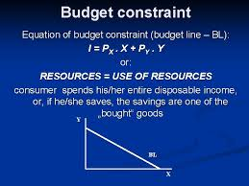
The Budget Constraint

Slide 38
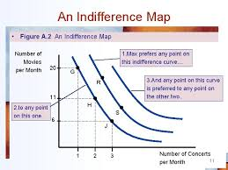
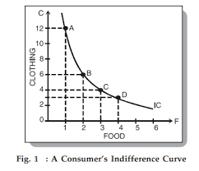
Indifference Curves
Indifference Maps

Slide 39
Perfect Subtitute Indifference Curve
Perfect Complement Indifference Curve

Slide 40
Income-consumption Curve

Slide 41


